Slide 1
DNS Database

Slide 2
The DNS Database
A set of text files such that
  Maintained and stored on the domain’s master name server
  Two types of entries
    Resource Records (RR)
      Used to store the information of
      The real part of DNS database
    Parser commands
      Used to modify or manage other RR data

Slide 3
The DNS Database
– Parser Commands
Commands must start in first column and be on a line by themselves
$ORIGIN domain-name
  Used to append to un-fully-qualified name
$INCLUDE file-name
  Separate logical pieces of a zone file
  Keep cryptographic keys with restricted permissions
$TTL default-ttl
  Default value for time-to-live filed of records
$GENERATE start-stop/[step] lhs type rhs
  Used to generate a series of similar records
  Can be used in only CNAME, PTR, NS record types

Slide 4
The DNS Database
– Resource Record (1)
Basic format
  [name] [ttl] [class] type data
    name: the entity that the RR describes
      Can be relative or absolute
    ttl: time in second of this RR’s validity in cache
    class: network type
      IN for Internet
      CH for ChaosNet
      HS for Hesiod
  Special characters
    ; (comment)
    @ (The current domain name)
    () (allow data to spam lines
    * (wild card character, name filed only)

Slide 5
The DNS Database
– Resource Record (2)
Type of resource record discussed later
  Zone records: identify domains and name servers
    SOA
    NS
  Basic records: map names to addresses and route mail
    A
    PTR
    MX
  Optional records: extra information to host or domain
    CNAME
    TXT
    LOC
    SRV

Slide 6
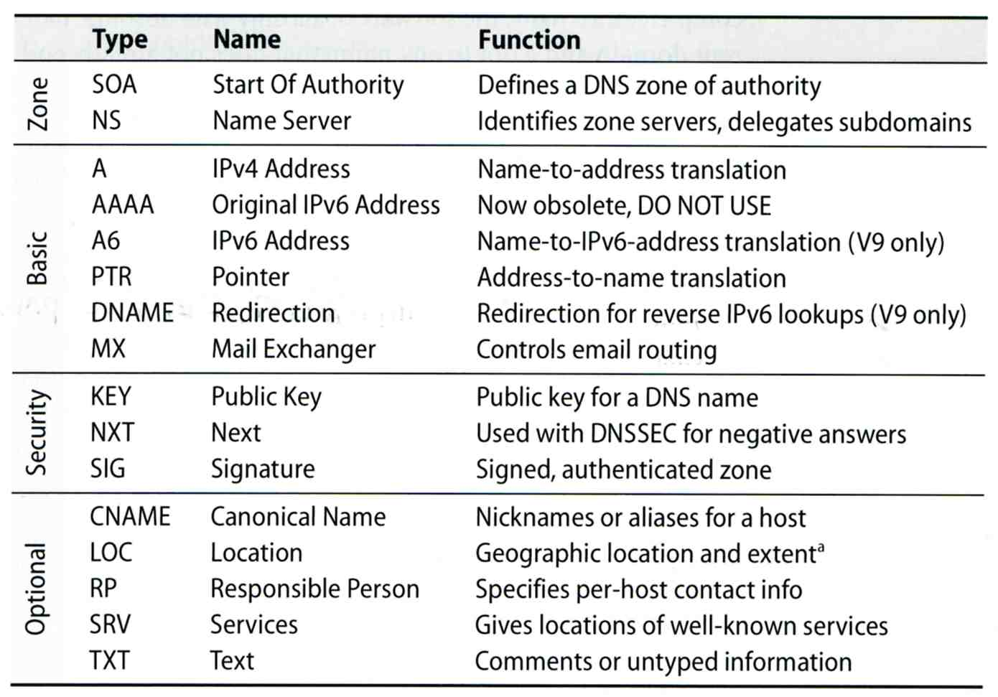
The DNS Database
– Resource Record (3)

Slide 7
The DNS Database
– Resource Record (4)
SOA: Start Of Authority
  Defines a DNS zone of authority, each zone has exactly one SOA record.
  Specify the name of the zone, the technical contact and various timeout information
  Format:
    [zone] IN SOA [server-name] [administrator’s mail] ( serial, refresh, retry, expire, ttl )
  Ex:
; means comments
@ means current domain name
( ) allow data to span lines
* Wild card character
$TTL 3600;
$ORIGIN cs.nctu.edu.tw.
@ IN SOA csns.cs.nctu.edu.tw. root.cs.nctu.edu.tw. (
2007052102 ; serial number
1D ; refresh time for slave server
30M ; retry
1W ; expire
2H ) ; minimum

Slide 8
The DNS Database
– Resource Record (5)
NS: Name Server
  Identify the authoritative server for a zone
  Usually follow the SOA record
  Every authoritative name servers should be listed both in current domain and parent domain zone files
    Delegation purpose
    Ex: cs.nctu.edu.tw and nctu.edu.tw
$TTL 3600;
$ORIGIN cs.nctu.edu.tw.
@ IN SOA csns.cs.nctu.edu.tw. root.cs.nctu.edu.tw. (
2007052102 ; serial number
1D ; refresh time for slave server
30M ; retry
1W ; expire
2H ) ; minimum
IN NS dns.cs.nctu.edu.tw.
IN NS dns2.cs.nctu.edu.tw.

Slide 9
The DNS Database
– Resource Record (6)
A record: Address
  Provide mapping from hostname to IP address
  Ex:
$ORIGIN cs.nctu.edu.tw.
@ IN NS dns.cs.nctu.edu.tw.
IN NS dns2.cs.nctu.edu.tw.
dns IN A 140.113.235.107
dns2 IN A 140.113.235.103
www IN A 140.113.235.111

Slide 10
The DNS Database
– Resource Record (7)
PTR: Pointer
  Perform the reverse mapping from IP address to hostname
  Special top-level domain: in-addr.arpa
    Used to create a naming tree from IP address to hostnames
$TTL 259200;
$ORIGIN 235.113.140.in-addr.arpa.
@ IN SOA csns.cs.nctu.edu.tw. root.cs.nctu.edu.tw. (
2007052102 ; serial
1D ; refresh time for secondary server
30M ; retry
1W ; expire
2H) ; minimum
IN NS dns.cs.nctu.edu.tw.
IN NS dns2.cs.nctu.edu.tw.
$ORIGIN in-addr.arpa.
103.235.113.140 IN PTR csmailgate.cs.nctu.edu.tw.
107.235.113.140 IN PTR csns.cs.nctu.edu.tw.

Slide 11
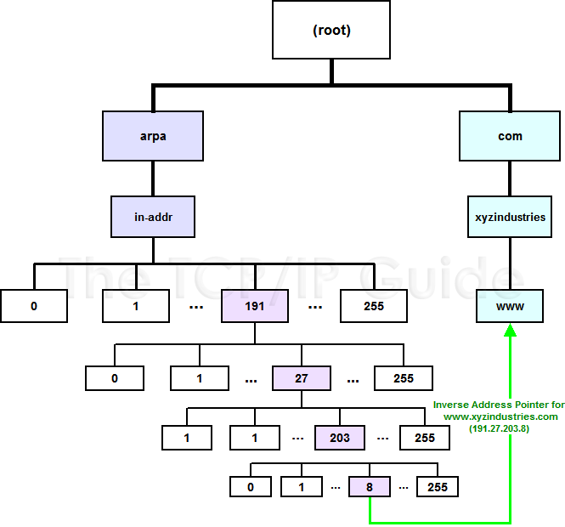
The DNS Database
– Resource Record (8)

Slide 12
The DNS Database
– Resource Record (9)
MX: Mail exchanger
  Direct mail to a mail hub rather than the recipient’s own workstation
  Ex:
$TTL 3600;
$ORIGIN cs.nctu.edu.tw.
@ IN SOA csns.cs.nctu.edu.tw. root.cs.nctu.edu.tw. (
2007052102 ; serial number
1D ; refresh time for slave server
30M ; retry
1W ; expire
2H ) ; minimum
IN NS dns.cs.nctu.edu.tw.
IN NS dns2.cs.nctu.edu.tw.
7200 IN MX 1 csmx1.cs.nctu.edu.tw.
7200 IN MX 5 csmx2.cs.nctu.edu.tw.
csmx1 IN A 140.113.235.104
csmx2 IN A 140.113.235.105

Slide 13
The DNS Database
– Resource Record (10)
CNAME: Canonical name
  nikename [ttl] IN CNAME hostname
  Add additional names to a host
    To associate a function or to shorten a hostname
  CNAME record can nest eight deep in BIND
  Other records must refer to its real hostname
  Not for load balance
  Ex:
www IN A 140.113.209.63
IN A 140.113.209.77
penghu-club IN CNAME www
King IN CNAME www
R21601 IN A 140.113.214.31
superman IN CNAME r21601

Slide 14
The DNS Database
– Resource Record (11)
TXT: Text
  Add arbitrary text to a host’s DNS records
$TTL 3600;
$ORIGIN cs.nctu.edu.tw.
@ IN SOA csns.cs.nctu.edu.tw. root.cs.nctu.edu.tw. (
2007052102 ; serial number
1D ; refresh time for slave server
30M ; retry
1W ; expire
2H ) ; minimum
IN NS dns.cs.nctu.edu.tw.
IN NS dns2.cs.nctu.edu.tw.
IN TXT “Department of Computer Science”

Slide 15
The DNS Database
– Resource Record (12)
LOC: Location
  Describe the geographic location and physical size of a DNS object
  Format:
    name [ttl] IN LOC latitude longitude [altitude [size [hp [vp]]]]
      latitude 緯度
      longitude 經度
      altitude 海拔
      size: diameter of the bounding sphere
      hp: horizontal precision
      vp: vertical precision
caida.org. IN LOC 32 53 01 N 117 14 25 W 107m 30m 18m 15m

Slide 16
The DNS Database
– Resource Record (13)
SRV: Service
  Specify the location of services within a domain
  Format:
    service.proto.name [ttl] IN SRV pri weight port target
  Ex:
; don’t allow finger
finger.tcp SRV 0 0 79 .
; 1/4 of the connections to old, 3/4 to the new
ssh.tcp SRV 0 1 22 old.cs.colorado.edu.
ssh.tcp SRV 0 3 22 new.cs.colorado.edu.
; www server
http.tcp SRV 0 0 80 www.cs.colorado.edu.
SRV 10 0 8000 new.cs.colorado.edu.
; block all other services
*.tcp SRV 0 0 0 .
*.udp SRV 0 0 0 .

Slide 17
The DNS Database
– Resource Record (14)
Glue record – Link between zones
  Parent zone needs to contain the NS records for each delegated zone
  Ex: In zone files of nctu, it might contain:
Lame delegation
  DNS subdomain administration has delegate to you and you never use the domain or parent domain’s glue record is not updated
cs IN NS dns.cs.nctu.edu.tw.
IN NS dns2.cs.nctu.edu.tw.
dns.cs IN A 140.113.235.107
dns2.cs IN A 140.113.235.103
ee IN NS ns.ee.nctu.edu.tw.
IN NS dns.ee.nctu.edu.tw.
IN NS reds.ee.nctu.edu.tw.
ns.ee IN A 140.113.212.150
dns.ee IN A 140.113.11.4
reds.ee IN A 140.113.202.1

Slide 18
BIND configuration

Slide 19
BIND
BIND
  the Berkeley Internet Name Domain system
Main versions
  BIND4
    Announced in 1980s
    Based on RFC 1034, 1035
  BIND8
    Released in 1997
    Improvements including:
      efficiency, robustness and security
  BIND9
    Released in 2000
    Enhancements including:
      multiprocessor support, DNSSEC, IPv6 support, etc

Slide 20
BIND
– components
Three major components
  named
    Daemon that answers the DNS query
    Perform Zone transfer
  Library routines
    Routines that used to resolve host by contacting the servers of DNS distributed database
      Ex: res_query, res_search, …etc.
  Command-line interfaces to DNS
    Ex: nslookup, dig, hosts

Slide 21
named in FreeBSD
startup
  Edit /etc/rc.conf
    named_enable=“YES”
  Manual utility command
    % rndc {stop | reload | flush …}
      In old version of BIND, use ndc command
Configuration files
  /etc/namedb/named.conf (Configuration file)
  /etc/namedb/named.root (DNS root server cache hint file)
  Zone data files
See your BIND version
  % dig @127.0.0.1 version.bin txt chaos
    version.bind. 0 CH TXT "9.3.3"

Slide 22
BIND Configuration
– named.conf
/etc/namedb/named.conf
  Roles of this name server
    Master, slave, or stub
  Global options
  Zone specific options
named.conf is composed of following statements:
  include, options, server, key, acl, zone,
  view, controls, logging, trusted-keys

Slide 23
BIND Configuration
– named.conf address match list
Address Match List
  A generalization of an IP address that can include:
    An IP address
      Ex. 140.113.17.1
    An IP network with CIDR netmask
      Ex. 140.113/16
    The ! character to do negate
    The name of a previously defined ACL
    A cryptographic authentication key
  First match
  Example:
    {!1.2.3.4; 1.2.3/24;};
    {128.138/16; 198.11.16/24; 204.228.69/24; 127.0.0.1;};

Slide 24
BIND Configuration
– named.conf acl
The “acl” statement
  Define a class of access control
  Define before they are used
  Syntax
    acl acl_name {
    address_match_list
    };
  Predefined acl classes
    any, localnets, localhost, none
  Example
  acl CSnets {
  140.113.235/24; 140.113.17/24; 140.113.209/24; 140.113.24/24;
  };
  acl NCTUnets {
  140.113/16; 10.113/16; 140.126.237/24;
  };
  allow-transfer {localhost; CSnets; NCTUnets};

Slide 25
BIND Configuration
– named.conf key
The “key” statement
  Define a encryption key used for authentication with a particular server
  Syntax
    key key-id {
    algorithm string;
    secret string;
    }
  Example:
    key serv1-serv2 {
    algorithm hmac-md5;
    secret “ibkAlUA0XXAXDxWRTGeY+d4CGbOgOIr7n63eizJFHQo=”
    }
  This key is used to
    Sign DNS request before sending to target
    Validate DNS response after receiving from target

Slide 26
BIND Configuration
– named.conf include
The “include” statement
  Used to separate large configuration file
  Another usage is used to separate cryptographic keys into a restricted permission file
  Ex:
    include "/etc/namedb/rndc.key";
    -rw-r--r-- 1 root wheel 4947 Mar 3 2006 named.conf
    -rw-r----- 1 bind wheel 92 Aug 15 2005 rndc.key
  If the path is relative
    Relative to the directory option

Slide 27
BIND Configuration
– named.conf option (1)
The “option” statement
  Specify global options
  Some options may be overridden later for specific zone or server
  Syntax:
    options {
    option;
    option;
    };
There are about 50 options in BIND9
  version “There is no version.”; [real version num]
    version.bind. 0 CH TXT “9.3.3”
    version.bind. 0 CH TXT “There is no version.”
  directory “/etc/namedb/db”;
    Base directory for relative path and path to put zone data files

Slide 28
BIND Configuration
– named.conf option (2)
  notify yes | no [yes]
    Whether notify slave sever when relative zone data is changed
  also-notify 140.113.235.101; [empty]
    Also notify this non-advertised NS server
  recursion yes | no [yes]
    Recursive name server
  allow-recursion {address_match_list }; [all]
    Finer granularity recursion setting
  check-names {master|slave|response action};
    check hostname syntax validity
      Letter, number and dash only
      64 characters for each component, and 256 totally
    Action:
      ignore: do no checking
      warn: log bad names but continue
      fail: log bad names and reject
    default action
      master fail
      slave warn
      response ignore

Slide 29
BIND Configuration
– named.conf option (3)
  listen-on port ip_port address_match_list; [53, all]
    NIC and ports that named listens for query
    Ex: listen-on port 5353 {192.168.1/24;};
  query-source address ip_addr port ip_port; [random]
    NIC and port to send DNS query
  forwarders {in_addr; …}; [empty]
    Often used in cache name server
    Forward DNS query if there is no answer in cache
  forward only | first; [first]
    If forwarder does not response, queries for forward only server will fail
  allow-query address_match_list; [all]
    Specify who can send DNS query to you
  allow-transfer address_match_list; [all]
    Specify who can request zone transfer of your zone data
  blackhole address_match_list; [empty]
    Reject queries and would never ask them for answers

Slide 30
BIND Configuration
– named.conf option (4)
  transfer-format one-answer | many-answers; [many-answers]
    Ways to transfer data records from master to slave
    How many data records in single packet
    Added in BIND 8.1
  transfers-in num; [10]
  transfers-out num; [10]
    Limit of the number of inbound and outbound zone transfers concurrently
  transfers-per-ns num; [2]
    Limit of the inbound zone transfers concurrently from the same remote server
  transfer-source IP-address;
    IP of NIC used for inbound transfers

Slide 31
BIND Configuration
– named.conf server
The “server” statement
  Tell named about the characteristics of its remote peers
  Syntax
    server ip_addr {
    bogus no|yes;
    provide-ixfr yes|no; (for master)
    request-ixfr yes|no; (for slave)
    transfers num;
    transfer-format many-answers|one-answer;
    keys { key-id; key-id};
    };
  ixfr
    Incremental zone transfer
  transfers
    Limit of number of concurrent inbound zone transfers from that server
    Server-specific transfers-in
  keys
    Any request sent to the remote server is signed with this key

Slide 32
BIND Configuration
– named.conf zone (1)
The “zone” statement
  Heart of the named.conf that tells named about the zones that it is authoritative
  zone statement format varies depending on roles of named
    Master or slave
  The zone file is just a collection of DNS resource records
  Basically
Syntax:
zone "domain_name" {
type master | slave| stub;
file "path”;
masters {ip_addr; ip_addr;};
allow-query {address_match_list}; [all]
allow-transfer { address_match_list}; [all]
allow-update {address_match_list}; [empty]
};
allow-update cannot be used for a slave zone

Slide 33
BIND Configuration
– named.conf zone (2)
Master server zone configuration
Slave server zone configuration
zone "cs.nctu.edu.tw" IN {
type master;
file "named.hosts";
allow-query { any; };
allow-transfer { localhost; CS-DNS-Servers; };
allow-update { none; };
};
zone "cs.nctu.edu.tw" IN {
type slave;
file "cs.hosts";
masters { 140.113.235.107; };
allow-query { any; };
allow-transfer { localhost; CS-DNS-Servers; };
};

Slide 34
BIND Configuration
– named.conf zone (3)
Forward zone and reverse zone
zone "cs.nctu.edu.tw" IN {
type master;
file "named.hosts";
allow-query { any; };
allow-transfer { localhost; CS-DNS-Servers; };
allow-update { none; };
};
zone "235.113.140.in-addr.arpa" IN {
type master;
file "named.235.rev";
allow-query { any; };
allow-transfer { localhost; CS-DNS-Servers; };
allow-update { none; };
};

Slide 35
BIND Configuration
– named.conf zone (4)
Example
  In named.hosts, there are plenty of A or CNAME records
  In named.235.rev, there are plenty of PTR records
…
bsd1 IN A 140.113.235.131
csbsd1 IN CNAME bsd1
bsd2 IN A 140.113.235.132
bsd3 IN A 140.113.235.133
bsd4 IN A 140.113.235.134
bsd5 IN A 140.113.235.135
…
…
131.235.113.140 IN PTR bsd1.cs.nctu.edu.tw.
132.235.113.140 IN PTR bsd2.cs.nctu.edu.tw.
133.235.113.140 IN PTR bsd3.cs.nctu.edu.tw.
134.235.113.140 IN PTR bsd4.cs.nctu.edu.tw.
135.235.113.140 IN PTR bsd5.cs.nctu.edu.tw.
…

Slide 36
BIND Configuration
– named.conf zone (5)
Setting up root hint
  A cache of where are the DNS root servers
Setting up forwarding zone
  Forward DNS query to specific name server, bypassing the standard query path
zone “." IN {
type hint;
file "named.root";
};
zone "nctu.edu.tw" IN {
type forward;
forward first;
forwarders { 140.113.250.135; 140.113.1.1; };
};
zone "113.140.in-addr.arpa" IN {
type forward;
forward first;
forwarders { 140.113.250.135; 140.113.1.1; };
};

Slide 37
BIND Configuration
– named.conf view (1)
The “view” statement
  Create a different view of DNS naming hierarchy for internal machines
    Restrict the external view to few well-known servers
    Supply additional records to internal users
  Also called “split DNS”
  In-order processing
    Put the most restrictive view first
  All-or-nothing
    All zone statements in your named.conf file must appear in the content of view

Slide 38
BIND Configuration
– named.conf view (2)
  Syntax
    view view-name {
    match_clients {address_match_list};
    view_options;
    zone_statement;
    };
  Example
view “external” {
match-clients {our_nets;};
recursion yes;
zone “cs.nctu.edu.tw” {
type master;
file “named-external-cs”;
};
};
view “internal” {
match-clients {any;};
recursion no;
zone “cs.nctu.edu.tw” {
type master;
file “named-internal-cs”;
};
};

Slide 39
BIND Configuration
– named.conf controls
The “controls” statement
  Specify how the named server listens for control message
  Syntax
    controls {
    inet ip_addr allow {address_match_list} keys {key-id;};
    };
  Example:
  include “/etc/named/rndc.key”;
  controls {
  inet 127.0.0.1 allow {127.0.0.1;} keys {rndc_key;};
  }
key "rndc_key" {
algorithm hmac-md5;
secret "GKnELuie/G99NpOC2/AXwA==";
};
SYNOPSIS
rndc [-c config-file] [-k key-file] [-s server] [-p port] [-V]
[-y key_id] {command}

Slide 40
BIND Configuration
– rndc
RNDC – remote name daemon control
  reload, restart, status, dumpdb, …..
  rndc-confgen
# Start of rndc.conf
key "rndc-key" {
algorithm hmac-md5;
secret "ayVEG7gJJdx+AMhA8+9jbg==";
};
options {
default-key "rndc-key";
default-server 127.0.0.1;
default-port 953;
};
# End of rndc.conf
SYNOPSIS
rndc [-c config-file] [-k key-file] [-s server] [-p port] [-V]
[-y key_id] {command}

Slide 41
Updating zone files
Master
  Edit zone files
    Serial number
    Forward and reverse zone files for single IP
  Do “rndc reload”
    “notify” is on, slave will be notify about the change
    “notify” is off, refresh timeout, or do “rndc reload” in slave
Zone transfer
  DNS zone data synchronization between master and slave servers
  AXFR (all zone data are transferred at once, before BIND8.2)
  IXFR (incremental updates zone transfer)
  TCP port 53

Slide 42
Dynamic Updates
The mappings of name-to-address are relatively stable
DHCP will dynamically assign IP addresses to the hosts
  Hostname-based logging or security measures become very difficulty
Dynamic updates
  BIND allows the DHCP daemon to notify the updating RR contents
  Using allow-update
  nsupdate
  DDNS – dynamic DNS
dhcp-host1.domain IN A 192.168.0.1
dhcp-host2.domain IN A 192.168.0.2

Slide 43
Non-byte boundary (1)
In normal reverse configuration:
  named.conf will define a zone
  statement for each reverse subnet
  zone and
  Your reverse db will contains lots
  of PTR records
  Example:
zone "1.168.192.in-addr.arpa." {
type master;
file "named.rev.1";
allow-query {any;};
allow-update {none;};
allow-transfer {localhost;};
};
$TTL 3600
$ORIGIN 1.168.192.in-addr.arpa.
@ IN SOA chwong.csie.net chwong.chwong.csie.net. (
2007050401 ; Serial
3600 ; Refresh
900 ; Retry
7D ; Expire
2H ) ; Minimum
IN NS ns.chwong.csie.net.
254 IN PTR ns.chwong.csie.net.
1 IN PTR www.chwong.csie.net.
2 IN PTR ftp.chwong.csie.net.
…

Slide 44
Non-byte boundary (2)
What if you want to delegate 192.168.2.0 to another sub-domain
  Parent
    Remove forward db about 192.168.2.0/24 network
      Ex:
      pc1.chwong.csie.net. IN A 192.168.2.35
      pc2.chwong.csie.net. IN A 192.168.2.222
      …
    Remove reverse db about 2.168.192.in-addr.arpa
      Ex:
      35.2.168.192.in-addr.arpa. IN PTR pc1.chwong.csie.net.
      222.2.168.192.in-addr.arpa. IN PTR pc2.chwong.csie.net.
      …
    Add glue records about the name servers of sub-domain
      Ex: in zone db of “chwong.csie.net”
      sub1 IN NS ns.sub1.chwong.csie.net.
      ns.sub1 IN A 192.168.2.1
      Ex: in zone db of “168.192.in-addr.arpa.”
      2 IN NS ns.sub1.chwong.csie.net.
      1.2 IN PTR ns.sub1.chwong.csie.net

Slide 45
Non-byte boundary (3)
What if you want to delegate 192.168.3.0 to four sub-domains (a /26 network)
  192.168.3.0 ~ 192.168.3.63
    ns.sub1.chwong.csie.net.
  192.168.3.64 ~ 192.168.3.127
    ns.sub2.chwong.csie.net.
  192.168.3.128 ~ 192.168.3.191
    ns.sub3.chwong.csie.net.
  192.168.3.192 ~ 192.168.3.255
    ns.sub4.chwong.csie.net.
It is easy for forward setting
  In zone db of chwong.csie.net
    sub1 IN NS ns.sub1.chwong.csie.net.
    ns.sub1 IN A 1921.68.3.1
    sub2 IN NS ns.sub2.chwong.csie.net.
    ns.sub2 IN A 192.168.3.65
    …

Slide 46
Non-byte boundary (4)
Non-byte boundary reverse setting
  Method1
  $GENERATE 0-63 $.3.168.192.in-addr.arpa. IN NS ns.sub1.chwong.csie.net.
  $GENERATE 64-127 $.3.168.192.in-addr.arpa. IN NS ns.sub2.chwong.csie.net.
  $GENERATE 128-191 $.3.168.192.in-addr.arpa. IN NS ns.sub3.chwong.csie.net.
  $GENERATE 192-255 $.3.168.192.in-addr.arpa. IN NS ns.sub4.chwong.csie.net.
  And
  zone “1.3.168.192.in-addr.arpa.” {
  type master;
  file “named.rev.192.168.3.1”;
  };
  ; named.rev.192.168.3.1
  @ IN SOA sub1.chwong.csie.net. root.sub1.chwong.csie.net. (1;3h;1h;1w;1h)
  IN NS ns.sub1.chwong.csie.net.

Slide 47
Non-byte boundary (5)
  Method2
  $ORIGIN 3.168.192.in-addr.arpa.
  $GENERATE 1-63 $ IN CNAME $.0-63.3.168.192.in-addr.arpa.
  0-63.3.168.192.in-addr.arpa. IN NS ns.sub1.chwong.csie.net.
  $GENERATE 65-127 $ IN CNAME $.64-127.3.168.192.in-addr.arpa.
  64-127.3.168.192.in-addr.arpa. IN NS ns.sub2.chwong.csie.net.
  $GENERATE 129-191 $ IN CNAME $.128-191.3.168.192.in-addr.arpa.
  128-191.3.168.192.in-addr.arpa. IN NS ns.sub3.chwong.csie.net.
  $GENERATE 193-255 $ IN CNAME $.192-255.3.168.192.in-addr.arpa.
  192-255.3.168.192.in-addr.arpa. IN NS ns.sub4.chwong.csie.net.
  zone “0-63.3.168.192.in-addr.arpa.” {
  type master;
  file “named.rev.192.168.3.0-63”;
  };
  ; named.rev.192.168.3.0-63
  @ IN SOA sub1.chwong.csie.net. root.sub1.chwong.csie.net. (1;3h;1h;1w;1h)
  IN NS ns.sub1.chwong.csie.net.
1 IN PTR www.sub1.chwong.csie.net.
IN PTR abc.sub1.chwong.csie.net.
…

Slide 48
BIND Security

Slide 49
Security
– named.conf security configuration
Security configuration
Feature | Config. Statement | comment
allow-query | options, zone | Who can query
allow-transfer | options, zone | Who can request zone transfer
allow-update | zone | Who can make dynamic updates
blackhole | options | Which server to completely ignore
bogus | server | Which servers should never be queried

Slide 50
Security
– With TSIG (1)
TSIG (Transaction SIGnature)
  Developed by IETF (RFC2845)
  Symmetric encryption scheme to sign and validate DNS requests and responses between servers
  Algorithm in BIND9
    HMAC-MD5, DH (Diffie Hellman)
  Usage
    Prepare the shared key with dnssec-keygen
    Edit “key” statement
    Edit “server” statement to use that key
    Edit “zone” statement to use that key with:
      allow-query
      allow-transfer
      allow-update

Slide 51
Security
– With TSIG (2)
TSIG example (dns1 with dns2)
  % dnssec-keygen –a HMAC-MD5 –b 128 –n HOST cs
  Edit /etc/named/dns1-dns2.key
  Edit both named.conf of dns1 and dns2
    Suppose dns1 = 140.113.235.107 dns2 = 140.113.235.103
% dnssec-keygen -a HMAC-MD5 -b 128 -n HOST cs
Kcs.+157+35993
% cat Kcs.+157+35993.key
cs. IN KEY 512 3 157 oQRab/QqXHVhkyXi9uu8hg==
% cat Kcs.+157+35993.private
Private-key-format: v1.2
Algorithm: 157 (HMAC_MD5)
Key: oQRab/QqXHVhkyXi9uu8hg==
key dns1-dns2 {
algorithm hmac-md5;
secret “oQRab/QqXHVhkyXi9uu8hg==”
};
include “dns1-dns2.key”
server 140.113.235.103 {
keys {dns1-dns2;};
};
include “dns1-dns2.key”
server 140.113.235.107 {
keys {dns1-dns2;};
};

Slide 52
BIND Debugging and Logging

Slide 53
Logging (1)
Terms
  Channel
    A place where messages can go
    Ex: syslog, file or /dev/null
  Category
    A class of messages that named can generate
    Ex: answering queries or dynamic updates
  Module
    The name of the source module that generates the message
  Facility
    syslog facility name
  Severity
    Priority in syslog
Logging configuration
  Define what are the channels
  Specify where each message category should go
When a message is generated
  It is assigned a “category”, a “module”, a “severity”
  It is distributed to all channels associated with its category

Slide 54
Logging (2)
The “logging” statement
  Either “file” or “syslog” in channel sub-statement
    size:
      ex: 2048, 100k, 20m, 15g, unlimited, default
    facility:
      ex: daemon, local0 ~ local7
    severity:
      critical, error, warning, notice, info, debug (with an optional numeric level), dynamic
      Dynamic is recognized and matches the server’s current debug level
logging {
channel_def;
channel_def;
…
category category_name {
channel_name;
channel_name;
…
};
};
channel channel_name {
file path [versions num|unlimited] [size siznum];
syslog facility;
severity severity;
print-category yes|no;
print-severity yes|no;
print-time yes|no;
};

Slide 55
Logging (3)
Predefined channels
Available categories
default_syslog | Sends severity info and higher to syslog with facility daemon
default_debug | Logs to file “named.run”, severity set to dynamic
default_stderr | Sends messages to stderr or named, severity info
null | Discards all messages
default | Categories with no explicit channel assignment
general | Unclassified messages
config | Configuration file parsing and processing
queries/client | A short log message for every query the server receives
dnssec | DNSSEC messages
update | Messages about dynamic updates
xfer-in/xfer-out | zone transfers that the server is receiving/sending
db/database | Messages about database operations
notify | Messages about the “zone changed” notification protocol
security | Approved/unapproved requests
resolver | Recursive lookups for clients

Slide 56
Logging (4)
Example of logging statement
logging {
channel security-log {
file "/var/named/security.log" versions 5 size 10m;
severity info;
print-severity yes;
print-time yes;
};
channel query-log {
file "/var/named/query.log" versions 20 size 50m;
severity info;
print-severity yes;
print-time yes;
};
category default { default_syslog; default_debug; };
category general { default_syslog; };
category security { security-log; };
category client { query-log; };
category queries { query-log; };
category dnssec { security-log; };
};

Slide 57
Debug
Named debug level
  From 0 (debugging off) ~ 11 (most verbose output)
  % named –d2 (start named at level 2)
  % rndc trace (increase debugging level by 1)
  % rndc trace 3 (change debugging level to 3)
  % rndc notrace (turn off debugging)
Debug with “logging” statement
  Define a channel that include a severity with “debug” keyword
    Ex: severity debug 3
    All debugging messages up to level 3 will be sent to that particular channel

Slide 58
Tools

Slide 59
Tools
– nslookup
Interactive and Non-interactive
  Non-Interactive
    % nslookup cs.nctu.edu.tw.
    % nslookup –type=mx cs.nctu.edu.tw.
    % nslookup –type=ns cs.nctu.edu.tw. 140.113.1.1
  Interactive
    % nslookup
    > set all
    > set type=any
    > server host
    > lserver host
    > set debug
    > set d2
csduty [/u/dcs/94/9455832] -chwong- nslookup
> set all
Default server: 140.113.235.107
Address: 140.113.235.107#53
Default server: 140.113.235.103
Address: 140.113.235.103#53
Set options:
novc nodebug nod2
search recurse
timeout = 0 retry = 3 port = 53
querytype = A class = IN
srchlist = cs.nctu.edu.tw/csie.nctu.edu.tw
>

Slide 60
Tools
– dig
Usage
  % dig cs.nctu.edu.tw
  % dig cs.nctu.edu.tw mx
  % dig @ns.nctu.edu.tw cs.nctu.edu.tw mx
  % dig -x 140.113.209.3
    Reverse query
Find out the root servers
  % dig @a.root-servers.net . ns

Slide 61
Tools
– host
host command
  % host cs.nctu.edu.tw.
  % host –t mx cs.nctu.edu.tw.
  % host 140.113.1.1
  % host –v 140.113.1.1

