Slide 1
FreeBSD 9.1 Installation
bsdinstall

Slide 2
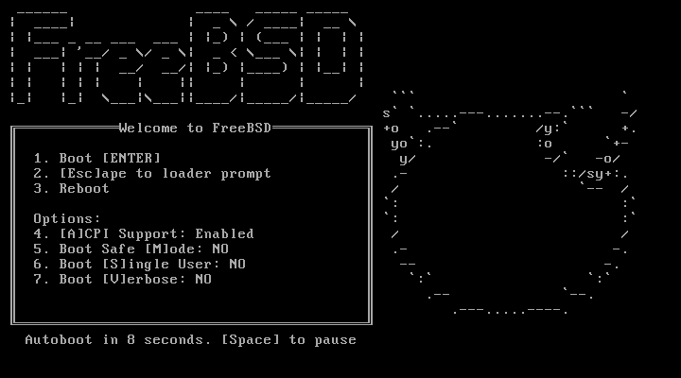
bsdinstall (FreeBSD 9.1) – (1)
說明文件(Documentation)
  http://www.freebsd.org/doc/handbook/bsdinstall.html
下載點 (Download)
  http://www.freebsd.org/releases/9.1R/announce.html

Slide 3
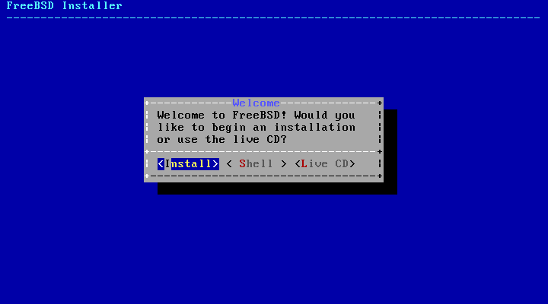
bsdinstall (FreeBSD 9.1) – (2)
Install、Shell、Live CD
  沒有要更改就直接選Install

Slide 4
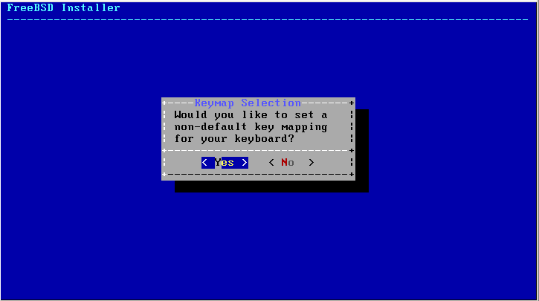
bsdinstall (FreeBSD 9.1) – (3)
Keymap(更改鍵盤對應)
  一般選NO

Slide 5
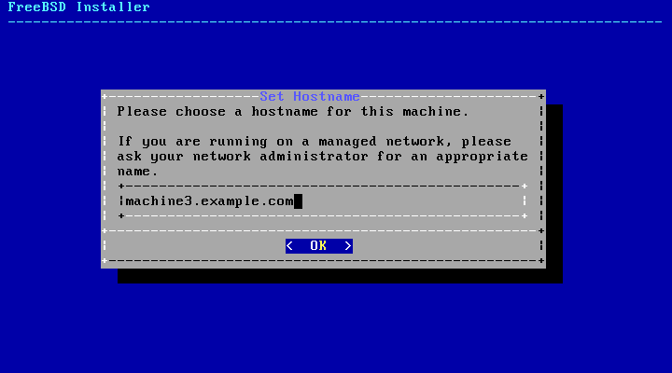
bsdinstall (FreeBSD 9.1) – (4)
Setting hostname

Slide 6
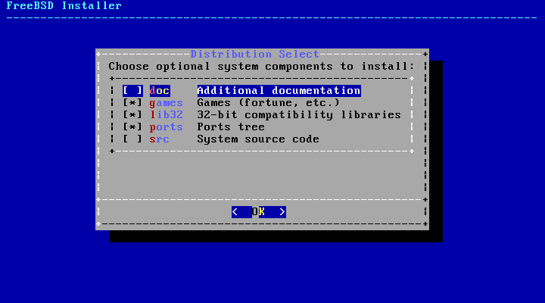
bsdinstall (FreeBSD 9.1) – (5)
Selecting components to install
  一般選擇 ports 和 src就可以了

Slide 7
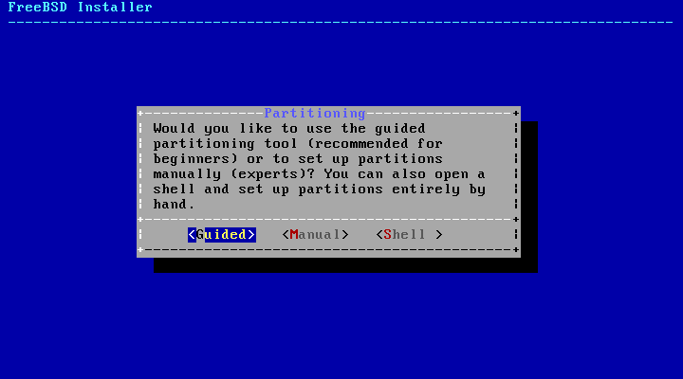
bsdinstall (FreeBSD 9.1) – (6)
Partitioning methods
  Shell – gpart(8)、fdisk(8)、bsdlabel(8)

Slide 8
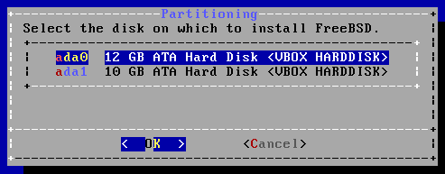
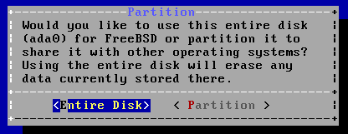
bsdinstall (FreeBSD 9.1) – (7)
Guided Partitioning
  Select disk
  Replace { ad | da }
  by ada
  { ad | da }’s are linked
  to ada’s
  How to partition the disk
    Entire Disk
    Partition – use free space

Slide 9
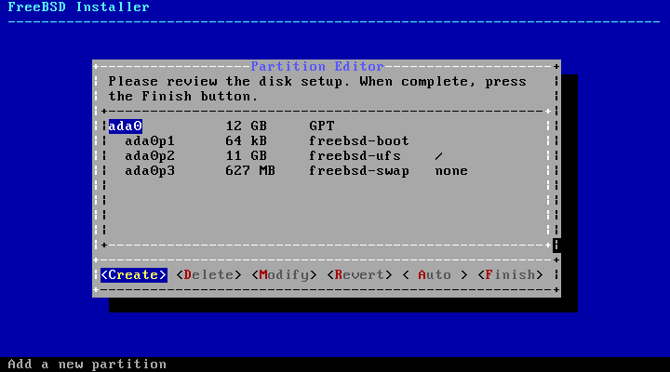
bsdinstall (FreeBSD 9.1) – (8)
Guided Partitioning result

Slide 10
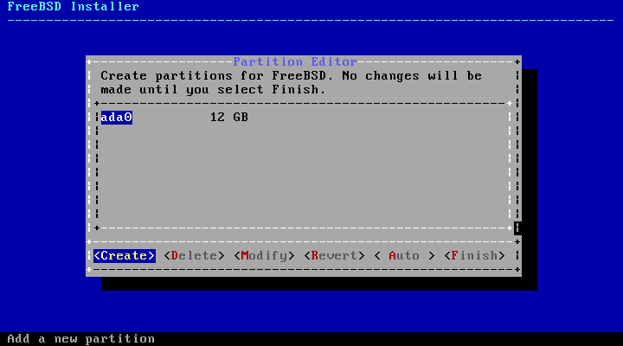
bsdinstall (FreeBSD 9.1) – (9)
Manual Partitioning

Slide 11
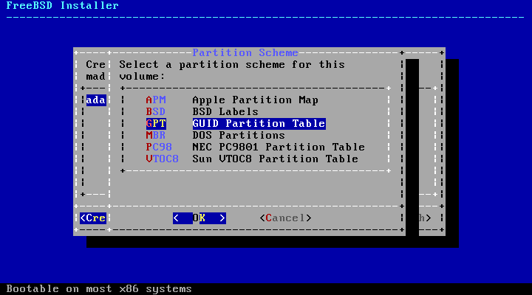
bsdinstall (FreeBSD 9.1) – (10)
Choose a partitioning scheme
  GPT、MBR
  DON’T use BSD!!!
Notes:
MBR (Master Boot Record)

Slide 12
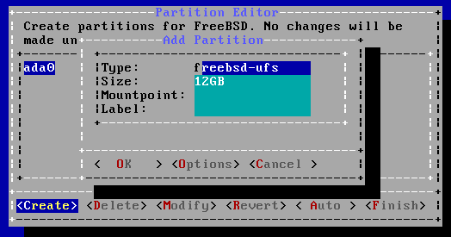
bsdinstall (FreeBSD 9.1) – (11)
Add partitions
  freebsd-boot
    FreeBSD boot code. This partition must be first on the disk.

Slide 13
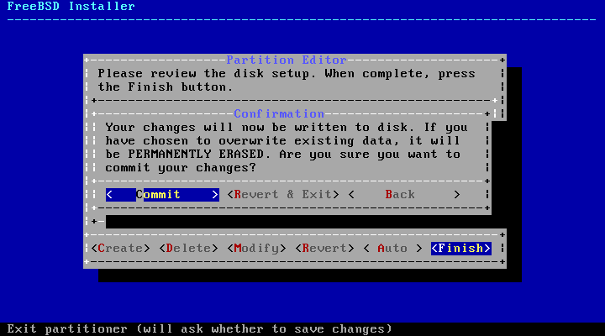
bsdinstall (FreeBSD 9.1) – (12)
Final confirmation

Slide 14
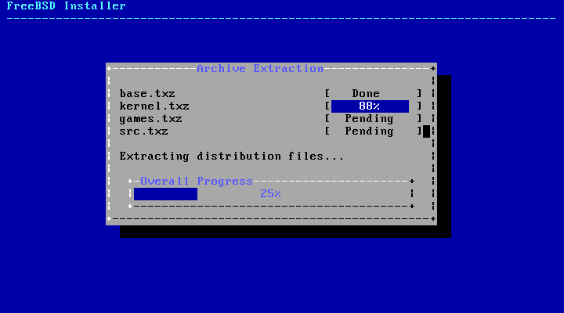
bsdinstall (FreeBSD 9.1) – (13)
Fetching → Checksum Verification → Extraction

Slide 15
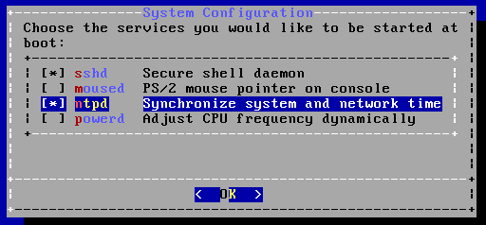
bsdinstall (FreeBSD 9.1) – (14)
Post-installation
  root password
  Network interfaces
    Wired – Static IPv4 / DHCP / Static IPv6 / SLAAC
    Wireless
    DNS
  Time Zone(按NO選時區)
  Services
  Add users
Notes:
通常使用IPV4 和 DHCP

Slide 16
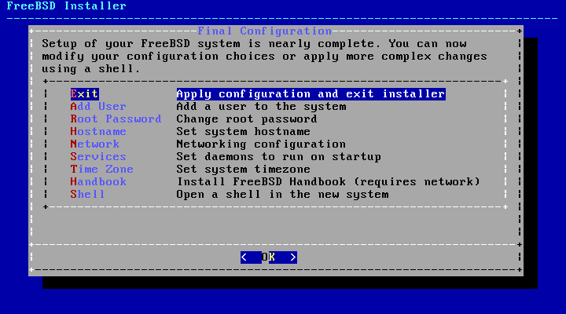
bsdinstall (FreeBSD 9.1) – (15)
Final configuration

