Slide 1
Network Hardware

Slide 2
Network Performance Issues
Three major factors
  Selection of high-quality hardware
  Reasonable network design
  Proper installation and documentation

Slide 3
Hardware Selection –
Classification of market
LAN
  Local Area Network
  Networks that exist within a building or group of buildings
  High-speed, low-cost media
WAN
  Wide Area Network
  Networks that endpoints are geographically dispersed
  High-speed, high-cost media
MAN
  Metropolitan Area Network
  Networks that exist within a city or cluster of cities
  High-speed, medium-cost media

Slide 4
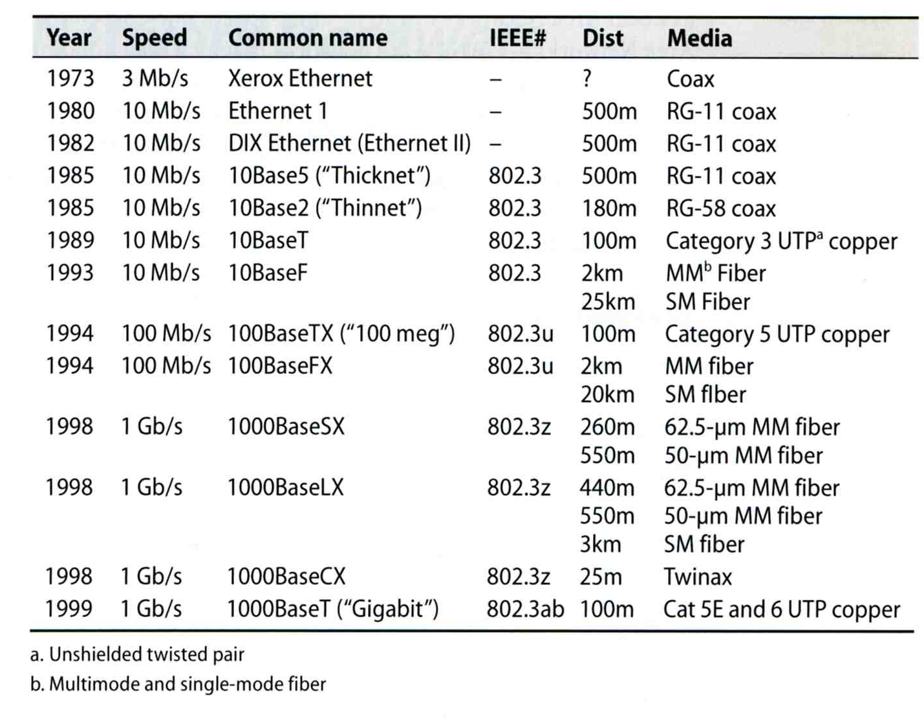
Hardware Selection –
LAN Media (1)
Evolution of Ethernet
Coaxial cable
UTP
Fiber

Slide 5
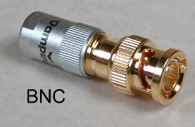
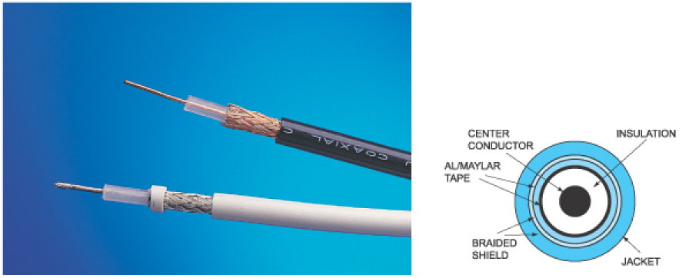
Hardware Selection –
LAN Media (2)
Coaxial cable
  Cooperated with BNC connector
  Speed: 10 Mbps
  Coaxial cable used in LAN
    RG11 (10Base5, 500m)
    RG58 (10Base2, 200m)

Slide 6
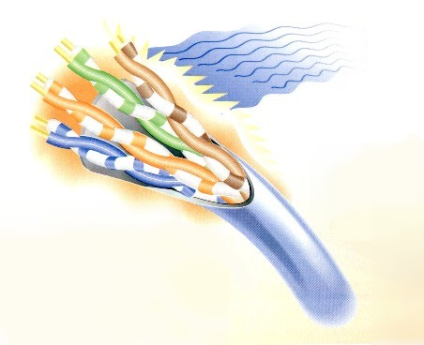
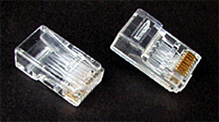
Hardware Selection –
LAN Media (3)
Twisted Pair Cable
  UTP (Unshielded) and STP (Shielded)
    STP has conductive shield
      More expensive but good in resisting cross talk
  Cooperated with RJ45 connector
  Categories
    From CATEGORY-1 ~ CATEGORY-7, CATEGORY-5E
      Cat3 up to 10Mbps (10BaseT, 100m)
      Cat5 up to 100Mbps (100BaseTX, 100m)
      Cat5e / Cat6 up to 1000Mbps (1000BaseT, 100m)

Slide 7
Hardware Selection –
LAN Media (4)
  UTP cable wiring standard
    TIA/EIA-568A, 568B
1 2 3 4 5 6 7 8
白 橘 白 綠 白 藍 白 棕
橘 綠 藍 棕
=======================================
白 橘 白 藍 白 綠 白 棕 EIA/TIA-568B
橘 綠 藍 棕
========================================
1-3 對調, 2-6 對調 EIA/TIA-568A
B-B 一般網路線
A-B 跳線

Slide 8
Hardware Selection –
LAN Media (5)
Fiber Optical Cable
  Mode
    Bundle of light rays that enter the fiber at particular angle
  Two mode
    Single-mode (exactly one frequency of light)
      One stream of laser-generated light
      Long distance, cheaper
    Multi-mode (allow multiple path in fiber)
      Multiple streams of LED-generated light
      Short distance, more expensive
  Wavelength
    0.85, 1.31, 1.55 μm
Connector
  ST, SC, MT-RJ

Slide 9
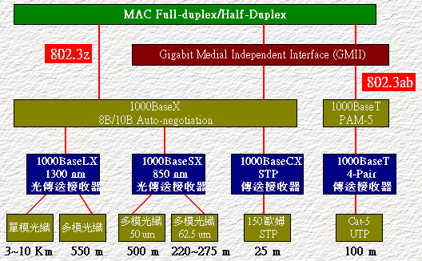
Hardware Selection –
LAN Media (6)
  1000BaseLX (Long wavelength, 1.31μm)
    Single mode
    Multi mode
  1000BaseSX (Short wavelength, 0.85 μm)
    Multimode

Slide 10
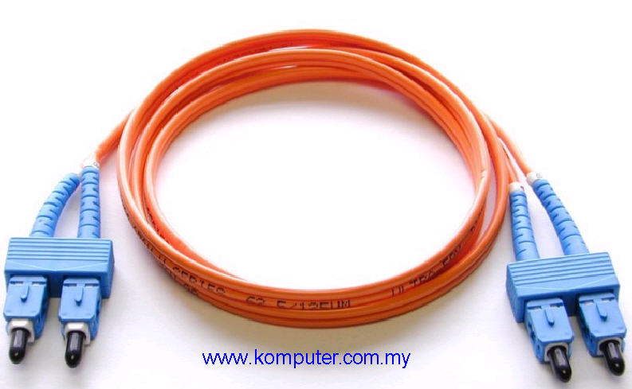
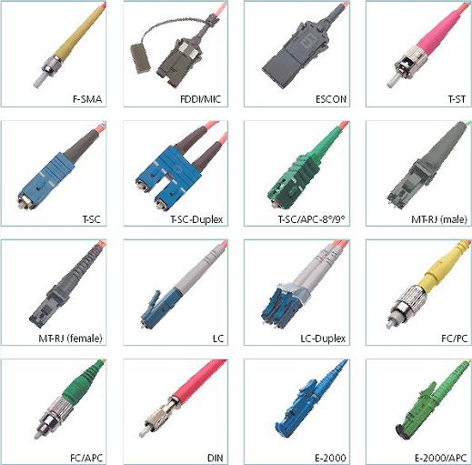
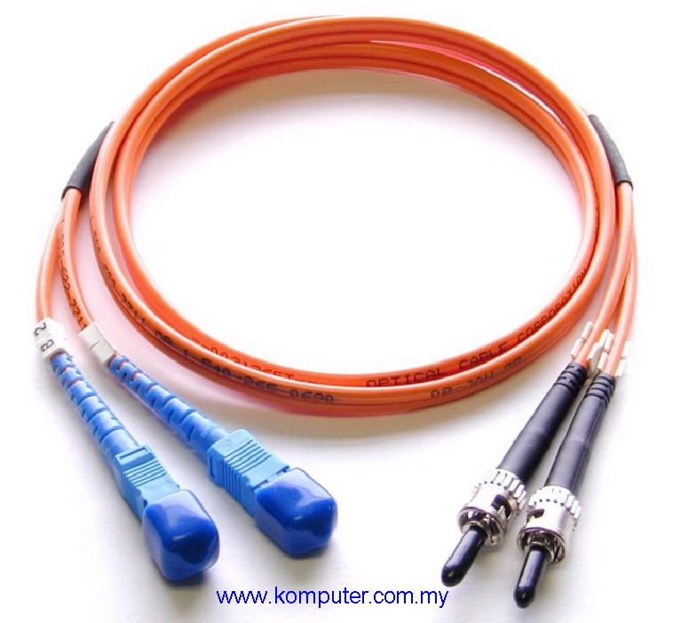
Hardware Selection –
LAN Media (7)
Fiber connector

Slide 11
Hardware Selection –
LAN Media (8)
Wireless
  802.11a
    5.4GHz
    Up to 22Mbps
  802.11b
    2.4GHz
    Up to 11Mbps
  802.11g
    2.4GHz
    Up to 54Mbps
  802.11n
    Development from 2002/09 to 2009/10 (finalize)
    2.4GHz & 5GHz
    Up to 300Mbps
    MIMO

Slide 12
Hardware Selection –
LAN Device (1)
Connecting and expanding Ethernet
  Layer1 device
    Physical layer
    Repeater, Transceiver, HUB
      Does not interpret Ethernet frame
  Layer2 device
    Data-link layer
    Switch, Bridge
      Transfer Ethernet frames based on hardware address
  Layer3 device
    Network layer
    Router
      Route message based on IP address

Slide 13
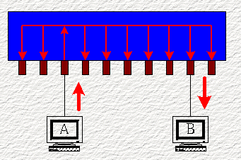
Hardware Selection –
LAN Device (2)
HUB
  Layer1 device
  Multi-port repeater
  Increasing collision domain size
  MDI and MDI-X ports
    (Media Dependent Interface Crossover)
    Auto-sense now
  5-4-3 rules in 10Mbps
    More severe in 100Mbps ~
Switching HUB
  Layer1 device but forward to
  required port

Slide 14
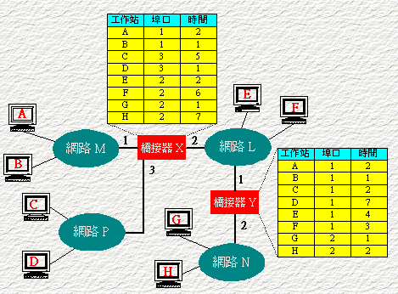
Hardware Selection –
LAN Device (3)
Bridge
  Layer2 device
  Forward Ethernet frames among different segments
  Bridge table
    Fewer collisions
  STP (Spanning Tree Protocol)
    Loop avoidances
    Including
      STA
      (Spanning Tree Algorithm)
      BPDUs
      (Bridge Protocol Data Units)

Slide 15
Hardware Selection –
LAN Device (4)
Switch (layer2)
  Layer2 device
  Multi-port bridge
    Each port is a single collision domain
    Learning
      Each port can learn 1024 Ethernet Address
    Store-and-Forward
  Port Trunks
    Aggregate multi-ports to form a logical one
      Bandwidth
      Reliability

Slide 16
VLAN – Virtual LAN
VLAN
  Spilt a physical switch into several logical switches
  Static VLAN
    Administratively assign which port to which VLAN
  Trunking
    IEEE 802.1Q Tagging
    Cisco's Inter-Switch Link Tagging
    3COM’s VLT Tagging

Slide 17
Last Mile Solution
xDSL
  Digital Subscriber Line
  ADSL for asymmetric DSL
  Use ordinary telephone wire to transmit data
Cable Modem
  Use TV cable to transmit data
Dedicated phone connection
  T1 (DS1 line)
    1.544Mbps, 24 channels, each channel 64Kbps
  T2 (DS2 line)
    6.1Mpbs, 96 channels, each channel 64Kbps
  T3 (DS3 line)
    43Mbps, 672 channels, each channel 64Kbps
FTTx (Fiber To The “x”)
  FTTH for home, FTTB for building, FTTC for Curb

