Slide 1
HW1

Slide 2
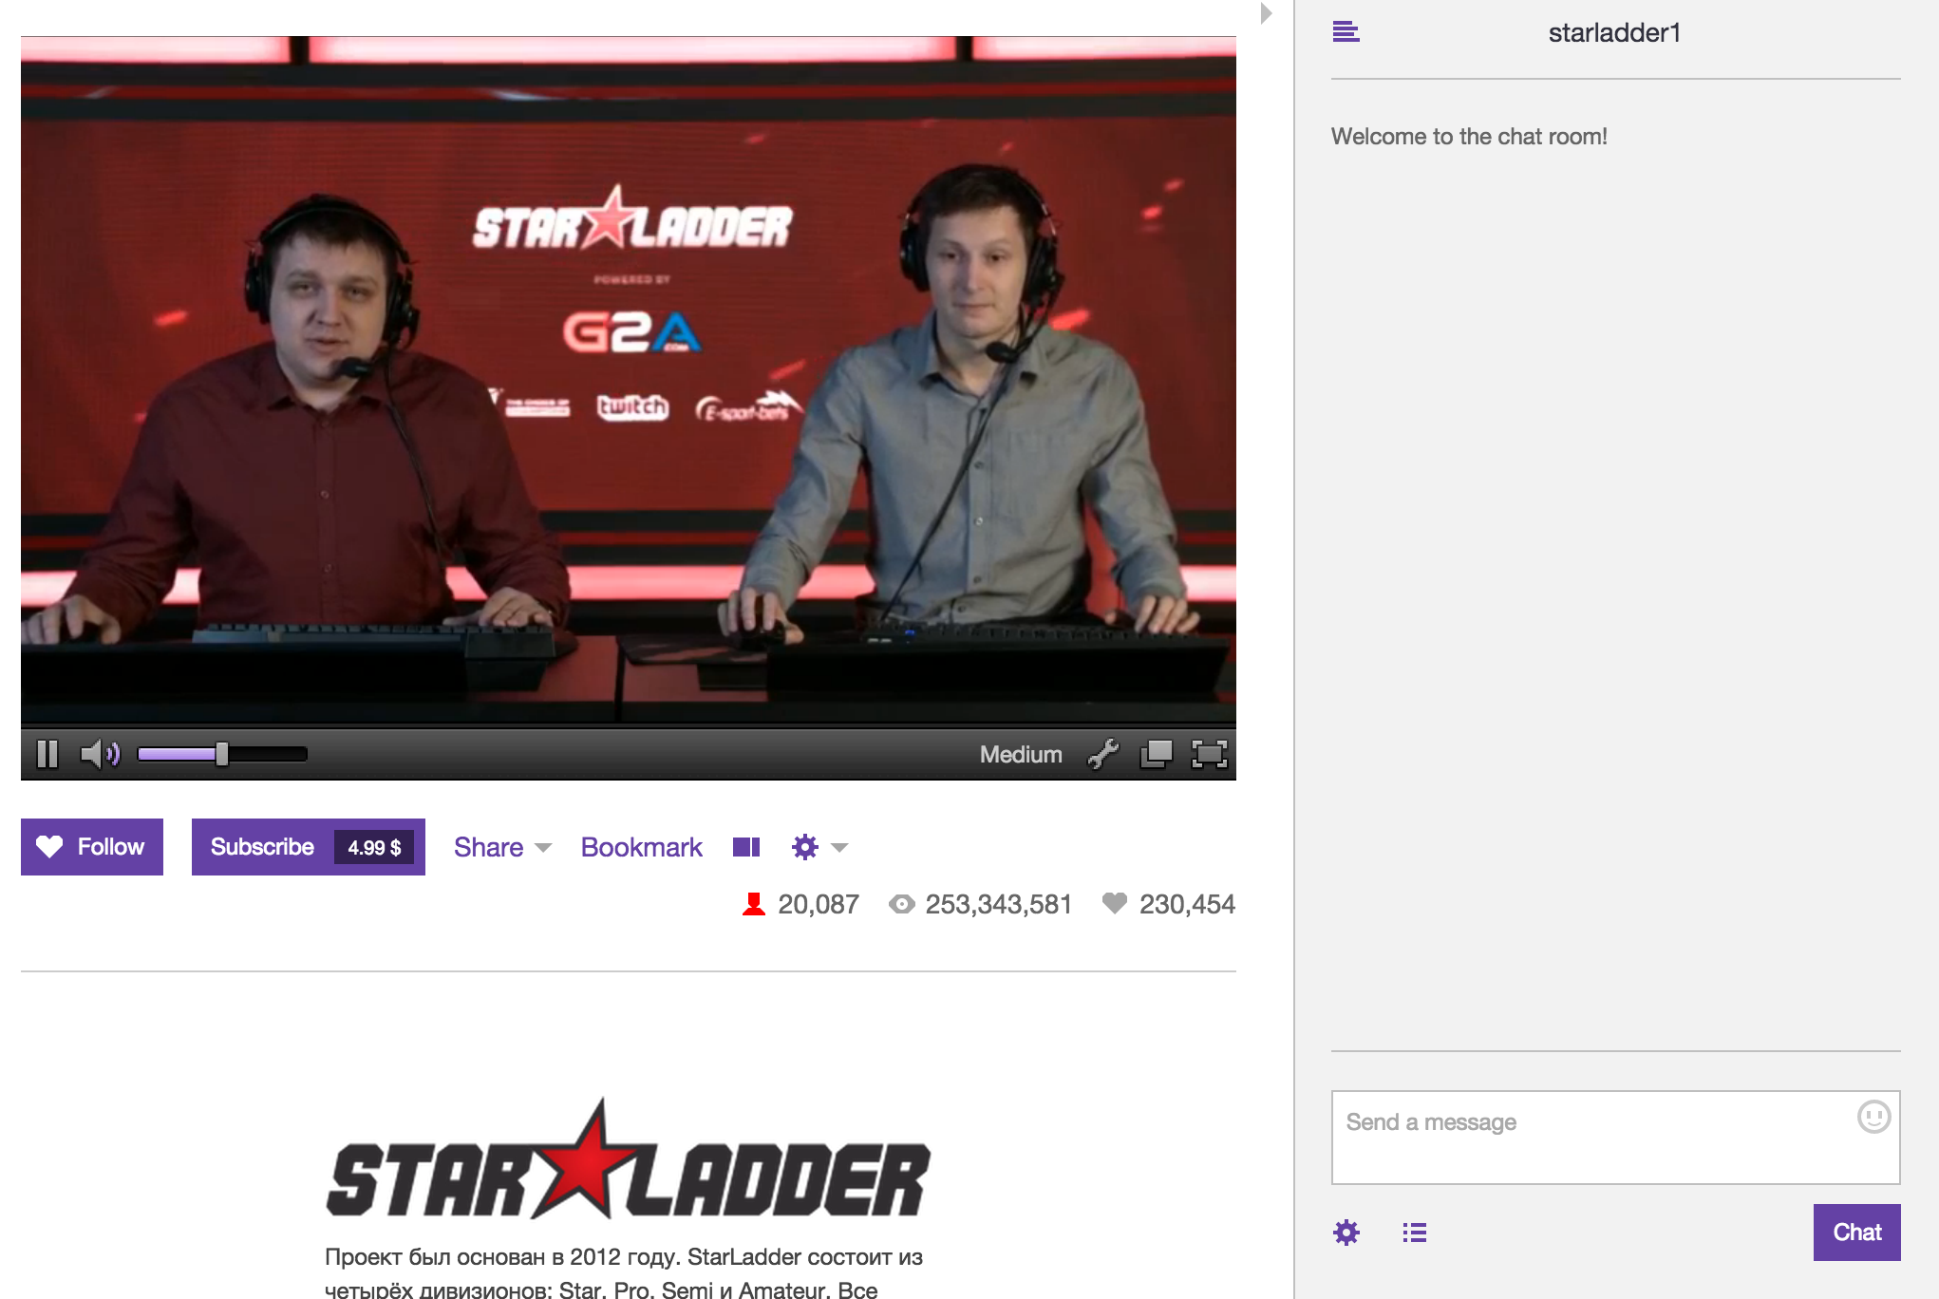
Twitch
Chatroom [IRC base]
http://help.twitch.tv/customer/portal/articles/1302780-twitch-irc

Slide 3
CMD Filter
Up, down, left, right, a, b, start, select
Muti-player ( sent the commands in 3s)
  A: upupup
  B: downdown
  C: leftleftrightright
  D: ab
Normal Mode (all cmds should be run)
  upupupdowndownleftlelftab
Democracy mode
(classify cmds first, then you should hold the elections to decide which cmds should run)
  up | down | left | right | a | b
Violence Ｍode (which cmd is longest. To run it !)
  upupup ( run ‘up’ just a times)

Slide 4
Log
Time
  When the player sent the command
  The game passing time
Nick Name
  player
Command
  All commands should be logged include the commands which did’t run.
  had run command (may deal with by mode)
Mode
  Current mode
Count
  Count of command player sent
  Count of command which had run

Slide 5
Game
Platform
  GameBoy
  https://github.com/Sanqui/pygb
  https://github.com/sunshinekitty/TwitchPlaysPokemon
  https://github.com/aidraj/twitch-plays
  http://www.wituz.com/tutorial-make-your-own-twitch-plays-stream.html
The Game
  It’s up to you.

Slide 6
Score
Connect to IRC server [15%]
CMD Filter [40%]
  Normal Mode [10%]
  Democracy Mode [15%]
  Violence Mode [15%]
Log [15%]
Game [30%]
  Load Game [10%]
  Control Game [20%]
Bonus
  Another funny Mode

Slide 7
Date
Demo
  2015 4/6(Mon.) ~ 4/10(Fri.)
Register Demo time at CSCC
  Due day 2015 3/31(Web.)

