Slide 1
Homework 02
NAT、DHCP、Firewall、FTP、Proxy

Slide 2
Basic Knowledge
DHCP
  Dynamically assigning IPs to clients
NAT
  Translating addresses for clients
Firewall
  Traffic filtering
FTP
  File Transfer Protocol
Proxy
  Intermediary of client and server to translate requests

Slide 3
Basic Knowledge – Isolated Execution Environment
Provide a sandbox with limited access to resource
  Protect other programs from compromised one
OS-level virtualization (Used in this HW)
  Resource isolation
    File system, device…
  Lightweight
  Easy to manage
Implementation
  FreeBSD: jail
  Linux: lxc

Slide 4




Architecture Overview
Network card
Internet
IP0 - public
Server
IP1 – private
Private IP domain
HostA - GUI based host
HostB - FTP server
IP2 – private
IP3 – private

Slide 5
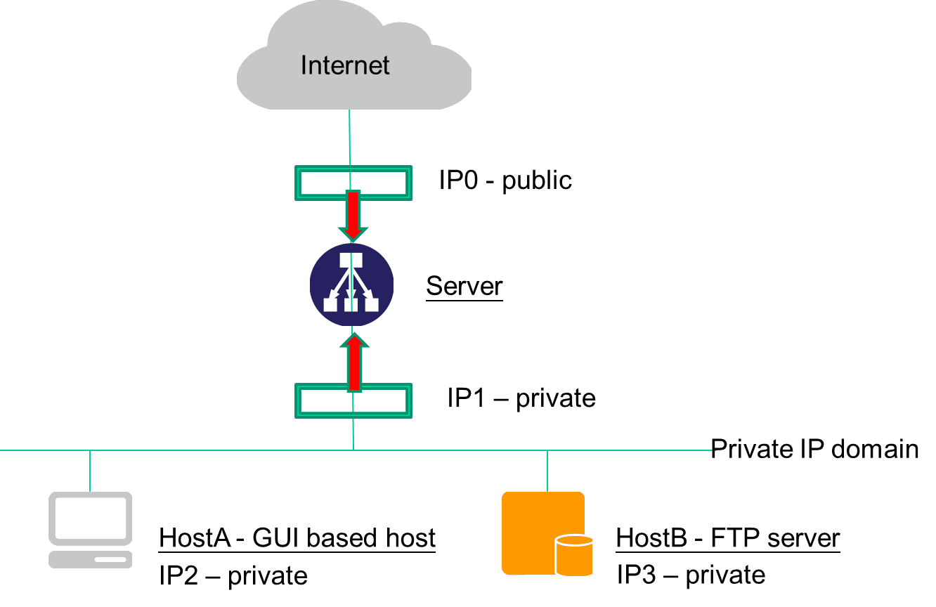
Architecture
Server
  UNIX-based OS
  Act as a gateway for all services
  DHCP & NAT server
  A dedicated Public IP and a static private IP
HostA
  Any OS
  A private IP via DHCP
HostB
  An isolated execution environment on Server
  Runs FTP service
  A static private IP

Slide 6
Requirement – NAT & DHCP
NAT
  HostA & HostB can access Internet via Server
DHCP
  Provided by Server
  Static range should be excluded
Authentication
  Only clients passed authentication can access the internet
    Exclude static range
  Redirect un-auth host to authentication page
    Web service on Server
    Serve a simple authentication page

Slide 7
Requirement – Firewall
Firewall
  Deny all connections come from <BadHost>
  Allow the connection from 140.113.168.0/24 to access HostB’s FTP server
  Drop packets from 140.113.235.0/24 to access HostB’s FTP server, and response TCP RST/ICMP unreachable
  Allow the connection from 140.113.168.0/24 to access HostB’s SSH server (Server will redirect the request for port 222 to HostB’s SSH server)
  The connection from other public IP to access HostB’s FTP and SSH server should be denied and not response TCP RST/ICMP unreachable
  All public IP can’t send ICMP echo request packets to server (will not response ICMP ECHO-REPLY packets)

Slide 8
Requirement – Proxy
FTP proxy
  Setup an FTP proxy on Server
  All FTP requests should be proxied to HostB
HTTP proxy
  Setup a transparent proxy on Server
  All http traffic should pass through this TP
Hint
  ftp-proxy(8) (ftp)
  www/squid (http)
  www/privoxy (http)

Slide 9
Bonus – LB and HA for HTTP Service
Setup multiple worker nodes (>=2)
  Load balance
    Load should be distributed across all nodes
  High availability
    Health check on all nodes
    Remove fail node(s)

Slide 10
Bonus – Area Defense
Setup multiple worker nodes (>=2)
Check login log
Add pf policy

Slide 11
Hand-in
Demo
  5/4 – 5/8
Book Demo
  4/28 – 5/2

