Slide 1
Computer Network Administration
Computer Center, Department of Computer Science
(CSCC)

Slide 2
Syllabus
Website:
https://nasa.cs.nctu.edu.tw/na/2020/
Instructors:
曾亮齊 lctseng@cs.nctu.edu.tw
王則涵 wangth@cs.nctu.edu.tw
林瑞男 jnlin@cs.nctu.edu.tw
許立文 lwhsu@cs.nctu.edu.tw
Time:
Thu. IJK (PM 6:30 ~ 9:20)
Place:
EC114
Lecture/Exam in Chinese
Not recommend for those do not speak Chinese
Notes:
中文授課，考試題目

Slide 3
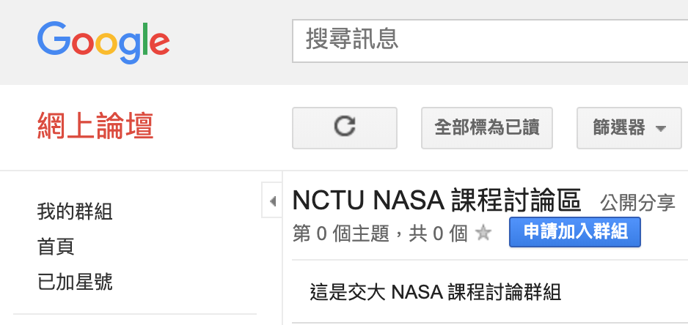
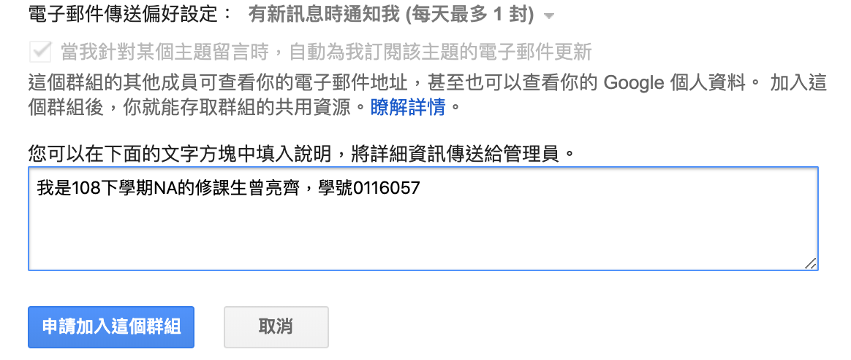
Syllabus
Discussion Forum
https://groups.google.com/forum/#!forum/nctunasa
We suggest you to join - TAs might give homework hints here
Request join and tell us your student ID
Ask course-related/technical questions here
Everyone in the group can answer/vote
But DON’T post direct answer/configuration here!
Otherwise you will be banned.
Notes:
中文授課，考試題目

Slide 4
Syllabus
TAs:
We might get about 4 TAs
Office hour: 3GH every week @ CSCC
Email to TAs: ta@nasa.cs.nctu.edu.tw
Also received by all lecturers
Email Policy (IMPORTANT)
Don’t send course-related/technical questions to TAs
TAs won’t answer you
Only ask TAs for personal/non-technical questions
Course registration/dropping
Grading
Office hour appointment
Demo appointment
Notes:
中文授課，考試題目

Slide 5
Syllabus - Registration & Dropping Policy
Registration (non-NCTU students)
Send registration form to CSCC front desk if cannot find lecturers
Dropping (after midterm)
Contact CS Department Office if cannot find lecturers near the deadline
Email to ta@nasa.cs.nctu.edu.tw
Notes:
中文授課，考試題目

Slide 6
Syllabus – Course Overview
Main topics
Networking
TCP/IP Networking Environment
NAT, DHCP, Firewall, VPN, Load Balancer, …
DNS – BIND (Berkeley Internet Name Domain)
Mail System - Postfix
SPF (Sender Policy Framework)
DKIM (Domain Keys Identified Mail)
DMARC (Domain-based Message Authentication, Reporting & Conformance)
Network Management/Authentication/Authorization
LDAP, SNMP
Configuration Management (Ansible, Puppet)

Slide 7


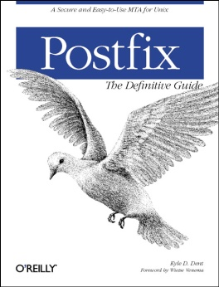
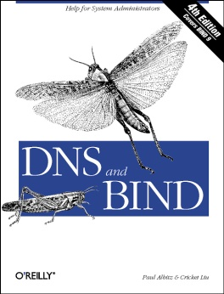

Syllabus – Course Textbook and Reference
Textbook
Unix and Linux System Administration Handbook (5th Edition)
Course slides
Reference book
TCP/IP Illustrated Volume 1
Postfix
DNS and BIND
SNMP, SNMPv2, SNMPv3 and RMON 1, 2

Slide 8
Syllabus – Text book outline
Part I. Basic Administration
Chap 1 – Where to start.
Chap 2 – Booting and Shutting Down
Chap 3 – The Filesystem
Chap 4 – Access control and rootly powers
Chap 5 – Controlling processes
Chap 6 – User Management
Chap 7 – Storage
Chap 8 – Periodic processes
Chap 9 – Backups
Chap 10 – Syslog and log files
Chap 11 – Software installation and management
Chap 12 – The Kernel
Chap 13 – Scripting and the Shell
Chap 14 – Configuration Management
Part II. Networking
Chap 15 – Physical Networking
Chap 16 – TCP/IP
Chap 17 – Routing
Chap 18 – DNS: Domain Name System
Chap 19 – NFS: Network File System
Chap 20 – HTTP: Hypertext Transfer Protocol
Chap 21 – SMTP: Simple Mail Transfer Protocol
Chap 22 – Directory Services
Chap 23 – Electronic Mail
Chap 24 – Web Applications
Chap 25 – Network Management and Debugging

Slide 9
Syllabus – Text book outline (Cont.)
Part III. Operations
Chap 26 – Continuous Integration and Delivery
Chap 27 – Security
Chap 28 – Cloud Computing
Chap 29 – Containers and Virtualization
Chap 30 – Monitoring
Chap 31 – Performance Analysis
Chap 32 – Policy and Politics

Slide 10
Syllabus – Grade Policy
Mid
15 ~ 20%
Final
15 ~ 20%
Homework
60 ~ 70%
No Delay Work
4 homework

Slide 11
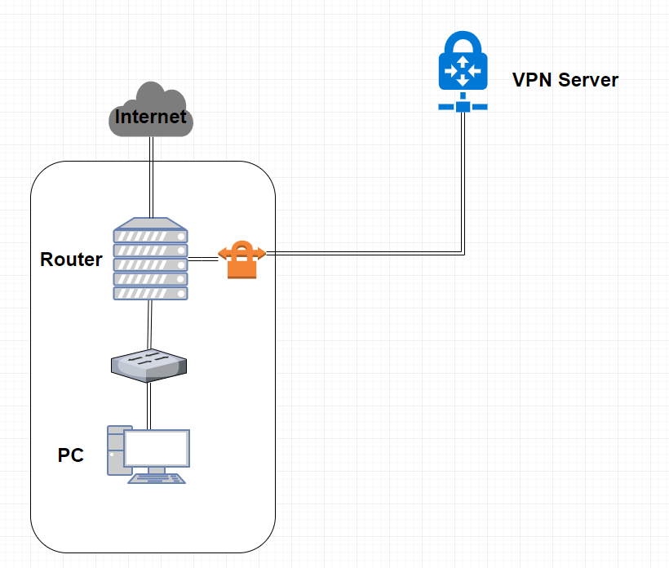
Syllabus – Homework Outline
Building an intranet with DHCP, NAT, VPN, DNS, LDAP, Mail, WWW… services
Understanding and managing all these services
Multiple internal servers

Slide 12
Syllabus – Homework Outline
Every homework is based on previous one
Homework 1
Setup Intranet
DHCP, NAT, VPN
Homework 2
+ DNS Service
Homework 3
+ Mail Service
Homework 4
Authorization, Authentication, Monitoring, Management
+ LDAP, SNMP

Slide 13
Syllabus – Prerequisite
Background Knowledges
Strongly recommend that you should take these first
“Computer System Administration” (計算機系統管理)
“Introduction to Networking” (計算機網路概論)
Unix-like system
You can use any OS for homework
FreeBSD is used for lecturing
Environment
A dedicate(powerful?) PC that can run multiple VMs
VirtualBox, VMWare
2~3 Unix-like system running at the same time

Slide 14

Attitude
Attend every class
Do every exercise
As early as possible
On your own
Read book and practice at least 6 hours every week
Use Unix-like environment
Recommend: more than 1.5 hours/day averagely
Collect information on the Internet
The newer, the better.
Not recommended for those have more than 3 major courses in this semester
This is a heavy course - loading roughly equal to a 9-credit course

Slide 15
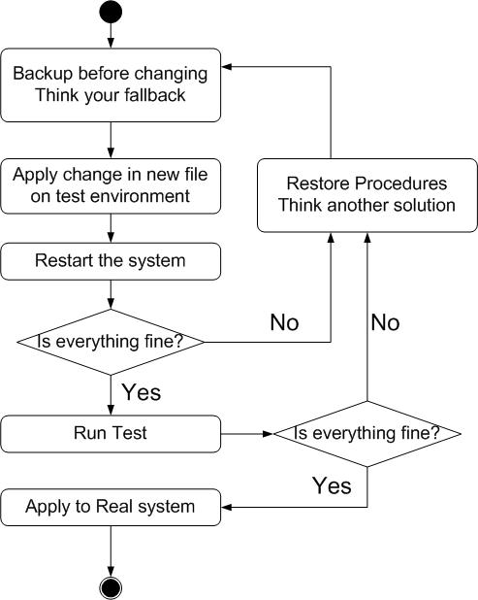
When You Perform Any Changes…
Flow of Change

Slide 16
SA-NA Junction
FreeBSD
12.0-RELEASE
Self-study for the SA course
https://nasa.cs.nctu.edu.tw/sa/2019/

