Slide 1
Network Introduction
jnlin

Slide 2
TCP/IP and the Internet
In 1969
ARPA funded and created the “ARPANET” network
高等研究計劃署 (Advanced Research Project Agency)
NCP – Network Control Protocol
Allow an exchange of information between separated computers
In 1973
How to connect ARPANET with SATNET and ALOHANET
TCP/IP begun to be developed
In 1983
TCP/IP protocols replaced NCP as the ARPANET’s principal protocol
ARPANET → MILNET + ARPANET = Internet
In 1985
The NSF created the NSFNET to connect to Internet
In 1990
ARPANET passed out of existence, and in 1995, the NSFNET became the primary Internet backbone network
ARPA: Advanced Research Project Agency
NSF: National Science Foundation

Slide 3
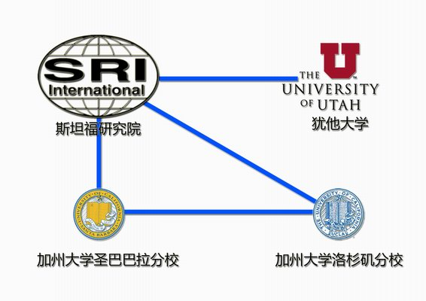
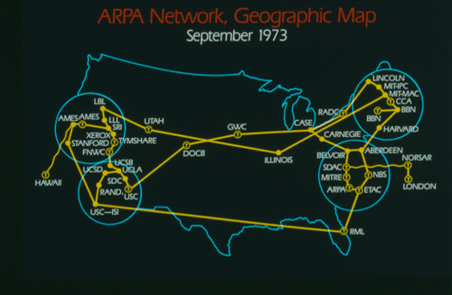
Introduction – APRANET
Stanford Research Institute
University of Utah
UC Santa Barbara
UCLA

Slide 4
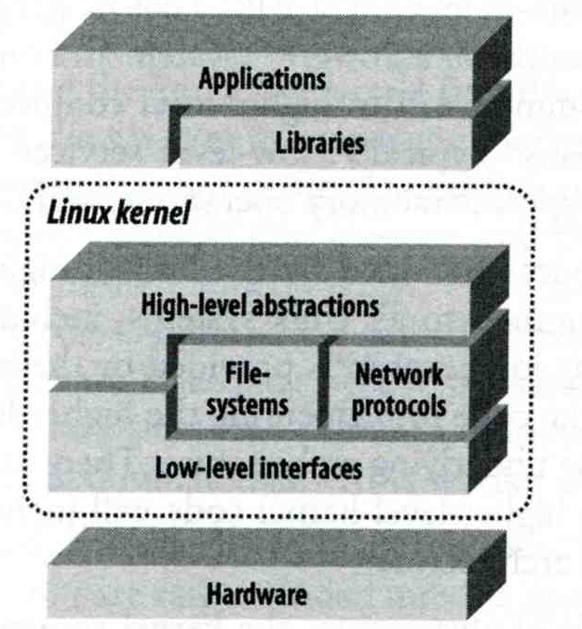
Introduction – Why TCP/IP ?
The gap between applications and Network
Network
802.3 Ethernet
802.4 Token bus
802.5 Token Ring
802.11 Wireless
Application
Reliable
Performance
We need something to do the translating work!
TCP/IP it is!!

Slide 5
Introduction – Layers of TCP/IP (1)
TCP/IP is a suite of networking protocols
4 layers Layering architecture
Link layer (data-link layer)
Include device drivers to handle hardware details
Network layer (IP)
Handle the movement of packets around the network
Transport layer (Port)
Handle flow of data between hosts
Application

Slide 6
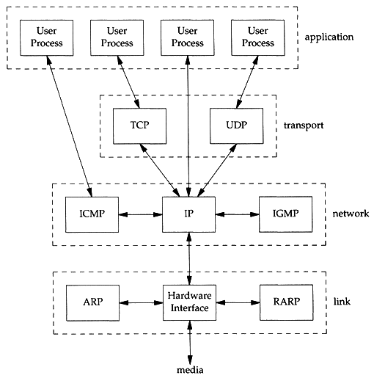
Introduction – Layers of TCP/IP (2)
Each layer has several protocols
A layer define a data communication function that may be performed by certain protocols
A protocol provides a service suitable to the function of that layer

Slide 7
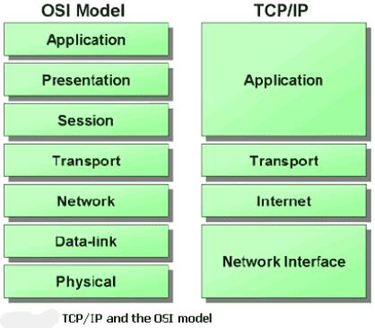
Introduction – Layers of TCP/IP (3)
ISO/OSI Model
TCP/IP Model
ISO: International Organization for Standardization
OSI: Open System Interconnection

Slide 8
Introduction
TCP/IP
Used to provide data communication between hosts
How to delivery data reliably
How to address remote host on the network
How to handle different type of hardware device

Slide 9
Introduction – Addressing
Addressing
MAC Address
Media Access Control Address
48-bit Network Interface Card Hardware Address
24-bit manufacture ID
24-bit serial number
Ex:
00:07:e9:10:e6:6b
IP Address
32-bit Internet Address (IPv4)
Ex:
140.113.209.64
Port
16-bit uniquely identify application (1 ~ 65536)
Ex:
FTP port 21, SSH port 22, Telnet port 23
sabsd [/home/chwong] -chwong- ifconfig
sk0: flags=8843<UP,BROADCAST,RUNNING,SIMPLEX,MULTICAST> mtu 1500
options=b<RXCSUM,TXCSUM,VLAN_MTU>
inet 140.113.17.215 netmask 0xffffff00 broadcast 140.113.17.255
inet 140.113.17.221 netmask 0xffffffff broadcast 140.113.17.221
ether 00:11:d8:06:1e:81
media: Ethernet autoselect (100baseTX <full-duplex,flag0,flag1>)
status: active
lo0: flags=8049<UP,LOOPBACK,RUNNING,MULTICAST> mtu 16384
inet 127.0.0.1 netmask 0xff000000

Slide 10
Link Layer

Slide 11
Link Layer – Introduction of Link Layer
Purpose of the link layer
Send and receive IP datagram for IP module
ARP request and reply
RARP request and reply
TCP/IP support various link layers, depending on the type of hardware used:
Ethernet
Teach in this class
Token Ring
FDDI (Fiber Distributed Data Interface)
Serial Line

Slide 12
Link Layer – Ethernet
Features
Predominant form of local LAN technology used today
Use CSMA/CD
Carrier Sense, Multiple Access with Collision Detection
Use 48-bit MAC address
Operate at 10 Mbps
Fast Ethernet at 100 Mbps
Gigabit Ethernet at 1000 Mbps
10 Gigabit Ethernet at 10,000 Mbps (10Gbps)
Ethernet frame format is defined in RFC 894
This is the actually used format in reality

Slide 13
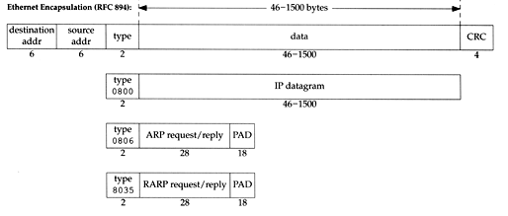
Link Layer – Ethernet Frame Format
48-bit hardware address
For both destination and source address
16-bit type is used to specify the type of following data
0800 → IP datagram
0806 → ARP, 8035 → RARP

Slide 14
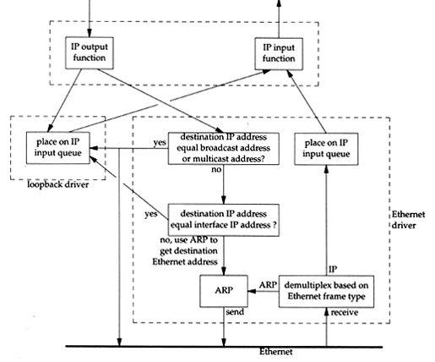
Link Layer – Loopback Interface
Pseudo NIC
Allow client and server on the same host to communicate with each other using TCP/IP
IP
127.0.0.1
Hostname
localhost

Slide 15
Network Layer

Slide 16
Network Layer – Introduction to Network Layer
Unreliable and connectionless datagram delivery service
IP Routing
IP provides best effort service (unreliable)
IP datagram can be delivered out of order (connectionless)
Protocols using IP
TCP, UDP, ICMP, IGMP

Slide 17
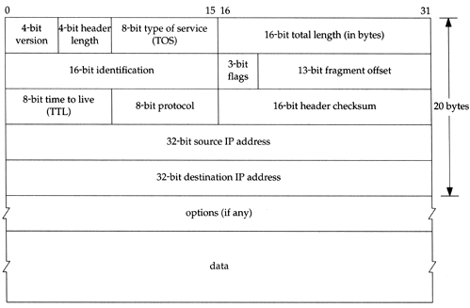
Network Layer – IP Header
20 bytes in total length, excepts options

Slide 18
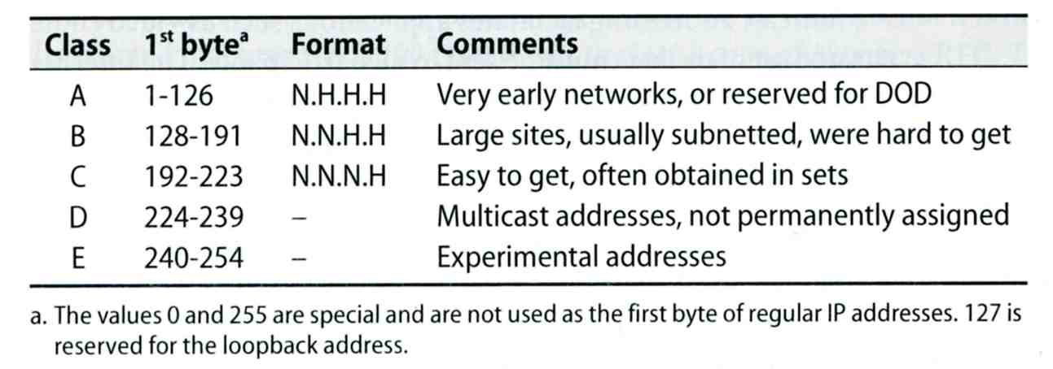
Network Layer – IP Address (1)
32-bit long
Network part
Identify a logical network
Host part
Identify a machine on certain network
IP address category
Ex:
NCTU
Class B address: 140.113.0.0
Network ID: 140.113
Number of hosts: 256*256 = 65536

Slide 19
Network Layer – Subnetting, CIDR, and Netmask (1)
Problems of Class A or B network
Number of hosts is enormous
Hard to maintain and management
Solution ➔ Subnetting
Problems of Class C network
255*255*255 number of Class C network make the size of Internet routes huge
Solution ➔ Classless Inter-Domain Routing

Slide 20
Network Layer – Subnetting, CIDR, and Netmask (2)
Subnetting
Borrow some bits from host ID to extend network ID
Ex:
Class B address : 140.113.0.0
= 256 Class C-like IP addresses
in N.N.N.H subnetting method
140.113.209.0 subnet
Benefits of subnetting
Reduce the routing table size of Internet’s routers
Ex:
All external routers have only one entry for 140.113 Class B network

Slide 21
Network Layer – Subnetting, CIDR, and Netmask (3)
Netmask
Specify how many bits of network-ID are used for network-ID
Continuous 1 bits form the network part
Ex:
255.255.255.0 in NCTU-CS example
256 hosts available
255.255.255.248 in ADSL example
Only 8 hosts available
Shorthand notation
Address/prefix-length
Ex: 140.113.209.8/24

Slide 22
Network Layer – Subnetting, CIDR, and Netmask (4)
How to determine your network ID?
Bitwise-AND IP and netmask
Ex:
140.113.214.37 & 255.255.255.0 ➔ 140.113.214.0
140.113.209.37 & 255.255.255.0 ➔ 140.113.209.0
140.113.214.37 & 255.255.0.0 ➔ 140.113.0.0
140.113.209.37 & 255.255.0.0 ➔ 140.113.0.0
211.23.188.78 & 255.255.255.248 ➔ 211.23.188.72
78 = 01001110
78 & 248= 01001110 & 11111000 =72

Slide 23
Network Layer – Subnetting, CIDR, and Netmask (5)
In a subnet, not all IP are available
The first one IP ➔ network ID
The last one IP ➔ broadcast address
Ex:
Netmask 255.255.255.0
140.113.209.32/24
140.113.209.0 ➔ network ID
140.113.209.255 ➔ broadcast address
1 ~ 254, total 254 IPs are usable
Netmask 255.255.255.252
211.23.188.78/29
211.23.188.72 ➔ network ID
211.23.188.79 ➔ broadcast address
73 ~ 78, total 6 IPs are usable

Slide 24
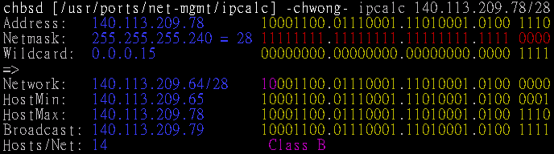
Network Layer – Subnetting, CIDR, and Netmask (6)
The smallest subnetting
Network portion : 30 bits
Host portion : 2 bits
➔ 4 hosts, but only 2 IPs are available
ipcalc
/usr/ports/net-mgmt/ipcalc
pkg install ipcalc

Slide 25
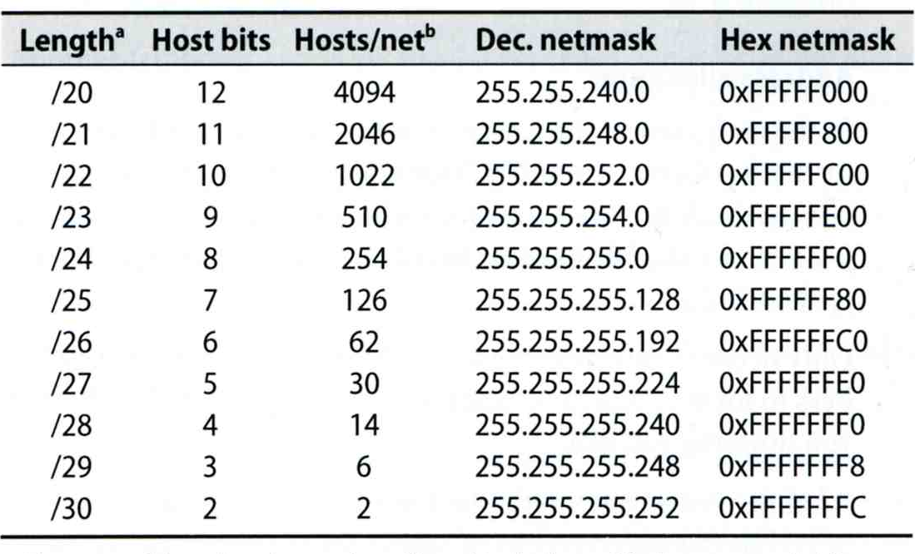
Network Layer – Subnetting, CIDR, and Netmask (7)
Network configuration for various lengths of netmask

Slide 26
Network Layer – Subnetting, CIDR, and Netmask (8)
CIDR (Classless Inter-Domain Routing)
Use address mask instead of old address classes to determine the destination network
CIDR requires modifications to routers and routing protocols
Need to transmit both destination address and mask
Ex:
We can merge two Class C network:
203.19.68.0/24, 203.19.69.0/24 ➔ 203.19.68.0/23
Benefit of CIDR
We can allocate continuous Class C network to organization
Reflect physical network topology
Reduce the size of routing table

Slide 27
Network Layer – IP Routing (1)
Difference between Host and Router
Router forwards datagram from one of its interface to another, while host does not
Almost every Unix system can be configured to act as a router or both
net.inet.ip.forwarding=1
Router
IP layer has a routing table, which is used to store the information for forwarding datagram
When router receiving a datagram
If Dst. IP = my IP, demultiplex to other protocol
Other, forward the IP based on routing table

Slide 28
Network Layer – IP Routing (2)
Routing table information
Destination IP
IP address of next-hop router or IP address of a directly connected network
Flags
Next interface
IP routing
Done on a hop-by-hop basis
It assumes that the next-hop router is closer to the destination
Steps:
Search routing table for complete matched IP address
Send to next-hop router or to the directly connected NIC
Search routing table for matched network ID
Send to next-hop router or to the directly connected NIC
Search routing table for default route
Send to this default next-hop router
host or network unreachable

Slide 29
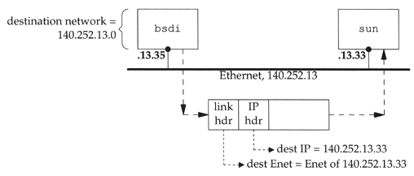
Network Layer – IP Routing (3)
Ex1: routing in the same network
bsdi: 140.252.13.35
sun: 140.252.13.33
Ex Routing table:
140.252.13.33 00:d0:59:83:d9:16 UHLW fxp1

Slide 30
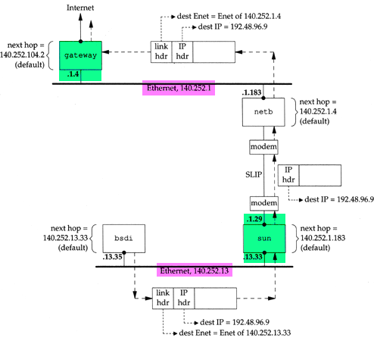
Network Layer – IP Routing (4)
Ex2:
routing across multi-network

Slide 31
ARP and RARP
Something between
MAC (link layer)
And
IP (network layer)

Slide 32
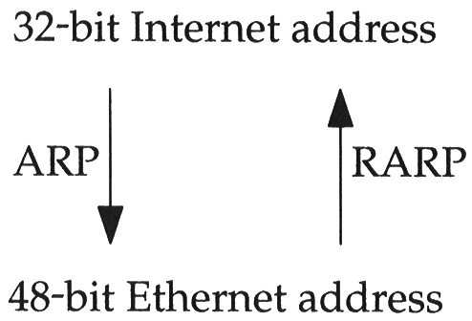
ARP and RARP
ARP – Address Resolution Protocol and RARP – Reverse ARP
Mapping between IP and Ethernet address
When an Ethernet frame is sent on LAN from one host to another,
It is the 48-bit Ethernet address that determines for which interface the frame is destined

Slide 33
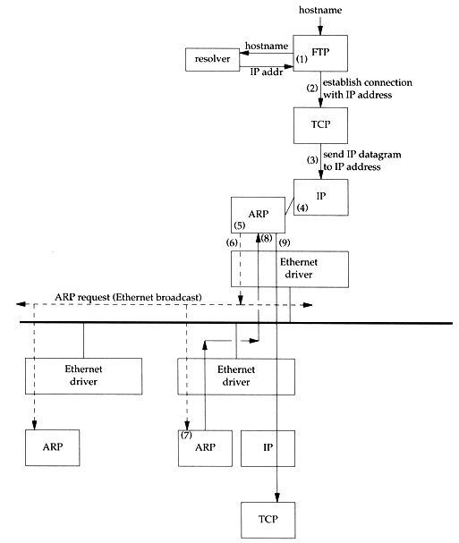
ARP and RARP – ARP Example
Example
% ftp bsd1
(4) next-hop or direct host
(5) Search ARP cache
(6) Broadcast ARP request
(7) bsd1 response ARP reply
(9) Send original IP datagram

Slide 34
ARP and RARP – ARP Cache
Maintain recent ARP results
come from both ARP request and reply
expiration time
Complete entry = 20 minutes
Incomplete entry = 3 minutes
Use arp command to see the cache
Ex:
% arp -a
% arp -da
% arp -S 140.113.235.132 00:0e:a6:94:24:6e
csduty /home/chwong] -chwong- arp -a
cshome (140.113.235.101) at 00:0b:cd:9e:74:61 on em0 [ethernet]
bsd1 (140.113.235.131) at 00:11:09:a0:04:74 on em0 [ethernet]
? (140.113.235.160) at (incomplete) on em0 [ethernet]

Slide 35

ARP and RARP – ARP/RARP Packet Format
Ethernet destination addr: all 1’s (broadcast)
Known value for IP <-> Ethernet
Frame type: 0x0806 for ARP, 0x8035 for RARP
Hardware type: type of hardware address (1 for Ethernet)
Protocol type: type of upper layer address (0x0800 for IP)
Hard size: size in bytes of hardware address (6 for Ethernet)
Protocol size: size in bytes of upper layer address (4 for IP)
Op: 1, 2, 3, 4 for ARP request, reply, RARP request, reply

Slide 36
ARP and RARP – Use tcpdump to see ARP
Host 140.113.17.212 → 140.113.17.215
Clear ARP cache of 140.113.17.212
% sudo arp -d 140.113.17.215
Run tcpdump on 140.113.17.215 (00:11:d8:06:1e:81)
% sudo tcpdump -i sk0 -e arp
% sudo tcpdump -i sk0 -n -e arp
% sudo tcpdump -i sk0 -n -t -e arp
On 140.113.17.212, ssh to 140.113.17.215
15:18:54.899779 00:90:96:23:8f:7d > Broadcast, ethertype ARP (0x0806), length 60:
arp who-has nabsd tell chbsd.csie.nctu.edu.tw
15:18:54.899792 00:11:d8:06:1e:81 > 00:90:96:23:8f:7d, ethertype ARP (0x0806), length 42:
arp reply nabsd is-at 00:11:d8:06:1e:81
15:26:13.847417 00:90:96:23:8f:7d > ff:ff:ff:ff:ff:ff, ethertype ARP (0x0806), length 60:
arp who-has 140.113.17.215 tell 140.113.17.212
15:26:13.847434 00:11:d8:06:1e:81 > 00:90:96:23:8f:7d, ethertype ARP (0x0806), length 42:
arp reply 140.113.17.215 is-at 00:11:d8:06:1e:81
00:90:96:23:8f:7d > ff:ff:ff:ff:ff:ff, ethertype ARP (0x0806), length 60:
arp who-has 140.113.17.215 tell 140.113.17.212
00:11:d8:06:1e:81 > 00:90:96:23:8f:7d, ethertype ARP (0x0806), length 42:
arp reply 140.113.17.215 is-at 00:11:d8:06:1e:81

Slide 37
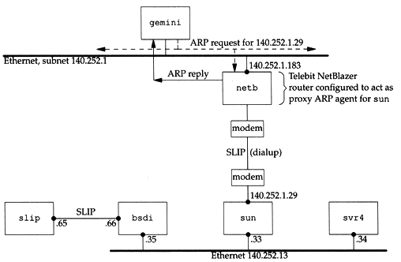
ARP and RARP – Proxy ARP
Let router answer ARP request on one of its networks for a host on another of its network

Slide 38
ARP and RARP – Gratuitous ARP
Gratuitous ARP
The host sends an ARP request looking for its own IP
Provide two features
Used to determine whether there is another host configured with the same IP
Used to cause any other host to update ARP cache when changing hardware address

Slide 39
ARP and RARP – RARP
Principle
Used for the diskless system to read its hardware address from the NIC and send an RARP request to gain its IP
RARP Server Design
RARP server must maintain the map from hardware address to an IP address for many host
Link-layer broadcast
This prevent most routers from forwarding an RARP request

Slide 40
ICMP – Internet Control Message Protocol

Slide 41
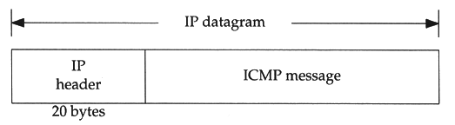
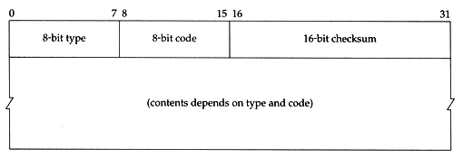
ICMP – Introduction
Part of the IP layer
ICMP messages are transmitted within IP datagram
ICMP communicates error messages and other conditions that require attention for other protocols
ICMP message format

Slide 42
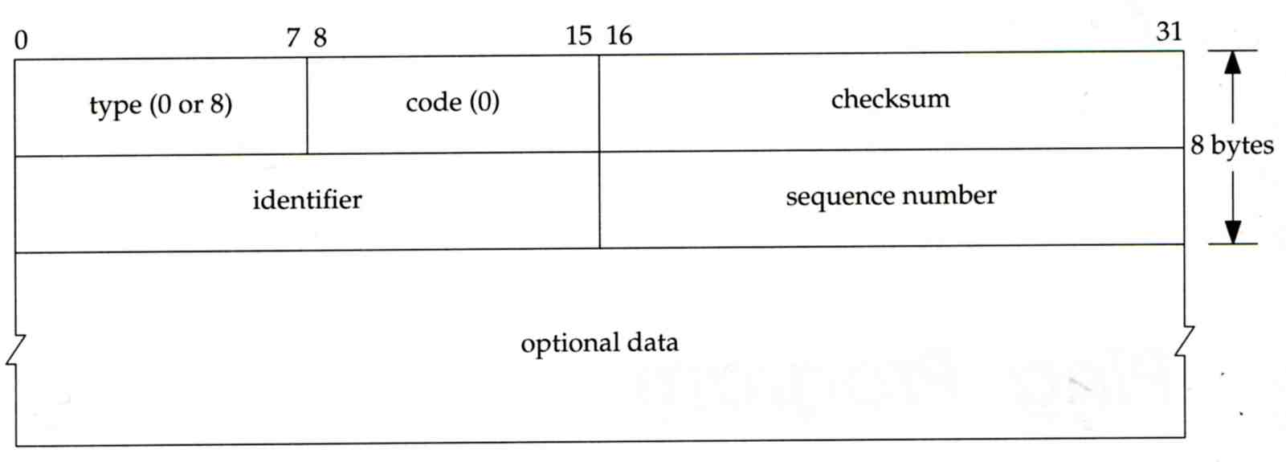
ICMP – Ping Program (1)
Use ICMP to test whether another host is reachable
Type 8, ICMP echo request
Type 0, ICMP echo reply
ICMP echo request/reply format
Identifier: process ID of the sending process
Sequence number: start with 0
Optional data: any optional data sent must be echoed

Slide 43
ICMP – Ping Program (2)
Ex:
chbsd ping nabsd
execute “tcpdump -i sk0 -X -e icmp” on nabsd
chbsd [/home/chwong] -chwong- ping nabsd
PING nabsd.cs.nctu.edu.tw (140.113.17.215): 56 data bytes
64 bytes from 140.113.17.215: icmp_seq=0 ttl=64 time=0.520 ms
15:08:12.631925 00:90:96:23:8f:7d > 00:11:d8:06:1e:81, ethertype IPv4 (0x0800), length 98:
chbsd.csie.nctu.edu.tw > nabsd: ICMP echo request, id 56914, seq 0, length 64
0x0000: 4500 0054 f688 0000 4001 4793 8c71 11d4 E..T....@.G..q..
0x0010: 8c71 11d7 0800 a715 de52 0000 45f7 9f35 .q.......R..E..5
0x0020: 000d a25a 0809 0a0b 0c0d 0e0f 1011 1213 ...Z............
0x0030: 1415 1617 1819 1a1b 1c1d 1e1f 2021 2223 .............!"#
0x0040: 2425 2627 2829 2a2b 2c2d 2e2f 3031 3233 $%&'()*+,-./0123
0x0050: 3435 45
15:08:12.631968 00:11:d8:06:1e:81 > 00:90:96:23:8f:7d, ethertype IPv4 (0x0800), length 98:
nabsd > chbsd.csie.nctu.edu.tw: ICMP echo reply, id 56914, seq 0, length 64
0x0000: 4500 0054 d97d 0000 4001 649e 8c71 11d7 E..T.}..@.d..q..
0x0010: 8c71 11d4 0000 af15 de52 0000 45f7 9f35 .q.......R..E..5
0x0020: 000d a25a 0809 0a0b 0c0d 0e0f 1011 1213 ...Z............
0x0030: 1415 1617 1819 1a1b 1c1d 1e1f 2021 2223 .............!"#
0x0040: 2425 2627 2829 2a2b 2c2d 2e2f 3031 3233 $%&'()*+,-./0123
0x0050: 3435 45
Type, Code
id

Slide 44
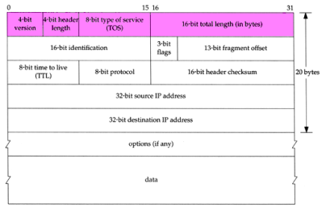
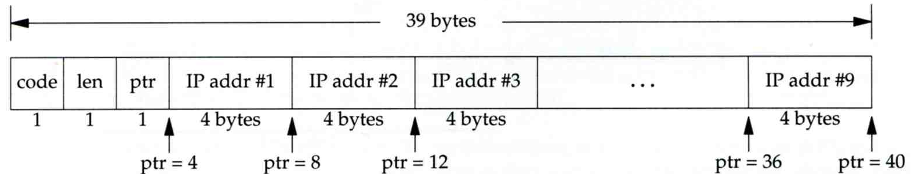
ICMP – Ping Program (3)
To get the route that packets take to host
Taking use of “IP Record Route Option”
Command: ping -R
Cause every router that handles the datagram to add its (outgoing) IP address to a list in the options field.
Format of Option field for IP RR Option
code: type of IP Option (7 for RR)
len: total number of bytes of the RR option
ptr:4 ~ 40 used to point to the next IP address
Only 9 IP addresses can be stored
Limitation of IP header

Slide 45
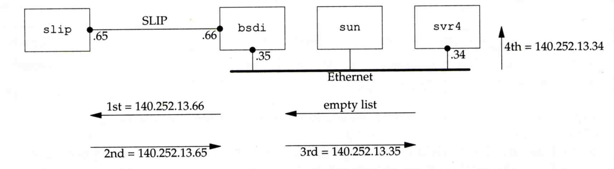
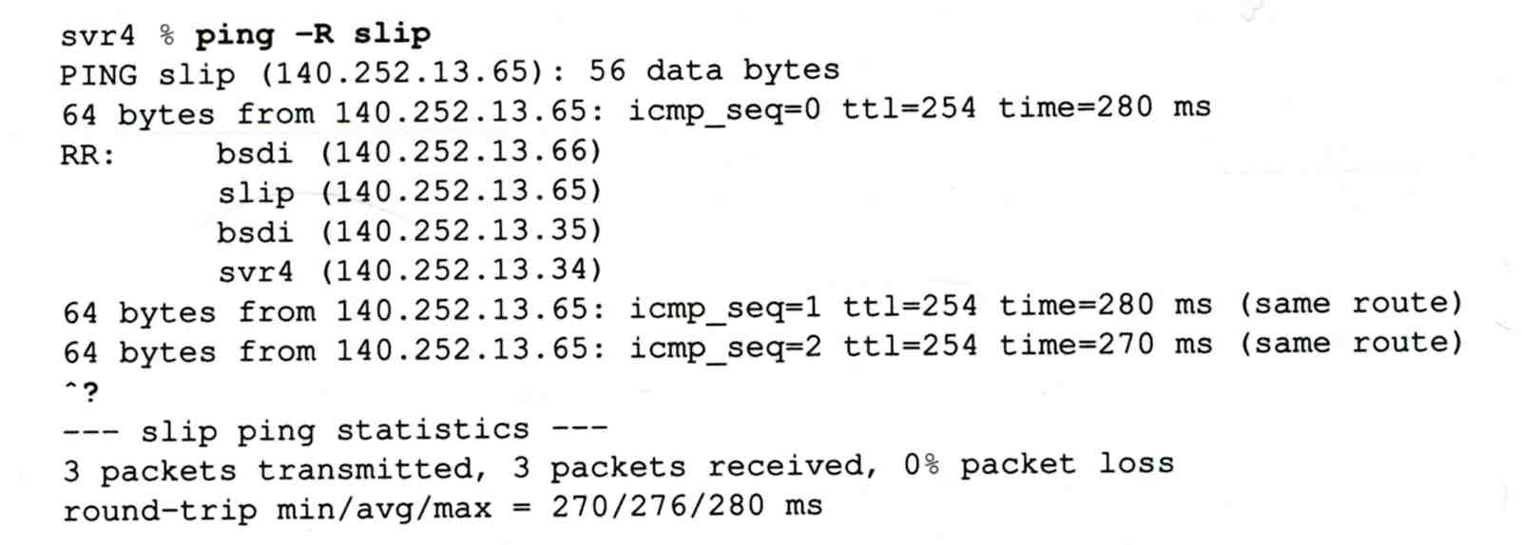
ICMP – Ping Program (4)
Example:

Slide 46
ICMP – Ping Program (5)
Example
chbsd [/home/chwong] -chwong- ping -R www.nctu.edu.tw
PING www.nctu.edu.tw (140.113.250.5): 56 data bytes
64 bytes from 140.113.250.5: icmp_seq=0 ttl=61 time=2.361 ms
RR: ProjE27-253.NCTU.edu.tw (140.113.27.253)
140.113.0.57
CC250-gw.NCTU.edu.tw (140.113.250.253)
www.NCTU.edu.tw (140.113.250.5)
www.NCTU.edu.tw (140.113.250.5)
140.113.0.58
ProjE27-254.NCTU.edu.tw (140.113.27.254)
e3rtn.csie.nctu.edu.tw (140.113.17.254)
chbsd.csie.nctu.edu.tw (140.113.17.212)
64 bytes from 140.113.250.5: icmp_seq=1 ttl=61 time=3.018 ms (same route)
chbsd [/home/chwong] -chwong- sudo tcpdump -v -n -i dc0 -e icmp
tcpdump: listening on dc0, link-type EN10MB (Ethernet), capture size 96 bytes
22:57:04.507271 00:90:96:23:8f:7d > 00:90:69:64:ec:00, ethertype IPv4 (0x0800), length 138: (tos 0x0, ttl 64, id 17878, offset 0, flags [none], proto: ICMP (1), length: 124,
options ( RR (7) len 390.0.0.00.0.0.00.0.0.00.0.0.00.0.0.00.0.0.00.0.0.00.0.0.00.0.0.0EOL
(0) len 1 )) 140.113.17.212 > 140.113.250.5: ICMP echo request, id 45561, seq 0, length 64
22:57:04.509521 00:90:69:64:ec:00 > 00:90:96:23:8f:7d, ethertype IPv4 (0x0800), length 138:
(tos 0x0, ttl 61, id 33700, offset 0, flags [none], proto: ICMP (1), length: 124,
options ( RR (7) len 39140.113.27.253, 140.113.0.57, 140.113.250.253, 140.113.250.5,
140.113.250.5, 140.113.0.58, 140.113.27.254, 140.113.17.254, 0.0.0.0EOL (0) len 1 ))
140.113.250.5 > 140.113.17.212: ICMP echo reply, id 45561, seq 0, length 64

Slide 47
Traceroute Program (1)
To print the route packets take to network host
Drawbacks of IP RR options (ping -R)
Not all routers have supported the IP RR option
Limitation of IP header length
Background knowledge of traceroute
When a router receive a datagram, , it will decrement the TTL by one
When a router receive a datagram with TTL = 0 or 1,
it will through away the datagram and
sends back a “Time exceeded” ICMP message
Unused UDP port will generate a “port unreachable” ICMP message

Slide 48
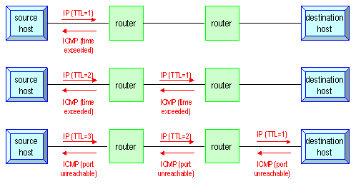
Traceroute Program (2)
Operation of traceroute
Send UDP with port > 30000, encapsulated with IP header with TTL = 1, 2, 3, … continuously
When router receives the datagram and TTL = 1, it returns a “Time exceed” ICMP message
When destination host receives the datagram and TTL = 1, it returns a “Port unreachable” ICMP message

Slide 49
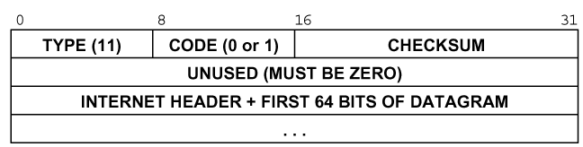
Traceroute Program (3)
Time exceed ICMP message
Type = 11, code = 0 or 1
Code = 0 means TTL=0 during transit
Code = 1 means TTL=0 during reassembly
First 8 bytes of datagram
UDP header

Slide 50
Traceroute Program (4)
Ex:
nabsd [/home/chwong] -chwong- traceroute bsd1.cs.nctu.edu.tw
traceroute to bsd1.cs.nctu.edu.tw (140.113.235.131), 64 hops max, 40 byte packets
1 e3rtn.csie.nctu.edu.tw (140.113.17.254) 0.377 ms 0.365 ms 0.293 ms
2 ProjE27-254.NCTU.edu.tw (140.113.27.254) 0.390 ms 0.284 ms 0.391 ms
3 140.113.0.58 (140.113.0.58) 0.292 ms 0.282 ms 0.293 ms
4 140.113.0.165 (140.113.0.165) 0.492 ms 0.385 ms 0.294 ms
5 bsd1.cs.nctu.edu.tw (140.113.235.131) 0.393 ms 0.281 ms 0.393 ms
nabsd [/home/chwong] -chwong- sudo tcpdump -i sk0 -t icmp
tcpdump: verbose output suppressed, use -v or -vv for full protocol decode
listening on sk0, link-type EN10MB (Ethernet), capture size 96 bytes
IP e3rtn.csie.nctu.edu.tw > nabsd: ICMP time exceeded in-transit, length 36
IP e3rtn.csie.nctu.edu.tw > nabsd: ICMP time exceeded in-transit, length 36
IP e3rtn.csie.nctu.edu.tw > nabsd: ICMP time exceeded in-transit, length 36
IP ProjE27-254.NCTU.edu.tw > nabsd: ICMP time exceeded in-transit, length 36
IP ProjE27-254.NCTU.edu.tw > nabsd: ICMP time exceeded in-transit, length 36
IP ProjE27-254.NCTU.edu.tw > nabsd: ICMP time exceeded in-transit, length 36
IP 140.113.0.58 > nabsd: ICMP time exceeded in-transit, length 36
IP 140.113.0.58 > nabsd: ICMP time exceeded in-transit, length 36
IP 140.113.0.58 > nabsd: ICMP time exceeded in-transit, length 36
IP 140.113.0.165 > nabsd: ICMP time exceeded in-transit, length 36
IP 140.113.0.165 > nabsd: ICMP time exceeded in-transit, length 36
IP 140.113.0.165 > nabsd: ICMP time exceeded in-transit, length 36
IP bsd1.cs.nctu.edu.tw > nabsd: ICMP bsd1.cs.nctu.edu.tw udp port 33447 unreachable, length 36
IP bsd1.cs.nctu.edu.tw > nabsd: ICMP bsd1.cs.nctu.edu.tw udp port 33448 unreachable, length 36
IP bsd1.cs.nctu.edu.tw > nabsd: ICMP bsd1.cs.nctu.edu.tw udp port 33449 unreachable, length 36

Slide 51
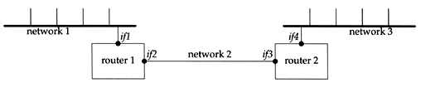
Traceroute Program (5)
The router IP in traceroute is the interface that receives the datagram. (incoming IP)
Traceroute from left host to right host
if1, if3
Traceroute from right host to left host
if4, if2

Slide 52
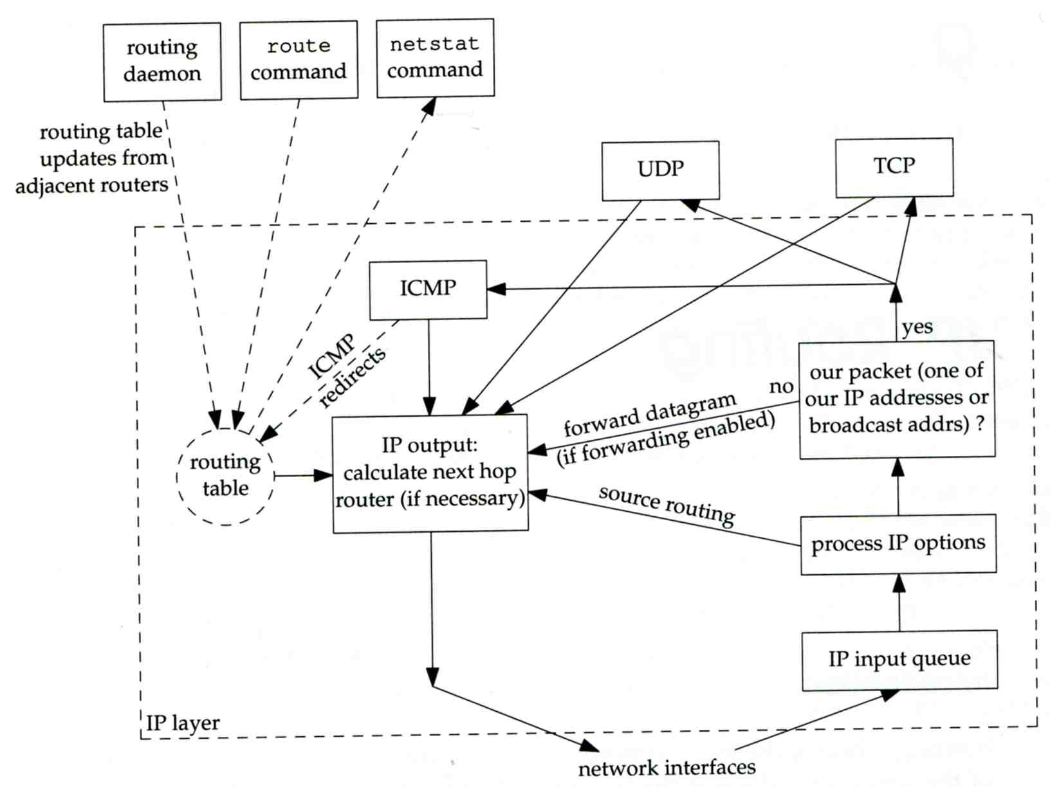
IP Routing – Processing in IP Layer

Slide 53
IP Routing – Routing Table (1)
Routing Table
Command to list: netstat -rn
Flag
U: the route is up
G: the route is to a router (indirect route)
Indirect route: IP is the dest. IP, MAC is the router’s MAC
H: the route is to a host (Not to a network)
The dest. filed is either an IP address or network address
S: the route is static
Expire: expiration time for each route
nasa [/home/wangth] -wangth- netstat -rn
Routing tables
Internet:
Destination Gateway Flags Netif Expire
Default 140.113.17.254 UGS em0
127.0.0.1 link#2 UH lo0
140.113.17.0/24 link#1 U em0
140.113.17.225 link#1 UHS lo0

Slide 54
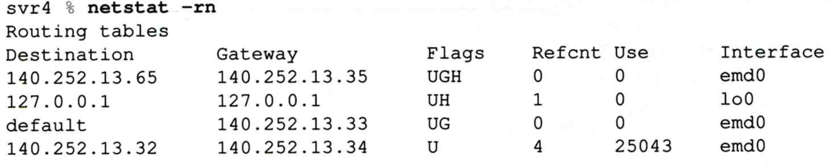
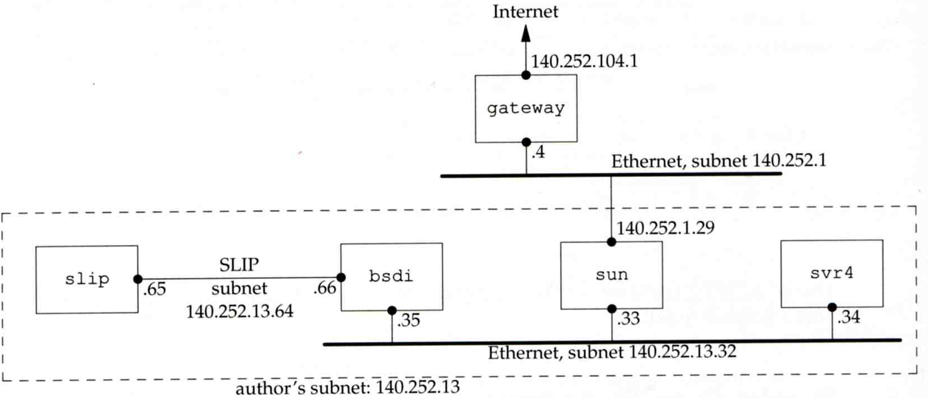
IP Routing – Routing Table (2)
dst. = sun
dst. = slip
dst. = 192.207.117.2
dst. = svr4 or 140.252.13.34
dst. = 127.0.0.1
Ex:
loopback

Slide 55
UDP – User Datagram Protocol

Slide 56
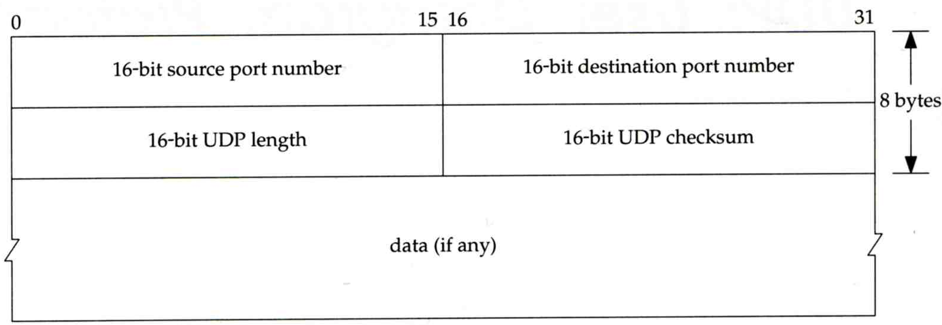
UDP
No reliability
Datagram-oriented, not stream-oriented protocol
UDP header
8 bytes
Source port and destination port
Identify sending and receiving process
UDP length: ≧ 8

Slide 57
UDP
Application
VoIP
VPN (OpenVPN over UDP)
DNS
SNMP
Quick UDP Internet Connections (QUIC)
Designed by Google, based on UDP
Renamed to “HTTP/3”
Keep reliability as TCP, but less latency
As most HTTP connections will demand TLS, QUIC makes the exchange of setup keys and supported protocols part of the initial handshake process.
During network-switch events, reuse old connection instead of creating a new one as TCP does.

Slide 58
TCP – Transmission Control Protocol

Slide 59
TCP
Services
Connection-oriented
Establish TCP connection before exchanging data
Reliability
Acknowledgement when receiving data
Retransmission when timeout
Ordering
Discard duplicated data
Flow control

Slide 60
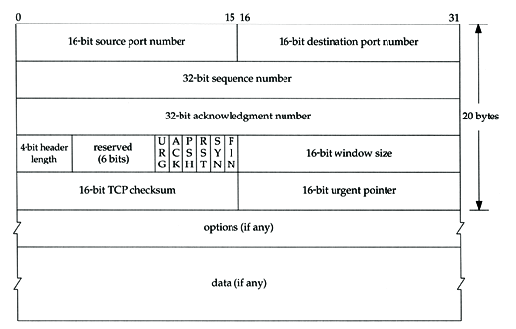
TCP – Header (1)

Slide 61
TCP – Header (2)
Flags
SYN
Establish new connection
ACK
Acknowledgement number is valid
Used to ack previous data that host has received
RST
Reset connection
FIN
The sender is finished sending data

Slide 62
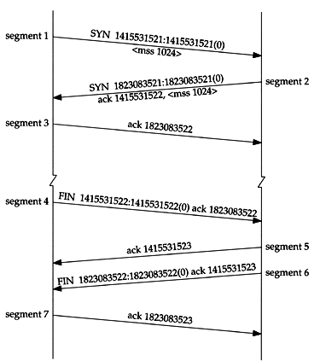
TCP connection establishment and termination
Three-way handshake
TCP’s half close

Slide 63
Appendix

Slide 64
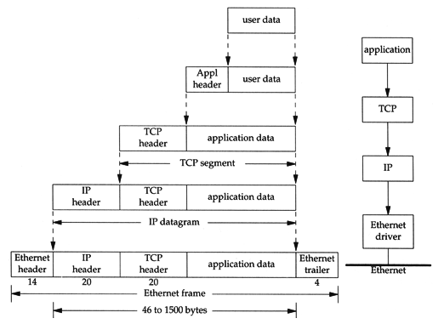
Introduction – Encapsulation
Multiplexing
Gathering data from multiple sockets, enveloping data with header

Slide 65
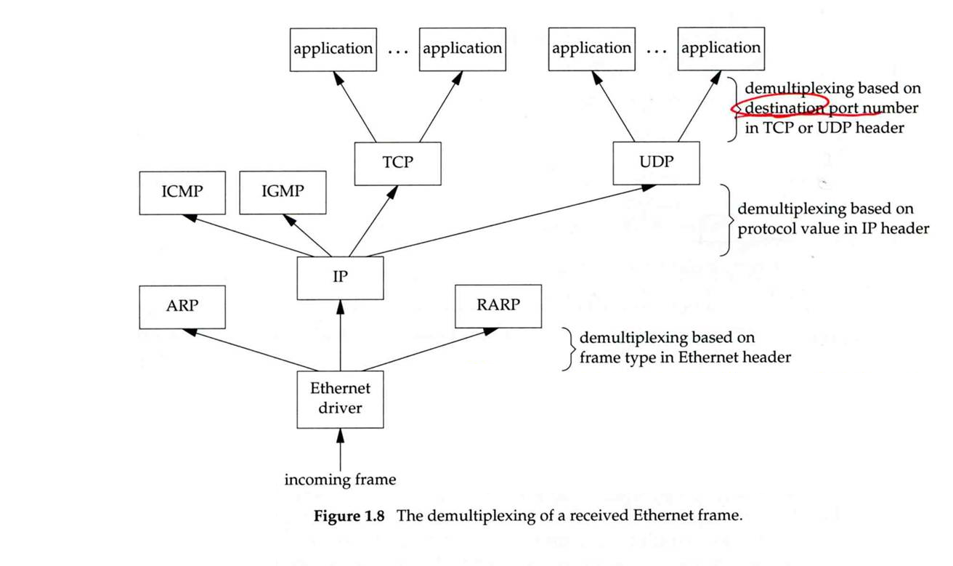
Introduction – Decapsulation
Demultiplexing
Delivering received segments to correct socket

Slide 66
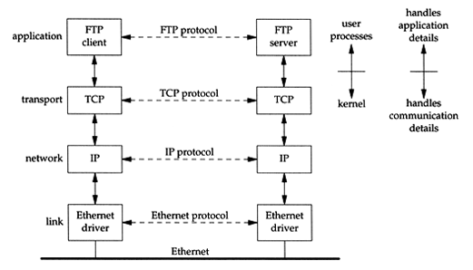
Introduction – Addressing
Addressing
Nearby (same network)

Slide 67
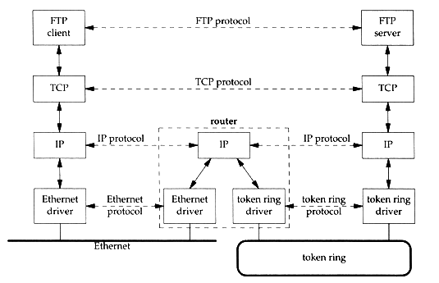
Introduction – Addressing
Addressing
Faraway (across network)

Slide 68
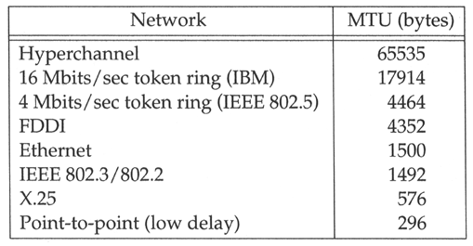
Link Layer – MTU
Maximum Transmission Unit
Limit size of payload part of Ethernet frame
1500 bytes
If the IP datagram is larger than MTU,
IP performs “fragmentation”
MTU of various physical device
Path MTU
Smallest MTU of any data link MTU between the two hosts
Depend on route

Slide 69
Link Layer – MTU
To get MTU info
% ifconfig
em0: flags=8843<UP,BROADCAST,RUNNING,SIMPLEX,MULTICAST> mtu 9000
options=b<RXCSUM,TXCSUM,VLAN_MTU>
inet 192.168.7.1 netmask 0xffffff00 broadcast 192.168.7.255
ether 00:0e:0c:01:d7:c8
media: Ethernet autoselect (1000baseTX <full-duplex>)
status: active
fxp0: flags=8843<UP,BROADCAST,RUNNING,SIMPLEX,MULTICAST> mtu 1500
options=b<RXCSUM,TXCSUM,VLAN_MTU>
inet 140.113.17.24 netmask 0xffffff00 broadcast 140.113.17.255
ether 00:02:b3:99:3e:71
media: Ethernet autoselect (100baseTX <full-duplex>)
status: active

Slide 70
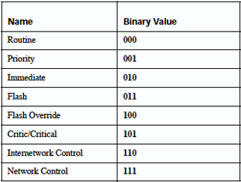
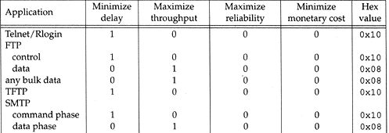
Network Layer – IP Header (1)
Version (4-bit)
4 for IPv4 and 6 for IPv6
Header length (4-bit)
The number of 32-bit words in the header (15*4=60 bytes)
Normally, the value is 5 (no option)
TOS - Type of Service (8-bit)
IP Precedence: 3-bit precedence + 4-bit TOS + 1-bit unused
DSCP: 3-bit major class + 3-bit drop preference + 2-bit ECN
Total length (16-bit)
Total length of the IP datagram in bytes
DSCP: Differentiated Services Code Point
ECN: Explicit Congestion Notification

Slide 71
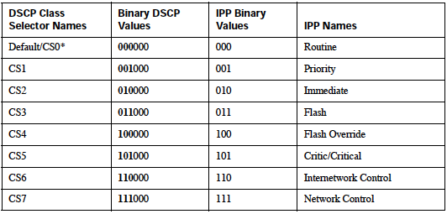
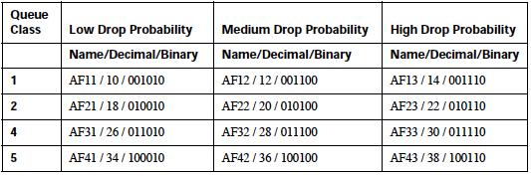
Network Layer – IP Header (2)
DSCP - Differentiated Services Code Point (6-bit)
Supersede the ToS field in IPv4 to make per-hop behavior (PHB) decisions
Default
Best-effort traffic
Expedited Forwarding (EF)
Dedicated to low-loss, low-latency traffic
Class Selector
Backward compatibility with the IP Precedence field
Assured Forwarding (AF)
Give assurance of delivery under prescribed conditions
ECN: Explicit Congestion Notification (2-bit)
FreeBSD 8.0 implement ECN support for TCP
Enable ECN via sysctl(8)
net.inet.tcp.ecn.enable=1
Linux Kernel supports ECN for TCP since version 2.4.20
Binary Value | Description
00 | Non ECN-Capable Transport, Non-ECT
10 | ECN Capable Transport, ECT(0)
01 | ECN Capable Transport, ECT(1)
11 | Congestion Encountered, CE

Slide 72
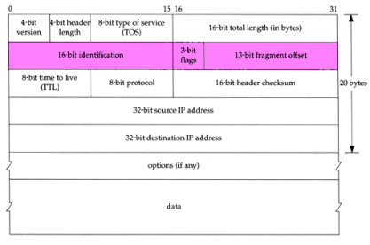
Network Layer – IP Header (3)
Identification (16-bit)
Identify the group of fragments of a single IP datagram
Fragmentation offset (13-bit)
Specify the offset of a particular fragment relative to the beginning of the original unfragmented IP datagram
Flags (3-bit)
All these three fields are used for fragmentation
Reserved | Don't Fragment (DF) | More Fragments (MF)

Slide 73
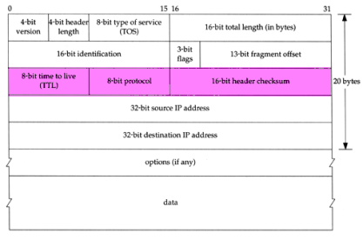
Network Layer – IP Header (4)
TTL (8-bit)
Limit of next hop count of routers
Protocol (8-bit)
Used to demultiplex to other protocols
TCP, UDP, ICMP, IGMP
Header checksum (16-bit)
Calculated over the IP header only
If checksum error, IP discards the datagram and no error message is generated

Slide 74
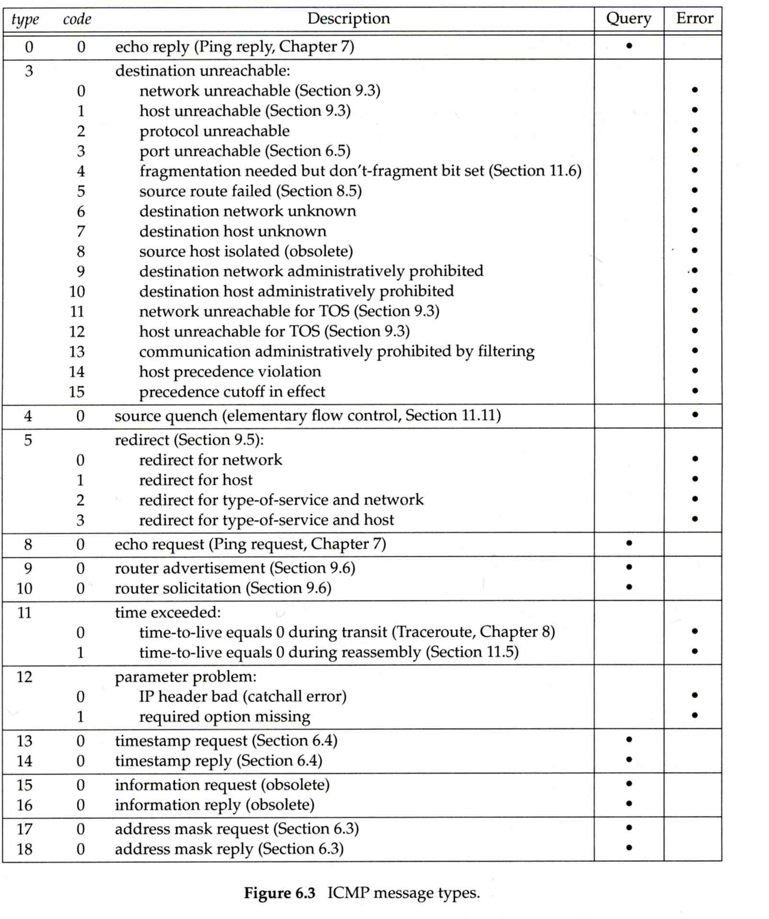
ICMP – Message Type (1)

Slide 75
ICMP – Message Type (2)

Slide 76
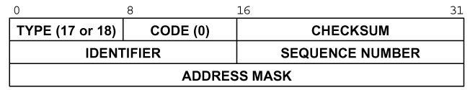
ICMP – Query Message – Address Mask Request/Reply (1)
Address Mask Request and Reply
Used for diskless system to obtain its subnet mask
Identifier and sequence number
Can be set to anything for sender to match reply with request
The receiver will response an ICMP reply with the subnet mask of the receiving NIC

Slide 77
ICMP – Query Message – Address Mask Request/Reply (2)
Ex:
chbsd [/home/chwong] -chwong- ping -M m sun1.cs.nctu.edu.tw
ICMP_MASKREQ
PING sun1.cs.nctu.edu.tw (140.113.235.171): 56 data bytes
68 bytes from 140.113.235.171: icmp_seq=0 ttl=251 time=0.663 ms mask=255.255.255.0
68 bytes from 140.113.235.171: icmp_seq=1 ttl=251 time=1.018 ms mask=255.255.255.0
68 bytes from 140.113.235.171: icmp_seq=2 ttl=251 time=1.028 ms mask=255.255.255.0
68 bytes from 140.113.235.171: icmp_seq=3 ttl=251 time=1.026 ms mask=255.255.255.0
^C
--- sun1.cs.nctu.edu.tw ping statistics ---
4 packets transmitted, 4 packets received, 0% packet loss
round-trip min/avg/max/stddev = 0.663/0.934/1.028/0.156 ms
chbsd [/home/chwong] -chwong- icmpquery -m sun1
sun1 : 0xFFFFFF00
※ icmpquery can be found in /usr/ports/net-mgmt/icmpquery

Slide 78
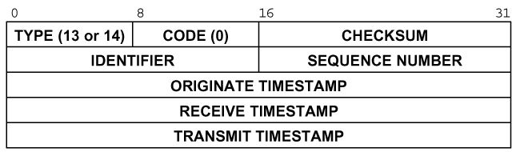
ICMP – Query Message – Timestamp Request/Reply (1)
Timestamp request and reply
Allow a system to query another for the current time
Milliseconds resolution, since midnight UTC
Requestor
Fill in the originate timestamp and send
Reply system
Fill in the receive timestamp when it receives the request and the transmit time when it sends the reply

Slide 79
ICMP – Query Message – Timestamp Request/Reply (2)
Ex:
chbsd [/home/chwong] -chwong- ping -M time nabsd
ICMP_TSTAMP
PING nabsd.cs.nctu.edu.tw (140.113.17.215): 56 data bytes
76 bytes from 140.113.17.215: icmp_seq=0 ttl=64 time=0.663 ms
tso=06:47:46 tsr=06:48:24 tst=06:48:24
76 bytes from 140.113.17.215: icmp_seq=1 ttl=64 time=1.016 ms
tso=06:47:47 tsr=06:48:25 tst=06:48:25
chbsd [/home/chwong] -chwong- icmpquery -t nabsd
nabsd : 14:54:47
nabsd [/home/chwong] -chwong- sudo tcpdump -i sk0 -e icmp
tcpdump: verbose output suppressed, use -v or -vv for full protocol decode
listening on sk0, link-type EN10MB (Ethernet), capture size 96 bytes
14:48:24.999106 00:90:96:23:8f:7d > 00:11:d8:06:1e:81, ethertype IPv4 (0x0800), length 110:
chbsd.csie.nctu.edu.tw > nabsd: ICMP time stamp query id 18514 seq 0, length 76
14:48:24.999148 00:11:d8:06:1e:81 > 00:90:96:23:8f:7d, ethertype IPv4 (0x0800), length 110:
nabsd > chbsd.csie.nctu.edu.tw: ICMP time stamp reply id 18514 seq 0: org 06:47:46.326,
recv 06:48:24.998, xmit 06:48:24.998, length 76
14:48:26.000598 00:90:96:23:8f:7d > 00:11:d8:06:1e:81, ethertype IPv4 (0x0800), length 110:
chbsd.csie.nctu.edu.tw > nabsd: ICMP time stamp query id 18514 seq 1, length 76
14:48:26.000618 00:11:d8:06:1e:81 > 00:90:96:23:8f:7d, ethertype IPv4 (0x0800), length 110:
nabsd > chbsd.csie.nctu.edu.tw: ICMP time stamp reply id 18514 seq 1: org 06:47:47.327,
recv 06:48:25.999, xmit 06:48:25.999, length 76

Slide 80
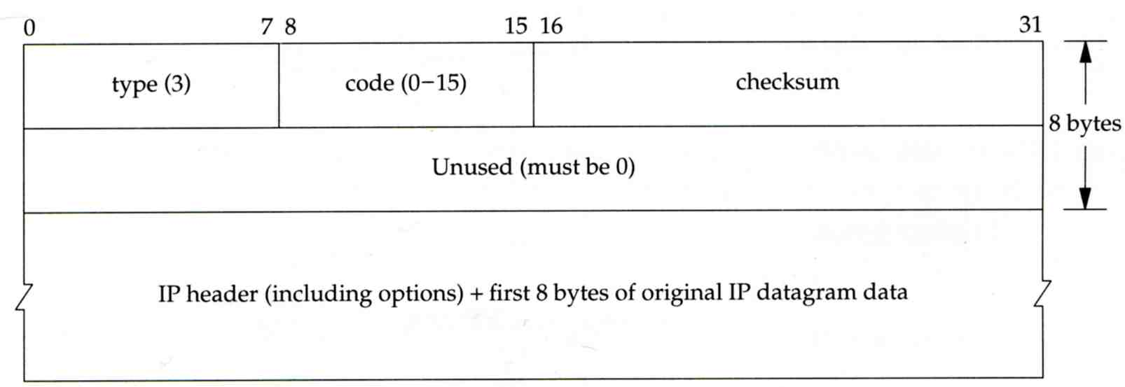
ICMP – Error Message – Destination Unreachable Error Message
Format
8 bytes ICMP Header
Application-depend data portion
IP header
Let ICMP know how to interpret the 8 bytes that follow
first 8 bytes that followed this IP header
Information about who generates the error

Slide 81
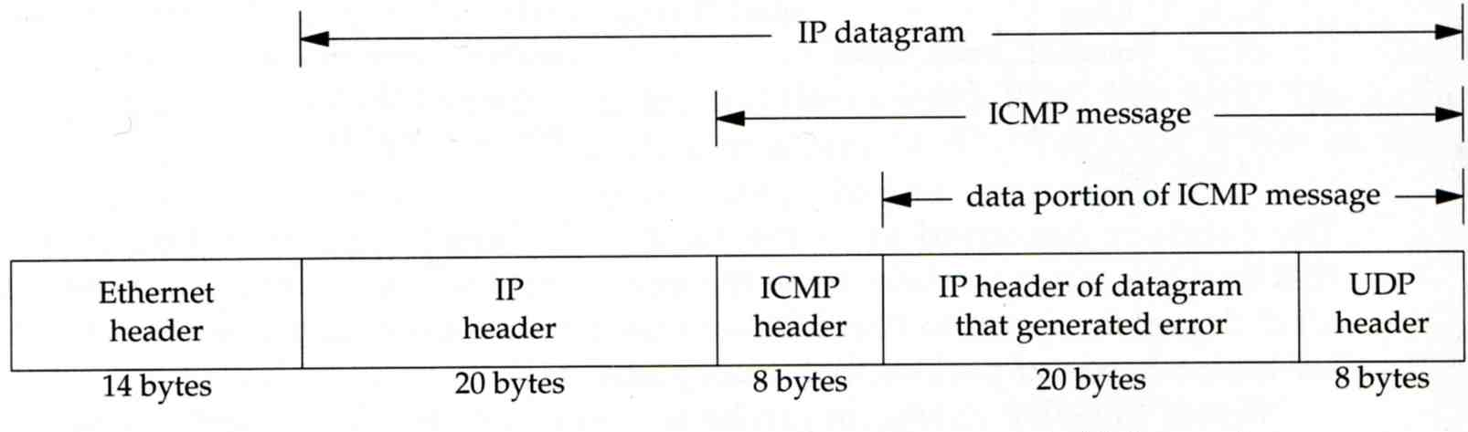
ICMP – Error Message – Port Unreachable (1)
ICMP port unreachable
Type = 3 , code = 3
Host receives a UDP datagram but the destination port does not correspond to a port that some process has in use

Slide 82
ICMP – Error Message – Port Unreachable (2)
Ex:
Using TFTP (Trivial File Transfer Protocol)
Original port: 69
chbsd [/home/chwong] -chwong- tftp
tftp> connect localhost 8888
tftp> get temp.foo
Transfer timed out.
tftp>
chbsd [/home/chwong] -chwong- sudo tcpdump -i lo0
tcpdump: verbose output suppressed, use -v or -vv for full protocol decode
listening on lo0, link-type NULL (BSD loopback), capture size 96 bytes
15:01:24.788511 IP localhost.62089 > localhost.8888: UDP, length 16
15:01:24.788554 IP localhost > localhost:
ICMP localhost udp port 8888 unreachable, length 36
15:01:29.788626 IP localhost.62089 > localhost.8888: UDP, length 16
15:01:29.788691 IP localhost > localhost:
ICMP localhost udp port 8888 unreachable, length 36

Slide 83
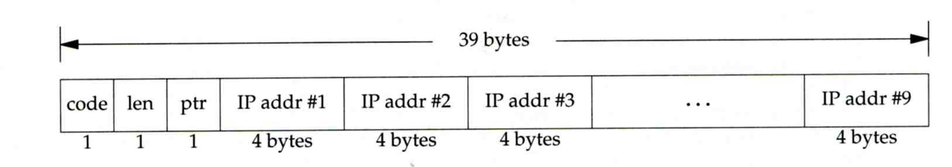
Traceroute Program – IP Source Routing Option (1)
Source Routing
Sender specifies the route
Two forms of source routing
Strict source routing
Sender specifies the exact path that the IP datagram must follow
Loose source routing
As strict source routing, but the datagram can pass through other routers between any two addresses in the list
Format of IP header option field
Code = 0x89 for strict and code = 0x83 for loose SR option

Slide 84
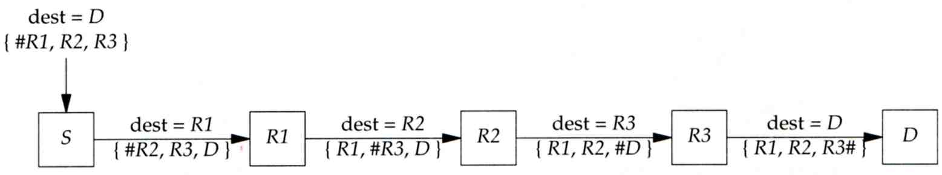
Traceroute Program – IP Source Routing Option (2)
Scenario of source routing
Sending host
Remove first entry and append destination address in the final entry of the list
Receiving router != destination
Loose source route, forward it as normal
Receiving router = destination
Next address in the list becomes the destination
Change source address
Increment the pointer

Slide 85
Traceroute Program – IP Source Routing Option (3)
Traceroute using IP loose SR option
Ex:
nabsd [/home/chwong] -chwong- traceroute u2.nctu.edu.tw
traceroute to u2.nctu.edu.tw (211.76.240.193), 64 hops max, 40 byte packets
1 e3rtn-235 (140.113.235.254) 0.549 ms 0.434 ms 0.337 ms
2 140.113.0.166 (140.113.0.166) 108.726 ms 4.469 ms 0.362 ms
3 v255-194.NTCU.net (211.76.255.194) 0.529 ms 3.446 ms 5.464 ms
4 v255-229.NTCU.net (211.76.255.229) 1.406 ms 2.017 ms 0.560 ms
5 h240-193.NTCU.net (211.76.240.193) 0.520 ms 0.456 ms 0.315 ms
nabsd [/home/chwong] -chwong- traceroute -g 140.113.0.149 u2.nctu.edu.tw
traceroute to u2.nctu.edu.tw (211.76.240.193), 64 hops max, 48 byte packets
1 e3rtn-235 (140.113.235.254) 0.543 ms 0.392 ms 0.365 ms
2 140.113.0.166 (140.113.0.166) 0.562 ms 9.506 ms 0.624 ms
3 140.113.0.149 (140.113.0.149) 7.002 ms 1.047 ms 1.107 ms
4 140.113.0.150 (140.113.0.150) 1.497 ms 6.653 ms 1.595 ms
5 v255-194.NTCU.net (211.76.255.194) 1.639 ms 7.214 ms 1.586 ms
6 v255-229.NTCU.net (211.76.255.229) 1.831 ms 9.244 ms 1.877 ms
7 h240-193.NTCU.net (211.76.240.193) 1.440 ms !S 2.249 ms !S 1.737 ms !S

Slide 86
ICMP – No Route to Destination
If there is no match in routing table
If the IP datagram is generated on the host
“host unreachable” or “network unreachable”
If the IP datagram is being forwarded
ICMP “host unreachable” error message is generated and sends back to sending host
ICMP message
Type = 3, code = 0 for host unreachable
Type = 3, code = 1 for network unreachable

Slide 87

ICMP – Redirect Error Message (1)
Concept
Used by router to inform the sender that the datagram should be sent to a different router
This will happen if the host has a choice of routers to send the packet to
Ex:
R1 found sending and receiving interface are the same

Slide 88

ICMP – Redirect Error Message (2)
ICMP redirect message format
Code 0: redirect for network
Code 1: redirect for host
Code 2: redirect for TOS and network (RFC 1349)
Code 3: redirect for TOS and hosts (RFC 1349)

Slide 89

ICMP – Router Discovery Messages (1)
Dynamic update host’s routing table
ICMP router solicitation message (懇求)
Host broadcast or multicast after bootstrapping
ICMP router advertisement message
Router response
Router periodically broadcast or multicast
Format of ICMP router solicitation message

Slide 90

ICMP – Router Discovery Messages (2)
Format of ICMP router advertisement message
Router address
Must be one of the router’s IP address
Preference level
Preference as a default router address

Slide 91

IP Fragmentation (1)
MTU limitation
Before network-layer to link-layer
IP will check the size and link-layer MTU
Do fragmentation if necessary
Fragmentation may be done at sending host or routers
Reassembly is done only in receiving host
1501 bytes
1500 bytes

Slide 92
IP Fragmentation (2)
identification: which unique IP datagram
flags: more fragments?
fragment offset offset of this datagram from the beginning of original datagram
identification: the same
flags: more fragments
fragment offset 0
identification: the same
flags: end of fragments
fragment offset 1480

Slide 93
IP Fragmentation (3)
Issues of fragmentation
One fragment lost, entire datagram must be retransmitted
If the fragmentation is performed by intermediate router, there is no way for sending host how fragmentation did
Fragmentation is often avoided
There is a “don’t fragment” bit in flags of IP header

Slide 94

ICMP Unreachable Error – Fragmentation Required
Type=3, code=4
Router will generate this error message if the datagram needs to be fragmented, but the “don’t fragment” bit is turn on in IP header
Message format

Slide 95
ICMP – Source Quench Error
Type=4, code=0
May be generated by system when it receives datagram at a rate that is too fast to be processed
Host receiving more than it can handle datagram
Send ICMP source quench or
Throw it away
Host receiving UDP source quench message
Ignore it or
Notify application

Slide 96

Appendix of IP Options: IP Timestamp Option
IP Timestamp Option
Similar to RR option
Record Timestamp in option filed
code, len, ptr are the same as IP RR option
OF
Overflow field
Router will increment OF if it can’t add a timestamp because of no room left
FL
Flags
0: only timestamp
1: both timestamp and IP address
3: the sender initiates the options with up to 4
pairs of IP address and timestamp
※

