Slide 1
Routing
jnlin

Slide 2
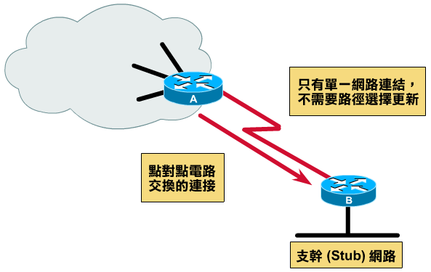
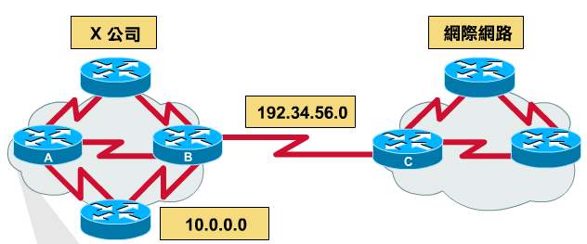
Why dynamic route ? (1)
Static route is ok only when
Network is small
There is a single connection point to other network
No redundant route

Slide 3
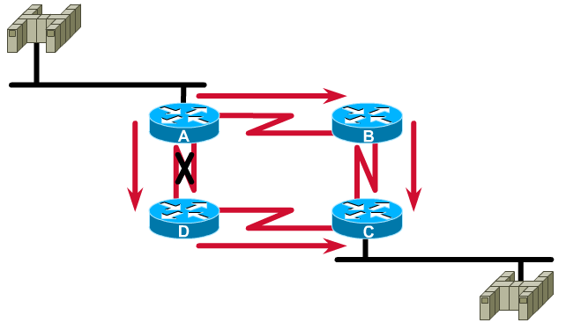
Why dynamic route ? (2)
Dynamic Routing
Routers update their routing table with the information of adjacent routers
Dynamic routing need a routing protocol for such communication
Advantage:
They can react and adapt to changing network condition

Slide 4
Routing Protocol
Used to change the routing table according to various routing information
Specify detail of communication between routers
Specify information changed in each communication,
Network reachability
Network state
Metric
Metric
A measure of how good a particular route
Hop count, bandwidth, delay, load, reliability, …
Each routing protocol may use different metric and exchange different information

Slide 5
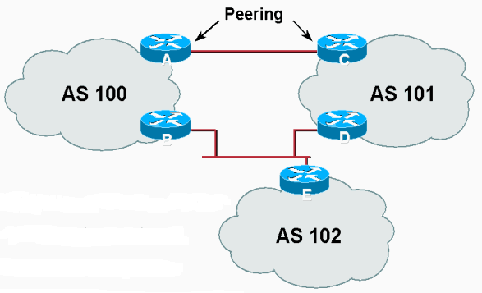
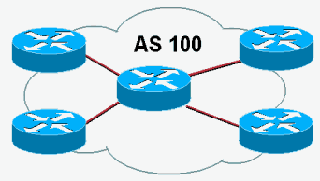
Autonomous System
Autonomous System (AS)
Internet is organized into a collection of autonomous system
An AS is a collection of networks with same routing policy
Single routing protocol
Normally administered by a single entity
Corporation or university campus
All depend on how you want to manage routing

Slide 6

Category of Routing Protocols – by AS
AS-AS communication
Communications between routers in different AS
Interdomain routing protocols
Exterior gateway protocols (EGP)
Ex:
BGP (Border Gateway Protocol)
Inside AS communication
Communication between routers in the same AS
Intradomain routing protocols
Interior gateway protocols (IGP)
Ex:
RIP (Routing Information Protocol)
IGRP (Interior Gateway Routing Protocol)
OSPF (Open Shortest Path First Protocol)

Slide 7
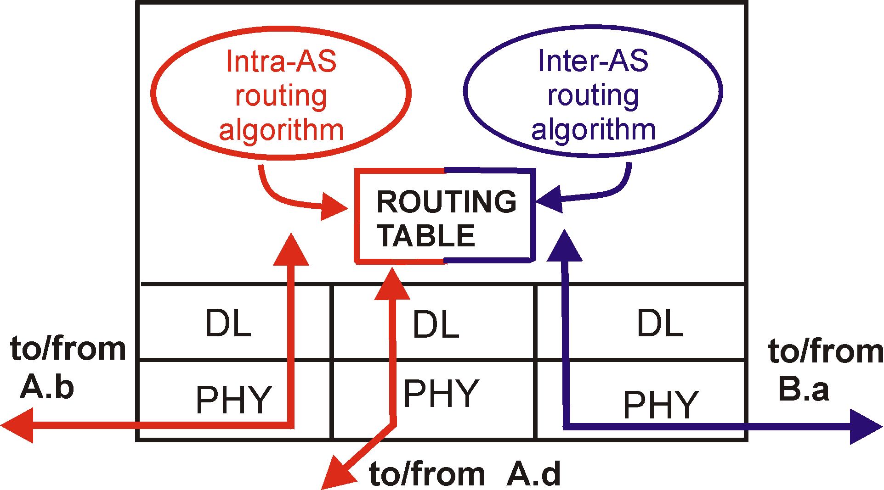
Intra-AS and Inter-AS routing
Inter-AS
routing
between
A and B
C.b
B.a
A.a
Host
h2
b
A.c
c
a
C
a
b
a
B
Host
h1
d
c
Intra-AS routing
within AS B
A
b
Intra-AS routing
within AS A
network layer
inter-AS, intra-AS routing in
gateway A.c
link layer
physical layer

Slide 8
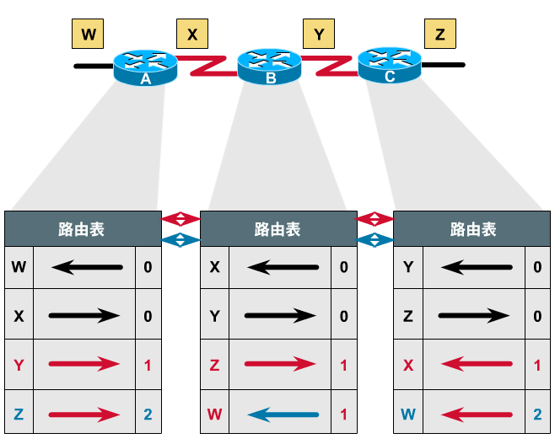
Category of Routing Protocols – by information changed (1)
Distance-Vector Protocol
Message contains a vector of distances, which is the cost to other network
Each router updates its routing table based on these messages received from neighbors
Protocols:
RIP
IGRP
BGP

Slide 9
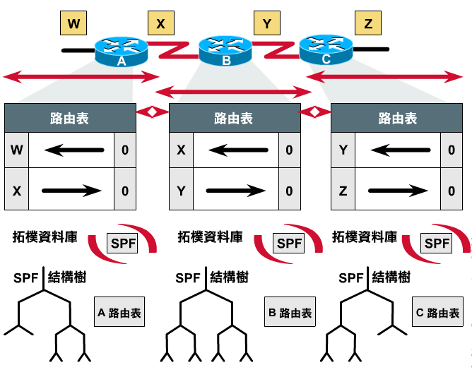
Category of Routing Protocols – by information changed (2)
Link-State Protocol
Broadcast their link state to neighbors and build a complete network map at each router using Dijkstra algorithm
Protocols:
OSPF

Slide 10
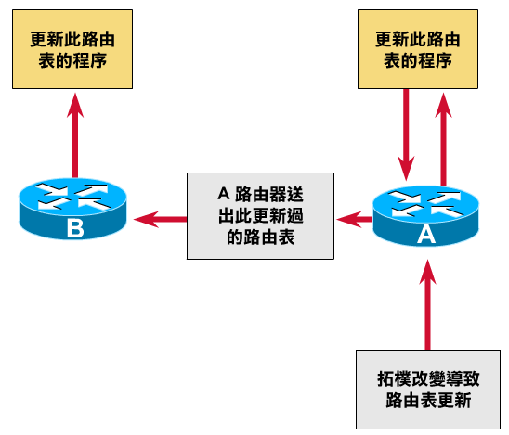
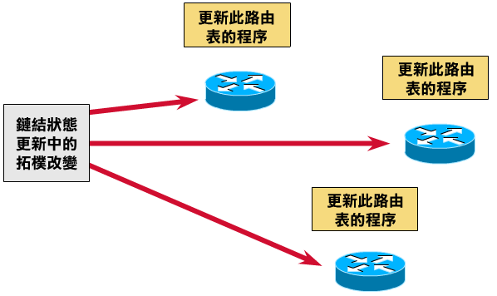
Difference between Distance-Vector and Link-State
Difference
Information update sequence
 | Distance-Vector | Link-State
Update | updates neighbor (propagate new info.) | update all nodes
Convergence | Propagation delay cause slow convergence | Fast convergence
Complexity | simple | Complex
Link-State
Distance-Vector

Slide 11
Routing Protocols
RIP IGP,DV IGRP IGP,DV OSPF IGP,LS BGP EGP

Slide 12
RIP
RIP
Routing Information Protocol
Category
Interior routing protocol
Distance-vector routing protocol
Using “hop-count” as the cost metric
Example of how RIP advertisements work
Destination network | Next router | # of hops to destination
1 | A | 2
20 | B | 2
30 | B | 7
Destination network | Next router | # of hops to destination
30 | C | 4
1 | -- | 1
10 | -- | 1
Destination network | Next router | # of hops to destination
1 | A | 2
20 | B | 2
30 | A | 5
Routing table in router before
Receiving advertisement
Advertisement from router A
Routing table after
receiving advertisement

Slide 13
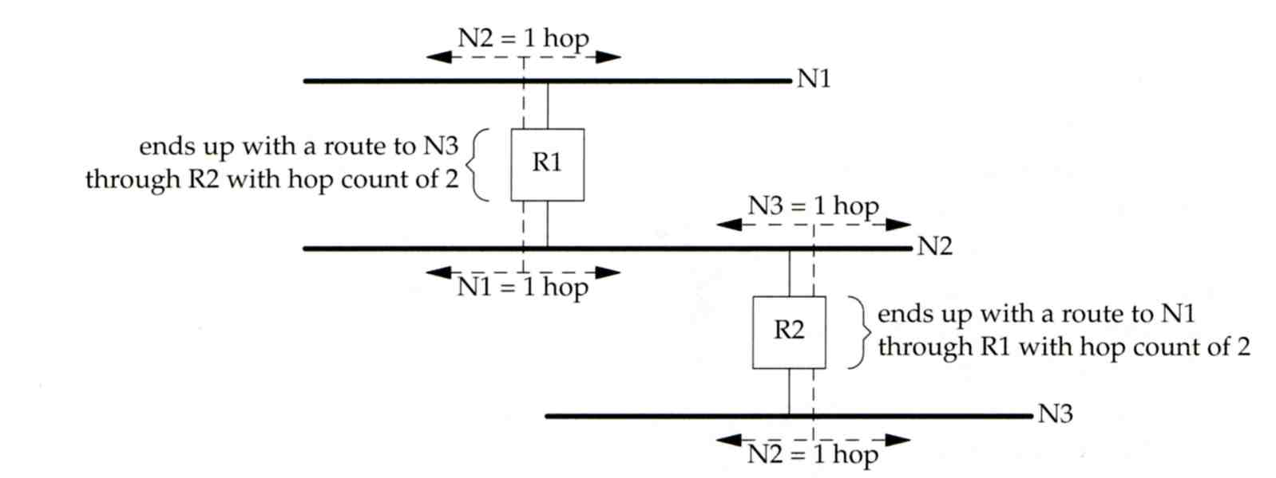
RIP – Example
Another example

Slide 14
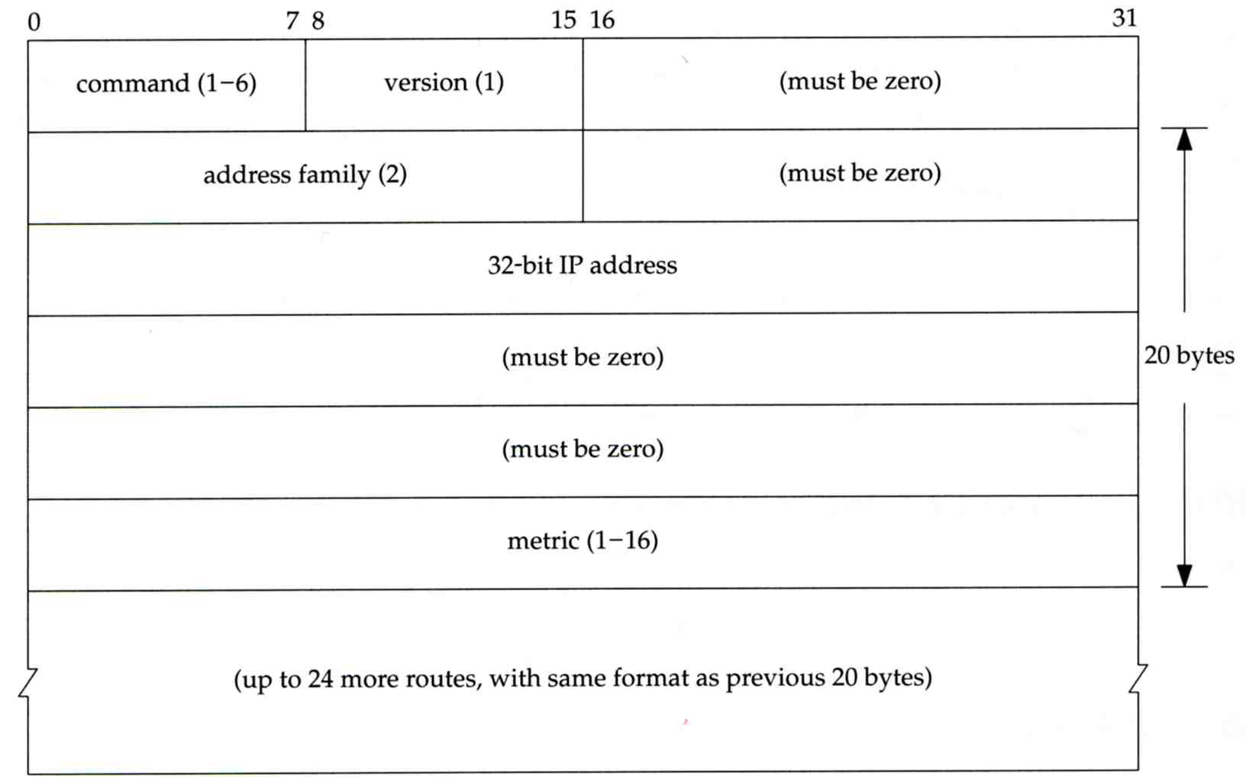
RIP – Message Format
RIP message is carried in UDP datagram
Command: 1 for request and 2 for reply
Version: 1 or 2 (RIP-2)
20 bytes per
route entry

Slide 15
RIP – Operation
routed – RIP routing daemon
Operated in UDP port 520
Operation
Initialization
Probe each interface
send a request packet out each interface, asking for other router’s complete routing table
Request received
Send the entire routing table to the requestor
Response received
Add, modify, delete to update routing table
Regular routing updates
Router sends out their routing table to every neighbor every 30 seconds
Triggered updates
Whenever a route entry’s metric change, send out those changed part routing table

Slide 16
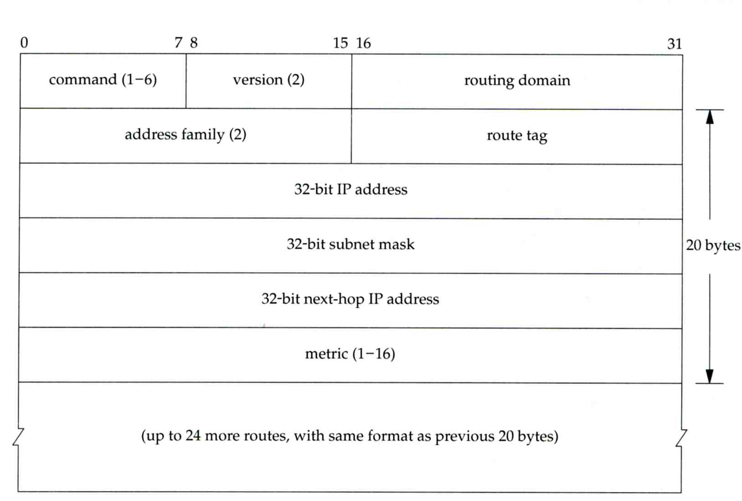
RIP – Problems of RIP
Issues
15 hop-count limits
Take long time to stabilize after the failure of a router or link
No CIDR
RIP-2
EGP support
AS number
CIDR support

Slide 17
IGRP (1)
IGRP – Interior Gateway Routing Protocol
Similar to RIP
Interior routing protocol
Distance-vector routing protocol
Difference between RIP
Complex cost metric other than hop count
delay time, bandwidth, load, reliability
The formula
Use TCP to communicate routing information
Cisco System’s proprietary routing protocol

Slide 18
IGRP (2)
Advantage over RIP
Control over metrics
Disadvantage
Still classful and has propagation delay

Slide 19
OSPF (1)
OSPF
Open Shortest Path First
Category
Interior routing protocol
Link-State protocol
Each interface is associated with a cost
Generally assigned manually
The sum of all costs along a path is the metric for that path
Neighbor information is broadcast to all routers
Each router will construct a map of network topology
Each router run Dijkstra algorithm to construct the shortest path tree to each routers

Slide 20
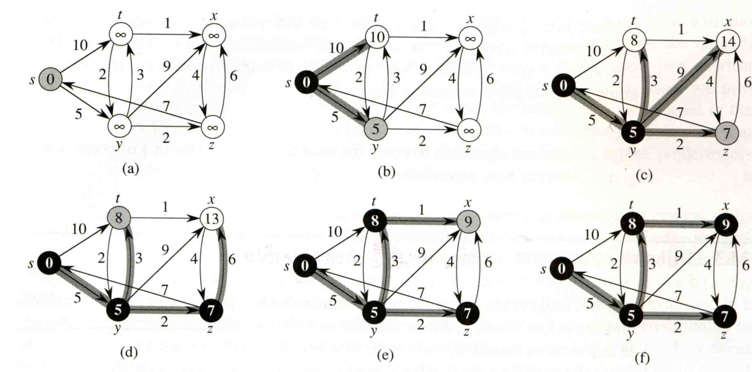
OSPF – Dijkstra Algorithm
Single Source Shortest Path Problem
Dijkstra algorithm use “greedy” strategy
Ex:

Slide 21
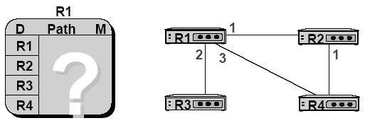
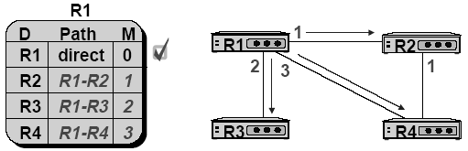
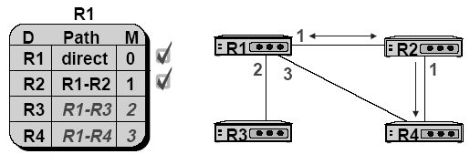
OSPF – Routing table update example (1)

Slide 22

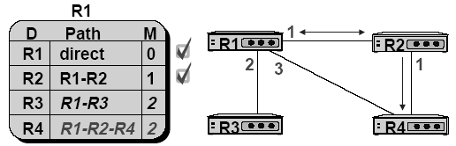
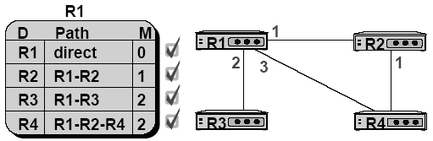
OSPF – Routing table update example (2)

Slide 23
OSPF – Summary
Advantage
Fast convergence
CIDR support
Multiple routing table entries for single destination, each for one type-of-service
Load balancing when cost are equal among several routes
Disadvantage
Large computation

Slide 24
BGP
BGP
Border Gateway Protocol
Exterior routing protocol
Now BGP-4
Exchange network reachability information with other BGP systems
Routing information exchange
Message:
Full path of autonomous systems that traffic must transit to reach destination
Can maintain multiple route for a single destination
Exchange method
Using TCP
Initial: entire routing table
Subsequent update: only sent when necessary
Advertise only optimal path
Route selection
Shortest AS path

Slide 25
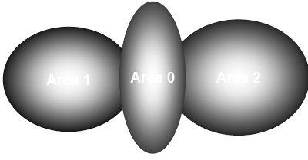
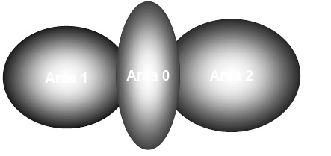
BGP – Operation Example
How BGP work
The whole Internet is a graph of autonomous systems
X→Z
Original: X→A→B→C→Z
X advertise this best path to his neighbor W
W→Z
W→X→A→B→C→Z
W
X
Z

Slide 26
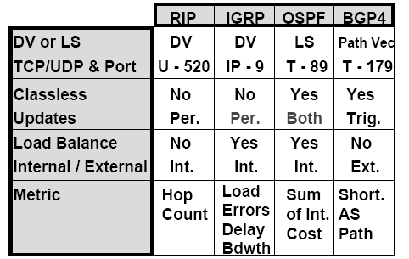
Routing Protocols Comparison
Notes:
Updates
Per. Periodic updates
Trig. Occurred based on information change
Load Balance
Multiple path & balance between equal-cost routes

Slide 27
routed

Slide 28

routed
Routing daemon
Speak RIP (v1 and v2)
Supplied with most every version of UNIX
Two modes
Server mode (-s) & Quiet mode (-q)
Both listen for broadcast, but server will distribute their information
routed will add its discovered routes to kernel’s routing table
Support configuration file - /etc/gateways
Provide static information for initial routing table

