Slide 1
OpenVPN
jnlin

Slide 2
Why Openvpn
Cross-platform portability
iOS / Android / Windows / Linux / FreeBSD
OpenWRT
Extensible VPN framework
Logging
Authentication
OpenVPN uses an industrial-strength security model

Slide 3
TUN/TAP
TAP
Layer 2
behave like adapter
More overhead(L2)
Transfer any protocol
Bridge
TUN
Layer 3
Less Overhead(L3)
Only IPv4 , IPv6(Ovpn2.3)
No Bridges!

Slide 4
Configuring Openvpn
A server/client setting can be describe as a ovpn/conf file.
At most circumstances, we will separate key/ca files to make config file clean.

Slide 5
Configuration
/usr/local/etc/openvpn/openvpn.conf
cp /usr/local/share/examples/openvpn/sample-config-files/server.conf /usr/local/etc/openvpn/openvpn.conf
In /etc/rc.conf.local
openvpn_enable=“YES”
openvpn_configfile=“/usr/local/etc/openvpn/openvpn.conf”

Slide 6
A simple server config(1/2)
port 1194
proto udp
dev tun
ca ca.crt
cert server.crt
key server.key # This file should be kept secret
dh dh2048.pem
topology subnet
server 192.168.14.0 255.255.255.0
ifconfig-pool-persist ipp.txt
client-config-dir static_clients
push "redirect-gateway def1 bypass-dhcp"
push "dhcp-option DNS 8.8.8.8"
push "dhcp-option DNS 8.8.4.4"
client-to-client
Notes:
def1 是使用0.0.0.0/31,128.0.0.0/31

Slide 7
A simple server config(2/2)
keepalive 10 120
tls-auth ta.key 0 # This file is secret
cipher AES-256-CBC # AES
comp-lzo
max-clients 10
user nobody
group nobody
persist-key
persist-tun
verb 5
mute 20

Slide 8
A simple client config
client
dev tun
proto udp
remote xxx.com 1194
resolv-retry infinite
nobind
persist-key
persist-tun
ca ca.crt
cert client.crt
key client.key
remote-cert-tls server
tls-auth ta.key 1
cipher AES-256-CBC
comp-lzo
verb 3
mute 20

Slide 9
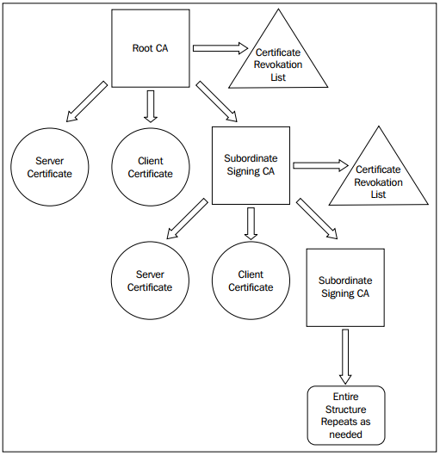
X.509 PKI

Slide 10
Diffie Hellman parameters
From wikipedia:
Diffie–Hellman is used to secure a variety of Internet services. However, research published in October 2015 suggests that the parameters in use for many D-H Internet applications at that time are not strong enough to prevent compromise by very well-funded attackers, such as the security services of large governments.
Generate 2048bit dhparams!

Slide 11
HMAC
tls-auth
The tls-auth directive adds an additional HMAC signature to all SSL/TLS handshake packets for integrity verification. Any UDP packet not bearing the correct HMAC signature can be dropped without further processing. The tls-auth HMAC signature provides an additional level of security above and beyond that provided by SSL/TLS. It can protect against:
DoS attacks or port flooding on the OpenVPN UDP port.
Port scanning to determine which server UDP ports are in a listening state.
Buffer overflow vulnerabilities in the SSL/TLS implementation.
SSL/TLS handshake initiations from unauthorized machines (while such handshakes would ultimately fail to authenticate, tls-auth can cut them off at a much earlier point).

Slide 12
Generate ca, cert
Use easy-rsa, an openvpn ca,cert generate tool
Do it from scratch with openssl
Question: Can we generate certificates using Let’s Encrypt?

Slide 13
easy-rsa
# pkg install easy-rsa
# mkdir /root/ca
# cd /root/ca
# easyrsa init-pki
# easyrsa build-ca
# cd /usr/local/etc/openvpn/
# easyrsa init-pki
# easyrsa gen-req [NAME] nopass
# easyrsa gen-dh
# mkdir /root/client
# cd /root/client
# easyrsa init-pki
# /easyrsa fen-req [NAME]
Reference:
https://community.openvpn.net/openvpn/wiki/EasyRSA3-OpenVPN-Howto

Slide 14
Sign key to CA
# cd /root/ca
# easyrsa import-req /usr/local/etc/openvpn/pki/reqs/[NAME].req [NAME]
# easyrsa import-req /root/client/pki/reqs/[NAME].req [NAME]
# easyrsa sign-req server [NAME]
# easyrsa sign-req client [NAME]

Slide 15
Diffie-Hellman / TLS-auth key
DH-KEY
# cd /usr/local/etc/openvpn
# easyrsa gen dh
AUTH KEY (Server & Client)
# cd /usr/local/etc/openvpn
# openvpn -genkey -secret ta.key

Slide 16
Package your config
Server
ca.crt
server.conf
server.key
server.crt
dh.pem
ta.key
Client
ca.crt
client.conf
client.key
client.crt
ta.key

Slide 17
Enable and start
SERVER SIDE
# cp keys,conf,crts… /usr/local/etc/openvpn
# /usr/local/etc/rc.d/openvpn start
CLIENT SIDE
# cp keys,conf,crts… /usr/local/etc/openvpn
# /usr/local/etc/rc.d/openvpn start

Slide 18
User-authentication
Simply by signing client certs.
Use Username/password
Use 3rd party authentication
RADIUS
LDAP

Slide 19
Server Side
Inside server.conf
# Using PAM to auth (Working with LDAP/NIS/Local Accout)
(verify-client-cert)
plugin /usr/local/lib/openvpn/plugins/openvpn-plugin-auth-pam.so login
# Use a shell script to auth
auth-user-pass-verify /etc/openvpn/auth.sh via-env
script-security 3 # To allow script reading passwords
Reference:
/usr/share/doc/openvpn-2.4.6/README.auth-pam
/etc/pam.d/login

Slide 20
Client Side
# A dialog will popup to ask you username/password
auth-user-pass
# Saving username/password into a file
auth-user-pass client.secret
# cat client.secret
ClientName
ClientPassword

Slide 21
Reference
https://www.digitalocean.com/community/tutorials/how-to-setup-and-configure-an-openvpn-server-on-centos-7
https://www.howtoforge.com/tutorial/how-to-install-openvpn-on-centos-7/
https://wiki.archlinux.org/index.php/OpenVPN

