Slide 1
IDS & IPS
jnlin

Slide 2
IDS & IPS
Intrusion detection system (IDS) is a device or software application that monitors a network or systems for malicious activity or policy violations.
The main functions of intrusion prevention systems (IPS) are to identify malicious activity, log information about this activity, report it and attempt to block or stop it.
Notes:
https://www.ithome.com.tw/node/48641

Slide 3
IDS / IPS with Firewall

Slide 4
Detection Method
Signature-based
Patterns of known malicious events
Difficult to detect new attacks
Anomaly-based
Use machine learning to create a model of trustworthy activity, and then compare new behavior against this model.

Slide 5
Pros & Cons
Pros
Simple
Cost Efficiency
Cons
False positives are frequent
Need to update signature library

Slide 6
Snort
An open source IDS
GPLv2
Very simple to use it

Slide 7
Snort - installation
FreeBSD: pkg install snort
Don’t forget to update latest updated rules
Configure PulledPort
cp /usr/local/etc/pulledpork/pulledpork.conf.sample /usr/local/etc/pulledpork/pulledpork.conf
mkdir /usr/local/etc/snort/so_rules
mkdir /usr/local/etc/snort/rules/iplists
touch /usr/local/etc/snort/rules/local.rules
cp /usr/local/etc/snort/preproc_rules/sensitive-data.rules-sample /usr/local/etc/snort/preproc_rules/sensitive-data.rules
/usr/local/etc/snort/rules/white_list.rules
/usr/local/etc/snort/rules/black_list.rules

Slide 8
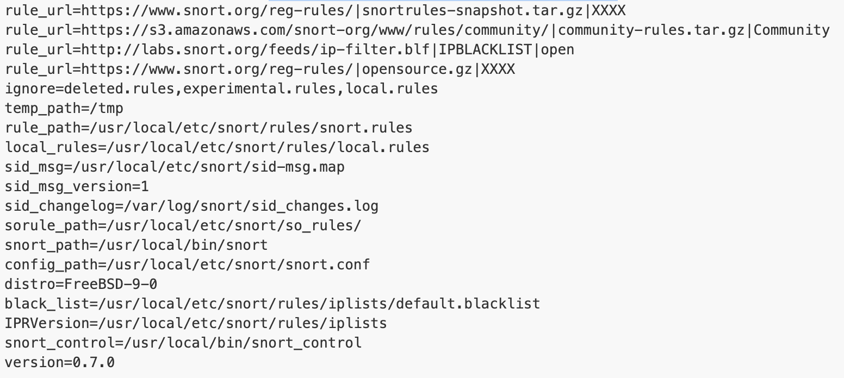
Snort - PulledPort
/usr/local/etc/pulledpork/pulledpork.conf

Slide 9
Run PulledPork
pulledpork.pl -c /usr/local/etc/pulledpork/pulledpork.conf -l

Slide 10
Start Snort
In /etc/rc.conf.local
snort_enable="YES”
snort_interface="em0”
/usr/local/etc/rc.d/snort start

Slide 11
Update rules periodically
crontab
0 6 * * * /usr/local/bin/pulledpork.pl -c /usr/local/etc/pulledpork/pulledpork.conf -l > /dev/null

