Slide 1
The Domain Name System
lwhsu (2020, CC-BY)
? (?-2019)

Slide 2
History of DNS
What and Why is DNS?
IP is not easy to remember
Domain Name ↔ IP Address(es)
Before DNS
ARPANET
HOSTS.txt contains all the hosts’ information (/etc/hosts)
Maintained by SRI’s Network Information Center
Register → Distribute DB
Problems: Not scalable!
Traffic and Load
Name Collision
Consistency
Domain Name System
Administration decentralization
Paul Mockapetris (University of Southern California)
RFC 882, 883 (1983) → 1034, 1035 (1984)
Notes:
SRI – Stanford Research Institute In Menlo Park, California

Slide 3
DNS Specification
Tree architecture – “domain” and “subdomain”
Divide into categories
Solve name collision
Distributed database
Each site maintains segment of DB
Each site opens self information via network
Client-Server architecture
Name servers provide information (Name Server)
Clients make queries to server (Resolver)

Slide 4
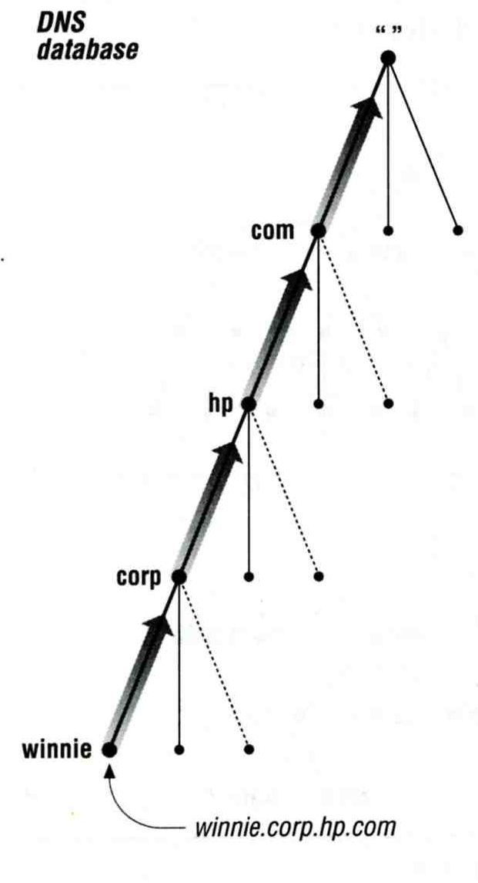
The DNS Namespace – (1)
Domain name is
A inverted tree (Rooted tree)
Root with label ‘.’
Root with label ‘’ (Null)
Domain and subdomain
Each domain has a “domain name” to identify its position in database
domain: nctu.edu.tw
subdomain: cs.nctu.edu.tw
Notes:
subdomain != delegation
Security need: wildcard, cookie
Management: Email address

Slide 5
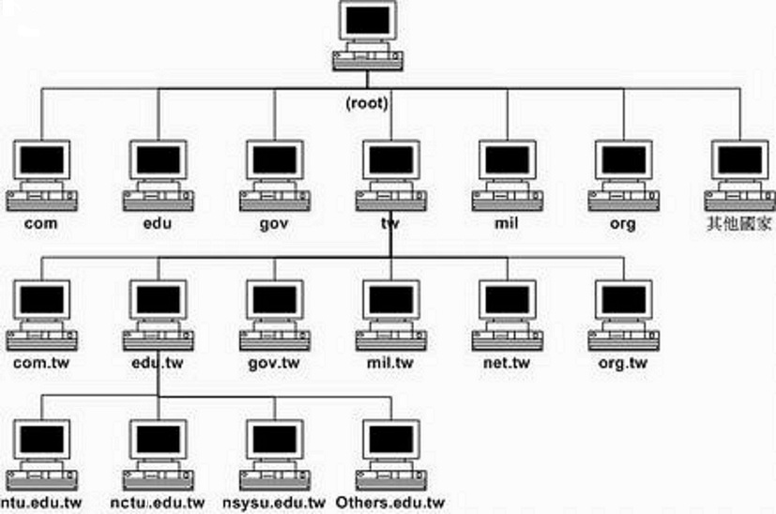
The DNS Namespace – (2)

Slide 6
The DNS Namespace – (3)
Domain level
Top-level / First level
Direct child of “root”
Maintained by ICANN (Internet Corporation for Assigned Names and Numbers)
Second-level
Child of a Top-level domain
Domain name limitations (RFC1035: 2.3.4 “Size limits”)
Up to 63-octets in each label
Up to 255-octets in a full domain name
253 visible characters and 2 length bytes
What is the real maximum length of a DNS name?
https://devblogs.microsoft.com/oldnewthing/20120412-00/?p=7873

Slide 7
The DNS Namespace – (4)
gTLDs (generic Top-Level Domains)
com: commercial organization, such as ibm.com
edu: educational organization, such as purdue.edu
gov: government organization, such as nasa.gov
mil: military organization, such as navy.mil
net: network infrastructure providing organization, such as hinet.net
org: noncommercial organization, such as x.org
int: International organization, such as nato.int

Slide 8
The DNS Namespace – (5)
New gTLDs launched in year 2000:
aero: for air-transport industry
biz: for business
coop: for cooperatives
info: for all uses
museum: for museum
name: for individuals
pro: for professionals
xxx: for adult entertainment industry (sTLD)
On March 18st , 2011
https://www.iana.org/domains/root/db

Slide 9
The DNS Namespace – (6)
Other than US, ccTLD (country code TLD)
ISO 3166, but just based on
Taiwan → tw
Japan → jp
United States → us
United Kingdom → uk (ISO3166 is GB)
European Union → eu
Follow or not follow US-like scheme
US-like scheme example
edu.tw, com.tw, gov.tw
Other scheme
ac.jp, co.jp

Slide 10
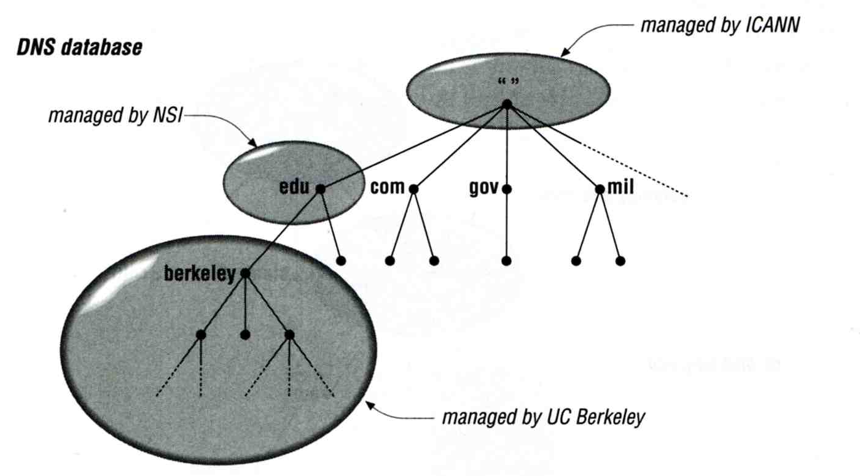
How DNS Works – DNS Delegation
Administration delegation
Each domain can delegate responsibility to subdomain
Specify name servers of subdomain

Slide 11
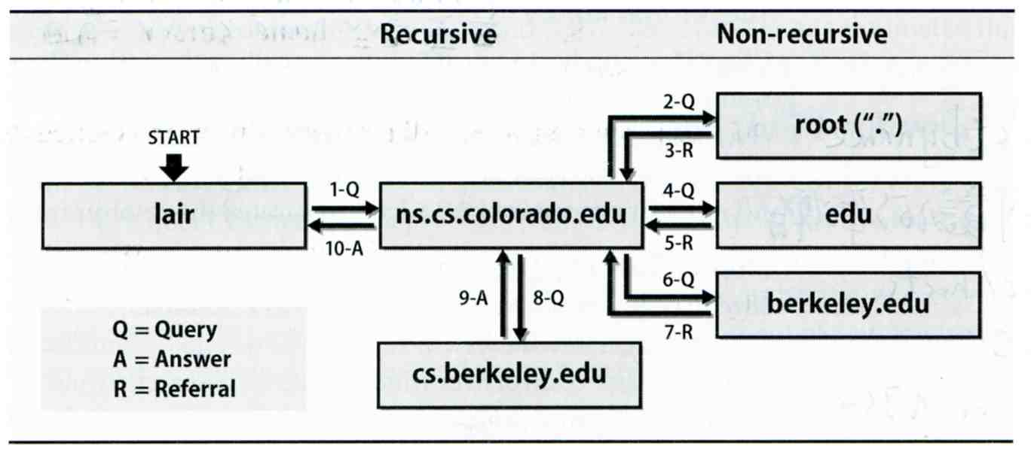
How DNS Works – DNS query process
Recursive query process
Ex: query lair.cs.colorado.edu → vangogh.cs.berkeley.edu,
name server “ns.cs.colorado.edu” has no cache data

Slide 12
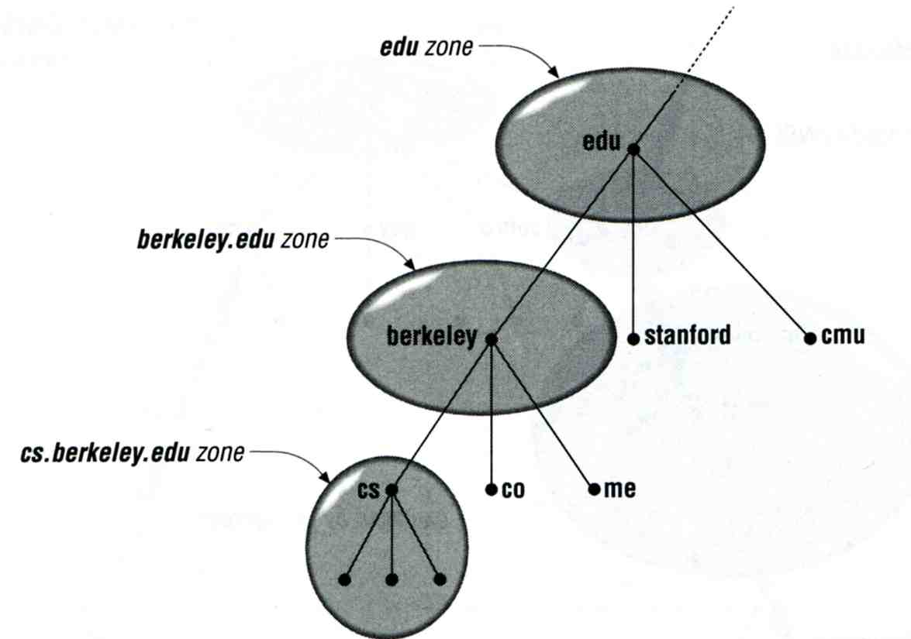
DNS Delegation – Administrated Zone
Zone
Autonomously administered piece of namespace
Once the subdomain becomes a zone, it is independent to it’s parent
Even parent contains NS’s A record

Slide 13
DNS Delegation – Administrated Zone
Two kinds of zone files
Forward Zone files
Hostname-to-Address mapping
Ex:
bsd1.cs.nctu.edu.tw. IN A 140.113.235.131
Reverse Zone files
Address-to-Hostname mapping
Ex:
131.235.113.140.in-addr.arpa. IN PTR bsd1.cs.nctu.edu.tw.

Slide 14
The Name Server Taxonomy (1)
Categories of name servers
Based on the source of name server’s data
Authoritative: official representative of a zone (master/slave)
Master: get zone data from disk
Slave: copy zone data from master
Nonauthoritative: answer a query from cache
caching: caches data from previous queries
Based on the type of answers handed out
Recursive: do query for you until it return an answer or error
Nonrecursive: refer you to the authoritative server
Based on the query path
Forwarder: performs queries on behalf of many clients with large cache
Caching: performs queries as a recursive name server

Slide 15
The Name Server Taxonomy (2)
Nonrecursive referral
Hierarchical and longest known domain referral with cache data of other zone’s name servers’ addresses
Ex:
Query lair.cs.colorado.edu from a nonrecursive server
Whether cache has
IP of lair.cs.colorado.edu
Name servers of cs.colorado.edu
Name servers of colorado.edu
Name servers of edu
Name servers of root
The resolver libraries do not understand referrals mostly. They expect the local name server to be recursive

Slide 16
The Name Server Taxonomy (3)
Caching
Positive cache (Long TTL)
Negative cache (Short TTL)
No host or domain matches the name queried
The type of data requested does not exist for this host
The server to ask is not responding
The server is unreachable of network problem
Negative cache
60% DNS queries are failed
To reduce the load of root servers, the authoritative negative answers must be cached

Slide 17
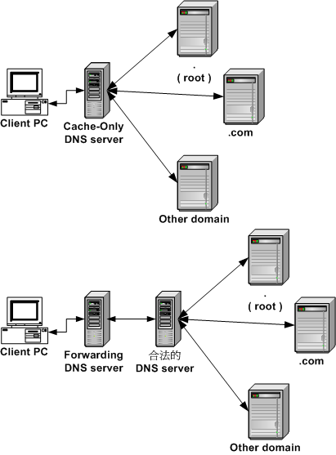
The Name Server Taxonomy (4)
Caching and forwarder DNS server

Slide 18
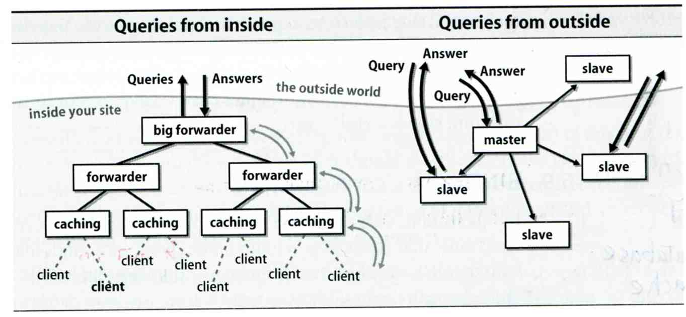
The Name Server Taxonomy (5)
How to arrange your DNS servers?
Ex:

Slide 19
The Name Server Taxonomy (6)
. 3600000 IN NS A.ROOT-SERVERS.NET.
A.ROOT-SERVERS.NET. 3600000 A 198.41.0.4
A.ROOT-SERVERS.NET. 3600000 AAAA 2001:503:BA3E::2:30
. 3600000 NS B.ROOT-SERVERS.NET.
B.ROOT-SERVERS.NET. 3600000 A 199.9.14.201
B.ROOT-SERVERS.NET. 3600000 AAAA 2001:500:200::b
. 3600000 NS C.ROOT-SERVERS.NET.
C.ROOT-SERVERS.NET. 3600000 A 192.33.4.12
C.ROOT-SERVERS.NET. 3600000 AAAA 2001:500:2::c
. 3600000 NS D.ROOT-SERVERS.NET.
D.ROOT-SERVERS.NET. 3600000 A 199.7.91.13
D.ROOT-SERVERS.NET. 3600000 AAAA 2001:500:2d::d
. 3600000 NS E.ROOT-SERVERS.NET.
E.ROOT-SERVERS.NET. 3600000 A 192.203.230.10
E.ROOT-SERVERS.NET. 3600000 AAAA 2001:500:a8::e
. 3600000 NS F.ROOT-SERVERS.NET.
F.ROOT-SERVERS.NET. 3600000 A 192.5.5.241
F.ROOT-SERVERS.NET. 3600000 AAAA 2001:500:2F::F
. 3600000 NS G.ROOT-SERVERS.NET.
G.ROOT-SERVERS.NET. 3600000 A 192.112.36.4
G.ROOT-SERVERS.NET. 3600000 AAAA 2001:500:12::d0d
. 3600000 NS H.ROOT-SERVERS.NET.
H.ROOT-SERVERS.NET. 3600000 A 198.97.190.53
H.ROOT-SERVERS.NET. 3600000 AAAA 2001:500:1::53
. 3600000 NS I.ROOT-SERVERS.NET.
I.ROOT-SERVERS.NET. 3600000 A 192.36.148.17
I.ROOT-SERVERS.NET. 3600000 AAAA 2001:7FE::53
. 3600000 NS J.ROOT-SERVERS.NET.
J.ROOT-SERVERS.NET. 3600000 A 192.58.128.30
J.ROOT-SERVERS.NET. 3600000 AAAA 2001:503:C27::2:30
. 3600000 NS K.ROOT-SERVERS.NET.
K.ROOT-SERVERS.NET. 3600000 A 193.0.14.129
K.ROOT-SERVERS.NET. 3600000 AAAA 2001:7FD::1
. 3600000 NS L.ROOT-SERVERS.NET.
L.ROOT-SERVERS.NET. 3600000 A 199.7.83.42
L.ROOT-SERVERS.NET. 3600000 AAAA 2001:500:3::42
. 3600000 NS M.ROOT-SERVERS.NET.
M.ROOT-SERVERS.NET. 3600000 A 202.12.27.33
M.ROOT-SERVERS.NET. 3600000 AAAA 2001:DC3::35
Root name servers
In named.root file of BIND
https://www.iana.org/domains/root/files

Slide 20
DNS Client Configurations
/etc/resolv.conf
nameserver
domain
search
resolver(5) resolverconf(8)
/etc/hosts
IP FQDN Aliases
C:\Windows\system32\drivers\etc\hosts
hosts(5)
/etc/nsswitch.conf
hosts: files (nis) (ldap) dns
nsswitch.conf(5)
Notes:
resolvconf.conf

Slide 21
DNS Client Commands – host
$ host nasa.cs.nctu.edu.tw
nasa.cs.nctu.edu.tw has address 140.113.17.32
$ host 140.113.17.32
32.17.113.140.in-addr.arpa domain name pointer nasa.cs.nctu.edu.tw.

Slide 22
DNS Client Commands – nslookup
$ nslookup nasa.cs.nctu.edu.tw
Server: 140.113.235.1 Address: 140.113.235.1#53 Name: nasa.cs.nctu.edu.tw Address: 140.113.17.32
$ nslookup 140.113.17.225
Server: 140.113.235.1 Address: 140.113.235.1#53 32.17.113.140.in-addr.arpa name = nasa.cs.nctu.edu.tw.

Slide 23
DNS Client Commands – dig (1)
$ dig nasa.cs.nctu.edu.tw
;; Got answer: ;; ->>HEADER<<- opcode: QUERY, status: NOERROR, id: 47883 ;; flags: qr aa rd ra; QUERY: 1, ANSWER: 1, AUTHORITY: 3, ADDITIONAL: 3 ;; QUESTION SECTION: ;nasa.cs.nctu.edu.tw. IN A ;; ANSWER SECTION: nasa.cs.nctu.edu.tw. 3600 IN A 140.113.17.32 ……

Slide 24
DNS Client Commands – dig (2)
$ dig -x 140.113.17.32
;; Got answer: ;; ->>HEADER<<- opcode: QUERY, status: NOERROR, id: 5514 ;; flags: qr aa rd ra; QUERY: 1, ANSWER: 1, AUTHORITY: 3, ADDITIONAL: 3 ;; QUESTION SECTION: ;32.17.113.140.in-addr.arpa. IN PTR ;; ANSWER SECTION: 32.17.113.140.in-addr.arpa. 86400 IN PTR nasa.cs.nctu.edu.tw. ……

Slide 25
DNS Security
DNSSEC
Provide
Origin authentication of DNS data
Data integrity
Authenticated denial of existence
Not provide
Confidentiality
Availability
$ dig +dnssec bsd1.cs.nctu.edu.tw
;; ANSWER SECTION: bsd1.cs.nctu.edu.tw. 3600 IN A 140.113.235.131 bsd1.cs.nctu.edu.tw. 3600 IN RRSIG A 7 5 3600 …
RRSIG: Resource Record Signature
Notes:
Availability – cannot prevent DDoS

Slide 26
DNS Security (c)
DNS over TLS (DoT)
DNS over HTTPS (DoH)
DNS Amplification Attack
http://www.cc.ntu.edu.tw/chinese/epaper/0028/20140320_2808.html

Slide 27
DNS Server Software
BIND
Complete DNS Server solution
Unbound
Local resolver
Validating
Recursive
Caching
https://en.wikipedia.org/wiki/Comparison_of_DNS_server_software

Slide 28
Misc.
Internationalized Domain Name (IDN)
Punycode
A representation of Unicode with ASCII
.台灣 <-> .xn--kpry57d
https://en.wikipedia.org/wiki/Punycode
Public & cloud services
Hurricane Electric Free DNS Hosting
https://dns.he.net/
AWS Route53
https://aws.amazon.com/route53/
GeoDNS
Different DNS answers based on client’s geographical location

