Slide 1
The BIND Software
lwhsu (2020, CC-BY)
? (?-2019)

Slide 2
BIND
BIND
The Berkeley Internet Name Domain system
CSRG, UC Berkeley, 1980s
Three main versions
BIND 4
Announced in 1980s
Based on RFC 1034, 1035
BIND 8
Released in 1997
Improvements including:
efficiency, robustness and security
BIND 9
Released in 2000
Enhancements including:
multiprocessor support, DNSSEC, IPv6 support, etc
BIND 10
Released version 1.0 and 1.1 in 2013
Released version 1.2 in 2014
ISC (Internet Software Consortium) has concluded BIND 10 development with Release 1.2
“Bundy” https://bundy-dns.de/

Slide 3
BIND – components
Four major components
named
Daemon that answers the DNS query
Perform Zone transfer
Library routines
Routines that used to resolve host by contacting the servers of DNS distributed database
Ex: res_query, res_search, …etc.
Command-line interfaces to DNS
Ex: nslookup, dig, host
bind-tools
rndc
A program to remotely control named

Slide 4
named in FreeBSD
Installation
/usr/ports/dns/bind916
pkg install bind916
Startup
Edit /etc/rc.conf
named_enable="YES"
Manual utility command
# service named start
% rndc {stop | reload | flush …}
In old version of BIND, use ndc command
See your BIND version
% dig @127.0.0.1 version.bind txt chaos
version.bind. 0 CH TXT "9.9.11"
% nslookup -debug -class=chaos -query=txt version.bind 127.0.0.1
version.bind text = "9.9.11“
Good to be put inside of a jail!

Slide 5
BIND – Configuration files
The complete configuration of named consists of
The config file
/usr/local/etc/namedb/named.conf
Zone data file
Address mappings for each host
Collections of individual DNS data records
The root name server hints

Slide 6
BIND Configuration – named.conf
/usr/local/etc/namedb/named.conf
Roles of this host for each zone it serves
Master, slave, stub, or caching-only
Options
Global options
The overall operation of named and server
Zone specific options
named.conf is composed of following statements:
include, options, server, key, acl, zone, view, controls, logging, trusted-keys, masters

Slide 7
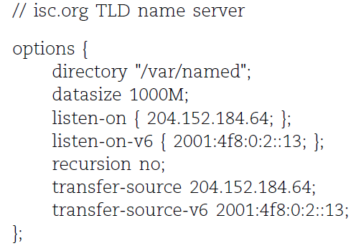
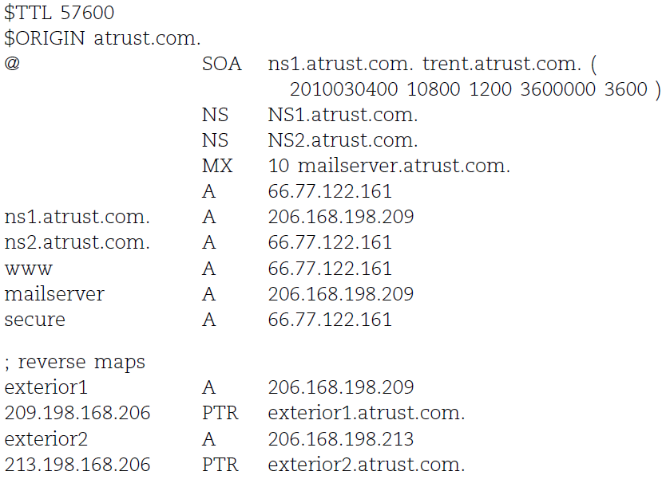
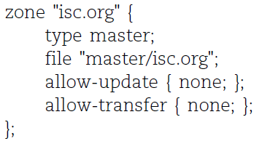
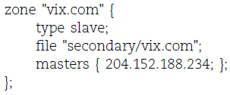
Examples of named configuration

Slide 8
DNS Database – Zone data

Slide 9
The DNS Database
A set of text files such that
Maintained and stored on the domain’s master name server
Often called zone files
Two types of entries
Resource Records (RR)
The real part of DNS database
Parser commands
Just provide some shorthand ways to enter records
Influence the way that the parser interprets sequence orders or expand into multiple DNS records themselves

Slide 10
The DNS Database – Parser Commands
Commands must start in first column and be on a line by themselves
$ORIGIN domain-name
Used to append to un-fully-qualified name
$INCLUDE file-name
Separate logical pieces of a zone file
Keep cryptographic keys with restricted permissions
$TTL default-ttl
Default value for time-to-live filed of records
$GENERATE start-stop/[step] lhs type rhs
Be found only in BIND
Used to generate a series of similar records
Can be used in only CNAME, PTR, NS, A, AAAA, etc. record types

Slide 11
The DNS Database – Resource Record (1)
Basic format
[name] [ttl] [class] type data
name: the entity that the RR describes
Can be relative or absolute
ttl: time in second of this RR’s validity in cache
class: network type
IN for Internet
CH for ChaosNet
HS for Hesiod
Special characters
; (comment)
@ (The current domain name)
() (allow data to span lines)
* (wild card character, name filed only)

Slide 12
The DNS Database – Resource Record (2)
Type of resource record discussed later
Zone records: identify domains and name servers
SOA
NS
Basic records: map names to addresses and route mails
A
AAAA
PTR
MX
Optional records: extra information to host or domain
CNAME
TXT
SRV

Slide 13
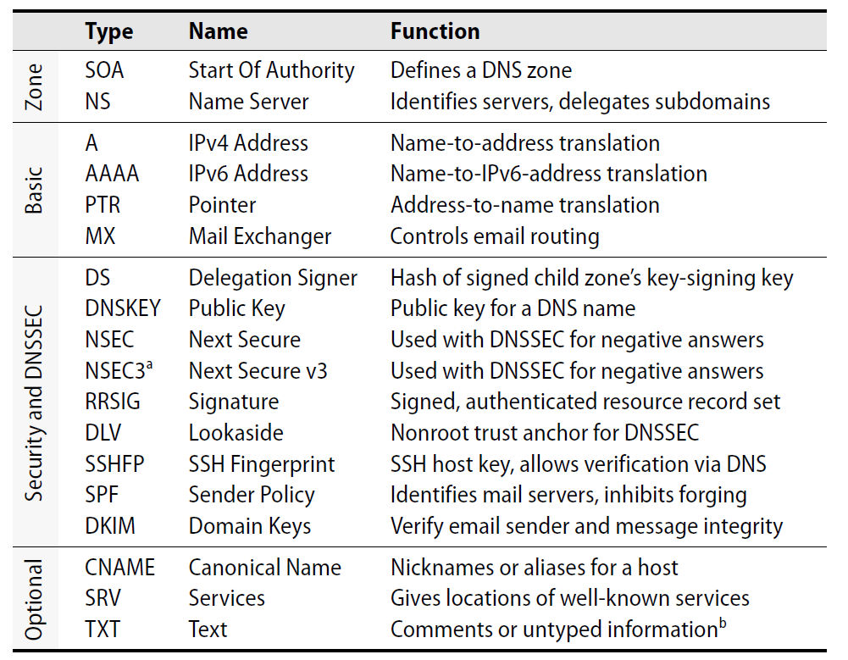
The DNS Database – Resource Record (3)

Slide 14
The DNS Database – Resource Record (4)
SOA: Start Of Authority
Defines a DNS zone of authority, each zone has exactly one SOA record
Specify the name of the zone, the technical contact and various timeout information
Format:
[zone] IN SOA [server-name] [administrator’s mail] ( serial, refresh, retry, expire, ttl )
Ex:
; means comments
@ means current domain name
( ) allow data to span lines
* Wild card character
$TTL 3600;
$ORIGIN cs.nctu.edu.tw.
@ IN SOA csns.cs.nctu.edu.tw. root.cs.nctu.edu.tw. (
2012050802 ; serial number
1D ; refresh time for slave server
30M ; retry
1W ; expire
2H ) ; minimum

Slide 15
The DNS Database – Resource Record (5)
NS: Name Server
Format
zone [ttl] [IN] NS hostname
Usually follow the SOA record
Goal
Identify the authoritative server for a zone
Delegate subdomains to other organization’s NS
$TTL 3600;
$ORIGIN cs.nctu.edu.tw.
@ IN SOA dns.cs.nctu.edu.tw. root.cs.nctu.edu.tw. (
2012050802 ; serial number
1D ; refresh time for slave server
30M ; retry
1W ; expire
2H ) ; minimum
IN NS dns.cs.nctu.edu.tw.
IN NS dns2.cs.nctu.edu.tw.
test IN NS dns.test.cs.nctu.edu.tw. ; delegate test.$ORIGIN

Slide 16
The DNS Database – Resource Record (6)
A record: Address
Format
hostname [ttl] [IN] A ipaddr
Provide mapping from hostname to IP address
Load balance
Ex:
$ORIGIN cs.nctu.edu.tw.
@ IN NS dns.cs.nctu.edu.tw.
IN NS dns2.cs.nctu.edu.tw.
dns IN A 140.113.235.107
dns2 IN A 140.113.235.103
www IN A 140.113.235.111

Slide 17
The DNS Database – Resource Record (7)
PTR: Pointer
Perform the reverse mapping from IP address to hostname
Special top-level domain: in-addr.arpa
Used to create a naming tree from IP address to hostnames
Format
addr [ttl] [IN] PTR hostname
$TTL 259200;
$ORIGIN 235.113.140.in-addr.arpa.
@ IN SOA csns.cs.nctu.edu.tw. root.cs.nctu.edu.tw. (
2007052102 ; serial number
1D ; refresh time for secondary server
30M ; retry
1W ; expire
2H) ; minimum
IN NS dns.cs.nctu.edu.tw.
IN NS dns2.cs.nctu.edu.tw.
$ORIGIN in-addr.arpa.
103.235.113.140 IN PTR csmailgate.cs.nctu.edu.tw.
107.235.113.140 IN PTR csns.cs.nctu.edu.tw.

Slide 18
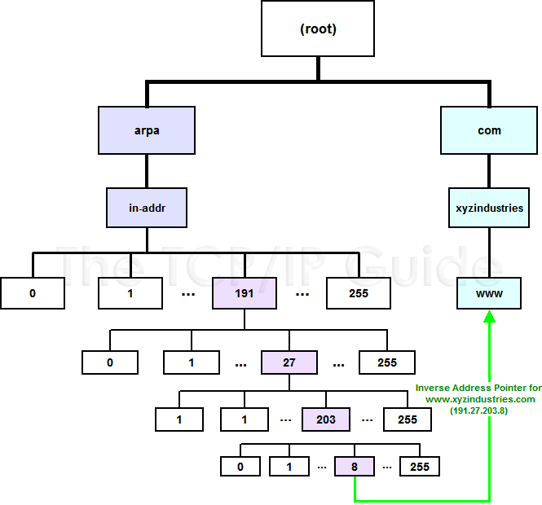
The DNS Database – Resource Record (8)

Slide 19
The DNS Database – Resource Record (9)
MX: Mail eXchanger
Direct mail to a mail hub rather than the recipient’s own workstation
Format
host [ttl] [IN] MX preference host
Ex:
$TTL 3600;
$ORIGIN cs.nctu.edu.tw.
@ IN SOA csns.cs.nctu.edu.tw. root.cs.nctu.edu.tw. (
2007052102 ; serial number
1D ; refresh time for slave server
30M ; retry
1W ; expire
2H ) ; minimum
IN NS dns.cs.nctu.edu.tw.
IN NS dns2.cs.nctu.edu.tw.
7200 IN MX 1 csmx1.cs.nctu.edu.tw.
7200 IN MX 5 csmx2.cs.nctu.edu.tw.
csmx1 IN A 140.113.235.104
csmx2 IN A 140.113.235.105

Slide 20
The DNS Database – Resource Record (10)
CNAME: Canonical name
nickname [ttl] IN CNAME hostname
Add additional names to a host
To associate a function or to shorten a hostname
CNAME record can nest eight deep in BIND
Other records must refer to its real hostname
Not for load balance (use multiple A/AAAA instead)
Ex:
www IN A 140.113.209.63
IN A 140.113.209.77
penghu-club IN CNAME www
King IN CNAME www
R21601 IN A 140.113.214.31
superman IN CNAME r21601

Slide 21
The DNS Database – Resource Record (11)
TXT: Text
Add arbitrary text to a host’s DNS records
Format
Name [ttl] [IN] TXT info
All info items should be quoted
They are sometimes used to test prospective new types of DNS records
SPF records
$TTL 3600;
$ORIGIN cs.nctu.edu.tw.
@ IN SOA csns.cs.nctu.edu.tw. root.cs.nctu.edu.tw. (
2007052102 ; serial number
1D ; refresh time for slave server
30M ; retry
1W ; expire
2H ) ; minimum
IN NS dns.cs.nctu.edu.tw.
IN NS dns2.cs.nctu.edu.tw.
IN TXT "Department of Computer Science"

Slide 22
The DNS Database – Resource Record (12)
SRV: Service
Specify the location of services within a domain
Format:
_service._proto.name [ttl] IN SRV pri weight port target
Needs application support
Ex:
; don’t allow finger
_finger._tcp SRV 0 0 79 .
; 1/4 of the connections to old, 3/4 to the new
_ssh. _tcp SRV 0 1 22 old.cs.colorado.edu.
_ssh. _tcp SRV 0 3 22 new.cs.colorado.edu.
; www server
_http. _tcp SRV 0 0 80 www.cs.colorado.edu.
SRV 10 0 8000 new.cs.colorado.edu.
; block all other services
*. _tcp SRV 0 0 0 .
*. _udp SRV 0 0 0 .

Slide 23
IPv6 Resource Records
IPv6 forward records
Format
Hostname [ttl] [IN] AAAA ip6addr
Example
IPv6 reverse records
IPv6 PTR records are in the ip6.arpa top-level domain
Example
f.0.0.0.0.0.0.0.0.0.0.0.0.0.0.0.0.0.0.0.f.2.0.0.0.0.5.0.1.0.0.2.ip6.arpa. PTR f.root-servers.net.
bsd1[~] -chiahung- dig f.root-servers.net AAAA
;; ANSWER SECTION:
f.root-servers.net. 604795 IN AAAA 2001:500:2f::f

Slide 24
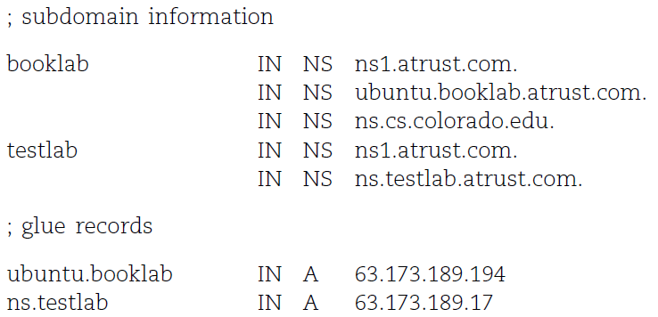
Glue Record (1/2)
Glue record – Link between zones
DNS referrals occur only from parent domains to child domains
The servers of a parent domain must know the IP of the name servers for all of its subdomains
Parent zone needs to contain the NS records for each delegated zone
Making a normal DNS query
Having copies of the appropriate A records
The foreign A records are called glue records

Slide 25
Glue Record (2/2)
There are two ways to link between zones
By including the necessary records directly
By using stub zone
Only contains SOA, NS, A (of NS)
Lame delegation
DNS subdomain administration has delegate to you and you never use the domain or parent domain’s glue record is not updated

Slide 26
Statements of named.conf

Slide 27
Examples of named configuration

Slide 28
BIND Configuration – named.conf address match list
Address Match List
A generalization of an IP address that can include:
An IP address
Ex. 140.113.17.1
An IP network with CIDR netmask
Ex. 140.113/16
The name of a previously defined ACL
A cryptographic authentication key
The ! character to negate things
First match
Examples:
{!1.2.3.4; 1.2.3/24;};
{128.138/16; 198.11.16/24; 204.228.69/24; 127.0.0.1;};

Slide 29
BIND Configuration – named.conf acl
The “acl” statement
Define a class of access control
Define before they are used
Syntax
acl acl_name {
address_match_list
};
Predefined acl classes
any, localnets, localhost, none
Example
acl CSnets {
140.113.235/24; 140.113.17/24; 140.113.209/24; 140.113.24/24;
};
acl NCTUnets {
140.113/16; 10.113/16; 140.126.237/24;
};
allow-transfer {localhost; CSnets; NCTUnets};

Slide 30
BIND Configuration – named.conf key
The “key” statement
Define a encryption key used for authentication with a particular server
Syntax
key key-id {
algorithm string;
secret string;
}
Example:
key serv1-serv2 {
algorithm hmac-md5;
secret "ibkAlUA0XXAXDxWRTGeY+d4CGbOgOIr7n63eizJFHQo="
}
This key is used to
Sign DNS request before sending to target
Validate DNS response after receiving from target

Slide 31
BIND Configuration – named.conf include
The “include” statement
Used to separate large configuration file
Another usage is used to separate cryptographic keys into a restricted permission file
Ex:
include "/etc/namedb/rndc.key";
-rw-r--r-- 1 root wheel 4947 Mar 3 2006 named.conf
-rw-r----- 1 bind wheel 92 Aug 15 2005 rndc.key
If the path is relative
Relative to the directory option

Slide 32
BIND Configuration – named.conf option (1/3)
The “option” statement
Specify global options
Some options may be overridden later for specific zone or server
Syntax:
options {
option;
option;
};
There are more than 150 options in BIND 9
version "There is no version."; [real version num]
version.bind. 0 CH TXT "9.3.3"
version.bind. 0 CH TXT "There is no version."
directory "/etc/namedb/db";
Base directory for relative path and path to put zone data files

Slide 33
BIND Configuration – named.conf option (2/3)
notify yes | no [yes]
Whether notify slave sever when relative zone data is changed
also-notify {140.113.235.101;}; [empty]
Also notify this non-advertised NS server
recursion yes | no [yes]
Recursive name server
Open resolver
allow-recursion {address_match_list }; [all]
Finer granularity recursion setting
recursive-clients number; [1000]
max-cache-size number; [unlimited]
Limited memory

Slide 34
BIND Configuration – named.conf option (3/3)
query-source address ip_addr port ip_port; [random]
NIC and port to send DNS query
DO NOT use port
use-v4-udp-ports { range beg end; }; [range 1024 65535]
avoid-v6-udp-ports { port_list }; [empty]
forwarders {in_addr; …}; [empty]
Often used in cache name server
Forward DNS query if there is no answer in cache
forward only | first; [first]
If forwarder does not response, queries for forward only server will fail
allow-query { address_match_list }; [all]
Specify who can send DNS query to you
allow-transfer address_match_list; [all]
Specify who can request zone transfer of your zone data
allow-update address_match_list; [none]
blackhole address_match_list; [empty]
Reject queries and would never ask them for answers

Slide 35
BIND Configuration – named.conf zone (1/5)
The “zone” statement
Heart of the named.conf that tells named about the zones that it is authoritative
zone statement format varies depending on roles of named
master, slave, hint, forward, stub
The zone file is just a collection of DNS resource records
Basically
Syntax:
zone "domain_name" {
type master | slave| stub;
file "path”;
masters {ip_addr; ip_addr;};
allow-query {address_match_list}; [all]
allow-transfer { address_match_list}; [all]
allow-update {address_match_list}; [empty]
};
allow-update cannot be used for a slave zone

Slide 36
BIND Configuration – named.conf zone (2/5)
Master server zone configuration
Slave server zone configuration
zone "cs.nctu.edu.tw" IN {
type master;
file "named.hosts";
allow-query { any; };
allow-transfer { localhost; CS-DNS-Servers; };
allow-update { none; };
};
zone "cs.nctu.edu.tw" IN {
type slave;
file "cs.hosts";
masters { 140.113.235.107; };
allow-query { any; };
allow-transfer { localhost; CS-DNS-Servers; };
};

Slide 37
BIND Configuration – named.conf zone (3/5)
Forward zone and reverse zone
zone "cs.nctu.edu.tw" IN {
type forward;
forwarders { CS-DNS-Servers; };
allow-query { any; };
};
zone "235.113.140.in-addr.arpa" IN {
type master;
file "named.235.rev";
allow-query { any; };
allow-transfer { localhost; CS-DNS-Servers; };
allow-update { none; };
};

Slide 38
BIND Configuration – named.conf zone (4/5)
Example
In named.hosts, there are plenty of A or CNAME records
In named.235.rev, there are plenty of PTR records
…
bsd1 IN A 140.113.235.131
csbsd1 IN CNAME bsd1
bsd2 IN A 140.113.235.132
bsd3 IN A 140.113.235.133
bsd4 IN A 140.113.235.134
bsd5 IN A 140.113.235.135
…
…
131.235.113.140 IN PTR bsd1.cs.nctu.edu.tw.
132.235.113.140 IN PTR bsd2.cs.nctu.edu.tw.
133.235.113.140 IN PTR bsd3.cs.nctu.edu.tw.
134.235.113.140 IN PTR bsd4.cs.nctu.edu.tw.
135.235.113.140 IN PTR bsd5.cs.nctu.edu.tw.
…

Slide 39
BIND Configuration – named.conf zone (5/5)
Setting up root hint
A cache of where are the DNS root servers
Setting up forwarding zone
Forward DNS query to specific name server, bypassing the standard query path
zone "." IN {
type hint;
file "named.root";
};
zone "nctu.edu.tw" IN {
type forward;
forward first;
forwarders { 140.113.250.135; 140.113.1.1; };
};
zone "113.140.in-addr.arpa" IN {
type forward;
forward first;
forwarders { 140.113.250.135; 140.113.1.1; };
};

Slide 40
BIND Configuration – named.conf server
The “server” statement
Tell named about the characteristics of its remote peers
Syntax
server ip_addr {
bogus no|yes;
provide-ixfr yes|no; (for master)
request-ixfr yes|no; (for slave)
transfer-format many-answers|one-answer;
keys { key-id; key-id};
};
ixfr
Incremental zone transfer
transfers
Limit of number of concurrent inbound zone transfers from that server
Server-specific transfers-in
keys
Any request sent to the remote server is signed with this key

Slide 41
BIND Configuration – named.conf view (1/2)
The “view” statement
Create a different view of DNS naming hierarchy for internal machines
Restrict the external view to few well-known servers
Supply additional records to internal users
Also called “split DNS”
In-order processing
Put the most restrictive view first
All-or-nothing
All zone statements in your named.conf file must appear in the content of view

Slide 42
BIND Configuration – named.conf view (2/2)
Syntax
view view-name {
match_clients {address_match_list};
view_options;
zone_statement;
};
Example
view "internal" {
match-clients {our_nets;};
recursion yes;
zone "cs.nctu.edu.tw" {
type master;
file "named-internal-cs";
};
};
view "external" {
match-clients {any;};
recursion no;
zone "cs.nctu.edu.tw" {
type master;
file "named-external-cs";
};
};

Slide 43
BIND Configuration – named.conf controls
The “controls” statement
Limit the interaction between the running named process and rndc
Syntax
controls {
inet ip_addr port ip-port allow {address_match_list} keys {key-id};
};
Example:
include "/etc/named/rndc.key";
controls {
inet 127.0.0.1 allow {127.0.0.1;} keys {rndc_key;};
}
key "rndc_key" {
algorithm hmac-md5;
secret "GKnELuie/G99NpOC2/AXwA==";
};

Slide 44
BIND Configuration – rndc
RNDC – remote name daemon control
reload, restart, status, dumpdb, …..
rndc-confgen -b 256
# Start of rndc.conf
key "rndc-key" {
algorithm hmac-md5;
secret "qOfQFtH1nvdRmTn6gLXldm6lqRJBEDbeK43R8Om7wlg=";
};
options {
default-key "rndc-key";
default-server 127.0.0.1;
default-port 953;
};
# End of rndc.conf
SYNOPSIS
rndc [-c config-file] [-k key-file] [-s server] [-p port] [-V]
[-y key_id] {command}

Slide 45
Updating zone files
Master
Edit zone files
Serial number
Forward and reverse zone files for single IP
Do “rndc reload”
“notify” is on, slave will be notify about the change
“notify” is off, refresh timeout, or do “rndc reload” in slave
Zone transfer
DNS zone data synchronization between master and slave servers
AXFR (all zone data are transferred at once, before BIND8.2)
IXFR (incremental updates zone transfer)
provide-ixfr
request-ixfr
TCP port 53

Slide 46
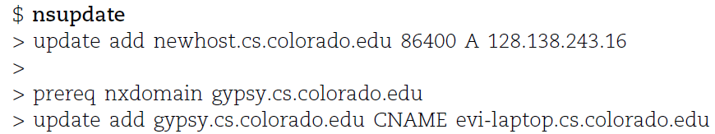
Dynamic Updates
The mappings of name-to-address are relatively stable
DHCP will dynamically assign IP addresses to the hosts
Hostname-based logging or security measures become very difficulty
Dynamic updates
RFC 2136
BIND allows the DHCP daemon to notify the updating RR contents
nsupdate
Using allow-update, or allow-policy
rndc frozen zone, rndc thaw zone
allow-policy (grant | deny) identity nametype name [types]
dhcp-host1.domain IN A 192.168.0.1
dhcp-host2.domain IN A 192.168.0.2

Slide 47
Non-byte boundary (1/5)
In normal reverse configuration:
named.conf will define a zone statement for each reverse subnet zone and
Your reverse db will contains lots of PTR records
Example:
zone "1.168.192.in-addr.arpa." {
type master;
file "named.rev.1";
allow-query {any;};
allow-update {none;};
allow-transfer {localhost;};
};
$TTL 3600
$ORIGIN 1.168.192.in-addr.arpa.
@ IN SOA chwong.csie.net chwong.chwong.csie.net. (
2007050401 ; Serial
3600 ; Refresh
900 ; Retry
7D ; Expire
2H ) ; Minimum
IN NS ns.chwong.csie.net.
254 IN PTR ns.chwong.csie.net.
1 IN PTR www.chwong.csie.net.
2 IN PTR ftp.chwong.csie.net.
…

Slide 48
Non-byte boundary (2/5)
What if you want to delegate 192.168.2.0 to another sub-domain
Parent
Remove forward db about 192.168.2.0/24 network
Ex:
pc1.chwong.csie.net. IN A 192.168.2.35
pc2.chwong.csie.net. IN A 192.168.2.222
…
Remove reverse db about 2.168.192.in-addr.arpa
Ex:
35.2.168.192.in-addr.arpa. IN PTR pc1.chwong.csie.net.
222.2.168.192.in-addr.arpa. IN PTR pc2.chwong.csie.net.
…
Add glue records about the name servers of sub-domain
Ex: in zone db of "chwong.csie.net"
sub1 IN NS ns.sub1.chwong.csie.net.
ns.sub1 IN A 192.168.2.1
Ex: in zone db of "168.192.in-addr.arpa."
2 IN NS ns.sub1.chwong.csie.net.
1.2 IN PTR ns.sub1.chwong.csie.net

Slide 49
Non-byte boundary (3/5)
What if you want to delegate 192.168.3.0 to four sub-domains (a /26 network)
192.168.3.0 ~ 192.168.3.63
ns.sub1.chwong.csie.net.
192.168.3.64 ~ 192.168.3.127
ns.sub2.chwong.csie.net.
192.168.3.128 ~ 192.168.3.191
ns.sub3.chwong.csie.net.
192.168.3.192 ~ 192.168.3.255
ns.sub4.chwong.csie.net.
It is easy for forward setting
In zone db of chwong.csie.net
sub1 IN NS ns.sub1.chwong.csie.net.
ns.sub1 IN A 1921.68.3.1
sub2 IN NS ns.sub2.chwong.csie.net.
ns.sub2 IN A 192.168.3.65
…

Slide 50
Non-byte boundary (4/5)
Non-byte boundary reverse setting
Method1
$GENERATE 0-63 $.3.168.192.in-addr.arpa. IN NS ns.sub1.chwong.csie.net.
$GENERATE 64-127 $.3.168.192.in-addr.arpa. IN NS ns.sub2.chwong.csie.net.
$GENERATE 128-191 $.3.168.192.in-addr.arpa. IN NS ns.sub3.chwong.csie.net.
$GENERATE 192-255 $.3.168.192.in-addr.arpa. IN NS ns.sub4.chwong.csie.net.
And
zone "1.3.168.192.in-addr.arpa. " {
type master;
file "named.rev.192.168.3.1";
};
; named.rev.192.168.3.1
@ IN SOA sub1.chwong.csie.net. root.sub1.chwong.csie.net. (1;3h;1h;1w;1h)
IN NS ns.sub1.chwong.csie.net.

Slide 51
Non-byte boundary (5/5)
Method2
$ORIGIN 3.168.192.in-addr.arpa.
$GENERATE 1-63 $ IN CNAME $.0-63.3.168.192.in-addr.arpa.
0-63.3.168.192.in-addr.arpa. IN NS ns.sub1.chwong.csie.net.
$GENERATE 65-127 $ IN CNAME $.64-127.3.168.192.in-addr.arpa.
64-127.3.168.192.in-addr.arpa. IN NS ns.sub2.chwong.csie.net.
$GENERATE 129-191 $ IN CNAME $.128-191.3.168.192.in-addr.arpa.
128-191.3.168.192.in-addr.arpa. IN NS ns.sub3.chwong.csie.net.
$GENERATE 193-255 $ IN CNAME $.192-255.3.168.192.in-addr.arpa.
192-255.3.168.192.in-addr.arpa. IN NS ns.sub4.chwong.csie.net.
zone "0-63.3.168.192.in-addr.arpa." {
type master;
file “named.rev.192.168.3.0-63”;
};
; named.rev.192.168.3.0-63
@ IN SOA sub1.chwong.csie.net. root.sub1.chwong.csie.net. (1;3h;1h;1w;1h)
IN NS ns.sub1.chwong.csie.net.
1 IN PTR www.sub1.chwong.csie.net.
IN PTR abc.sub1.chwong.csie.net.
…

Slide 52
BIND Security

Slide 53
Security – named.conf security configuration
Security configuration
Feature | Config. Statement | comment
allow-query | options, zone | Who can query
allow-transfer | options, zone | Who can request zone transfer
allow-update | zone | Who can make dynamic updates
blackhole | options | Which server to completely ignore
bogus | server | Which servers should never be queried
acl bogusnet {
0.0.0.0/8 ; // Default, wild card addresses
1.0.0.0/8 ; // Reserved addresses
2.0.0.0/8 ; // Reserved addresses
169.254.0.0/16 ; // Link-local delegated addresses
192.0.2.0/24 ; // Sample addresses, like example.com
224.0.0.0/3 ; // Multicast address space
10.0.0.0/8 ; // Private address space (RFC1918)25
172.16.0.0/12 ; // Private address space (RFC1918)
192.168.0.0/16 ; // Private address space (RFC1918)
};
allow-recursion { ournets; };
blackhole { bogusnet; };
allow-transfer { myslaves; };

Slide 54
Security – With TSIG (1)
TSIG (Transaction SIGnature)
Developed by IETF (RFC2845)
Symmetric encryption scheme to sign and validate DNS requests and responses between servers
Algorithm in BIND9
DH (Diffie Hellman), HMAC-MD5, HMAC-SHA1, HMAC-SHA224, HMAC-SHA256, HMAC-SHA384, HMAC-SHA512
Usage
Prepare the shared key with dnssec-keygen
Edit “key” statement
Edit “server” statement to use that key
Edit “zone” statement to use that key with:
allow-query
allow-transfer
allow-update

Slide 55
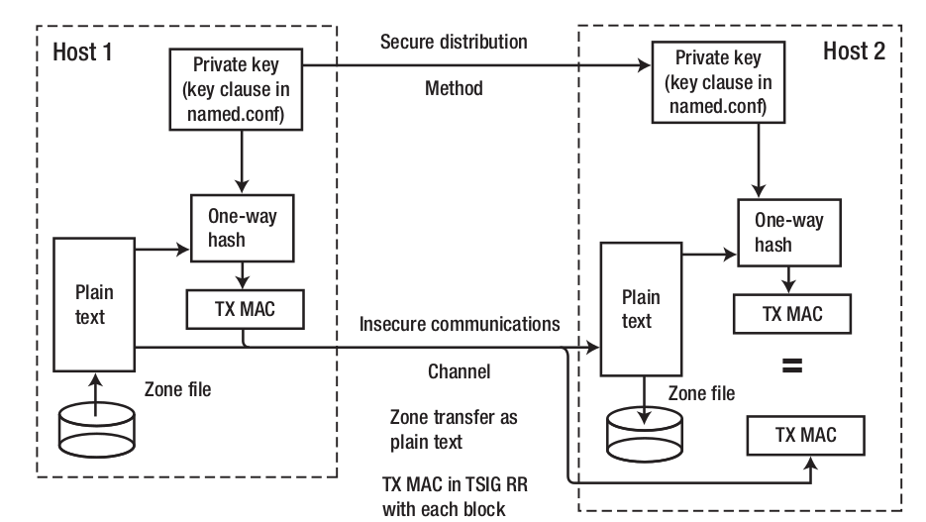
Security – With TSIG (2)

Slide 56
Security – With TSIG (3)
TSIG example (dns1 with dns2)
% dnssec-keygen -a HMAC-MD5 -b 128 -n HOST cs
Edit /etc/named/dns1-dns2.key
Edit both named.conf of dns1 and dns2
Suppose dns1 = 140.113.235.107 dns2 = 140.113.235.103
% dnssec-keygen -a HMAC-MD5 -b 128 -n HOST cs
Kcs.+157+35993
% cat Kcs.+157+35993.key
cs. IN KEY 512 3 157 oQRab/QqXHVhkyXi9uu8hg==
% cat Kcs.+157+35993.private
Private-key-format: v1.2
Algorithm: 157 (HMAC_MD5)
Key: oQRab/QqXHVhkyXi9uu8hg==
key dns1-dns2 {
algorithm hmac-md5;
secret “oQRab/QqXHVhkyXi9uu8hg==”
};
include “dns1-dns2.key”
server 140.113.235.103 {
keys {dns1-dns2;};
};
include “dns1-dns2.key”
server 140.113.235.107 {
keys {dns1-dns2;};
};

Slide 57
Security – With DNSSEC (1)
DNSSEC (Domain Name System SECurity Extensions)
Using public-key cryptography (asymmetric)
Follow the delegation of authority model
Provide data authenticity and integrity
Signing the RRsets with private key
Public DNSKEYs are published, used to verify RRSIGs
Children sign their zones with private key
The private key is authenticated by parent’s signing hash (DS) of the child zone’s key
RRset: Resource Record Set
RRSIG: Resource Record Signature
DS: Delegation of Signing

Slide 58
Security – With DNSSEC (2)
Types of Resource Record for DNSSEC
RRSIG (Resource Record Signature)
Crypto signatures for A, AAAA, NS, etc.
Tracks the type and number at each node.
NSEC (Next Secure)/NSEC3
Confirms the NXDOMAIN response
DNSKEY
Public keys for the entire zone
Private side is used generate RRSIGs
DS (Delegation Signer) Record
Handed up to parent zone to authenticate the NS record

Slide 59
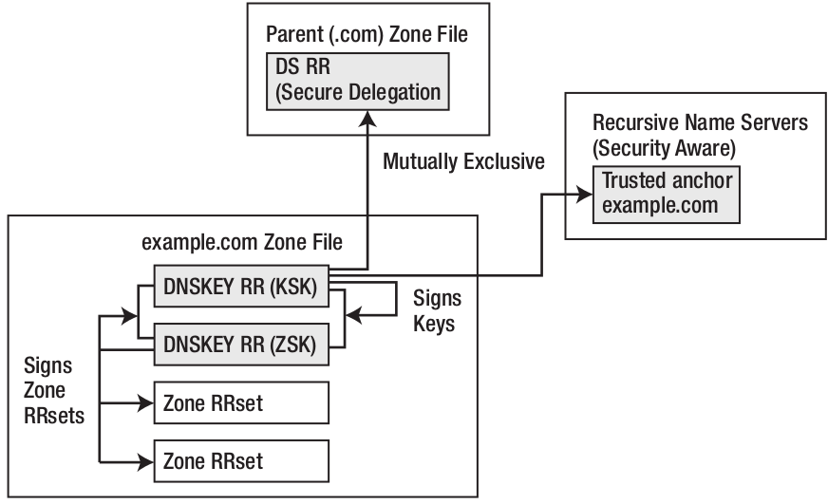
Security – With DNSSEC (3)
KSK (Key Signing Key)
The private key is used to generate a digital signature for the ZSK
The public key is stored in the DNS to be used to authenticate the ZSK
ZSK (Zone Signing Key)
The private key is used to generate a digital signature (RRSIG) for each RRset in a zone
The public key is stored in the DNS to authenticate an RRSIG

Slide 60
BIND Debugging and Logging

Slide 61
Logging (1)
Logging configuration
Using a logging statement
Define what are the channels
Specify where each message category should go
Terms
Channel
A place where messages can go
Ex: syslog, file or /dev/null
Category
A class of messages that named can generate
Ex: answering queries or dynamic updates
Module
The name of the source module that generates the message
Facility
syslog facility name
Severity
Priority in syslog
When a message is generated
It is assigned a “category”, a “module”, a “severity”
It is distributed to all channels associated with its category

Slide 62
Logging (2)
Channels
Either “file” or “syslog” in channel sub-statement
size:
ex: 2048, 100k, 20m, 15g, unlimited, default
facility:
Daemon and local0 ~ local7 are reasonable choices
severity:
critical, error, warning, notice, info, debug (with an optional numeric level), dynamic
Dynamic is recognized and matches the server’s current debug level
logging {
channel_def;
channel_def;
…
category category_name {
channel_name;
channel_name;
…
};
};
channel channel_name {
file path [versions num|unlimited] [size siznum];
syslog facility;
severity severity;
print-category yes|no;
print-severity yes|no;
print-time yes|no;
};

Slide 63
Logging (3)
Predefined channels
Available categories
default_syslog | Sends severity info and higher to syslog with facility daemon
default_debug | Logs to file “named.run”, severity set to dynamic
default_stderr | Sends messages to stderr or named, severity info
null | Discards all messages
default | Categories with no explicit channel assignment
general | Unclassified messages
config | Configuration file parsing and processing
queries/client | A short log message for every query the server receives
dnssec | DNSSEC messages
update | Messages about dynamic updates
xfer-in/xfer-out | zone transfers that the server is receiving/sending
db/database | Messages about database operations
notify | Messages about the “zone changed” notification protocol
security | Approved/unapproved requests
resolver | Recursive lookups for clients

Slide 64
Logging (4)
Example of logging statement
logging {
channel security-log {
file "/var/named/security.log" versions 5 size 10m;
severity info;
print-severity yes;
print-time yes;
};
channel query-log {
file "/var/named/query.log" versions 20 size 50m;
severity info;
print-severity yes;
print-time yes;
};
category default { default_syslog; default_debug; };
category general { default_syslog; };
category security { security-log; };
category client { query-log; };
category queries { query-log; };
category dnssec { security-log; };
};

Slide 65
Debug
Named debug level
From 0 (debugging off) ~ 11 (most verbose output)
% named -d2 (start named at level 2)
% rndc trace (increase debugging level by 1)
% rndc trace 3 (change debugging level to 3)
% rndc notrace (turn off debugging)
Debug with “logging” statement
Define a channel that include a severity with “debug” keyword
Ex: severity debug 3
All debugging messages up to level 3 will be sent to that particular channel

Slide 66
Tools

Slide 67
Tools – nslookup
Interactive and Non-interactive
Non-Interactive
% nslookup cs.nctu.edu.tw.
% nslookup -type=mx cs.nctu.edu.tw.
% nslookup -type=ns cs.nctu.edu.tw. 140.113.1.1
Interactive
% nslookup
> set all
> set type=any
> server host
> lserver host
> set debug
> set d2
csduty [/u/dcs/94/9455832] -chwong- nslookup
> set all
Default server: 140.113.235.107
Address: 140.113.235.107#53
Default server: 140.113.235.103
Address: 140.113.235.103#53
Set options:
novc nodebug nod2
search recurse
timeout = 0 retry = 3 port = 53
querytype = A class = IN
srchlist = cs.nctu.edu.tw/csie.nctu.edu.tw
>

Slide 68
Tools – dig
Usage
% dig cs.nctu.edu.tw
% dig cs.nctu.edu.tw mx
% dig @ns.nctu.edu.tw cs.nctu.edu.tw mx
% dig -x 140.113.209.3
Reverse query
Find out the root servers
% dig @a.root-servers.net . ns

Slide 69
Tools – host
host command
% host cs.nctu.edu.tw.
% host -t mx cs.nctu.edu.tw.
% host 140.113.1.1
% host -v 140.113.1.1

Slide 70
Appendix

Slide 71
Security – Configuring DNSSEC (1)
Creating DNS Keys for a Zone
Generate KSK (Key signing key)
Generate ZSK (Zone signing key)
-P : publish
-A : activate
-I : inactive
-D : delete
YYYYMMDDHHMMSS (GMT timezone)
$ dnssec-keygen -a RSASHA256 -b 2048 -f KSK -n ZONE example.com
Kexample.com.+008+34957
$ dnssec-keygen -a RSASHA256 -b 2048 -n ZONE example.com
Kexample.com.+008+27228

Slide 72
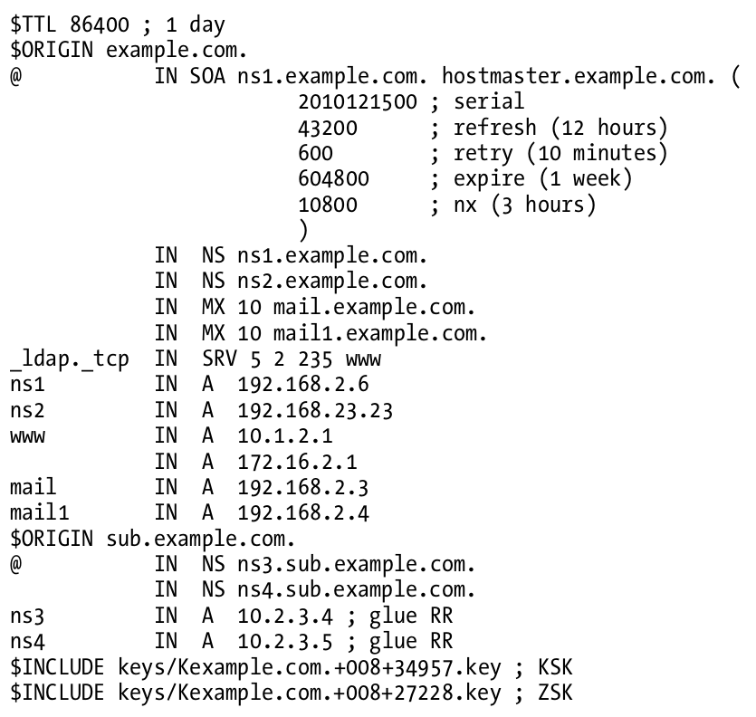
Security – Configuring DNSSEC (2)
Publishing DNS Keys (public keys) in a Zone

Slide 73
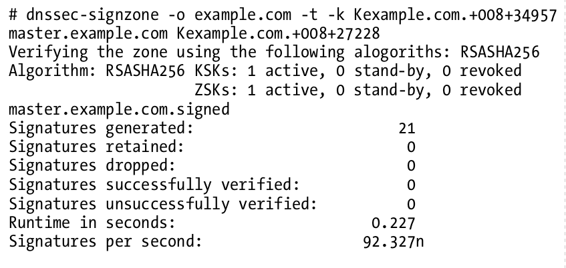
Security – Configuring DNSSEC (3)
Signing a Zone
When signing the zone with only ZSK, just omit the -k parameter

Slide 74
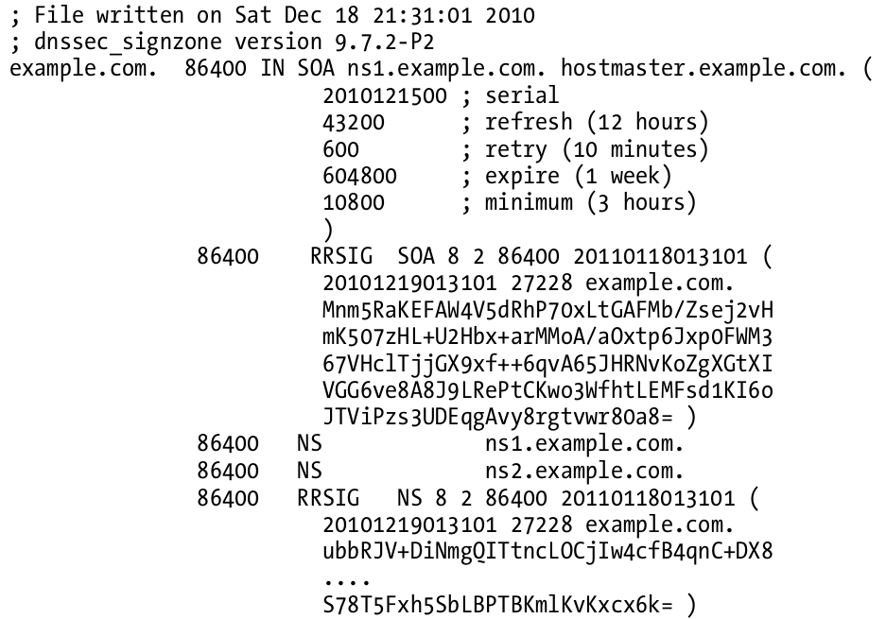
Security – Configuring DNSSEC (4)
Signing a Zone (Cont.)
example.com.signed

Slide 75
Security – Configuring DNSSEC (5)
Updating the Zone file
Edit the zone file
Load the new zone file
rndc reload
zone "example.com" {
type master;
file "example.com.signed”;
masters {ip_addr; ip_addr;};
allow-query {address_match_list};
allow-transfer { address_match_list};
allow-update {address_match_list};
};

Slide 76
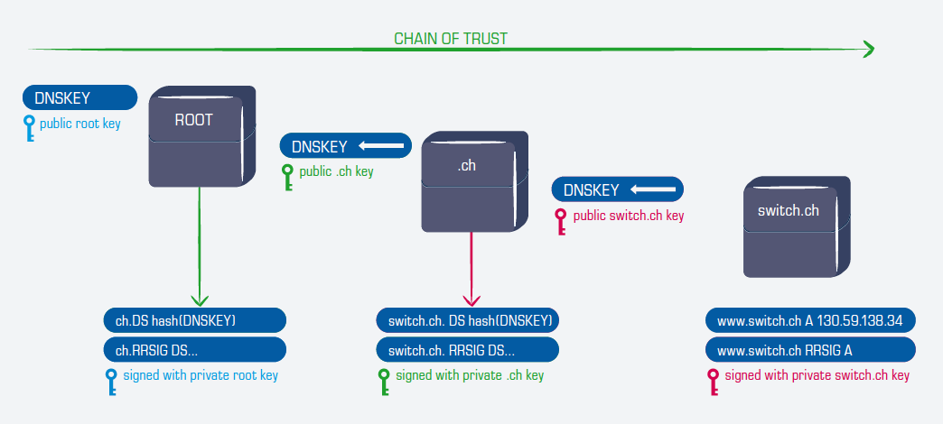
Security – Configuring DNSSEC (6)
Create Chain of Trust
Extract DNSKEY RR and use dnssec-dsfromkey
Add -g parameter when signing zone using dnssec-signzone
A file named ds-set.example.com was also created, which contains DS record
DS records have to be entered in your parent domain
$ dnssec-signzone -g …

Slide 77
Security –DNSSEC maintenance
Modify zone
nsupdate(1)
By hand
Freeze zone
rndc freeze
Edit zone file
Sign zone file
dnssec-signzone
Reload zone file
rndc reload
Unfreeze zone
rndc thaw

