Slide 1
E-Mail System
lctseng

Slide 2
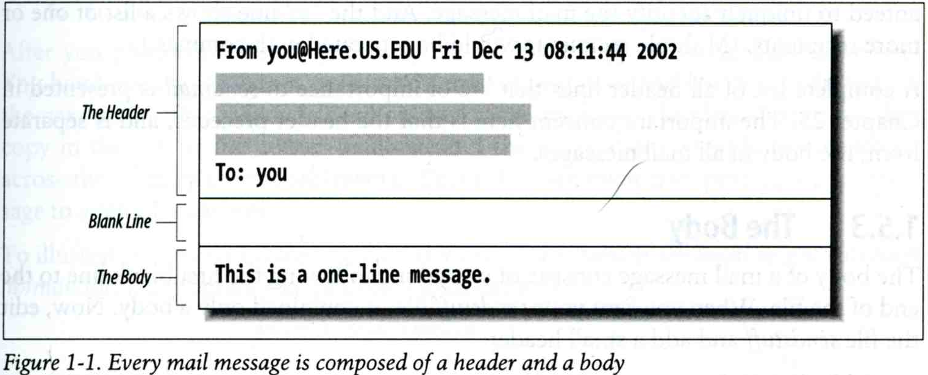
Components of an E-Mail (1)
You can really see …
Headers, which can be forged, altered, etc.
Body

Slide 3
Components of an E-Mail (2)
Three major components
The envelope
Invisible to users
Determine where the message should be delivered, or to whom it should be returned
The headers
Information about the messages, defined in RFC2822
Date, From, To, Content-Type, charset
Content-Length, MessageID, …
No checking consistent “To” in envelope and header
The message body
Plain text only
Various MIME contents (attachments)
7bit, quoted-printable, base64
8bit, binary

Slide 4
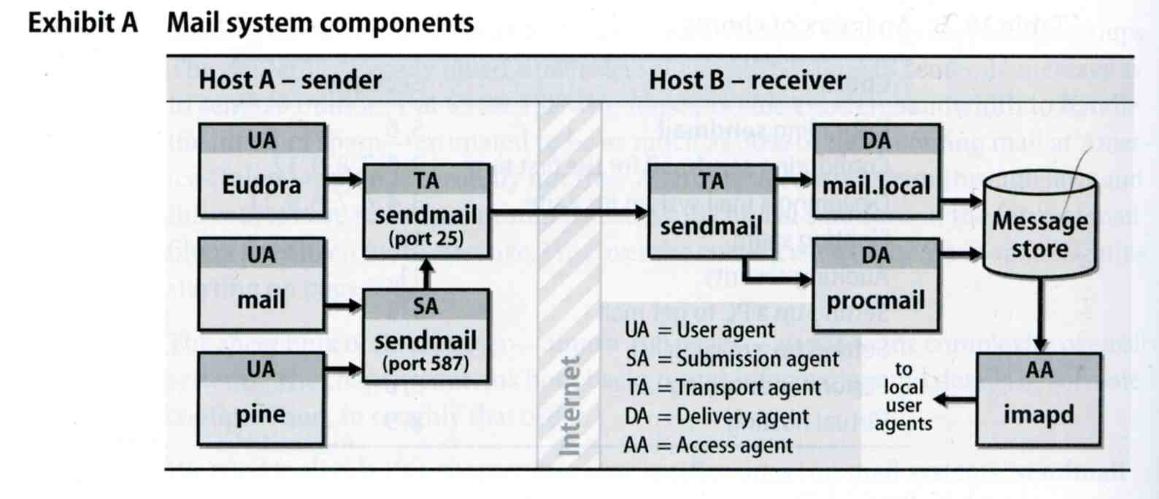
Mail System
Major components
Mail User Agent (MUA)
Help user read and compose mails
Submission Agent (SA)
Route mails to local MTA
Mail Transport Agent (MTA)
Route mails among machines
Delivery Agent (DA)
Place mails in users’ mail boxes
Access Agent (AA)
Connects the user agent to the mail box using POP3 or IMAP protocols

Slide 5
Mail System – The User Agent (1)
Help user read and compose mails
UA must know mail format
Originally: Text only
Now: MIME
※ MIME (Multipurpose Internet Mail Extensions)
Include several types of content that can be encoded in the mail
image, video, virus, …

Slide 6
Mail System – The User Agent (2)
Popular Mail User Agents
User Agent | System Config. | User Config. | MIME | POP | IMAP | SMTP
mail | mail.rc | .mailrc
mutt | /etc/muttrc | .muttrc
Netscape | - | -
Outlook Ep. | - | -
MS Outlook | - | -
Thunderbird | - | -
In Smartphones | - | -

Slide 7
Mail System – The Submission Agent
Route mails to local MTA
Typical works that a MTA must do:
Ensuring that all hostname are fully qualified
Modifying headers
MessageID
Date
DomainKeys/DKIM
Logging errors
…
RFC2476 introduces the idea of splitting MTA
Let SA to share the load

Slide 8
Mail System – The Transport Agent (1)
Route mails among machines
Accept mail from UA, examine the recipients’ addresses, and delivery the mail to the correct host
Protocols
SMTP (Simple Mail Transport Protocol)
RFC 821
ESMTP (Extended SMTP)
RFC 2821 → … → 5321 (2008)
Popular transport agents
sendmail http://www.sendmail.org/
Postfix http://www.postfix.org/
exim, qmail, …

Slide 9
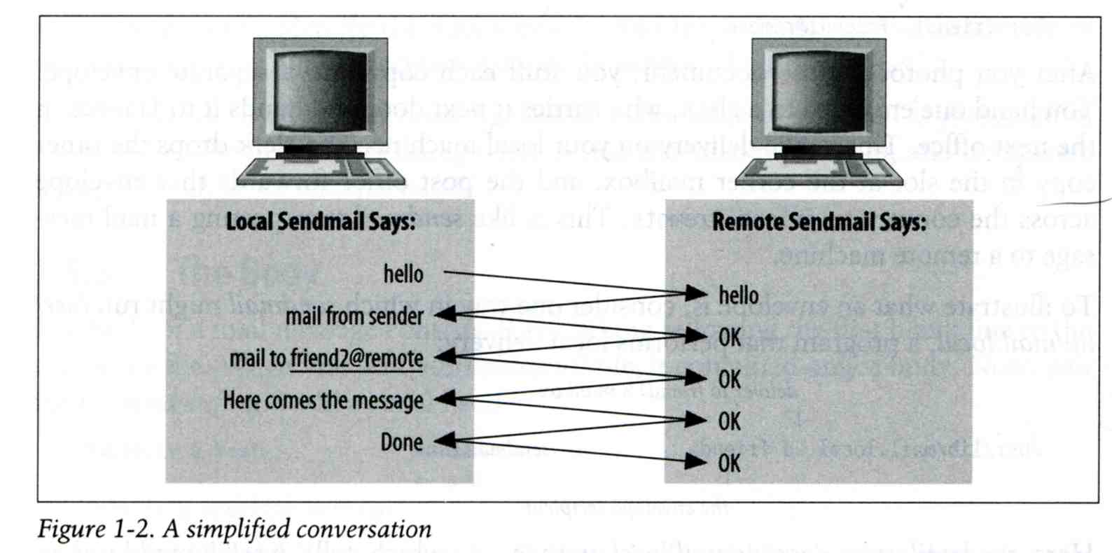
Mail System – The Transport Agent (2)
Conversation between MTAs
Threat of eavesdropping

Slide 10
Mail System – The Transport Agent (3)
Protocol: SMTP
$ telnet csmailgate 25
Trying 140.113.235.103...
Connected to csmailgate.
Escape character is '^]'.
220 csmailgate.cs.nctu.edu.tw ESMTP Postfix
ehlo bsd5.cs.nctu.edu.tw
250-csmailgate.cs.nctu.edu.tw
250-PIPELINING
250-SIZE 204800000
250-VRFY
250-ETRN
250-ENHANCEDSTATUSCODES
250-8BITMIME
250 DSN
mail from: <liuyh@cs.nctu.edu.tw>
250 2.1.0 Ok
rcpt to: <liuyh@cs.nctu.edu.tw>
250 2.1.5 Ok
data
354 End data with <CR><LF>.<CR><LF>
From: haha <devnull@cs.nctu.edu.tw>
To: admin@hinet.net
hehe... I spammed you!
.
250 2.0.0 Ok: queued as 81BD4FB4
quit
221 2.0.0 Bye
Connection closed by foreign host.
From: haha <devnull@cs.nctu.edu.tw>
To: admin@hinet.net
Message-Id: <20120501070002.81BD4FB4@csmailgate.cs.nctu.edu.tw>
Date: Tue, 1 May 2012 14:59:53 +0800 (CST)
hehe... I spammed you!

Slide 11
Mail System – The Delivery Agent
Place mails in users’ mailboxes
Accept mail from MTA and deliver the mail to the local recipients
Type of recipients
User
Program
procmail
bogofilter
procmail
Do something between mail coming in and stored in mail box
https://help.cs.nctu.edu.tw/help/index.php/設定_-_郵件過濾設定

Slide 12
Mail System – The Access Agent
Help user download mail from server
Protocols
IMAP (Internet Message Access Protocol)
POP3 (Post Office Protocol – Version 3)

Slide 13
Mail Addressing – Domain (1)
Two kinds of email addresses:
Route based address (obsolete)
Message will travel through several intermediate hosts to the destination
Format: host!path!user
Ex: castle!sun!sierra!hplabs!ucbvax!winsor
This mail is sent from “castle” host to the user “winsor” at “ucbvax” host
Location independent address
Simply identify the final destination
Format: user@host.domain
Ex: liuyh@nasa.cs.nctu.edu.tw

Slide 14
Mail Addressing – Domain (2)
Where to send the mail?
When you want to send a mail to liuyh@cs.nctu.edu.tw, the MTA will:
First, lookup up the mail exchanger of “cs.nctu.edu.tw”
If there is any servers, try until success from the higher preference one to the lower
If no MX records, mail it directly to the host (A record)
$ dig mx cs.nctu.edu.tw
;; ANSWER SECTION:
cs.nctu.edu.tw. 3600 IN MX 5 csmx2.cs.nctu.edu.tw.
cs.nctu.edu.tw. 3600 IN MX 10 csmx3.cs.nctu.edu.tw.
cs.nctu.edu.tw. 3600 IN MX 5 csmx1.cs.nctu.edu.tw.

Slide 15
Mail Addressing – Domain (3)
Why using “Mail eXchanger”?
We can centralize all the mail tasks to group of servers
Multiple mail exchangers make it more robust

Slide 16
Mail Addressing – Alias
Alias
Map a username to something else
Be careful of mail looping
Several mechanisms to define aliases:
Traditional method: in files
Traditional method with NIS
LDAP (Light-weight Directory Access Protocol)
When the mail server wants to resolve name
File-based method
look up files to resolve by itself
LDAP-based method
call LDAP server to resolve the name and return the results

Slide 17
Mail Alias – Traditional aliasing mechanism (1)
Aliases can be defined in three places
In MUA’s configuraiton file
Read by MUA and expand the alias before injecting the message into the mail system
In the system-wide /etc/mail/aliases file
Read by DA
The path to the system-wide alias file can be specified in mail server’s configuration file
In user’s forwarding file, ~/.forward
Read by DA after system-wide alias file
forward(5)

Slide 18
Mail Alias – Traditional aliasing mechanism (2)
The format of an entry in aliases file
Local-name: recipient1,recipient2,…
Ex:
admin: huanghs,chiahung,liuyh
liuyh: liuyh@cs.nctu.edu.tw
root: ta
Local-name: :include:filename
Ex:
ta: :include:/usr/local/mail/TA
Contents of TA
chiahung
huanghs
liuyh
changlp
cychao
wangth
pmli

Slide 19
Mail Alias – Traditional aliasing mechanism (3)
The format of an entry in aliases file
Local-name: absolute-path-file
Mails will be appended to this file
Ex:
complaints: /dev/null
troubles: trouble_admin,trouble_log
trouble_admin: :include:/usr/local/mail/troadm
trouble_log: /usr/local/mail/logs/troublemail
Local-name: "|program-path"
Route mail to stdin of program
Ex:
autoftp: “|/usr/local/bin/ftpserver”
nahw1: “|/home/nahw1/receive.pl”

Slide 20
Mail Alias – Traditional aliasing mechanism (4)
The hashed aliases DB
/etc/mail/aliases is the plaintext aliases information
/etc/mail/aliases.db is the hashed version for efficiency
Use “newaliases” command to rebuild the hashed version when you change the aliases file
The file read from “:include:” is outside the aliases file

Slide 21
Mail Alias – Traditional aliasing mechanism (5)
User maintainable forwarding file
In ~/.forward
Format: comma-separated
Ex:
liuyhh@gmail.com
\liuyh, liuyhh@gmail.com, liuyhh00@yahoo.com.tw
Must be owned by user and with permission of 600
The path to .forward file should be writable only to user

Slide 22
Mail Alias – Traditional aliasing mechanism (6)
Alias must
postmaster and MAILER-DAEMON
Mail system maintainer
bin, sys, daemon, nobody, …
System accounts (root)
root
forward root mail to the administrator
/root/.forward
aliases
MAILER-DAEMON: postmaster
postmaster: root
bin: root
bind: root
daemon: root
games: root
kmem: root
mailnull: postmaster
nobody: root
operator: root
…

Slide 23
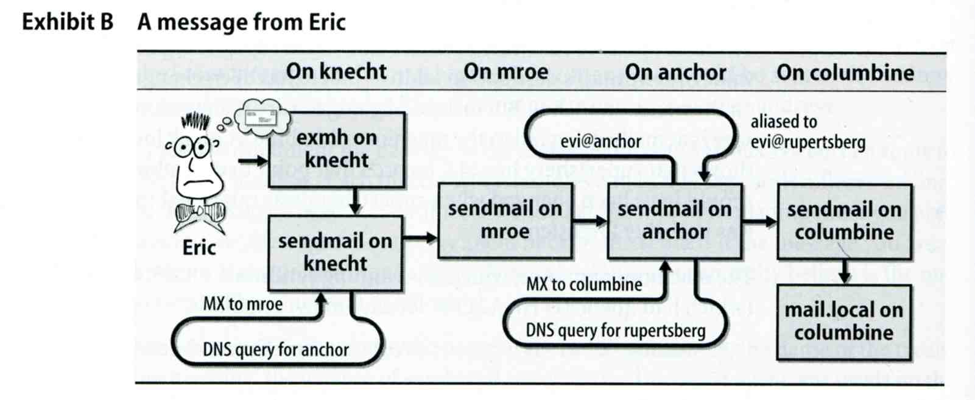
Mail Transport Example
User eric@knecht.sendmail.org sends a email to user evi@anchor.cs.colorado.edu
% dig mx anchor.cs.colorado.edu
mroe.cs.colorado.edu

Slide 24
Mail Headers (1)
Defined by RFC2822
Mail reader will hide some uninteresting header information
Date: Wed, 18 Apr 2007 14:05:04 +0800
From: 大小姐 <lkkg-girl@mail.richhome.net>
Subject: 笑狗好可怕
To: Yung-Hsiang Liu <liuyh@nabsd.cs.nctu.edu.tw>
User-Agent: Mutt/1.5.15 (2007-04-06)
你趕快把牠趕跑好不好？

Slide 25
Mail Headers (2)
From chwong@chbsd.cs.nctu.edu.tw Wed Apr 18 14:07:21 2007
Return-Path: <chwong@chbsd.cs.nctu.edu.tw>
X-Original-To: liuyh@nasa.cs.nctu.edu.tw
Delivered-To: liuyh@nasa.cs.nctu.edu.tw
Received: from chbsd.cs.nctu.edu.tw (chbsd.csie.nctu.edu.tw [140.113.17.212])
by nasa.cs.nctu.edu.tw (Postfix) with ESMTP id 22EC73B4D51
for <chwong@nabsd.cs.nctu.edu.tw>; Wed, 18 Apr 2007 14:07:21 +0800 (CST)
Received: from chbsd.cs.nctu.edu.tw (localhost [127.0.0.1])
by chbsd.cs.nctu.edu.tw (8.13.8/8.13.8) with ESMTP id l3I654P3060925
for <chwong@nabsd.cs.nctu.edu.tw>; Wed, 18 Apr 2007 14:05:04 +0800 (CST)
(envelope-from chwong@chbsd.cs.nctu.edu.tw)
Received: (from chwong@localhost)
by chbsd.cs.nctu.edu.tw (8.13.8/8.13.8/Submit) id l3I654AY060924
for chwong@nabsd.cs.nctu.edu.tw; Wed, 18 Apr 2007 14:05:04 +0800 (CST)
(envelope-from chwong)
Date: Wed, 18 Apr 2007 14:05:04 +0800
From: =?utf-8?B?5aSn5bCP5aeQ?= <lkkg-girl@mail.richhome.net>
To: Yung-Hsiang Liu <liuyh@nasa.cs.nctu.edu.tw>
Subject: =?utf-8?B?56yR54uX5aW95Y+v5oCV?=
Message-ID: <20070418060503.GA60903@chbsd.csie.nctu.edu.tw>
MIME-Version: 1.0
Content-Type: text/plain; charset=utf-8
Content-Disposition: inline
Content-Transfer-Encoding: 8bit
User-Agent: Mutt/1.5.15 (2007-04-06)
Status: RO
Content-Length: 23
Lines: 1
你趕快把牠趕跑好不好？

Slide 26
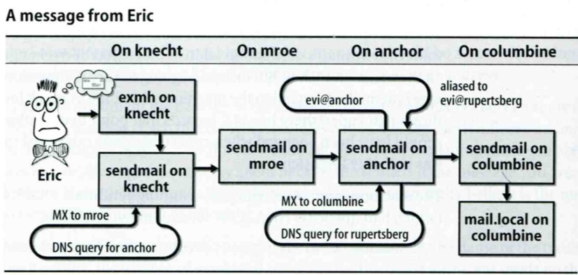
Mail Headers (3)
Headers in the example
From eric@knecht.sendmail.org
Added by mail.local when the mail is put in user’s mailbox
Used to separate message boundary
Return-Path: eric@knecht.sendmail.org
The envelope “mail from”
Used to send the error message to this address
May be different to the “From” address
Delivered-To: evi@rupertsberg
Final envelope “rcpt to”
Received: from knecht.sendmail.org (localhost [127.0.0.1]) by knecht.sendmail.org (8.9.3/8.9.2) with ESMTP id GAA18984; Fri 1 Oct 1999 06:04:02 -800 (PST)
Every machine that is ever processed this mail will add a “Received” record in top of headers
Sending machine、Receiving machine、Mail server software in receiving machine Unique queue identifier of mail server in receiving machine、Date and time

Slide 27
Mail Headers (4)
Received: from anchor.cs.Colorado.EDU (root@anchor.cs.colorado.edu [128.138.242.1]) by columbine.cs.colorado.edu (8.9.3/8.9.2) with ESMTP id HAA21741 for <evi@rupertsberg.cs.colorado.edu>; Fri, 1 Oct 1999 07:04:25 -0700 (MST)
Received: from more.cs.colorado.edu (more.cs.colorado.edu [128.138.243.1]) by anchor.cs.colorado.edu (8.9.3/8.9.2) with ESMTP id HAA26176 for <evi@anchor.cs.colorado.edu>; Fri, 1 Oct 1999 07:04:24 -0700 (MST)
Received: from knecht.sendmail.org (knecht.sendmail.org [209.31.233.160]) by more.cs.colorado.edu (8.9.3/8.9.2) with ESMTP id HAA09899 fro <evi@anchor.cs.colorado.edu>; Fri, 1 Oct 1999 07:04:23 -700 (MST)
Received: from knecht.sendmail.org (localhost [127.0.0.1]) by knecht.sendmail.org (8.9.3/8.9.2) with ESMTP id GAA18984; Fri 1 Oct 1999 06:04:02 -800 (PST)

Slide 28
Mail Headers (5)
Message-Id: <199910011404.GAA18984@knecht.sendmail.org)
Add by sender’s MTA
X-Mailer: exmh version 2.0.2 2/24/98
MUA
Non-standard header information
To: Evi Nemeth <evi@anchor.cs.colorado.edu>
Subject: Re: hi
Date: Fri, 1 Oct 1999 06:04:02 -800

Slide 29
Mail Storage
The place on the local machine where email is stored
Usually the directory: /var/mail or /var/spool/mail
Users’ mails are stored in files named with each user’s login name
Eg. /var/mail/liuyh
Permission “775” and root:mail as the owner and group owner
drwxrwxr-x 2 root mail 512 Dec 16 15:51 mail/
Using database
When the organization is large or for ISP with millions of customers
Easy to search, categorize

Slide 30
Mail System Architecture
Simplest architecture
Only one machine
Has MTA to let you send and receive mail
Provides storage for mailboxes
Provides IMAP or POP3 to let you download mail from PC
Components in a mail system architecture
Mail servers for incoming and/or outgoing mails
Storage for mailboxes
IMAP or POP3 to integrate PC and remote clients
The issue of file locking

Slide 31
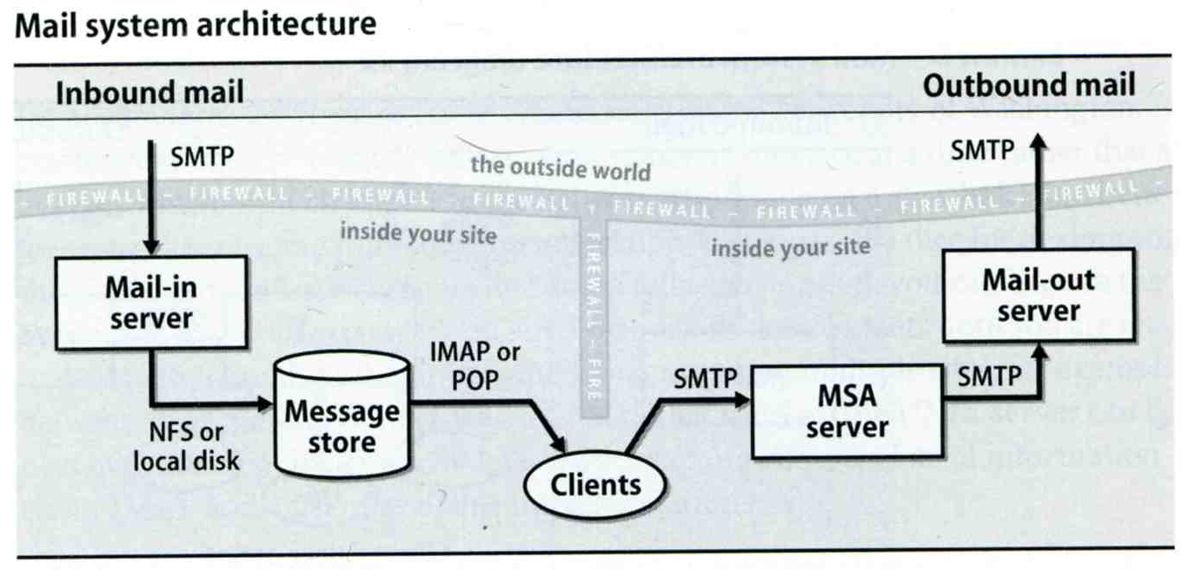
Mail System Architecture – Scalable architecture for medium sites
Centralize
At least one machine for incoming message and
Mail home can be the same host or another one
At least one machine for outgoing message
Each host run MSA and forward mail to the same mail-out server or send the mail directly

Slide 32
To, Cc, and Bcc
You should always make sure you e-mail the right people
The To field is for people that the message directly affects, and that you require action from.
The Cc (or carbon copy) field is for people you want to know about the message, but are not directly involved.
The Bcc field (Blind Carbon Copy) is used when you want other people to receive the message, but you don't want the other recipients to know they got it.
There are “To” and “Cc,” but not “Bcc” in the email headers.
Why “No checking consistent “To” in envelope and header”

Slide 33
vacation(1)
E-mail auto-responder
returns a message, ~/.vacation.msg by default
~/.vacation.db
default database file for db(3)
~/.vacation.{dir,pag}
default database file for dbm(3)
~/.vacation.msg
default message to send
Use with forward(5)
\liuyh, |/usr/bin/vacation
33

