Slide 1
SNMP
Simple Network Management Protocol
wangth

Slide 2
Network Management
The network management is to
Monitor the network
Ensure the operations over the network are functional
Assure the network works efficiently
An ounce of prevention is worth a pound of cure
Something wrong
Service down, fix the problem, resume the service
Nothing wrong
Service is somewhat abnormal, try to fix it online
Requirements
FCAPS

Slide 3
Requirements of Network Management
Fault Management
Detect, isolate, reconfigurate and repair the abnormal network environment
Problem tracking and control
Configuration Management
Gather configuration information of network components
Accounting Management
Track the use of network resources by end-user to provide
Impropriate usage tracing, charging, statistics
Performance Management
Capacity utilization, throughput, response time, bottleneck
Collect information and assess current situation
Security Management
Information protection and access control

Slide 4
In that time
Network environment is simple
ICMP is the only way to do network investigation
ping, traceroute, ….
As Internet goes popular, three approaches are proposed:
HEMS: High-level Entity Management System
Considered to be the first network management tools
SGMP and SNMP
SNMP was an enhanced version of the Simple Gateway Management Protocol
For TCP/IP-based network management standards
Supposed to be short-term solution
CMIP over TCP/IP (CMOT)
Common Management Information Protocol
For ISO-based network management standards
Supposed to be long-term solution

Slide 5
Introduction
SNMP – Simple Network Management Protocol
A set of standards for network management
Protocol
Database structure specification
Data objects
A set of standardized tools that
Control costs of network management
Across various product types
End system, bridges, routers, telecommunications, …
Two roles
Network management station: SNMP collector, manager
SNMP agent

Slide 6
History
In 1989
SNMP was adopted as TCP/IP-based Internet standards
In 1991
RMON – Remote network MONitoring
Supplement to SNMP to include management of LAN and WAN packet flow
In 1995
SNMPv2 (2c)
Functional enhancements to SNMP
SNMP on OSI-based networks
RMON2
Network layer and application layer
In 1998
SNMPv3
Precise definition, but the content is the same as SNMPv2
Security capability for SNMP

Slide 7
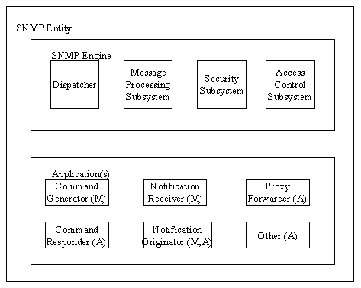
The roles in SNMPv3
Notes:
http://www.tml.tkk.fi/Opinnot/Tik-110.551/1999/papers/12ManagementOfIPngCore/ipcore.html

Slide 8
Network Management System (1)
A collection of tools for
Network monitoring
Network control
These tools must be integrated
Single operator interface with powerful but user-friendly
Support of managed equipment

Slide 9
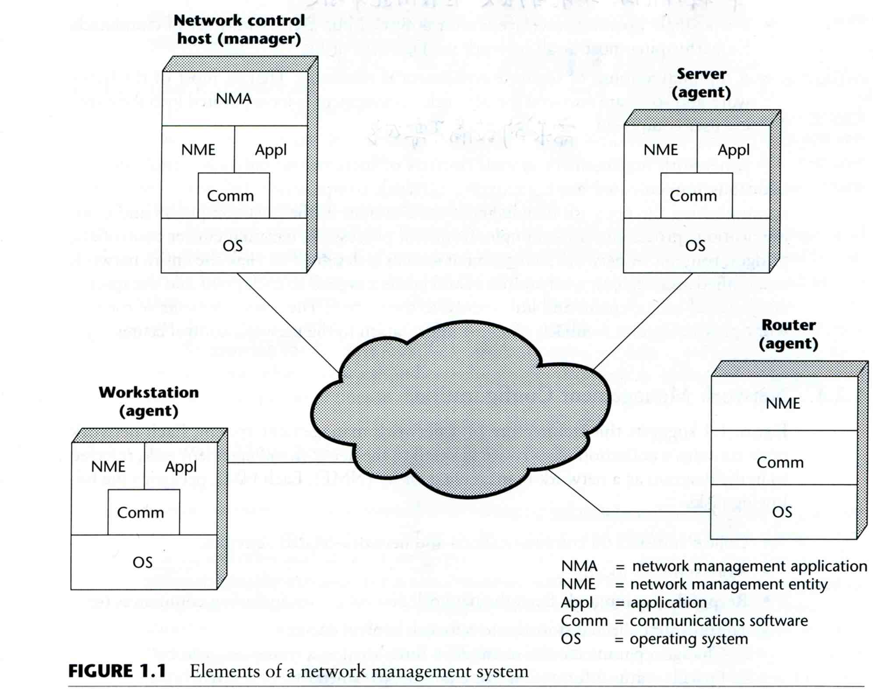
Network Management System (2)
Architecture of NMS
NMA
Operator interface
NME
Collect statistics
Response to NMA
Alert NMA when environment changing

Slide 10
SNMP Concepts

Slide 11
SNMP Architecture (1)
4 key elements
Management Station
Serve as the interface between manager and devices
Management applications
User-friendly interface
Translate manager’s requirements into actual monitoring or control operations
Database extracted from MIBs of all managed device
Management Agent
Respond to request from management station
Change settings in MIB of managed device
Asynchronously report abnormal event (Trap)
Management Information Base (MIB)
Each resource is represented as an object and MIB is a collection of objects
Network Management Protocol
get, setnext, set, getresponse, trap, ...

Slide 12
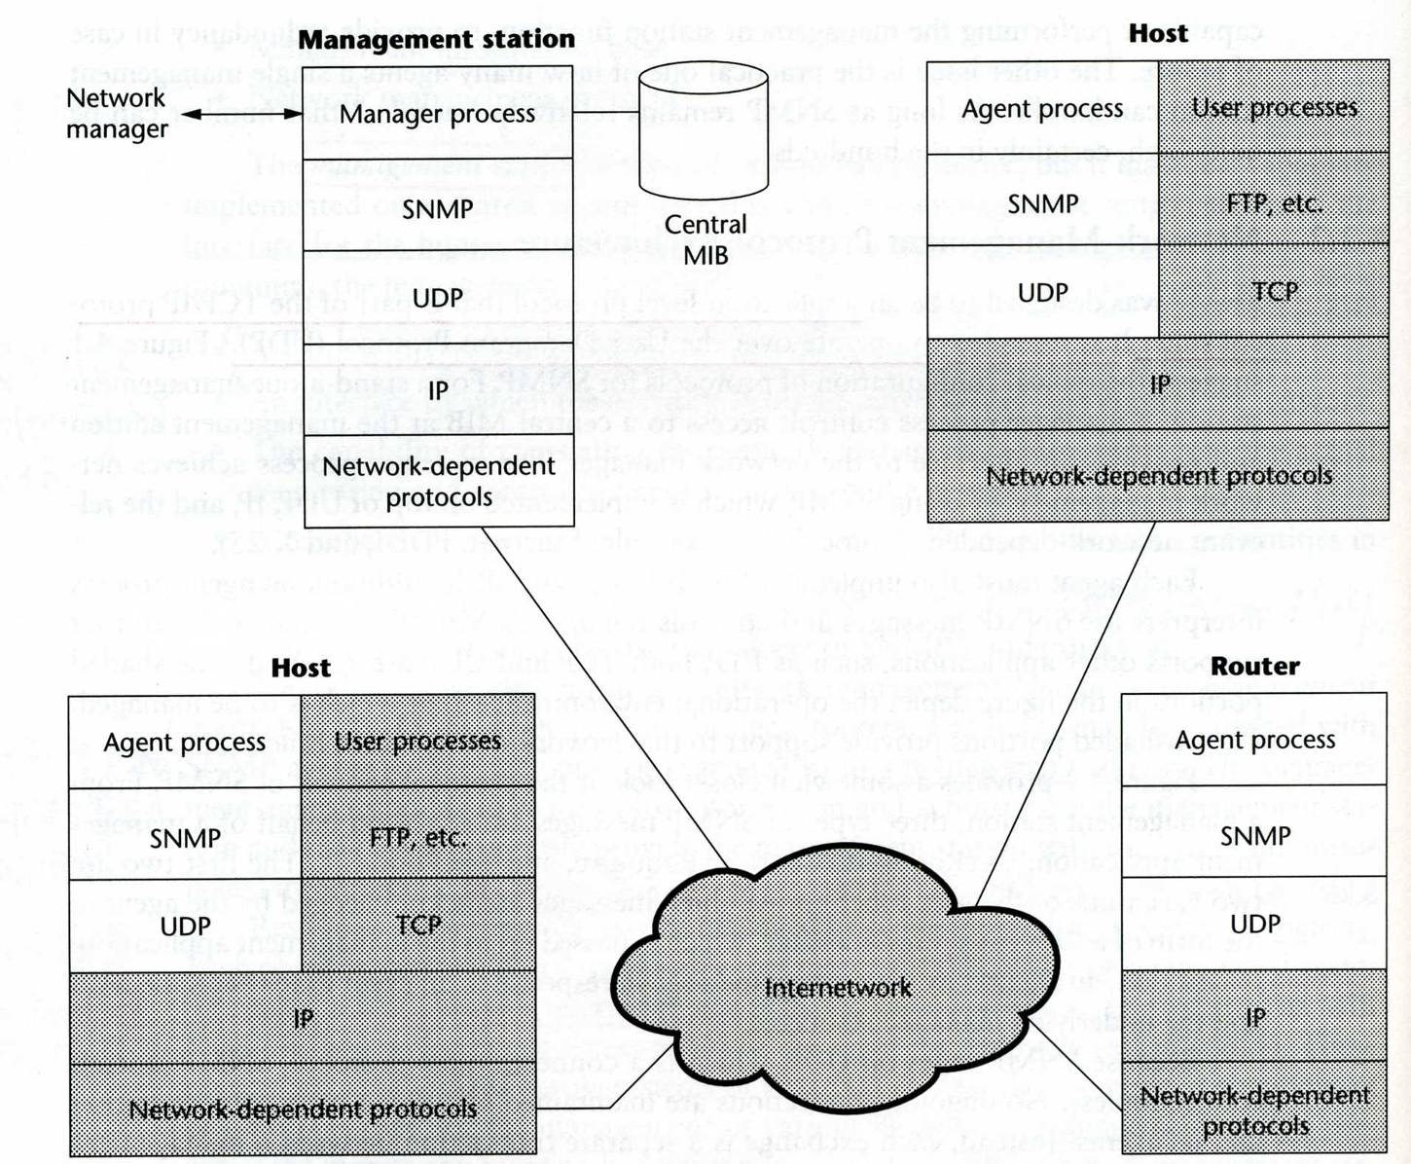
SNMP Architecture (2)
SNMP
UDP
Port 161(snmp)
Port 162(snmp-trap)

Slide 13
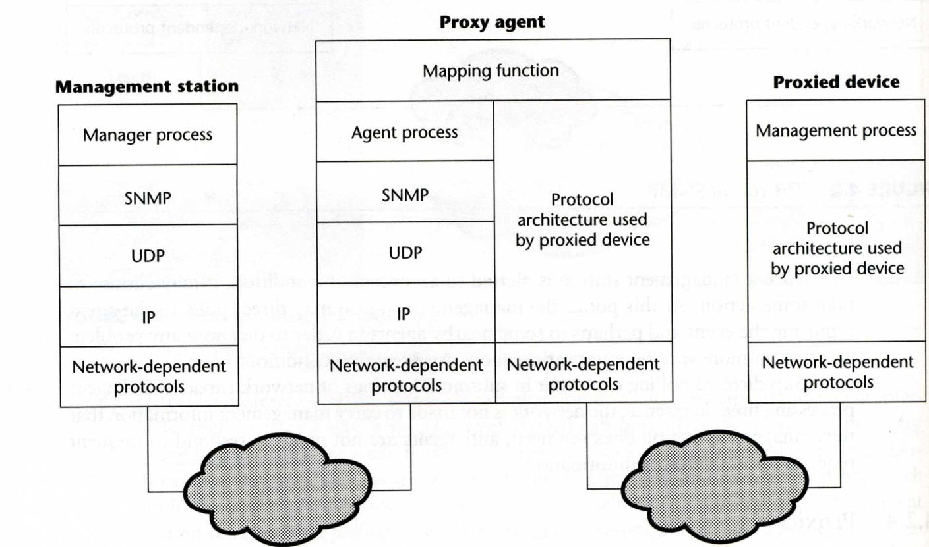
SNMP Architecture (3)
SNMP proxy
Devices that do not support UDP/IP
e.g., Bridge, Modem
Devices that do not want to add burden of SNMP agent
e.g., PC, programmable controller

Slide 14
SNMP Management Information
Management Information Base (MIB)
Collection of objects
Each object represents certain resource of managed device
Interoperability of MIB
Object that represents a particular resource should be the same cross various system
What objects
(MIB-I) and MIB-II
Common representation format
SMI (Structure of Management Information)

Slide 15
SNMP Management Information – SMI (1)
SMI
Structure of Management Information
Identify the data type that can be used in MIB
How resources are represented and named, including
MIB structure
Syntax and value of each object
Encoding of object value

Slide 16
SNMP Management Information – SMI (2)
MIB structure
Rooted tree
The leaves are the actual managed objects
Each object has an identifier (OBJECT IDENTIFIER)
Number with dot as delimiter
The internet node
iso(1) -> org(3) -> dod(6) -> internet(1)
object identifier of internet node: 1.3.6.1
Under internet node
directory(1) :OSI X.500 directory
mgmt(2): used for objects defined in IAB (Internet Activities Board)
experimental(3): used for internet experiments
private(4): unilaterally usage

Slide 17
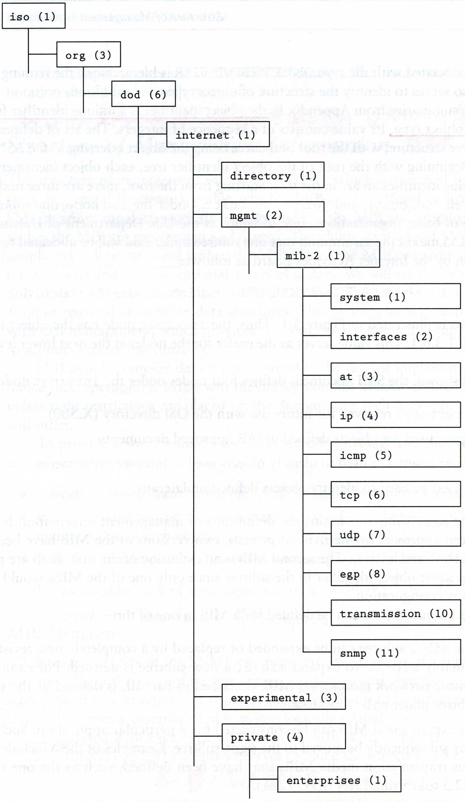
SNMP Management Information – SMI (3)
MIB Tree
Define additional objects
Under mib-2
1.3.6.1.2.1
Under experimental
1.3.6.1.3
Under enterprises
1.3.6.1.4.1

Slide 18
SNMP Management Information – Object Syntax (1)
Definition of object
Data type
Application-independent type (UNIVERSAL type)
Integer, Octet String, Object Identifier, Null, Sequence, Sequence Of
Application-wide types (RFC 1155)
NetworkAddress → Not used
IpAddress
Counter (0 ~ 2³² -1), increasing only, wrap to 0
Gauge (0 ~ 2³² -1)
TimeTicks
Opaque (encoded as OCTET STRING for transmission)
Value ranges
Relationship with other objects in MIB

Slide 19
SNMP Management Information – Object Syntax (2)
ASN.1
Abstract Syntax Notation One
A formal language developed by CCITT and ISO
In SNMP, we use macro to define other types used to define managed objects
Macro definition (template)
Macro instance (particular type)
Macro instance value

Slide 20
SNMP Management Information – Object Syntax (3)
Example: /usr/share/snmp/mibs/BEGEMOT-HOSTRES-MIB.txt
-- Additional stuff for the HOST-RESOURCES MIB.
BEGEMOT-HOSTRES-MIB DEFINITIONS ::= BEGIN
IMPORTS
MODULE-IDENTITY, OBJECT-TYPE, TimeTicks
FROM SNMPv2-SMI
begemot
FROM BEGEMOT-MIB;
begemotHostres MODULE-IDENTITY
….
::= { begemot 202 }
begemotHostresObjects OBJECT IDENTIFIER ::= { begemotHostres 1 }
begemotHrStorageUpdate OBJECT-TYPE
SYNTAX TimeTicks
MAX-ACCESS read-write
STATUS current
DESCRIPTION
"The maximum number of ticks the storage table is cached."
::= { begemotHostresObjects 1 }

Slide 21
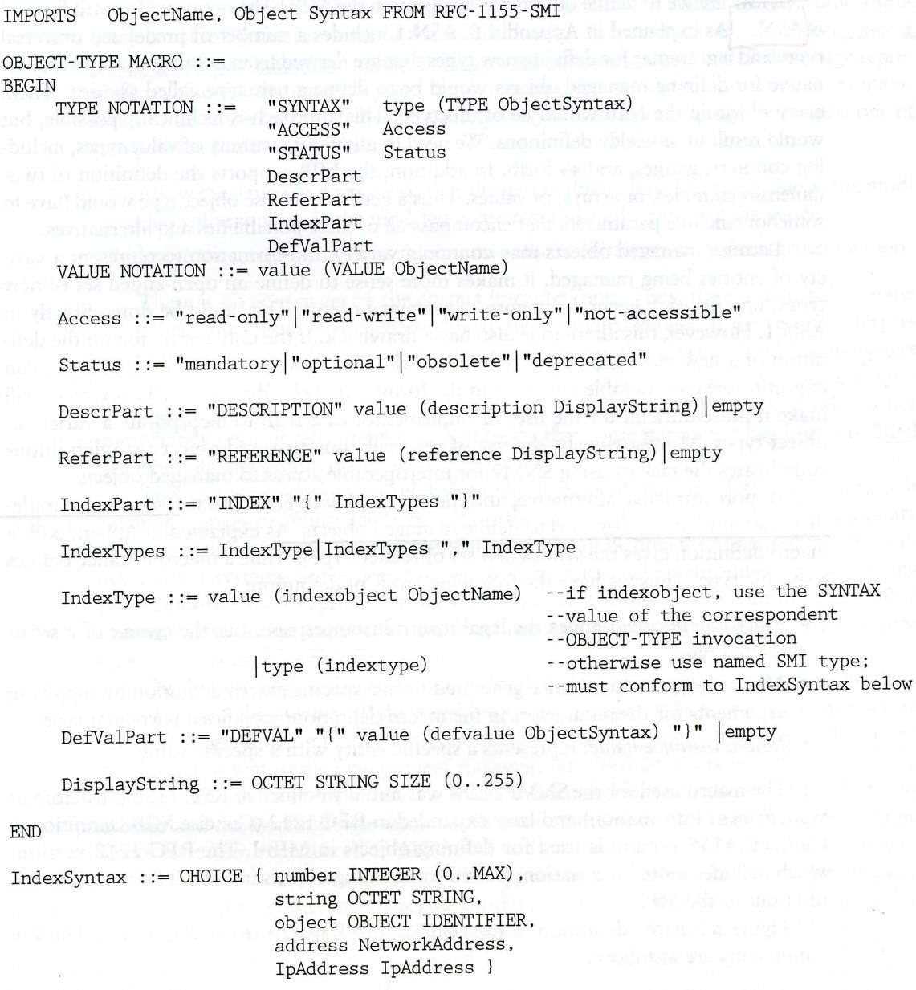
SNMP Management Information – Object Syntax (4)
OBJECT-Type macro

Slide 22
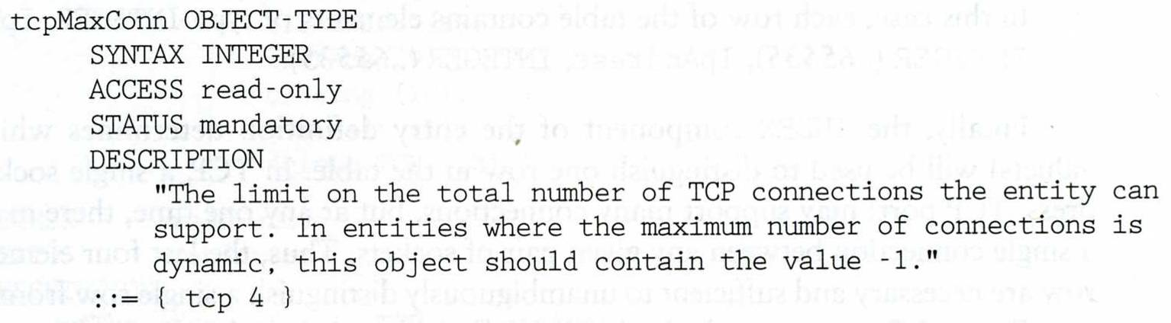
SNMP Management Information – Object Syntax (5)
Example of object definition
iso.org.dod.internet.mgmt.mib-2.tcp.tcpMaxConn
1.3.6.1.2.1.6.4

Slide 23
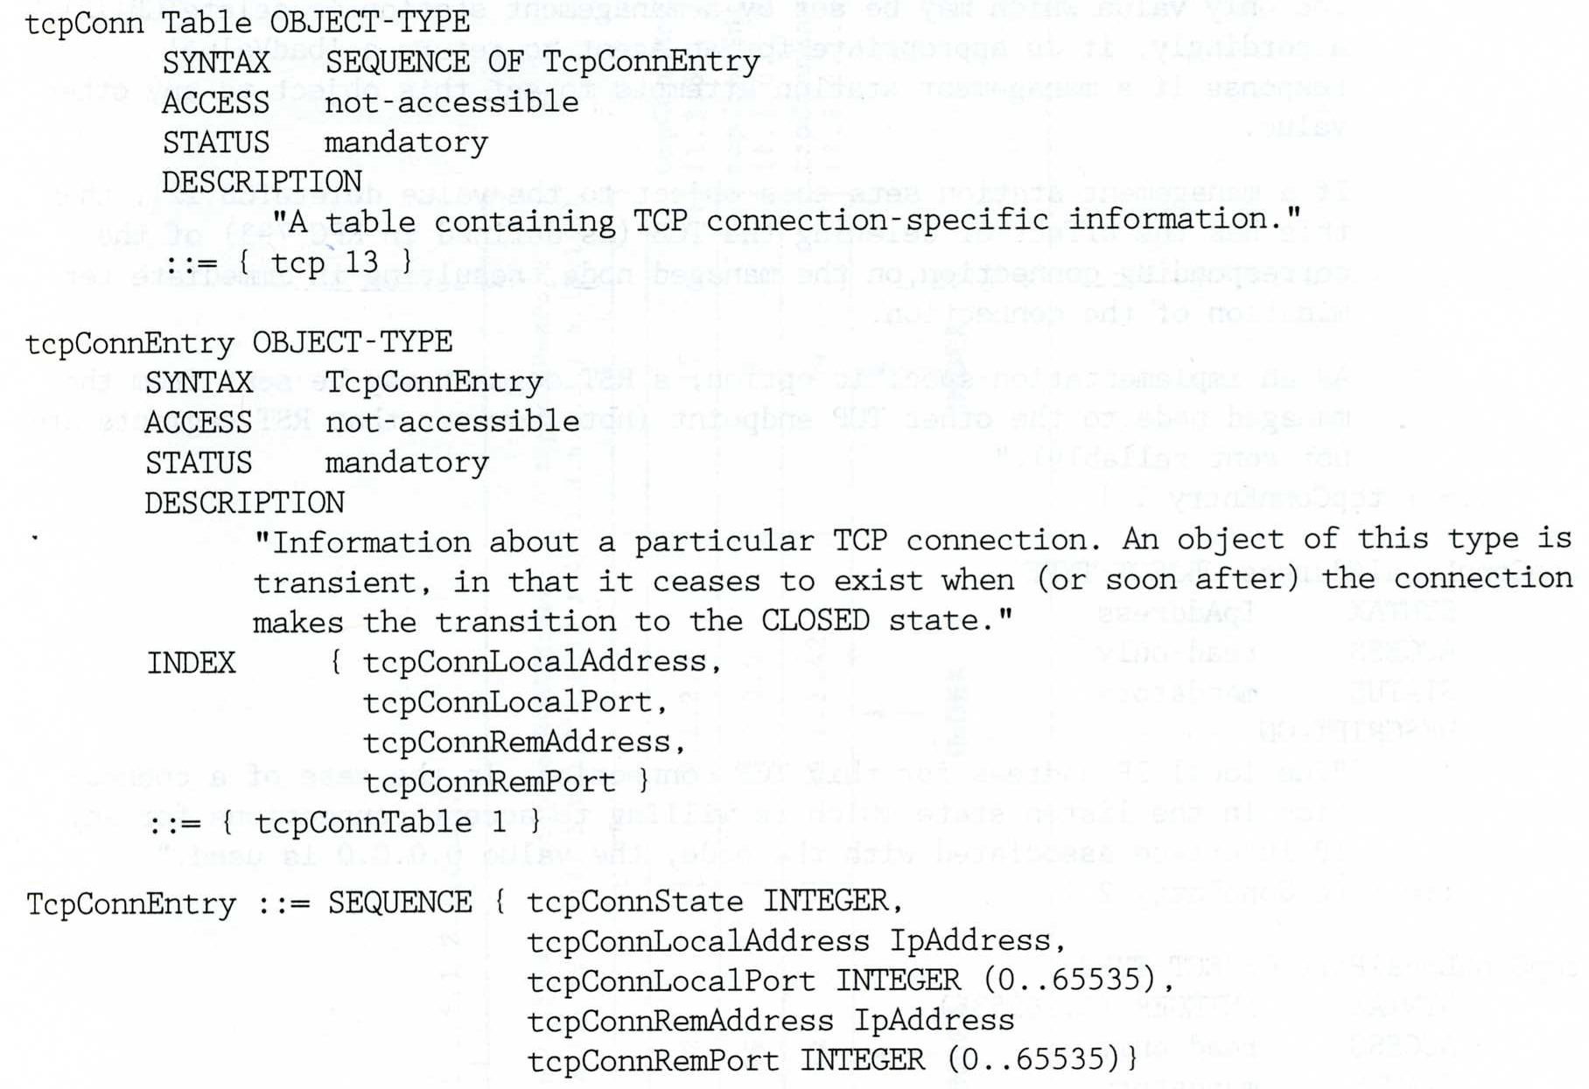
SNMP Management Information – Object Syntax (6)
2-D table
Two-dimensional array with scalar-valued entries
Ex: tcpConnTable (RFC1213)

Slide 24
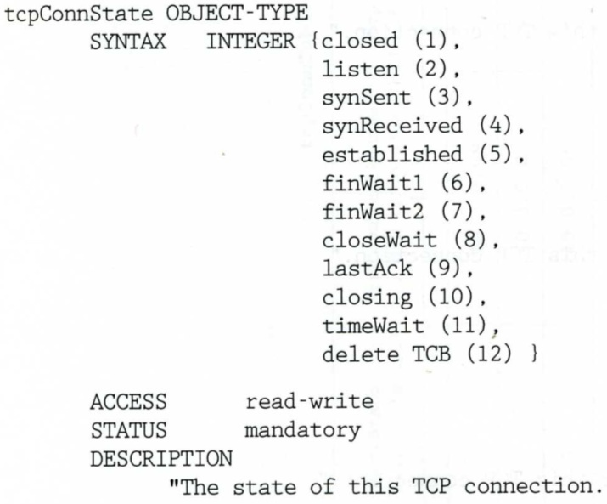
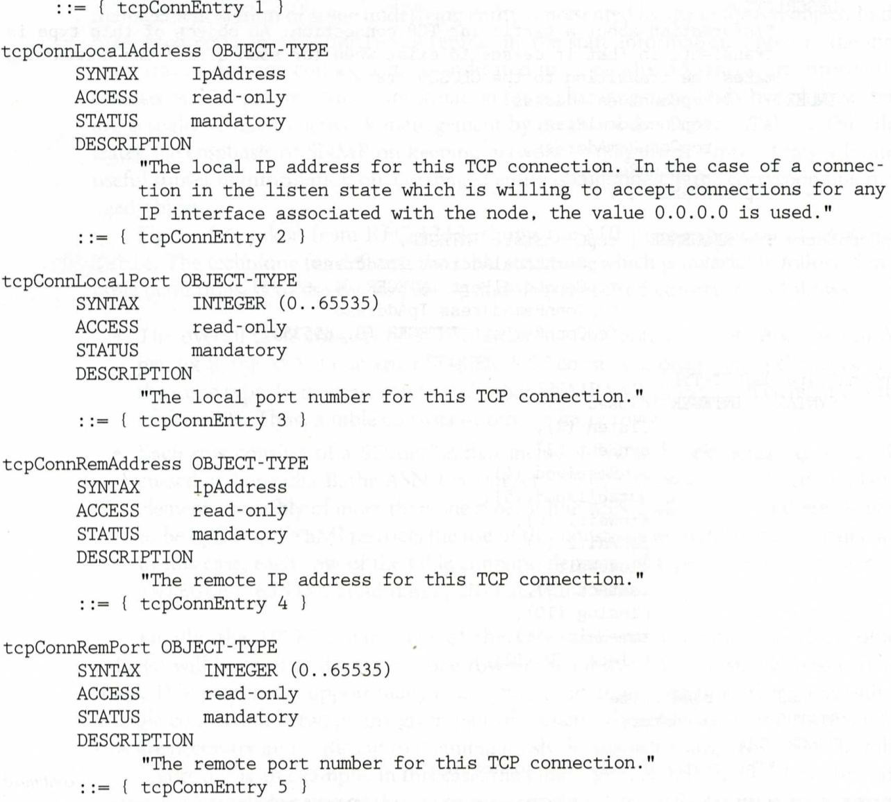
SNMP Management Information – Object Syntax (7)

Slide 25
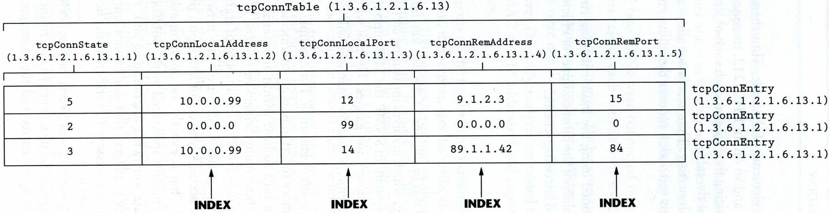
SNMP Management Information – Object Syntax (8)
iso (1) -> org (3) -> dod (6) -> internet (1) -> mgmt (2)
mib-2 (1) -> tcp (6) -> tcpConnTable(13)

Slide 26
Standard MIBs

Slide 27
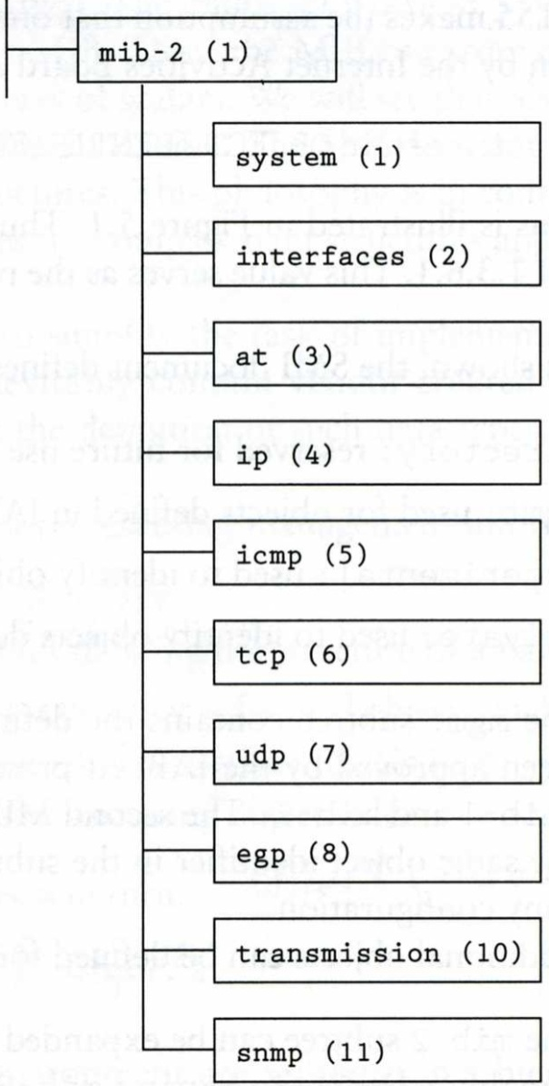
MIB-II (1)
RFC1213
MIB-I (RFC 1156)
MIB-II is a superset of MIB-I with some additional objects and groups

Slide 28
MIB-II (2)
First layer under mib-2
1.3.6.1.2.1 (iso.org.dod.internet.mgmt.mib-2)
system
Overall information about the system
interfaces
Information about each interface
at
Address translation (obsolete)
ip, icmp, tcp, udp, egp
transmission
Transmission schemes and access protocol at each system interface
snmp

Slide 29
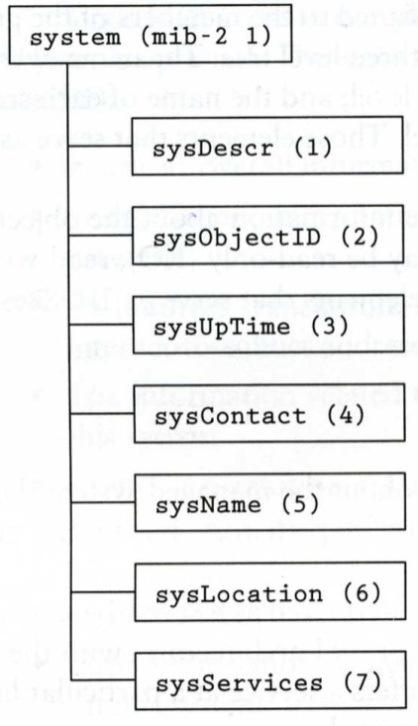
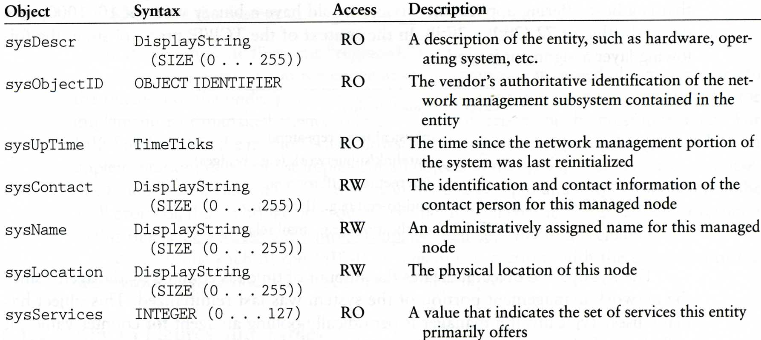
MIB-II system group
sysServices
1 physical (ex: repeater)
2 datalink/subnetwork (ex: bridge)
3 internet (ex: router)
4 end-to-end (ex: IP hosts)
7 applications (ex: mail relays)

Slide 30
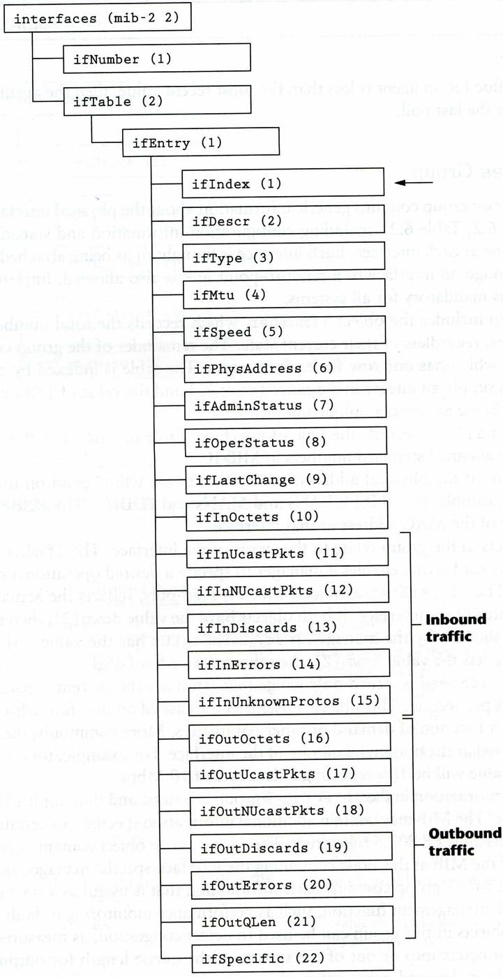
MIB-II interface group (1)

Slide 31
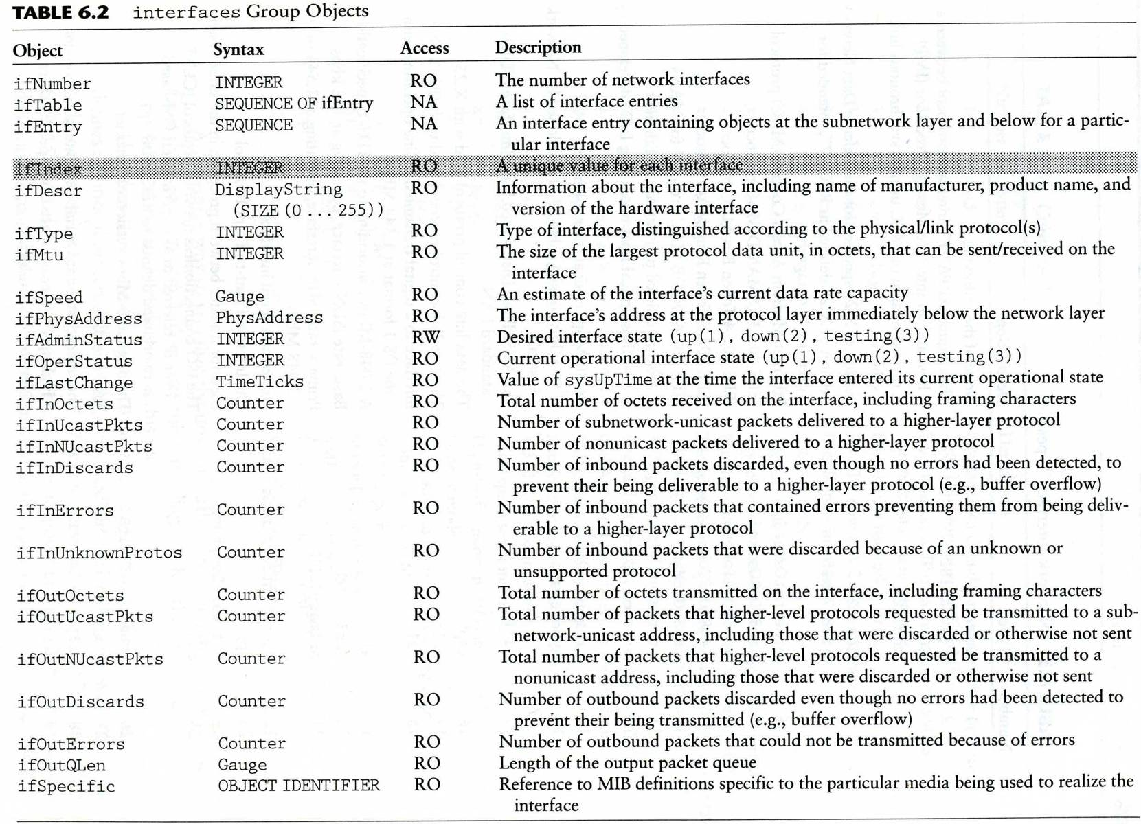
MIB-II interface group (2)

Slide 32
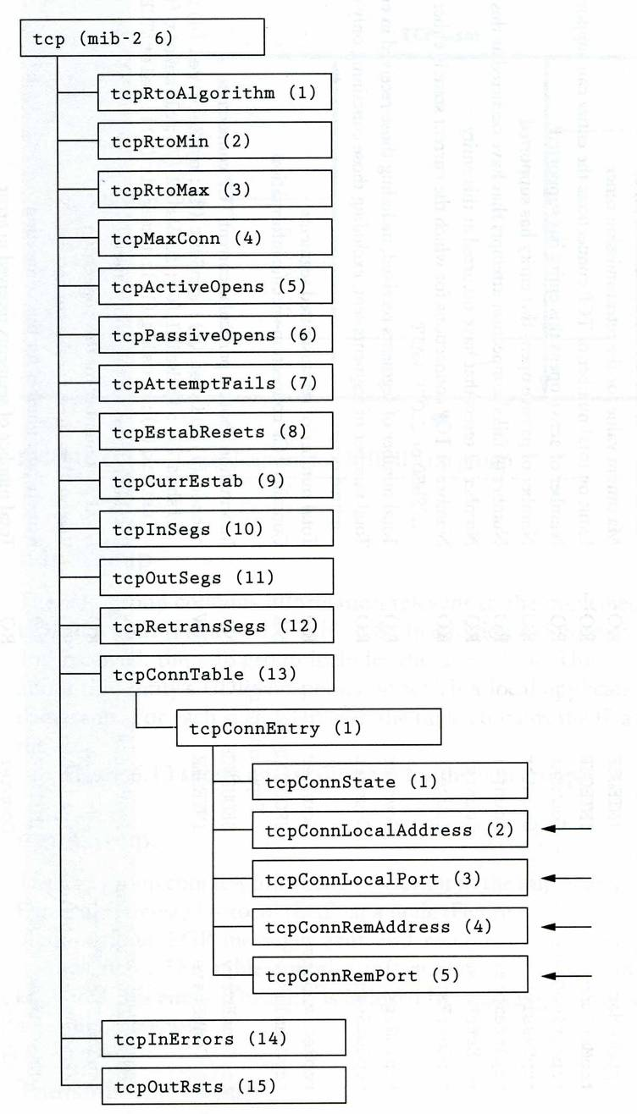
MIB-II tcp group

Slide 33
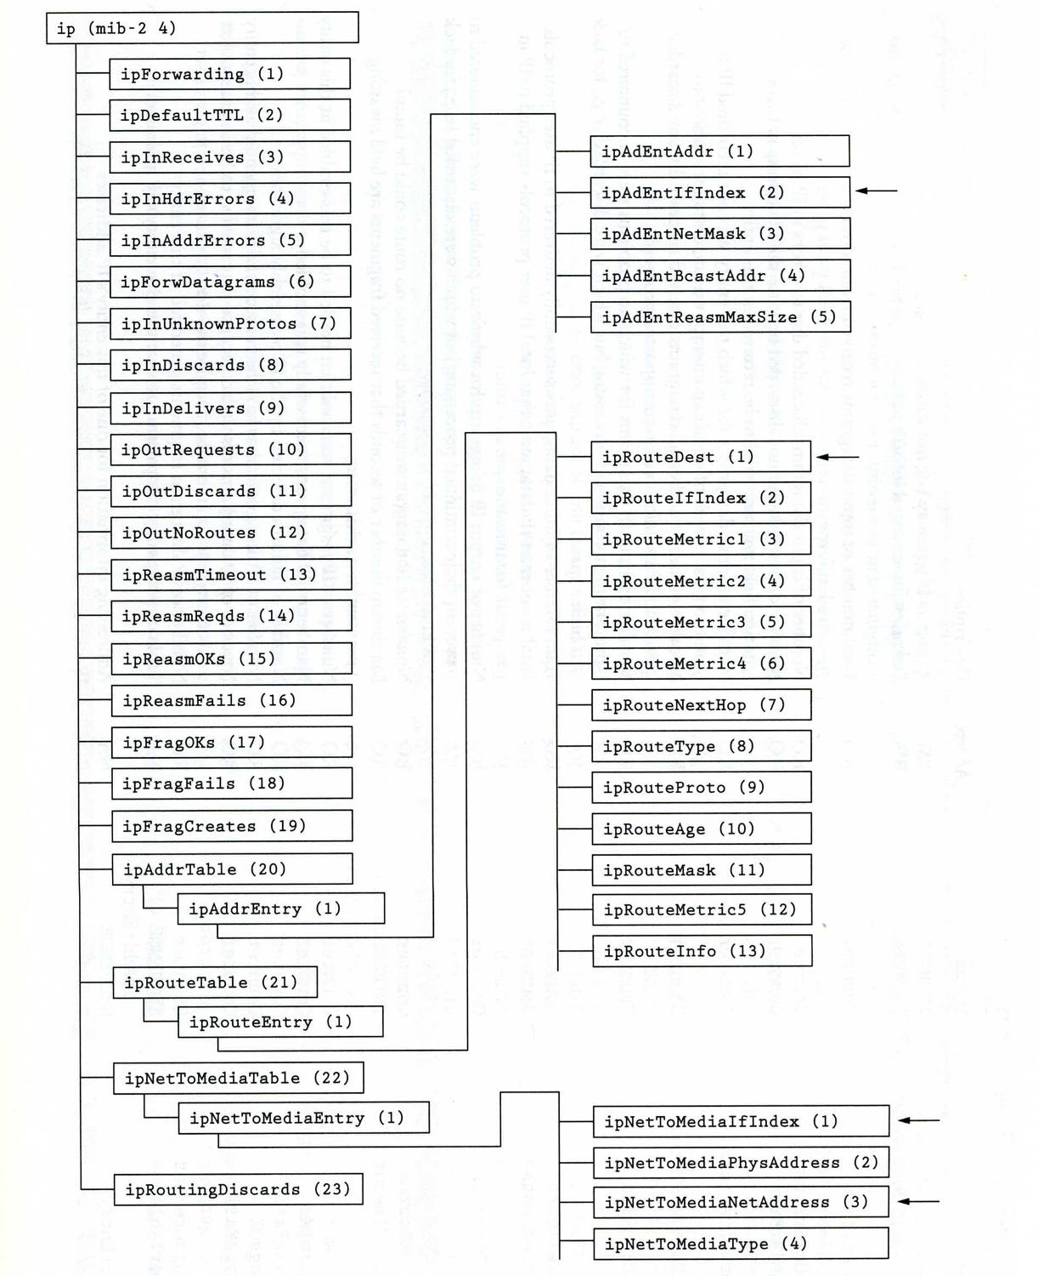
MIB-II ip group

Slide 34
Host Resources MIB
RFC2790
host OBJECT IDENTIFIER ::= { mib-2 25 }
hrSystem OBJECT IDENTIFIER ::= { host 1 }
hrStorage OBJECT IDENTIFIER ::= { host 2 }
hrDevice OBJECT IDENTIFIER ::= { host 3 }
hrSWRun OBJECT IDENTIFIER ::= { host 4 }
hrSWRunPerf OBJECT IDENTIFIER ::= { host 5 }
hrSWInstalled OBJECT IDENTIFIER ::= { host 6 }
hrMIBAdminInfo OBJECT IDENTIFIER ::= { host 7 }

Slide 35
SNMP Protocol

Slide 36
SNMP Protocol
Supported operations
get, getnext, set, getresponse, trap, …
Simplicity vs. limitations
Not possible to change the structure of MIB by adding or deleting object instances
Access is provided only to leaf objects

Slide 37
SNMP Protocol – security concern
In management environment
The management station and managed agent
One-to-many relationship
One station may manage all or a subset of target
The managed agent and management station
One-to-many relationship
Each managed agent controls its local MIB and must be able to control the use of that MIB
Three aspects
Authentication service
Access policy
Proxy service

Slide 38
SNMP Protocol – communities (1)
An SNMP community
A relationship between an SNMP agent and a set of SNMP managers that defines
Authentication, access control and proxy
The managed system establishes one community for each combination of authentication, access control and proxy
Each community has a unique “community name”
Management station use certain community name in all get and set operations

Slide 39
SNMP Protocol – communities (2)
Authentication
The community name (password)
Access policy
Community profile
SNMP MIB view
A subset of MIB objects
SNMP access mode
read-only, read-write, write-only, non-accessible

Slide 40
SNMP Protocol – Where is the security
SNMPv3
User-based Security Model (USM)
Message Authentication
HMAC
MD5, SHA-1
Authentication passphrase, secret key
Encryption
CBC-DES
View-based Access Control Model (VACM)
Context table
Security to group table
Access table
View tree family table

Slide 41
BSNMP
mini SNMP daemon

Slide 42
BSNMP (1)
A portable SNMP framework consisting of a daemon (bsnmpd), modules and tools
Enable bsnmpd
/etc/rc.conf
Configure bsnmpd
/etc/snmpd.config
Start bsnmpd
/etc/rc.d/bsnmpd start
Firewall allows
snmpd: udp 161
snmptrapd: udp 162
bsnmpd_enable="YES"
location := "Room 200"
contact := "sysmeister@example.com"
system := 1 # FreeBSD
traphost := localhost
trapport := 162
# Change this!
read := "public“
# Host resources module
# This requires the mibII module.
#
#begemotSnmpdModulePath."hostres" = "/usr/lib/snmp_hostres.so"

Slide 43
BSNMP (2)
bsnmp-ucd
bsnmpd module that implements parts of UCD-SNMP-MIB
The counters will be available under the following MIB: .1.3.6.1.4.1.2021 (UCD-SNMP-MIB::ucdavis)
Install bsnmp-ucd
net-mgmt/bsnmp-ucd
Configure bsnmpd
/etc/snmpd.config
Restart bsnmpd
Other bsnmp modules
bsnmp-jails
bsnmpd module to measure statistics about jails
bsnmp-regex
bsnmpd module allowing creation of counters from log files
begemotSnmpdModulePath."ucd" = "/usr/local/lib/snmp_ucd.so"

Slide 44
Net-SNMP
previously known as "ucd-snmp"

Slide 45
Net-SNMP (1)
Install net-snmp
net-mgmt/net-snmp
# make [OPTIONS] install clean
Firewall allows
snmpd: udp 161
snmptrapd: udp 162
DEFAULT_SNMP_VERSION="3" Default version of SNMP to use.
NET_SNMP_SYS_CONTACT="nobody@nowhere.invalid"
Default system contact.
NET_SNMP_SYS_LOCATION="somewhere"
Default system location.
NET_SNMP_LOGFILE="/var/log/snmpd.log"
Default log file location for snmpd.
NET_SNMP_PERSISTENTDIR="/var/net-snmp"
Default directory for persistent data storage.

Slide 46
Net-SNMP (2)
After installing…
/usr/local/share/snmp/snmpd.conf.example
If you want to auto-start snmpd and snmptrapd:, add the following to
/etc/rc.conf:
snmpd_enable="YES"
snmpd_flags="-a"
snmpd_conffile="/usr/local/share/snmp/snmpd.conf /etc/snmpd.conf"
snmptrapd_enable="YES"
snmptrapd_flags="-a -p /var/run/snmptrapd.pid"
# Full access from the local host
# rocommunity public localhost
# Default access to basic system info
rocommunity public default -V systemonly

Slide 47
Net-SNMP (3)
Use snmpconf command to generate the configuration files
snmpconf -g basic_setup
snmpconf
System Information Setup
Location, contact, service
Access Control Setup
SNMPv3 or SNMPv1 access community
Trap Destination
Where to send the trap
Monitor Various Aspects of the Running Host
Process, disk space, load, file
Extending the Agent
Let snmp agent to return information that yourself define
Agent Operating Mode
User/group, IP port,…

Slide 48
Net-SNMP (4)
To get various value
man snmpget, snmpgetnext, snmptable
% snmpget -c public -v 1 nasa system.sysContact.0
% snmpgetnext -c public –v 1 nasa system.sysContact.0
% snmptable -c public -v 1 nasa mib-2.tcp.tcpConnTable
% snmpwalk -c public -v 1 nasa system
% snmpwalk -c public -v 1 nasa iso.org.dod.internet.private.enterprises

Slide 49
Appendix
Cacti

Slide 50
Cacti(1)
About
Cacti is a complete network graphing solution designed to harness the power of RRDTool's data storage and graphing functionality.
Cacti provides a fast poller, advanced graph templating, multiple data acquisition methods, and user management features out of the box.
All of this is wrapped in an intuitive, easy to use interface that makes sense for LAN-sized installations up to complex networks with hundreds of devices.
Install cacti
/usr/ports/net/cacti

Slide 51
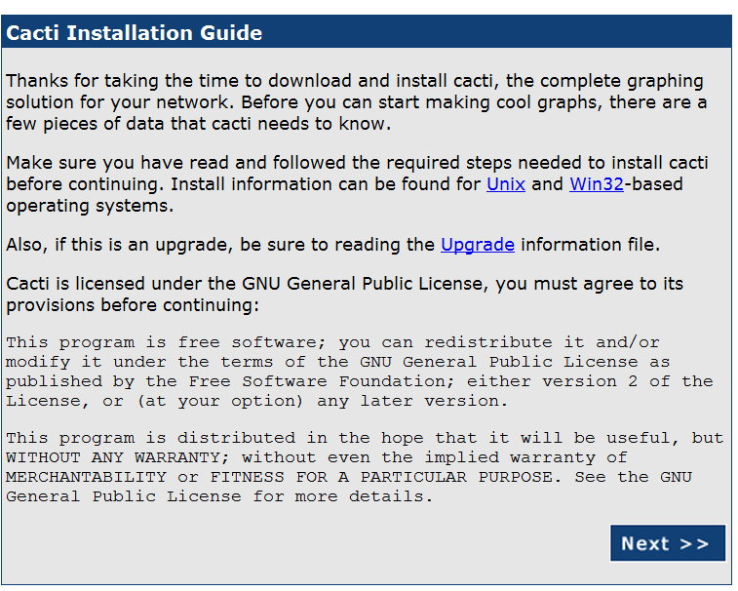
Cacti(2)

Slide 52
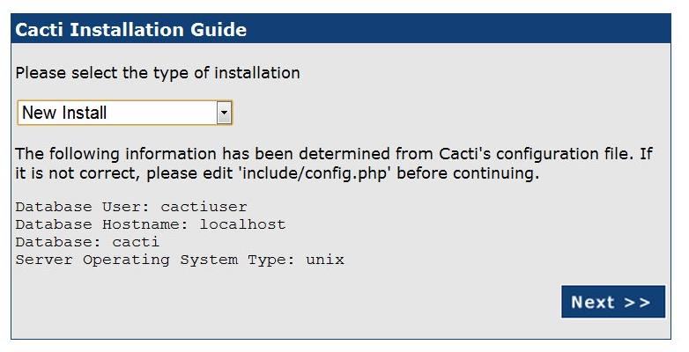
Cacti(3)

Slide 53
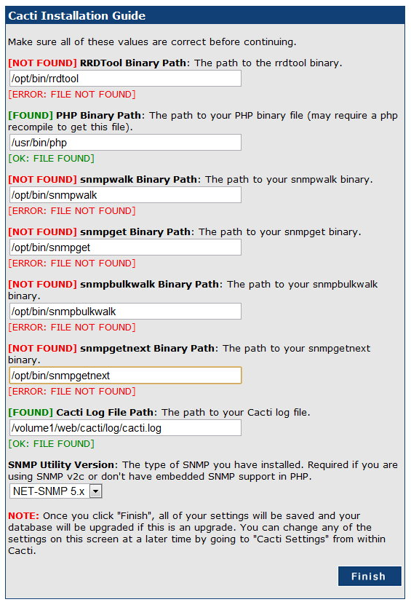
Cacti(4)

Slide 54
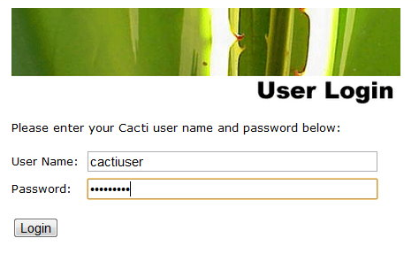
Cacti(5)
Default account/pwd
admin/admin

Slide 55

Cacti(6)

Slide 56
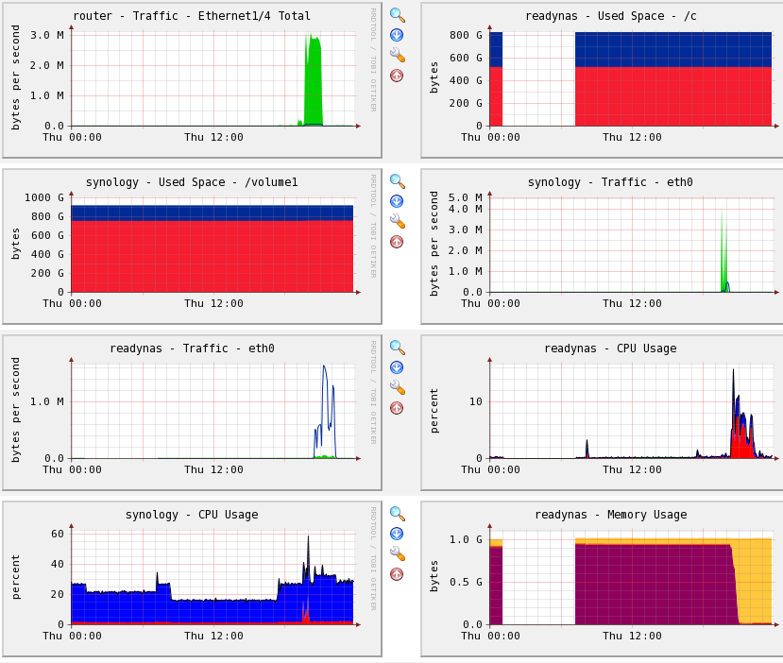
Cacti(7)

