Slide 1
Configuration Management
wangth

Slide 2
Automate, automate, automate
Automated setup of new machines
Not just OS installation, also includes all the additional software and local configuration necessary
Systematic patching and updating of existing machines
Deploy updates to all affected machines
A monitoring system
You need some kind of monitoring system that raises an alarm as soon as problems are evident
A communication system
Keep in touch with the needs of your users
A request-tracking system is a necessity
A central location where users can find system status and contact information is also helpful

Slide 3
Infrastructure as Code (IaC) (1)
A process of managing and provisioning IT infrastructure through machine-readable definition files
The definition files are usually stored on a version control system, it can use either scripts or declarative definitions
Three measurable categories for the value of IaC
Cost (Reduction)
Speed (Faster execution)
Risk (Remove errors and security violations)

Slide 4
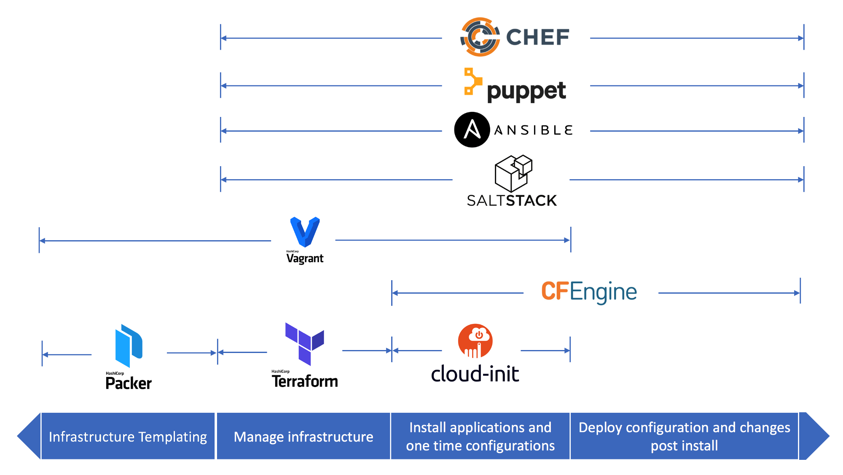
Infrastructure as Code (IaC) (2)
The spectrum of leading IaC tools available today
When to use which Infrastructure-as-code tool
https://medium.com/cloudnativeinfra/when-to-use-which-infrastructure-as-code-tool-665af289fbde

Slide 5
Push Model vs. Pull Model
What Is Chef? – A Tool Used For Configuration Management
https://www.edureka.co/blog/what-is-chef

Slide 6
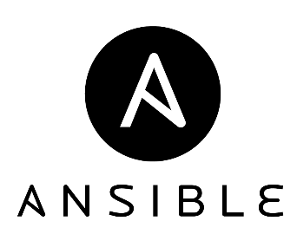
Ansible – Introduction (1)
An software provisioning, configuration management, and application deployment tool
Manages machines in an agentless manner
Cross platform
FreeBSD, Linux, macOS, Solaris, Windows
Use ‘push’ model by default
Pull mode is provided for when you would rather have nodes check in every N minutes on a particular schedule
ansible-pull
Pulls playbooks from a VCS repo and executes them for the local host

Slide 7
Ansible – Introduction (2)
Playbook
Ordered lists of tasks, saved so you can run those tasks in that order repeatedly
Task
The units of action in Ansible
Module
The units of code Ansible executes
Ansible Galaxy
A repository for Ansible Roles that are available to drop directly into your Playbooks
User Guide — Ansible Documentation
https://docs.ansible.com/ansible/latest/user_guide
Notes:
“If Ansible modules are the tools in your workshop, playbooks are your instruction manuals, and your inventory of hosts are your raw material.”

Slide 8
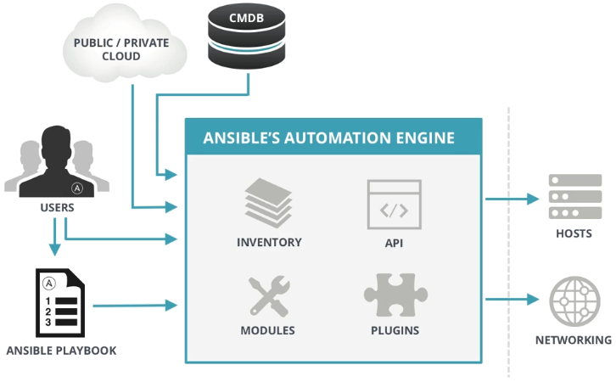
Ansible – Architecture
Control node
Any machine with Ansible installed
Managed nodes
The network devices (and/or servers) you manage with Ansible
Inventory
A list of managed nodes (hostfile)
What is Ansible? | Ansible Quick Start Video
https://www.ansible.com/resources/videos/quick-start-video

Slide 9

Chef – Introduction
A configuration management tool written in Ruby and Erlang
Cross platform agents
FreeBSD, Linux, macOS, Windows, AIX, Solaris
Use ‘pull’ model
Cookbook
Provide structure to your recipes and, in general, helps you stay organized
Recipe
A file that groups related resources, such as everything needed to configure a web server, database server, or a load balancer

Slide 10
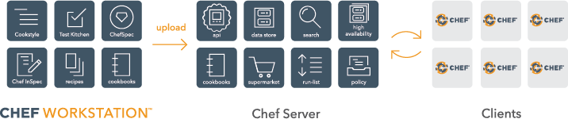
Chef – Architecture
Chef Workstation
Allows you to author cookbooks and administer your infrastructure
Command line tools for interacting with Chef Infra
knife: interacts with the Chef Infra Server, e.g., upload your cookbooks
chef: interacts with your local chef code repository (chef-repo)
Chef Infra Server
Chef Infra Client
An Overview of Chef Infra
https://docs.chef.io/chef_overview

Slide 11


Puppet – Introduction (1)
A configuration management system written in C++, Clojure and Ruby
Master-agent architecture
Cross platform agents
FreeBSD, Linux, macOS, Windows
Use ‘pull’ model
Master
Agent

Slide 12
Puppet – Introduction (2)
Manifest
Describe how your network and operating system resources should be configured
Catalog
Compiled version of the manifest
Module
Manage a specific task in your infrastructure, such as installing and configuring a piece of software
Serve as the basic building blocks of Puppet and are reusable and shareable
Puppet Forge
A catalogue of modules created by Puppet

Slide 13
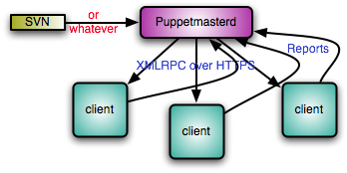
Puppet – Architecture
Master (Server)
Write and keep the manifests
Passively wait for connection from agents
Agent (Client)
Fetch manifests from master (periodically or manually)
Compare and execute manifests if needed
Report status to master
Cited from Puppet official site

Slide 14

SaltStack – Introduction
A configuration management system, capable of maintaining remote nodes in defined states
Server-agent communication model
Cross platform agents
FreeBSD, Linux, macOS, Windows
Use ‘pull’ model
State module
Formula
Package Manager
Repo System

Slide 15
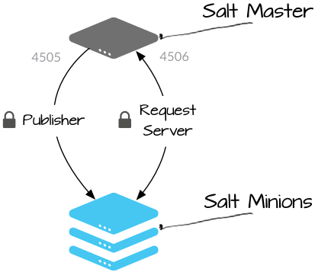
SaltStack – Architecture
Salt Master (Server)
Responsible for sending commands to minions, and then aggregating and displaying the results of those commands
A single Salt master can manage thousands of systems
Salt Minion (Agent)
Understanding SaltStack GET STARTED TUTORIAL
https://docs.saltstack.com/en/getstarted/system/communication.html

Slide 16
Comparison of CM Tools
 | Ansible | Chef | Puppet | SaltStack
Method | Push, Pull | Pull | Pull, Push | Pull, Push
 | Agentless | Agent | Agent Agentless (Bolt) | Agent Agentless (Salt SSH)
Configuration Language | YAML Python | Ruby DSL | Puppet DSL | YAML Python
Implementation Language | Python | Ruby Erlang | Ruby C++ Clojure | Python
Company | Red Hat | Chef | Puppet | SaltStack
DSL: Domain Specific Language

Slide 17
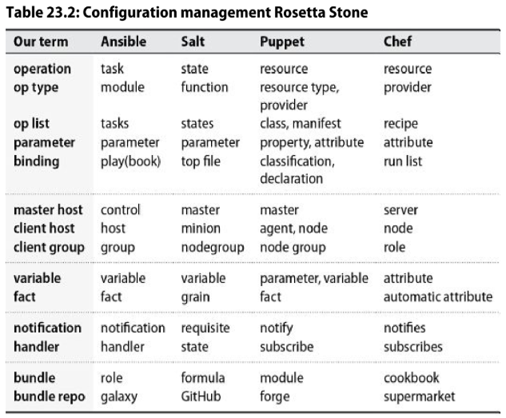
Terms used by each CM tool

Slide 18
Reference
Chef vs Puppet vs Ansible - Whizlabs Blog
https://www.whizlabs.com/blog/chef-vs-puppet-vs-ansible
User Guide — Ansible Documentation
https://docs.ansible.com/ansible/latest/user_guide/index.html
Chef Web Docs
https://docs.chef.io
Puppet documentation
https://puppet.com/docs/puppet/latest/puppet_index.html
SaltStack Documentation
https://docs.saltstack.com/en/latest

