Slide 1
Network Administration HW1
zswu

Slide 2
Purposes
The goal is to build an intranet provides several services, which may include DHCP, NAT, VPN, DNS, LDAP, Mail, WWW, etc.
Know what you should know about configuring and managing of these services.

Slide 3
HW1 Overview
Create an intranet contains several VMs
“Router” (Required)
The only VM which directly connects to outside world (Internet).
Provides NAT and DHCP.
Connects to all VMs inside your intranet.
Connects to VPN Server and the whole 10.113.0.0/16 intranet.
“Agent” (Provided by TA)
Helps TA to verify your works.
“ClientPC” (Optional)
Simulates a simple PC inside your subnet.
Helps you verify your results.

Slide 4
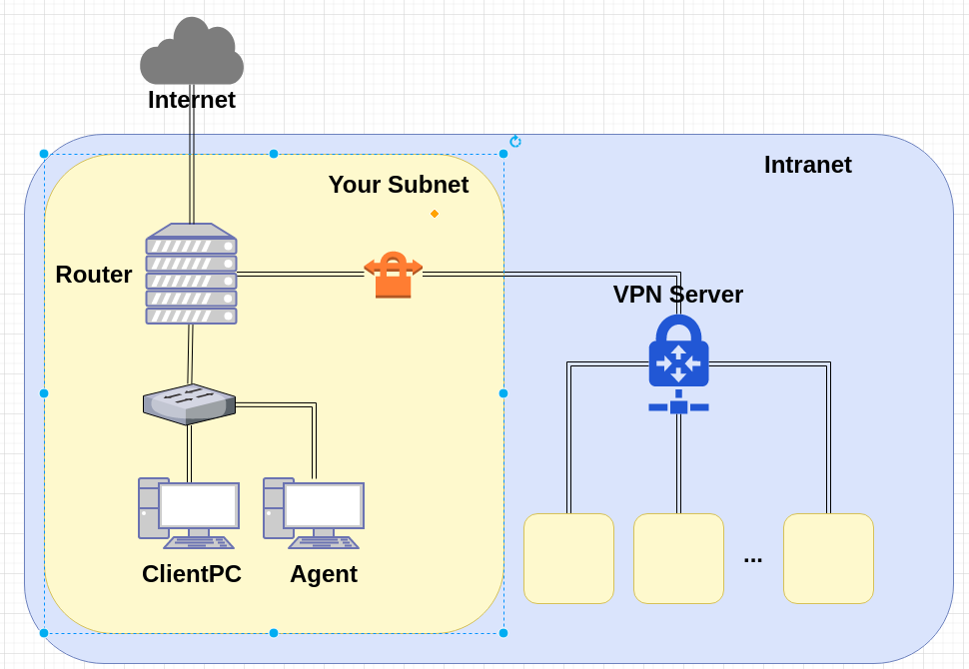
NA Intranet Schematic Diagram

Slide 5
Definitions
Internet
The ip addresses that is not in our intranet.
Intranet
10.113.0.0/16, a private network for you to do your homeworks.
OJ
Online Judge System, https://nasa.nctu.me
ID
See the profile page of OJ.
Your subnet
10.113.ID.0/24, a subnet of Intranet which is completely controlled by you.
VPN Server
A wireguard server which connects subnets together.

Slide 6
Requirements (1/6)
“Router”
Router should have these network interfaces
Public : To Internet
Provides NAT on this interface. Packets from your subnet can go to Internet through this interface.
IP: Not limited.
Private : To your subnet (10.113.ID.0/24)
Provides DHCP on this interface. IP offered by DHCP should between 10.113.ID.100 and 10.113.ID.200
IP: 10.113.ID.254
Wireguard : To VPN Server and Intranet (10.113.0.0/16)
Connects to VPN Server.
Everyone in the Intranet can access your public services through this interface.
IP: 10.113.0.ID
SSH service should be enabled on “Router”

Slide 7
Requirements (2/6)
About VPN
Wireguard (https://www.wireguard.com/)
Try to completed HW0 if you don't know how to use Wireguard.
You can test your work through 10.113.254.ID by connecting to VPN Server with another private key. See OJ for the details.
About VM Network
We assume that you use Virtualbox. You can choose other VM engines. However, the network structure should satisfy the requirements.
About the network interfaces type (Virtualbox as example)
You can use “NAT” for the public interface of “Router”; “Internal Network” for the private interface of “Router”.
For other VMs, you should only assign an interface with the type of “Internal Network”. That is, all the network traffics from these VMs should go through the private interface of “Router”.

Slide 8
Requirements (3/6)
About OS
Any UNIX-like OS is accepted. However, those services required by homeworks should be provided by your chosen OS.
CentOS, Archlinux, Ubuntu and FreeBSD should be fine
The OS of each VM need not to be the same.

Slide 9
Requirements (4/6)
“Agent”
TA will provide the OVA for you, don’t install this VM by yourself.
“Agent” should have an only network interface, which is connected to the private interface of “Router”
“Agent” will try to get IP by DHCP. Configure your DHCP server to assign the IP of 10.113.ID.129 to it.
Judge may SSH into “Agent” to test your network configuration.

Slide 10
Requirements (5/6)
Routing
All traffic from and to your subnet should go through “Router”.
Traffic to Internet go through the public interface of “Router” and should be NAT wrapped.
Traffic to Intranet go through the VPN interface of “Router” and should not be NAT wrapped.
Traffic to your subnet go through the private interface of “Router” and then go to its destination.

Slide 11
Requirements (6/6)
Firewall
Imagine that you are providing services to the Internet, so several firewall configurations must be taken for security.
We suggest you to configure firewall rules on “Router”.
Rules:
By default, all connections from outside (include Intranet) to your subnet should be rejected.
By default, all services only trust the connections from your subnet (For example, you cannot SSH to “Router” from your test IP (10.113.254.ID) directly. Therefore, you may need to create a VM to help you "jump" into your subnet.)
SSH connections from anywhere to “Agent” are allowed.
ICMP connections from anywhere to anywhere are allowed.

Slide 12
Debugging
“ClientPC” (Optional)
A VM in your subnet for debugging.
OS is not limited. GUI should be fine if you need it.
Test IP (10.113.254.ID)
With a different Wireguard private key, you can connect to Intranet with a test IP. This may help you debugging the firewall configurations or testing something cannot be tested from your subnet.

Slide 13
Hint
How to check Internet is connected ?
Ping 8.8.8.8 from different VMs.
Ping www.google.com from different VMs.
How to check Wireguard is connected ?
Ping nasa.nctu.me (VPN server)
Ping 10.113.0.254 (Intranet gateway)
Ping from / to your test IP.
Try to copy your private key through SSH instead of type it by hand.

Slide 14
DEMO
Your works will be tested by our online judge system
Submit a judge request when you are ready.
You can submit multiple times. However, the score of the last submission instead of the submission with the highest score, will be taken.
Late submissions are not accepted.
Please check your score at OJ after judge completed.
Rate-limit: 60 minutes cool-down
Scoring start at : 2020/4/9 00:00
You can test your works once the judge is prepared. However, make sure to submit at least once after this time, otherwise no score will be taken.
Deadline: 2020/4/16 23:59

Slide 15
Help!
https://groups.google.com/forum/#!forum/nctunasa
You may send email to ta@nasa.cs.nctu.edu.tw for these reasons:
You got a weird result from OJ.
You have some personal issues that don’t want to post to public.
You are in a special situation that need to contact us.
Your question is not "May I ask TAs a question?"
Try to use the google groups first. We regret that we may not be able to reply every email. Thank you for understanding.
How To Ask Questions The Smart Way
http://www.catb.org/~esr/faqs/smart-questions.html https://github.com/ryanhanwu/How-To-Ask-Questions-The-Smart-Way
Office Hours:
3GH, EC 3F CSCC

