Slide 1
Network Administration HW2
yca

Slide 2
Part 1: DNS

Slide 3
Purpose
Knowing the basic usage of DNS.
Knowing the basic configuration of BIND.

Slide 4
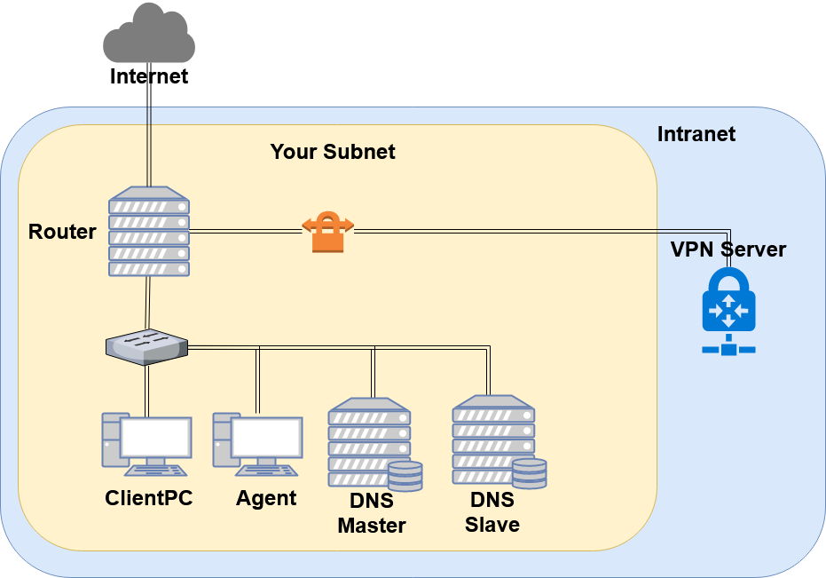
Overview - DNS
...

Slide 5
Overview (Cont.)
Use “{student_ID}.nasa.” as your domain name.
ns1.{student_ID}.nasa.
IP: 10.113.ID.1
Master zone
{student_ID}.nasa.
ns2.{student_ID}.nasa.
IP: 10.113.ID.2
Slave zone
{student_ID}.nasa.

Slide 6
Requirements
Setup a DNS servers with BIND.
ns1.{student_ID}.nasa.
Serve your own domain.
{student_ID}.nasa.
Be able to query from the intranet. (10.113.x.x/16)
Setup another DNS server with BIND
ns2.{student_ID}.nasa.
Slave zone for “{student_ID}.nasa.” synchronized from ns1.
Updates should be synchronized
SOA must have same Serial number

Slide 7
Requirements (Cont.)
DHCP
You have to configure the DHCP server to suggest the clients to use your internal DNS as the primary DNS.
Set nameserver to your internal DNS.
Set search domain to your domain.
Properly query for “{other_student_ID}.nasa.”.
Security
Only allow zone transfer from Slave and Agent.
Only allow recursion from Agent.

Slide 8
Requirements (Cont.)
Add A record for the machines.
router
ns1 (DNS Master)
ns2 (DNS Slave)
agent (Agent)
Add CNAME record
nasa => nasa.cs.nctu.edu.tw.
web => agent
Confuse your BIND version number.
$ dig version.bind txt chaos @server
For ns1, use “Name Server 1”.
For ns2, use “Name Server 2”.
Only allow queries from your internal network.

Slide 9
Requirements (Cont.)
VIEW
Add A record for view.{your_domain}.
For queries from 10.113.1.x/24
Answer 140.113.235.131
For queries from 10.113.ID.x/24
Answer 140.113.235.151
For other queries
Answer 10.113.ID.87
You have to set up VIEW for both the master and the slave server.
Is there any elegant way to do it?

Slide 10
Requirements (Cont.)
Allow reverse lookup from the intranet.
The answers should be forward-confirmed.
Return NXDOMAIN if there is no corresponding A record.
Add SSHFP record of your machines’ ssh key fingerprint.
For the following machines
router
ns1 (DNS Master)
ns2 (DNS Slave)
agent (agent)
The algorithm ECDSA and ED25519 should be implement.
The hash type SHA-256 should be implement.

Slide 11
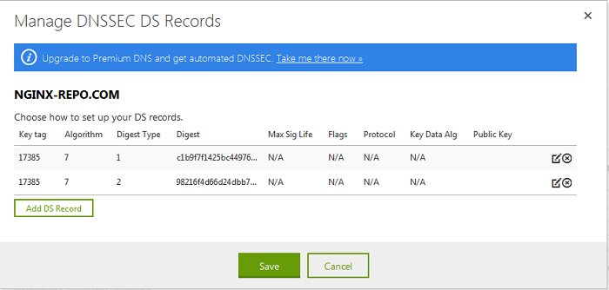
Requirements (Cont.)
DNSSEC
Normally, after you registered a domain name and set up a DNS to serve the subdomain. If you want DNSSEC to secure your records, it’s necessary to publish the DS record to the nameserver of the top-level domain.

Slide 12
Requirements (Cont.)
DNSSEC
nasa. → {student_ID}.nasa.
In this scenario we are serving a private TLD which is not delegated from root DNS server, thus the trust chain from root will be broken.
You need to manage the DS record on https://nasa.nctu.me/ for the DNSSEC.
It has a 1-day cooldown on the OJ.
You must use NSEC3 to implement it.
Tool for you to check the trust chain.
delv(1)
https://github.com/dnsviz/dnsviz

Slide 13
Part 2. Server Load Balancer

Slide 14
Purpose
Knowing the basic usage of a load balancer.
Knowing the basic concept of the reverse proxy.

Slide 15
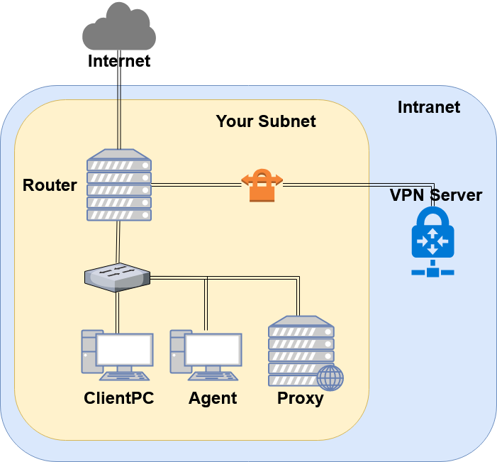
Overview - Server Load Balancer
You may have several service on one machine.

Slide 16
Requirements
You have to re-deploy your “Agent” by downloading the new file from OJ.
Reverse proxy
Make a reverse proxy under http://$yourdomain/reverse/
Round-robin
10.113.ID.129:8001
10.113.ID.129:8002
Make a reverse proxy under http://$yourdomain/ip/
10.113.ID.129:8003
Pass non-standard HTTP headers to the backend.
“X-Forwarded-For”
“X-Real-IP”: The real client IP.

Slide 17
Requirements (Cont.)
Prevent DDoS
Set timeout of HTTP request to be 5 seconds.
Each user can only have 10 connections opened.
Each user can only have 30 connections opened within 10 seconds.
If a user send over 20 HTTP requests within 5 seconds, then blacklist the user’s IP.
Return 403 for any new request from this user.
Refuse any new connection from this user.
Until 10 seconds after they stop sending requests and establishing connections.

Slide 18
Part 3: Firewall
You have to properly adjust your firewall rules to let the new services in this homework run correctly.
Recall the rules.
By default, all connections from outside (include Intranet) to your subnet should be rejected.
By default, all services only trust the connections from your subnet.
SSH connections from anywhere to “Agent” are allowed.
ICMP connections from anywhere to anywhere are allowed.
You won’t get any points for this part, but you will get some points down for the incorrect firewall setting.

Slide 19
DEMO
Your work will be tested by our online judge system
Submit a judge request when you are ready.
You can submit request multiple times. However, the score of the last submission instead of the submission with the highest score, will be taken.
Late submissions are not accepted.
Please check your score at OJ after judge completed.
Rate-limit: 60 minutes cool-down
Scoring start at : 2020/4/29 00:00
You can test your works once the judge is prepared. However, make sure to submit at least once after this time, otherwise no score will be taken.
Deadline: 2020/5/7 23:59

Slide 20
Help!
https://groups.google.com/forum/#!forum/nctunasa
You may send email to ta@nasa.cs.nctu.edu.tw for these reasons:
You get a weird result from OJ.
You have some personal issues that don’t want to post to the public.
You are in a special situation that needs to contact us.
Your question is not "May I ask TAs a question?"
Try to use the google groups first. We regret that we may not be able to reply every email. Thank you for understanding.
How To Ask Questions The Smart Way
http://www.catb.org/~esr/faqs/smart-questions.html https://github.com/ryanhanwu/How-To-Ask-Questions-The-Smart-Way
Office Hours:
3GH, EC 3F CSCC

