Slide 1
Network Administration HW3
tzute

Slide 2
Purposes
Build a basic mail service
Understand how to maintain Postfix service
Understand how to maintain Dovecot service
Understand how to protect your mail service

Slide 3
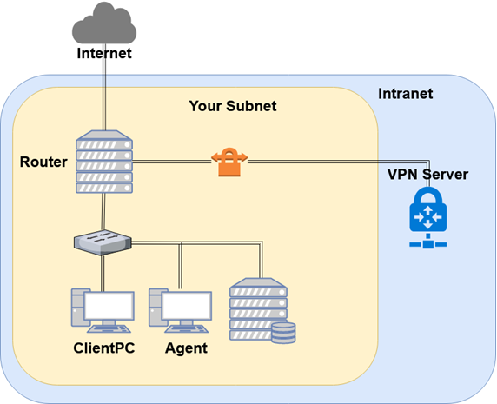
Overview
Mail
Server

Slide 4
Overview (cont.)
One Mail Server
Providing IMAP service
Providing SMTP service
Scanning virus
Detecting spam mails

Slide 5
Requirements (1/8)
Mail Server
IP: 10.113.ID.y/24 with static DHCP
Hostname: mail.{student_ID}.nasa.
Mail domain:
@{student_ID}.nasa.
@mail.{student_ID}.nasa.
STARTTLS on IMAP/SMTP
Use self-signed certificate
User Authentication on IMAP/SMTP
Only send emails with authenticated username@
Avoid to fake other users on envelop from
No Open Relay

Slide 6
Requirements (2/8)
MX record
Set MX record on your domain
Sending mail to @{student_ID}.nasa will go to mail.{student_ID}.nasa
SPF
DNS TXT and DNS SPF record
Allow your server to send mail using your domain
Deny other servers from pretending your domain, and drop these invalid mail
Do SPF policy check on incoming email
{student_ID}.nasa. [TTL] IN TXT <SPF-rules>

Slide 7
Requirements (3/8)
DKIM
Signing your outgoing email with your private key
A DNS TXT record for DKIM
DKIM policy check on the incoming email
<selector>._domainkey.{student_ID}.nasa. IN TXT <DKIM-Information>

Slide 8
Requirements (4/8)
DMARC
A DNS TXT record for DMARC
Let others drop mails that does not pass DMARC policy check
Do DMARC policy check to the incoming email
_dmarc.{student_ID}.nasa. IN TXT <DMARC-Rules>

Slide 9
Requirements (5/8)
Greylisting
For incoming mail from new mail server
Greylist for 30 seconds

Slide 10
Requirements (6/8)
Specific user TA, TU
Set password to your VPN private key (WG_KEY) in HW1
Retrieve the key from nasa.nctu.me
Keep all mails that TA and TU received on your server
Virtual alias
for any mail to TO@ alias to TA@
for any mail to <sth>|<user>@ alias to <user>@
e.g. i-am-a|TA@ send to TA@
Sender rewrite
Rewrite @mail.{student_ID}.nasa to @{student_ID}.nasa
Rewrite TU@ to TUTU@

Slide 11
Requirements (6/8)
Ingoing mail filter
Add "*** SPAM ***" in front of the subject if the mail contains virus or spam message
You can use amavisd-new/rspamd
Test cases
http://www.eicar.org/download/eicar.com
https://github.com/apache/spamassassin/blob/trunk/sample-spam.txt

Slide 12
Requirements (7/8)
Outgoing mail filter
Reject mails whose subject contains keyword "肺炎" or "wuhan"

Slide 13
Test your email services
IMAP (143) Testing
https://wiki.dovecot.org/TestInstallation
openssl s_client -connect mail.{student_ID}.nasa:143 -starttls imap
SMTP (25) Testing
http://www.postfix.org/INSTALL.html
openssl s_client -connect mail.{student_ID}.nasa:25 -starttls smtp
Or just install a GUI mail client in your client PC

Slide 14
Demo
Your work will be tested by our online judge system
Submit a judge request when you are ready.
You can submit request multiple times. However, the score of the last submission instead of the submission with the highest score, will be taken.
Late submissions are not accepted.
Please check your score at OJ after judge completed.
Rate-limit: 60 minutes cool-down
Scoring start at : 2020/05/15 00:00
You can test your works once the judge is prepared. However, make sure to submit at least once after this time, otherwise no score will be taken.
Deadline: 2020/05/28 23:59

Slide 15
Help!
https://groups.google.com/forum/#!forum/nctunasa
You may send email to ta@nasa.cs.nctu.edu.tw for these reasons:
You get a weird result from OJ.
You have some personal issues that don’t want to post to the public.
You are in a special situation that needs to contact us.
Your question is not "May I ask TAs a question?"
Try to use the google groups first. We regret that we may not be able to reply every email. Thank you for understanding.
How To Ask Questions The Smart Way
http://www.catb.org/~esr/faqs/smart-questions.html https://github.com/ryanhanwu/How-To-Ask-Questions-The-Smart-Way
Office Hours:
3GH, EC 3F CSCC

