Slide 1
Network Administration HW4
yysung

Slide 2
Purposes
Build a standalone LDAP service
Understand how to define LDAP schema from scratch
Understand how to manage LDAP datas using LDIF
Understand how to integrate other applications with LDAP

Slide 3
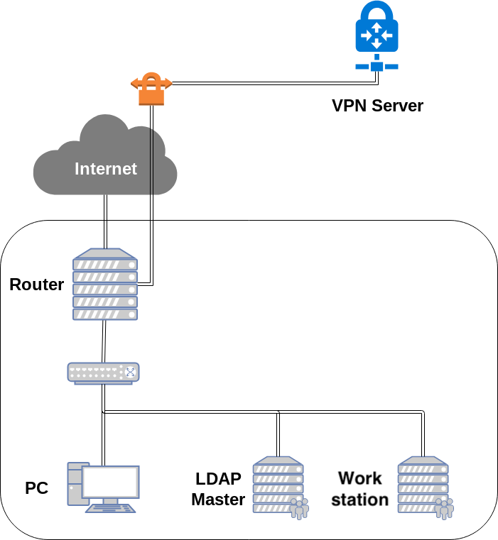
Overview

Slide 4
Overview (Cont.)
One LDAP master server
Providing LDAP service
Connecting into your intranet
LDAP Client
One Workstation
SNMP Agent
Connecting into your intranet
LDAP Client

Slide 5
Requirements (1/10)
LDAP master
IP: 10.113.ID.y/24 with static DHCP
Hostname: ldap1.{student_ID}.nasa.
Base DN: dc=<student-id>,dc=nasa
StartTLS on LDAP service
Not LDAPS
Use self-signed certificate
Add TXT Record
cert => `base64 cacert.pem`
Support SASL
Store hashed password into each DN's userPassword

Slide 6
Requirements (2/10)
Custom objectClass "ludouCredit"
attributeType "ludoucredit"
ludoucredit should be an integer.
ludoucredit can be compared with some constant integer. (Ordering Matching Rules)
Everyone can read each other’s ludoucredit, but only cn=TA and your manager account can modify other’s ludoucredit.

Slide 7
Requirements (3/10)
LDAP master, Workstation
Users can login with LDAP posixAccount
At least, login via SSH should be worked
Users can execute passwd to change their own password
Use attribute "uid" as username
Specific user "cn=<student-id>,ou=People,<Base DN>"
uid: <student-id>
uidNumber: 3001
set your own password

Slide 8
Requirements (4/10)
objectClass "publicKeyLogin"
attributeType "sshPublicKey"
Specific DN "cn=TA,ou=People,<Base DN>"
objectClass: posixAccount, publicKeyLogin, ludouCredit
uid: TA
uidNumber: 3000
ludouCredit: 100
sshPublicKey: <TA's public key>
userPassword: your VPN private key (WG_KEY)
Should can login SSH with sshPublicKey and password
Retrieve TA's public key here
https://nasa.cs.nctu.edu.tw/na/2020/ta_rsa.pub

Slide 9
Requirements (5/10)
Specific DN "cn=taipeirioter,ou=People,<Base DN>"
objectClass: posixAccount, publicKeyLogin, ludouCredit
uid: taipeirioter
uidNumber: 4000
ludouCredit: 100
sshPublicKey: <TA's public key>
userPassword: your VPN private key (WG_KEY)
Should can login SSH with sshPublicKey and password

Slide 10
Requirements (6/10)
Specs of ludouCredit about User Account and SSH Login:
If some users’ ludoucredit > 0, they can login via SSH.
If some users’ ludoucredit == 0, they can’t login via SSH with TA’s private key, but their account still exist on the system.
If some users’ ludoucredit < 0, they can’t login via SSH and their account will be disappeared on the LDAP master and Workstation. (i.e. id: user: no such user)

Slide 11
Requirements (7/10)
Time-based One-Time Password (TOTP) (RFC6238)
Support TOTP on your LDAP master
time step = 30 seconds, digits = 6 (default value)
You may use https://github.com/openldap/openldap/tree/master/contrib/slapd-modules/passwd/totp overlay to implement.
Specific DN "cn=totp,ou=People,<Base DN>"
objectClass: posixAccount, ludouCredit
uid: totp
userPassword: "{TOTP1}`printf ${WG_KEY} | base32`"
Can login via SSH or bind DN in LDAP with TOTP

Slide 12
Requirements (8/10)
Enable ACL
Everyone (including anonymous) can read all data except userPassword
Authenticated users can write their own userPassword
LDAP Manager can write everyone’s userPassword
LDAP Manager and TA can write everyone’s ludoucredit, all the other users can’t write anyone’s ludoucredit

Slide 13
Requirements (9/10)
Workstation
IP: 10.113.ID.y/24 with static DHCP
Hostname: ws1.{student_ID}.nasa.
Users can login via SSH with LDAP posixAccount
SNMP Agent (Net-SNMP)
SNMP Agent on Workstation
Support v2c
Community "public"
Can access from intranet and your private network
Read Only
Community "private"
Can access only from 10.113.ID.0/24 and localhost
Read and Write

Slide 14
Requirements (10/10)
{public, private} can read CPU 1 minute load
UCD-SNMP-MIB::laLoad.1
{public, private} can read SNMPv2-MIB::sysName.0
{private} can write SNMPv2-MIB::sysName.0
Write an extend named "servicecheck"
Check the connection to tcp:10.113.ID.129:5566
If connected, nsExtendResult should be 0
If not connected, nsExtendResult should not be 0
You can test by command `snmpget -v2c -c public -Oqv localhost 'NET-SNMP-EXTEND-MIB::nsExtendResult."servicecheck"'`
Set your NET-SNMP-EXTEND-MIB::nsExtendCacheTime."servicecheck" <= 5

Slide 15
Firewall
Open {LDAP, SSH} port on LDAP master to intranet
Open {SNMP, SSH} port on Workstation to intranet
Recall the rules.
By default, all connections from outside (include Intranet) to your subnet should be rejected.
By default, all services only trust the connections from your subnet.
SSH connections from anywhere to “Agent” are allowed.
ICMP connections from anywhere to anywhere are allowed.
You won’t get any points for this part, but you will get some points down for the incorrect firewall setting.

Slide 16
Warning!!!
Always SNAPSHOT or BACKUP YOUR SYSTEM before judging!!!
Set {TA, taipeirioter, totp}’s luduocredit == 100 before judging.
Set {TA, taipeirioter}’s passwords as your VPN private key (WG_KEY) before judging.
Set totp’s password as "{TOTP1}`printf ${WG_KEY} | base32`"
TA’s test script will modify some LDAP data and restore data if your LDAP server run correctly.

Slide 17
DEMO
TAs will try to login via public key and execute some script to validate your works.
Due date: 6/18 23:55

Slide 18
Tips
Google "How to get your own OID"
Google "sshd_config AuthorizedKeysCommand"
Google "LDAP Filter"
https://blog.irontec.com/openldap-y-passwords-temporales-otp/ (Spanish, but I think you can understand the UNIX command)
Google "net-snmp extend" or man snmpd.conf

Slide 19
Help!
https://groups.google.com/forum/#!forum/nctunasa
Don’t send email
EC 3F CSCC

