Slide 1
Homework 1
Network Environment Setting
changhoy, kuochw, yiyuchang

Slide 2
Purpose
The goal is to build an intranet provides several services, which may include DHCP, NAT, VPN, DNS, Mail, LDAP, WWW, etc.
Know what you should know about configuring and managing of these services.

Slide 3
Overview
Create an intranet which contains several VMs:
“Router”
The only VM which directly connect to outside world (Internet).
Provides NAT and DHCPd.
Can connects to all VMs inside your intranet.
Can connects to VPN server and the whole 10.113.0.0/16 intranet.
“Agent”
Simulates a simple VM inside your subnet to help TAs and OJ verify results.
“Client” (Optional)
Simulates a simple VM inside your subnet to help you verify results.

Slide 4
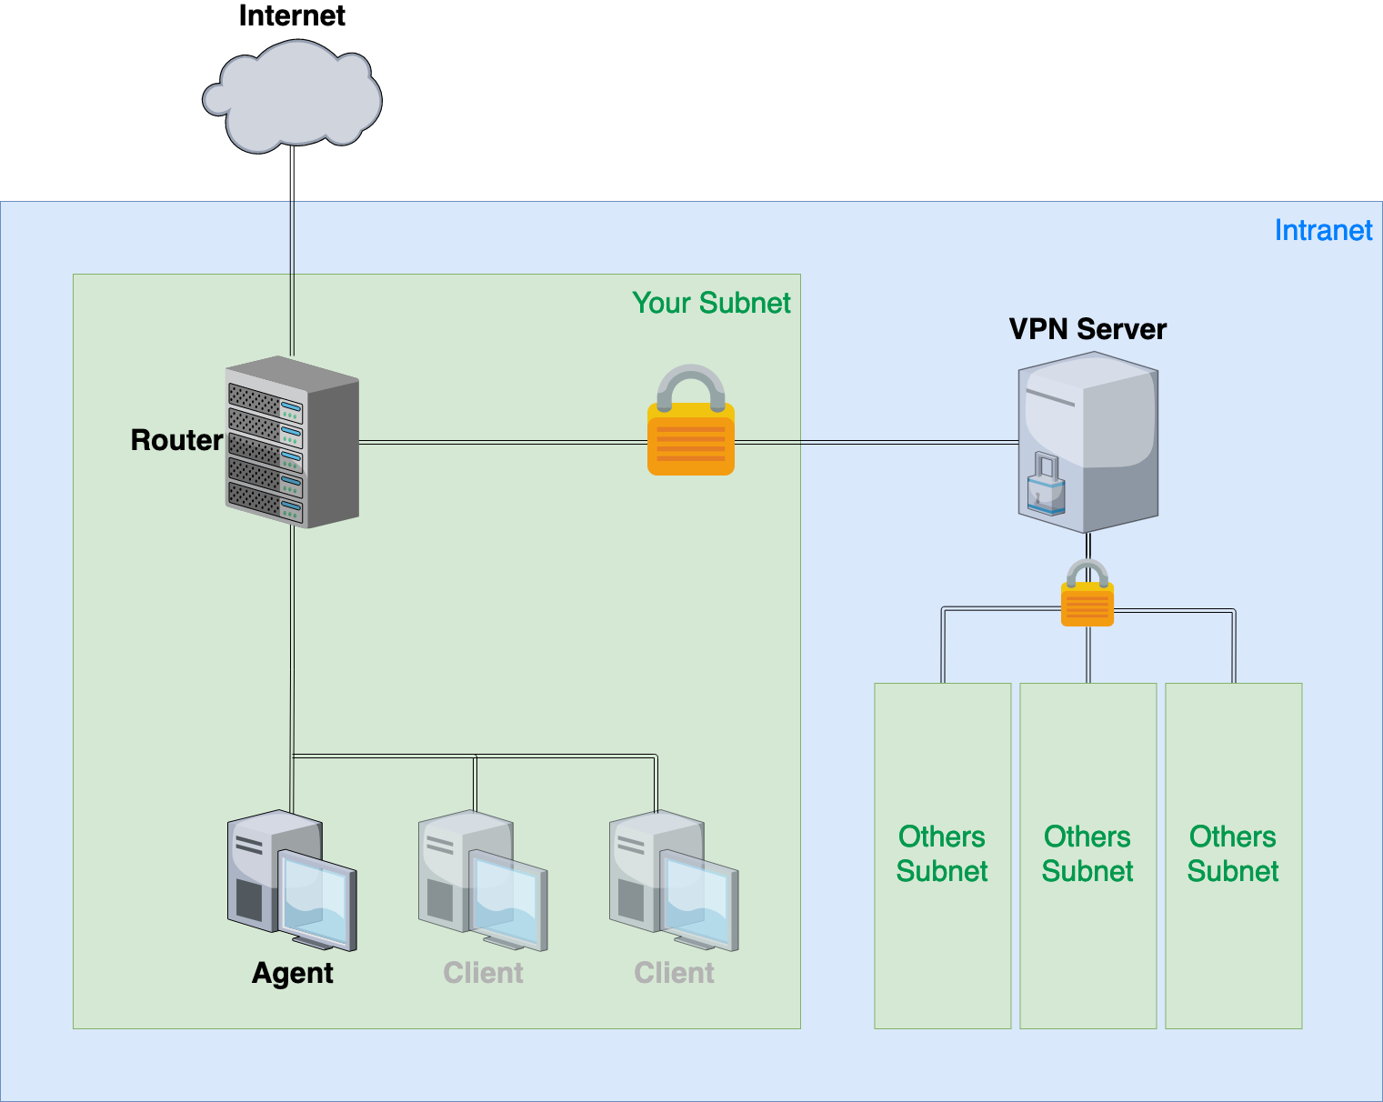
Intranet Schematic Diagram

Slide 5
Definitions
Internet
The IP addresses that is not in our intranet.
Intranet
10.113.0.0/16, a private network for you to do your homeworks.
OJ
Online Judge system, https://nasa.nycucs.org/ .
ID
See the profile page on OJ.
Your subnet
10.113.{ID}.0/24, a subnet of intranet controlled by yourself.
VPN server
A WireGuard server which connects subnets together.

Slide 6
Requirements (1/4)
“Router”
Any Unix-like OS is acceptable. Please set the hostname to “nasa-router”.
This VM MUST have these network interfaces:
Public(WAN): Internet facing
Provide NAT on this interface. Packets from your subnet can go to Internet through this interface.
IP: No limitation.
Private(LAN): To your subnet (10.113.{ID}.0/24)
Provide DHCP on this interface. IP offered by DHCP should be between 10.113.{ID}.111 and 10.113.{ID}.222.
IP: 10.113.{ID}.254.
WireGuard: To VPN server and intranet (10.113.0.0/16)
Connect to VPN server. Everyone in intranet can access your public services through this interface.
IP: 10.113.0.{ID}.
Enable sshd service.

Slide 7
Requirements (2/4)
“Agent”
There is this VM OVA file below, don’t install this VM by yourself.
NA_2021_HW1_Agent_OVA
This VM will get IP 10.113.{ID}.123 by DHCP.
OJ will login “Agent” to judge your VMs’ settings.

Slide 8
Requirements (3/4)
Routing
All traffic from and to your subnet should go through “Router”.
Traffic to the Internet go through the public interface of “Router” and should be NAT wrapped.
Traffic to the intranet go through the VPN interface of “Router” and should not be NAT wrapped.
Traffic to your subnet go through the private interface of “Router” and then go to its destination.

Slide 9
Requirements (4/4)
Firewall
Consider you are providing services to the Internet, so several firewall configurations must be taken for security.
We suggest you to configure firewall rules on “Router”.
Rules:
By default, all connections from outside (include Intranet) to your subnet should be rejected.
By default, all services only trust the connections from your subnet.
SSH connections from anywhere to “Agent” are allowed.
ICMP connections from anywhere to anywhere are allowed.

Slide 10
Hints
How to check Internet is connected?
Ping 8.8.8.8 from different VMs.
Ping www.google.com from different VMs.
How to check WireGuard is connected? (Please make sure your private key is correct.)
Ping nasa.nycucs.org (VPN server).
Ping 10.113.0.254 (intranet gateway).
Ping from/to your test IP (10.113.254.{ID}).

Slide 11
Appendix: About VPN (1/2)
Install WireGuard
Server Address:
nasa.nycucs.org:51821
Using information on OJ profile to connect WireGuard Server:
ID (Your IP in WireGuard is 10.113.0.{ID}.)
WG_PRIVATE_KEY
WG_PRIVATE_TEST_KEY (Test IP is 10.113.254.{ID}.)
WG_PUBLIC_KEY

Slide 12
Appendix: About VPN (2/2)
WireGuard config example
# wg0.conf
[Interface]
Address = 10.113.0.{ID}/32 # Test IP: 10.113.254.{ID}/32
PrivateKey = {WG_PRIVATE_KEY}
[Peer]
PublicKey = {WG_PUBLIC_KEY}
AllowedIPs = 10.113.0.0/16
Endpoint = nasa.nycucs.org:51821
PersistentKeepalive = 25

Slide 13
Appendix: About VM Network (1/2)
We assume that you use Virtualbox. You can choose other VM engines. However, the network structure should satisfy the requirements.
About the network interfaces type (take Virtualbox as an example):
You can use “NAT” for the public interface of “Router”; “Internal Network” for the private interface of “Router”.
For other VMs, you should only assign an interface with the type of “Internal Network”. That is, all the network traffics from these VMs should go through the private interface of “Router”.

Slide 14
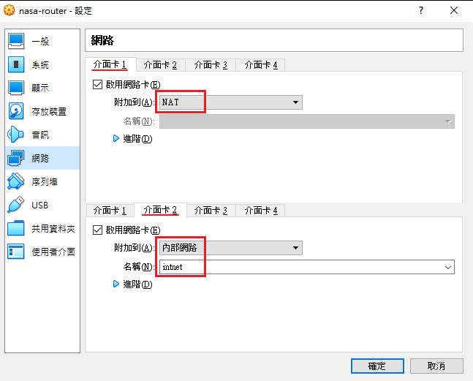
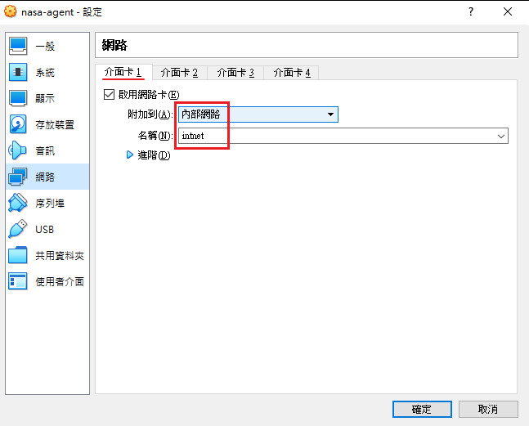
Appendix: About VM Network (2/2)
VirtualBox

Slide 15
Appendix: About OS
Any Unix-like OS is acceptable. However, those services required by homeworks should be provided by the OS you choose.
CentOS, Ubuntu or FreeBSD should be fine.
The OS of each VM doesn’t need to be the same.

Slide 16
Attention
Your work will be tested by Online Judge system.
You can submit multiple judge requests. However, OJ will cool down for 30 minutes after each judge.
We will take the last submitted score instead of the highest score.
Late submissions will not be accepted.
Make sure everything is fine after reboot.
Backup your VM before judge every time.
We may do something bad when judging.
Due date: 23:59 March 31st (Wed. ) 2021

Slide 17
Help Me!
TA office hours: W78 (15:30~17:20 Wed.) at EC 324 (PC Lab).
We do not allow walk-ins except TA office hours or e-mail appointments.
Questions about this homework.
Make sure you have studied through lecture slides and the HW spec.
Clarify your problems and google it to find out solutions.
Ask them on https://groups.google.com/g/nctunasa .
Be sure to include all information you think others would need.
We MIGHT give out hints on google group.
Be sure to join the group!
Do not mail us unless it’s personal or you’re making an appointment.

Slide 18
Good Luck!

