Slide 1
Homework 2
Network Administration
kuochw、yiyuchang、zongwei

Slide 2
DNS

Slide 3
Purpose
Knowing the basic usage of DNS.
Knowing the basic configuration of BIND.

Slide 4
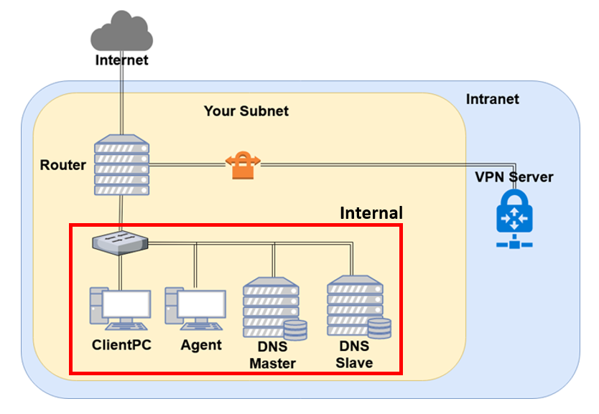
Overview - DNS

Slide 5
Overview (Cont.)
Use “{ID}.nasa.” as your domain name.
ns1.{ID}.nasa.
IP: 10.113.ID.1
Master zone
{ID}.nasa.
ns2.{ID}.nasa.
IP: 10.113.ID.2
Slave zone
{ID}.nasa.

Slide 6
Requirements (1/6)
Setup a DNS servers with BIND.
ns1.{ID}.nasa.
Serve your own domain.
{ID}.nasa.
Be able to query from the intranet. (10.113.0.0/16)
Setup another DNS server with BIND
ns2.{ID}.nasa.
Slave zone for “{ID}.nasa.” synchronized from ns1.
Updates should be synchronized
SOA must have same Serial number

Slide 7
Requirements (2/6)
DHCP
You have to configure the DHCP server to suggest the clients to use your internal DNS as the primary DNS.
Set nameserver to your internal DNS.
Set search domain to your domain.
Properly query for “{ID}.nasa.”.
Security
Only allow zone transfer from Slave and Agent.
Only allow recursion from Agent.

Slide 8
Requirements (3/6)
Add A records for the machines.
router
ns1 (DNS Master)
ns2 (DNS Slave)
agent (Agent)
Add CNAME records
nasa => nasa.cs.nctu.edu.tw.
web => agent
Confuse your BIND version number.
$ dig version.bind txt chaos @server
For ns1, use “Name Server 1”.
For ns2, use “Name Server 2”.
Only allow queries from your internal network.

Slide 9
Requirements (4/6)
VIEW
Add A record for view.{your_domain}.
For queries from 10.113.13.x/24
Answer 140.113.235.131
For queries from 10.113.ID.x/24
Answer 140.113.235.151
For other queries
Answer 10.113.ID.87
You have to set up VIEW for both the master and the slave servers.

Slide 10
Requirements (5/6)
Allow reverse lookup from the intranet.
The answers should be forward-confirmed.
Return NXDOMAIN if there is no corresponding A record.
Add SSHFP records of your machines’ ssh key fingerprints.
For the following machines
router
ns1 (DNS Master)
ns2 (DNS Slave)
agent (agent)
The algorithm RSA and ECDSA and ED25519 should be implemented.
The hash type SHA-256 should be implemented.

Slide 11
Requirements (6/6)
DNSSEC
nasa. → {ID}.nasa.
In this scenario we are serving a private TLD which is not delegated from root DNS server, thus the trust chain from root will be broken.
You need to manage the DS record on https://nasa.nycucs.org/ for the DNSSEC.
It has a 1-day cooldown on the OJ.
You must use NSEC3 to implement it.

Slide 12
Server Load Balancer

Slide 13
Purpose
Knowing the basic usage of a load balancer.
Knowing the basic concept of the reverse proxy.

Slide 14
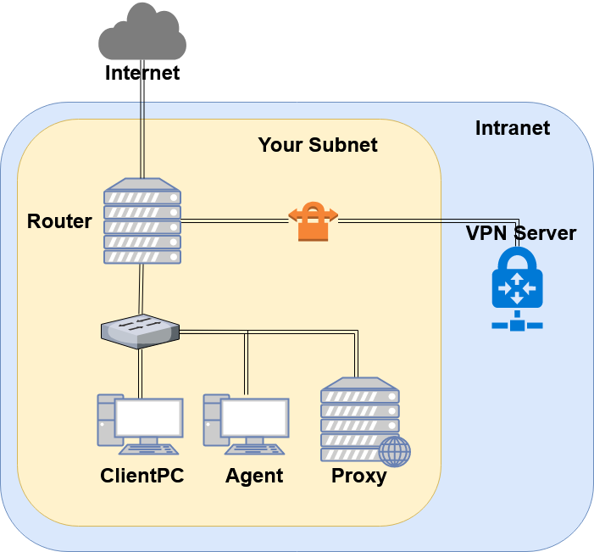
Overview - Server Load Balancer
You may have several service on one machine.

Slide 15
Requirements
You have to re-deploy your “Agent” by downloading the new file from OJ ( Link here ).
Reverse proxy
Make a reverse proxy under http://$yourdomain/reverse/
Round-robin
10.113.ID.123:8001
10.113.ID.123:8002
Make a reverse proxy under http://$yourdomain/ip/
10.113.ID.123:8003
Pass non-standard HTTP headers to the backend.
“X-Forwarded-For”
“X-Real-IP”: The real client IP.

Slide 16
Necessary Condition of Firewall
You have to properly adjust your firewall rules to let the new services in this homework run correctly.
Recall the rules.
By default, all connections from outside (include Intranet) to your subnet should be rejected.
By default, all services only allow the connections from your subnet.
SSH connections from anywhere to “Agent” are allowed.
ICMP connections from anywhere to anywhere are allowed.
New rules.
SSH connections from “Agent” to 10.113.13.123 and 10.113.14.123 are allowed.
All connections from “Router” to your proxy server is allowed.
You won’t get any points for this part, but you will lose some points for incorrect firewall settings.

Slide 17
Submission
Your work will be tested by our online judge system
Submit a judge request when you are ready.
You can submit request multiple times. However, the score of the last submission instead of the submission with the highest score, will be taken.
Late submissions are not accepted.
Please check your score at OJ after judge completed.
Scoring start at : 2020/4/02 00:00
You can test your works once the judge is prepared. However, make sure to submit at least once after this time, otherwise no score will be counted.
Deadline: 2020/4/16 00:00

Slide 18
Help
TA office hours: W78 (15:30~17:20 Wed.) at EC 324 (PC Lab).
We do not allow walk-ins except TA office hours or e-mail appointments.
Questions about this homework.
Make sure you have studied through lecture slides and the HW spec.
Clarify your problems and search it to find out solutions first.
Ask them on https://groups.google.com/g/nctunasa .
Be sure to include all the information you think others would need.

Slide 19
Good Luck!

