Slide 1
Homework 3
Network Administration
tcyuan, zongwei

Slide 2
Purposes
Build a basic mail service
Understand how to maintain Postfix service
Understand how to maintain Dovecot service
Understand how to protect your mail service

Slide 3
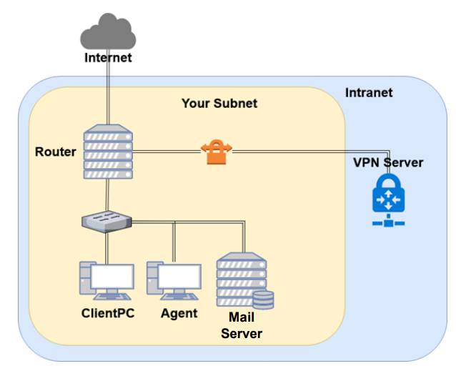
Overview

Slide 4
Overview (cont.)
A simple Mail Server
Providing IMAP service
Providing SMTP service
Scanning virus
Detecting spam mails

Slide 5
DNS Server Setting
DNS server: 10.113.0.254
These RRs are on the server
$GENERATE 1-200 $ IN NS ns1.$
$GENERATE 1-200 $ IN NS ns2.$
$GENERATE 1-200 ns1.$ IN A 10.113.$.1
$GENERATE 1-200 ns2.$ IN A 10.113.$.2
You are required to redirect any DNS query within .nasa to this DNS server
Failed to do so will lead to failed Judge results

Slide 6
Requirements (1/8)
Mail Server
IP: 10.113.ID.y/24 with static DHCP, where y is arbitary
Hostname: mail.{ID}.nasa.
Mail domain:
@{ID}.nasa.
@mail.{ID}.nasa.
STARTTLS on IMAP/SMTP
Use self-signed certificate
User Authentication on IMAP/SMTP
Only send emails with authenticated username@
Avoid to fake other users on envelop from
No Open Relay

Slide 7
Requirements (2/8)
MX record
Set MX record on your domain
Sending mail to @{ID}.nasa will go to mail.{ID}.nasa
SPF
DNS SPF record
Allow only your server to send mails using your domain
Deny other servers from pretending you, and drop these invalid mail
Do SPF policy check on incoming email
{ID}.nasa. [TTL] IN TXT <SPF-rules>

Slide 8
Requirements (3/8)
DKIM
Signing your outgoing email with your private key
A DNS TXT record for DKIM
DKIM policy check on the incoming email
<selector>._domainkey.{ID}.nasa. IN TXT <DKIM-Information>

Slide 9
Requirements (4/8)
DMARC
A DNS TXT record for DMARC
Let others drop mails that does not pass DMARC policy check
Do DMARC policy check to the incoming email
_dmarc.{ID}.nasa. IN TXT <DMARC-Rules>

Slide 10
Requirements (5/8)
Greylisting
For incoming mail from new mail server
Greylist for 30 seconds

Slide 11
Requirements (6/8)
Specific user TA, cool-TA
Set passwords to your VPN private key (WG_PRIVATE_KEY)
Retrieve the key from Online Judge
Keep all mails that TA and cool-TA received on your server
Virtual alias
for any mail to NASATA@ alias to TA@
for any mail to <sth>|<user>@ alias to <user>@
e.g. i-am-a|TA@ send to TA@
Sender rewrite
Rewrite @mail.{ID}.nasa to @{ID}.nasa
Rewrite cool-TA@ to notcool-TA@

Slide 12
Requirements (7/8)
Ingoing mail filter
Prepend "*** SPAM ***" in front of the subject if the mail contains
virus or spam message
You can use amavisd-new / SpamAssassin / rspamd
Test cases
http://www.eicar.org/download/eicar.com
https://github.com/apache/spamassassin/blob/trunk/sample-spam.txt

Slide 13
Requirements (8/8)
Outgoing mail filter
Reject mails whose subject contains keyword
"NCTU" or "陽交"

Slide 14
Test your email services
IMAP (143) Testing
https://wiki.dovecot.org/TestInstallation
openssl s_client -connect mail.{ID}.nasa:143 -starttls imap
SMTP (25) Testing
http://www.postfix.org/INSTALL.html
openssl s_client -connect mail.{ID}.nasa:25 -starttls smtp
Or just install a GUI / TUI mail client
Microsoft Outlook
Mozilla Thunderbird
mutt, etc

Slide 15
Submission
Your work will be tested by our online judge system
Submit a judge request when you are ready.
You can submit request multiple times. However, the score of the last submission instead of the submission with the highest score, will be taken.
Late submissions are not accepted.
Please check your score at OJ after judge completed.
Scoring start at : 2021/4/23 00:00
The cool-down time is 30 Minutes
Deadline: 2021/5/6 23:59

Slide 16
Help
TA office hours: W78 (15:30~17:20 Wed.) at EC 324 (PC Lab).
We do not allow walk-ins except TA office hours or e-mail appointments.
Questions about this homework.
Make sure you have studied through lecture slides and the HW spec.
Clarify your problems and search it to find out solutions first.
Ask them on https://groups.google.com/g/nctunasa .
Be sure to include all the information you think others would need.

