Slide 1
DHCP & NAT
wangth (2018-2021, CC BY-SA)
? (2009-2017)

Slide 2
DHCP –
Dynamic Host Configuration Protocol

Slide 3
DHCP Motivation
BOOTP (Bootstrap Protocol)
Support sending extra information beyond an IP address to a client to enable customized configuration
Effectively solve one of the major problems that administrators have with manual configuration
Problems of BOOTP
BOOTP normally uses a static method of determining what IP address to assign to a device
Dynamic Host Configuration Protocol (DHCP)
DHCP is an extension of the BOOTP. The first word describe the most important new capability added to BOOTP
Assign IP dynamically
Move away from static, permanent IP address assignment
Compatible with BOOTP

Slide 4
DHCP introduction
DHCP
Dynamic address assignment
A pool of IP address is used to dynamically allocate addresses
Still support static mapping of addresses
Enable a DHCP client to “lease” a variety of network parameters
IP, netmask
Default router, DNS servers
A system can connect to a network and obtain the necessary information dynamically
Client-Server architecture
DHCP client broadcasts request for configuration info.
UDP port 68
DHCP server reply on UDP port 67, including
IP, netmask, DNS, router, IP lease time, etc.
RFC
RFC 2131 – Dynamic Host Configuration Protocol
RFC 2132 – DHCP Options
Two main function of DHCP
Provide a mechanism for assigning addresses
A method by which clients can request addresses and other configurations

Slide 5
DHCP Address Assignment
Address allocation mechanisms
Provide flexibility for configuring addresses on different types of clients
Three different address allocation mechanisms
Manual allocation
IP address is pre-allocated to a single device
Automatic allocation
Assign an IP address permanently to a device
Dynamic allocation
Assign an IP address from a pool for a limited period of time
Manual allocation
Equivalent to the method BOOTP used
For servers and routers
Administrative benefit

Slide 6
Dynamic allocation
Benefits for dynamic allocation
Automation
No intervention for an administrator
Centralized management
An administrator can easily look to see which devices are using which addresses
Address reuse and sharing
Portability and universality
Do NOT require DHCP server know the identity of each client
Support mobile devices
Conflict avoidance

Slide 7
DHCP Leases
Dynamic address allocation is by far the most popular
Hosts are said to “lease” an address instead of “own” one
DHCP lease length policy
A trade-off between stability and allocation efficiency
The primary benefit of using long lease is that the addresses of hosts are relatively stable
Servers
The main drawback of using long leases is to increase the amount of time that an IP can be reused
Assigning lease length by client type
Use long lease for desktop computers
Use short lease for mobile devices
Factoring lease renewal into lease length selection

Slide 8
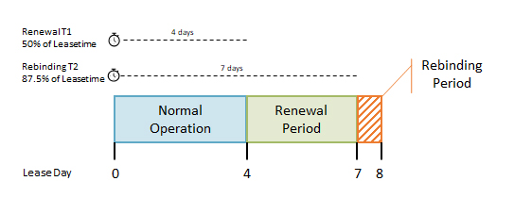
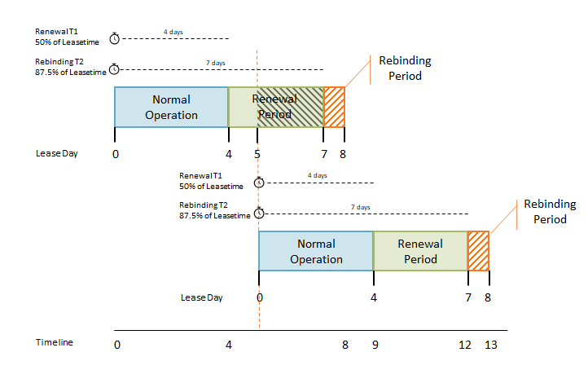
DHCP Lease “Life Cycle”
Life cycle
Allocation
Reallocation
Normal operation
Renewal
Rebinding
Release
DHCP Lease Time - What is it and How does it work? — LazyAdmin

Slide 9
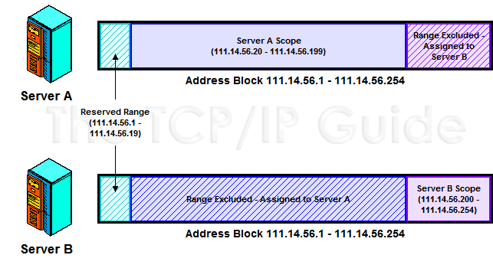
DHCP Lease Address Pools
Each DHCP server maintains a set of IP addresses
Use to allocate leases to clients
Most of clients are equals
A range of addresses is normally handled as a single group defined for a particular network
The TCP/IP Guide - DHCP Lease Address Pools, Ranges (Scopes) and Address Management

Slide 10
DHCP Protocol (1)
Client
Server
DHCP Discover
Broadcasted by client to find available server
Client can request its last-known IP, but the server can ignore it
DHCP Offer
Server find IP for client based on clients hardware address (MAC)
DHCP Request
Client request the IP it want to the server.
DHCP Acknowledge
Server acknowledges the client, admit him to use the requested IP
※ Question
Why not use the IP after DHCP offer?
廣播: 我要 IP
DHCP Discover
src: 0.0.0.0 port: 68
dst: 255.255.255.255 port: 67
你可以用 IP1
DHCP Offer
src: 192.168.1.1 port: 67
dst: 255.255.255.255 port: 68
DHCP option
IP=192.168.1.100
netmask=255.255.255.0
router=192.168.1.1 dns=192.168.1.1
IP lease time=1 day
請給我 IP1
DHCP Request
src: 0.0.0.0 port: 68
dst: 255.255.255.255 port: 67
DHCP option
Request IP=192.168.1.100
DHCP Server=192.168.1.1
給你用 IP1
DHCP Ack
src: 192.168.1.1 port: 67
dst: 255.255.255.255 port: 68
DHCP option
IP=192.168.1.100
netmask=255.255.255.0
router=192.168.1.1 dns=192.168.1.1
IP lease time=1 day

Slide 11
DHCP Protocol (2)
DHCP Inform
Request more information than the server sent
Repeat data for a particular application
ex. browsers request web proxy settings from server
It does not refresh the IP expiry time in server’s database
DHCP Release
Client send this request to server to releases the IP, and the client will un-configure this IP
Not mandatory

Slide 12
DHCP Server on FreeBSD (1)
Kernel support
device bpf (FreeBSD 5.x↑)
pseudo-device bpf (FreeBSD 4.x↓)
Install DHCP server
/usr/ports/net/isc-dhcp44-server/
pkg install isc-dhcp44-server
Enable DHCP server in /etc/rc.conf
dhcpd_enable="YES"
dhcpd_flags="-q"
dhcpd_conf="/usr/local/etc/dhcpd.conf"
dhcpd_ifaces=""
dhcpd_withumask="022"

Slide 13
DHCP Server on FreeBSD (2)
Three-way handshake
Option definitions
option domain-name "cs.nctu.edu.tw";
option domain-name-servers 140.113.235.107, 140.113.1.1;
default-lease-time 600;
max-lease-time 7200;
ddns-update-style none;
log-facility local7;
/etc/syslogd.conf
/etc/newsyslog.conf

Slide 14
DHCP Server on FreeBSD (3)
Subnet definition
Host definition
subnet 192.168.1.0 netmask 255.255.255.0 {
range 192.168.1.101 192.168.1.200;
option domain-name "cs.nctu.edu.tw";
option routers 192.168.1.254;
option broadcast-address 192.168.1.255;
option domain-name-servers 140.113.17.5, 140.113.1.1;
default-lease-time 3600;
max-lease-time 21600;
}
host fantasia {
hardware ethernet 08:00:07:26:c0:a5;
fixed-address 192.168.1.30;
}
host denyClient {
hardware ethernet 00:07:95:fd:12:13;
deny booting;
}

Slide 15
DHCP Server on FreeBSD (4)
Important files
/usr/local/sbin/dhcpd
/usr/local/etc/dhcpd.conf
/var/db/dhcpd.leases (leases issued)
/usr/local/etc/rc.d/isc-dhcpd

Slide 16
NAT –
Network Address Translation

Slide 17
IP Address Crisis
IP address crisis
Run out of class B address
The most desirable ones for moderately large organizations
IP address were being allocated on a FCFS
With no locality of reference
Solutions
Short term
Subnetting and CIDR (classless inter-domain routing)
NAT (network address translation)
Long term
IPv6

Slide 18
Network Address Translation (NAT)
Some important characteristics of how most organizations use the internet
Most hosts are client
Few hosts access the internet simultaneously
Internet communications are routed
Network Address Translation
RFC 1631, in May 1994
A basic implementation of NAT involves
Using one of the private addresses for local networks
Assigned one or more public IP addresses
The word ‘translator’ refers to the device that implements NAT

Slide 19
Private Address Space
Private addresses space defined by RFC1918
24-bit block (Class A)
10.0.0.0/8
20-bit block (16 contiguous Class B)
172.16.0.0/12 ~ 172.31.0.0/12
16-bit block (256 contiguous Class C)
192.168.0.0/16 ~ 192.168.255.0/16
Operation consideration
Router should set up filters for both inbound and outbound private network traffic

Slide 20
Network Address Translation (NAT)
What is NAT?
Network Address Translation
Re-write the source and/or destination addresses of IP packets when they pass through a router or firewall
What can be re-written?
Source/destination IPs
Source/destination ports
What can NAT do?
Solve the IPv4 address shortage. (the most common purpose)
Kind of firewall (security)
Load balancing
Fail over (for service requiring high availability)

Slide 21
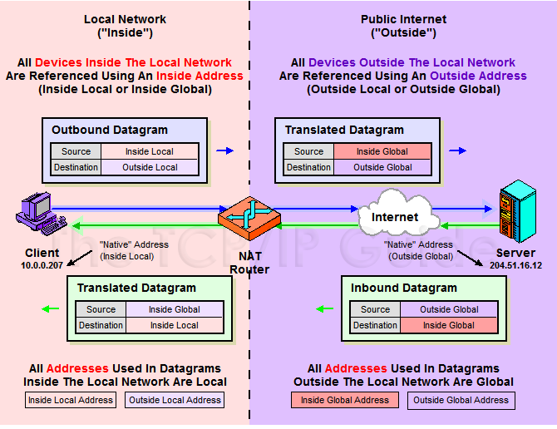
NAT Terminology
The TCP/IP Guide - IP NAT Address Terminology

Slide 22
NAT Address Mappings
Each time a NAT router encounters an IP datagram
It must translate addresses
BUT, how does it know what to translate, and what to use for the translated addresses
Translation table
Maps the inside local address to the inside global address
Also contains mappings between outside global address and outside local address for inbound translations
Two address mappings
Static mappings
Allow the inside host with an inside local address to always use a inside global address
Dynamic mappings
Allow a pool of inside global addresses to be shared by a large number of inside hosts

Slide 23
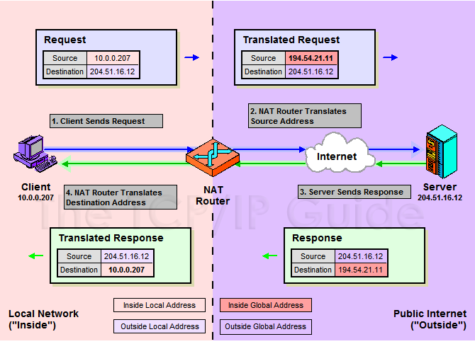
NAT Unidirectional Operation
NAT Unidirectional Operation
Traditional/Outbound operation
The original variety of NAT in RFC 1631
The simplest NAT
The client/server request/response communication would sent from the inside to outside network
The TCP/IP Guide - IP NAT Unidirectional (Traditional/Outbound) Operation

Slide 24
NAT Bidirectional Operation
NAT Bidirectional Operation
Two-Way/Inbound operation
A host on the outside network initiate a transaction with one on the inside
The problem with inbound NAT
NAT is inherently asymmetric
The outside network does not know the private addresses of the inside network
Hidden addresses are not routable
The outbound hosts DO NOT know the identity of the NAT router
NAT mapping table

Slide 25
NAT Bidirectional Operation
Two methods to resolve the hidden address problem
Static mapping
DNS
RFC 2694, DNS extensions to NAT
The basic process is as follows
The outside host sends a DNS request using the name of the private host
The DNS server for the internal network resolves the name into an inside local address
The inside local address is passed to NAT and used to create a dynamic mapping
DNS server sends back the name resolution with the inside global address

Slide 26
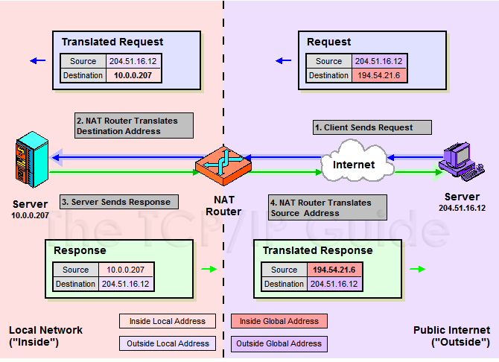
NAT Bidirectional Operation
The TCP/IP Guide - IP NAT Bidirectional (Two-Way/Inbound) Operation

Slide 27
NAT Port-Based Operation
NAT Port-Based Operation
Overloaded operation
Network Address Port Translation (NAPT)/Port Address Translation (PAT)
Both traditional NAT and bidirectional NAT work by swapping inside network and outside network addresses
One-to-one mapping between inside local address and inside global address
Use dynamic address assignment to allow a large number of private hosts to share a small number of registered public addresses
Using ports to multiplex private addresses
Also translate port addresses
Allow 250 hosts on the private network to use only 20 IP address
Overloading of an inside global address

Slide 28
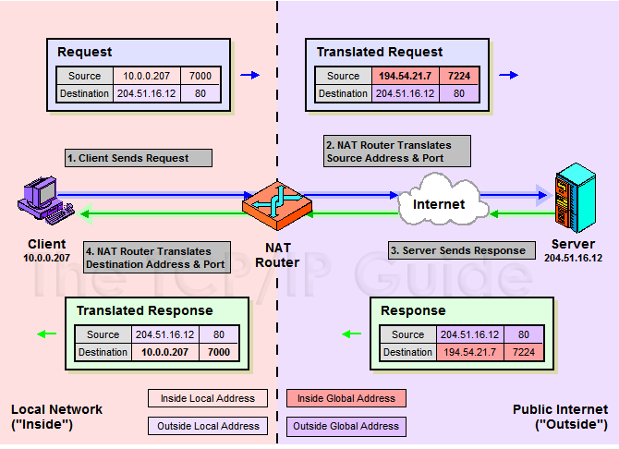
NAT Port-Based Operation
The TCP/IP Guide - IP NAT Port-Based ("Overloaded") Operation: Network Address Port Translation (NAPT) / Port Address Translation (PAT)

Slide 29

NAT Port-Based Operation
NAT example:
NAT mapping table
Orig | Alias | Remote
192.168.1.1:1029 192.168.1.1:1030 192.168.1.2:1029 192.168.1.2:1030 | 140.113.235.219:1029 140.113.235.219:1030 140.113.235.219:30029 140.113.235.219:30030 | ⇔ 140.113.235.72:23 ⇔ 140.113.235.72:23 ⇔ 140.113.235.72:21 ⇔ 140.113.235.72:21
140.113.235.72
140.113.235.0
140.113.235.219
Router with NAT
192.168.1.0
192.168.1.253
Orig:
192.168.1.1:1029 ⇔ 140.113.235.72:23
After NAT:
140.113.235.219:1092 ⇔ 140.113.235.72:23
192.168.1.1
192.168.1.2

Slide 30
NAT Overlapping Operation
NAT Overlapping Operation
Twice NAT Operation
The previous three versions of NAT are normally used to connect a network using private, non-routable addresses to the public internet
No overlap between the address spaces of the inside and outside network
Cases with overlapping private and public address blocks
Private network to private network connections
Invalid assignment of public address space to private network
Dealing with overlapping blocks by using NAT twice
Translate both the source and destination address on each transition
Rely on use of the DNS
Let the inside network send requests to the overlapping network in a way that can be uniquely identified

Slide 31
NAT Overlapping Operation
A client, 18.0.0.18, wants to send a request to the server www.twicenat.mit.edu, 18.1.2.3.
18.0.0.18 sends a DNS request
NAT router intercepts this DNS request
Consult its tables to find a special mapping for this outside host
NAT router returns 172.16.44.55 to the source client
The TCP/IP Guide - IP NAT Port-Based ("Overloaded") Operation: Network Address Port Translation (NAPT) / Port Address Translation (PAT)

Slide 32
NAT Compatibility Issues
It is NOT possible for NAT to be completely transparent to the hosts that use it
ICMP Manipulations
Applications that embed IP address
FTP
Additional issues with port translation
The issues applying to addresses now apply to ports as well
Problems with IPSec
IP datagram
ICMP message
data portion of ICMP message
Ethernet header
IP header
ICMP header
IP header of datagram that generated error
UDP header
14 bytes
20 bytes
8 bytes
20 bytes
8 bytes

Slide 33



SNAT
SNAT & DNAT
S: Source D: Destination
SNAT
Rewrite the source IP and/or Port.
The rewritten packet looks like one sent by the NAT server.
S: 192.168.1.1:1234
D: 140.113.235.107:53
S: 140.113.235.250:10234
D: 140.113.235.107:53
NAT Mapping Table:
192.168.1.1:1234 – 140.113.235.250:10234
192.168.1.254
140.113.235.250
192.168.1.1
140.113.235.250

Slide 34
DNAT
DNAT
Rewrite the destination IP and/or Port.
The rewritten packet will be redirect to another IP address when it pass through NAT server.
Both SNAT and DNAT are usually used together in coordination for two-way communication.
S: 140.113.24.107:1357
D: 192.168.1.1:80
S: 140.113.24.107:1357
D: 140.113.235.107:8080
NAT Mapping Table:
140.113.235.250:8080 – 192.168.1.1:80
192.168.1.254
140.113.235.250
192.168.1.1
140.113.24.107

Slide 35
NAT on FreeBSD (1)
Setup
Network topology
configuration
Advanced redirection configuration
Other Public Service Unprotected area
Web Server 192.168.1.1
Switch
Uplink to Internet
NAT Server Public: 140.113.235.4
Private: 192.168.1.254
Protected area
FTP Server 192.168.1.2
Switch
ipwf firewall
PC1 192.168.1.101
Private Network Hosts

Slide 36
NAT on FreeBSD (2)
IP configuration (in /etc/rc.conf)
ifconfig_fxp0="inet 140.113.235.4 netmask 255.255.255.0 media autoselect"
ifconfig_fxp1="inet 192.168.1.254 netmask 255.255.255.0 media autoselect“
defaultrouter="140.113.235.254“
Enable NAT
Here we use Packet Filter (PF) as our NAT server
Configuration file: /etc/pf.conf
nat
rdr
binat
# macro definitions
extdev='fxp0'
intranet='192.168.1.0/24'
webserver='192.168.1.1'
ftpserver='192.168.1.2'
pc1='192.168.1.101'
# nat rules
nat on $extdev inet from $intranet to any -> $extdev
rdr on $extdev inet proto tcp to port 80 -> $webserver port 80
rdr on $extdev inet proto tcp to port 443 -> $webserver port 443
rdr on $extdev inet proto tcp to port 21 -> $ftpserver port 21

Slide 37
NAT on FreeBSD (3)
# macro definitions
extdev='fxp0‘
intranet='192.168.219.0/24‘
winxp=‘192.168.219.1’
server_int=‘192.168.219.2’
server_ext=‘140.113.214.13’
# nat rules
nat on $extdev inet from $intranet to any -> $extdev
rdr on $extdev inet proto tcp to port 3389 -> $winxp port 3389
binat on $extdev inet from $server_int to any -> $server_ext

