Slide 1
Postfix
lctseng (2020-2022, CC-BY)
? (?-2019)

Slide 2
Postfix
Postfix v3.6.x
Latest stable release: 3.7.0 (Feb 2022)
/usr/ports/mail/postfix
pkg install postifx
http://www.postfix.org
http://www.postfix.org/documentation.html

Slide 3
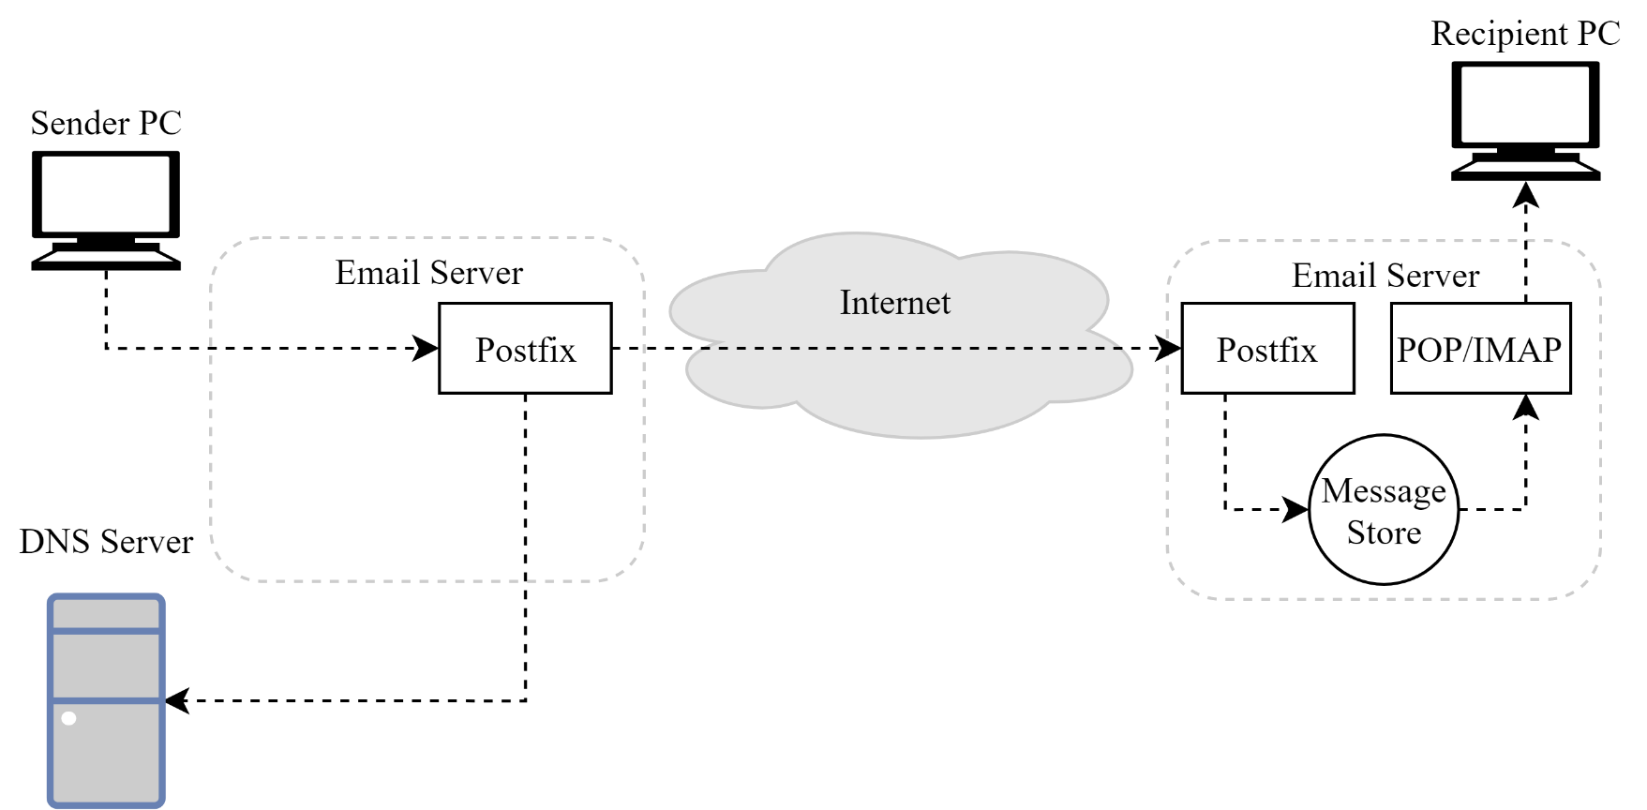
Role of Postfix
MTA that
Receive and deliver email over the network via SMTP
Local delivery directly or use other mail delivery agent
http://www.postfix.org/OVERVIEW.html

Slide 4
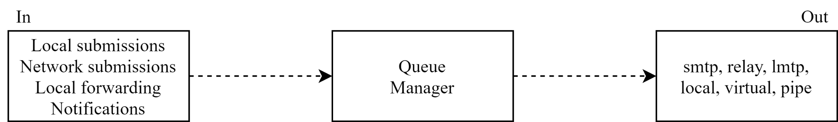
Postfix Architecture
Modular-design MTA
Not like sendmail of monolithic system
Decompose into several individual program that each one handle specific task
The most important daemon: master daemon
Reside in memory
Get configuration information from master.cf and main.cf
Invoke other process to do jobs
Major tasks
Receive mail and put in queue
Queue management
Delivery mail from queue

Slide 5
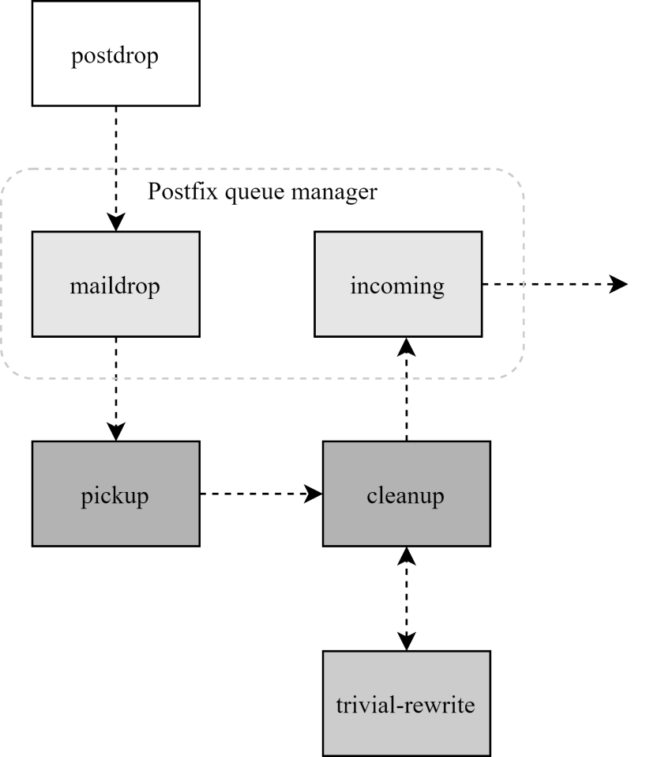
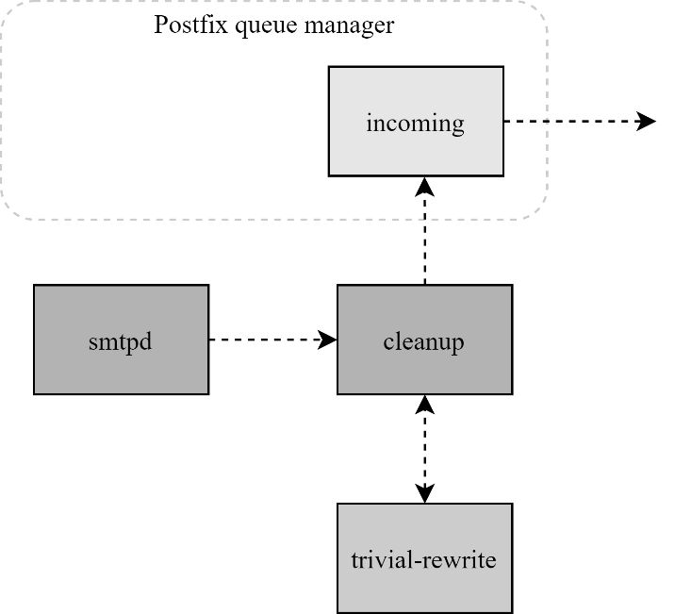
Postfix Architecture – Message IN
Four ways
Local submission
postdrop command
maildrop queue
pickup daemon
cleanup daemon
Header validation
Address translation
incoming queue
Network submission
smtpd daemon
Local forwarding
Resubmit for such as .forward
Envelope "to" is changed
Notification
Notify admin when error happens
Local submission
Network submission

Slide 6
Postfix Architecture – Queue
Five different queues
incoming
The first queue that every incoming email will stay
active
Queue manager will move message into active queue whenever there is enough system resources
Queue manager then invokes suitable DA to delivery it
deferred
Messages that cannot be delivered are moved here
These messages are sent back either with bounce or defer daemons
corrupt
Used to store damaged or unreadable message
hold
Requested by admin (manually or automatically)
Stay in queue until admin intervenes
http://www.postfix.org/QSHAPE_README.html#queues

Slide 7
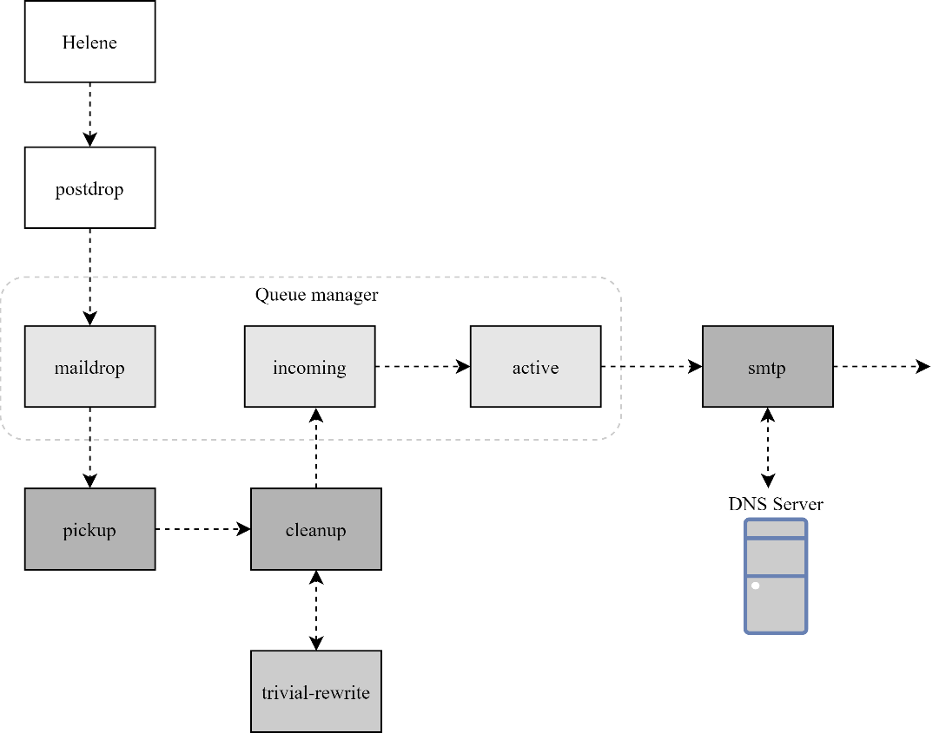
Message Flow in Postfix (1)
Example
helene@oreilly.com => frank@postfix.org (doel@onlamp.com)
Phase1:
Helene compose mail using her MUA, and then call postfix’s sendmail command to send it
alias
oreilly.com

Slide 8
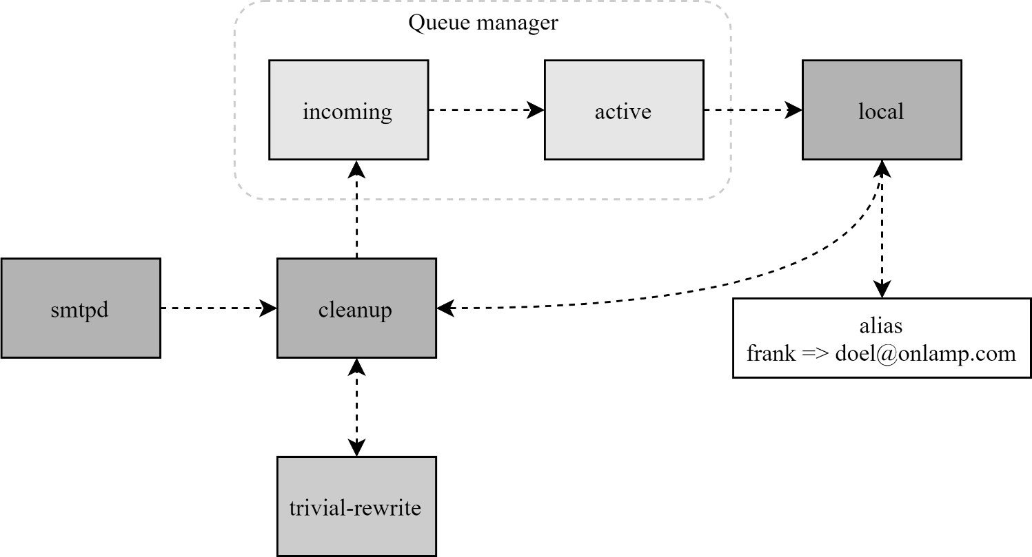
Message Flow in Postfix (2)
Example
frank@postfix.org => doel@onlamp.com
Phase2:
The smtpd on postfix.org takes this message and invoke cleanup then put in incoming queue
The local DA find that frank is an alias, so it resubmits it through cleanup daemon for further delivery
Postfix.org

Slide 9
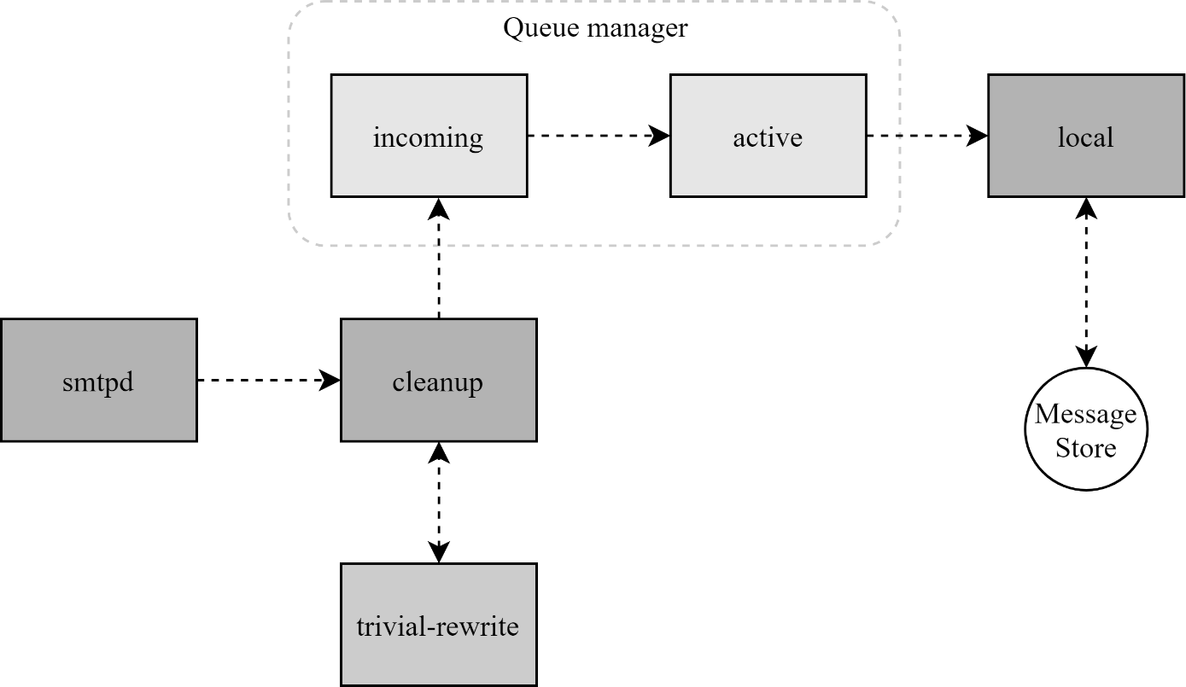
Message Flow in Postfix (3)
Example
frank@postfix.org => doel@onlamp.com
Phase3
The smtpd on onlamp.com takes this message and invoke cleanup then put in incoming queue
Local delivery to message store
onlamp.com

Slide 10
Message Store Format
The Mbox format
Store messages in single file for each user
Each message start with "From" line and continued with message headers and body
Mbox format has file-locking problem (performance)
The Maildir format
Use structure of directories to store email messages
Each message is in its owned file
Three subdirectories - cur, new, and tmp
Maildir format has scalability problem
locate and delete mails quickly, but waste amounts of fd, inodes, space
Problems of quota and backup
Related parameters (in main.cf)
mail_spool_directory = /var/mail (Mbox)
mail_spool_directory = /var/mail/ (Maildir)
cur: already read
new: unread
tmp: under receving (working dir)

Slide 11
Read your mail from terminal
To read mails, you must login via ssh
Built-in command to read mail: "mail"
Friendly command-line MUA: "mutt"
Pkg: mutt
Port: mail/mutt
To read from remote host
Supports MUA like Outlook, Thunderbird, or even Gmail
You need MAA (supports IMAP/POP3)
Dovecot
Pkg: dovecot
Port: mail/dovecot

Slide 12
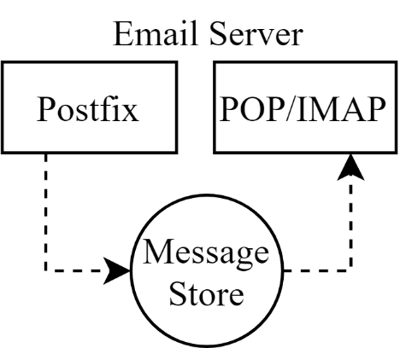
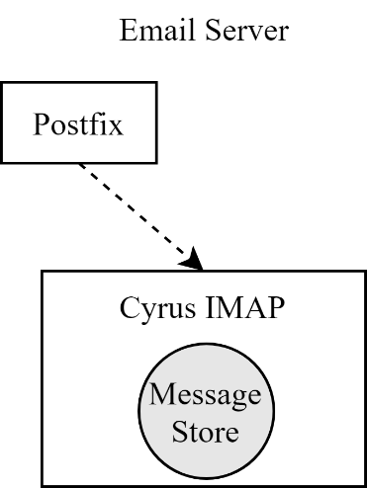
Postfix & POP3/IMAP
POP3 vs. IMAP
Both are used to retrieve mail from server for remote clients
POP3 has to download entire message, while IMAP can download headers only
POP3 can download only single mailbox, while IMAP can let you maintain multiple mailboxes and folders on server
Postfix works together with POP3/IMAP
Postfix and POP3/IMAP must agree on the type of mailbox format and style of locking
Standard message store
Non-standard message store
Such as Cyrus IMAP or Dovecot

Slide 13
Postfix Configuration
Two most important configuration files
/usr/local/etc/postfix/main.cf – postconf(5)
Core configuration
/usr/local/etc/postfix/master.cf – master(5)
Which postfix service should invoke which program
Edit main.cf
Using text editor
postconf
$ postconf [-e] "myhostname=nasa.cs.nctu.edu.tw"
$ postconf -d myhostname (print default setting)
$ postconf myhostname (print current setting)
Reload postfix whenever there is a change
$ postfix reload

Slide 14
Postfix Configuration – Lookup tables (1)
Parameters that use external files to store values
Such as mydestination, mynetwork, relay_domains
Text-based table is ok, but time-consuming when table is large
Lookup tables syntax
Key values
Database format
$ postconf -m
List all available database format
In main.cf
default_database_type
% postconf -m
btree
cidr
environ
hash
internal
proxy
regexp
static
tcp
texthash
unix
$ postconf default_database_type
default_database_type = hash
$ postconf -h default_database_type
hash
http://www.postfix.org/DATABASE_README.html

Slide 15
Postfix Configuration – Lookup tables (2)
Use databased-lookup table in main.cf
syntax
parameter = type:name
E.g.
In main.cf canonical_maps = hash:/usr/local/etc/postfix/canonical
After execute postmap /usr/local/etc/postfix/canonical.db
postmap command
Generate database
$ postmap hash:/usr/local/etc/postfix/canonical
Query
$ postmap -q nctu.edu.tw hash:/usr/local/etc/postfix/canonical
don’t need to add ".db" here

Slide 16
Postfix Configuration – Lookup tables (3)
Regular expression tables
More flexible for matching keys in lookup tables
Sometimes you cannot list all the possibilities
Two regular expression libraries used in Postfix
POSIX extended regular expression (regexp, default)
Perl-Compatible regular expression (PCRE)
Usage
/pattern/ value
Do some content checks (filtering)
header_checks
body_checks
Design some features
/(\S+)\.(\S+)@cs\.nctu\.edu\.tw/ $1@cs.nctu.edu.tw

Slide 17
Postfix Configuration – Categories
Categories
Server identities
my...
Mail rewriting
for incoming/outgoing mails
Access control
restrictions
Mail processing
filter
Operation details
…

Slide 18
Postfix Configuration – MTA Identity
Four related parameters
myhostname
myhostname = nasa.cs.nctu.edu.tw
If un-specified, postfix will use ‘hostname’ command
mydestination
List all the domains that postfix should accept for local delivery
mydestination = $myhostname, localhost.$mydomain $mydomain
This is the CS situation that MX will route mail to mailgate
mydestination = $myhostname www.$mydomain, ftp.$mydomain
mydomain
mydomain = cs.nctu.edu.tw
If un-specified, postfix use myhostname minus the first component
myorigin
myorigin = $mydomain (default is $myhostname)

Slide 19
Postfix Configuration – System-wide aliases
Using aliases in Postfix (first-matching)
alias_maps = hash:/etc/aliases
alias_maps = hash:/etc/aliases, nis:mail.aliases
alias_database = hash:/etc/aliases
alias_map vs alias_database
alias_map
Which map to use (lookup table)
Not all of them is controlled by Postfix
E.g. nis
alias_database
Tell "newaliases" which (local) database to rebuild

Slide 20
Postfix Configuration – System-wide aliases
To Build alias database file
$ postalias /etc/aliases
Can be used on files other than /etc/aliases
$ newaliases
For /etc/aliases => can be changed by "alias_database"
Alias file format (same as sendmail)
Value can be
Email address, filename, |command, :include:
Alias restriction (alias, forward, include)
allow_mail_to_commands = alias, forward
allow_mail_to_files = alias, forward

Slide 21
Postfix Configuration – Virtual Alias Maps
Virtual Alias Map
It recursively rewrites envelope recipient addresses for all local, all virtual, and all remote mail destinations.
virtual_alias_domains = $virtual_alias_maps (default)
virtual_alias_maps = hash:/usr/local/etc/postfix/virtual
src-address dst-address
lctseng@cs.nctu.edu.tw @nasa.cs.nctu.edu.tw
lctseng alice@gmail.com
@cs.nycu.edu.tw @cs.nctu.edu.tw
Applying regular expression
virtual_alias_maps = pcre:/usr/local/etc/postfix/virtual
/^root(\..+)?@(t)?(cs|np)?bsd\d*\.cs\.nctu\.edu\.tw$/ bsdta@cs.nctu.edu.tw
/^root(\..+)?@(t)?(cs|np)?linux\d*\.cs\.nctu\.edu\.tw$/ linuxta@cs.nctu.edu.tw
/^root(\..+)?@(t)?csmail\w*\d*\.cs\.nctu\.edu\.tw$/ mailta@cs.nctu.edu.tw

Slide 22
Postfix Configuration – Virtual Alias Maps vs Alias Map
alias_map
Used by local(8) delivery
Key must be local recipients
Value can be email/file/command/…
virtual_alias_maps
Used by virtual(5) delivery
Higher priority than alias_map
Key can be
user@domain
user
@domain
Value must be valid email addresses or local recipients

Slide 23
Postfix Configuration – Relay Control (1)
Open relay
A mail server that permit anyone to relay mails
Neither originates or ends with a user from its domain
Spam
By default, postfix is not an open relay
A mail server should
Relay mail for trusted user
Such as lctseng@smtp.cs.nctu.edu.tw
Relay mail for trusted domain
E.g. smtp.cs.nctu.edu.tw trusts cs.nctu.edu.tw

Slide 24
Postfix Configuration – Relay Control (2)
Restricting relay access by mynetworks_style
mynetworks_style = subnet
Allow relaying from other hosts in the same subnet, configured in this machine
mynetworks_style = host
Allow relaying for only local machine
mynetworks_style = class
Any host in the same class A, B or C
Usually we don’t use this - your server may trust the whole subnet from your provider

Slide 25
Postfix Configuration – Relay Control (3)
Restricting relay access by mynetworks (override mynetworks_style)
List individual IP or subnets in network/netmask notation
E.g. in /usr/local/etc/postfix/mynetworks
127.0.0.0/8
140.113.0.0/16
10.113.0.0/16
Relay depends on the type of your mail server
smtp.cs.nctu.edu.tw will be different from csmx1.cs.nctu.edu.tw
Outgoing: usually accepts submission from local domain
Incoming: may relay mails for trusted domains

Slide 26
Postfix Configuration – Rewriting address (1)
For unqualified address
To append "myorigin" to local name
lctseng => lctseng@nasa.cs.nctu.edu.tw
append_at_myorigin = yes
To append "mydomain" to address that contain only host.
lctseng@nasa=> lctseng@nasa.cs.nctu.edu.tw
append_dot_mydomain = yes

Slide 27
Postfix Configuration – Rewriting address (2)
Masquerading hostname
Hide the names of internal hosts to make all addresses appear as if they come from the same mail server
It is often used in out-going mail gateway
masquerade_domains = cs.nctu.edu.tw
lctseng@subdomain.cs.nctu.edu.tw => lctseng@cs.nctu.edu.tw
masquerade_domains = !chairman.cs.nctu.edu.tw cs.nctu.edu.tw
masquerade_exceptions = admin, root
Rewrite to all envelope and header address excepts envelope recipient address (the default)
masquerade_class = envelope_sender, header_sender, header_recipient
This allows incoming messages can be filtered based on their recipient address

Slide 28
Postfix Configuration – Rewriting address (3)
Canonical address – canonical(5)
Rewrite both header and envelope recursively invoked by cleanup daemon
In main.cf
canonical_maps = hash:/usr/local/etc/postfix/canonical
canonical_classes = envelope_sender, envelope_recipient, header_sender, header_recipient
In canonical
/^(.*)@(t)?(cs)?(bsd|linux|sun)\d*\.cs\.nctu\.edu\.tw$/ $1@cs.nctu.edu.tw
Simlar configurations
sender_canonical_maps、sender_canonical_classes
recipient_canonical_maps、recipient_canonical_classes

Slide 29
Postfix Configuration – Rewriting address (4)
Relocated users
Used to inform sender that the recipient is moved
"user has moved to new_location" bounce messages
In main.cf
relocated_maps = hash:/usr/local/etc/postfix/relocated
In relocated
andy@nasa.cs.nctu.edu.tw andyliu@abc.com
lctseng EC319, NCTU, Hsinchu, ROC
@nabsd.cs.nctu.edu.tw zfs.cs.nctu.edu.tw
Unknown users
Not local user and not found in maps
Default action: reject
Value can be anything: phone number, street address, …

Slide 30
Postfix Configuration – master.cf (1)
/usr/local/etc/postfix/master.cf (master(5))
Define services that master daemon can invoke
Each row defines a service and
Each column contains a specific configuration option
# ==========================================================================
# service type private unpriv chroot wakeup maxproc command + args
# (yes) (yes) (yes) (never) (100)
# ==========================================================================
smtp inet n - n - - smtpd
pickup unix n - n 60 1 pickup
cleanup unix n - n - 0 cleanup
rewrite unix - - n - - trivial-rewrite
smtp unix - - n - - smtp
local unix - n n - - local
virtual unix - n n - - virtual
relay unix - - n - - smtp
-o smtp_fallback_relay=
lmtp unix - - n - - lmtp
maildrop unix - n n - - pipe
flags=DRhu user=vmail argv=/usr/local/bin/maildrop -d ${recipient}

Slide 31
Postfix Configuration – master.cf (2)
Configuration options
Service name
Service type
inet, unix, fifo (obsolete), or pass
Private
Access to this component is restricted to the Postfix system
"inet" type cannot be private
Unprivileged
Run with the least amount of privilege required
y will run with the account defined in "mail_owner"
n will run with root privilege
local, pipe, spawn, and virtual

Slide 32
Postfix Configuration – master.cf (3)
Configuration options
Chroot
chroot location is defined in "queue_directory"
Wake up time
Automatically wake up the service after the number of seconds
Process limit
Number of processes that can be executed simultaneously
Default count is defined in "default_process_limit"
command + args
Default path is defined in "daemon_directory"
/usr/libexec/postfix

Slide 33
Postfix Architecture – Message OUT
Local delivery
Relay to the destinations
Other delivery agent (MDA)
Specify in /usr/local/etc/postfix/master.cf
How a client program connects to a service and what daemon program runs when a service is requested
lmtp
Local Mail Transfer Protocol (Limited SMTP)
No queue
One recipient at once
Used to deliver to mail systems on the same network or even the same host
pipe
Used to deliver message to external program

Slide 34
Mail Relaying – Transport Maps (1)
Transport maps – transport(5)
It override default transport method to deliver messages
In main.cf
transport_maps = hash:/usr/local/etc/postfix/transport
In transport file
domain_or_address transport:nexthop
csie.nctu.edu.tw smtp:[mailgate.csie.nctu.edu.tw]
cs.nctu.edu.tw smtp:[csmailgate.cs.nctu.edu.tw]
cis.nctu.edu.tw smtp:[mail.cis.nctu.edu.tw]
example.com smtp:[192.168.23.56]:20025
orillynet.com smtp
ora.com maildrop
kdent@ora.com error:no mail accepted for kdent
"Service" defined in master.cf

Slide 35
Mail Relaying – Transport Maps (2)
Usage in transport map
MX => Local delivery mail server
mailpost to bbs/news
Postponing mail relay
Such as ISP has to postpone until customer network is online
In transport map: abc.com ondemand
In /usr/local/etc/postfix/master.cf ondemand unix - - n - - smtp
In /usr/local/etc/postfix/main.cf defer_transports = ondemand transport_maps = hash:/usr/local/etc/postfix/transport
Whenever the customer network is online, do
$ postqueue -s abc.com
"ondemand" transport should trigger by postqueue

Slide 36
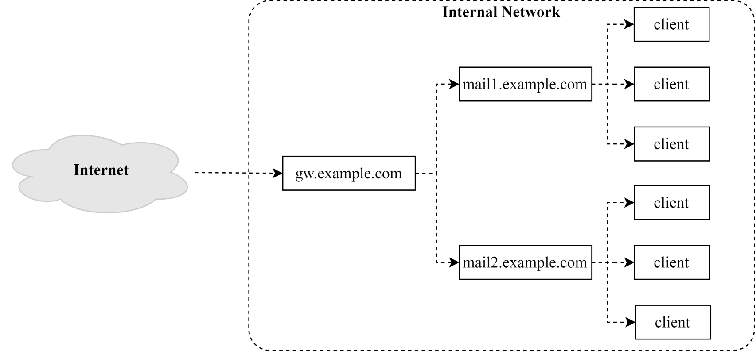
Mail Relaying – Inbound Mail Gateway (1)
Inbound Mail Gateway (IMG, MX)
Accept all mail for a network from the Internet and relays it to internal mail systems
E.g.
gw.example.com is a IMG
With MX records
mail1.example.com is internal mail system
Serves internal subnet

Slide 37
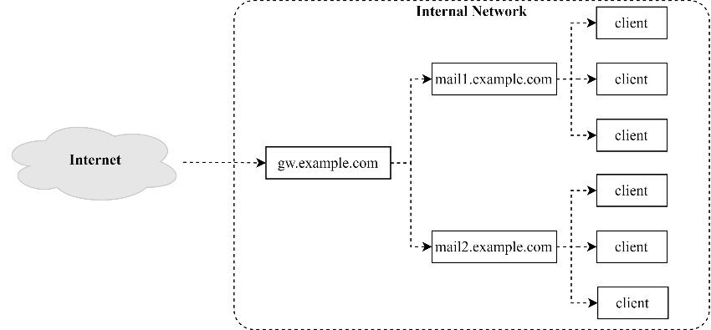
Mail Relaying – Inbound Mail Gateway (2)
To be IMG, suppose
You are administrator for cs.nctu.edu.tw
Hostname is csmx1.cs.nctu.edu.tw
You have to be the IMG for secureLab.cs.nctu.edu.tw and javaLab.cs.nctu.edu.tw
Firewall only allow outsource connect to IMG port 25
The MX record for secureLab.cs.nctu.edu.tw and javaLab.cs.nctu.edu.tw should point to csmx1.cs.nctu.edu.tw
In csmx1.cs.nctu.edu.tw, relay_domains = secureLab.cs.nctu.edu.tw javaLab.cs.nctu.edu.tw transport_maps = hash:/usr/local/etc/postfix/transport secureLab.cs.nctu.edu.tw relay:[secureLab.cs.nctu.edu.tw] javaLab.cs.nctu.edu.tw relay:[javaLab.cs.nctu.edu.tw]
In secureLab.cs.nctu.edu.tw ( and so do javaLab.cs.nctu.edu.tw) mydestination = secureLab.cs.nctu.edu.tw
csmx1
javaLab
secureLab

Slide 38
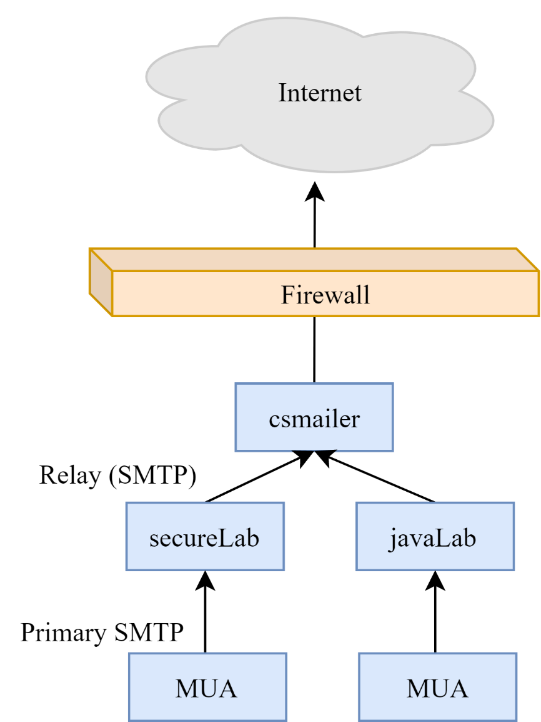
Mail Relaying – Outbound Mail Gateway
Outbound Mail Gateway
Accept mails from inside network and relay them to Internet hosts
To be OMG, suppose
You are administrator for cs.nctu.edu.tw
Hostname is csmailer.cs.nctu.edu.tw
You have to be the OMG for secureLab.cs.nctu.edu.tw and javaLab.cs.nctu.edu.tw
In main.cf of csmailer.cs.nctu.edu.tw
mynetworks = hash:/usr/local/etc/postfix/mynetworks
All students in secureLab/javaLab will configure their MUA to use secureLab/javaLab.cs.nctu.edu.tw to be the SMTP server
In main.cf of secureLab/javaLab.cs.nctu.edu.tw,
relayhost = [csmailer.cs.nctu.edu.tw]
secureLab.cs.nctu.edu.tw
javaLab.cs.nctu.edu.tw

Slide 39
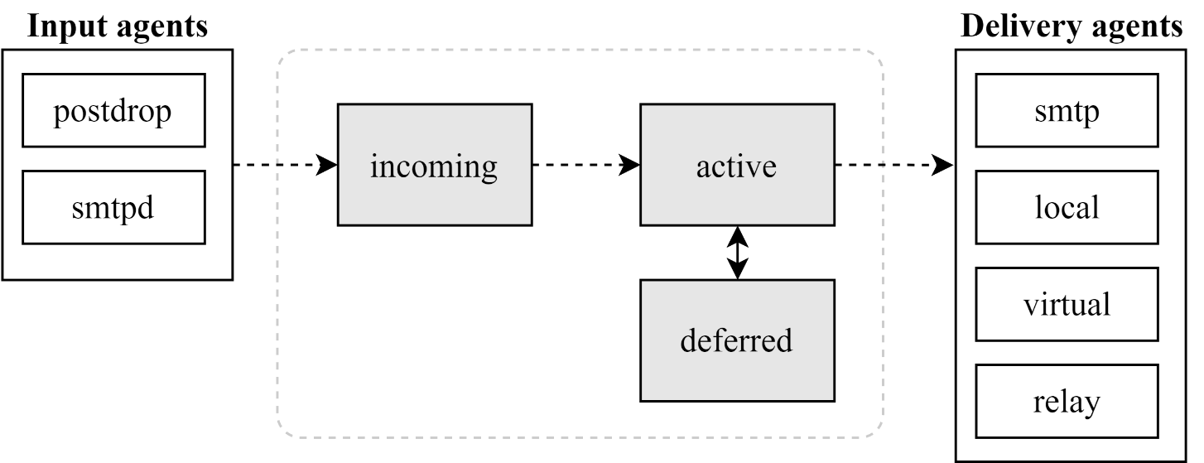
Queue Management
The queue manage daemon
qmgr daemon
Unique queue ID
Queue directories (/var/spool/postfix/*)
active, bounce, corrupt, deferred, hold
Message movement between queues
Temporary problem => deferred queue
qmgr takes messages alternatively between incoming and deferred queue to active queue

Slide 40
Queue Management – Queue Scheduling
Double delay in deferred messages
Between
minimal_backoff_time = 300s
maximal_backoff_time = 4000s
qmgr daemon periodically scan deferred queue for reborn messages
queue_run_delay = 300s
Deferred => bounce
maximal_queue_lifetime = 5d

Slide 41
Queue Management – Message Delivery
Controlling outgoing messages
When there are lots of messages in queue for the same destination, it should be careful not to overwhelm it
If concurrent delivery is success, postfix can increase concurrency between:
initial_destination_concurrency = 5
default_destination_concurrency_limit = 20
Under control by
maxproc in /usr/local/etc/postfix/master.cf
You can override the default_destination_concurrency_limit for any transport mailer:
smtp_destination_concurrency_limit = 25 for external delivery
local_destination_concurrency_limit = 10 for local recipients
Control how many recipients for a single outgoing message
default_destination_recipient_limit = 50
You can override it for any transport mailer in the same idea:
smtp_destination_recipient_limit = 100

Slide 42
Queue Management – Error Notification
Sending error messages to administrator
Set notify_classes parameter to list error classes that should be generated and sent to administrator
Ex: notify_classes = resource, software
Error classes
Error Class | Description | Noticed Recipient (all default to postmaster)
bounce | Send headers of bounced mails | bounce_notice_recipient
2bounce | Send undeliverable bounced mails | 2bounce_notice_recipient
delay | Send headers of delayed mails | delay_notice_recipient
policy | Send transcript when mail is reject due to anti-spam restrictions | error_notice_recipient
protocol | Send transcript that has SMTP error | error_notice_recipient
resource | Send notice because of resource problem | error_notice_recipient
software | Send notice because of software problem | error_notice_recipient

Slide 43
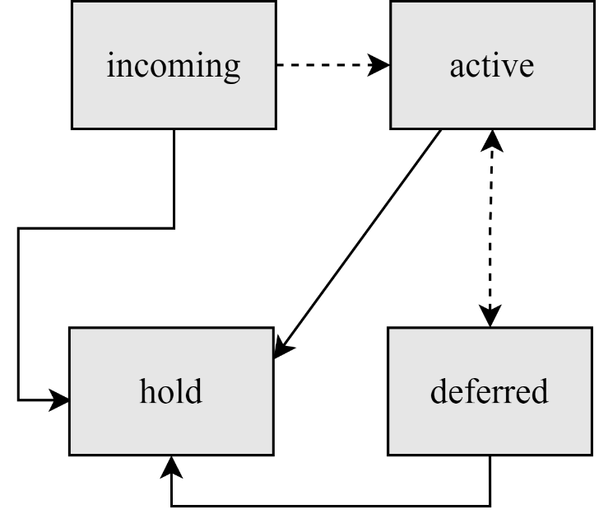
Queue Management – Queue Tools (1)
postqueue(1)
postqueue –p (or mailq)
Show the queued mails (with information like message ID, but not mail content)
postqueue –f
Attempt to flush(deliver) all queued mail
postqueue –s cs.nctu.edu.tw
Schedule immediate delivery of all mail queued for site
postsuper(1)
Delete queued messages
postsuper –d E757A3428C6 (from incoming, active, deferred, hold)
postsuper –d ALL
Put messages "on hold" so that no attempt is made to deliver it
postsuper –h E757A3428C6 (from incoming, active, deferred)
Release messages in hold queue (into deferred queue)
postsuper –H ALL
Requeue messages into maildrop queue (maildrop => pickup => cleanup => incoming)
postsuper –r E757A3428C6
postsuper –r ALL

Slide 44
Queue Management – Queue Tools (2)
postcat(1)
Display the contents of a queue file
nasa [/home/lctseng] -lctseng- mailq
-Queue ID- --Size-- ----Arrival Time---- -Sender/Recipient-------
3314234284A 602 Sat May 19 04:16:20 root@nasa.cs.nctu.edu.tw
(connect to csmx1.cs.nctu.edu.tw[140.113.235.104]:25: Operation timed out)
lctseng@cs.nctu.edu.tw
nasa [/home/lctseng] -lctseng- sudo postcat -q 3314234284A
*** ENVELOPE RECORDS deferred/3/3314234284A ***
message_size: 602 214 1 0 602
message_arrival_time: Sat May 19 04:16:20 2012
create_time: Sat May 19 04:16:20 2012
sender: root@nasa.cs.nctu.edu.tw
named_attribute: rewrite_context=local
original_recipient: root
recipient: lctseng@cs.nctu.edu.tw
*** MESSAGE CONTENTS deferred/3/3314234284A ***
Received: by nasa.cs.nctu.edu.tw (Postfix)
id 3314234284A; Sat, 19 May 2012 04:16:20 +0800 (CST)
Delivered-To: root@nasa.cs.nctu.edu.tw
Received: by nasa.cs.nctu.edu.tw (Postfix, from userid 0)
id 2CB713427A5; Sat, 19 May 2012 04:16:20 +0800 (CST)
To: root@nasa.cs.nctu.edu.tw
Subject: nasa.cs.nctu.edu.tw weekly run output
Message-Id: <20120518201620.2CB713427A5@nasa.cs.nctu.edu.tw>
Date: Sat, 19 May 2012 04:16:20 +0800 (CST)
From: root@nasa.cs.nctu.edu.tw (NASA Root)
Rebuilding locate database:
Rebuilding whatis database:
…

Slide 45
Multiple Domains
Use single system to host many domains
E.g.
We use csmailgate.cs.nctu.edu.tw to host both cs.nctu.edu.tw and csie.nctu.edu.tw
Purpose
Final delivery on the machine
Forwarding to destination elsewhere (mail gateway)
Important considerations
Does the same user id with different domain should go to the same mailbox or different mailbox?
YES (shared domain)
NO (separate domain)
Does every user require a system account in /etc/passwd ?
YES (system account)
NO (virtual account)

Slide 46
Multiple Domains – Shared Domain with System Account
Situation
The mail system should accept mails for both canonical and virtual domains and
The same mailbox for the same user id (lctseng@ => /var/mail/lctseng)
Procedure
Setup MX records for both domains
Modify "mydomain" to canonical domain
Modify "mydestination" parameter to let mails to virtual domain can be local delivered
E.g.
mydomain = cs.nctu.edu.tw
mydestination = $myhostname, $mydomain, csie.nctu.edu.tw
※ In this way, mail to both lctseng@cs.nctu.edu.tw and lctseng@csie.nctu.edu.tw will go to csmailgate:/var/mail/lctseng
Limitation
Can not separate lctseng@cs.nctu.edu.tw from lctseng@csie.nctu.edu.tw

Slide 47
Multiple Domains – Separate Domains with System Accounts
Situation
The mail system should accept mails for both canonical and virtual domains
Mailboxes are not necessarily the same for the same user id
Procedure
Modify "mydomain" to canonical domain
Modify "virtual_alias_domains" to accept mails to virtual domains
Create "virtual_alias_maps" map
E.g.
mydomain = cs.nctu.edu.tw
virtual_alias_domains = abc.com.tw, xyz.com.tw
virtual_alias_maps = hash:/usr/local/etc/postfix/virtual
Limitation
Need to maintain system accounts for virtual domain users
CEO@abc.com.tw andy
@xyz.com.tw jack

Slide 48
Multiple Domains – Separate Domains with Virtual Accounts (1)
Useful when users in virtual domains:
Do not need to login to system
Only need to retrieve mail through POP/IMAP server
Procedure
Modify "virtual_mailbox_domains" to let postfix know what mails it should accepts
Modify "virtual_mailbox_base" and create related directory to put mails
Create "virtual_mailbox_maps" map
E.g.
virtual_mailbox_domain = abc.com.tw, xyz.com.tw
virtual_mailbox_base = /var/vmail
Create /var/vmail/abc-domain and /var/vmail/xyz-domain
virtual_mailbox_maps = hash:/usr/local/etc/postfix/vmailbox
In /usr/local/etc/postfix/vmailbox
CEO@abc.com.tw abc-domain/CEO (Mailbox format)
CEO@xyz.com.tw xyz-domain/CEO/ (Maildir format)

Slide 49
Multiple Domains – Separate Domains with Virtual Accounts (2)
Ownerships of virtual mailboxes
Simplest way:
The same owner of POP/IMAP Servers
Flexibility in postfix
virtual_uid_maps and virtual_gid_maps
E.g.
virtual_uid_maps = static:1003
virtual_gid_maps = static:105
virtual_uid_maps = hash:/usr/local/etc/postfix/virtual_uids
virtual_uid_maps = hash:/usr/local/etc/postfix/virtual_uids static:1003
In /usr/local/etc/postfix/virtual_uids
CEO@abc.com.tw 1004
CEO@xyz.com.tw 1008

Slide 50
Step by Step Examples
Let’s learn from examples

Slide 51
Step by Step Examples
Build a Basic MTA
Send test mails to verify your MTA
Check whether your mail is sent or not
MTA Authentication
MTA Encryption
MAA for POP3 and IMAP
Note
In this example, we assume you have public IP/domain

Slide 52
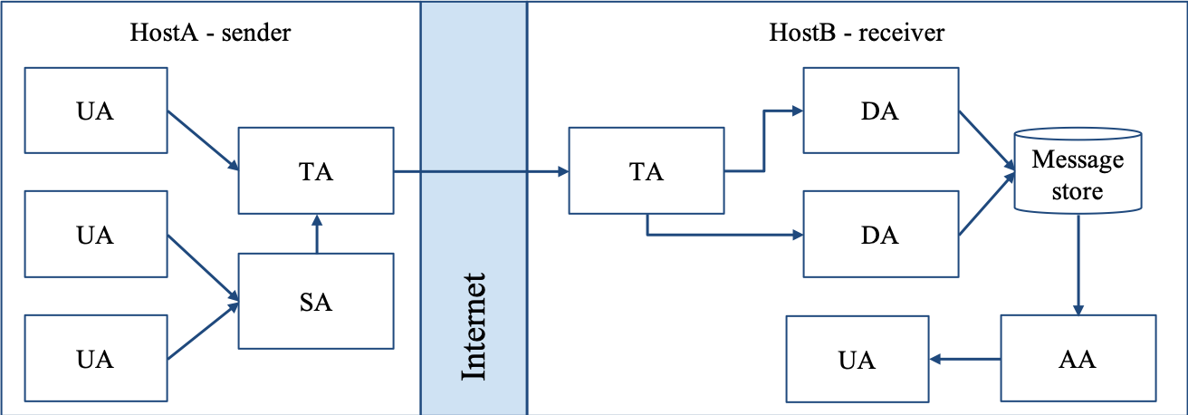
Build a Basic MTA
Can send mails to other domain

Slide 53
Build a basic MTA(1)
Can send mails to other domain
Install Postfix
Pkg: postfix
Port: mail/postfix
After installation
Disable "sendmail" program
service sendmail stop
In /etc/rc.conf
In /etc/periodic.conf (create if not exists)
sendmail_enable="NONE"
daily_clean_hoststat_enable="NO"
daily_status_mail_rejects_enable="NO"
daily_status_include_submit_mailq="NO"
daily_submit_queuerun="NO"

Slide 54
Build a basic MTA(2)
Replace sendmail by Postfix modified version
Edit /etc/mail/mailer.conf
Sendmail /usr/local/sbin/sendmail
send-mail /usr/local/sbin/sendmail
Mailq /usr/local/sbin/sendmail
newaliases /usr/local/sbin/sendmail

Slide 55
Build a basic MTA(3)
After installation
Enable postfix
Edit /etc/rc.conf
service postfix start
Set up DNS records
Some domains will reject mails from hosts without DNS record
Suppose the hostname is "demo1.nasa.lctseng.nctucs.net"
Set up these records
(A record) demo1.nasa.lctseng.nctucs.net
(A record) nasa.lctseng.nctucs.net
(MX record) nasa.lctseng.nctucs.net
Points to "demo1.nasa.lctseng.nctucs.net"
postfix_enable="YES"

Slide 56
Build a basic MTA(4)
Set up MTA identity
In main.cf
Reload or restart postfix to apply changes
$ postfix reload
myhostname = demo1.nasa.lctseng.nctucs.net
mydomain = nasa.lctseng.nctucs.net
myorigin = $myhostname
mydestination = $myhostname, localhost. $mydomain,
localhost, $mydomain

Slide 57
Send test mails to verify your MTA(1)
"telnet" or "mail" command
> telnet localhost 25
Trying 127.0.0.1...
Connected to localhost.
Escape character is '^]'.
220 demo1.nasa.lctseng.nctucs.net ESMTP Postfix
EHLO localhost
250-demo1.nasa.lctseng.nctucs.net
250-PIPELINING
250-SIZE 10240000
250-VRFY
250-ETRN
250-ENHANCEDSTATUSCODES
250-8BITMIME
250 DSN
MAIL FROM: lctseng@nasa.lctseng.nctucs.net
250 2.1.0 Ok
RCPT TO: lctseng@cs.nctu.edu.tw
250 2.1.5 Ok
DATA
354 End data with <CR><LF>.<CR><LF>
Subject: This is test mail
DATA
.
250 2.0.0 Ok: queued as 3C868150
telnet

Slide 58
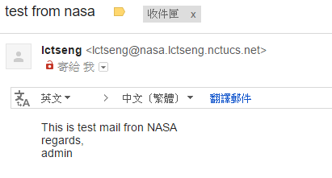
Send test mails to verify your MTA(2)
The "mail" command
See man page for more details
Result (gmail)
> mail -s "test from nasa" lctseng@gmail.com
This is test mail from NASA
regards,
admin
(Press Ctrl+D)
mail

Slide 59
Send test mails to verify your MTA(3)
Mail source text of the previous example
Delivered-To: lctseng@gmail.com
Received: by 10.129.125.135 with SMTP id y129csp874822ywc;
Sun, 6 Mar 2016 02:39:22 -0800 (PST)
X-Received: by 10.98.87.90 with SMTP id l87mr25639644pfb.70.1457260762400;
Sun, 06 Mar 2016 02:39:22 -0800 (PST)
Return-Path: <lctseng@nasa.lctseng.nctucs.net>
Received: from demo1.nasa.lctseng.nctucs.net …(omitted)
by mx.google.com with ESMTP id bz6si20406744pad.30.2016.03.06.02.39.21
for <lctseng@gmail.com>;
Sun, 06 Mar 2016 02:39:21 -0800 (PST)
Received-SPF: neutral (google.com: 140.113.168.238 is neither permitted …(omitted)
Authentication-Results: mx.google.com;
spf=neutral (google.com: 140.113.168.238 is neither permitted …(omitted)
Received: by demo1.nasa.lctseng.nctucs.net (Postfix, from userid 1001)
id 6D916162; Sun, 6 Mar 2016 18:38:04 +0800 (CST)
To: lctseng@gmail.com
Subject: test from nasa
Message-Id: <20160306103804.6D916162@demo1.nasa.lctseng.nctucs.net>
Date: Sun, 6 Mar 2016 18:38:04 +0800 (CST)
From: lctseng@nasa.lctseng.nctucs.net (lctseng)
This is test mail from NASA
regards,
admin

Slide 60
Check whether your mail is sent or not (1)
Sometimes, we do not receive mails immediately
There may be some errors when your MTA sending mails to other domain
Mails will stay in queues
Contain information about each mail
Tools to management mail queues
postqueue
postsuper

Slide 61
Check whether your mail is sent or not (2)
Example for rejected mails (send mails to @cs.nctu.edu.tw)
Problem
The destination MX cannot verify the domain of sender host
Reason
You may forget to set up correct DNS record
This mail will NOT be delivered until you set up your DNS record
-Queue ID- --Size-- ----Arrival Time---- -Sender/Recipient-------
3C868150 377 Sun Mar 6 18:23:11 lctseng@nasa.lctseng.nctucs.net
(host csmx3.cs.nctu.edu.tw[140.113.235.119] said: 450 4.1.8
<lctseng@nasa.lctseng.nctucs.net>: Sender address rejected: Domain not found
(in reply to RCPT TO command)) lctseng@cs.nctu.edu.tw
-- 0 Kbytes in 1 Request.

Slide 62
Check whether your mail is sent or not (3)
Example for deferred mails
Problem
The mail is deferred for a short time
Reason
Destination host wants to examine our server is a spamming host or not
The mail will be delivered after a short time
Generally within 30 minutes
-Queue ID- --Size-- ----Arrival Time---- -Sender/Recipient-------
3C868150 377 Sun Mar 6 18:23:11 lctseng@nasa.lctseng.nctucs.net
(host csmx1.cs.nctu.edu.tw[140.113.235.104] said: 450 4.2.0
<lctseng@cs.nctu.edu.tw>: Recipient address rejected: Greylisted,
see http://postgrey.schweikert.ch/help/cs.nctu.edu.tw.html
(in reply to RCPT TO command)) lctseng@cs.nctu.edu.tw
-- 0 Kbytes in 1 Request.

Slide 63
MTA Authentication
We don’t want unauthorized user to access our MTA

Slide 64
MTA authentication(1)
In previous example, only localhost can send mail to other domain
If you try telnet on other host, when you try to send mails to other domain, you will get:
That is because you have following lines (default) in main.cf
So Postfix only trust clients from localhost
> telnet demo1.nasa.lctseng.nctucs.net 25
Trying 140.113.168.238...
Connected to demo1.nasa.lctseng.nctucs.net.
Escape character is '^]'.
220 demo1.nasa.lctseng.nctucs.net ESMTP Postfix
MAIL FROM: lctseng@demo1.nasa.lctseng.nctucs.net
250 2.1.0 Ok
RCPT TO: lctseng@gmail.com
454 4.7.1 <lctseng@gmail.com>: Relay access denied
mynetworks_style = host

Slide 65
MTA authentication(2)
How to let SMTP clients outside from trust networks get the same privileges as trusted hosts?
Can send mails to other domain, not only $mydestination
We need authentication (account and password)
SASL Authentication
Simple Authentication and Security Layer
RFC 2554, RFC 4954
To configure SASL for Postfix, we need another daemon
Dovecot SASL (we use it in our example)
Cyrus SASL (need to enable it by port)
References
http://wiki2.dovecot.org/
http://www.postfix.org/SASL_README.html

Slide 66
MTA authentication(3) - Dovecot SASL
Installation
Pkg: dovecot
Port: mail/dovecot
Enable Dovecot SASL daemon
In /etc/rc.conf
Copy configuration files
Create SSL keys for Dovecot (self-signed or use Let’s Encrypt)
Change path for SSL files in /usr/local/etc/dovecot/conf.d/10-ssl.conf
Note: these are mainly for POP3s and IMAPs, not SASL in Postfix
service dovecot start
dovecot_enable="YES"
cp -R /usr/local/etc/dovecot/example-config/* \
/usr/local/etc/dovecot

Slide 67
MTA authentication(4) - Postfix with Dovecot SASL
Set up Dovecot SASL authenticate (using system account)
In /usr/local/etc/dovecot/conf.d/10-master.conf:
In /usr/local/etc/dovecot/conf.d/10-auth.conf
service auth {
...
# Postfix smtp-auth
unix_listener /var/spool/postfix/private/auth {
mode = 0666
}
...
}
auth_mechanisms = plain login

Slide 68
MTA authentication(5) - Postfix with Dovecot SASL
Set up Dovecot SASL in Postfix
In main.cf
Restart/Reload Dovecot and Postfix
# Set SASL to Dovecot
smtpd_sasl_type = dovecot
# Specify the UNIX socket path
smtpd_sasl_path = private/auth
# Enable SASL
smtpd_sasl_auth_enable = yes
# For client (backward) capability
broken_sasl_auth_clients = yes
# Allow SASL authenticated clients
smtpd_recipient_restrictions = permit_mynetworks,
permit_sasl_authenticated,
reject_unauth_destination

Slide 69
MTA authentication(6)
Now you can authenticate your identity in SMTP
> telnet demo1.nasa.lctseng.nctucs.net 25
Trying 140.113.168.238...
Connected to demo1.nasa.lctseng.nctucs.net.
Escape character is '^]'.
220 demo1.nasa.lctseng.nctucs.net ESMTP Postfix
EHLO linuxhome.cs.nctu.edu.tw
250-demo1.nasa.lctseng.nctucs.net
250-PIPELINING
250-SIZE 10240000
250-VRFY
250-ETRN
250-AUTH PLAIN LOGIN
250-AUTH=PLAIN LOGIN
250-ENHANCEDSTATUSCODES
250-8BITMIME
250 DSN

Slide 70
MTA authentication(7)
The account and password are encoded in Base64
If you have perl installed, suggest your account is test and password is testpassword
It will generate encoded account and password
For example: AHRlc3QAdGVzdHBhc3N3b3Jk
perl -MMIME::Base64 -e 'print encode_base64("\000test\000testpassword");'

Slide 71
MTA authentication(8)
Use the encoded account and password to authenticate it
> telnet demo1.nasa.lctseng.nctucs.net 25
Trying 140.113.168.238...
Connected to demo1.nasa.lctseng.nctucs.net.
Escape character is '^]'.
220 demo1.nasa.lctseng.nctucs.net ESMTP Postfix
AUTH PLAIN AHRlc3QAdGVzdHBhc3N3b3Jk
235 2.7.0 Authentication successful
MAIL FROM: lctseng@nasa.lctseng.nctucs.net
250 2.1.0 Ok
RCPT TO: lctseng@gmail.com
250 2.1.5 Ok
DATA
354 End data with <CR><LF>.<CR><LF>
To: lctseng@gmail.com
Subject: This is authenticated client
Message-Id: <20160307120109.861A9154@demo1.nasa.lctseng.nctucs.net>
Date: Mon, 7 Mar 2016 15:01:09 +0800 (CST)
From: lctseng@demo1.nasa.lctseng.nctucs.net (lctseng)
Test Mail
.
250 2.0.0 Ok: queued as F3D59171

Slide 72
MTA Encryption
The Internet is dangerous, we need to protect ourselves from sniffing.

Slide 73
MTA encryption(1)
In previous example, all SMTP sessions are in plain text
Your encoded authentication information is in danger!
We need encryption over SSL/TLS
Like HTTP can be enhanced to HTTPs
Postfix supports two kinds of encryption
SMTP over TLS
SMTPs
Before we enable SMTP over TLS (or SMTPs), you need SSL keys and certificates
Again, just like HTTPs
Self-signed or use Let’s Encrypt
You can use the same certificates/keys as Dovecot’s
In main.cf
smtpd_tls_cert_file = /path/to/cert.pem
smtpd_tls_key_file = /path/to/key.pem

Slide 74
MTA encryption(2-1) - Set up SMTP over TLS
Recommended for SMTP encryption
Use the same port as SMTP (port 25)
No force encryption
Client can choose whether to encrypt mails or not
But server can configured to force encryption
In main.cf
No force encryption
Force encryption
Reload Postfix
smtpd_tls_security_level = may
smtpd_tls_security_level = encrypt

Slide 75
MTA encryption(2-2) - Set up SMTP over TLS
Now your server supports SMTP over TLS
If you use force encryption, you must STARTTLS before sending mails
> telnet demo1.nasa.lctseng.nctucs.net 25
Trying 140.113.168.238...
Connected to demo1.nasa.lctseng.nctucs.net.
Escape character is '^]'.
220 demo1.nasa.lctseng.nctucs.net ESMTP Postfix
EHLO linuxhome.cs.nctu.edu.tw
250-demo1.nasa.lctseng.nctucs.net
250-PIPELINING
250-SIZE 10240000
250-VRFY
250-ETRN
250-STARTTLS
250-ENHANCEDSTATUSCODES
250-8BITMIME
250 DSN
MAIL FROM: lctseng@nasa.lctseng.nctucs.net
530 5.7.0 Must issue a STARTTLS command first

Slide 76
MTA encryption(2-3) - Set up SMTP over TLS
Send mail with STARTTLS
You cannot use telnet (plain-text client) anymore
Connection becomes encrypted after STARTTLS
telnet cannot read encrypted text
OpenSSL client
openssl s_client -connect demo1.nasa.lctseng.nctucs.net:25 -starttls smtp

Slide 77
MTA encryption(3-1) - Set up SMTPs
Alternative way to encrypt SMTP sessions
Use different port: 465
Force encryption
Can coexist with SMTP over TLS
In master.cf
Uncomment these lines
This will open port 465 for SMTPs and use "smtps" as syslog name
Reload Postfix
smtps inet n - n - - smtpd
-o syslog_name=postfix/smtps
-o smtpd_tls_wrappermode=yes

Slide 78
MTA encryption(3-2) - Set up SMTPs
Now you can use SSL clients to use SMTPs
telnet may not work in encrypted sessions
SSL client:
Important note
In openssl s_client, DO NOT use capital character "R"
"R" is a special command in openssl s_client (for renegotiating)
So use "mail from/rcpt to" instead of "MAIL FROM/RCPT TO"
For SMTP, they are all the same
If you use "R", you will see following output (NOT a part of SMTP)
openssl s_client –connect host:port
RENEGOTIATING
depth=2 O = Digital Signature Trust Co., CN = DST Root CA X3
verify return:1
depth=1 C = US, O = Let's Encrypt, CN = Let's Encrypt Authority X1
verify return:1
depth=0 CN = nasa.lctseng.nctucs.net
verify return:1

Slide 79
MAA for POP3 and IMAP
Read mails from remote host

Slide 80
MAA for POP3 and IMAP (1)
Dovecot already provides POP3 and IMAP services
Include SSL versions: POP3s, IMAPs
That why we need SSL certificates and keys for Dovecot
When you activate Dovecot service, these MAA services are also brought up.
But you cannot access mail directly, you need some configuration
Configuration files are in : /usr/local/etc/dovecot/
There are many files included by dovecot.conf
In conf.d directory
Splitting configuration files is easier to management
Reference: https://doc.dovecot.org/configuration_manual/quick_configuration/

Slide 81
MAA for POP3 and IMAP (2) - Dovecot Configuration
Allow GID = 0 to access mail (optional)
By default, Dovecot do not allow users with GID = 0 to access mail. If your users are in wheel group, you need following settings
In dovecot.conf
Specify the mail location (must agrees with Postfix)
In conf.d/10-mail.conf
Add authenticate configuration to use PAM module
Dovecot use system PAM module to authenticate
Allow system users to access mails
Create a new file: /etc/pam.d/dovecot
first_valid_gid = 0
mail_location = mbox:~/mail:INBOX=/var/mail/%u
auth required pam_unix.so
account required pam_unix.so

Slide 82
MAA for POP3 and IMAP (3)
After restart Dovecot, your MAA is ready
To check these services, you can use "telnet" or "openssl s_client"
POP3: 110
POP3s: 995
IMAP: 143
IMAPs: 993

Slide 83
MAA for POP3 and IMAP (4)
IMAP + STARTTLS
POP3 + STARTTLS
IMAPs
POP3s
Sample message from Dovecot when succeed
POP
IMAP
openssl s_client -connect host.example.com:143 -starttls imap
openssl s_client -connect host.example.com:110 -starttls pop3
openssl s_client -connect host.example.com:993
openssl s_client -connect host.example.com:995
+OK Dovecot ready.
* OK [CAPABILITY IMAP4rev1 LITERAL+ SASL-IR LOGIN-REFERRALS ID ENABLE IDLE AUTH=PLAIN AUTH=LOGIN] Dovecot ready.

Slide 84


MAA for POP3 and IMAP (5)
Set up MUAs like Outlook or Thunderbird
You can see the tutorial in CS mail server, they should be similar to set up your server
Settings for Gmail is also available
https://mail.cs.nctu.edu.tw/

