Slide 1
Homework 1
Network Environment Setting
stchang, cwang

Slide 2
Purpose
The goal is to build an intranet provides several services, which may include DHCP, NAT, VPN, DNS, Mail, LDAP, WWW, etc.
Know what you should know about configuring and managing of these services.

Slide 3
Overview
Create an intranet which contains several VMs:
“Router”
The only VM which directly connect to outside world (Internet).
Provides NAT and DHCP.
Can connects to all VMs inside your subnet.
Can connects to VPN server and the whole 10.113.0.0/16 intranet.
“Agent”
Simulates a simple VM inside your subnet to help TAs and OJ verify results.
“Client” (Optional)
Simulates a simple VM inside your subnet to help you verify results.

Slide 4
Topology (1)
Internet
Intranet
VPN
Server
Your subnet
External
🔒
Router
VPN
10.113.ID.1
10.113.ID.254
🔒
Internal
172.16.ID.254
172.16.ID.123
Other
subnet
Other
subnet
Other
subnet
Agent
Client
Client

Slide 5
Definitions
Internet
The IP addresses that is not in our intranet.
Intranet
10.113.0.0/16, a private network for you to do your homeworks.
OJ
Online Judge system, https://nasa.nycucs.org/ .
ID
See the profile page on OJ.
Your subnet
172.16.{ID}.0/24, a subnet of intranet controlled by yourself.
VPN server
A WireGuard server which connects subnets together.

Slide 6
Requirements (1/4)
“Router”
Any Unix-like OS is acceptable. Please set the hostname to “nasa-router”.
This VM MUST have these network interfaces:
External: Internet facing
Provide NAT on this interface. Packets from your subnet can go to Internet through this interface.
IP: No limitation.
Internal: To your subnet (172.16.{ID}.0/24)
Provide DHCP on this interface. IP offered by DHCP should be between 172.16.{ID}.111 and 172.16.{ID}.222.
IP: 172.16.{ID}.254.
VPN: To WireGuard server and intranet (10.113.0.0/16)
Connect to WireGuard server.
Everyone in intranet can access your public services through this interface.
IP: 10.113.{ID}.1.
Enable ssh service.

Slide 7
Requirements (2/4)
“Agent”
There is this VM OVA file below, don’t install this VM by yourself.
Download from https://bit.ly/na2022agent
This VM will get IP 172.16.{ID}.123 by DHCP (Hint: MAC binding).
OJ will log in “Agent” to judge your VMs’ settings.

Slide 8
Topology (2)
Public Zone
Internet
VPN Zone
VPN
Server
External
🔒
Router
VPN
10.113.ID.1
10.113.ID.254
🔒
Internal
172.16.ID.254
Private Zone
172.16.ID.123
Other
subnet
Other
subnet
Other
subnet
Agent
Client
Client

Slide 9
Requirements (3/4)
Routing
All traffic from and to your subnet should go through “Router”.
Traffic from Private zone to Internet zone should be NAT masqueraded.
Traffic from Private zone to VPN zone should not be NAT masqueraded.
Traffic from VPN zone to Private zone should go to its destination.

Slide 10
Requirements (4/4)
Firewall
Consider you are providing services to the Internet, so several firewall configurations must be taken for security.
We suggest you to configure firewall rules on “Router”.
Rules:
By default, all connections from Internet and VPN zone to Private zone should be rejected.
By default, all services only trust the connections from Private zone and router.
SSH connections from anywhere to “Agent” are allowed.
ICMP connections from anywhere to anywhere are allowed.

Slide 11
Hints
How to check Internet is connected?
Ping 8.8.8.8 from different VMs.
Ping www.google.com from different VMs.
How to check WireGuard is connected? (Please make sure your private key is correct.)
Ping nasa.nycucs.org (VPN server).
Ping 10.113.0.254 (intranet gateway).

Slide 12
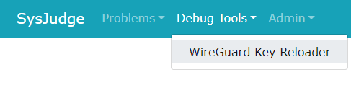
Appendix: About VPN (1/2)
Install WireGuard
Configurate VPN connection
Download configuration file from Online Judge system: Debug Tools > WireGuard Key Reloader

Slide 13
Appendix: About VM Network (1/2)
We assume that you use Virtualbox. You can choose other VM engines. However, the network structure should satisfy the requirements.
About the network interfaces type (take Virtualbox as an example):
You can use “NAT” for the External interface of “Router”; “Internal Network” for the Internal interface of “Router”.
For other VMs, you should only assign an interface with the type of “Internal Network”. That is, all the network traffics from these VMs should go through the Internal interface of “Router”.

Slide 14
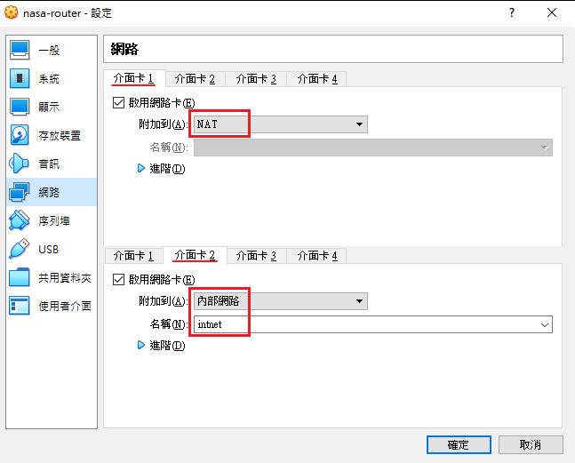
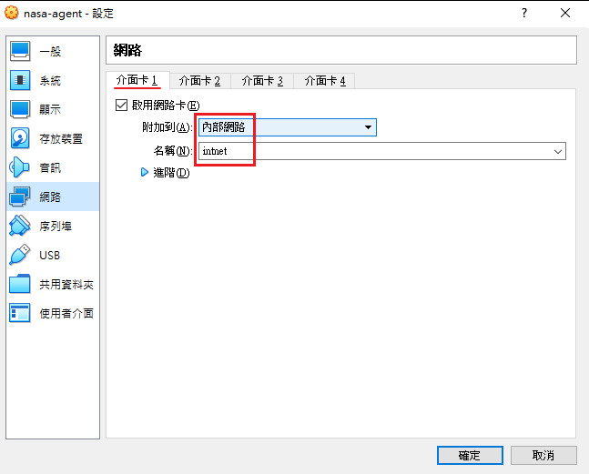
Appendix: About VM Network (2/2)
VirtualBox

Slide 15
Appendix: About OS
Any Unix-like OS is acceptable. However, those services required by homeworks should be provided by the OS you choose.
CentOS, Ubuntu or FreeBSD should be fine.
The OS of each VM doesn’t need to be the same.

Slide 16
Attention
Your work will be tested by Online Judge system.
You can submit multiple judge requests. However, OJ will cool down for several minutes after each judge.
We will take the last submitted score instead of the highest score.
Late submissions will not be accepted.
Make sure everything is fine after reboot.
Backup your VM before judge every time.
We may do something bad when judging.
Due date: 2022/03/24 Thu. 23:59:59

Slide 17
Help Me!
TA office hours: 15:30~17:20 Wed. at EC 324 (PC Lab).
We do not allow walk-ins except TA office hours or e-mail appointments.
Questions about this homework.
Make sure you have studied through lecture slides and the HW spec.
Clarify your problems and google it to find out solutions.
Ask them on https://groups.google.com/g/nctunasa .
Be sure to include all information you think others would need.
We MIGHT give out hints on google group.
Be sure to join the group!
Do not mail us unless it’s personal or you’re making an appointment.

Slide 18
Good Luck!

