Slide 1
Computer Network Administration
王則涵

Slide 2
Syllabus
Website:
https://nasa.cs.nctu.edu.tw/na/2023/
Instructors:
曾亮齊 lctseng@cs.nctu.edu.tw
王則涵 wangth@cs.nctu.edu.tw
林瑞男 jnlin@cs.nctu.edu.tw
許立文 lwhsu@cs.nctu.edu.tw
Time:
Rabc (Thu. 18:30 ~ 21:20)
Place:
EC114 + Live streaming (only if announced)

Slide 3
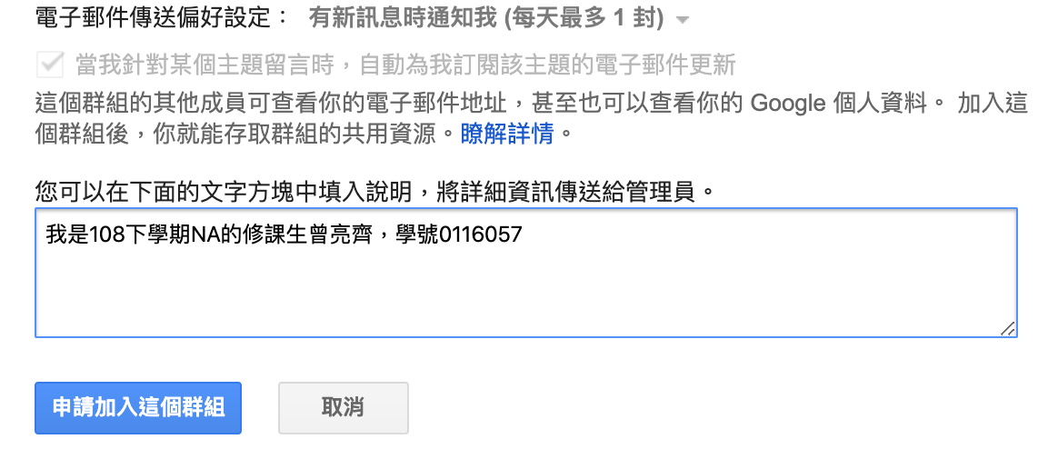
Syllabus
Discussion Forum
https://groups.google.com/g/nctunasa
We suggest you to join - TAs might give homework hints there
Request join and tell us your student ID
Ask course-related/technical questions there
Everyone in the group can answer/vote
But DON'T post direct answer/configuration there!
You will be banned

Slide 4
Syllabus
Lecture/Exam in Chinese
Not recommend for those do not speak Chinese
TAs:
We might have about 6 TAs.
Email to TAs: ta@nasa.cs.nctu.edu.tw
Also received by all lecturers
Office hour
Wed, 15:30 ~ 17:20, by appointment, @CSIT

Slide 5
Syllabus
Email Policy (IMPORTANT)
Don't send course-related/technical questions to TAs
TAs won't answer you
Please ask them on course forum instead
Only ask TAs for personal/non-technical questions
Course registration/dropping
Grading
Office hour appointment
Demo appointment

Slide 6
Syllabus – Registration & Dropping Policy
Registration (if you are not able to register on web)
Fill the registration form and email to ta@nasa.cs.nctu.edu.tw
Dropping (after midterm)
Contact CS Department Office if you cannot find lecturers near the deadline
Or email to ta@nasa.cs.nctu.edu.tw

Slide 7
Syllabus – Course Overview
Main topics
Networking
TCP/IP Networking Environment
NAT, DHCP, Firewall, VPN, Load Balancer, …
DNS – BIND (Berkeley Internet Name Domain)
Mail System - Postfix
SPF (Sender Policy Framework)
DKIM (Domain Keys Identified Mail)
DMARC (Domain-based Message Authentication, Reporting & Conformance)
Network Management/Authentication/Authorization
LDAP, SNMP
Configuration Management (Ansible, Puppet)

Slide 8



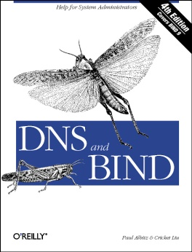

Syllabus – Course Textbook and Reference
Textbook
Unix and Linux System Administration Handbook (5th Edition)
Course slides
Reference book
TCP/IP Illustrated Volume 1
Postfix
DNS and BIND
SNMP, SNMPv2, SNMPv3 and RMON 1, 2

Slide 9
Syllabus – Text book outline
Part II. Networking
Chap 16 – TCP/IP
Chap 17 – Routing
Chap 18 – DNS: Domain Name System
Chap 21 – SMTP: Simple Mail Transfer Protocol
Chap 22 – Directory Services
Chap 23 – Electronic Mail
Chap 25 – Network Management and Debugging
Operations
Chap 30 – Monitoring

Slide 10
Syllabus – Grade Policy
Mid
15 ~ 20%
Final
15 ~ 20%
Homework
60 ~ 70%
No Delay Work
4 homework + 1 term project (might be a group project)

Slide 11
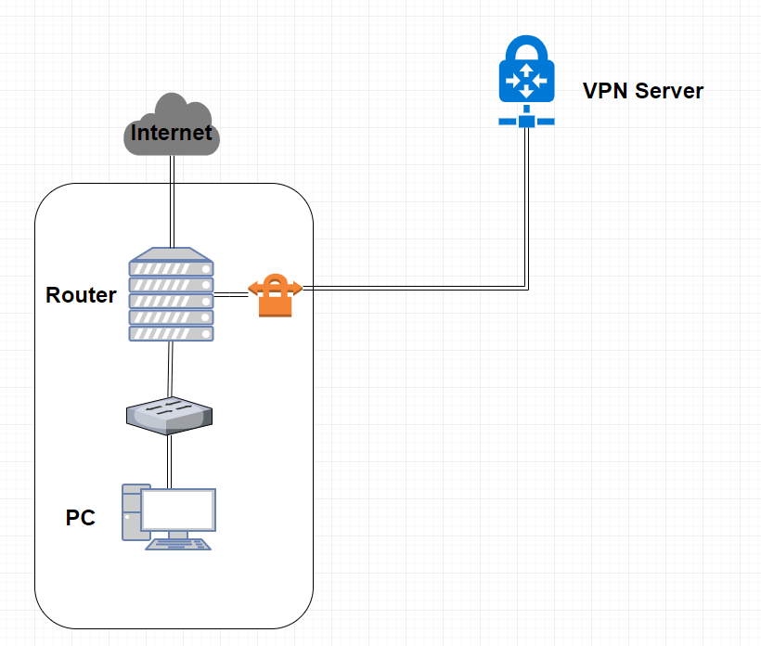
Syllabus – Homework Outline
Building an intranet with DHCP, NAT, VPN, DNS, LDAP, Mail, WWW… services
Understanding and managing all these services
Multiple internal servers

Slide 12
Syllabus – Homework Outline
Every homework is based on previous one
Homework 1
Setup Intranet
DHCP, NAT, VPN
Homework 2
+ DNS Service
Homework 3
+ Mail Service
Homework 4
Authorization, Authentication, Monitoring, Management
+ LDAP, SNMP
Term project: TBA

Slide 13
Syllabus – Prerequisite
Background Knowledge
We recommend that you should take these first
"Computer System Administration" (計算機系統管理)
"Introduction to Networking" (計算機網路概論)
About OS
You can use any POSIX-compliant Unix-like OS for homework
FreeBSD is used for lecturing
Environment
A dedicated (powerful?) PC that can run multiple VMs
VirtualBox, VMware
2~3 Unix-like system running at the same time

Slide 14
Attitude
Attend every class
Do every exercise
As early as possible
On your own
Collect information on the Internet
The newer, the better.
Not recommended for those have more than 3 major courses in this semester
Sometimes your may spend the whole weekend to just figure out what to do in the homework
Loading of this course roughly equals to 2~3 major courses
You will learn a lot if you study hard!

Slide 15
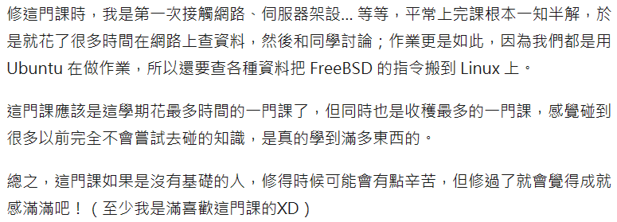
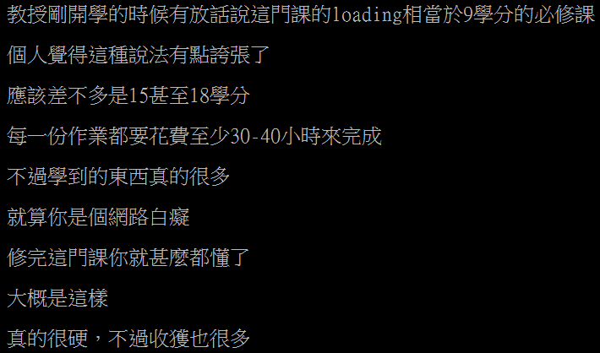
Some comments on the Internet
交大修課心得 - 網路管理實務(計算機網路管理) NAP2018
[心得] 曾亮齊 計算機網路管理(NA) NA2020

Slide 16
When You Perform Any Changes…
Flow of Change
Backup before changing Think your fallback
Apply change in new file on test environment
Restore Procedures Think another solution
Restart the system
Is everything fine ?
Run Test
Is everything fine ?
Apply to Real System

Slide 17
SA-NA Junction
FreeBSD
13.1-RELEASE
Self-study for the SA course
https://nasa.cs.nctu.edu.tw/sa/2022/

Slide 18
Q & A

