Slide 1
Server Load Balancer

Slide 2
Introduction
More users, more resources needed
CPU, RAM, HDD …
Scale Up & Scale Out
One powerful server to service more users; or
Multiple servers to service more users
Pros & Cons ?
C10K / C100K Problem

Slide 3
Introduction
High Availability
A characteristic of a system, which aims to ensure an agreed level of operational performance, usually uptime, for a higher than normal period.
Availability (per year)
99%: 3.65days
99.9%: 8.77 hours (3 nines)
99.99%: 52.60 minutes (4 nines)
99.999%: 5.26 minutes (5 nines)

Slide 4
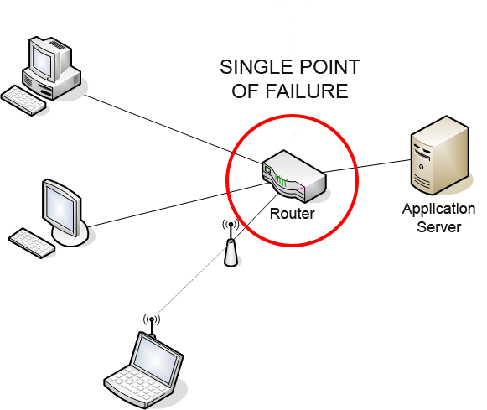
High Availability
Principles
Elimination of single points of failure.
Reliable crossover.
Reliable configuration / topology change
Detection of failures as they occur.
Graceful Degradation
the ability of a computer, machine, electronic system or network to maintain limited functionality even when a large portion of it has been destroyed or rendered inoperative.
Single point of failure - Wikipedia

Slide 5
Load Balancing
Client Side
e.g: DNS round-robin
Pros & Cons
Server Side
Server Load Balancer

Slide 6
Server Load Balancer (1)
Provide “Scale-Out” and HA features
Share loading among all backend nodes with some algorithms
Static Algorithms: does not take into account the state of the system for the distribution of tasks.
Dynamic Algorithms

Slide 7
Server Load Balancer (2)
Layer 4 or Layer 7
Layer 4 Switch
Distribution Algorithms
Round-robin
Random
Ratio
Hash Table
Least-connections
Persistence
Session-ID (e.g. HTTP Cookie)

Slide 8

Server Load Balancer (3)
Persistence (Stickiness)
"The Server" in OLG
How to handle information that must be kept across the multiple requests in a user's session.
Session ID?
Cookie
IP Address
TCP Connection
Pros & Cons ?

Slide 9
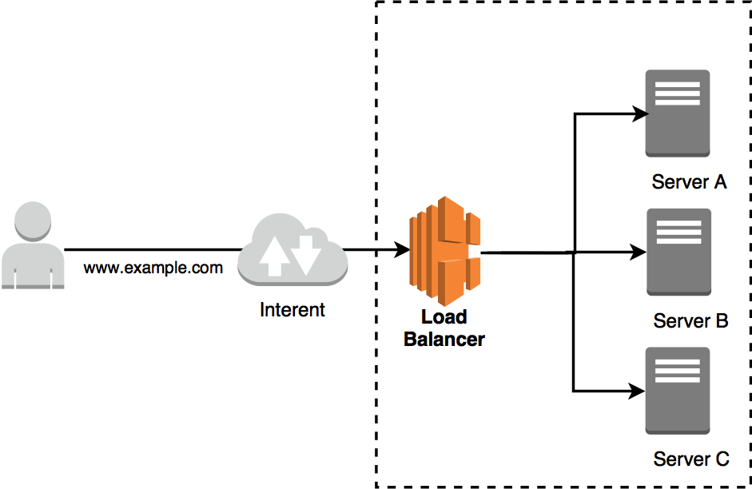
Server Load Balancer (4)
SSL offloading (SSL/TLS termination)
Pros?
Problems of Server Load Balancer
SPoF
Capacity Limit
Latency

Slide 10
HW & SW of Server Load Balancer
Nginx
Ingress in K8S
PF in FreeBSD
haproxy
Envoy Proxy
F5 BIG-IP
A10
on Cloud
AWS ELB (Elastic Load Balancer)
Google CLB (Cloud Load Balancer)

Slide 11
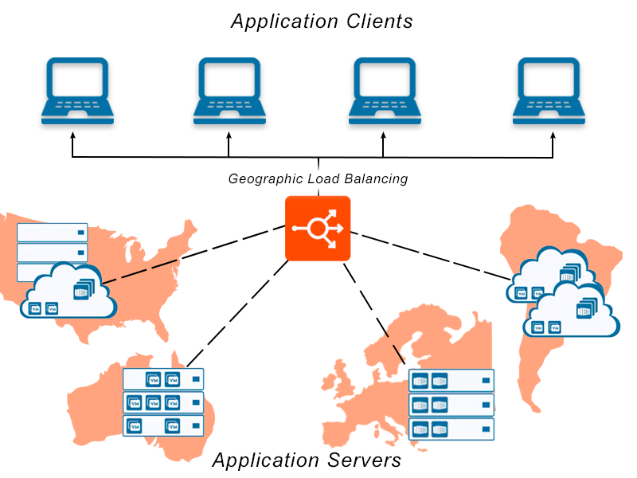
Global Server Load Balancer (GSLB)
Globally balancing traffic to the nearest node.
Pros
(Speed of light)
Cons ?
Technology
GeoDNS
resolve IP address based by the location of clients
Anycast
use BGP
Google DNS 8.8.8.8

Slide 12
Haproxy
http://www.haproxy.org
Reliable & High Performance TCP/HTTP Load Balancer
Layer 4 (TCP) and Layer 7 (HTTP) load balancing
SSL/TLS termination
Gzip compression
Health checking
HTTP/2

Slide 13
Haproxy - Installation
In FreeBSD:
pkg install haproxy
You can also build it from ports
Config file: /usr/local/etc/haproxy.conf

Slide 14
Haproxy - Configuration
global
daemon
log 127.0.0.1 local0
log 127.0.0.1 local1 notice
maxconn 4096
tune.ssl.default-dh-param 2048
defaults
log global
retries 3
maxconn 2000
timeout connect 5s
timeout client 50s
timeout server 50s
listen stats
bind 127.0.0.1:9090
balance
mode http
stat enable
stat auth admin:admin

Slide 15
Haproxy - Configuration
frontend www_csie_nctu
bind 140.113.208.102:80
mode http
use_backend www_csie_nctu_server
frontend cscc_csie_nctu
bind 140.113.208.103:80
mode http
use_backend www_csie_nctu_server
frontend game_server
bind 140.113.208.104:9876
mode tcp
backend www_csie_nctu_server
balance roundrobin
mode http
http-request set-header X-forwarded-Port %[dst_port]
http-request set-header X-forwarded-Proto https if { ssl_fc }
server www1 192.168.99.1:80
server www1 192.168.99.2:80

Slide 16
Haproxy - Configuration
backend cscc_csie_nctu_server
balance roundrobin
mode http
option httpchk HEAD /health_check.php HTTP/1.1\r\nHost:\ cscc.cs.nctu.edu.tw
option forwardfor
http-request set-header X-forwarded-Port %[dst_port]
http-request set-header X-forwarded-Proto https if { ssl_fc }
server www1 192.168.99.101:80 check fall 3 rise 2
server www1 192.168.99.102:80 check fall 3 rise 2

Slide 17
Haproxy Configuration
global
log
chroot
uid / gid
pidfile

Slide 18
Haproxy Configuration
defaults
log
option
retries
timeout

Slide 19
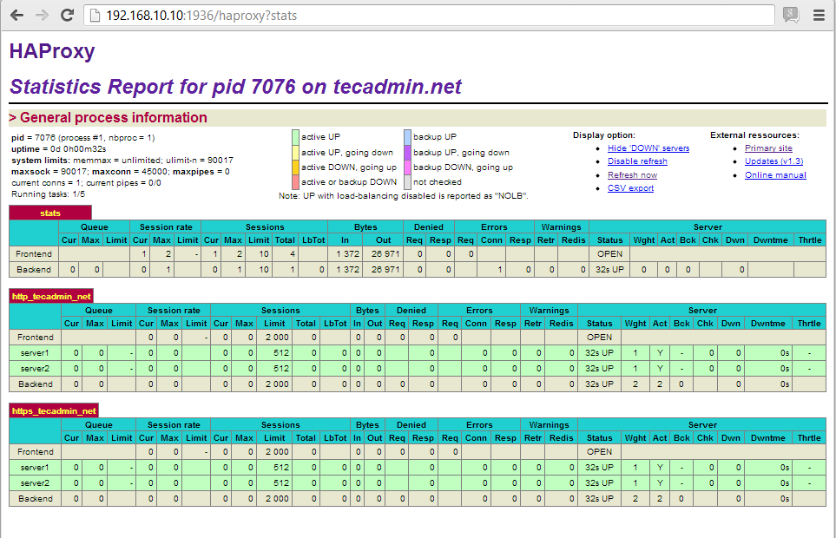
Haproxy Configuration
listen
stats

Slide 20
Haproxy Configuration
frontend
bind
mode
option
use_backend

Slide 21
Haproxy Configuration
backend
balance
roundrobin, leastconn, hdr(param)
mode
http-request
server
check
fall
rise
inter
cookie

Slide 22
Haproxy - run
/etc/rc.conf.local
haproxy_enable="YES"
/usr/local/etc/rc.d/haproxy start
Question: how to setup a backup node for haproxy?

Slide 23
Haproxy - Reference
http://cbonte.github.io/haproxy-dconv/2.1/configuration.html

Slide 24
Envoy
https://www.envoyproxy.io
Developed by Lyft (a ride-sharing company like Uber) and opensourced in 2017
Apache License 2.0
Features
Dynamic APIs for configuration
Service Discovery
gRPC / MongoDB / HTTP support
MicroService

Slide 25
Envoy - Installation
Broken in FreeBSD now (require BoringSSL)
You can install it on Linux instead
https://www.getenvoy.io
Debian: https://www.getenvoy.io/install/envoy/debian/
Ubuntu: https://www.getenvoy.io/install/envoy/ubuntu/
Centos: https://www.getenvoy.io/install/envoy/centos/

Slide 26
Envoy - Configuration
static_resources:
listeners:
- name: listener_0
address:
socket_address: { address: 127.0.0.1, port_value: 10000 }
filter_chains:
- filters:
- name: envoy.filters.network.http_connection_manager
typed_config:
"@type": type.googleapis.com/envoy.extensions.filters.network.http_connection_manager.v3.HttpConnectionManager
stat_prefix: ingress_http
codec_type: AUTO
route_config:
name: local_route
virtual_hosts:
- name: local_service
domains: ["*"]
routes:
- match: { prefix: "/" }
route: { cluster: some_service }
http_filters:
- name: envoy.filters.http.router
Examples — envoy 1.18.0-dev-fce386 documentation (envoyproxy.io)

Slide 27
Envoy - Configuration
clusters:
- name: some_service
connect_timeout: 0.25s
type: STATIC
lb_policy: ROUND_ROBIN
load_assignment:
cluster_name: some_service
endpoints:
- lb_endpoints:
- endpoint:
address:
socket_address:
address: 127.0.0.1
port_value: 1234
Examples — envoy 1.18.0-dev-fce386 documentation (envoyproxy.io)

Slide 28
Envoy - Configuration
YAML file format
Basic concept is same as haproxy
Listen (frontend) address
Backend addresses
Healthy Checks
https://www.envoyproxy.io/learn/health-check
Routes

Slide 29
Envoy - Run
envoy -c config.yaml

Slide 30
Envoy - Reference
https://www.envoyproxy.io/docs/envoy/latest/
https://blog.getambassador.io/envoy-vs-nginx-vs-haproxy-why-the-open-source-ambassador-api-gateway-chose-envoy-23826aed79ef

