Slide 1
LDAP
Lightweight Directory Access Protocol
wangth

Slide 2
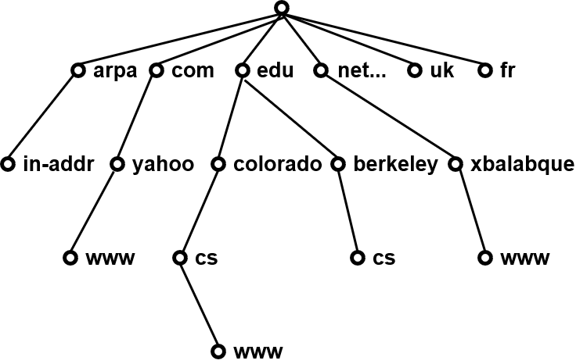
What is Directory Service?
What is Directory Service (目錄服務)
Highly optimized for reads
Implements a distributed model for storing information
Can extend the type of information it stores
Has advanced search capabilities
Has loosely consistent replication among directory servers
Domain Name Service

Slide 3
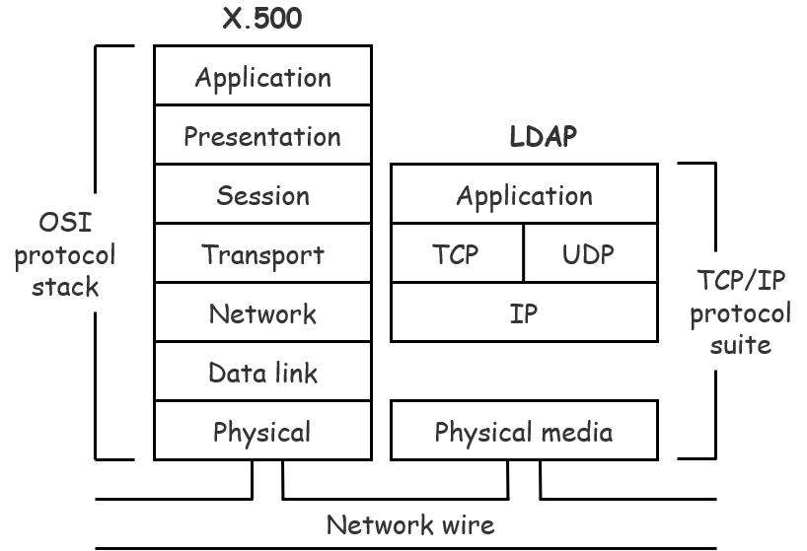
What is LDAP?
Lightweight Directory Access Protocol (LDAP)
LDAPv3: RFC 3377
RFC 2251-2256, 2829, 2830, 3377
Why LDAP is lightweight
A subset of the X.500 standard
X.500 is based on OSI model
LDAP is based on TCP/IP model
LDAP omits many X.500 operations that are rarely used
Provides a smaller and simpler set of operations

Slide 4
LDAP Directory Information Tree (DIT)
dc: domain component
ou: organization unit
cn: common name
o: organizationName
c: countryName
dc=cc
dc=nctucs
dc=na
ou=Group
ou=People
cn=student
cn=ta
cn=tzute
cn=tcyuan
cn=tzute,ou=People,dc=na,dc=nctucs,dc=cc
o="na, nctucs, cc", c=TW
o=na.nctucs.cc

Slide 5
LDAP Directory Information Tree (DIT)
dn: ou=People,dc=na,dc=nctucs,dc=cc
dc=cc
ou: People
objectClass: top
objectClass: organizationalUnit
objectClass: domainRelatedObject
associatedDomain: na.nctucs.cc
dc=nctucs
dc=na
ou=Group
ou=People
objectClass: person
cn: tzute
sn: Kuo
telephoneNumber: 123-4567
cn=tzute
DN (distinguished name):
cn=tzute,ou=People,dc=na,dc=nctucs,dc=cc
RDN: Relative Distinguished Name

Slide 6
LDAPv3 Overview – LDIF (1/4)
LDAP Interchange Format (LDIF)
Defined in RFC 2849
Standard text file format for storing LDAP configuration information and directory contents
An LDIF file is
A collection of entries separated from each other by blank lines
A mapping of attribute names to values
A collection of directives that instruct the parser how to process the information
The data in the LDIF file must obey the schema rules of your LDAP directory

Slide 7
LDAPv3 Overview – LDIF (2/4)
Sample LDIF
# A sample entry
# Format: <Attribute>: <Value>
dn: cn=tzute,ou=people,dc=na,dc=nctucs,dc=cc
objectClass: person
cn: tzute
telephoneNumber: 123-4567
dc=cc
dc=nctucs
dc=na
ou=people
ou=group
cn=tzute

Slide 8
LDAPv3 Overview – LDIF (3/4)
Sample LDIF – Modify one DN
# Modify user info
dn: cn=tzute,ou=people,dc=na,dc=nctucs,dc=cc
changetype: modify
add: description
description: NA TA
-
replace: telephoneNumber
telephoneNumber: 0987654321
objectClass: person
cn: tzute
sn: abc
telephoneNumber : 123-4567
objectClass: person
cn: tzute
sn: abc
description : NA TA
telephoneNumber : 0987654321

Slide 9
LDAPv3 Overview – LDIF (4/4)
Sample LDIF – Modify more than one DN
# Modify user info
dn: cn=tzute,ou=people,dc=na,dc=nctucs,dc=cc
changetype: modify
add: description
description: NA TA
dn: cn=tcyuan,ou=people,dc=na,dc=nctucs,dc=cc
changetype: modify
add: description
description: NA TA

Slide 10
LDAPv3 Overview – objectClass
/usr/local/etc/openldap/schema/core.schema
objectclass ( 2.5.6.6 NAME ‘person’
DESC ‘RFC2256: a person’
SUP top STRUCTURAL
MUST ( sn $ cn )
MAY ( userPassword & telephoneNumber & seeAlso & description ))
ObjectClassDescription = “(” whsp
numericoid whsp ; ObjectClass identifier
[ “Name” qdescrs ]
[ “DESC” qdstring ]
[ “OBSOLETE” whsp ]
[ “SUP” oids ] ; Superior ObjectClasses
[ ( “ABSTRACT” / “STRUCTURAL” / “AUXILIARY” ) whsp ]
; default structural
[ “MUST” oids ] ; AttributeTypes
[ “MAY” oids ] ; AttributeTypes
Whsp “)”
http://www.openldap.org/doc/admin26/schema.html

Slide 11
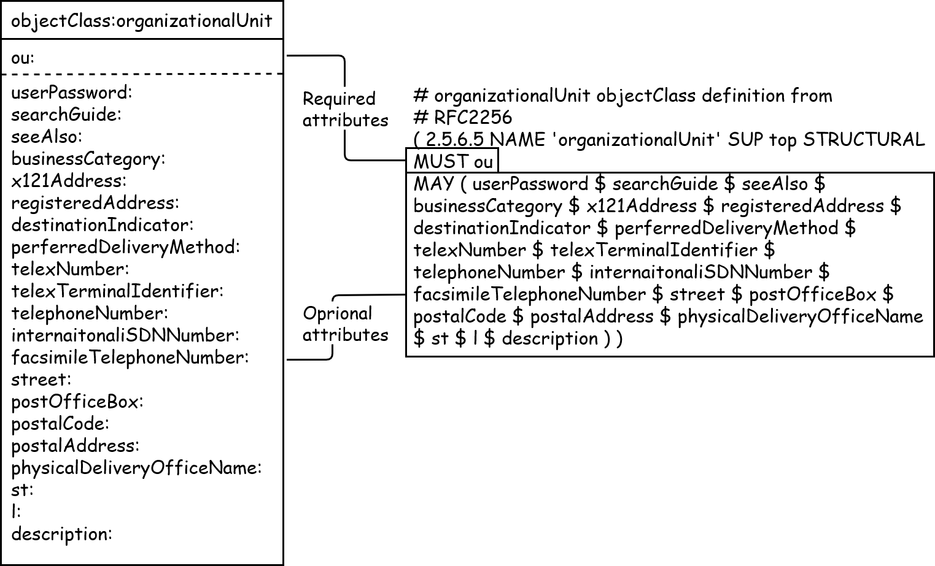
LDAPv3 Overview – objectClass (Cont.)
http://www.openldap.org/doc/admin26/schema.html

Slide 12
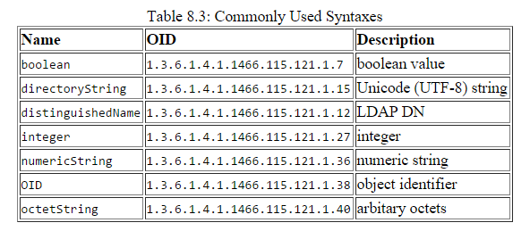
LDAPv3 Overview – Attribute
Attributetype ( 2.5.4.20 NAME ‘telephoneNumber’
DESC ‘RFC2256: Telephone Number’
EQUALITY telephoneNumberMatch
SUBSTR telephobeNumberSubstringsMatch
SYNTAX 1.3.6.1.4.1.1466.115.121.1.50{32} )
Matching Rules
Types
Server should
support values of
this length
https://www.openldap.org/doc/admin26/schema.html

Slide 13
Comparison with relational databases
It is tempting to think that having a RDBMS backend to the directory solves all problems. However, it is wrong.
This is because the data models are very different. Representing directory data with a relational database is going to require splitting data into multiple tables.

Slide 14

OpenLDAP
An open source implementation of the Lightweight Directory Access Protocol

Slide 15
OpenLDAP on FreeBSD
Three main components
slapd – stand-alone LDAP daemon and associated modules and tools
libraries implementing the LDAP protocol and ASN.1 Basic Encoding Rules (BER)
client software: ldapsearch, ldapadd, ldapdelete, and others
Installation
pkg install openldap-server
cd /usr/ports/net/openldap-server26; make install clean
slapd.conf
Blank lines and lines beginning with a pound sign (#) are ignored
Parameters and associated values are separated by whitespace characters
A line with a blank space in the first column is considered to be a continuation of the previous one.

Slide 16
slapd.conf
include /usr/local/etc/openldap/schema/core.schema
pidfile /var/run/openldap/slapd.pid
argsfile /var/run/openldap/slapd.args
loglevel 256
modulepath /usr/local/libexec/openldap
moduleload back_mdb
moduleload back_ldap
database mdb
maxsize 1073741824
suffix "dc=na,dc=nctucs,dc=cc"
rootdn "cn=Manager,dc=na,dc=nctucs,dc=cc"
rootpw <generated by slappasswd>
directory /var/db/openldap-data
# Indices to maintain
index objectClass eq
# ACL rules here for specific database

Slide 17
Directory ACL
# access to <what> [ by <who> [<accesslevel>] [<control>] ]+
access to dn.exact="cn=Manager,dc=na,dc=nctucs,dc=cc"
by peername.ip="127.0.0.1" auth
by users none
by anonymous none
by * none
access to attrs=userPassword
by self write
by anonymous auth
by dn.base="cn=Manager,dc=na,dc=nctucs,dc=cc" write
by * none
access to attrs=englishname,birthdate
by self write
by users read
by anonymous read
If one access directive is more specific than another in terms of the entries it selects, it should appear first in the configuration

Slide 18
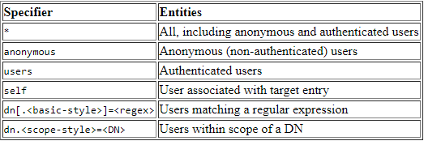
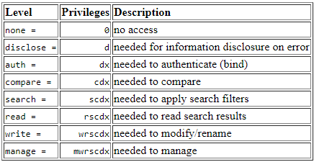
Directory ACL
http://www.openldap.org/doc/admin26/access-control.html
Access Entity Specifiers (Who)
Access Levels

Slide 19
Overlays
Software components that provide hooks to functions analogous to those provided by backends, which can be stacked on top of the backend calls and as callbacks on top of backend responses to alter their behavior
Frontend
handles network access and protocol processing
Backend
deals strictly with data storage
https://www.openldap.org/doc/admin26/overlays.html
https://en.wikipedia.org/wiki/OpenLDAP#Overlays
Frontend
Overlay
Backend

Slide 20
Overlays – memberOf
dc=cc
Membership
dc=nctucs
dc=na
ou=People
ou=Group
cn=tzute
cn=nata
objectClass: posixGroup
objectClass: top
objectClass: posixAccount
cn: tzute
gidNumber: 1234
objectClass: posixGroup
objectClass: top
cn: nata
displayName: nata
description: Domain Unix group
gidNumber: 1234

Slide 21
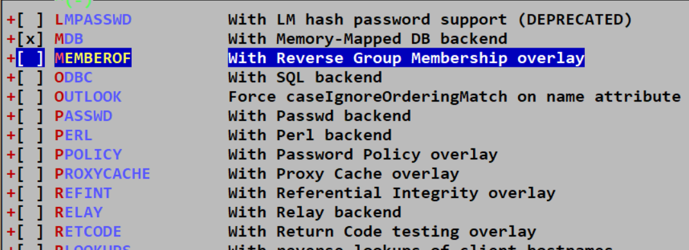
Overlays – memberOf
Installation
Ports
make config → enable option
https://www.openldap.org/doc/admin26/overlays.html

Slide 22
Overlays – memberOf
Edit /usr/local/etc/openldap/slapd.conf
restart slapd
Query Result
https://www.openldap.org/doc/admin26/overlays.html
# MemberOf
Overlay memberof
dn: cn=nata,ou=MemberGroup,dc=na,dc=nctucs,dc=cc
objectclass: groupOfNames
cn: nata
member: cn=tzute,ou=People,dc=na,dc=nctucs,dc=cc

Slide 23
OLC – Online Configuration (1/3)
OpenLDAP 2.3 and later have transitioned to using a dynamic runtime configuration engine
Uses a configuration DIT to control the operational configuration
Modifying entries in this DIT immediate changes to slapd's operational behavior
Note: Configuration changes should be performed via LDAP operations. DON’T edit any of the LDIF files directly.
https://www.openldap.org/doc/admin26/slapdconf2.html
https://www.zytrax.com/books/ldap/ch6/slapd-config.html

Slide 24
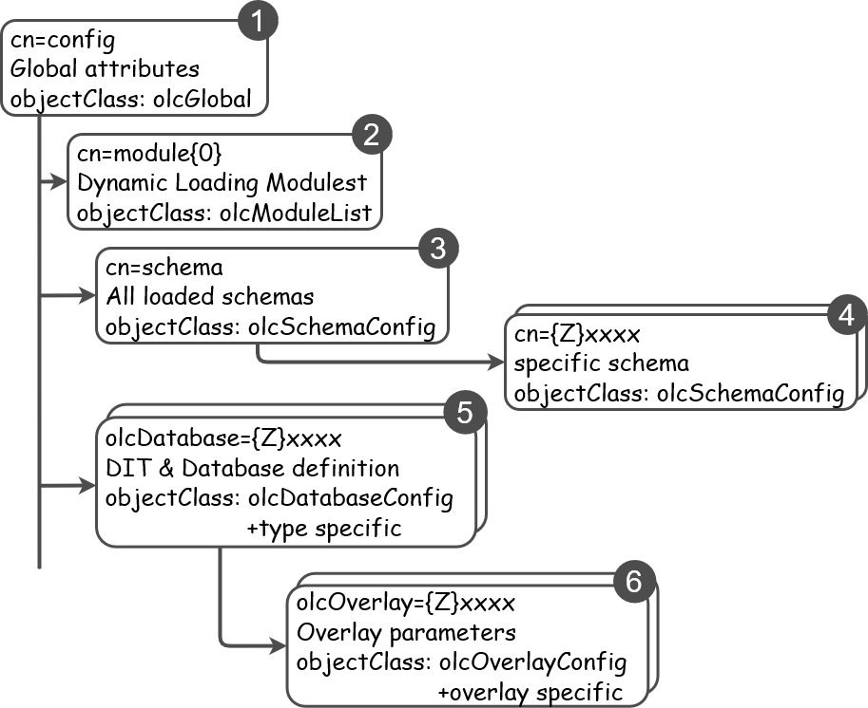
OLC – Online Configuration (2/3)

Slide 25
OLC – Online Configuration (3/3)
# {1}mdb, config
dn: olcDatabase={1}mdb,cn=config
objectClass: olcDatabaseConfig
objectClass: olcMdbConfig
olcDatabase: {1}mdb
olcDbDirectory: /var/db/openldap-data/na
olcSuffix: dc=na,dc=nctucs,dc=cc
olcAddContentAcl: FALSE
olcLastMod: TRUE
olcMaxDerefDepth: 15
olcReadOnly: FALSE
olcRootDN: cn=Manager,dc=na,dc=nctucs,dc=cc
olcRootPW: secret

Slide 26
Enable slapd
Edit /etc/rc.conf
slapd_enable="YES"
slapd_flags for specific options
service slapd start
http://www.openldap.org/doc/admin26/runningslapd.html

Slide 27
slapd tools
slapcat
This tool reads records from a slapd database and writes them to a file or standard output
slapadd
This tool reads LDIF entries from a file or standard input and writes the new records to a slapd database
slapindex
This tool regenerates the indexes in a slapd database
slappasswd
This tool generates a password hash suitable for use as an Lq in slapd.conf

Slide 28
LDAP tools
ldapsearch
This tool issues LDAP search queries to directory servers
ldapadd, ldapmodify
These tools send updates to directory servers
ldapcompare
This tool server to compare two values
ldapdelete
This tool deletes entries from an LDAP directory

Slide 29
ldapsearch
Options
-b searchbase
-s {base|one|sub|children} # default is sub
-D binddn
-x # Use simple authentication instead of SASL
-W # password for simple authentication
-H ldapuri
ldapsearch [options] filter
default filter, (objectClass=*)
ldapsearch -H ldap://ldap.na.nctucs.cc
-D "cn=tzute,dc=na,dc=nctucs,dc=cc"
-b "dc=na,dc=nctucs,dc=cc" -s one
man ldapsearch

Slide 30
ldapsearch (Cont.)
dc=cc
dc=nctucs
dc=na
ou=Group
ou=People
cn=student
cn=ta
cn=tzute
cn=tcyuan

Slide 31

ldap.conf
ldapsearch -H ldap://ldap.na.nctucs.cc
-b "dc=na,dc=nctucs,dc=cc" cn=tzute
Edit /usr/local/etc/openldap/ldap.conf
=> ldapsearch -x "cn=tzute"
# See ldap.conf(5) for details
# This file should be world readable but not world writable.
BASE dc=na,dc=nctucs,dc=cc
URI ldap://ldap.na.nctucs.cc
# See ldap.conf(5) for details
# This file should be world readable but not world writable.
BASE dc=na,dc=nctucs,dc=cc
URI ldap://ldap.na.nctucs.cc

Slide 32
ldapsearch – searchbase vs. filter
Search by dn
It does not work!
Use search base
It works!
Why?
You have got full dn, don’t need to search
# ldapsearch dn="cn=tzute,dc=na,dc=nctucs,dc=cc"
# ldapsearch -b "cn=tzute,dc=na,dc=nctucs,dc=cc" -s base

Slide 33
ldapsearch – searchbase vs. filter
Example
Assume there are two kinds of searchbase
dc=na,dc=nctucs,dc=cc
ou=People, dc=na,dc=nctucs,dc=cc
dc=cc
dc=nctucs
dc=na
ou=Group
ou=People
cn=student
cn=ta
cn=tzute
cn=tcyuan

Slide 34
ldapsearch – searchbase vs. filter
Example (Cont.)
filter – search for all entries that have cn=nata
cn=nata
cn=nata → Can’t be found, because the cn=nata is not in this subtree
dc=cc
dc=nctucs
dc=na
ou=Group
ou=People
cn=student
cn=ta
cn=tzute
cn=tcyuan

Slide 35
LDAP Authentication

Slide 36
LDAP Authentication (1/3)
pkg install nss-pam-ldapd
Edit /usr/local/etc/nslcd.conf
Edit /etc/nsswitch.conf
Edit /etc/pam.d/system

Slide 37
LDAP Authentication (2/3)
Edit /usr/local/etc/nslcd.conf
Just like ldap.conf
# The user and group nslcd should run as.
uid nslcd
gid nslcd
uri ldap://ldap.na.nctucs.cc
base dc=na,dc=nctucs,dc=cc

Slide 38
LDAP Authentication (3/3)
Edit /etc/nsswitch.conf
https://www.freebsd.org/doc/en/articles/ldap-auth/client.html
# nsswitch.conf(5) - name service switch configuration file
# $FreeBSD: releng/11.1/etc/nsswitch.conf
group: files ldap
passwd: files ldap

Slide 39
References
Understanding Directory Services
Beth Sheresh, Doug Sheresh - Sams Publishing
LDAP System Administration: Putting Directories to Work
Gerald Carter - O'Reilly Media, Inc.
The Lightweight Directory Access Protocol: X.500 Lite
Timothy A. Howes
Internet protocol suite – Wikipedia
https://en.wikipedia.org/wiki/Internet_protocol_suite#Comparison_of_TCP/IP_and_OSI_layering

