Slide 1
Log Management
wangth

Slide 2
Log Management
A system for gathering, processing and storing large volumes of logs, which were generated by operating systems, network appliance (switches, routers), or software applications.
Provides an interface for human reading, and may have APIs for program processing

Slide 3
Why Log Management (1)
For Debug
Some bugs occurs only in particular situation, not always happen
”Replay” the actions to reproduce the bug
“Test” new features without affecting customers
For Audit
Who did the management? Who did “rm –rf” ?

Slide 4
Why Log Management (2)
For Monitoring
Statistics from logs (e.g. HTTP 500s)
Abnormal numbers (increasement or decrement) means some parts of systems going wrong
For AIOps
Help administrators to predict accidents by machine learning models
Data is the key part of AI

Slide 5
Log Management Key Points
Accessible
Visual Dashboard
Raw logs for deep debugging
Durable
Can not be deleted / modified by anyone
Keep for reasonable time
Financial records: 7 years
Realtime / near real-time
Find accidents ASAP
Alert administrators if there is bad smell from statistics

Slide 6
Log Management Features
Log collection
Centralized log aggregation
Long-term log storage and retention
Log rotation
Log analytics
Log search and reporting

Slide 7
Log Management Software
ELK / EFK
Elasticsearch + Logstash (Fluentd) + Kibana
Sentry (Application Monitoring)
Splunk (Data Platform)
Datadog (SaaS, Cloud Monitoring as a Service)
Google Cloud Logging (Stackdriver)
AWS CloudWatch

Slide 8






ELK / EFK
Elasticsearch + Logstash (Fluentd) + Kibana
Elasticsearch
Storage and Index service for logs
Logstash / Fluentd
Log collection, preprocessing, and aggregation
Kibana
Visual dashboard for log analytics
Logstash
Fluentd
Elasticsearch
Kibana

Slide 9
Elasticsearch
An open-source, full-text search engine based on Apache Lucene
Features
Distributed
Multitenancy
Serving multiple types of documents in one Elasticsearch cluster
Near real-time search
Developed and maintained by Elastic NV
The “open-source business model”

Slide 10
Elasticsearch – Basic Concept (1)
Document
The base unit of storage of Elasticsearch
“Row” in RDBMS
JSON format
Unique ID (UID)
Index
The logical partition of documents
“Table” in RDBMS
Store similar documents
We can have multiple indices in one Elasticsearch cluster

Slide 11
Elasticsearch – Basic Concept (2)
Nodes
The service instance running Elasticsearch
Types
Master node
Maintain cluster state
Distribute shards to data nodes
Create and delete indices
Data node
Hot & warm node
Cold node
Ingest node
Pre-processing pipelines

Slide 12
Elasticsearch – Basic Concept (3)
Shards
Store index and documents
A single Lucene index
Indices will be split to serval shards
Shards will be duplicated for high availability

Slide 13
Logstash
Collect, parse and transform logs
An open-source software developed by Elastic NV
Support plugins for input, filtering and output
https://www.elastic.co/guide/en/logstash/current/input-plugins.html
https://www.elastic.co/guide/en/logstash/current/output-plugins.html
https://www.elastic.co/guide/en/logstash/current/filter-plugins.html
Input
Web access logs / Syslogd / APIs / …
Output
Elasticsearch/ IM (Slack / Discord) / Syslogd / …

Slide 14
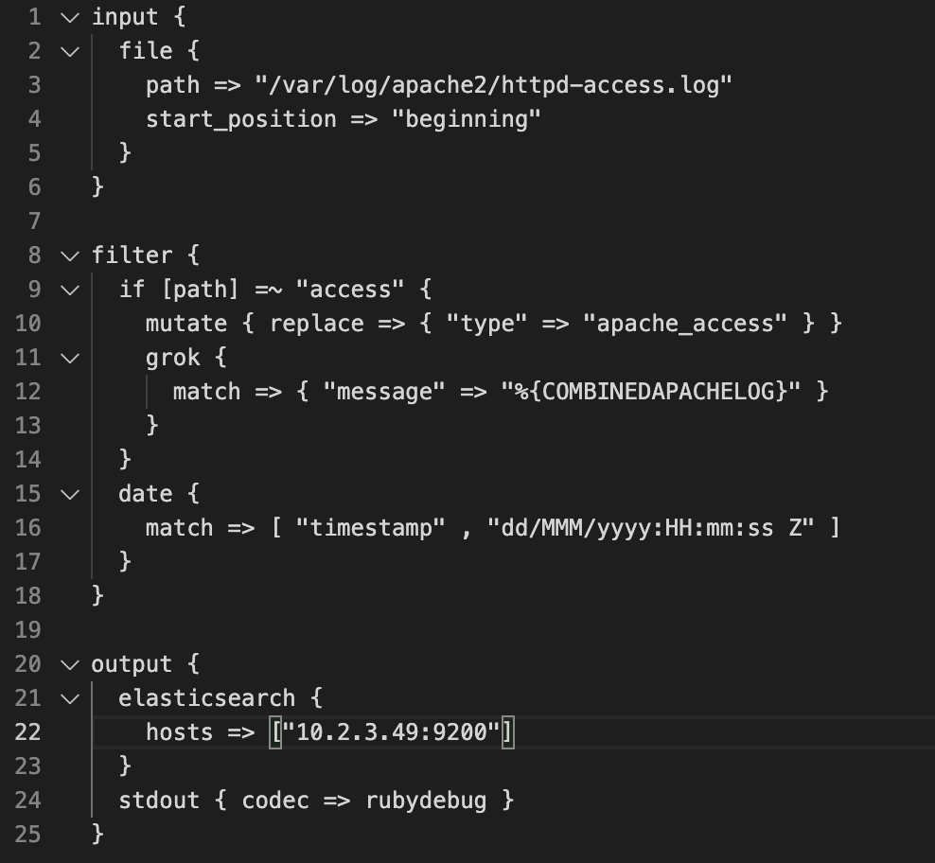
Logstash – Configuration
logstash.conf

Slide 15
Fluentd: Unified Logging Layer
An open-source project for unifying the data collection and consumption
Original developed by Treasure Data, now it is under the Cloud Native Computing Foundation (CNCF)
https://www.fluentd.org
Support plugins for data source, outputs and processing

Slide 16
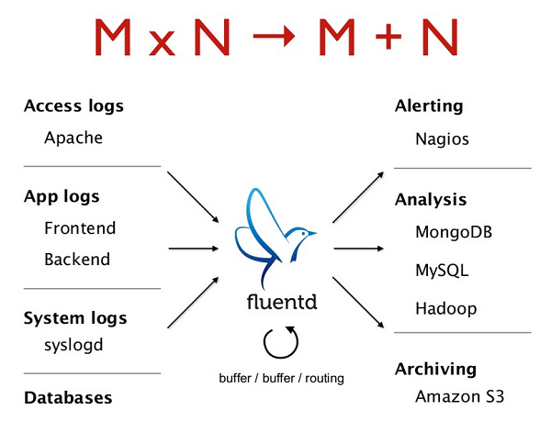
Unified Logging Layer
A layer for filtering, buffering and routing data
Provides a unifying format (JSON) for data processing and transport
Data buffering and retry-able data-transfer
Horizontally scalable
Reduce Complexity

Slide 17
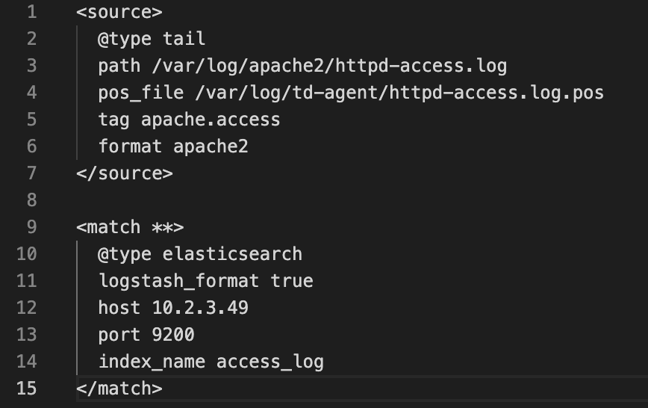
Fluentd - Configuration

Slide 18
Beats
A lightweight data collector, developed by Elastic NV
Send collected data to Logstash or Elasticsearch
Centralized configuration in Kibana
Types
Auditbeat: Audit data
Filebeat: Log files
Functionbeat: Cloud data
Heartbeat: Availability
Metricbeat: Metrics
Packetbeat: Network traffic
Winlogbeat: Windows event logs

Slide 19
Kibana
Visual dashboard for users querying logs stored in Elasticsearch
An open-source project developed by Elastic NV

Slide 20
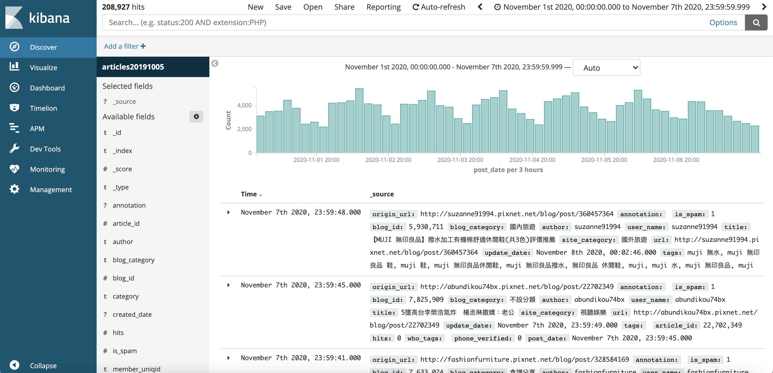
Kibana - Dashboard

Slide 21
Reference
https://www.elastic.co/guide/en/elasticsearch/reference/current/getting-started.html
https://www.elastic.co/guide/en/logstash/current/index.html
https://docs.fluentd.org/

