Slide 1
Homework 1
Network Environment Setting
zyyang, jschou

Slide 2
Purpose
The goal is to build an intranet that provides several services including DHCP, NAT, VPN, DNS, Mail, LDAP, WWW, etc.
Know what you should know about the configuration and management of these services.

Slide 3
Overview
Create an intranet which contains several VMs:
“Router”
The only VM is directly connected to the outside world (Internet).
Provides NAT and DHCP.
Can connect to all VMs inside your subnet.
Can connect to the VPN server and the whole 10.113.0.0/16 intranet.
“Agent”
Simulates a simple VM inside your subnet to help TAs and OJ verify results.
“Client” (Optional)
Simulates a simple VM inside your subnet to help you verify results.

Slide 4
Topology (1)
Intranet
Intranet
VPN
Server
Your subnet
External
Internet
Router
VPN
10.113.ID.1
🔒
10.113.ID.254
Internal
192.168.ID.254
🔒
192.168.ID.123
Other
subnet
Other
subnet
Other
subnet
Agent
Client
Client

Slide 5
Definitions
Internet
The IP addresses that are not in our intranet.
Intranet
10.113.0.0/16, a private network for you to do your homework.
OJ
Online Judge system, https://nasaoj.cs.nycu.edu.tw/ .
ID
See the profile page on OJ.
Your subnet
192.168.{ID}.0/24, a subnet of intranet controlled by yourself.
VPN server
A WireGuard server which connects subnets together.

Slide 6
Requirements (1/4)
“Router”
Any OS is acceptable.
This VM MUST have these network interfaces:
External: Internet facing
Provides NAT on this interface. Packets from your subnet can go to the Internet through this interface.
IP: No limitation.
Internal: To your subnet (192.168.{ID}.0/24)
Provides DHCP on this interface. IP offered by DHCP should from 192.168.{ID}.111 to 192.168.{ID}.222 .
IP: 192.168.{ID}.254
VPN: To WireGuard server and intranet (10.113.0.0/16)
Connected to the WireGuard server.
Everyone in the intranet can access your public services through this interface.
IP: 10.113.{ID}.1
Enable sshd service on port 22.

Slide 7
Requirements (2/4)
“Agent”
Get this VM OVA file below, don’t install this VM by yourself.
Download from https://bit.ly/na2023agent
This VM will get IP 192.168.{ID}.123 by DHCP (Hint: MAC binding).
OJ will log in to “Agent” to judge your VMs’ settings.

Slide 8
Topology (2)
Internet
VPN Zone
VPN
Server
External
🔒
Router
VPN
10.113.ID.1
10.113.ID.254
🔒
Internal
192.168.ID.254
Private Zone
192.168.ID.123
Other
subnet
Other
subnet
Other
subnet
Agent
Client
Client

Slide 9
Requirements (3/4)
Routing
All inbound and outbound traffic in and out your subnet should go through “Router”.
Traffic from Private zone to Internet should be NAT masqueraded.
Traffic from Private zone to VPN zone should not be NAT masqueraded.
Traffic from VPN zone to Private zone should go to its destination.

Slide 10
Requirements (4/4)
Firewall
Consider you are providing services to the Internet, so several firewall configurations must be taken for security.
Configure firewall rules on “Router”.
Rules:
SSH connections from anywhere to “Agent” are allowed.
SSH connections from VPN zone to “Router” are not allowed.
ICMP connections from anywhere to anywhere are allowed.
In Private zone (including router) all connections are allowed.
By default, all connections from Internet to Private zone should be rejected.

Slide 11
Grading
Automated grading (Online Judge), 100pts
Enable Router’s sshd service. (5%)
Trace Route from Agent to Internet. (15%)
Trace Route from Agent to Private Zone. (15%)
IP offered by DHCP should be 192.168.{ID}.111-222 (20%)
Agent get IP 192.168.{ID}.123 by DHCP (15%)
Check Firewall rules for Router (15%)
Check Firewall rules for Agent (15%)

Slide 12
Hints
How to check if Internet connection is fine?
Ping 8.8.8.8 from different VMs.
Ping www.google.com from different VMs.
How to check WireGuard is connected? (Please make sure your private key is correct.)
Ping 10.113.$ID.254 (intranet gateway).

Slide 13
Appendix: VM Network
We assume that you use Virtualbox. You can choose other VM hypervisor. However, the network structure should satisfy the requirements.
About the network interfaces type (take Virtualbox as an example):
You can use “NAT” for the External interface of “Router”; “Internal Network” for the Internal interface of “Router”.
For other VMs, you should only assign an interface with the type of “Internal Network”. That is, all the network traffics from these VMs should go through the Internal interface of “Router”.

Slide 14
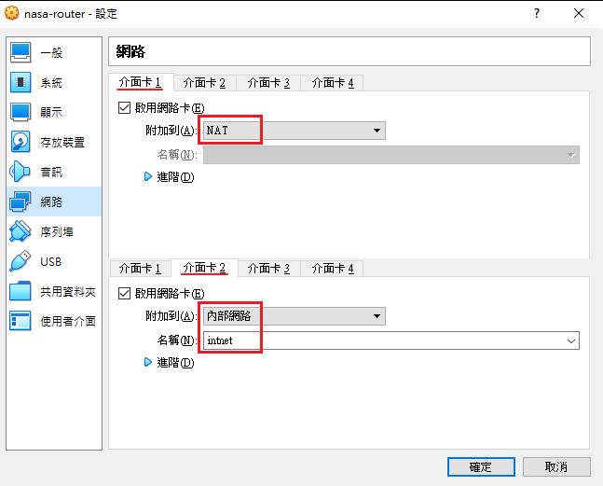
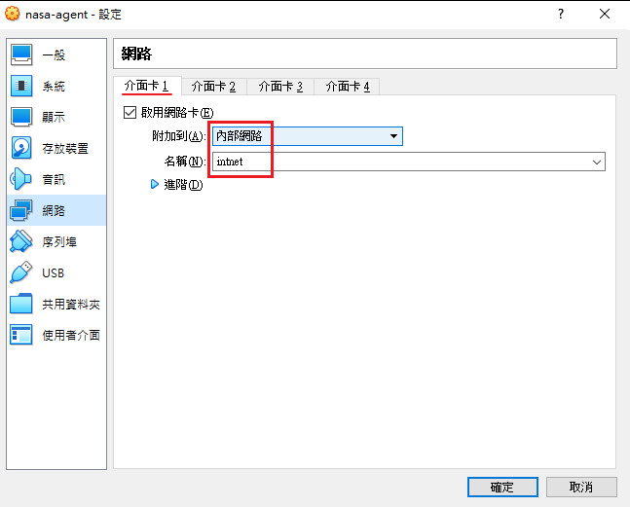
Appendix: VM Network
VirtualBox

Slide 15
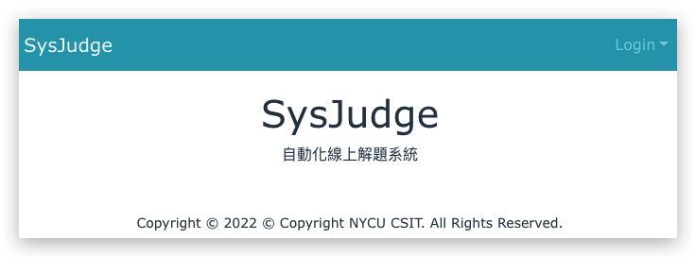
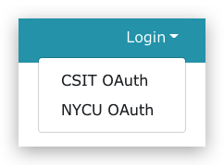
Appendix: Online Judge System
Login into https://nasaoj.cs.nycu.edu.tw/
You can login with NYCU or CSIT account.

Slide 16
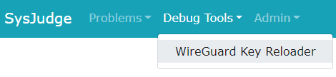
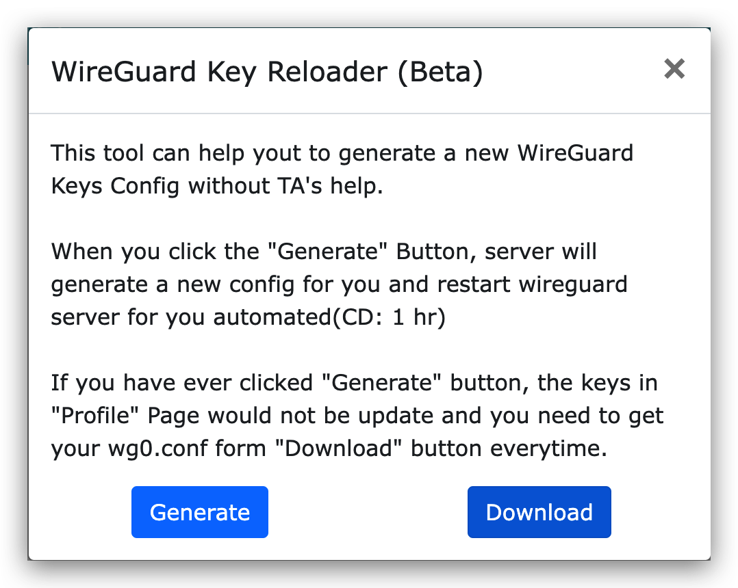
Wireguard – Get key and configuration
Install WireGuard
Configurate VPN connection
Download the configuration file
Apply it to connect VPN server

Slide 17
Wireguard – Regenerate key
If you cannot connect to Wireguard
Regenerate key and configuration file
Download and apply it

Slide 18
Attention
Your work will be tested by Online Judge system.
You can submit multiple judge requests. However, OJ will cool down for 10 minutes after each judge.
We will take the last submitted score instead of the highest score.
Late submissions will not be accepted.
Make sure everything is fine after reboot.
Backup your VM before judging every time.
We may do something bad when judging.
Due date: 2023/03/22 Thu. 23:59:59

Slide 19
Help Me!
Questions about this homework.
Make sure you have studied through lecture slides and the HW spec.
Clarify your problems and google them to find out solutions.
Ask them on https://groups.google.com/g/nctunasa .
Be sure to include all information you think others would need.
We MIGHT give out hints on google group.
Be sure to join the group!
Do not mail us unless it’s personal or you’re making an appointment.

Slide 20
Help Me!
UNIX 常見指令教學
https://it.cs.nycu.edu.tw/unix-basic-commands
How To Ask Questions The Smart Way
https://github.com/ryanhanwu/How-To-Ask-Questions-The-Smart-Way

Slide 21
Good Luck!

