Slide 1
Computer System Administration
曾亮齊
Notes:
講課時間：1.5節

Slide 2
Online Course Announcement
The live course will be available online
Using Microsoft Teams
Available at https://nasa.cs.nctu.edu.tw/sa/2021/content.php
We will record the meeting during the class
For reference only
Will not release to public
DO NOT record this meeting by yourself without approval from the lecturer!

Slide 3
What System Administrator Should do?
Ordinary list
Installing new system, programs and OS updates
Monitoring system and tuning performance
Adding and removing users
Adding and removing hardware
Backup and restore
Configuration management (Ansible, Chef, Puppet, SaltStack, …)
Infrastructure management (Terraform, …)

Slide 4
What System Administrator Should do?
Ordinary list
Continuous Integration & Delivery (Jenkins, Travis CI, …)
Log management (Fluentd, Papertrail, … )
Security monitoring and reaction
Virtualization (VMWare, Xen, Bhyve, …)
Containerization (Docker, …)
Capacity planning
…

Slide 5
What System Administrator Should do?
Non-technique list
Helping users
Maintaining documentation
Moving furniture
Good communication and memorization
Leverage external memory
Burning your liver

Slide 6
What System Administrator Should do?
The best words to describe the job
Thankless job.
https://sysadminday.com/
System administration is like keeping the trains on time; no one notices it except when they're late.
When we do right, no one remembers; when we do wrong, no one forgets.

Slide 7
What System Administrator Must do?
Philosophy of system administration
Know how things really work.
Plan it before you do it.
Make it revertible.
Make changes incrementally and backward-compatible.
Test thoroughly before unleash it.

Slide 8
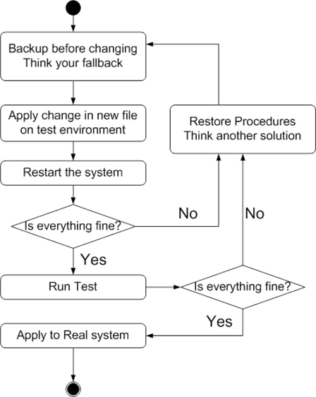
What System Administrator Should do?
Flow of Change

Slide 9
What System Administrator Should do?
The skills to be a candidate of system administrator
We are not going to teach you cool & new things
But the how to master these skills
Find and read authoritative docs, not just copy & paste from a random webpage on Internet
System Administration (110A)
Manage one server
Network Administration (110B)
Manage a network consist of multiple servers and devices

Slide 10
About the Operating System
Most of the course materials will take FreeBSD as examples
Homework is guaranteed to be doable under FreeBSD
Linux?
Lots of distributions
You are still allowed to use them in homework
On your own risk

Slide 11
Why FreeBSD
Our goal is to learn "How it works"
FreeBSD is simple and easy to learn the internals
Unified environment is good for educational purpose
BSDs are still popular in some ways
Apple MacOS, iOS and many other products or services are based or heavily using BSDs
https://en.wikipedia.org/wiki/Darwin_(operating_system)

Slide 12
Attitude
Attend every class
Do every exercise
As early as possible
On your own
Read book and practice at least 6 hours every week
Use unix-like environment
Recommend: more than 1.5 hours/day averagely.
Collect information on the internet
The newer, the better.

Slide 13
Syllabus
Instructors:
曾亮齊 lctseng@cs.nctu.edu.tw
王則涵 wangth@cs.nctu.edu.tw
林瑞男 jnlin@cs.nctu.edu.tw
許立文 lwhsu@cs.nctu.edu.tw
Time:
Thu. abc (18:30 ~ 21:20)
Place:
EC122 Online Course

Slide 14
Syllabus
Discussion Forum
https://groups.google.com/forum/#!forum/nctunasa
We suggest you to join - TAs might give homework hints there
Request join and tell us your student ID
Ask course-related/technical questions there
Everyone in the group can answer/vote
But DON'T post direct answer/configuration there!
You will be banned

Slide 15
Syllabus
Lecture/Exam in Chinese
Not recommend for those do not speak Chinese
TAs:
We might have about 6 TAs.
Email to TAs: ta@nasa.cs.nctu.edu.tw
Also received by all lecturers
Office hour
Wed, 15:30 ~ 17:20, by appointment, @CSIT
Website:
https://nasa.cs.nctu.edu.tw/sa/2021/

Slide 16
Syllabus
Email Policy (IMPORTANT)
Don't send course-related/technical questions to TAs
TAs won't answer you
Please ask them on course forum instead
Only ask TAs for personal/non-technical questions
Course registration/dropping
Grading
Office hour appointment
Demo appointment

Slide 17
Syllabus
Registration (if you are not able to register on web)
Fill the registration form and email to ta@nasa.cs.nctu.edu.tw
Dropping (after midterm)
Contact CS Department Office if you cannot find lecturers near the deadline
Or email to ta@nasa.cs.nctu.edu.tw

Slide 18
Syllabus – Text book outline
Part I. Basic Administration
Chap 1 – Where to start.
Chap 2 – Booting and Shutting Down
Chap 3 – The Filesystem
Chap 4 – Access control and rootly powers
Chap 5 – Controlling processes
Chap 6 – User Management
Chap 7 – Storage
Chap 8 – Periodic processes
Chap 9 – Backups

Slide 19
Syllabus – Text book outline
Part I. Basic Administration
Chap 10 – Syslog and log files
Chap 11 – Software installation and management
Chap 12 – The Kernel
Chap 13 – Scripting and the Shell
Chap 14 – Configuration Management

Slide 20
Syllabus – Text book outline
Part II. Networking
Chap 19 – NFS: Network File System
Chap 20 – HTTP: Hypertext Transfer Protocol
Operations
Chap 27 – Security
Chap 31 – Performance Analysis

Slide 21
Syllabus – Grade Policy
Mid
15 ~ 20%
Final
15 ~ 20%
Exercise (Homeworks)
60 ~ 70%
No Delay Submission
4 exercises
1 term project

Slide 22
What you should prepare?
Background knowledge
Basic knowledge of UNIX commands
Basic Programming skills
Basic of TCP/IP Networking
Environment
Virtual Machine (Virtualbox, VMware)
Bare-metal Machine is also fine
Yourself
Your hard study

Slide 23
Finally, Am I OK to take this course?
Are you willing to devote yourself to exercise?
Yes! Please come
Are you newbie in this area?
Yes!? It's ok, Please come
Do you take more than 3 major courses?
Sometimes your may spend the whole weekend to just figure out what to do in the homework
Loading of this course roughly equals to 2~3 major courses
You will learn a lot if you study hard

Slide 24
Basic knowledge in this course

Slide 25
Play with Unix-Like system
Our department has FreeBSD/Linux workstations for all students
bsd{1,2,3,4}.cs.nctu.edu.tw
linux{1,2,3,4}.cs.nctu.edu.tw
alumni.cs.nctu.edu.tw
About CS workstation
https://it.cs.nycu.edu.tw/workstation-guide
Get familiar with CLI (command line interface)
Without GUI (graphics user interface)
Don't be afraid

Slide 26
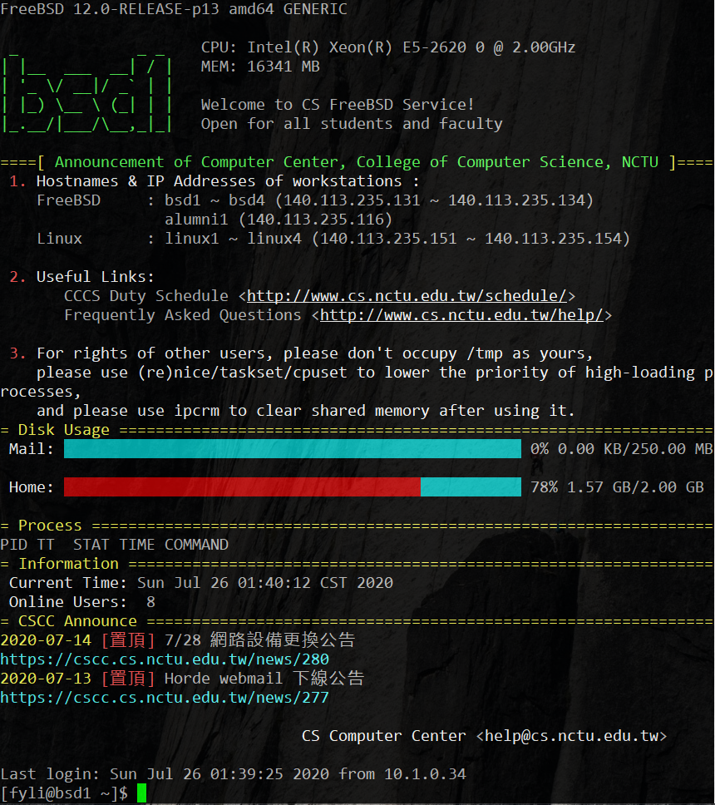
Usage
SSH (Secure Shell)
Putty (Windows)
Terminal (macOS)
GNOME Terminal

Slide 27
Commands
Useful commands
ls
passwd
mkdir, rmdir
cp, mv, rm
poweroff, shutdown -p now
reboot, shutdown -r now
…
Most important command: man
Basic command tutorials
https://it.cs.nycu.edu.tw/unix-basic-commands

Slide 28
Conventions
Syntax of commands:
Anything between "[" and "]" is optional.
Anything followed by "…" can be repeated.
{a | b} – you should choose one of them.
bork [-x] { on | off } filename...
Yes/No | Commands
O | bork on /etc/hosts
O | bork -x off /etc/hosts /etc/passwd
X | bork -x /etc/hosts
X | bork -h /etc/hosts

Slide 29
Q & A

