Slide 1
Install FreeBSD
lctseng (2019-2021, CC BY-SA)
? (1996-2018)

Slide 2
Outline
FreeBSD version
13.0-RELEASE
Installing FreeBSD
From CD-ROM
From USB

Slide 3
FreeBSD Version

Slide 4
FreeBSD Branches/Tags
Three parallel development branches:
RELEASE
Suitable for production use
Latest Release: 13.0 (April, 2021)
http://www.freebsd.org/releases/
STABLE
Tested new features and bug fixes
ABI/KBI is "stable"
Still considered a development branch
CURRENT
Working space for FreeBSD developers
13.0-CURRENT (January, 2021)
http://www.freebsd.org/releng/
Notes:
"stable" 指的是 ABI/KBI stable 且不可以更動, 但是實質上還是 development branch, 使用上還是可能會碰到問題。做為自用和評估及加入測試是個好的選擇。中階使用者可以使用。
目前的制度是 STABLE 每年生出一個 .x release. 有在討論要將頻率變高。
目前的制度是 CURRENT 約每兩年 branch 成一個新的 stable branch, 同時生出一個新的 .0 release. 所以使用者應該有足夠的時間在 support 期間內升級到新的 major number release.

Slide 5
FreeBSD Versions
FreeBSD–A.B.C–Type
A: major version Number
B: minor version Number
C: slight patch version number
Type: version type
PRERELEASE, BETA, RC
RELEASE
STABLE
CURRENT
freebsd-version(1)
-pN
patch level, increased after SA/EN announced
Notes:
.C -> 碰到重大 release 問題時才會用，已經很久沒有使用過了，上次應該是 5.2.1
這是要發布一個完整的 release, 連 iso 等都會重新發布，不是只有 patch.

Slide 6
End-of-Life (EoL)
The last supporting date of given OS version
Typically, no guaranteed security update/patch for an OS passed its EoL
All OS have EoL
FreeBSD 13.0: 13.1-RELEASE + 3 months
Ubuntu 14.04 LTS: 2024-04
CentOS Linux 8: 2021-12-31
Windows 7: 2020-01-14
If your OS is approaching its EoL, please consider updating it
Plan as early as possible
Good habit: prepare and evaluate upgrading when new version is out
Notes:
Python 2.7 also has EoL(2020-01-01)
但過了之後還是有出新版release (2020.4)，可謂世界奇觀

Slide 7
Support Model
Use FreeBSD as an example
https://www.freebsd.org/security/#model
Under the current support model, each major version's stable branch is explicitly supported for 5 years, while each individual point release is only supported for three months after the next point release.
Common support types
Normal (feature and security updates)
Security only (maintenance mode)
LTS (Long term support, good for services infrastructure)
Extended (longer than normal), paid (commercial) support, ...
Notes:
support model 可以簡單看成一個版本會 support 多久, 像是 ubuntu normal version 會 support 9 個月, LTS 為五年, 有些商業的軟體甚至會到 10 年，但是需要付相當的費用。
因為 point release 間有保證向前向後的 binary compatible, 所以希望使用者可以在 3 個月左右完成 upgrade.
同時因為 major version 會有 5 年的 support time, 可以想成每個 major version 都是 LTS, 而每年都會出一個相容且有新功能和修正的升級版。

Slide 8
FreeBSD Installation

Slide 9
Installation Handbook
Complete installation guide and be found at
https://www.freebsd.org/doc/handbook/bsdinstall.html
https://www.freebsd.org/doc/zh_TW/books/handbook/bsdinstall.html

Slide 10
View of Disk (1)
Guided partitioning layout (GPT) between UFS and Root on ZFS
GPT (UFS)
Partition 1 (/dev/ada0p1) | freebsd-boot
Partition 2 (/dev/ada0p2) | freebsd-ufs
Partition 3 (/dev/ada0p3) | freebsd-swap
GPT (ZFS on Root)
Partition 1 (/dev/ada0p1) | freebsd-boot
Partition 2 (/dev/ada0p2) | freebsd-swap
Partition 3 (/dev/ada0p3) | freebsd-zfs
Notes:
現今安裝多建議使用GPT，但等等還是會以傳統MBR為介紹
ada0p1 => GPT
ada0s1 => MBR

Slide 11
View of Disk (2)
ada0p1: GPT
ada0s1: MBR
MBR
Partition 1 (ada0s1)
Partition 2 (ada0s2)
Partition 3 (ada0s3)
Partition 4 (ada0s4)
Windows (NTFS)
Linux (EXT4)
bsdlabel
ada0s3a
ada0s3b
ada0s3c
ada0s3d
ada0s3e
/ (root)
swap
Extended Partition
D:\ (NTFS) | Linux Swap
/home

Slide 12
FreeBSD View of Disk
What is the meaning of ada0s1a
Disk name
ada : IDE, SATA
da: SCSI, usb stick
Partition (slice)
Primary partition: s1 ~ s4
Extended partition: s5 ~ sn
Label in each slice
a: root partition /
b: swap
c: entire slice
defgh: /usr, /home, …
MBR
Partition 1 (ada0s1)
Partition 2 (ada0s2)
Partition 3 (ada0s3)
Partition 4 (ada0s4)
Partition 5 (ada0s5) | Partition 6 (ada0s6)

Slide 13
Know Your Hardware
CPU
32bit or 64bit
Intel、AMD
Architecture: amd64, i386 (powerpc, mips, riscv, …)
RAM
Size, Speed
HDD
Size, amount, SATA, SCSI, SAS, …
Graphics
Brand, ram size
Sound
Brand

Slide 14
Know Your Hardware
Network Interface and settings
Brand
Media type (10/100, 1G, 2.5G, 10G, …)
Hostname, IP, Netmask, Default gateway, DNS
Other Special devices
pciconf -lv

Slide 15
Pre-Installation Tasks
Virtual Machine
VirtualBox、VMware、KVM
Network Information
IP address
Subnet mask
Default router IP address
domain name of the local network
DNS server IP address(es)
Prepare the Installation Media
https://www.freebsd.org/where.html
Installer image (iso, disc1 or dvd1)

Slide 16
bsdinstall
bsdinstall (8)
An easy to use, text-based installation program
Beginning with FreeBSD 9.0-RELEASE
Official handbook
https://www.freebsd.org/doc/handbook/using-bsdinstall.html
https://www.freebsd.org/doc/zh_TW/books/handbook/using-bsdinstall.html

Slide 17
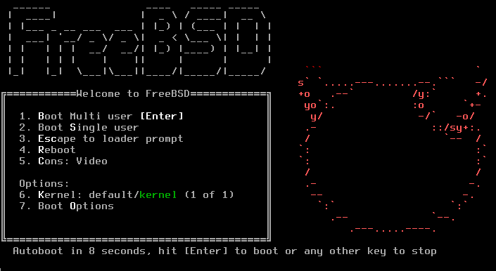
bsdinstall – (1)
Boot screen of FreeBSD 13.0

Slide 18
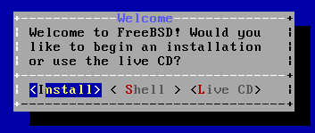
bsdinstall – (2)
Install、Shell、Live CD

Slide 19
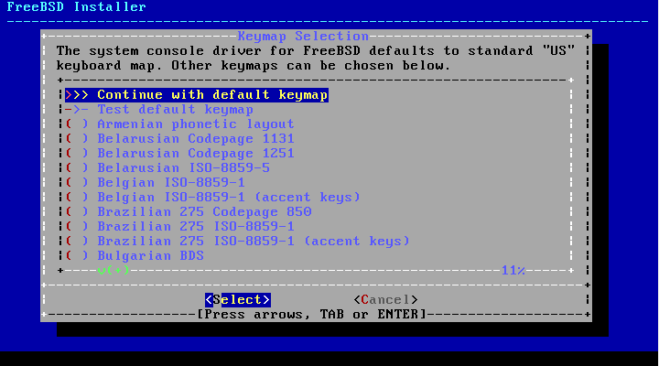
bsdinstall – (3)
Select keymap

Slide 20
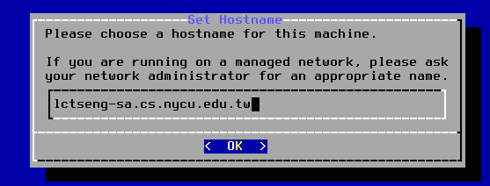
bsdinstall – (4)
Setting hostname
e.g., xxx-sa.cs.nycu.edu.tw

Slide 21
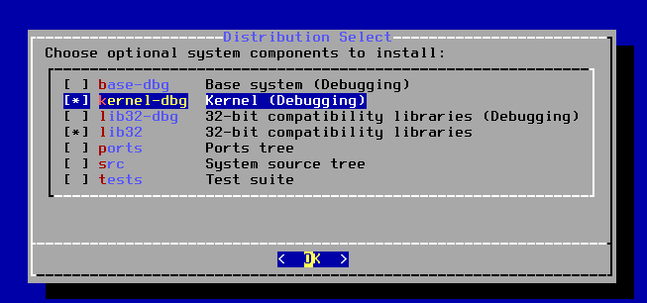
bsdinstall – (5)
Select components to install - use default values

Slide 22
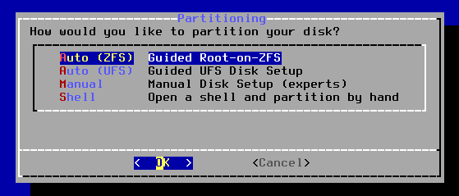
bsdinstall – (6)
Partitioning methods
Shell – gpart(8)、fdisk(8)、bsdlabel(8)
Use Auto (ZFS)

Slide 23
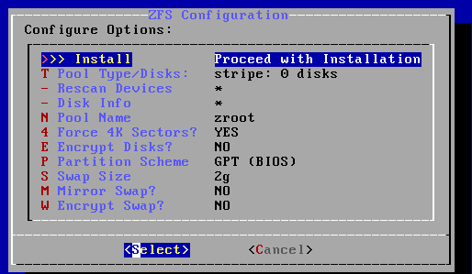
bsdinstall – (7) Auto (ZFS)
Guided Root-on-ZFS
Enter a pool name, disable forcing 4k sectors, enable or disable encryption
Switch between GPT (recommended) and MBR partition table types, and select the amount of swap space

Slide 24
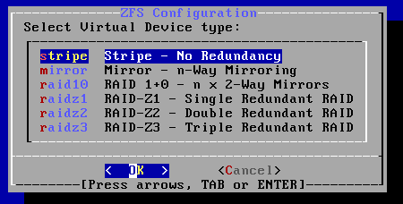
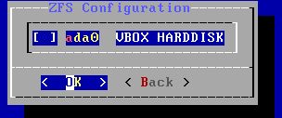
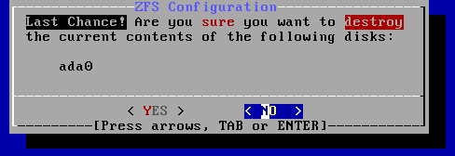
bsdinstall – (8)
Virtual Device type
Stripe
Mirror
RAID10
RAID-Z 1, 2, 3
Caution! Backup important data when using dual OS

Slide 25
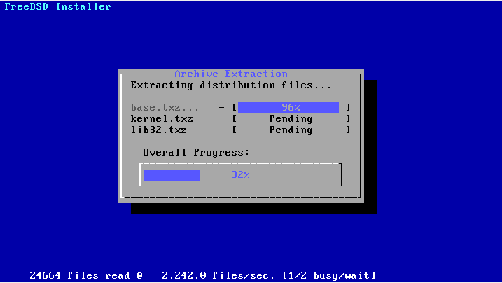
bsdinstall – (9)
Fetching → Checksum Verification → Extraction

Slide 26
bsdinstall – (10)
Post-installation
root password
Network interfaces
Wired – Static IPv4 / DHCP / Static IPv6 / SLAAC
Wireless
DNS
Time Zone
Services
System security hardening options
Add users

Slide 27
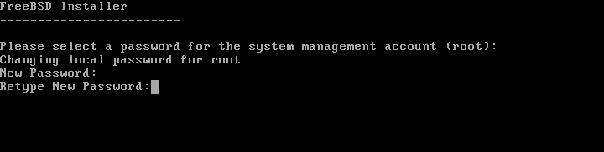
Post-installation
Setting the root Password

Slide 28
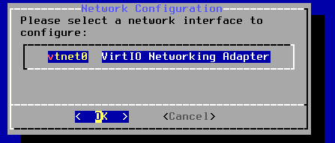
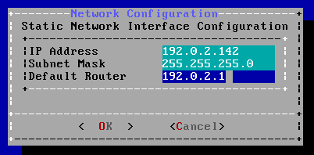
Post-installation
Select a network interfaces
Configuring IPv4 Networking with DHCP

Slide 29
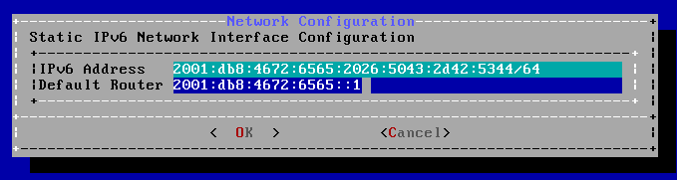
Post-installation
Configuring IPv6 Networking
IPv6 Stateless Address Auto configuration (SLAAC)
http://tools.ietf.org/html/rfc4862

Slide 30
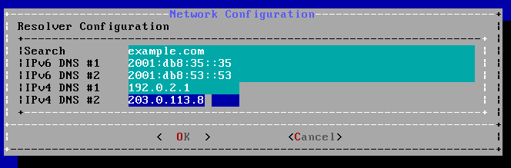
Post-installation
Configuring DNS

Slide 31
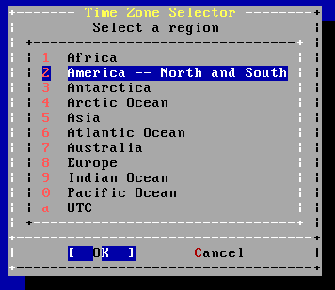
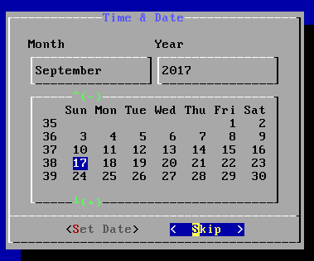
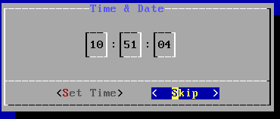
Post-installation
Setting the Time Zone
Asia → Taiwan

Slide 32
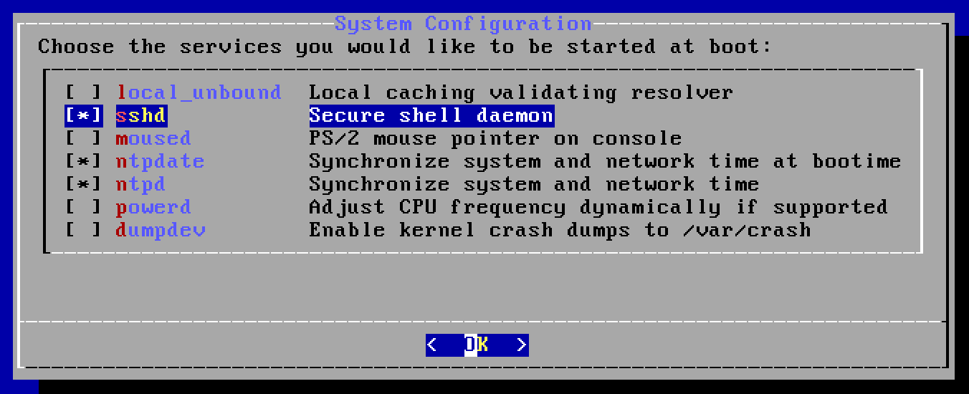
Post-installation
Selecting services to be enabled at boot
Enable sshd, ntpd, ntpdate
Disable dumpdev

Slide 33
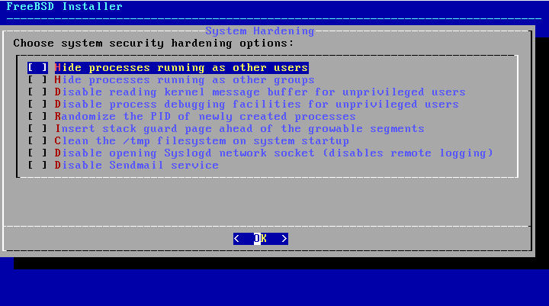
Post-installation
Selecting system security hardening options

Slide 34
Post-installation
Add Users
Username - lctseng
Full name - Liang-Chi Tseng
Uid - User ID. Typically left blank for default.
Login group - The user's group. - "staff" is good for you
Invite user into other groups? - wheel
Login class - Typically left blank for default.
Shell - The interactive shell for this user. CSCC use tcsh.
Home directory - The user's home directory.
Home directory permissions - The default is usually correct.
Use password-based authentication? - Typically "yes".

Slide 35
Post-installation
Add Users (Cont.)
Use an empty password? - Typically "no".
Use a random password? - Typically "no".
Enter password - The actual password for this user.
Enter password again - The password must be typed again for verification.
Lock out the account after creation? - Typically "no".

Slide 36
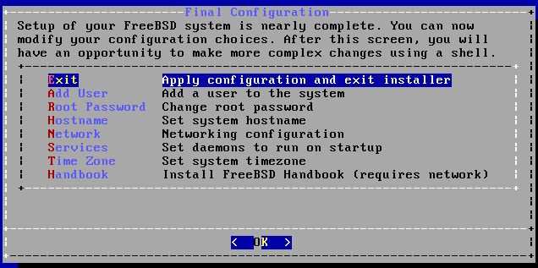
Post-installation
Final Configuration

Slide 37
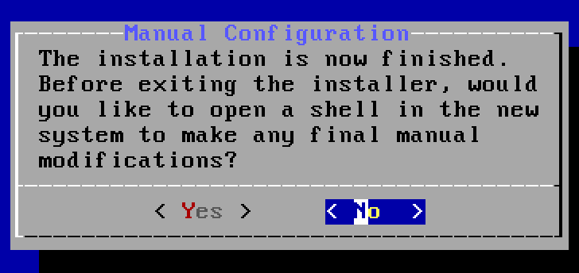
Post-installation
Make change if needed
Remove installation media

Slide 38
Post-installation
Update your system to latest patch
$ sudo freebsd-update fetch install
Check your patch version
$ uname -r
Should be "13.0-RELEASE-p4"

Slide 39
FreeBSD Handbook
Chapter 2. Installing FreeBSD (FreeBSD 9.0 Release and Later)
http://www.tw.freebsd.org/doc/en/books/handbook/bsdinstall.html
Chinese resources
https://www.tw.freebsd.org/doc/zh_TW/books/handbook/bsdinstall.html

Slide 40
Appendix
bsdinstall – Manual (UFS)

Slide 41
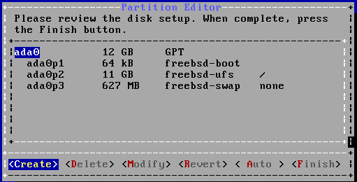
bsdinstall – Manual (UFS)
Guided partitioning result

Slide 42
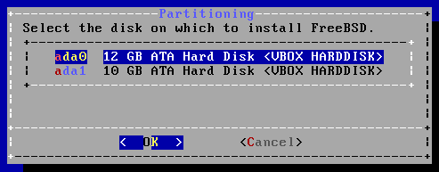
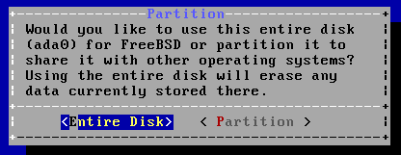
bsdinstall – Manual (UFS)
Guided partitioning
Select disk
How to partition the disk
Entire Disk
Partition – use free space

Slide 43
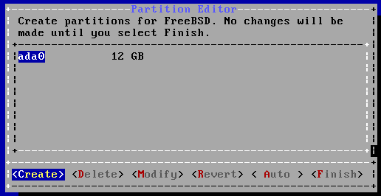
bsdinstall – Manual (UFS)
Manual Partitioning

Slide 44
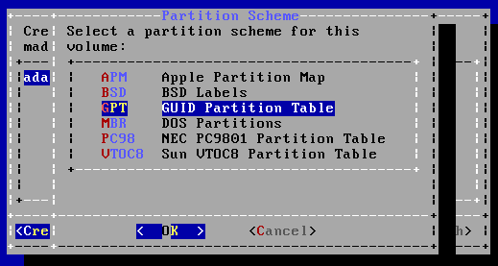
bsdinstall – Manual (UFS)
Choose a partitioning scheme
Master Boot Record (MBR)
4 Primary Partition, 1 Extended Partition, multiple Logical Partition
GUID Partition Table (GPT)
128 Partitions per disk
DON’T use BSD
Some disk tools cannot identify this label

Slide 45
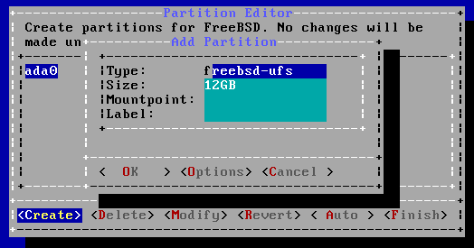
bsdinstall – Manual (UFS)
Add partitions
freebsd-boot
FreeBSD boot code. This partition must be first on the disk.

Slide 46
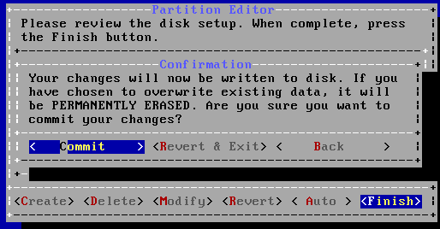
bsdinstall – Manual (UFS)
Final confirmation

Slide 47
bsdinstall – Manual (UFS)
Reference (handbook)
https://www.freebsd.org/doc/handbook/bsdinstall-partitioning.html
https://www.freebsd.org/doc/zh_TW/books/handbook/bsdinstall-partitioning.html

