Slide 1
Installing Applications in FreeBSD
lctseng (2019-2021, CC BY-SA)
? (1996-2018)
Notes:
講課時間：一小時

Slide 2
Handbook and Manual pages
Complete guide and be found at
https://www.freebsd.org/doc/handbook/ports.html
https://www.freebsd.org/doc/zh_TW/books/handbook/ports.html
ports(7)
pkg(7), pkg(8)

Slide 3
Before we start
Permission issue
root: the superuser
In Unix-like system, root is the conventional name of the user who has all rights or permissions (to all files and programs) in all modes (single- or multi-user)
Don't execute all commands as root directly
It's DANGEROUS
However sometimes you still need to be root to do something
Install software
Manage system settings
Create/modify/delete users

Slide 4
Before we start
Become root
Console login with root
By default, you cannot login as root via SSH
Change current user
Don't need to login with console
Use command "su -", and then type root's password
Only user in "wheel" group can use "su -"
To see which credit you are using, use "whoami"
$ whoami
lctseng
$ su -
Password:
$ whoami
root

Slide 5
Before we start
As mentioned before, don't run as root directly
Can we execute with root's credential only for some specific commands?
Like 'Run as administrator' in Windows
Is there similar commands in Unix-like system/FreeBSD?

Slide 6
Install software: Overview (1)
Pre-built binary package
pkg
Source
Using Ports collection
Download source tarball (.tar.gz)
Checkout from VCS (git/svn)

Slide 7
Before we start
Run commands with other user's permission
"sudo" command
Only simplest explanation here for basic usage
"sudo" syntax and other details will be explained in later chapters
Here only tell you how to simply enable 'sudo'
How to enable sudo?
"sudo" is not a command in the base, needs to be installed manually

Slide 8
Before we start – Enable "sudo" (1)
Install the package
Check Internet connection
$ ping -c4 8.8.8.8
Become root
$ su -
Install the package of sudo
$ pkg install sudo
This will install 'sudo' from Internet
Type 'Y'( means yes) when it asks for confirmation

Slide 9
Before we start – Enable "sudo" (2)
Allowing your user to execute "sudo"
Switch to root first
Type "setenv EDITOR ee" to change your editor for this time
Will explain this in later chapters
This will allow you using a notepad-like editor
If you are familiar with the default editor 'vi', just skip this step

Slide 10
Before we start – Enable "sudo" (3)
Allowing your user to execute "sudo"
Type "visudo" to edit the sudoer file
Specify who can use "sudo"
##
## User privilege specification
##
root ALL=(ALL) ALL
lctseng ALL=(ALL) ALL
Save the file and exit, back to normal user
Use "logout" command or press Ctrl+D

Slide 11
Before we start – Using "sudo"
Now, you can prepend "sudo" before commands to run them as root
But please think carefully before you hit enter
Execute commands with "sudo"
sudo whoami
You have root's credential
sudo pkg install vim
Install software without become root directly
You need to re-type your password
Don't need to re-type within 5 minutes

Slide 12
Install software: Overview (2)
Package
Like installers (.msi) in Windows
"package" (.txz) on FreeBSD
rpm on RedHat Linux, deb on Debian Linux
Package Manager
install/remove/upgrade packages
Other Unix-like systems
rpm, yum, dpkg, apt, dnf, pacman …
FreeBSD
pkg
Notes:
windows 比較沒有對應的 package manager, 或許可以把 microsoft store, 或是 https://chocolatey.org/ 吧

Slide 13
Install software: Overview (3)
Install from source
Managed source collection
FreeBSD Ports
With dependency checking and FreeBSD specified patches
Others
Download source tarball (.tar.gz) from websites
Checkout from VCS (git/svn)
No dependency checking

Slide 14
Install software: Comparison (1)
Method | Description | Dependency Checking
Packages | Pre-built ports, contains pre-compiled copies of all the commands for the software with default settings, as well as any configuration files or documentation. | Yes
Ports | A collection of files designed to automate the process of compiling an software from source code and additional patches (a set of Makefile, patches, description files, …) | Yes
Tarball VCS | fetch it, configure the installation options, and compile it by yourself. | No

Slide 15
Install software: Comparison (2)
Method | Benefits
Packages | Packages do not require any additional compilation Benefit for slow machines
Ports | Optimization You can tweak the compilation options to generate code that is specific to a different processor Customization Some software have compilation time options relating to what they can and cannot do
Tarball VCS | Some software cannot be found in ports collection Newly created projects, latest versions, ... Some latest versions of software may have new configurations that do not exist in ports (cannot configure it through the ports easily)

Slide 16
Package System (1)
pkg
New generation of FreeBSD package system
Install new software
Fetch packages from a repository
Need root permission (sudo)
Automatically update the database
By default invoking either of pkg install or pkg upgrade will cause repository catalogues to be updated automatically
Perform dependency check
Will install software that required by new software

Slide 17
Package System (2)
Install new software
pkg install <names of packages…>
pkg install vim-console tmux
Upgrade currently installed software
pkg upgrade <names of packages…>
pkg upgrade vim-console
pkg upgrade
Upgrade all installed software
This will also update the database

Slide 18
Package System (3)
Update packages database only
pkg update
Delete a package
pkg delete <names of packages>
Search
pkg search <keyword>
Search package repository catalogues

Slide 19
Package System (4)
Show information about installed packages
pkg info
Show all installed packages
Use "grep" to find specific packages
pkg info | grep vim
pkg info <name of package>
Show detailed information
pkg info vim-console

Slide 20
Package System (5)
Show version of installed packages
pkg version
pkg version -v
$ pkg version -v
bash-4.3.46_1 < needs updating (remote has 4.4.12_2)
bind99-9.9.9P8_1 < needs updating (remote has 9.9.10P3)
ca_root_nss-3.32 = up-to-date with remote

Slide 21
Port System
We should…
Obtain the ports collection
List of ports available to be installed into system
Find the application
Change to the directory for the port
Ports will
Fetch the source tarball
Ask for configuration friendly
Compile the source code to a package
Install the application via the just built package
Deinstall process
Notes:
port 最後也是先 build 成 package 再 install

Slide 22
Obtaining the Ports Collection (1/3)
portsnap(8)
Fetch and update your ports tree
fetch, extract, update, cron
sudo portsnap fetch extract update
https://www.freebsd.org/doc/en_US.ISO8859-1/books/handbook/ports-using.html

Slide 23
Obtaining the Ports Collection (2/3)
git (1)
Install git command line tool
sudo pkg install git
Checkout from a given repository
sudo git clone https://git.FreeBSD.org/ports.git /usr/ports

Slide 24
Obtaining the Ports Collection (3/3)
Port directory
/usr/ports/<category>/<name>
$ ls /usr/ports/
CHANGES archivers finance multimedia textproc
CONTRIBUTING.md astro french net ukrainian
COPYRIGHT audio ftp net-im vietnamese
GIDs base games net-mgmt www
Keywords benchmarks german net-p2p x11
LEGAL biology graphics news x11-clocks
…
$ ls /usr/ports/editors/vim
Makefile distinfo files pkg-descr pkg-plist

Slide 25
Ports system (1)
Find your application
cd /usr/ports
For the first time, run "sudo make fetchindex" to fetch index for searching
make search name=program name
make search key=string
$ make search name=vim-console
Port: vim-console-8.2.1558
Path: /usr/ports/editors/vim-console
Info: Improved version of the vi editor (console only)
Maint: adamw@FreeBSD.org
B-deps: pkgconf-1.7.3,1
R-deps:
WWW: http://www.vim.org/

Slide 26
Ports system (2)
psearch(1)
Simple but useful tool to find ports
ports-mgmt/psearch
or pkg install psearch
psearch <name of port>
psearch vim
$ psearch vim
audio/vitunes Curses-based media player with vim-like keybinds
devel/clewn Clewn provides Gdb support within Vim
editors/cream Gvim extension with many features
...

Slide 27
Ports system (3)
Type "make install clean" to install your application
make config (/var/db/ports/)
make fetch (/usr/ports/distfiles/)
make checksum
make extract
make patch
make configure
make build
make install
make clean
Clean files generated by configure process
make distclean
Clean downloaded distribution files (tarball)
make (all)

Slide 28
Ports system (4)
The ports system uses fetch(1) to download the files
MASTER_SITES environment variable
/etc/make.conf
MASTER_SITE_BACKUP?= \
http://FreeBSD.cs.nctu.edu.tw/distfiles/${DIST_SUBDIR}/
MASTER_SITE_OVERRIDE?= ${MASTER_SITE_BACKUP}
Options for ports
make config
Won't build or install the port
Use this to re-configure ports (otherwise, it uses old one instead)
hidden options (not shown in 'make config')
Edit the Makefiles under that port directory

Slide 29
Ports system (5)
I have installed the application but
Command not found…
Logout, and then login.
If you use (t)csh or zsh
rehash

Slide 30
Upgrading Ports using Portmaster
ports-mgmt/portmaster
A utility for easily upgrading and installing ports
$ cd /usr/ports/ports-mgmt/portmaster && make install clean
Install or upgrade a port
portmaster <category>/<name>
portmaster sysutils/lsof
/usr/ports/UPDATING
Read before attempting any port upgrades!!!
Useful options
-B, -D, -a, -r, -y, -H, -w
portmaster -dyBwH editors/vim
/usr/local/etc/portmaster.rc

Slide 31
Security
Show security issues about installed packages
No matter from port or from package
pkg audit
Upgrade these packages to mitigate security problems
$ pkg audit
python38-3.8.10 is vulnerable:
Python -- multiple vulnerabilities
WWW: https://vuxml.FreeBSD.org/freebsd/145ce848-1165-11ec-ac7e-08002789875b.html

Slide 32
Install from source (1)
Compile the source files first and then install
Tarball, a pack of source code
tar -xzf certain-source.tar.gz
cd certain-source
./configure [options …]
./configure --help
make
make install (root permission)

Slide 33
Install from source (2)
Compile the source files first and then install
Checkout master branch from VCS
git clone --depth=1 https://github.com/curl/curl.git
cd curl
./buildconf
./configure --enable-debug
make
sudo make install

Slide 34
Security Considerations (1)
How to find secure source
Check the official site, read the announcement and change log
Verify the checksum (tarball)
Fetch via https or ssh (VCS)

Slide 35
Security Considerations (2)
Why "curl URL | sh" is bad?
Example: "curl get.pow.cx | sh"
Why do you think this is good?
Search: "curl pipe bash"
Even the file does not contain evil code, broken connection may turn it.
"rm -rf /tmp/foo.bar" becomes "rm -rf /"
Instead: download the script, read it, execute it.

Slide 36
Deinstall Applications
Two methods
pkg delete
Find the package name via pkg info
Dependency check
Disable dependency check
-f : force
pkg delete -f <names of packages>
make deinstall
Change to the port’s directory
make deinstall
Delete it anyway
Similar to "pkg delete -f"

Slide 37
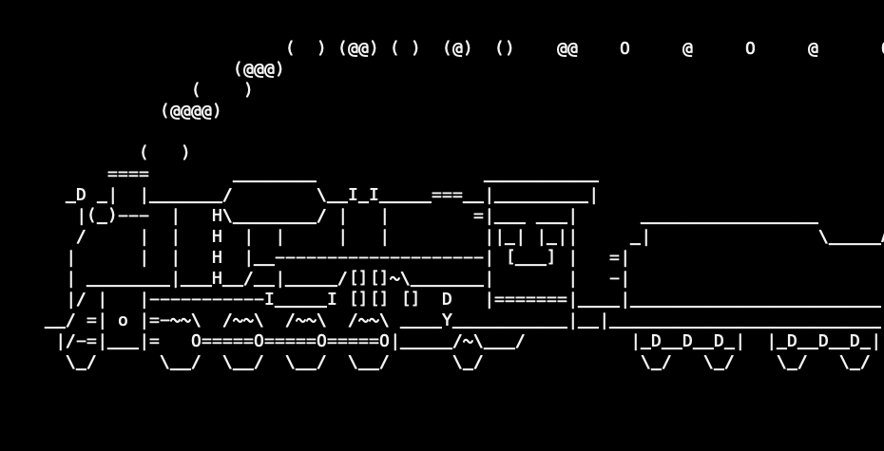
Try to install from ports/pkg
tmux
vim-console, emacs
mutt
wget, curl
lftp
lynx, w3m
expect
zsh, bash
sl

Slide 38
Appendix
Package management in other Unix-like systems

Slide 39
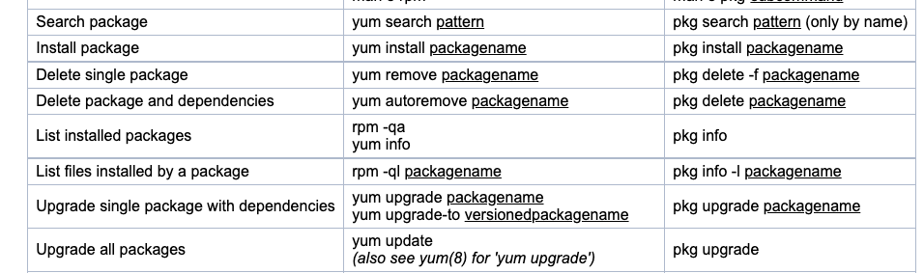
Package Manager Rosetta Stone
Package commands in the most common systems
https://wiki.freebsd.org/PackageManagerRosettaStone

