Slide 1
Shells
lctseng (2019-2021, CC BY-SA)
? (1996-2018)
Notes:
2020上課時數：第一週30分鐘沒上完，只上到P21
剩下的講完花了40分鐘

Slide 2

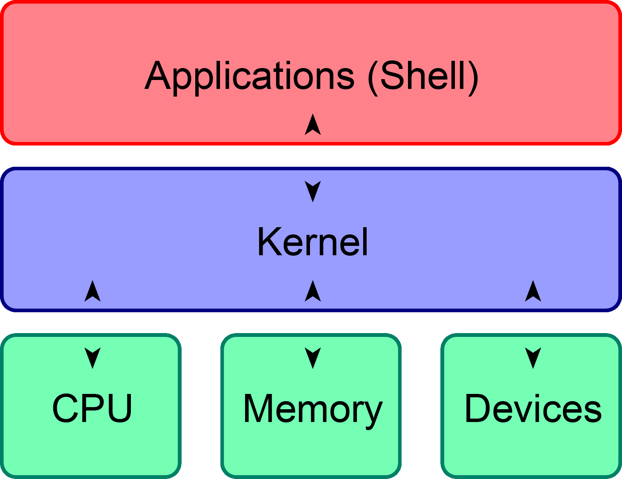
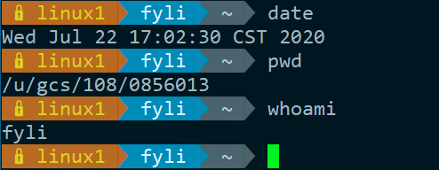
UNIX Kernel and Shell
Interface to communicate with kernel
Where you type commands

Slide 3
UNIX Kernel and Shell (2)
YOUR SHELL PROGRAMS
KORN SHELL C SHELL
KERNEL
FETCH COMMAND
HARDWARE
OTHER UNIX COMMANDS BOURNE SHELL
ANALYZE
OTHER APPLICATION PROGRAMS
EXECUTE
Interpret

Slide 4
The UNIX Shells
Shell | Originator | System Name | Prompt
Bourne Shell (In FreeBSD base) | S. R. Bourne | /bin/sh | $
C Shell (In FreeBSD base, Default for root) | Bill Joy | /bin/csh | %
TENEX C Shell (In FreeBSD base) | Ken Greer | /bin/tcsh | >
Korn Shell | David Korn | (shells/ksh93) | $
Bourne-Again Shell (Widely used) | Brian J. Fox | (shells/bash) | $
Z Shell (macOS default) | Paul Falstad | (shells/zsh) | %
Notes:
tcsh: tee c-shell

Slide 5
Windows Shell
cmd.exe
First released in 1987
For Windows NT/Windows CE
Still used in modern Windows
PowerShell
First released in 2006
To provide the same functionality as UNIX shells
Also has Linux/MacOS releases

Slide 6
Shell Startup Files
sh | /etc/profile | login shell, system wide
 | ~/.profile | login shell
 | ENV
csh | /etc/csh.cshrc | always, system wide
 | /etc/csh.login | login shell, system wide
 | ~/.cshrc | always
 | ~/.login | login shell
 | ~/.logout | logout shell
 | etc/csh.logout | logout shell, system wide

Slide 7
Shell Startup Files (2)
tcsh | ~/.tcshrc | login shell
 | (csh startup files) | backward compatibility for csh
bash | /etc/profile ~/.bash_profile ~/.bash_login ~/.profile | login shell
 | ~/.bashrc | login shell
 | BASH_ENV
Bash Startup Files : https://www.gnu.org/software/bash/manual/html_node/Bash-Startup-Files.html

Slide 8
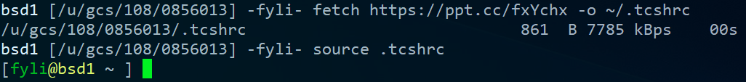
Shell Startup Files (3)
A sample tcshrc for you to change your prompt
Simplest install steps
Take a look at the content before running it
$ fetch https://ppt.cc/fxYchx -o ~/.tcshrc
$ source ~/.tcshrc

Slide 9
Shell Environment Variables (1)
Controlling shell behaviors
There are many environment variables that control the shell behavior
To dump them:
$ env
To get value:
$ echo $VARIABLE_NAME
$ echo ${VARIABLE_NAME}
$ echo "$PATH"

Slide 10
Shell Environment Variables (2)
Useful Environment Variables
Variables | Description
HOME | User's home directory
MAIL | User's mailbox
PATH | Command search path

Slide 11
Variables and Strings Quotes
Char. |  | Purpose
sh | var=value | Assign value to variable
csh | set var=value
$var, ${var} |  | Get shell variable
`cmd` |  | Substitution stdout
'string' |  | Quote character without substitution
"string" |  | Quote character with substitution

Slide 12
Variables and Strings Quotes (2)
Shell | sh | csh
Commands | $ varname=`/bin/date` $ echo $varname $ echo 'Now is $varname' $ echo "Now is $varname" | $ set varname2=`/bin/date` $ echo $varname2 $ echo 'Now is varname2' $ echo "Now is $varname2"
Result | Sun Jun 9 06:22:19 CST 2019 Now is $varname Now is Sun Jun 9 06:22:19 CST 2019

Slide 13
Global Variables
Use "env" command to display global variables
Assignment
 | Bourne Shell | C Shell
Local variable | my=test current_month=`date +%m` | set my=test set current_month=`date +%m`
Global variable | export my=test export EDITOR=/usr/bin/ee | setenv my test setenv EDITOR /usr/bin/ee

Slide 14
Shell Special Characters
Reduce typing as much as possible
sh | Characters | Description
 | * | Match any string of characters
 | ? | Match any single alphanumeric character
 | […] | Match any single character within []
 | [!...] | Match any single character not in []
 | ~ | Home directory

Slide 15
Shell Special Characters (2)
Example: There are some files in current directory
test1, test2, test3, test4, test-5, testmess
sh | Command | Result
 | $ ls test* | test1 test2 test3 test4 test-5 testmess
 | $ ls test? | test1 test2 test3 test4
 | $ ls test[123] | test1 test2 test3
 | $ ls test[!345]* | test1 test2 test-5 testmess
 | $ ls ~ | List files under your home

Slide 16
Shell Special Characters (3)
Char. | Purpose | Example
# | Start a shell comment | # this is a comment
; | Command separator | $ ls test*; ls test?
&& | Executes the first command, and then executes the second if first command success (exit code=0) | $ cd foo/bar && make install
|| | Executes the first command, and then executes the second if first command fail (exit code≠0) | $ cp x y || touch y

Slide 17
Shell Special Characters (4)
Char. | Purpose | Example
\ | (1)Escape character (2)Command continuation indicator | $ touch test\*; ls test\* test* $ ls \ > test*
& | Background execution | $ make buildworld & $ sleep 5 &

Slide 18
Common Built-in Commands
SH | CSH | Description
set/unset |  | Set/Unset shell options and positional parameters
(empty)/unset | set/unset | Set/Unset a local variable
export | setenv/unsetenv | Set/Unset a global variable
set |  | Display shell variables (sh: local + global, csh: local)
env |  | Display global (environment) variables
(N/A) | login, logout | Logout
exit |  | exit shell

Slide 19
Common Built-in Commands (2)
SH | CSH | Description
(N/A) | dirs | print directory stack
(N/A) | popd, pushd | Pop/push directory stack
echo |  | write arguments on stdout
alias/unalias |  | command aliases
fg, bg |  | Bring a process to foreground/background (e.g. sleep 5 &)
jobs |  | List active jobs (with job numbers)
%[job no.] |  | Bring a process to foreground (e.g. %1)

Slide 20
Built-in Shell Commands (3)
SH | CSH | Description
kill |  | Send a signal to a job (kill %job or kill pid)
(N/A) | stop | Suspend a background process (%job | pid)
exec |  | execute arguments
nice |  | Change nice value

Slide 21
Built-in Shell Commands (4)
SH | CSH | Description
(N/A) | history | Display history list
(N/A) | rehash | Evaluate the internal hash table of the contents of directories
(N/A) | source | Read and execute a file
References:
https://it.cs.nycu.edu.tw/unix-basic-commands
http://www.unix.org.ua/orelly/unix/unixnut/ch04_06.htm
http://publib.boulder.ibm.com/infocenter/pseries/index.jsp?topic=/com.ibm.aix.doc/aixuser/usrosdev/list_c_builtin_cmds.htm
https://www.freebsd.org/cgi/man.cgi?query=tcsh
https://www.freebsd.org/cgi/man.cgi?query=sh

Slide 22
Input/Output Redirection
There are 3 default file descriptors
Integer value | Name
0 | stdin (Standard Input)
1 | stdout (Standard Output)
2 | stderr (Standard Error)
Using man command to read more information
sh(1): Redirection
tcsh(1): Input/Output

Slide 23
Input/Output Redirection (2)
Method | Name
cmd < file | Open the file as stdin of cmd
cmd > file | Write stdout of cmd in the following file. Truncates existing files. (tcsh: use "set noclobber" to avoid overwriting)
cmd >> file | Append stdout of cmd to the following file
2>&1 | Merge stdout with stderr
cmd1 | cmd2 | Pipe stdout of cmd1 into stdin of cmd2

Slide 24
File and Directory Related Commands
Command | Purpose
ls | List a directory's content
pwd | Print working directory
cd | Change to other directory
mkdir | Make(create) a new directory
rmdir | Remove existing empty directory
cat | Concatenate file
cp | Copy file

Slide 25
File and Directory Related Commands (2)
Command | Purpose
ln | Link files
mv | Move file
rm | Remove file
stat | Display file status

Slide 26
Select and File Processing Related Commands
Command | Purpose
head | Display first lines of a file
tail | Select trailing lines
grep | Select lines
diff | Compare and select difference in two files
wc | Count characters, words or lines of a file
uniq | Select uniq lines
cut | Select columns

Slide 27
Select and File Processing Related Commands (2)
Command | Purpose
sort | Sort and merge multiple files together
sed | Edit streams of data
awk | Pattern scanning and processing language

Slide 28
Select and File Processing Related Commands (3) - Example Usage
Look first few lines or last few lines
$ head /var/log/message
$ tail /var/log/message
-n : specific how many lines
Find the occurrence of certain pattern in file
$ grep -l lctseng *
Print the filename that has "lctseng" as content
$ grep -n lctseng /etc/passwd
Print the line number when using grep

Slide 29
Select and File Processing Related Commands (4) - Example Usage
List lctseng's id, uid, home, shell in /etc/passwd
$ grep lctseng /etc/passwd | cut -f1,3,6,7 -d:
-f1,3,6,7 : fetch 1st ,3rd ,6th ,7th column
-d : separation symbol
lctseng:*:1001:20:Liang-Chi Tseng:/home/lctseng:/bin/tcsh
$ grep lctseng /etc/passwd | cut -f1,3,6,7 -d:
lctseng:1001:/home/lctseng:/bin/tcsh

Slide 30
Select and File Processing Related Commands (5) - Example Usage
Cut out file permission and file name from ls output
$ ls -l | grep -v ^total | cut -c 1-11,47-
-c1-12：1st~12th characters (start from 1, instead of 0)
-c47-：characters after 47th character (include 47th )
total 12
drwxr-xr-x 4 lctseng staff 512 9 20 16:21 Unix-User-Config/
-rw-r--r-- 1 lctseng staff 274 9 19 16:09 sa.tmp
-rw-r--r-- 1 lctseng staff 0 9 19 16:38 history.txt
$ ls -l | grep -v ^total | cut -c 1-11,47-
drwxr-xr-x Unix-User-Config/
-rw-r--r-- sa.tmp
-rw-r--r-- history.txt

Slide 31
Select and File Processing Related Commands (6) - Example Usage
Use awk to generate the same behavior of cut
$ ls -l | grep -v ^total | awk '{print $1 " " $9}'
Result is same as P.30
total 12
drwxr-xr-x 4 lctseng staff 512 9 20 16:21 Unix-User-Config/
-rw-r--r-- 1 lctseng staff 274 9 19 16:09 sa.tmp
-rw-r--r-- 1 lctseng staff 0 9 19 16:38 history.txt
$ ls -l | grep -v ^total | awk '{print $1 " " $9}'
drwxr-xr-x Unix-User-Config/
-rw-r--r-- sa.tmp
-rw-r--r-- history.txt

Slide 32
Select and File Processing Related Commands (7) - Example Usage
Use awk to generate the same behavior of cut
$ awk -F: '{print $1 " " $6}' /etc/passwd
-F ：separation symbol
lctseng:*:1001:20:Liang-Chi Tseng:/home/lctseng:/bin/tcsh
$ awk -F: '{print $1 " " $6}' /etc/passwd
lctseng /home/lctseng

Slide 33
Select and File Processing Related Commands (8) - Example Usage
Options of "sort" command
-r : reverse
-u : unique keys
-n : numeric keys sorting
Default: string sorting, 14 > 123
-k : specific columns to sort with
-t : field separator

Slide 34
Select and File Processing Related Commands (9) - Example Usage
List directory contents and sort by file size decreasingly
$ ls -al | sort -n -k 5,5 -r
-k : specific columns to sort with
-r : reverse
-rw------- 1 lctseng staff 3954 9 20 18:39 .viminfo
-rw-r--r-- 1 lctseng staff 1066 9 20 00:05 .cshrc
-rw-r--r-- 1 lctseng staff 978 9 20 00:05 .shrc
-rw-r--r-- 1 lctseng staff 817 9 20 00:05 .profile

Slide 35
Select and File Processing Related Commands (10) - Example Usage
Sort contents of /etc/passwd by username and remove annotations
$ sort -t: -k 1,1 /etc/passwd | grep -v ^#
-t : field separator
-k : specific columns to sort with
games:*:7:13:Games pseudo-user:/usr/games:/usr/sbin/nologin
git_daemon:*:964:964:git daemon:/nonexistent:/usr/sbin/nologin
hast:*:845:845:HAST unprivileged user:/var/empty:/usr/sbin/nologin
kmem:*:5:65533:KMem Sandbox:/:/usr/sbin/nologin
lctseng:*:1001:20:Liang-Chi Tseng:/home/lctseng:/bin/tcsh

Slide 36
Select and File Processing Related Commands (11) - Example Usage
List records in /etc/hosts sorted by IPv4 address
$ sort -t. -n -k 1,1 -k 2,2 -k 3,3 -k 4,4 '/etc/hosts' | grep -v ^#
-n : numeric keys sorting
Before sorting
# In the presence of the domain name service or NIS, this file may
# not be consulted at all; see /etc/nsswitch.conf for the
# resolution order.
#
::1 localhost localhost.my.domain
127.0.0.1 localhost localhost.my.domain
140.113.17.26 nctucs.tw
64.233.187.95 www.googleapis.com googleapis.l.google.com

Slide 37
Select and File Processing Related Commands (12) - Example Usage
List records in /etc/hosts sorted by IPv4 address
$ sort -t. -n -k 1,1 -k 2,2 -k 3,3 -k 4,4 '/etc/hosts' | grep -v ^#
-n : numeric keys sorting
After sorting
::1 localhost localhost.my.domain
64.233.187.95 www.googleapis.com googleapis.l.google.com
127.0.0.1 localhost localhost.my.domain
140.113.17.26 nctucs.tw

Slide 38
Select and File Processing Related Commands (13) - Example Usage
Translate characters
$ echo "Hello World" | tr "a-z" "A-Z"
Change all alphabet to uppercase
$ echo "Hello World" | tr "a-z" "A-Z"
HELLO WORLD
$ tr -d "\t" < file1
Delete TAB in file1
$ tr -s " " " " < file1
Delete multiple space in file1

Slide 39
Select and File Processing Related Commands (14) - Example Usage
Translate characters
$ grep lctseng /etc/passwd | tr ":" "\n"
Change all ":" to "\n"
$ grep lctseng /etc/passwd | tr ":" "\n" lctseng
*
1001
20
Liang-Chi Tseng
/home/lctseng
/bin/tcsh

Slide 40
xargs Command
xargs – construct argument list(s) and execute utility
-n number
-I replstr (every)
-J replstr (first )
-s size
...

Slide 41
xargs Command (2)
% ls
2.sh 3.csh 4.csh 4.sh bsd1.ping testin
% ls | xargs echo
2.sh 3.csh 4.csh 4.sh bsd1.ping testin
% ls | xargs -n1 echo
2.sh
3.csh
4.csh
4.sh
bsd1.ping
testin

Slide 42
xargs Command (3)
% ls | xargs -I % -n1 echo % here %
2.sh here 2.sh
3.csh here 3.csh
4.csh here 4.csh
4.sh here 4.sh
bsd1.ping here bsd1.ping
testin here testin

Slide 43
xargs Command (4)
% ls | xargs -J % -n1 echo % here %
2.sh here %
3.csh here %
4.csh here %
4.sh here %
bsd1.ping here %
testin here %

Slide 44
xargs Command (5)
Example : ping all hosts in file
$ cat host
www.google.com
bsd1.cs.nctu.edu.tw
linux3.cs.nctu.edu.tw
cs.nctu.edu.tw
$ cat host | xargs -n1 ping -c 1 | grep "bytes from"
64 bytes from 64.233.188.103: icmp_seq=0 ttl=47 time=6.944 ms
64 bytes from 140.113.235.135: icmp_seq=0 ttl=57 time=1.451 ms
64 bytes from 140.113.235.153: icmp_seq=0 ttl=57 time=1.612 ms
64 bytes from 140.113.235.47: icmp_seq=0 ttl=57 time=1.856 ms

Slide 45
The Unix Philosophy
https://en.wikipedia.org/wiki/Unix_philosophy
Lots of little tools, each good at one thing
Use them together to achieve your goal
Try other shells (install from package/ports)
zsh
Oh-my-zsh: https://github.com/robbyrussell/oh-my-zsh
fish

Slide 46
ShellCheck
Finds bugs in your shell scripts
https://www.shellcheck.net/
devel/hs-ShellCheck
pkg install hs-ShellCheck

Slide 47
Appendix
Command History in (t)csh

Slide 48
Command History in (t)csh
Commands | Description
!n | exec previous command line n (see history)
!-n | exec current command line minus n
!! | exec last command (the same as !-1)
!str | exec previous command line beginning with str
!?str | exec previous command line containing str
% history
10 8:31 cp ypwhich.1 ypwhich.1.old
11 8:31 vi ypwhich.1
12 8:32 diff ypwhich.1.old ypwhich.1
13 8:32 history
% !?old

Slide 49
Command History in (t)csh (2)
Commands | Description
!!:n | use the nth word of previous comm
!!:m-n | select words m ~ n of previous command
!!:* | use all arguments of previous command
!!:s/str1/str2/ | substitute str1 with str2 in previous command
% history
15 8:35 cd /etc
16 8:35 ls HOSTS FSTAB
17 8:35 history
% cat !-2:*:s/HOSTS/hosts/:s/FSTAB/fstab → cat hosts fstab
tcsh(1): History Substitution

