Slide 1
Utilities - tmux & git
lctseng (2019-2021, CC BY-SA)
wnlee and others (1996-2018)
Notes:
講課時間：65分鐘

Slide 2
Tmux
Terminal Multiplexer

Slide 3
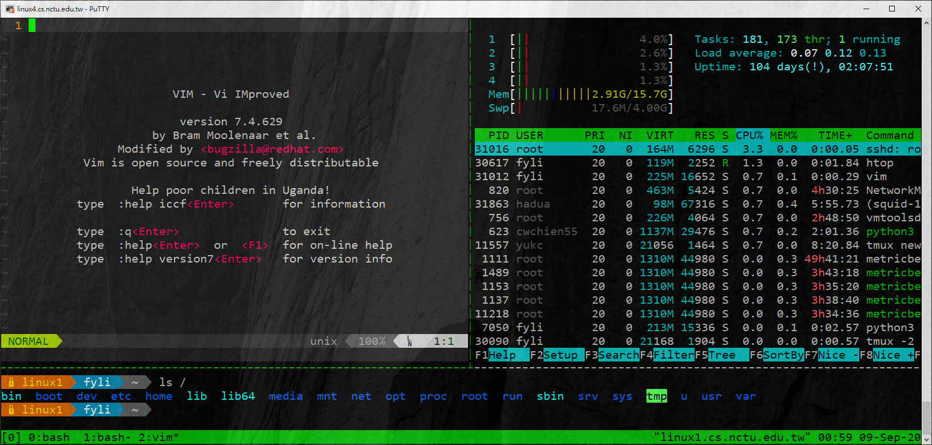
What is tmux?
Terminal Multiplexer
Allow open multiple tabs (multiple terminals)

Slide 4

What is tmux?
SSH
Tmux Client
Tmux Server

Slide 5
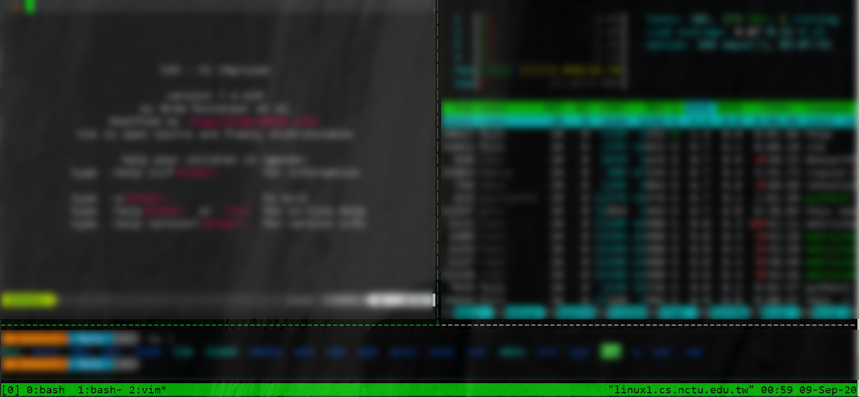
What is tmux?
Pane
Pane
Session
Window
Pane

Slide 6
Why should I use tmux?
Keep your working session alive
By default, shell is terminated when connection is lost
Including any programs/editors opened
Any unsaved changes are discarded without warning
tmux will not be terminated when connection is lost
Attach to previous sessions!

Slide 7
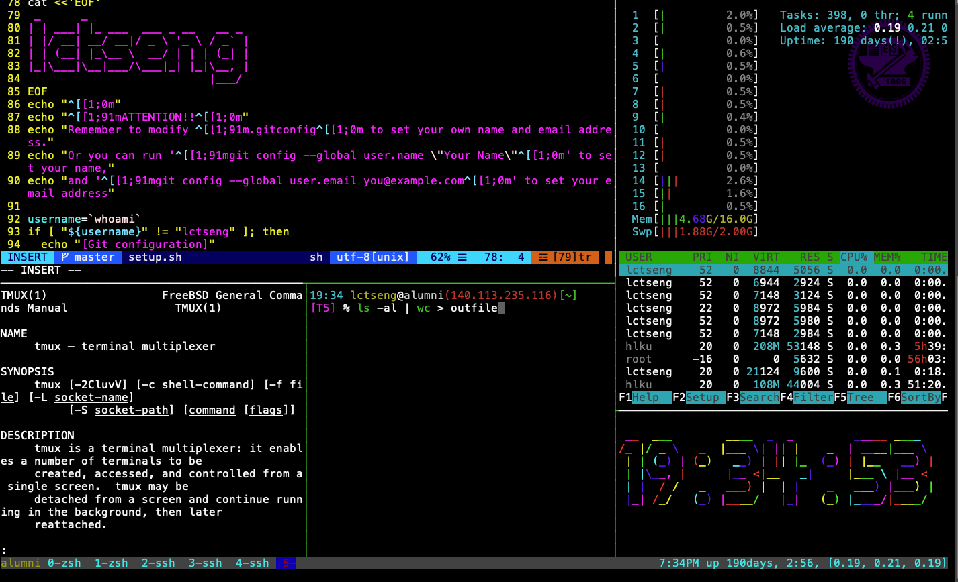
Example screenshot of tmux
https://github.com/lctseng/Unix-User-Config/blob/master/.tmux.conf

Slide 8
Advantages of tmux
Multiple sessions, windows, panes
Keep the sessions, attach/detach anytime
Powerful window division (panes)
Share screen by attaching to the same session

Slide 9
Start tmux
tmux
tmux attach [ -t <number> ]
tmux detach
tmux ls
tmux kill-session [ <number> ]

Slide 10
tmux 101
Basic operations and configurations

Slide 11
Session
Create new session (open a new browser)
Execute outside of any tmux sessions
$ tmux
Detach current session
When attached in a session
$ tmux detach
Or close the terminal directly
Attach to previous session
$ tmux attach
Attach only if previous sessions exist

Slide 12
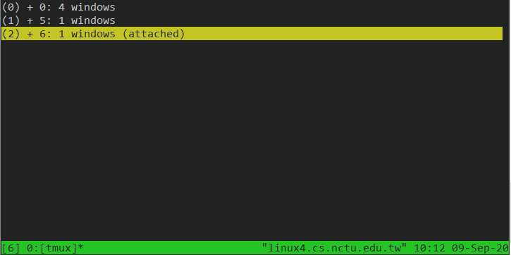
Multiple sessions (1)
Open multiple browsers

Slide 13
Multiple sessions (2)
Open multiple browsers
List opened sessions
$ tmux list-sessions
0: 1 windows (created Sun Jun 16 18:49:57 2019) [128x38]
1: 3 windows (created Sun Jun 16 18:50:03 2019) [128x38]
Attach to previous session by id
$ tmux attach -t session-id

Slide 14
tmux - bindkey
Operations start with a special key combination
Default is C-b
Where C is Ctrl (control)

Slide 15
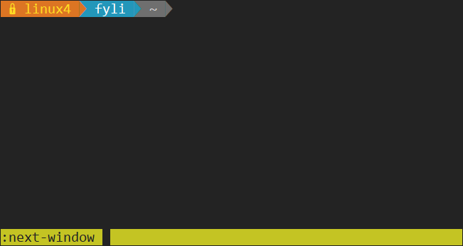
tmux - command
Bindkey + :
Open command prompt and execute tmux commands

Slide 16
Bindkey - Window
bindkey (default is C-b) //C == control | C | new-window
 | N | next-window
 | P | previous-window
 | L | last-window
 | <NUM> | select-window -t := <NUM>
 | & | confirm-before -p "kill-window #W? (y/n)" kill-window
 | , | command-prompt -I "#W" "rename-window '%%'"
 | . | command-prompt "move-window -t '%%'"

Slide 17
Bindkey - Pane
bindkey (default is C-b) //C == control | % | split-window -h
 | “ | split-window
 | arrow-key | select-pane
 | alt + arrow-kwy | resize-pane
 | x | confirm-before -p "kill-pane #P? (y/n)" kill-pane
 | { | swap-pane -U
 | } | swap-pane -D

Slide 18
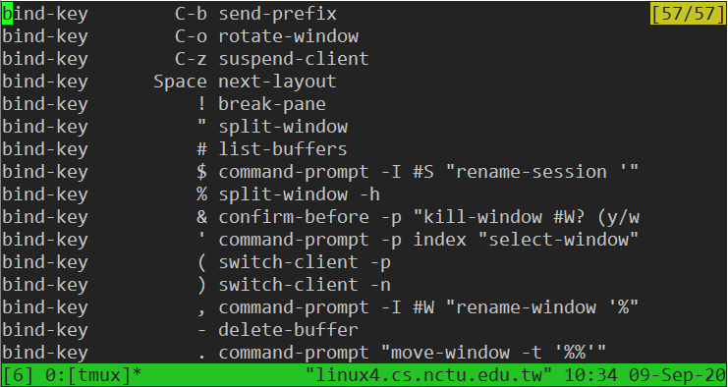
tmux - bindkey
bindkey + ?

Slide 19
Configuration - tmux.conf
~/.tmux.conf
design yourself style
colorful

Slide 20
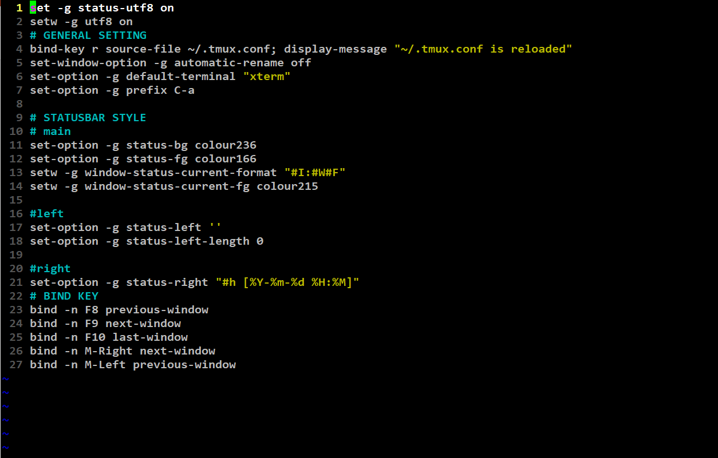

Configuration - tmux.conf
~/.tmux.conf

Slide 21
Configuration - bindkey
~/.tmux.conf
bind-key ( alias: bind )
C ( alias: <Ctrl> )
M ( alias: <Alt> )
bind-key <key> <command>
-T key-table ( default table is prefix )
-n : alias for -T root => Don’t need to press C-b first
-r : repeat

Slide 22
Configuration - set
~/.tmux.conf
set-window-option ( alias: setw )

Slide 23
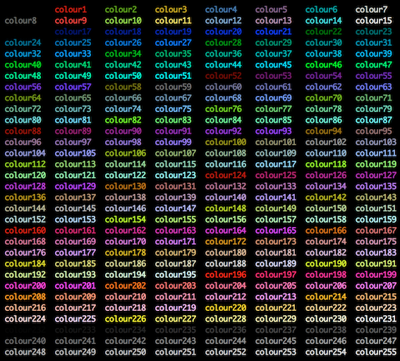
Configuration - set

Slide 24
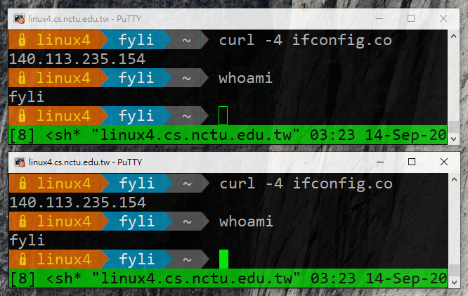
tmux - share session
Both side can edit and execute commands

Slide 25
Reference
tmux (1)
tmux shortcuts & cheatsheet
https://gist.github.com/MohamedAlaa/2961058
tmux brief introduction (chinese)
https://5xruby.tw/posts/tmux/

Slide 26
Appendix: tmux v.s. screen
 | tmux | screen
Window Split | top-down & left-right | top-down only (default)
 | different sessions can have different schemes | scheme must shared by all sessions
Session | switch between sessions without detach | detach first then re-attach another session
 | multiple clients can attach to same session | one session for one client only (force detach)
Profile | .tmux | .screenrc
 | highly customizable | less than tmux

Slide 27
Git
One of the most popular Version Control Systems

Slide 28
Version Control Systems (VCS)
Also known as Source Code Management (SCM)
Records changes to a set of files over time so that you can recall specific versions later.
Easy for developing, finding bug, blame someone else, ...
Popular tools
Git, Subversion (svn), Mercurial (hg)

Slide 29
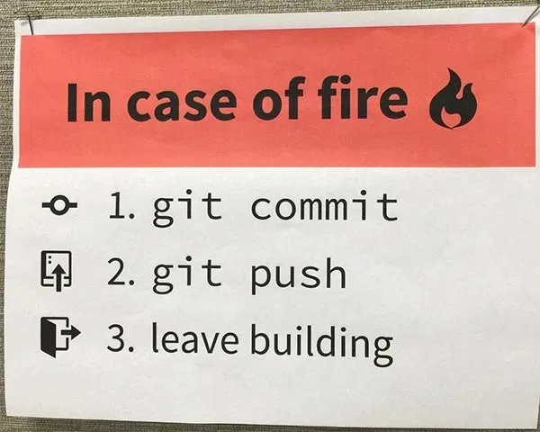
Version Control Systems (VCS)
Web hosting
Backup projects
Collaborating
Commercial providers
Github, Gitlab, Bitbucket
Self-hosted
git.cs.nctu.edu.tw

Slide 30
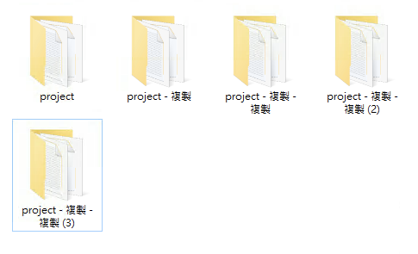
Without VCS
Copy-paste manually
# 2015-11-10
cp -r project project.bak
# 2015-11-11
cp -r project project.bak1
# 2015-11-12
cp -r project project.bak2
# 2015-11-15
cp -r project project.bak3

Slide 31
How VCS works
In addition to your files, VCS stores extra information under your project folder
Hidden folders
.git for Git
.hg for Mercurial
Previous versions of files (compressed)
Remote repository information

Slide 32
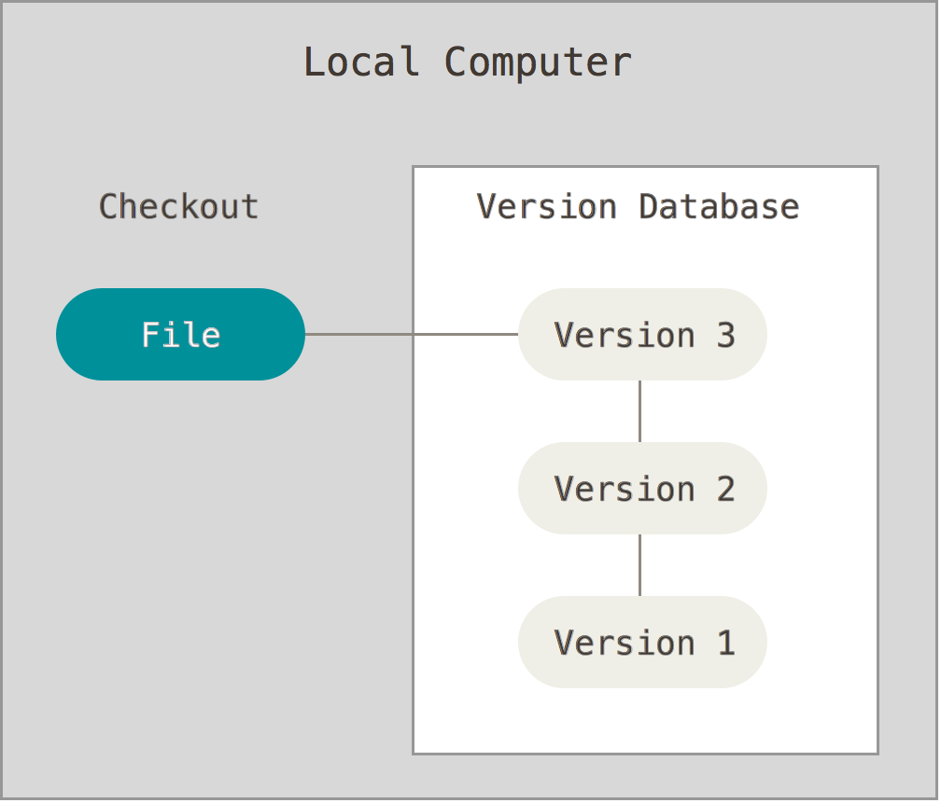
Types of VCS (1)
Local VCS
All versions are in local
Cannot share with others
No remote backup
Example
Manually copy-paste
Git/Hg without setting remote upstream

Slide 33
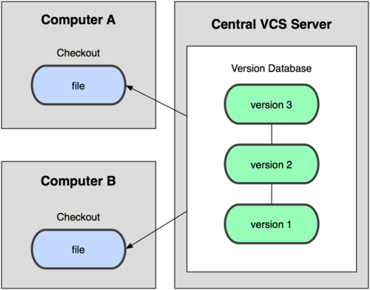
Types of VCS (2)
Centralized VCS
User can checkout one specific version
Remote server has all versions
Lost access to other versions if network is down
Lost all versions if server is down
Example
Subversion

Slide 34
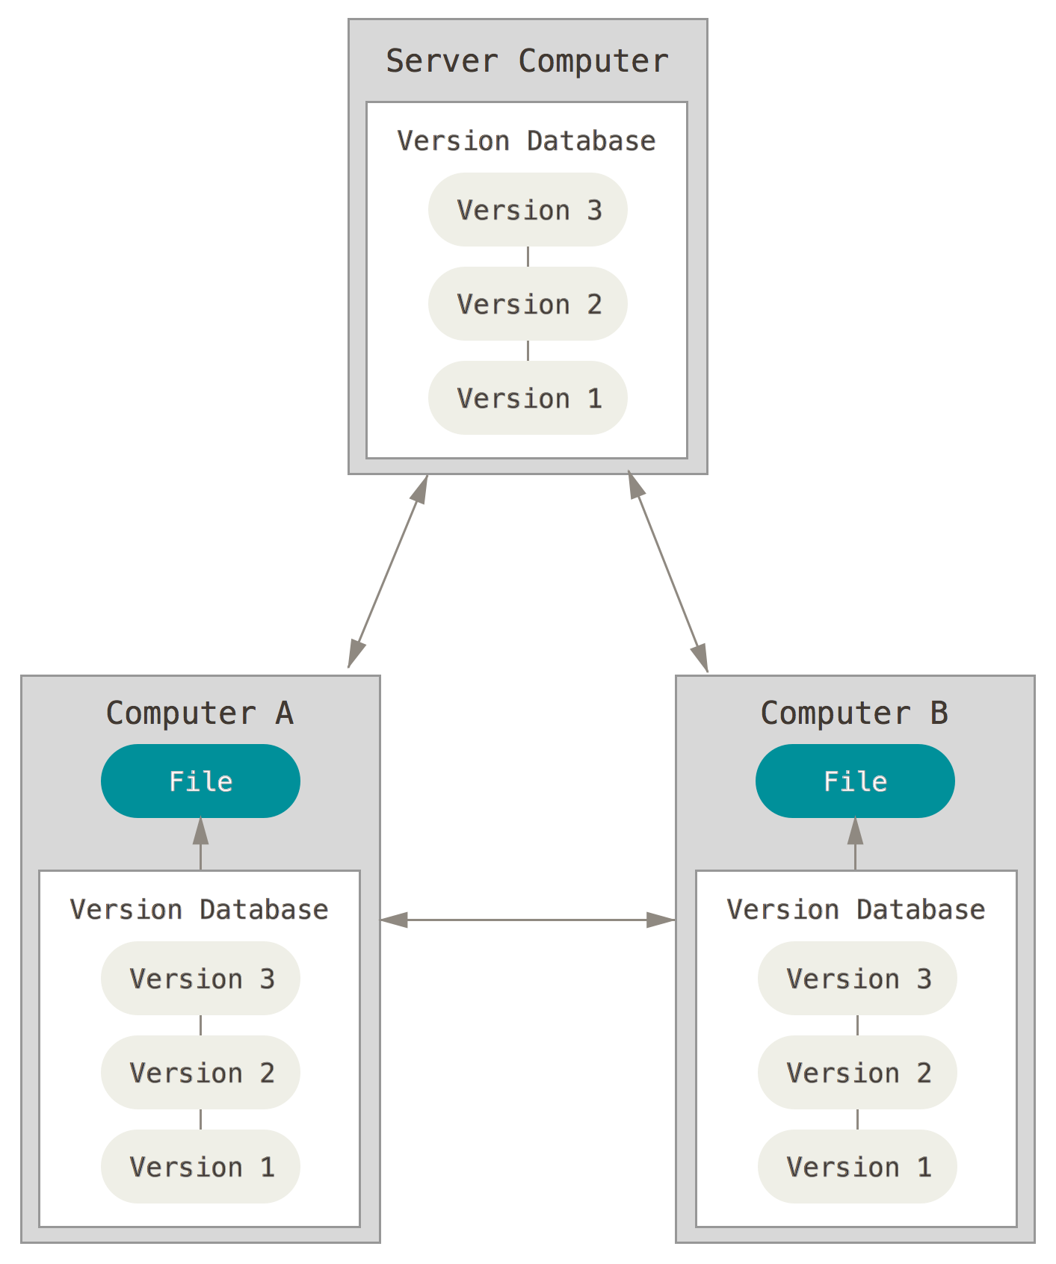
Types of VCS (3)
Distributed VCS
Every node has complete copy of versions
Offline working
Synchronization
Usually using a server as the source of truth
Example
Git, Mercurial

Slide 35
Git
Distributed VCS
History
Linus Torvalds (the creator of Linux)
Source Control Management for Linux Kernel
~2005
Using BitKeeper (commercial software)
2005~
Developed Git

Slide 36
Git
Snapshots, not differences
All versions of all files are stored independently
Easy for checking out to any version
Nearly every operation is local
Git has integrity
SHA checking
Git generally only adds data
Delete
Store the file in .git folder and hide from your workspace
Modify
Backup the original file to .git folder

Slide 37
Git
Git is very powerful, with many features
In this class, we only talk about the very simple one
We will cover
How to install and create repos
How to add files/make changes
How to create commits
How to navigate between versions
How to push to remote
Will NOT cover
branching (git branch, git merge, ...)
Anything else
Homework 2

Slide 38
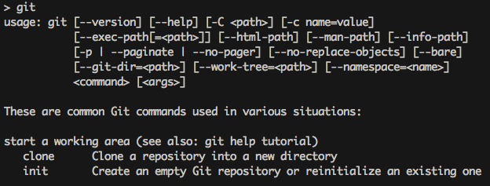
Git - installation
FreeBSD
pkg install git
Other OS
https://git-scm.com/book/en/v2/Getting-Started-Installing-Git

Slide 39
Git - getting started
Developer information
In terminal
$ git config --global user.email "you@example.com"
$ git config --global user.name "Name"
Or edit manually in ~/.gitconfig
Create a new repository
$ mkdir hw2
$ cd hw2
$ git init
Initialize an empty project with .git directory

Slide 40
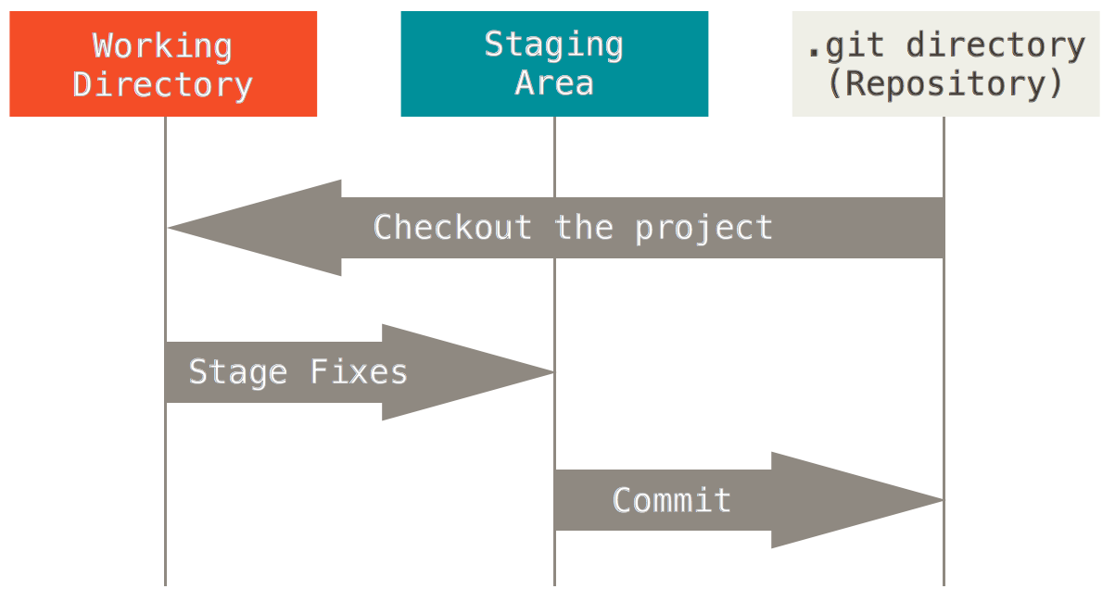
Git - the three stages

Slide 41
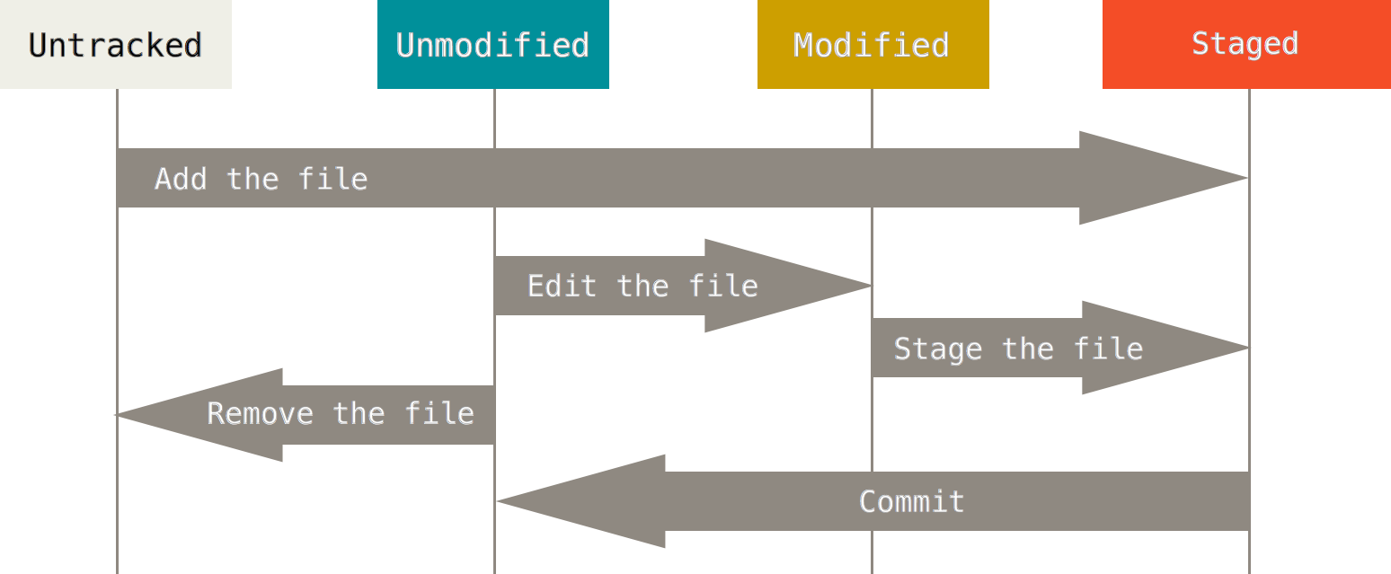
Git - file lifecycle
The lifecycle of the status of your files

Slide 42
Git - basic operations (1)
git add
Add file contents to the index (staged)
$ git add file1 file2...
$ git add directory
$ git add .

Slide 43
Git - basic operations (2)
git commit
Confirm your staged change and create a commit (revision)
Will open default text editor for commit message
Useful options
-a: stage all modified and deleted path (git add)
-m MSG: use MSG as commit message without opening editors

Slide 44
Git - basic operations (3)
git status
View the working directory status of current project
$ git status -s
M README.md # updated in index
D run.sh # deleted from index
R src/main.js # renamed in index
A src/index.html # added to index
?? src/README.md # untracked

Slide 45
Git - basic operations (4)
git diff
Compare change with the previous version
https://git-scm.com/docs/git-diff
$ git diff
diff --git a/README.md b/README.md
index 76f177f..f4986c2 100644
--- a/README.md
+++ b/README.md
@@ -1 +1 @@
-# Hi
+# Hello

Slide 46
Git - basic operations (5)
git log
View the commit log (history)
Change the log format
http://gits-scm.com/docs/pretty-formats
$ git log
commit 2f2bd00051fbd4d4978b7e96508b97950d6e60b1
Author: lctseng lctseng@cs.nctu.edu.tw
Date: Thu Oct 8 17:10:13 2020 +0800
Initial commit

Slide 47
Git - basic operations (6)
git checkout
Go to other revisions or branches
$ git checkout <commit-id>
Go back to latest change:
$ git checkout master
$ git status
On branch master
$ git checkout 2f2bd00
Note: checking out '2f2bd00'.
$ git status
HEAD detached at 2f2bd00

Slide 48
Git - basic operations (7)
git bisect
Finding problematic commit
Flow (similar to binary search)
$ git bisect start
Define endpoints
$ git bisect good <good-commit-id>
$ git bisect bad <bad-commit-id>
After that, git will checkout to some commit
If that commit is good
$ git bisect good
If that commit is bad
$ git bisect bad
After several rounds, git will checkout to first bad commit

Slide 49
Git - push to remote
git remote
Manage the remote repository
$ git remote add origin https://git.cs.nctu.edu.tw/lctseng/sa-demo.git
Set the remote server & repo for push/pull
git push
$ git push -u origin master
Push to the remote and create the remote master branch
Later on, you can simply use "git push"

Slide 50
Git - pull from remote
git clone
Download the full repository from remote server
$ git clone https://github.com/curl/curl.git
git pull
Pull the latest revisions from remote in an existing repository

