Slide 1
Booting Up and Shutting Down
lctseng (2019-2021, CC BY-SA)
? (1996-2018)
Notes:
50分鐘

Slide 2
Handbook and Manual pages
Complete guide and be found at
https://www.freebsd.org/doc/en/books/handbook/boot.html
https://www.freebsd.org/doc/zh_TW/books/handbook/boot.html

Slide 3
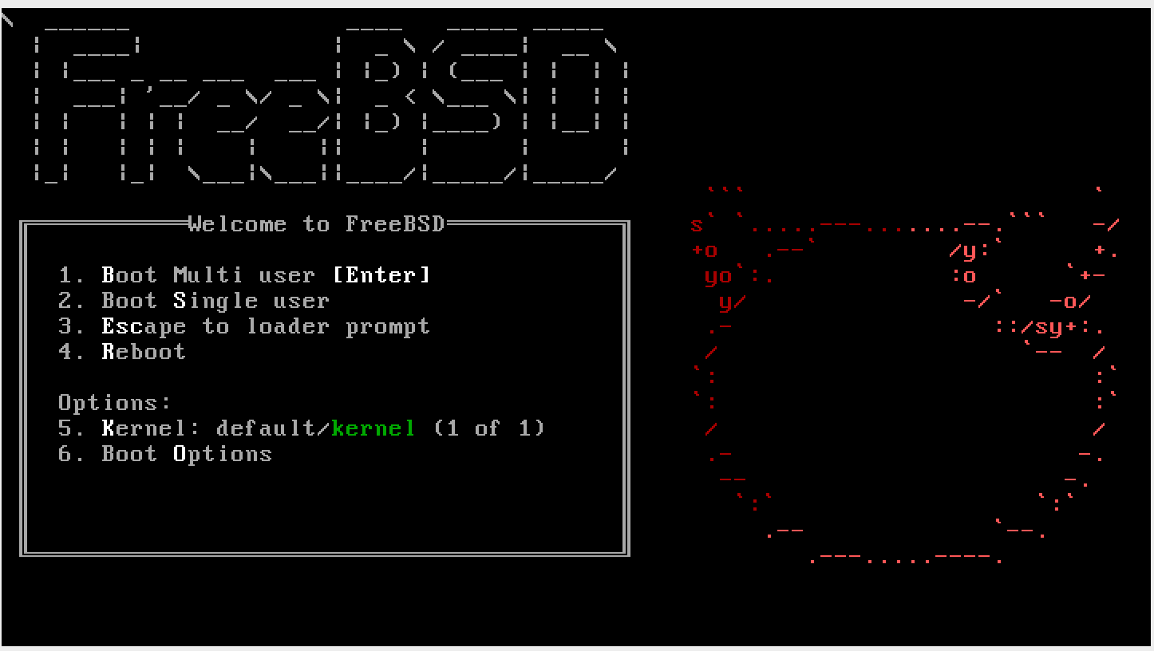
Booting Overview - After Powering On
BIOS (Basic Input/Output System) - stored on motherboard
Find MBR in the bootable media (disk,cd,usb stick,...)
MBR (Master Boot Record) - stored on the first sector of disk/media
Record partition information of the disk
Load boot loader in Boot Sector (prompt if multiple choices available)
Boot Sector - stored in the each slice (outside of usual file system)
Recognize FreeBSD file system. Find kernel loader under /boot
Kernel loader - stored in main file system (all below)
Show booting prompt and load selected kernel
OS Kernel
Initialize hardware/drivers
Init
Mount filesystem, acquire DHCP, start shell, ...

Slide 4
MBR – Master Boot Record
First 512 bytes of disk, outside the FreeBSD filesystem
Last 2 Bytes are 0x55AA
Corresponding copy in FreeBSD is /boot/boot0 or /boot/mbr
nctucs [~] -lctseng- ls -l /boot/boot0
-r--r--r-- 1 root Wheel 512 Nov 12 2014 /boot/boot0
nctucs [~] -lctseng- ls -l /boot/mbr
-r--r--r-- 1 root Wheel 512 Nov 12 2014 /boot/mbr
nctucs [~] -lctseng- xxd /boot/mbr
00000000: fc31 c08e c08e d88e d0bc 007c be1a 7cbf .1.........|..|.
00000010: 1a06 b9e6 01f3 a4e9 008a 31f6 bbbe 07b1 ..........1.....
…
000001d0: 0000 0000 0000 0000 0000 0000 0000 0000 ................
000001e0: 0000 0000 0000 0000 0000 0000 0000 0000 ................
000001f0: 0000 0000 0000 0000 0000 0000 0000 55aa ..............U.

Slide 5
MBR – Master Boot Record
466 bytes - code for booting
64 bytes - partition table
Responsible to find the boot code on the boot sector of bootable slice.
MBR
Slice 1 (dev/ad0s1)
Slice 2 (dev/ad0s2)
Slice 3 (dev/ad0s3)
Slice 4 (dev/ad0s4)
F1 Win
F2 FreeBSD
Default: F2
boot0 Screenshot
Slice 5 /dev/ad0s5 | Slice 6 /dev/ad0s6
Notes:
10/10 16:23

Slide 6
FreeBSD Booting Stages
Stage 0 (MBR)
/boot/mbr or /boot/boot0
Finds bootable partitions
Stage 1 (Boot Sector)
/boot/boot1
Limited to 512 byte. Only recognize bsdlabel.
Find /boot/boot2 in somewhere of Boot Sector
Stage 2 (Boot Sector)
/boot/boot2
Find /boot/loader or load kernel directly
Stage 3 (BSD file system)
/boot/loader
Show prompt and load kernel

Slide 7
Boot Stage One and Stage Two
boot1 and boot2 (/boot/boot1 + /boot/boot2 = /boot/boot)
In boot sector of given partition (outside of FreeBSD file system)
They belongs to the same program, but divided into two parts because of space constraint
Copied from /boot/boot
Used to run the loader.
MBR
Slice 1 (dev/ad0s1)
[Boot Sector] /boot/boot{1,2}
[File System] loader, kernel
Slice 2 (dev/ad0s2) ...
Slice 3 (dev/ad0s3) ...
>> FreeBSD/i386 BOOT
Default: 0:ad(0,a)/boot/loader
boot:
boot2 Screenshot

Slide 8
Boot Stage Three
Boot Stage Three: The loader
Provide a user-friendly interface to configure booting choice.
/boot/loader
Wait for 10 seconds then autoboot
Configuration
Kernel options, kernel modules, boot delay, ...
Default loader behavior | User-defined loader behavior
/boot/defaults/loader.conf | /boot/loader.conf
autoboot_delay="10"
zfs_load="YES"
/boot/loader.conf

Slide 9
Files in /boot/
/boot/mbr (Standard)
Simplified version of boot0, blindly boot the partition marked active
/boot/boot0 (BootMgr)
bootmanager
/boot/boot{1,2} = /boot/boot
boot1 is very simple, since it can only be 512 bytes in size, and knows just enough about the FreeBSD bsdlabel, which stores information about the slice, to find and execute boot2.
boot2 is slightly more sophisticated, and understands the FreeBSD file system enough to find files on it, and can provide a simple interface to choose the kernel or loader to run /boot/loader
/boot/loader
load the kernel from disk
/boot/kernel/kernel

Slide 10
MBR recover
If MBR is overwritten by MS (or others), and you want to replace it with FreeBSD MBR:
Boot with CD or Floppy
$ fdisk -B -b /boot/boot0 ad0 or boot0cfg -B /dev/ad0
-B means reinitialize the boot code contained in sector 0 of the disk
-b is used to specify the boot code
If you want to replace it with MS MBR
Boot with DOS CD/floppy
C:\fdisk /mbr

Slide 11
Single User Mode
Similar to Windows "Safe Mode"
Repair system
Inconsistent file system
Error in a boot configuration
Reset lost root password
Entering single user mode requires no password
Full access to local file and configuration (root permission)
No network access

Slide 12
Boot in single user mode
OS | Command
FreeBSD | Interrupt the boot loader and type "boot -s" Or type "2" in the menu
Linux | Lilo: linux single Grub: append 'single' in the boot menu
Solaris | Press "STOP" and "a" to enter the boot PROM and Press "boot -s"

Slide 13
Insecure single user mode
Single user mode requires no password by default
When the physical security to the console is considerable, set console to be insecure in /etc/ttys
# name getty type status comments
#
# If console is marked "insecure", then init will ask
# for the root password
# when going to single-user mode.
# console none unknown off secure
console none unknown off insecure

Slide 14
Using Single User Mode
Only the root partition is mounted and mounted as read only
mount -u /
Indicates that the status of an already mounted file system should be changed
mount -a -t ufs (or other external types)
Mount all file systems with specific type
swapon -a
Enable all swap

Slide 15
Multibooting (1)
FreeBSD
FreeBSD boot loader will try to detect bootable partitions
You can also declare the bootable partitions explicitly with boot0cfg
$ boot0cfg -B -m 0x7 ad0
-m means mask, Specify slices to be enabled/disabled,
E.g. 0x7 means 0111,boot menu will detect slice 1~3 to show the options (and slice 4 is disabled)

Slide 16
Multibooting (2)
default 0
timeout 30
fallback 1
# For booting GNU/Linux
title GNU/Linux
kernel (hd1,0)/vmlinuz root=/dev/hdb1
# For booting FreeBSD
title FreeBSD
root (hd0,2,a)
kernel /boot/loader
# For booting Windows NT or Windows95
title Windows NT / Windows 95 boot menu
root (hd0,0)
makeactive
chainloader +1
Linux
Using lilo or grub

Slide 17
Steps in the boot process
Loading and initialization of the kernel
Device detection and configuration
Creation of spontaneous system processes
Execution of system startup scripts
Multiuser operation

Slide 18
Steps in the boot process – Kernel initialization
Get kernel image into memory to be executed
Perform memory test
Allocate internal data structures of kernel
OS | Kernel Image Path
FreeBSD | /boot/kernel/kernel
Linux | /boot/vmlinuz
Solaris | /kernel/genunix
SunOS | /vmunix

Slide 19
Steps in the boot process –
Hardware configuration
Devices specified in kernel configuration file
Kernel will try to locate and initialize it
Devices not specified in kernel configuration file
Kernel tries to determine other information by probing the bus
If the driver is missing or not responsible to the probe, device is disabled
We can load kernel module to support this device.
kldload, kldstat, kldunload
/boot/kernel/*.ko
if_em_load="YES"
vboxdrv_load="YES"
vboxnet_enable="YES"
/boot/loader.conf

Slide 20
Steps in the boot process –
System Processes
Spontaneous process
Not created by the normal UNIX fork mechanism
OS | Pid 0 | Pid 1 | Pid 2 and more
FreeBSD | kernel | init | g_event
Linux | - | init | kthreadd, kflushed,kupdate kpiod,kswapd
SunOS | sched | init | pageout

Slide 21
Steps in the boot process –
Execution of startup scripts
The startup scripts are selected and run by init
Typical works are:
Setting the name of the computer
Setting the time zone
Checking the disk with fsck
Mounting the system's disks
Removing files from /tmp directory
Configuring network interface
Starting up daemons and network services

Slide 22
Steps in the boot process –
Multiuser operation
From now on, the system is fully operational, but no one can login
init will spawn getty processes to listen for login
PID 1
init
sh
PID 563
exec
grep
Fork
Fork
init
PID 424
exec
getty
PID 424
exec
login
PID 424
exec
sh

Slide 23
FreeBSD startup scripts
The BSD-style booting
init will run /etc/rc
/etc/rc will reads the following configuration
/etc/defaults/rc.conf
/etc/rc.conf
/etc/rc.d
rc(8)

Slide 24
Ways to shutdown or reboot
Turn off the power ← Please Don't
Use the shutdown(8) command
Or using the halt and reboot command
halt = shutdown -h
reboot = shutdown -r

Slide 25
Ways to shutdown or reboot –
shutdown command
OS | Pathname | Time | Reboot | Halt | Single User Mode | Skip Fsck
FreeBSD | /sbin/shutdown | time | -r | -h
Linux | /sbin/shutdown | time | -r | -h
Solaris | /usr/sbin/shutdown | -gsecs | -i6 | -i0 | -is
SunOS | /usr/sbin/shutdown | +mins | -r | -h |  | -f
Time format can be
+m
hh:mm => Linux
yymmddhhmm => FreeBSD

Slide 26



Halt ? Poweroff ?
Halt
Terminate all processes, write data back to disks
When everything is ready, tell user to turn off the power
Or reboot by press any key
In older systems, you need to manually do so

Slide 27
Poweroff
Halt + Turn off the power
ACPI / APM
Advanced Configuration and Power Interface
Advanced Power Management
In FreeBSD
Try “shutdown -p now”
Compile this into kernel
device apm0 at nexus?flag 0x20
Rebuild the kernel
Edit /etc/rc.conf
apm_enable="YES"
apmd_enable="YES"
Reboot
Try “shtudown -p now” (or poweroff)
In case it does not work…

Slide 28
Other Booting Manager
Besides BSD-style booting, another line is System-V
Used by many Linux distributions
Solaris, Debian

Slide 29
System-V Startup Scripts
Run-level
/etc/inittab
init follow the inittab from level 0 to level k
Example: inittab in sun1
Run Level | Startup scripts | Meaning
0 | /etc/rc.d/rc0.d/ | Halt
1 | /etc/rc.d/rc1.d/ | Single user mode
2 | /etc/rc.d/rc2.d/ | Multiuser without NFS
3 | /etc/rc.d/rc3.d/ | Full multiuser mode
4 | /etc/rc.d/rc4.d/ | User defined
5 | /etc/rc.d/rc5.d/ | Multiuser with graphical interface
6 | /etc/rc.d/rc6.d/ | Reboot

Slide 30
Ways to shutdown or reboot –
telinit
Only for SystemV systems (and Systemd)
telinit: change run-level
Halt/poweroff
$ telinit 0
Reboot
$ telinit 6
Single user mode
$ telinit 1

Slide 31
Systemd
Modern system/service manager for many Linux distributions
Ubuntu, Debian, …
Evolved from System-V
Another booting manager beside BSD
Used by older versions of Linux distributions
Debian < 8.0 : System-V
Debian >= 8.0 : Systemd
Similar to System-V, but faster and easier to use

Slide 32
Systemd
Use 'targets' to replace run-levels
SysV Run Level | Systemd targets | Meaning
0 | runlevel0.target, poweroff.target | Poweroff
1 | runlevel1.target, rescue.target | Single user mode
2 | runlevel2.target, multi-user.target | User defined. Default: same as level 3
3 | runlevel3.target, multi-user.target | Multiuser mode
4 | runlevel4.target, multi-user.target | User defined. Default: same as level 3
5 | runlevel5.target, graphical.target | Multiuser with graphical interface
6 | runlevel6.target, reboot.target | Reboot

