Slide 1
Controlling Processes
wangth (2017-2020, CC BY-SA)
? (1996-2016)

Slide 2
Handbook and Manual pages
Official guide and be found at
https://www.freebsd.org/doc/en/books/handbook/basics-processes.html
https://www.freebsd.org/doc/zh_TW/books/handbook/basics-processes.html

Slide 3
Program to Process
PID 1
init
init
Fork
Program is dead
Just lie on disk
"grep" is a program
/usr/bin/grep
$ file /usr/bin/grep
ELF 32-bit LSB executable
Executable and Linkable Format
When you execute it
It becomes a process
Process is alive
It resides in memory
PID 424
exec
getty
PID 424
exec
login
grep
PID 424
exec
PID 563
exec
sh
sh
Fork

Slide 4
Components of a Process
An address space in memory
Code and data of this process
A set of data structures within the kernel
Used to monitor, schedule, trace, …., this process
Owner, Group (Credentials)
Current status
VM space
Execution priority (scheduling info)
Information of used resource
Resource limits
Syscall vector
Signal actions

Slide 5
Attributes of the Process
PID, PPID
Process ID and parent process ID
UID, EUID
User ID and Effective user ID
GID, EGID
Group ID and Effective group ID
Niceness
The suggested priority of this process

Slide 6
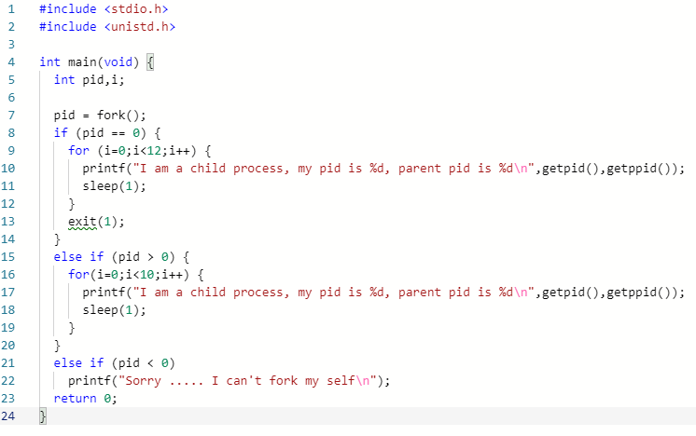
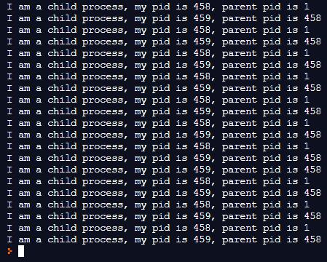
Attributes of the Process - PID and PPID
PID – process id
Unique number assigned for each process in increasing order when they are created
PPID – parent PID
The PID of the parent from which it was cloned
UNIX uses fork-and-exec model to create new process

Slide 7
Process Lifecycle
fork
child has the same program context – fork(2)
exec
child use exec to change the program context – execve(2)
exit
child use _exit to tell kernel that it is ready to die and this death should be acknowledged by the child’s parent – _exit(2)
wait
parent use wait to wait for child’s death
If parent died before child, this orphan process will have init as it’s new parent – wait(2)

Slide 8
Attributes of the process –
UID、GID、EUID and EGID
UID, GID, EUID, EGID
The effective uid and gid can be used to enable or restrict the additional permissions
Effective uid will be set to
Real uid if setuid bit is off
The file owner’s uid if setuid bit is on
Example
/etc/master.passwd is "root read-write only"
/usr/bin/passwd is a "setuid root" program
sabsd [/etc] -chwong- ls -al | grep passwd
-rw------- 1 root wheel 2946 Sep 24 00:26 master.passwd
-rw-r--r-- 1 root wheel 2706 Sep 24 00:26 passwd
sabsd [/usr/bin] -chwong- ls -al /usr/bin/passwd
-r-sr-xr-x 2 root wheel 5860 Sep 17 15:19 passwd
sabsd [/etc] -chwong- ls -al | grep passwd
-rw------- 1 root wheel 2946 Sep 24 00:26 master.passwd
-rw-r--r-- 1 root wheel 2706 Sep 24 00:26 passwd
sabsd [/usr/bin] -chwong- ls -al /usr/bin/passwd
-r-sr-xr-x 2 root wheel 5860 Sep 17 15:19 passwd

Slide 9
Signal
A way of telling a process something has happened
Signals can be sent
Among processes as a means of communication
By the terminal driver to kill, interrupt, or suspend process
<Ctrl-C>、<Ctrl-Z>
bg, fg
By the administrator to achieve various results
With kill(1)
By the kernel when a process violate the rules
divide by zero
Illegal memory access

Slide 10
Signal – Actions when receiving signal
Depend on whether there is a designated handler routine for that signal
If yes, the handler is called
If no, the kernel takes some default action
"Catching" the signal
Specify a handler routine for a signal within a program
Two ways to prevent signals from arriving
Ignored
Just discard it and there is no effect to process
Blocked
Queue for delivery until unblocked
The handler for a newly unblocked signal is called only once

Slide 11
Signal – FreeBSD signals
signal(3) or see /usr/include/sys/signal.h
FreeBSD
# | Name | Description | Default | Catch | Block | Dump Core
1 | SIGHUP | Hangup | Terminate | ✔ | ✔ | ❌
2 | SIGINT | Interrupt (^C) | Terminate | ✔ | ✔ | ❌
3 | SIGQUIT | Quit | Terminate | ✔ | ✔ | ✔
9 | SIGKILL | Kill | Terminate | ❌ | ❌ | ❌
10 | SIGBUS | Bus error | Terminate | ✔ | ✔ | ✔
11 | SIGSEGV | Segmentation fault | Terminate | ✔ | ✔ | ✔
15 | SIGTERM | Soft. termination | Terminate | ✔ | ✔ | ❌
17 | SIGSTOP | Stop | Stop | ❌ | ❌ | ❌
18 | SIGTSTP | Stop from tty (^Z) | Stop | ✔ | ✔ | ❌
19 | SIGCONT | Continue after stop | Ignore | ✔ | ❌ | ❌

Slide 12
Signal – Send signals: kill
kill(1) – terminate or signal a process
$ kill [-signal] pid
Ex.
First, find out the pid you want to kill
(ps, top, sockstat, lsof…)
$ kill -l (list all available signals)
$ kill 49222
$ kill -TERM 49222
$ kill -15 49222
killall(1)
kill processes by name
$ killall tcsh
$ killall -u chwong

Slide 13
Niceness
How kindly of you when contending CPU time
High nice value ➔ low priority
Related to CPU time quantum
Inherent Property
A newly created process inherits the nice value of its parent
Prevent processes with low priority from bearing high-priority children
Root has complete freedom in setting nice value
Use "nice" to start a high-priority shell to beat berserk process

Slide 14
Niceness – nice and renice
nice(1) format
OS nice : $ /usr/bin/nice [range] utility [argument]
csh nice(built-in) : $ nice [range] utility [argument]
$ nice +10 ps -l
renice(8) format
$ renice [prio | -n incr] [-p pid] [-g gid] [-u user]
$ renice 15 -u chwong
System | Prio. Range | OS nice | csh nice | renice
FreeBSD | -20 ~ 20 | -incr | -n incr | +prio | -prio | prio | -n incr
Red Hat | -20 ~ 20 | -incr | -n incr | +prio | -prio | prio
Solaris | 0 ~ 39 | -incr | -n incr | +incr | -incr | prio | -n incr
SunOS | -20 ~ 19 | -incr | +prio | -prio | prio

Slide 15
cpuset command (1/2)
A system may have more than one CPU core
How many CPU resource a process can use
cpuset(1)

Slide 16
cpuset command (2/2)
To see how many CPUs on your machine
$ cpuset -g
Run commands with less CPUs
$ cpuset -l cpus cmd
$ cpuset -l 8-15 ./hw1.out
Change number of CPUs for current processes
$ cpuset -l cpus -p pid
$ cpuset -l 8-15 -p 5566
Combine with nice
$ cpuset -l 8-15 /usr/bin/nice -n 20 cmd

Slide 17
Process States
man "ps" and see "state" keyword
State | Meaning
I | Idle (20+ second)
R | Runnable
S | Sleeping (~20 second)
T | Stopped
Z | Zombie
D | in Disk

Slide 18
ps command (BSD、Linux)
ps
sabsd [/home/chwong] -chwong- ps
PID TT STAT TIME COMMAND
52363 p0 Ss 0:00.01 -tcsh (tcsh)
52369 p0 R+ 0:00.00 ps
ps aux
sabsd [/home/chwong] -chwong- ps aux
USER PID %CPU %MEM VSZ RSS TT STAT STARTED TIME COMMAND
chwong 52362 0.0 0.4 6536 3852 ?? S 5:02PM 0:00.01 sshd: chwong@ttyp0 (sshd)
root 52380 0.0 0.3 3756 3224 ?? Ss 5:08PM 0:00.00 sendmail: accepting connections (s
smmsp 52384 0.0 0.3 3644 2968 ?? Ss 5:08PM 0:00.00 sendmail: Queue runner@00:30:00 fo
ps auxww
sabsd [/home/chwong] -chwong- ps auxww
USER PID %CPU %MEM VSZ RSS TT STAT STARTED TIME COMMAND
chwong 52362 0.0 0.4 6536 3864 ?? S 5:02PM 0:00.02 sshd: chwong@ttyp0 (sshd)
root 52380 0.0 0.3 3756 3224 ?? Ss 5:08PM 0:00.00 sendmail: accepting connections (sendmail)
smmsp 52384 0.0 0.3 3644 2968 ?? Ss 5:08PM 0:00.00 sendmail: Queue runner@00:30:00 for /var/spool/clientmqueue (sendmail)

Slide 19
ps command –
Explanation of ps –aux (BSD、Linux)
Field | Contents
USER | Username of process's owner
PID | Process ID
%CPU | Percentage of the CPU this process is using
%MEM | Percentage of the real memory this process is using
VSZ | Virtual size of process, in kilobytes
RSS | Resident set size (number of 1K pages in memory)
TT | Control terminal ID
STAT | Current process status:
 | R = Runnable I = Sleeping (> 20 sec) S = Sleeping (< 20 Sec) | T = Stopped D = In disk (or short-term) wait Z = Zombie
 | Additional Flags: > = Process has higher than normal priority N = Process has lower than normal priority < = Process is exceeding soft limit on memory ues A = Process has requested random page replacement S = Process has asked for FIFO page replacement V = Process is suspended during a vfork E = Process is trying to exit L = Some pages are locked in core X = Process is being traced ro debugged s = Process is a session leader (head of controller terminal) W = Process is swapped out + = Process is in the foreground of its control terminal
STARTED | Time the process was started
TIME | CPU time the process has consumed
COMMAND | Command name and arguments

Slide 20
ps command (BSD、Linux)
ps -j
Use these options with shell scripts
sabsd [/home/chwong] -chwong- ps -j
USER PID PPID PGID SID JOBC STAT TT TIME COMMAND
chwong 52363 52362 52363 52363 0 Ss p0 0:00.03 -tcsh (tcsh)
chwong 52458 52363 52458 52363 1 R+ p0 0:00.00 ps -j
ps -o
sabsd [/home/chwong] -chwong- ps -o uid,pid,ppid,%cpu,%mem,command
UID PID PPID %CPU %MEM COMMAND
1001 52363 52362 0.0 0.3 -tcsh (tcsh)
1001 52462 52363 0.0 0.1 ps -o uid,pid,ppid,%cpu,%mem,command
ps -L
sabsd [/home/chwong] -chwong- ps -L
%cpu %mem acflag acflg args blocked caught comm command cpu cputime emuletime f flags ignored inblk inblock jid jobc ktrace label lim lockname login logname lstart lwp majflt minflt msgrcv msgsnd mwchan ni nice nivcsw nlwp nsignals nsigs nswap nvcsw nwchan oublk oublock paddr pagein pcpu pending pgid pid pmem ppid pri re rgid rgroup rss rtprio ruid ruser sid sig sigcatch sigignore sigmask sl start stat state svgid svuid tdev time tpgid tsid tsiz tt tty ucomm uid upr uprocp user usrpri vsize vsz wchan xstat

Slide 21
top command
last pid: 52477; load averages: 0.01, 0.05, 0.02 up 0+19:38:37 17:23:38
29 processes: 1 running, 28 sleeping
CPU states: 0.4% user, 0.0% nice, 0.0% system, 0.0% interrupt, 99.6% idle
Mem: 19M Active, 308M Inact, 113M Wired, 88K Cache, 111M Buf, 556M Free
Swap: 1024M Total, 1024M Free
PID USERNAME THR PRI NICE SIZE RES STATE TIME WCPU COMMAND
697 root 1 76 0 3784K 2728K select 0:02 0.00% sshd
565 root 1 76 0 1468K 1068K select 0:00 0.00% syslogd
704 root 1 8 0 1484K 1168K nanslp 0:00 0.00% cron
Various usage
top -q run top and renice it to -20
top -u don’t map uid to username
top -U username show process owned by user
Interactive command
o change display order (cpu, res, size, time)
u show only processes owned by user ("+" means all)
m show IO information
? Listing available options

Slide 22
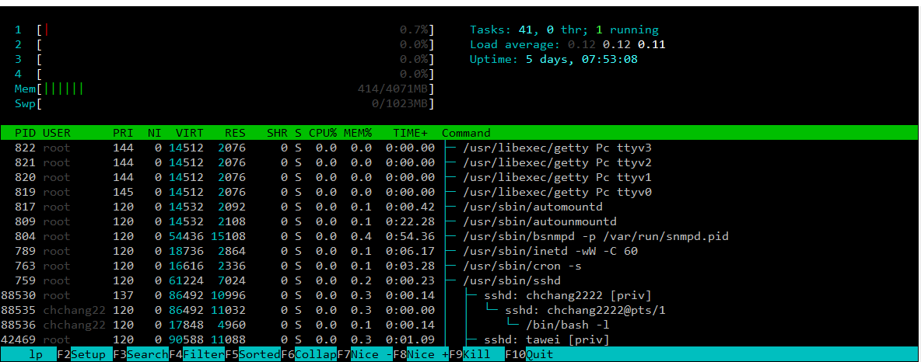
htop command
A better top
Install it from sysutils/htop

Slide 23
Runaway process
Processes that use up excessive system resource or just go berserk
kill -TERM for unknown process
renice it to a higher nice value for reasonable process

Slide 24
Appendix
Fork Bomb

Slide 25
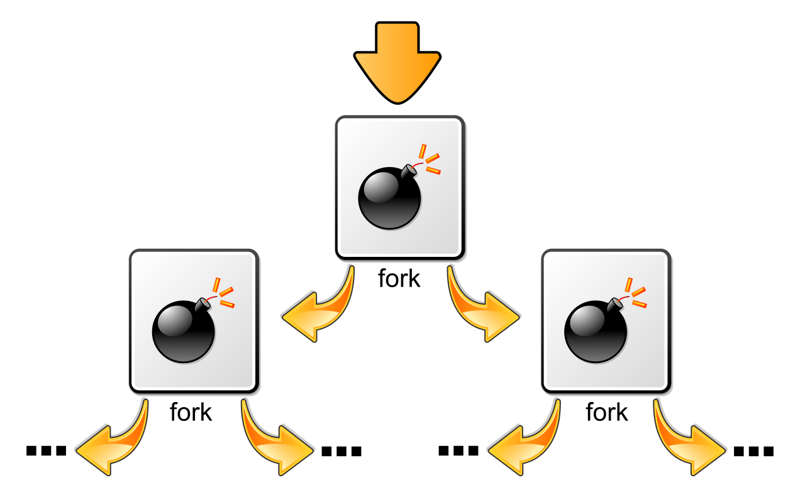
Fork Bomb
A process forking out of control
Cited from wiki

Slide 26
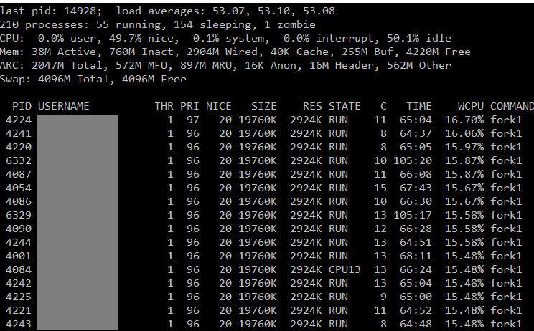
Fork Bomb
A process forking out of control

Slide 27
Fork Bomb –
How to create a fork bomb
C/C++
Perl
Bash (Shell script)
#include <unistd.h>
int main(void) {
while(1)
fork();
return 0;
}
:(){ :|:& };:
# Define function
forkbomb() {
# Run twice with pipe
forkbomb|forkbomb &
}
;
# Start the fork bomb
forkbomb
fork while fork
Windows
%0 | %0
DON’T DO THAT!!!!

Slide 28
Fork Bomb (1/2)
How to deal with fork bomb
Just kill all of them
$ killall -KILL bombName
When you have no more resource to fork you shell
$ exec killall -KILL bombName
That shell will become "killall", and never goes back
"killall" isn’t an atomic command
More bombs may be created when killing them
Run multiple "killall"

Slide 29

Fork Bomb (2/2)
Prevent fork bomb
Limit the maximum number of processes for a specific user
/etc/login.conf

