Slide 1
File System
jnlin(2019-2021, CC BY-SA)
? (1996-2018)
Notes:
講課時間：55分鐘

Slide 2
Handbook and Manual pages
Official guide and be found at
https://www.freebsd.org/doc/en/books/handbook/permissions.html

Slide 3
Files
$ ls -l
drwx--x--x 7 liuyh gcs 1024 Sep 22 17:25 public_html
File Type | d
File Access Mode | rwx--x--x
inodes | 7
File User Owner | liuyh
File Group Owner | gcs
File Size | 1024
File Last Modify Time | Sep 22 17:25
File Name | public_html

Slide 4
Outline
File System Architecture
Pathname
File Tree
Mounting
File Types
inode and file
Link
File Access Mode
Changing File Owner
FreeBSD bonus flags

Slide 5
File System Architecture (1)
Application ↔ Kernel ↔ Hardware
Applications call system-calls to request service
Kernel invokes corresponding drivers to fulfill this service
Process 1
Process 2
．．．
Process N
User mode
System mode
Virtual file system
ext2
msdos
minix
．．．
proc
Buffer cache
File system
Device drives
．．．

Slide 6
File System Architecture (2)
The basic purpose of filesystem
Represent and organize the system’s storage
Four main components:
Namespace
A way of naming things and arranging them in a hierarchy
Application Programming Interface (API)
A set of system calls for navigating and manipulating nodes
Security model
A scheme for protecting, hiding and sharing things
Implementation
Code that ties the logical model to an actual disk

Slide 7
File System Architecture (2)
System call sequence to copy the contents of one file to another file
Example System Call Sequence
Acquire input file name
Write prompt to screen, Accept input
Acquire output file name
Write prompt to screen, Accept input
Open the input file
if file doesn't exist, abort
Create output file
if file exists, abort
Loop
Read from input file
Write to output file
Until read fails
Close output file
Write completion message to screen
Terminate normally
Source file
destination file

Slide 8
File System Architecture (2)
Consider the ReadFile() function in the Win32 API – a function for reading from a file
Return Value
BOOL ReadFile c (HANDLE file,
LPVOID buffer,
DWORD bytes To Read,
LPDWORD bytes Read,
LPOVERLAPPED ovl );
Function Name
Parmenters
A description of the parameters passed to ReadFile()
HANDLE file — the file to be read
LPVOID buffer — a buffer where the data will be read into and written from
DWORD bytesToRead — the number of bytes to be read into the buffer
LPDWORD bytesRead — the number of bytes read during the last read
LPOVERLAPPED ovl — indicates if overlapped I/O is being used

Slide 9
File System Architecture (3)
API – System Call – OS Relationship
user application
open ()
user mode
system call interface
kernelmode
.
.
i
.
.
open()
implementaion of open() systme call
.
.
return

Slide 10
File System Architecture (4)
Objects in the filesystem:
What you can find in a filesystem:
Files and directories
Hardware device files
Processes information
Interprocess communication channel (IPC)
Shared memory segments (SHM)
We can use common file system interface to access such "object"
open、read、write、close、seek、ioctl, fcntl, …

Slide 11
Pathname
Two kinds of path
Absolute path → start from /
E.g. /u/dcs/109/1091028/test/haha.c
Relative path → start from your current directory
E.g. test/haha.c
Constraints of pathname
Single component: ≦ 255 characters
Single absolute path: ≦ 1023 characters

Slide 12
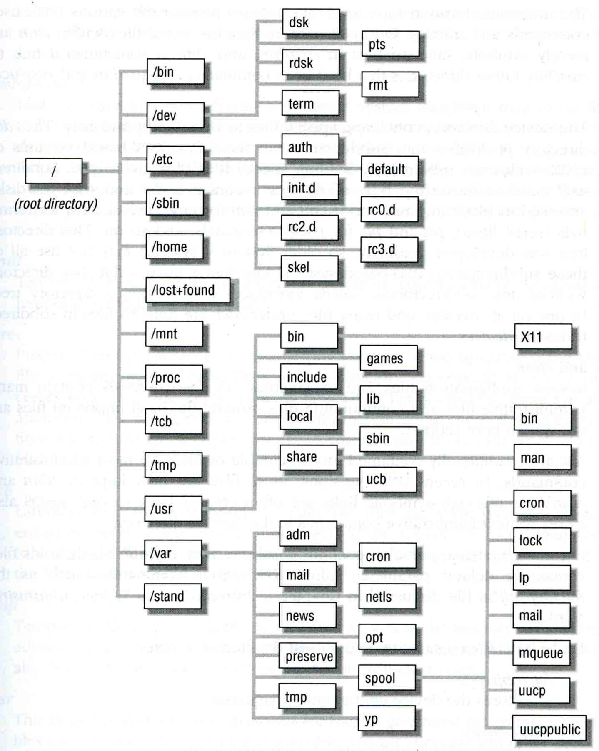
File Tree
/
/bin
/dev
/etc
/sbin
/home
/lost+found
/mnt
/proc
/tcb
/tmp
/usr
/var
/stand
dsk
pts
rdsk
rmn
term
auth
default
init.d
rc0.d
rc2.d
rc3.d
skel
bin | games
include | lib
local | sbin
share | ucb
adm | cron
mail | netls
news | opt
preserve | spool
tmp | yp
Cron
lock
ip
mail
mqueue
uucp
uucppublic
man
bin
x11

Slide 13
Layout of File Systems (1)
hier(7)
Path Name | Contents
/ | The root directory of the file system
/bin & /sbin | User utilities & system programs fundamental to both single-user and multi-user environments
/usr | User utilities and applications
/usr/bin & /usr/sbin | Local executable
/lib | Shared and archive libraries
/libexec | Critical system utilities needed for binaries in /bin and /sbin
/mnt | Empty directory commonly used by system administrators as a temporary mount point
/tmp | Temporary files that are not guaranteed to persist across system reboots. Also, there is /var/tmp
/usr/lib | Support libraries for standard UNIX programs
/usr/libexec | System daemons & system utilities (executed by other programs)
/usr/include | Libraries Header files
/usr/local | Local executables, libraries, etc

Slide 14
Layout of File Systems (2)
Path Name | Contents
/usr/src | BSD, third-party, and/or local source files
/usr/obj | Architecture-specific target tree produced by building the /usr/src tree
/etc | System configuration files and scripts
/usr/local/etc | /etc of /usr/local, mimics /etc
/dev | Device entries for disks, terminals, modems, etc
/proc | Images of all running process
/var | Multi-purpose log, temporary, transient, and spool files
/var/db | Database files
/var/db/pkg & /var/db/ports | Ports Collection management files. ports(7)
/var/log | Various system log files
/var/mail | User mailbox files
/var/spool | Spooling directories for printers, mails, etc

Slide 15
Mounting file system (1)
mount(8)
Common types of file systems
Most are disk partitions
Network file servers
Memory disk emulators
Kernel components
Etc,…
"mount" command
Map the mount point of the existing file tree to the root of the newly attached filesystem
$ mount /dev/ad2s1e /home2
The previous contents of the mount point become inaccessible

Slide 16
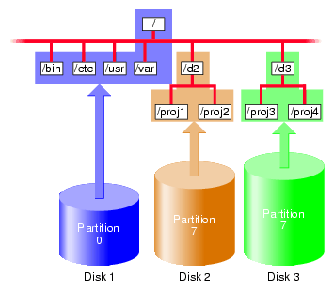
Mounting file system (2)

Slide 17
Mounting file system (3)
fstab(5)
Filesystem table – fstab
Automatically mounted at boot time
/etc/fstab
Filesystem in this file will be checked and mounted automatically at boot time
Ex:
# Device Mountpoint FStype Options Dump Pass#
/dev/ad0s1a / ufs rw 1 1
/dev/ad0s1b none swap sw 0 0

Slide 18
Mounting file system (4)
umount(8)
Unmounting file system
"umount" command
$ umount { node | device }
Ex:
Busy file system
Someone’s current directory is there or there are opened files
Use "umount -f"
We can use "lsof" or "fstat" like utilities to figure out who makes it busy
umount /home | umount /dev/ad0s1e

Slide 19
Mounting file system (5)
fstat(1)
lsof(8) (/usr/ports/sysutils/lsof) – list open files
liuyh@NASA ~ $ fstat
USER CMD PID FD MOUNT INUM MODE SZ|DV R/W
liuyh fstat 94218 wd / 234933 drwxr-xr-x 16 r
root screen 87838 4 /tmp 9947 prwx------ 0 r
liuyh@NASA ~ $ lsof
COMMAND PID USER FD TYPE SIZE/OFF NODE NAME
screen 87838 root cwd VDIR 7 522069 /usr/ports/sysutils/screen
screen 87838 root rtd VDIR 26 3 /
screen 87838 root txt VREG 337968 424757 /usr/local/bin/screen
screen 87838 root txt VREG 245976 679260 /libexec/ld-elf.so.1
screen 87838 root txt VREG 314504 678109 /lib/libncurses.so.8
screen 87838 root txt VREG 64952 678438 /lib/libutil.so.8
screen 87838 root txt VREG 33536 677963 /lib/libcrypt.so.5

Slide 20
File Types (1)
File types
Symbol | File types
- | Regular file
b | Block device file
c | Character device file
d | Directory
l | Symbolic link
s | UNIX domain socket
p | Named pipe

Slide 21
File Types (2)
file command
determine file type
$ file .tcshrc .tcshrc: ASCII text
$ file /bin /bin: directory
$ file /bin/sh /bin/sh: ELF 32-bit LSB executable, Intel 80386, version 1 (FreeBSD), dynamically linked (uses shared libs), stripped
/usr/ports/sysutils/file

Slide 22
File Types (2)
Directory
. and ..
mkdir / rmdir

Slide 23
File Types (3)
UNIX domain socket
Created by socket()
Local to a particular host
Be referenced through a filesystem object rather than a network port
Process A
Process B
Writes data
Reads data
Unix kernel
Socket buffer

Slide 24
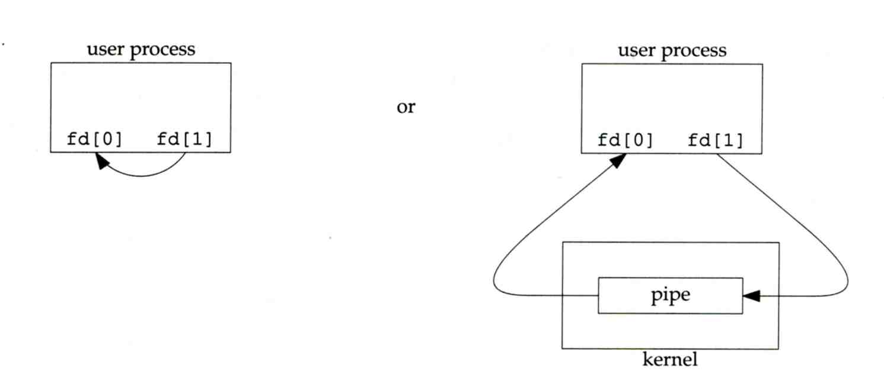
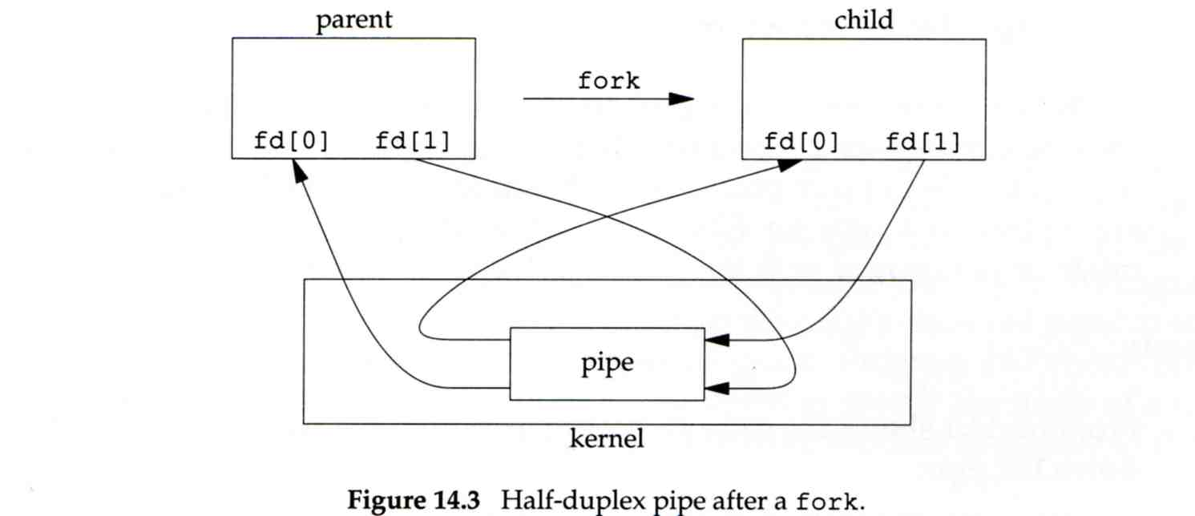
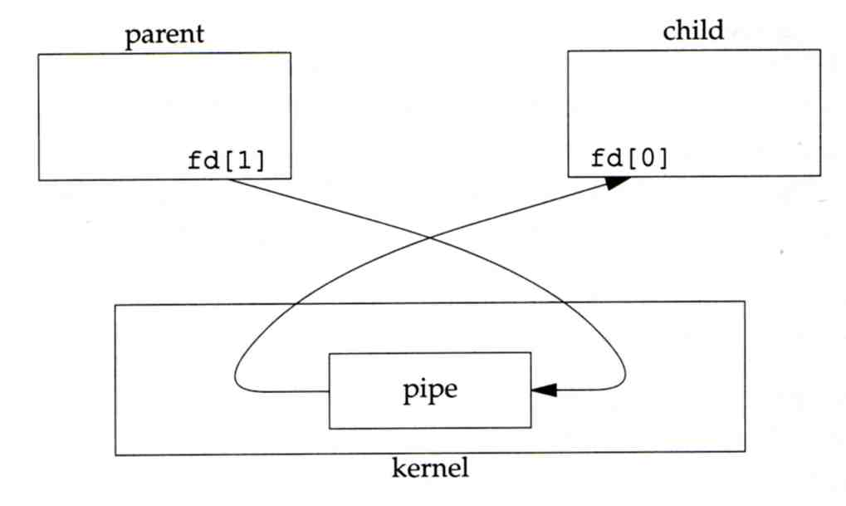
File Types (4)
Named Pipes
Let two processes do "FIFO" communication
Parent
Child
Fork
fd[0]
fd[1]
fd[0]
fd[1]
User Process
fd[0]
fd[1]
Pipe
Pipe
User Process
Child
Kernel
fd[1]
fd[0]
Pipe
Kernel

Slide 25
File Types (5)
Named Pipe
$ mkfifo [-m mode] fifo_name ...
$ mkfifo pipe
$ du >> pipe
(another process)
$ sort -n pipe

Slide 26
File Types (6)
Symbolic Link
A file which points to another pathname
$ ln -s ori-file soft-file
Like "short-cut" in Windows

Slide 27
inode and file (1)
inode
A structure that records information of a file
You can use "ls -i" to see each file’s inode number
mode
owners(2)
timestamps(3)
size block
count
direct blocks
single indirect
double indirect
triple indirect
fyli@NASA ~ $ ls -i
data
data
data
.
.
.
data
.
.
.
data
data
data
.
.
.
.
.
.
data
data
.
.
.
.
.
.
data

Slide 28
inode and file (2)
Filesystem
Boot blocks
Super block
Inode list
Data block
ProcA
Open file table
Ref count:2 offset:
Ref count:1 offset:
Ref count:1 A_filename
Ref count:1 B_filename
ProcB
ProcC
Process file desc

Slide 29
inode and file (3)
More detail of inode and data block
directory blocks and data blocks
i-list |  | data block |  | data block |  | directory block |  | data block |  | directory block
first data block
second data block
third data block
i-node | i-node |  | i-node |  | i-node
i-ndoe number | filename
i-ndoe number | filename

Slide 30
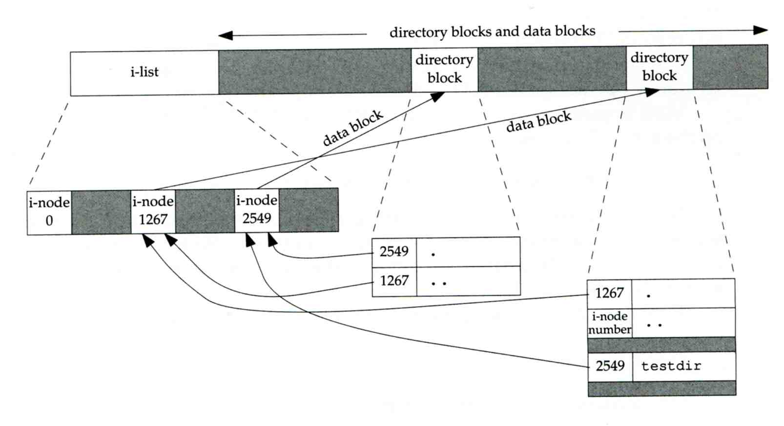
inode and file (4)
Example
.
..
testdir
directory blocks and data blocks
i-list |  | directory block |  | directory block
testdir
data block
liuyh
data block
i-node 0 |  | i-node 1267 |  | i-node 2549
2549 | .
1267 | ..
/home/fyli/testdir
1267 | .
i-node number | ..
2549 | testdir

Slide 31
Hard Link V.S. Symbolic Link (1)
Link
Hard link
Associate two or more filenames with the same inode
Must in the same partition
$ ln ori-file hard-file
Soft (symbolic) link
A file which points to another pathname
$ ln -s ori-file soft-file

Slide 32
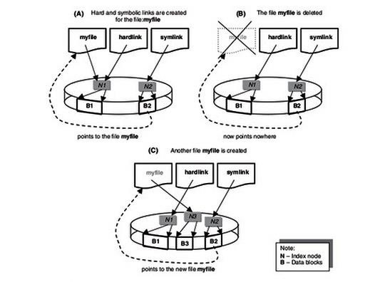
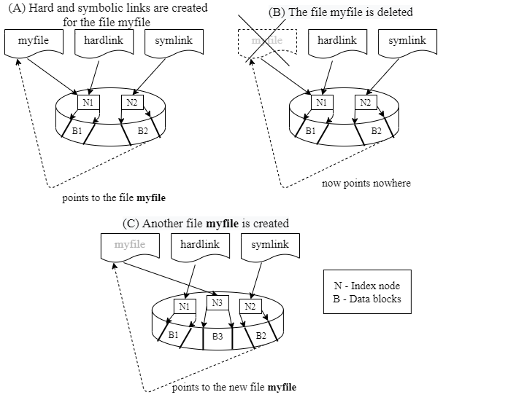
Hard Link V.S. Symbolic Link (2)
$ touch index
$ ln index hlink
$ ln –s index slink

Slide 33
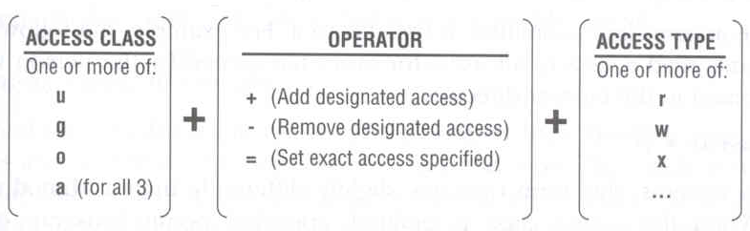
File Access Mode (1)
rwx r-x r-x
User, group, other privileges
chmod command
chmod(1), "MODES" section
$ chmod access-string file
$ chmod u+x test.sh
$ chmod go-w .tcshrc
$ chmod u+w,g-w hehe haha
$ chmod –R 755 public_html/

Slide 34
File Access Mode (2)
setuid, setgid, sticky bit
setuid, setgid on file
The effective uid/gid of resulting process will be set to the UID/GID of the file
setuid
passwd, chsh, crontab
setgid
top, fstat, write

Slide 35
File Access Mode (3)
setgid on directory
Cause newly created files within the directory to be the same group as directory
sticky on directory (/tmp)
Do not allow to delete or rename a file unless you are
The owner of the file
The owner of the directory
root

Slide 36
File Access Mode (4)
Decimal argument of chmod
setuid: 4000
setgid: 2000
sticky : 1000
Mode | Attribute | Mode | Attribute
755 | - rwx r-x r-x | 644 | - rw- r-- r--
4755 | - rws r-x r-x | 600 | - rw- --- ---
2755 | - rwx r-s r-x | 400 | - r-- r-- r--
2775 | d rwx rws r-x | 1777 | d rwx rwx rwt
755 | d rwx r-x r-x | 4555 | - r-s r-x r-x
750 | d rwx r-x --- | 711 | - rwx --x --x
700 | d rwx --- --- | 711 | d rwx --x --x

Slide 37
File Access Mode (5)
Assign default permissions: umask
Shell built-in command
Inference the default permissions given to the files newly created.
The newly created file permission:
Use full permission bit (file: 666, dir: 777) xor umask value.
Ex:
umask | New File | New Dir
022 | - rw- r-- r-- | d rwx r-x r-x
033 | - rw- r-- r-- | d rwx r-- r--
066 | - rw- --- --- | d rwx --x --x
000 | - rw- rw- rw- | d rwx rwx rwx
477 | - r-- --- --- | d r-x --- ---
777 | - --- --- --- | d --- --- ---

Slide 38
File Protection
Command | Minimum Access Needed
 | On file itself | On directory file is in
cd /home/test |  | x
ls /home/test/*.c |  | r
ls -s /home/test/*.c |  | rx
cat runme | r | x
cat >> runme | w | x
run-binary | x | x
run-script | rx | x
rm rumme |  | wx

Slide 39
Changing File Owner
Changing File Owner
Commands:
chown(8) -- change user owner
chgrp(1) -- change group owner
Change the file ownership and group ownership
$ chown -R fyli /home/fyli
$ chgrp -R cs /home/fyli
$ chown -R fyli:gcs /home/fyli
$ chown -R :gcs /home/fyli

Slide 40
FreeBSD bonus flags
chflags(1) command
schg system immutable flag (root only)
sunlnk system undeletable flag (root only)
sappnd system append-only flag (root only)
uappend user append-only flag (root, user)
uunlnk user undeletable flag (root, user)
ls -ol
fyli@NASA ~ $ ls -ol /libexec/
total 1034
-r-xr-xr-x 1 root wheel schg 238472 Sep 21 12:50 ld-elf.so.1*
-r-xr-xr-x 1 root wheel - 238512 Jul 24 17:15 ld-elf.so.1.old
-r-xr-xr-x 1 root wheel schg 212204 Sep 21 12:51 ld-elf32.so.1
-r-xr-xr-x 1 root wheel - 212248 Jul 24 17:17 ld-elf32.so.1.old

Slide 41
Appendix

Slide 42
Journaling File System
Write operational logs to the jornal first, then commit it asynchronously.
If system crashed, check the log
fully committed: skip
partial committed: rollback or commit
non-committed: ignore or commit
Reduce "fsck" time and data inconsistency
Example
ext3, ext4
xfs
btrfs

Slide 43
CoW (Copy on Write) File System
If some data is copied but not modified, they will be referred to the same physical address in the storage
Pros
Reduce the space used
Low cost snapshots
Cons
Data inconsistency (for example, the reference count is not consistent)
Not "real" used space on file
Example
ZFS deduplication

Slide 44
File Attribute Extension
Associate files with metadata not interpreted by the filesystem
Key-value pairs, saved in the inode
Example
mime_type
md5/sha1 checksum
security attributes

