Slide 1
Services & Settings
lctseng (2019-2021, CC BY-SA)
? (1996-2018)
Notes:
講課時間：40分鐘

Slide 2
Handbook and Manual pages
Official guide and be found at
Configuring Starting Services
https://www.freebsd.org/doc/en/books/handbook/configtuning-starting-services.html
https://www.freebsd.org/doc/zh_TW/books/handbook/configtuning-starting-services.html
Configuring RC
https://www.freebsd.org/doc/en/books/handbook/configtuning-rcd.html
https://www.freebsd.org/doc/zh_TW/books/handbook/configtuning-rcd.html
rc(8), service(8)

Slide 3
Basic Knowledge about Services
For FreeBSD

Slide 4
The Service
Background processes that provide services
A.k.a daemon process (usually with name xxxd)
Automatically started during boot
Example
Standard services
NTP (ntpd)
Secure Shell (sshd)
Commonly known services
Web (httpd)
DNS (named)

Slide 5
Common Flow of Running a Service
Installation
Through ports, packages, or source tarballs
pkg install kde4
Configuration
Service specific configuration file(s)
Make it start on boot
Manually update /etc/rc.conf
kdm4_enable="YES"
Or using service(8) command
service kdm4 enable

Slide 6
Common Flow of Running a Service
Start the service now
Calling script under rc.d/*
/usr/local/etc/rc.d/kdm4 start
Or using "service"
service kdm4 start
Maintenance
Updating、Restarting

Slide 7
Configuration Files
/usr/local/etc
Configuration files of local installed programs are located there.
Daemon | User Program
/usr/local/etc/pure-ftpd.conf | /usr/local/etc/vim/vimrc
/usr/local/etc/apache24/httpd.conf | /usr/local/etc/screenrc
Default config file usually installed with .sample suffix, .default suffix, or different suffix for different purpose. (Copy and rename before using.)
pure-ftpd.conf.sample
php.ini-dist
php.ini-recommended

Slide 8
Configuration Files
A program with multiple config files are usually located in /usr/local/etc/program-name/
apache*
postfix
Most configuration files have clear comment at the beginning or before each description
# pure-ftpd.conf
# IP address/port to listen to (default=all IP and port 21)
Bind 127.0.0.1,21
# Fork in background
Daemonize yes

Slide 9
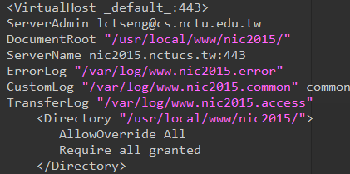

Configuration Files
Most popular styles
key <space> value
key = value
Some with local effectiveness (e.g. http server)
Markup language-like:
<directory /path>
setting-for-this-path…
</directory>
Samba、rsync、devfs…
[xxxx]
settings…
[yyyy]
settings…

Slide 10
RC Script
Scripts for starting / stopping a service

Slide 11
What does RC means?
Run Commands (RunCom)
Command scripts for auto-reboot and daemon startup
rc(8)
https://www.freebsd.org/doc/handbook/configtuning-rcd.html

Slide 12
Why do we need RC Script?
Start services on system startup
Starting and stopping services in a standard way
Write configuration in the rc script for easy launch
with RC script | $ service pure-ftpd start
without RC script | $ /usr/local/sbin/pure-ftpd -g /var/run/pure-ftpd.pid -A -c50 -B -C8 -D -fftp -H -I15 -lpam -lunix -L10000:8 -m4 -s -U133:022 -u100 -k99 -Z

Slide 13
RC Script
Start
Samba
rsyncd
prftpd
mysql-server
lighttpd
…...
/etc/rc.d/*
Sort by rcorder
Include
/usr/local/etc/rc.d/*
/etc/rc.subr
End
Dependency between each service is described in header of the script
rcorder(8) is used to find out dependency ordering of each script
Each rc script defines what to do when start / stop …
/etc/rc.subr defines what to do & check before / after start stop ….
rc.subr(8)

Slide 14
Components to launch daemon processes
To launch a daemon process in background, we need:
Launch command
Path to the executable binary/script
/usr/sbin/inetd
Path to configuration file
Program-specified configuration (ports to use, files to read/write, … )
/etc/inetd.conf
Pidfile
Records (master) process id of the service
Other process (like “service" tool) can know what PID to show/kill
/var/run/inetd.pid

Slide 15
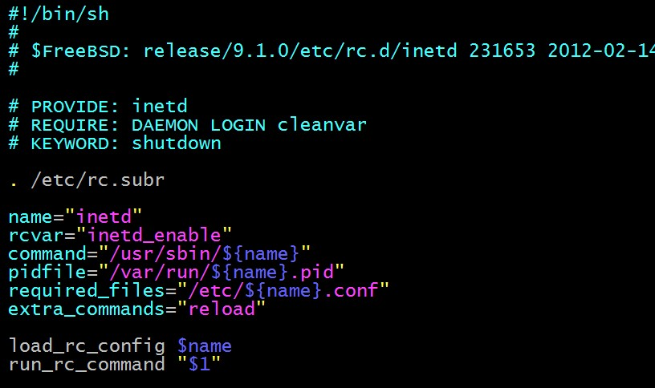
Inside the RC Script
Example: /etc/rc.d/inetd
for rcorder(8) to sort.
need to be included
by every RC script.
what to do with
start/stop/....

Slide 16
How to use rc script
Example: ntpd
nctucs [~] -lctseng- /etc/rc.d/ntpd
Usage: /etc/rc.d/ntpd [fast|force|one|quiet](start|stop|restart|rcvar|enable|disable|delete|enabled|describe|extracommands|fetch|needfetch|status|poll
After booting… (rc.conf)
nctucs [~] -lctseng- cat /var/db/ntp/ntpd.pid
4239
nctucs [~] -lctseng- ps aux | grep ntp
ntpd 4239 0.0 0.8 16488 16580 - Ss 08:45 0:00.02 /usr/sbin/ntpd -p /var/db/ntp/ntpd.pid -c /etc/ntp.conf -f /var/db/
An easy way to access: "service"
$ service ntpd start/stop/restart/reload/…
Search /etc/rc.d and /usr/local/etc/rc.d

Slide 17
How to use rc script
Start
Start the service and write PID files now
Stop
Terminates the service by killing the process with PID recorded in pidfile
Restart
Restart the service (or just start a new one if not running)
Some services implement 'restart' by ‘stop + start'
Enable/Disable
Edit /etc/rc.conf with XXX_enable=“YES" or “NO"
Whether to automatically launch when booting

Slide 18
How to use rc script
Status
Check the service is running or not
Reload
Reload configuration file if the service support
Rcvar
Show the variables used in rc.conf
nctucs [~] -lctseng- service pure-ftpd rcvar
# pureftpd
#
pureftpd_enable="no"
# (default: "")

Slide 19
How to use rc script
[one | fast | force]
One
Skip the check of rcvar="YES"
Start the service even if XXXX_enable="NO"
Force
Force start the service
Ignore any error it encountered (no prerequisite test)
ignore rcvar="YES" and set rc_force="YES"
Fast
Skip the check for an existing running process (pid check)
Set rc_fast="YES"

Slide 20
Local installed service
More about how to use rc.conf for an installed service, read comments from that script
/usr/local/etc/rc.d/pure-ftpd
# Add the following lines to /etc/rc.conf to enable pure-ftpd:
#
# pureftpd_enable="yes"
# pureftpd_flags="<set as needed>"
#
# Add the following lines to /etc/rc.conf to enable pure-authd daemon:
#
# pureftpd_authd_enable="yes"
# pureftpd_authdscript="/full/path/to/auth_script"
# pureftpd_authsocket="/var/run/ftpd.sock"
#
# Add the following lines to /etc/rc.conf to enable uploadscript daemon:
#
# pureftpd_upload_enable="yes"
# pureftpd_uploadscript="/full/path/to/upload_script"

Slide 21
System-V

Slide 22
Startup Scripts
SystemV-style startup scripts
Sun
/etc/init.d/
/etc/rc.d/rcn.d/
Each script is responsible for one daemon or one aspect of system.
Example: sshd in SunOS
case "$1" in
'start')
if [ -x /usr/local/sbin/sshd ]; then
echo "Starting the secure shell daemon"
/usr/local/sbin/sshd &
fi
;;
'stop')
echo "Stopping the secure shell daemon "
pkill -TERM sshd
;;
*)
echo "Usage: /etc/init.d/sshd { start | stop }"
;;
esac
exit 0
Symbolic link

Slide 23
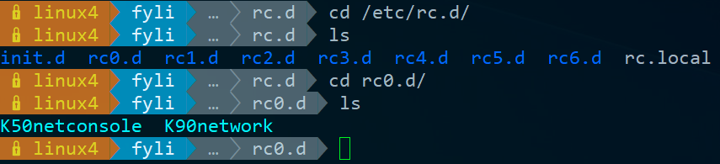
Startup Scripts –
SystemV-style startup scripts (1)
/etc/rc.d/rcn.d/
When init transitions from lower run level to higher one,
It runs all the scripts that start with "S" in ascending order with "start" argument
When init transitions from high run level to lower one,
It runs all the scripts that start with "K" in descending order with "stop" argument

Slide 24
Startup Scripts –
SystemV-style startup scripts (2)
If you write a daemon and want init to start/stop it,
write a script and put in /etc/init.d
make suitable symbolic link in rcn.d
ln -s /etc/init.d/initiald /etc/rc2.d/S61initiald
ln -s /etc/init.d/initiald /etc/rc0.d/K33initiald

Slide 25
Systemd

Slide 26
Systemd
Evolved from System-V
Backward compatibility
Goal: provide a faster booting process
Less processes
Parallel launching
Use "targets" replace run-levels
Easier to use
Tool
systemctl (1)
Similar to "service" tool in FreeBSD

Slide 27
Flow of Running a Service with Systemd
Example with Ubuntu
Installation
Through packages, or source tarballs
apt install apache2
Configuration
Service specific configuration file(s)
/etc/apache2/*
systemctl enable apache2
Start
systemctl start apache2
Maintenance
Updating、Restarting

Slide 28
How to use systemctl
Usage
systemctl [OPTIONS…] {COMMAND} …
Common commands
enable / disable
Enable/disable launch when booting
start / stop / reload / restart / status
condrestart
Restart only if service is running

Slide 29
Unit files
[Unit]
Description=Some simple daemon
[Service]
Type=forking
ExecStart=/usr/sbin/my-simple-daemon -d
PIDFile=/var/run/my-daemon.pid
[Install]
WantedBy=multi-user.target
Define services
/lib/systemd/system/*
Similar to /etc/rc.d/* in FreeBSD
systemd.service (5)
Example 1: (simple service)
Type
Simple: main process keeps running
Forking: main process forks and exits
ExecStart
Command to launch the service
WantedBy
Run this service at which target

Slide 30
Unit files
apache2.service
After
Dependency. Start service after dependency is fulfilled
ExecStop / ExecReload
Custom command to stop / reload the service
[Unit]
Description=The Apache HTTP Server
After=network.target remote-fs.target nss-lookup.target
[Service]
Type=forking
Environment=APACHE_STARTED_BY_SYSTEMD=true
ExecStart=/usr/sbin/apachectl start
ExecStop=/usr/sbin/apachectl stop
ExecReload=/usr/sbin/apachectl graceful
PrivateTmp=true
Restart=on-abort
[Install]
WantedBy=multi-user.target

Slide 31
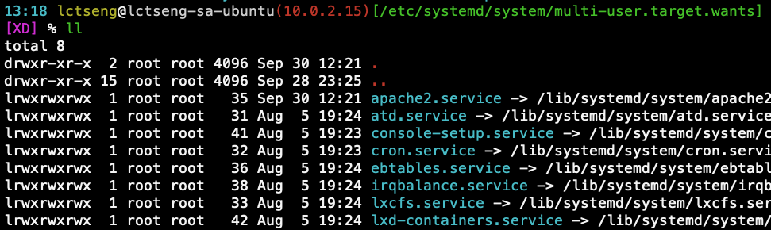
Unit files
When enable a service, it will create links from "lib/systemd/system/*.service" to "etc/systemd/system/XXX.target.wants/*"
/etc/systemd/system/multi-user.target.wants/apache2.service
-> /lib/systemd/system/apache2.service

Slide 32
Appendix: Other init systems

Slide 33
Different Init Systems
 | BSD rc | sysvinit (System V) | systemd | launchd | OpenRC
Operating Systems | NetBSD, FreeBSD, OpenBSD | Debian (< 8.0) | Ubuntu, Debian (>= 8.0) | Mac OS X | Gentoo Linux, FreeBSD, NetBSD
Example commands | service | init, telinit, runlevel | systemctl | launchctl | rc-service, rc-update
Service config files | /etc/rc.d | /etc/init.d/ | /lib/systemd/system/ | /System/Library/LaunchDaemons | /etc/init.d/

