Slide 1
GUID Partition Table
lwhsu (2021, CC BY-SA)
jnlin(2019-2021, CC BY-SA)
? (1996-2018)
Notes:
講課時間：20分鐘

Slide 2
Topics
Unified Extensible Firmware Interface (UEFI)
Master Boot Record (MBR)
GUID Partition Table (GPT)

Slide 3
Unified Extensible Firmware Interface
Operating System
Legacy BIOS limitations
16-bit processor mode
1 MB addressable space
Advantages
32-bit/64-bit processor mode
Ability to boot from larger disk with a GPT
Flexible pre-OS environment, including network capability
Modular design
Compatibility Support Module (CSM)
BIOS-MBR
BIOS-GPT
Extensible Firmware Interface
Firmware
Hardware
Reference:
https://man.freebsd.org/uefi

Slide 4
Master Boot Record (1/2)
The Master Boot Record (MBR) is the first 512 bytes of a storage device
Offset | Length | Contents
0 | 446 bytes | Boot code area
446 | 64 bytes | Partition tables, each has 16 bytes
510 | 2 bytes | Boot signature (0x55AA)
 | 512 bytes | Total size: 446 + 64 + 2
Reference:
https://en.wikipedia.org/wiki/Master_boot_record
https://wiki.osdev.org/MBR_(x86)

Slide 5
Master Boot Record (2/2)
Drawbacks
(4 primary partitions) or (3 primary + 1 extended partitions)
Arbitrary number of logical partitions within the extended partition
The logical partition meta-data is stored in a linked-list structure
One byte partition type codes which leads to many collisions
Maximum addressable size is 2 TiB, i.e. any space beyond 2 TiB cannot be defined as a partition
MBR stores partition sector information using 32-bit LBA values
512 bytes per sector
2^32 * 512 bytes = 2 TiB

Slide 6
Booting Process
System initializing and self testing with the firmware called BIOS
BIOS loads the MBR of the boot device to memory (0000:7C00), then point CPU to start execute it (as 1st bootloader).
Bootloader reads the partition table and find the next boot program
Conventional Windows/DOS MBR bootloader searches for one active and primary partition
Different operating systems or boot manager have their own implementations
The final member in the boot chain loads the operating system

Slide 7
GUID Partition Table (1/9)
GUID stands for Globally Unique Identifier
Ex: 3F2504E0-4F89-41D3-9A0C-0305E82C3301
Part of the UEFI specification
Solves some legacy problems with MBR but also may have compatibility issues
Also recognized on a BIOS system via the protective MBR (LBA 0)
LBA: Logical Block Address
Reference:
https://en.wikipedia.org/wiki/Logical_block_addressing
https://en.wikipedia.org/wiki/GUID_Partition_Table

Slide 8
GUID Partition Table (2/9)
Advantages
Filesystem-independent
No partition type collision because of GUIDs
8 ZiB
GPT uses 64-bit LBA
512 bytes per sector
2^64 * 512 bytes = 8 ZiB
Backup header and partition table at the end of the disk
CRC32 checksums for header and partition table

Slide 9
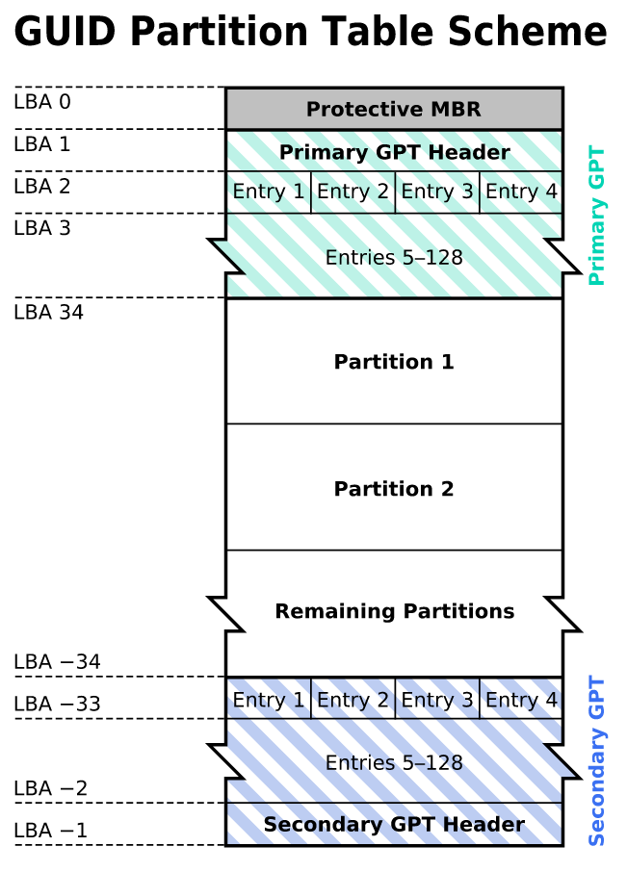
GUID Partition Table (3/9)
GPT Scheme
LBA 0: Protective MBR
LBA 1: GPT header
LBA 2~33: Partition entries
Up to 128 partitions
LBA 34~: Partitions
LBA -34~-1: Secondary GPT data
Kbolino is the original author of this work. It is based heavily upon an image created by Scorpiuss.

Slide 10
GUID Partition Table (4/9)
Legacy MBR (LBA 0)
A single partition type of 0xEE
For OSes cannot read GPT disks: Unknown type, no empty space
Refuse to take actions unless further instructions (safety reasons)
For GPT-aware OSes: check the protective MBR
Check if the enclosed partition type is single 0xEE type
If not, refuse to take action

Slide 11
GUID Partition Table (5/9)
GPT header (LBA 1)
Offset | Length | Contents
0 | 8 bytes | Signature ("EFI PART", 45 46 49 20 50 41 52 54)
8 | 4 bytes | Revision (For GPT version 1.0 (through at least UEFI version 2.3.1), the value is 00 00 01 00)
12 | 4 bytes | Header size in little endian (in bytes, usually 5C 00 00 00 meaning 92 bytes)
16 | 4 bytes | CRC32 of header (0 to header size), with this field zeroed during calculation
20 | 4 bytes | Reserved; must be zero
24 | 8 bytes | Current LBA (location of this header copy)
32 | 8 bytes | Backup LBA (location of the other header copy)
40 | 8 bytes | First usable LBA for partitions (primary partition table last LBA + 1)
48 | 8 bytes | Last usable LBA (secondary partition table first LBA - 1)
56 | 16 bytes | Disk GUID (also referred as UUID on UNIXes)
72 | 8 bytes | Partition entries starting LBA (always 2 in primary copy)
80 | 4 bytes | Number of partition entries
84 | 4 bytes | Size of a partition entry (usually 128)
88 | 4 bytes | CRC32 of partition array
92 | * | Reserved; must be zeroes for the rest of the block (420 bytes for a 512-byte LBA)

Slide 12
GUID Partition Table (6/9)
GPT header (LBA 1)
# dd if=/dev/ada0 bs=512 count=1 skip=1 | hd
1+0 records in
1+0 records out
512 bytes transferred in 0.004644 secs (110259 bytes/sec)
00000000 45 46 49 20 50 41 52 54 00 00 01 00 5c 00 00 00 |EFI PART....\...|
00000010 b4 89 4d 11 00 00 00 00 01 00 00 00 00 00 00 00 |..M.............|
00000020 ff ff ff 01 00 00 00 00 28 00 00 00 00 00 00 00 |........(.......|
00000030 d7 ff ff 01 00 00 00 00 fa 2e 89 f8 d5 c6 ea 11 |................|
00000040 ad c5 08 00 27 9c b4 87 02 00 00 00 00 00 00 00 |....'...........|
00000050 80 00 00 00 80 00 00 00 0f 3e 88 1f 00 00 00 00 |.........>......|
00000060 00 00 00 00 00 00 00 00 00 00 00 00 00 00 00 00 |................|
*
00000200

Slide 13
GUID Partition Table (7/9)
Partition entries (LBA 2)
Offset | Length | Contents
0 | 16 bytes | Partition type GUID
16 | 16 bytes | Unique partition GUID
32 | 8 bytes | First LBA (little-endian)
40 | 8 bytes | Last LBA (inclusive, usually odd)
48 | 8 bytes | Attribute flags (e.g. bit 60 denotes read-only)
56 | 72 bytes | Partition name (36 UTF-16LE code units)
 | 128 bytes | Total

Slide 14
GUID Partition Table (8/9)
Partition type GUID
efi | C12A7328-F81F-11D2-BA4B-00A0C93EC93B
freebsd-boot | 83BD6B9D-7F41-11DC-BE0B-001560B84F0F
freebsd-swap | 516E7CB5-6ECF-11D6-8FF8-00022D09712B
freebsd-ufs | 516E7CB6-6ECF-11D6-8FF8-00022D09712B
freebsd-zfs | 516E7CBA-6ECF-11D6-8FF8-00022D09712B
Reference:
gpart(8) https://man.freebsd.org/gpart/8

Slide 15
GUID Partition Table (9/9)
Partition entries (LBA 2)
# dd if=/dev/ada0 bs=512 count=1 skip=2 | hd
1+0 records in
1+0 records out
512 bytes transferred in 0.000425 secs (1205747 bytes/sec)
00000000 9d 6b bd 83 41 7f dc 11 be 0b 00 15 60 b8 4f 0f |.k..A.......`.O.|
00000010 d1 0e 8a f8 d5 c6 ea 11 ad c5 08 00 27 9c b4 87 |............'...|
00000020 28 00 00 00 00 00 00 00 27 04 00 00 00 00 00 00 |(.......'.......|
00000030 00 00 00 00 00 00 00 00 67 00 70 00 74 00 62 00 |........g.p.t.b.|
00000040 6f 00 6f 00 74 00 30 00 00 00 00 00 00 00 00 00 |o.o.t.0.........|
00000050 00 00 00 00 00 00 00 00 00 00 00 00 00 00 00 00 |................|
*
00000080 b5 7c 6e 51 cf 6e d6 11 8f f8 00 02 2d 09 71 2b |.|nQ.n......-.q+|
00000090 f8 60 8f f8 d5 c6 ea 11 ad c5 08 00 27 9c b4 87 |.`..........'...|
000000a0 28 04 00 00 00 00 00 00 27 04 40 00 00 00 00 00 |(.......'.@.....|
000000b0 00 00 00 00 00 00 00 00 73 00 77 00 61 00 70 00 |........s.w.a.p.|
000000c0 30 00 00 00 00 00 00 00 00 00 00 00 00 00 00 00 |0...............|
000000d0 00 00 00 00 00 00 00 00 00 00 00 00 00 00 00 00 |................|
*
00000100 ba 7c 6e 51 cf 6e d6 11 8f f8 00 02 2d 09 71 2b |.|nQ.n......-.q+|
00000110 ca 38 94 f8 d5 c6 ea 11 ad c5 08 00 27 9c b4 87 |.8..........'...|
00000120 28 04 40 00 00 00 00 00 d7 ff ff 01 00 00 00 00 |(.@.............|
00000130 00 00 00 00 00 00 00 00 7a 00 66 00 73 00 30 00 |........z.f.s.0.|
00000140 00 00 00 00 00 00 00 00 00 00 00 00 00 00 00 00 |................|
*
00000200
freebsd-boot
freebsd-swap
freebsd-zfs

Slide 16
gpart(8)
$ ls /dev/nvd0*
/dev/nvd0 /dev/nvd0p1 /dev/nvd0p2 /dev/nvd0p3
$ gpart show
=> 40 976773088 nvd0 GPT (466G)
40 532480 1 efi (260M)
532520 2008 - free - (1.0M)
534528 4194304 2 freebsd-swap (2.0G)
4728832 972044288 3 freebsd-zfs (464G)
976773120 8 - free - (4.0K)

