Slide 1
Disks
lwhsu (2021, CC BY-SA)
wangth (2017-2020, CC BY-SA)
? (1996-2016)
Notes:
講課時間：30分鐘，不含Appendix

Slide 2
Handbook and Manual pages
Official guide can be found at
Adding Disks https://docs.freebsd.org/en/books/handbook/disks/#disks-adding
Tuning Disks https://docs.freebsd.org/en/books/handbook/config/#configtuning-disk

Slide 3
Outline
Interface
Geometry
Add new disks
Installation procedure
Filesystem check
Add a disk
RAID
GEOM

Slide 4
Disk Interfaces & Protocols
SCSI
Small Computer Systems Interface
IDE (or ATA)
Integrated Device Electronics (or Advanced Technology Attachment)
Renamed to PATA (Parallel ATA) after SATA is out
SATA
Serial ATA
AHCI, Advanced Host Controller Interface
SAS
Serial Attached SCSI
NVMe (Non-Volatile Memory Express)
Non-Volatile Memory Host Controller Interface Specification
USB (Universal Serial Bus)
Mass Storage Class (MSC)
Bulk Transfer

Slide 5
Disk Interfaces - ATA & SATA
ATA (AT Attachment)
ATA2
PIO, DMA
LBA (Logical Block Addressing)
ATA3, Ultra DMA/33/66/100/133
ATAPI (ATA Packet Interface)
CDROM, TAPE
Only one device can be active at a time
SCSI support overlapping commands, command queuing, scatter-gather I/O
Master-Slave
40-pin ribbon cable
SATA
Serial ATA
SATA-1 1.5Gbit/s, SATA-2 3Gbit/s, SATA-3 6Gbit/s
SATA 3.1, SATA 3.2 16Gbit/s, SATA 3.3, eSATA, mSATA
Primary Master (0) / Slave (1)
Secondary Master (2) / Slave (3)

Slide 6
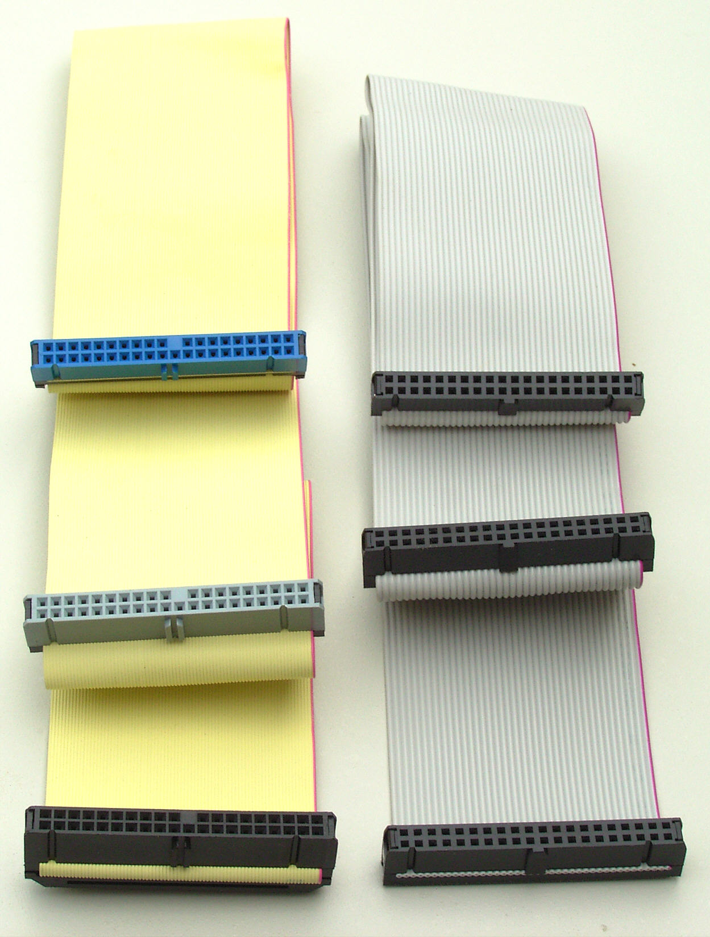
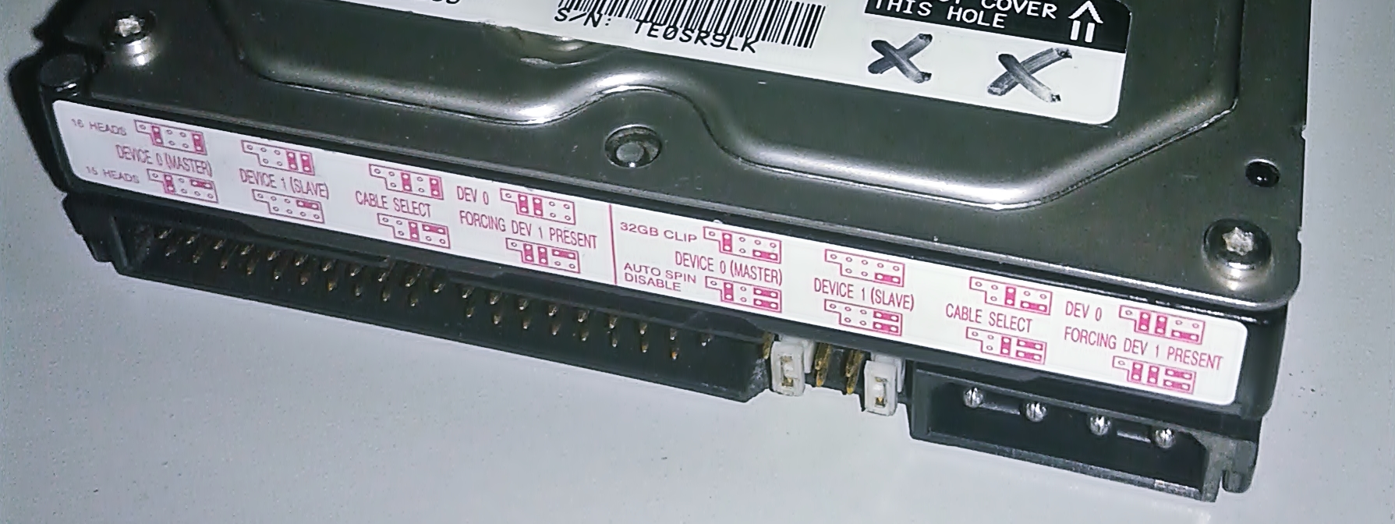
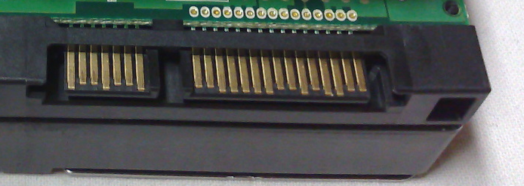

Disk Interfaces - ATA & SATA Interfaces
ATA interface and its cable
SATA interface and its cable
Data
Power
Credit: JulianVilla26
Credit: User Smial on de.wikipedia
Data
Power
Credit: Dsimic

Slide 7
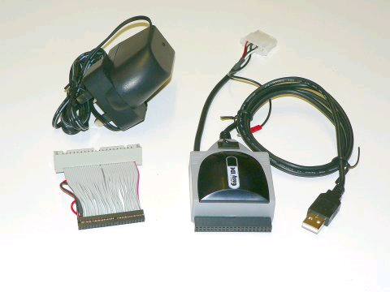

Disk Interfaces - USB
IDE/SATA to USB converters

Slide 8
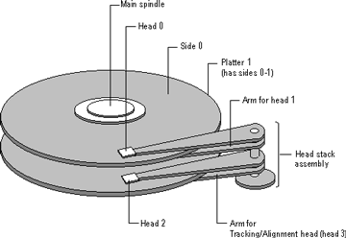
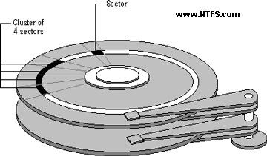
Disk Geometry (1)
Like CDs..
Sector
Individual data block
Track
circle
Cylinder
circle on all platters
Position
CHS:
Cylinder,
Head (0, 1, …)
Sector

Slide 9
Disk Geometry (2)
40G HD
4866 cylinders, 255 heads
63 sectors per track, 512 bytes per sector
512 * 63 * 4866 * 255 = 40,024,212,480 bytes
1KB = 1024 bytes
1MB = 1024 KB = 1,048,576 bytes
1GB = 1024 MB = 1,073,741,824 bytes
40,024,212,480 / 1,073,741,824 ≒ 37.275 GB
G
M
K
Why?
10^3 vs. 2^10…

Slide 10
CHS & LBA
CHS: Cylinder-Head-Sector
Not useful for block device other than spinning disk
LBA: Logical Block Addressing
First block -> LBA0, Second block -> LBA1, …
Conversion
HPC: Heads per Cylinder
SPT: Sectors per Track
LBA = (C × HPC + H) × SPT + (S − 1)
C = LBA ÷ (HPC × SPT)
H = (LBA ÷ SPT) mod HPC
S = (LBA mod SPT) + 1

Slide 11
Disk Installation Procedure
(in FreeBSD…)

Slide 12
Disk Installation Procedure (1)
The procedure involves the following steps:
Connecting the disk to the computer
IDE: master/slave
SATA
SCSI: ID, terminator
Power, hot-plug or not
Creating device files
Auto created by devfs(5)
Formatting the disk
Low-level format
Manufacturer diagnostic utility
Kill all address information and timing marks on platters
Repair bad sectors -> mark the bad sectors and don’t use them!
Metadata
Hard Disk
Data
Format (metadata + data) v.s. fast format (metadata only)

Slide 13
Disk Installation Procedure (2)
Partitioning (and Labeling) the disk
Allow the disk to be treated as a group of independent data blocks
e.g. partitions for root, home, swap
Former Suggestions:
/var, /tmp
Separated partition (for backup issue)
Make a copy of root filesystem for emergency
Establishing logical volumes
Combine multiple partitions into a logical volume
Related to RAID
Software RAID technology
GEOM: geom(4)、geom(8)
ZFS: zpool(8)、zfs(8)、zdb(8)

Slide 14
Disk Installation Procedure (3)
Creating UNIX filesystems within disk partitions
Use "newfs(8)" to install a filesystem for a partition
Establish all filesystem components
A set of inode storage cells
A set of data blocks
A set of superblocks
A map of the disk blocks in the filesystem
A block usage summary
Reference:
https://man.freebsd.org/newfs

Slide 15
Disk Installation Procedure (4)
Superblock contents
The length of a disk block
Size and location of inode table
Disk block map
Usage information
Other filesystem’s parameters
sync
The sync(2) system call forces a write of dirty (modified) buffers in the block buffer cache out to disk.
The sync(8) utility can be called to ensure that all disk writes have been completed before the processor is halted in a way not suitably done by reboot(8) or halt(8).

Slide 16
Disk Installation Procedure (5)
mount
Bring the new partition to the filesystem tree
mount point can be any directory (empty)
$ mount /dev/ad1s1e /home2
Setting up automatic mounting
Automount at boot time
/etc/fstab
$ mount -t ufs /dev/ad2s1a /backup
$ mount -t cd9600 -o ro,noauto /dev/acd0c /cdrom
ad1
s1
d
partition,
newfs
e
f
Mount CD
Also for ISO image file
liuyh@NASA:/etc> cat fstab
# Device Mountpoint Fstype Options Dump Pass#
/dev/ad0s1b none swap sw 0 0
/dev/ad2s1b none swap sw 0 0
/dev/ad0s1a / ufs rw 1 1
/dev/acd0 /cdrom cd9660 ro,noauto 0 0
/dev/ad2s1a /backup ufs rw,noauto 2 2
csduty:/bsdhome /bsdhome nfs rw,noauto 0 0
Usually: 2, 1 for root;
0: No need to check
Mount from the network; will talk about it in "NFS"
Reference: https://man.freebsd.org/fstab

Slide 17
Disk Installation Procedure (6)
Setting up swapping on swap partitions
swapon(8), swapoff(8), swapctl(8)
$ swapon -a
mount all partitions for swap usage
swapinfo(8), pstat(8)
nctucs [~] -wangth- swapinfo
Device 1K-blocks Used Avail Capacity
/dev/da0p2 2097152 42772 2054380 2%

Slide 18
fsck – check and repair filesystem (1)
System crashes will cause
Inconsistency between memory image and disk contents
fsck(8)
Examine filesystem listed in /etc/fstab with (pass > 0 & option in "rw", "rq", "ro"
Automatically correct the following damages:
Unreferenced inodes
Inexplicably large link counts
Unused data blocks not recorded in block maps
Data blocks listed as free but used in file
Incorrect summary information in the superblock
fsck(8)、fsck_ffs(8)
ffsinfo(8): dump metadata
Check if filesystem is clean…
1: clean (ro)
0: dirty (rw)

Slide 19
fsck – check and repair filesystem (2)
Run fsck in manual to fix serious damages
Blocks claimed by more than one file
Blocks claimed outside the range of the filesystem
Link counts that are too small
Blocks that are not accounted for
Directories that refer to unallocated inodes
Other errors
fsck will suggest you the action to perform
Delete, repair, …
There is no guarantee that fsck will fully recover your disk.

Slide 20
Adding a disk to FreeBSD (1)
Check disk connection
Look system boot message
Use gpart(8) to create a partition on the new HD
$ gpart create -s GPT ada3
$ gpart add -t freebsd-ufs -a 1M ada3
Use newfs(8) to construct new UFS file system
$ newfs -U /dev/ada3p1
Make mount point and mount it
# mkdir /home2
# mount -t ufs /dev/ada3p1 /home2
`-t ufs` is omittable
$ df
Edit /etc/fstab
ada3: 238475MB <Hitachi HDS722525VLAT80 V36OA6MA> at ata1-slave UDMA100
Line, speed

Slide 21
Adding a disk to FreeBSD (2)
If you forget to enable soft-update when you add the disk
$ umount /home2
$ tunefs -n enable /dev/ada3p1
$ mount -t ufs /dev/ada3p1 /home2
$ mount
/dev/ada0p2 on / (ufs, local, soft-updates)
/dev/ada1p1 on /home (ufs, local, soft-updates)
procfs on /proc (procfs, local)
/dev/ada3p1 on /home2 (ufs, local, soft-updates)

Slide 22
GEOM
Modular Disk Transformation Framework

Slide 23
Handbook and Manual pages
Official guide can be found at
https://docs.freebsd.org/en/books/handbook/geom/

Slide 24
GEOM - (1)
Support
ELI – geli(8): cryptographic GEOM class
JOURNAL – gjournal(8): journaled devices
LABEL – glabel(8): disk labelization
MIRROR – gmirror(8): mirrored devices
STRIPE – gstripe(8): striped devices
NOP – gnop(8): for setting metadata and testing
GATE – ggatec(8), ggated(8), ggatel(8): share over network
Journalize (logs) before write
Software RAID1
Software RAID0

Slide 25
GEOM - (2)
GEOM framework in FreeBSD
Major RAID control utilities
Kernel modules (/boot/kernel/geom_*)
Name and Providers
"manual" or "automatic"
Metadata in the last sector of the providers
Kernel support
{glabel,gmirror,gstripe,g*} load/unload
device GEOM_* in kernel config
geom_*_load="YES" in /boot/loader.conf
devices
Logical
volumes
On demand load/unload kernel modules
load automatically at booting
Build-in kernel and recompile

Slide 26
GEOM - (3)
Bundle by name instead of bundle by provider
LABEL
Used for GEOM provider labelization
Kernel
device GEOM_LABEL
geom_label_load="YES"
glabel (for new storage)
$ glabel label -v usr da2
$ newfs /dev/label/usr
$ mount /dev/label/usr /usr
$ glabel stop usr
$ glabel clear da2
UFS label (for an using storage)
$ tunefs -L data /dev/da4s1a
$ mount /dev/ufs/data /mnt/data
e.g. ad0s1d => usr
glabel label … => Create permanent labels
glabel create … => Create transient labels
/dev/label/usr
Stop using the name
Clear metadata on provider
"data" is a name

Slide 27
GEOM - (4)
MIRROR
Kernel
device GEOM_MIRROR
geom_mirror_load="YES"
gmirror
$ gmirror label -v -b round-robin data da0
$ newfs /dev/mirror/data
$ mount /dev/mirror/data /mnt
$ gmirror insert data da1
$ gmirror forget data
$ gmirror insert data da1
$ gmirror stop data
$ gmirror clear da0
logical volume called "data",
using HD: da0, …
Add a HD into the volume
Remove non-existent HDs

Slide 28
GEOM - (5)
STRIPE
Kernel
device GEOM_STRIPE
geom_stripe_load="YES"
gstripe
$ gstripe label -v -s 131072 data da0 da1 da2 da3
$ newfs /dev/stripe/data
$ mount /dev/stripe/data /mnt
$ gstripe stop data
$ gstripe clear da0
Create logical volume "data",
which stripe da0~da3 HDs

Slide 29
GEOM - (6)
ELI
Passphrase and keyfile on USB
Encrypt swap
# dd if=/dev/random of=/mnt/pendrive/da2.key bs=64 count=1
# geli init -s 4096 -K /mnt/pendrive/da2.key /dev/da2
Enter new passphrase:
Reenter new passphrase:
# geli attach -k /mnt/pendrive/da2.key /dev/da2
Enter passphrase:
# dd if=/dev/random of=/dev/da2.eli bs=1m
# newfs /dev/da2.eli
# mount /dev/da2.eli /mnt/secret
...
# umount /mnt/secret
# geli detach da2.eli
# dd if=/dev/random of=/dev/ada0s1b bs=1m
# geli onetime –d ada0s1b
# swapon /dev/ada0s1b.eli

Slide 30
Appendix

Slide 31
RAID - (1)
Redundant Array of Inexpensive Disks
A method to combine several physical hard drives into one logical unit
Depending on the type of RAID, it has the following benefits:
Fault tolerance
Higher throughput
Real-time data recovery
RAID Level
RAID 0, 1, 0+1, 2, 3, 4, 5, 6
Hierarchical RAID
e.g. HD1, HD2 v.s D:\ in windows
RAID1
- RAID0
- HD
- HD
- HD
- RAID0
- HD
- HD
- HD
RAID1
RAID0
RAID0

Slide 32
RAID - (2)
Hardware RAID
There is a dedicate controller to take over the whole business
RAID Configuration Utility after BIOS
Create RAID array, build Array
Software RAID
GEOM
CACHE、CONCAT、ELI、JOURNAL、LABEL、MIRROR、MULTIPATH、NOP、PART、RAID3、SHSEC、STRIPE、VIRSTOR
ZFS
JBOD、STRIPE
MIRROR
RAID-Z、RAID-Z2、RAID-Z3

Slide 33
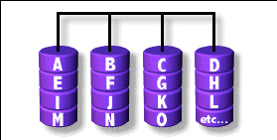
RAID 0 (normally used)
(500GB+500GB=1TB)
Stripped data intro several disks
Minimum number of drives: 2
Advantage
Performance increase in proportional to n theoretically
Simple to implement
Disadvantage
No fault tolerance
Recommended applications
Non-critical data storage
Application requiring high bandwidth (such as video editing)
e.g. HD1 (500GB), HD2 (500GB) v.s. D:\ in windows (1TB)
parallel file io from/to different HDs

Slide 34
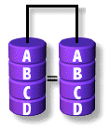
RAID 1 (normally used)
(500GB+500GB=500GB)
Mirror data into several disks
Minimum number of drives: 2
Advantage
100% redundancy of data
Disadvantage
100% storage overage
Moderately slower write performance
Recommended application
Application requiring very high availability (such as home)
Caused by double check mechanisms on data…

Slide 35
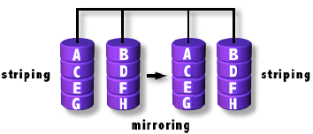
RAID 0+1 (normally used)
([(500GB+500GB)+(500GB+500GB)=1TB)
Combine RAID 0 and RAID 1
Minimum number of drives: 4
RAID1, RAID1
Them RAID0 above it

Slide 36
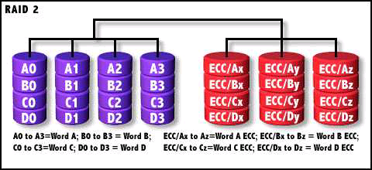
RAID 2
Hamming Code ECC Each bit of data word
Advantage
"On the fly" data error correction
Disadvantage
Inefficient
Very high ratio of ECC disks to data disks
Recommended applications
No commercial implementations exist / not commercially viable
Read, check if correct, then read

Slide 37
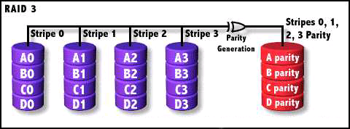
RAID 3
RAID1 if two HDs
Parallel transfer with Parity
Minimum number of drives: 3
Advantage
Very high data transfer rate
Disadvantage
Transaction rate equal to that of a single disk drive at best
Recommended applications
Any application requiring high throughput
Save parity

Slide 38
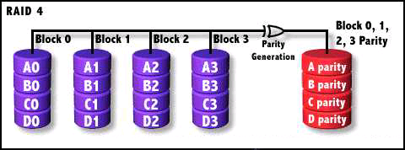
RAID 4
Similar to RAID3
RAID 3 V.S RAID 4
Byte Level V.S Block Level
Block interleaving
Small files (e.g. 4k)
Block normally 512bytes (4k for WD HDs)

Slide 39
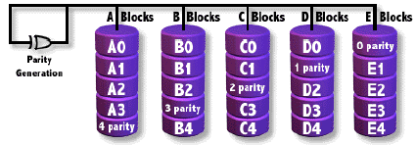
RAID 5 (normally used)
Independent Disk with distributed parity blocks
Minimum number of drives: 3
Advantage
Highest read data rate
Medium write data rate
Disadvantage
Disk failure has a medium impact on throughput
Complex controller design
When one disk failed, you have to rebuild the RAID array
Origin from RAID3
Parallel file I/O
Can tolerate only 1 HD failure

Slide 40
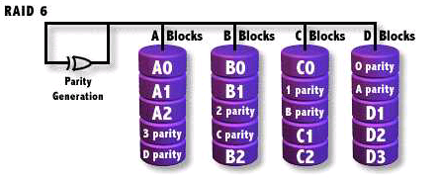
RAID 6 (normally used)
Similar to RAID5
Minimum number of drives: 4
2 parity checks, 2 disk failures tolerable.
Slower than RAID5 because of storing 2 parities…

