Slide 1
Backups
lwhsu (2019-2020, CC BY)
? (?-2018)

Slide 2
Outline
Backup devices and media
Backup philosophy
Unix backup and archiving commands

Slide 3
Key Concepts
The backup that has never been verified is the same as no backup
Types
Scope
Full
Incremental
Differential
Storage
Hot/Cold
Online/Offline
Remote

Slide 4
Backup Media – By Physical Characteristics
Hard Disk
Pro: common
Con: fragile
Optical Disk
Pro: durable
Con: size
Magnet Tape
Pro: cost-effective
Con: slow

Slide 5
Backup Media – By Product
RAID
Redundant Array of Independent Disks
NAS
Network Attached Storage
SAN
Storage Area Network

Slide 6
Backup Media – By Availability
Off-line Storage
CD、DVD、MO
Adv:
Low cost, high reliability
Disadv:
Not-convenient, low speed
Near-line Storage
JukeBox、Tape Library
Adv:
High capacity, high reliability
Disadv:
High malfunction rate, Not-convenient
On-line Storage
Disk Array (RAID)
Adv:
Fast and high availability
Disadv:
High cost

Slide 7

Backup Media – Cloud
Azure Backup
AWS S3 Glacier / Deep Archive
GCP Archival Cloud Storage
https://www.safer-computing.com/?p=5010

Slide 8
Backup Philosophy
Perform all dumps from one machine
Label your taps
Pick a reasonable backup interval
Choose filesystems carefully
Make daily dumps fit on one tape
Make filesystems smaller than your dump device
Keep Tapes off-site
Protect your backups
Limit activity during dumps
Check your tapes
Develop a tape life cycle
Design your data for backups
Prepare for the worst

Slide 9
Dumping filesystems – dump command (1)
Used to backup filesystem into a large file to archive to an external device
Advantages:
Backups can span multiple output media
Files of any type can be backed up and restored
Permissions, ownerships, and modification times are preserved
Files with holes are handled correctly
Backups can be performed incrementally
Limitations:
Each filesystems must be dumped individually
Only filesystems on the local machine can be dumped
NFS filesystem is not allowed

Slide 10
Dumping filesystems – dump command (2)
Backup level
0 ~ 9
Level 0 -> full backup
Level N -> incremental backup of Level≦ N-1 for N = 1 ~ 9
dump command format
% dump [arguments] file-system
dump command arguments
u: update the /etc/dumpdates file after dump
f: the output backup file
Special device file, like /dev/nrsa0
Ordinary file
'-' to standard out
"user@host:file"
d: tape density in bytes per inch
s: tape length in feet
a: auto-size, bypass all tape length considerations (default d = 1600, s = 2300)

Slide 11
Dumping filesystems – dump command (3)
Example: Full backup
zfs[/mnt] -chiahung- ls -lh
drwxr-xr-x 3 root wheel 512B Nov 22 15:34 ./
drwxr-xr-x 20 root wheel 25B Nov 18 20:02 ../
-rw-r--r-- 1 root wheel 512M Nov 21 22:20 haha
zfs[/mnt] -chiahung- cat /etc/dumpdates
zfs[/mnt] -chiahung- df -h
Filesystem Size Used Avail Capacity Mounted on
zfs 15G 4.1G 11G 27% /
devfs 1.0K 1.0K 0B 100% /dev
/dev/da0s1a 8.7G 512M 7.G 6% /mnt
zfs[/mnt] -chiahung- sudo dump 0uLf - /dev/da0s1a > ~/dump.0
DUMP: Date of this level 0 dump: Sun Nov 22 15:37:44 2009
DUMP: Date of last level 0 dump: the epoch
DUMP: Dumping snapshot of /dev/da0s1a to standard output
DUMP: mapping (Pass I) [regular files]
DUMP: mapping (Pass II) [directories]
DUMP: estimated 525772 tape blocks.
DUMP: dumping (Pass III) [directories]
DUMP: dumping (Pass IV) [regular files]
DUMP: DUMP: 525625 tape blocks
DUMP: finished in 36 seconds, throughput 14600 KBytes/sec
DUMP: level 0 dump on Sun Nov 22 15:37:44 2009
DUMP: DUMP IS DONE
zfs[/mnt] -chiahung- cat /etc/dumpdates
/dev/da0s1a 0 Sun Nov 22 15:37:44 2009

Slide 12
Dumping filesystems – dump command (4)
Example: Incremental backup
zfs[/mnt] -chiahung- sudo cp -Rp /etc /mnt/
zfs[/mnt] -chiahung- ls -lh
drwxr-xr-x 4 root wheel 512B Nov 22 15:48 ./
drwxr-xr-x 20 root wheel 25B Nov 18 20:02 ../
drwxr-xr-x 20 root wheel 2.0K Nov 22 15:35 etc/
-rw-r--r-- 1 root wheel 512M Nov 21 22:20 haha
zfs[/mnt] -chiahung- sudo dump 2uLf - /dev/da0s1a > ~/dump.2
DUMP: Date of this level 2 dump: Sun Nov 22 15:49:04 2009
DUMP: Date of last level 0 dump: Sun Nov 22 15:37:44 2009
DUMP: Dumping snapshot of /dev/da0s1a to standard output
DUMP: mapping (Pass I) [regular files]
DUMP: mapping (Pass II) [directories]
DUMP: estimated 2267 tape blocks.
DUMP: dumping (Pass III) [directories]
DUMP: dumping (Pass IV) [regular files]
DUMP: DUMP: 2124 tape blocks
DUMP: finished in less than a second
DUMP: level 2 dump on Sun Nov 22 15:49:04 2009
DUMP: DUMP IS DONE
zfs[/mnt] -chiahung- cat /etc/dumpdates
/dev/da0s1a 0 Sun Nov 22 15:37:44 2009
/dev/da0s1a 2 Sun Nov 22 15:49:04 2009
zfs[/mnt] -chiahung- ls -lh ~/dump*
-rw-rw-r-- 1 chiahung user 513M Nov 22 15:38 /home/chiahung/dump.0
-rw-rw-r-- 1 chiahung user 2.1M Nov 22 15:49 /home/chiahung/dump.2

Slide 13
Restoring from dumps –
restore command (1)
Restore can do
Restoring individual files
Restoring entire filesystem
Options of restore command
i: interactive restore
r: restore an entire filesystem
f: the backup file that restore is going to use

Slide 14
Restoring from dumps –
restore command (2)
Restore individual file interactively
zfs[/tmp] -chiahung- cat ~/dump.2 | restore if -
restore > ?
Available commands are:
ls [arg] - list directory
cd arg - change directory
pwd - print current directory
add [arg] - add `arg' to list of files to be extracted
delete [arg] - delete `arg' from list of files to be extracted
extract - extract requested files
setmodes - set modes of requested directories
quit - immediately exit program
what - list dump header information
verbose - toggle verbose flag (useful with ``ls'')
help or `?' - print this list
If no `arg' is supplied, the current directory is used

Slide 15
Restoring from dumps –
restore command (3)
Restore individual file interactively (cont.)
zfs[/tmp] -chiahung- cat ~/dump.2 | restore if -
restore > ls
.:
.snap/ etc/
restore > cd etc
restore > add make.conf
restore > extract
set owner/mode for '.'? [yn] n
restore > quit
zfs[/tmp] -chiahung- ls -ld etc
drwxr-xr-x 2 chiahung wheel 3 Nov 22 15:35 etc/
zfs[/tmp] -chiahung- ls -l etc
drwxr-xr-x 2 chiahung wheel 3 Nov 22 15:35 ./
drwxrwxrwt 10 root wheel 42 Nov 22 15:58 ../
-rw-r--r-- 1 chiahung wheel 590 Nov 19 23:04 make.conf

Slide 16
Restoring from dumps –
restore command (4)
Restore entire filesystem
$ restore -rf /home/temp/root.0
Steps
Restore level 0 first
Restore incremental dumps
0 0 0 0 0
0 5 5 5 5
0 3 2 5 4 5
0 9 9 5 9 9 3 9 9 5 9 9
0 3 5 9 3 5 9

Slide 17
Other archiving programs
tar command
Read multiple files and packages them into one file
Example
dd command
Copy filesystems between partitions of exactly the same size
Example
# tar czvf etc.tar.gz /etc/
# tar xzvf etc.tar.gz # tar cf - fromdir | tar xfp - -C todir
# dd if=/dev/rst0 of=/dev/rst1
# dd if=/tmp/kern.flp of=/dev/fd0
# dd if=/dev/da1 of=/dev/da2 bs=1048576

Slide 18
CS home backup
Using rsync
rsync -a --delete
-a: archive mode
Recursive and preserve everything
--delete:
Delete any file that are not in the sending sid
0 4 * * 1 (cd /raid && /usr/local/bin/rsync -aH --delete cs /backup/user/)
0 4 * * 2 (cd /raid && /usr/local/bin/rsync -aH --delete gcs /backup/user/)
0 4 * * 3 (cd /raid && /usr/local/bin/rsync -aH --delete dcs /backup/user/)
0 4 * * 4 (cd /raid && /usr/local/bin/rsync -aH --delete alumni /backup/user/)

Slide 19
CS home backup
Snapshot
CS home snapshot
wangth@csduty.cs.nctu.edu.tw[/u/gcs][20:14]$ ls -a
. 01 103 109 91 95 99
.. 100 104 193 92 96
.snap 101 105 199 93 97
.snapshot 102 106 90 94 98
wangth@csduty.cs.nctu.edu.tw[/u/gcs/.snapshot][20:14]$ cd .snapshot/
wangth@csduty.cs.nctu.edu.tw[/u/gcs/.snapshot][20:14]$ ls
4hour.2018-01-02_0000 4hour.2018-01-02_2000 daily.2018-01-01_0010
4hour.2018-01-02_0400 daily.2017-12-28_0010 daily.2018-01-02_0010
4hour.2018-01-02_0800 daily.2017-12-29_0010 weekly.2017-12-17_0015
4hour.2018-01-02_1200 daily.2017-12-30_0010 weekly.2017-12-24_0015
4hour.2018-01-02_1600 daily.2017-12-31_0010 weekly.2017-12-31_0015

Slide 20
UFS Snapshot
derek[/] -chiahung- df -h
Filesystem Size Used Avail Capacity Mounted on
/dev/ad4s1a 70G 16G 48G 25% /
devfs 1.0K 1.0K 0B 100% /dev
derek[/] -chiahung- sudo mount -u -o snapshot /.snap/snapshot /
derek[/] -chiahung- df -h
Filesystem Size Used Avail Capacity Mounted on
/dev/ad4s1a 70G 16G 48G 25% /
devfs 1.0K 1.0K 0B 100% /dev
derek[~] -chiahung- sudo mdconfig -a -t vnode -f /.snap/snapshot -u 1
WARNING: opening backing store: /.snap/snapshot readonly
derek[~] -chiahung- sudo mount -r /dev/md1 /mnt
derek[~] -chiahung- ls /mnt/
./ COPYRIGHT compat@ ftp/ mnt/ sys@
../ bin/ dev/ home/ proc/ tmp/
.cshrc boot/ dist/ lib/ rescue/ usr/
.profile cdrom/ entropy libexec/ root/ var/
.snap/ cdrom1/ etc/ media/ sbin/
derek[~] -chiahung- sudo umount /mnt
derek[~] -chiahung- sudo mdconfig -d -u 1

Slide 21
Appendix

Slide 22
Backup Media – By Storage (1)
By Storage category
Hard disk
SATA / SAS / SSD
120 ~ 450 MB /s
1 TB SATA3: NT 1,500
2 TB SATA3: NT 2,000
4 TB SAS: NT 9,000
256 G SSD: NT 2,500
Different "types"
RAID
Cold Archive
CD/DVD R RW
CD
6 ~ 8 MB/s
DVD
8 ~ 15 MB/s
CD-R 0.7G: NT 6
DVD-R 4.7G: NT 9
DVD DL 8.5GB: NT 35
BD
4x 18 MB/s, 12x 64 MB/x
6x double-layer BD-R 50GB：NT 60

Slide 23
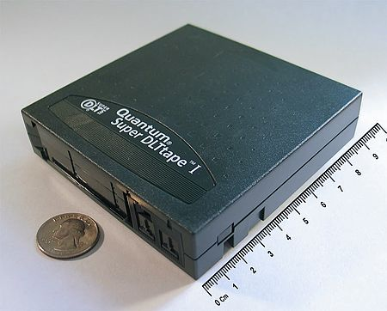
Backup Media – By Storage (2)
Types
DAT (Digital Audio Tape) 4mm tapes
DDS (Digital Data Storage), Minimal Error Rate, Higher Efficiency
DDS-4 (often used)
20/40GB(compressed), about NT 400.
1.0~3.0MB/s
Travan tapes
High Transfer Rate
Travan 40 (often used)
20/40GB(compressed), about NT 2000.
Up to 8.0MB/s
DLT (Digital Linear Tape)
High Capacity, Solid Reliability
Media
Max 800 GB, about NT 4000.
Speed: Up to 60 MB/s
LTO Ultrium
Fast Transfer Rate, High Performance, and High Storage Capacity
LTO Ultrium 3 (often used)
Max 1600 GB, about NT 5000.
Speed: up to 80 MB/s
Tape Drive is much more expensive……
https://en.wikipedia.org/wiki/Digital_Linear_Tape

Slide 24
Backup Media – By Storage (3.1)
Backup media compare
Medium | Capacity | Speed | Drive | Media | Cost/GB | Reuse? | Random?
CD-R | 700MB | 7MB/s | $15 | 15¢ | 21¢ | No | Yes
CD-RW | 700MB | 4MB/s | $20 | 30¢ | 42¢ | Yes | Yes
DVD ± R | 4.7GB | 30MB/s | $30 | 30¢ | 6¢ | No | Yes
DVD + R DL | 8.5GB | 30MB/s | $30 | $1 | 12¢ | No | Yes
DVD ± RW | 4.7GB | 10MB/s | $30 | 40¢ | 9¢ | Yes | Yes
Blu-ray | 25GB | 30MB/s | $100 | $3 | 12¢ | No | Yes
DDS-4 (4mm) | 20GB | 30MB/s | $100 | $5 | 25¢ | Yes | No
DLT/S-DLT | 160GB | 16MB/s | $500 | $10 | 6¢ | Yes | No
DLT-S4 | 800GB | 60MB/s | $2,500 | $100 | 13¢ | Yes | No
AIT-4 (8mm) | 200GB | 24MB/s | $1,200 | $40 | 20¢ | Yes | No
AIT-5 | 400GB | 24MB/s | $2,500 | $50 | 13¢ | Yes | No
VXA-320 | 160GB | 12MB/s | $800 | $60 | 38¢ | Yes | No
LTO-3 | 400GB | 80MB/s | $200 | $25 | 6¢ | Yes | No
LTO-4 | 800GB | 120MB/s | $1,600 | $40 | 5¢ | Yes | No

Slide 25
Backup Media – By Storage (3.2)
MO (Magneto-Optical)
MO 540M, 640M, 1.3G, 2.3G
Removable Media
Floppy, ZIP, LS-120
Jukebox
Automatically change removable media
DAT, DLT, CD, …
Tape Library
Hardware backup solution for large data set

Slide 26
Backup Media – By Storage (4)
Jukebox
Automatically change removable media
Available for several types of media
DAT, DLT, CD
Specifications
Number of Magazines (50-disc Magazine) | Max. 6 units (front: max. 4, rear: max. 3)
Number of Magazines (20-disc) | 1
Number of Drives | Max. 8 drives
Disc Change Time | Max. 8 seconds

Slide 27
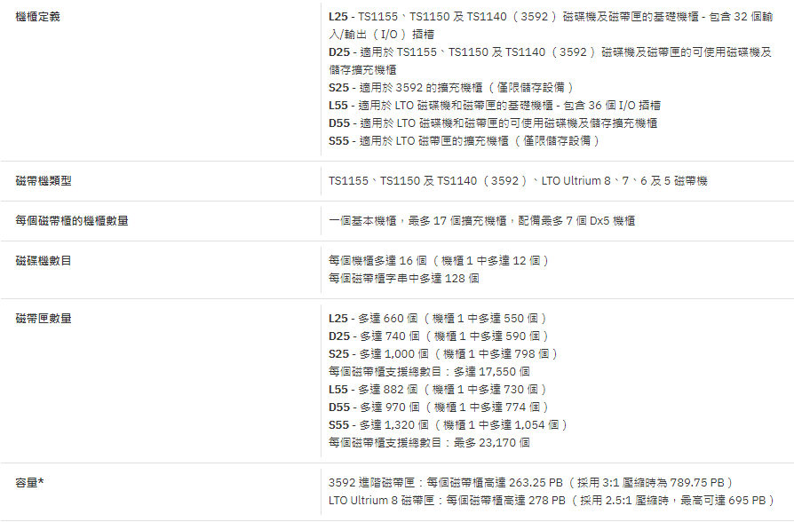
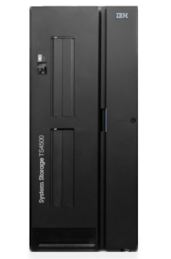
Backup Media – By Storage (5)
Tape Library
IBM TS4500 Tape Library

Slide 28

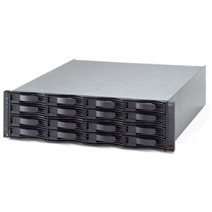
Backup Media – By Enterprise Product (1)
RAID architecture
SCSI cable
Fiber Channel
Disk array
Server
IBM TotalStorage DS6000 的目標：
以合理價格的儲存系統解決方案，為大中型企業提供高可用性
具有企業級功能、模組化、可擴充特性，能支援開放性平台與大型主機
提供進階複製服務，與 IBM TotalStorage DS8000 系列及 IBM TotalStorage Enterprise Storage Server® (ESS) 800 和 750 系統互通
提供 GUI 介面與「快捷組態 (Express Configuration)」精靈，透過隨附的 IBM TotalStorage DS Storage Manager 來簡化系統配置與管理
採用模組化、3U、16 個磁碟機、機架式，隨儲存需求而增，最高可達 67.2 TB 的實體容量

Slide 29
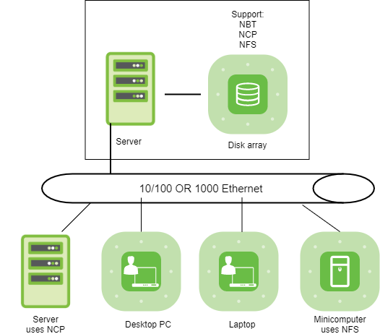
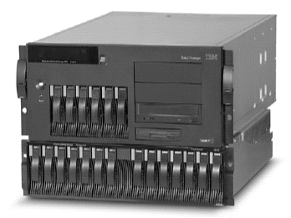
Backup Media – By Enterprise Product (2)
NAS (Network Attached Storage)
Storage + Server + Cross-platform access OS + network access protocol
IBM NAS 300G
Supported Protocol:
NFS, HTTP, FTP, CIFS
Netware

