Slide 1
FTP - File Transfer Protocol
jnlin(2019-2021, CC BY-SA)
? (1996-2018)

Slide 2
FTP
FTP
File Transfer Protocol
Used to transfer data from one computer to another over the internet
Client-Server Architecture
Separated control/data connections

Slide 3
FTP
FTP connections
Control connection
Created when an FTP session is established
Only for passing control information
Data connection
Each time that data is sent, a distinct TCP data connect is established
Data Connection Modes
Active
Passive

Slide 4
FTP
Security concern
As we seen, FTP connections (both command and data) are transmitted in clear text
What if somebody sniffing the network?
We need encryption

Slide 5
FTP
Solutions
FTP over SSH
A normal FTP session tunneled through a SSH channel
SSH File Transfer Protocol (SFTP)
Both commands and data are encrypted while transmitting
One connection, but poor performance
FTP over TLS (ftps, ftpes)
Only commands are encrypted while transmitting
Better performance

Slide 6
FTP - Pure-FTPd(1/3)
Introduction
A small, easy to set up, fast and secure FTP server
Support chroot
Restrictions on clients, and system-wide.
Verbose logging with syslog
Anonymous FTP with more restrictions
Virtual Users, and Unix authentication
FXP (File eXchange Protocol)
FTP over TLS
UTF-8 support for filenames

Slide 7
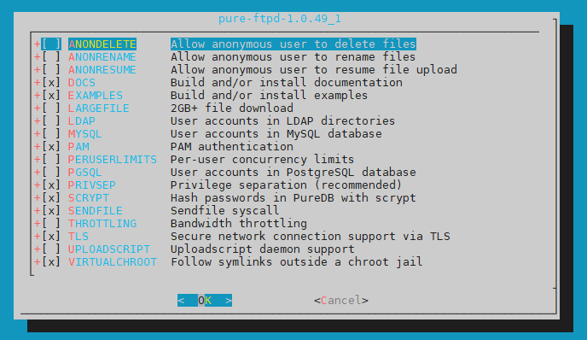
FTP - Pure-FTPd(2/3)
Installation
Ports: /usr/ports/ftp/pure-ftpd
Options

Slide 8
FTP - Pure-FTPd(3/3)
Other options
LANGUAGE
Change the language of output messages
Startup
Add pureftpd_enable="YES" in /etc/rc.conf
nctucs [/usr/ports/ftp/pure-ftpd] -wangth- sudo make extract
…
You can use the following additional options:
LANGUAGE=lang (default: english)
- Enable compilation of one language support
available lang: brazilian-portuguese, catalan, czech, danish, dutch,
english, french, french-funny, german, hungarian, italian, korean,
norwegian, polish, romanian, russian, simplified-chinese, slovak,
spanish, swedish, traditional-chinese, Turkish

Slide 9
FTP - Pure-FTPd Configurations(1/3)
Configurations:
File: /usr/local/etc/pure-ftpd.conf
Documents
Configuration sample: /usr/local/etc/pure-ftpd.conf.sample
All options are explained clearly in this file.
Other documents
See /usr/local/share/doc/pure-ftpd/*
nctucs [/usr/ports/ftp/pure-ftpd] -wangth- ls
AUTHORS README.LDAP CONTACT README.MySQL COPYING README.PGSQL
HISTORY README.TLS NEWS
README.Virtual-Users README
THANKS README.Authentication-Modules
pure-ftpd.png README.Configuration-File
pureftpd.schema

Slide 10
FTP - Pure-FTPd Configurations(2/3)
# Restrict users to their home directory
ChrootEveryone yes
# If the previous option is set to "no", members of the following group
# won't be restricted. Others will be. If you don't want chroot()ing anyone,
# just comment out ChrootEveryone and TrustedGID.
TrustedGID 0
# Disallow authenticated users - Act only as a public FTP server.
AnonymousOnly no
# Disallow anonymous connections. Only accept authenticated users.
NoAnonymous yes
# If you want simple Unix (/etc/passwd) authentication, uncomment this
UnixAuthentication yes
# Port range for passive connections - keep it as broad as possible.
PassivePortRange 30000 50000

Slide 11
FTP - Pure-FTPd Configurations(3/3)
# This option accepts three values:
# 0: disable SSL/TLS encryption layer (default).
# 1: accept both cleartext and encrypted sessions.
# 2: refuse connections that don't use the TLS security mechanism,
# including anonymous sessions.
# Do _not_ uncomment this blindly. Double check that:
# 1) The server has been compiled with TLS support (--with-tls),
# 2) A valid certificate is in place,
# 3) Only compatible clients will log in.
TLS 2
# UTF-8 support for file names (RFC 2640)
# Set the charset of the server filesystem and optionally the default charset
# for remote clients that don't use UTF-8.
# Works only if pure-ftpd has been compiled with --with-rfc2640
# FileSystemCharset UTF-8
# ClientCharset UTF-8

Slide 12
FTP - Pure-FTPd Problem Shooting
Logs Location
In default, syslogd keeps ftp logs in /var/log/xferlog
Most frequent problems
pure-ftpd: (?@?) [ERROR] Unable to find the 'ftp' account
It’s ok, but you may need it for Virtual FTP Account.
pure-ftpd: (?@?) [ERROR] Sorry, but that file doesn't exist: [/etc/ssl/private/pure-ftpd.pem]
If you set TLS = 2, then this file is needed.
How to generate a pure-ftpd.pem?
See README.TLS

Slide 13
FTP - Pure-FTPd Tools
pure-*
pure-ftpwho(8)
List info of users who are currently connecting to the FTP server.
pure-pw(8)
Manage Virtual Users in PureDB format
See README.Virtual-Users
nctucs [~] -wangth- ls /usr/local/sbin/pure-*
/usr/local/sbin/pure-alwaysfail /usr/local/sbin/pure-mrtginfo
/usr/local/sbin/pure-authd /usr/local/sbin/pure-quotacheck
/usr/local/sbin/pure-ftpd /usr/local/sbin/pure-uploadscript
/usr/local/sbin/pure-ftpwho
nctucs [~] -wangth- ls /usr/local/bin/pure-*
/usr/local/bin/pure-pw /usr/local/bin/pure-statsdecode
/usr/local/bin/pure-pwconvert

Slide 14
FTP - More Tools
ftp/pureadmin
Management utility for the PureFTPd
ftp/lftp
Shell-like command line ftp client
Support TLS
ftp/wget, ftp/curl
Retrieve files from the Net via HTTP(S) and FTP
ftp/mget
Multithreaded command line web-download manager
FileZilla (ftp/filezilla)
A graphical cross-platform FTP client
Support TLS

