Slide 1
Syslog and Log Rotate
wangth (2017-2021, CC BY-SA)
? (1996-2016)

Slide 2
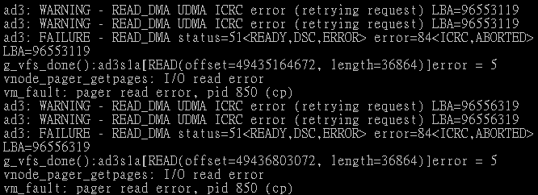
Log files
Execution information of each services
sshd log files
httpd log files
ftpd log files
Purpose
For post-incident tracking
Like insurance

Slide 3
Logging Policies
Common schemes
Throw away all log files
Rotate log files at periodic intervals
Archiving log files
#!/bin/sh
/usr/bin/cd /var/log
/bin/mv logfile.2.gz logfile.3.gz
/bin/mv logfile.1.gz logfile.2.gz
/bin/mv logfile logfile.1
/usr/bin/touch logfile
/bin/kill –signal pid
/usr/bin/gzip logfile.1
#!/bin/sh
/usr/bin/cd /var/log
/bin/mv logfile.2.gz logfile.3.gz
/bin/mv logfile.1.gz logfile.2.gz
/bin/mv logfile logfile.1
/usr/bin/touch logfile
/bin/kill –signal pid
/usr/bin/gzip logfile.1
0 3 * * * /usr/bin/tar czvf /backup/logfile.`/bin/date +\%Y\%m\%d`.tar.gz /var/log
0 3 * * * /usr/bin/tar czvf /backup/logfile.`/bin/date +\%Y\%m\%d`.tar.gz /var/log

Slide 4
Finding Log Files
Ways and locations
Common directory
/var/log
Read software configuration files
Ex: /usr/local/etc/apache22/httpd.conf
Ex: /usr/local/etc/smb.conf
See /etc/syslog.conf
TransferLog /home/www/logs/access.log
TransferLog /home/www/logs/access.log
log file = /var/log/samba/%m.log
log file = /var/log/samba/%m.log

Slide 5
Under /var/log in FreeBSD (1/2)
You can see that under /var/log …
Applications
zfs[/var/log] -chiahung- ls
./ lastlog maillog.7.bz2 sendmail.st
../ lpd-errs messages sendmail.st.0
auth.log maillog messages.0.bz2 sendmail.st.1
cron maillog.0.bz2 messages.1.bz2 sendmail.st.2
cron.0.bz2 maillog.1.bz2 messages.2.bz2 sendmail.st.3
cron.1.bz2 maillog.2.bz2 mount.today setuid.today
cron.2.bz2 maillog.3.bz2 mount.yesterday wtmp
debug.log maillog.4.bz2 pf.today xferlog
dmesg.today maillog.5.bz2 ppp.log
dmesg.yesterday maillog.6.bz2 security
Lots of logs
zfs[/var/log] -chiahung- ls
./ lastlog maillog.7.bz2 sendmail.st
../ lpd-errs messages sendmail.st.0
auth.log maillog messages.0.bz2 sendmail.st.1
cron maillog.0.bz2 messages.1.bz2 sendmail.st.2
cron.0.bz2 maillog.1.bz2 messages.2.bz2 sendmail.st.3
cron.1.bz2 maillog.2.bz2 mount.today setuid.today
cron.2.bz2 maillog.3.bz2 mount.yesterday wtmp
debug.log maillog.4.bz2 pf.today xferlog
dmesg.today maillog.5.bz2 ppp.log
dmesg.yesterday maillog.6.bz2 security

Slide 6
Under /var/log in FreeBSD (2/2)
Logs – because of syslogd
bsd5[~] -chiahung- cat /etc/syslog.conf | grep -v ^#
*.* /var/log/all.log
*.* @loghost
*.err;kern.warning;auth.notice;mail.crit /dev/console
*.notice;authpriv.none;kern.debug;lpr.info;mail.crit;news.err /var/log/messages
security.* /var/log/security
auth.info;authpriv.info /var/log/auth.log
mail.info /var/log/maillog
lpr.info /var/log/lpd-errs
ftp.info /var/log/xferlog
cron.* /var/log/cron
*.=debug /var/log/debug.log
*.emerg *
console.info /var/log/console.log
!sudo
*.* /var/log/sudo.log
bsd5[~] -chiahung- cat /etc/syslog.conf | grep -v ^#
*.* /var/log/all.log
*.* @loghost
*.err;kern.warning;auth.notice;mail.crit /dev/console
*.notice;authpriv.none;kern.debug;lpr.info;mail.crit;news.err /var/log/messages
security.* /var/log/security
auth.info;authpriv.info /var/log/auth.log
mail.info /var/log/maillog
lpr.info /var/log/lpd-errs
ftp.info /var/log/xferlog
cron.* /var/log/cron
*.=debug /var/log/debug.log
*.emerg *
console.info /var/log/console.log
!sudo
*.* /var/log/sudo.log

Slide 7
Syslogd

Slide 8
Syslog –
The system event logger (1/2)
Two main functions
To release programmers from the tedious of writing log files
To put administrators in control of logging
Three parts:
syslogd, /etc/syslog.conf
The logging daemon and configure file
openlog(), syslog(), closelog()
Library routines to use syslogd
logger
A user command that use syslogd from shell

Slide 9
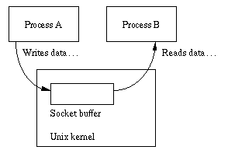
Syslog –
The system event logger (2/2)
derek[~] -chiahung- ls -al /var/run/log /var/run/logpriv /dev/klog
crw------- 1 root wheel 0x17 Sep 9 18:19 /dev/klog
srw-rw-rw- 1 root wheel 0 Sep 9 18:20 /var/run/log
srw------- 1 root wheel 0 Sep 9 18:20 /var/run/logpriv
auth
ssh
ftpd
/var/run/log
Syslogd
messages
su
cron
mail
rsh
derek[~] -chiahung- ls -al /var/run/log /var/run/logpriv /dev/klog
crw------- 1 root wheel 0x17 Sep 9 18:19 /dev/klog
srw-rw-rw- 1 root wheel 0 Sep 9 18:20 /var/run/log
srw------- 1 root wheel 0 Sep 9 18:20 /var/run/logpriv
Process A
Process B
Unix Kernel
Socket Buffer

Slide 10
Configuring syslogd (1/6)
Basic format
The configuration file /etc/syslog.conf controls syslogd’s behavior
selector <Tab> action
Selector: program.level
Program: the program that sends the log message
Level: the message severity level
Action: tells what to do with the message
Ex.
mail.info /var/log/maillog

Slide 11
Configuring syslogd (2/6)
selector
Syntax: facility.level
Facility and level are predefined
(see next page)
Combined selector
facility.level
facility1,facility2.level
facility1.level;facility2.level
*.level
Level indicate the minimum importance that a message must be logged
A message matching any selector will be subject to the line’s action

Slide 12
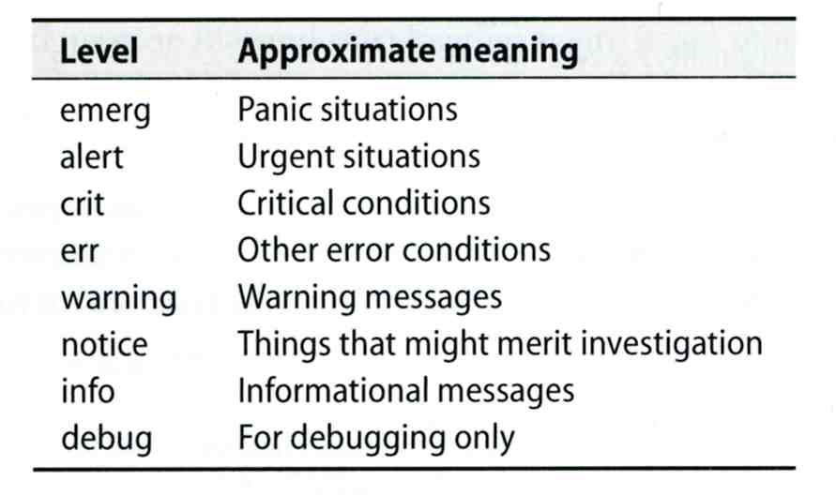
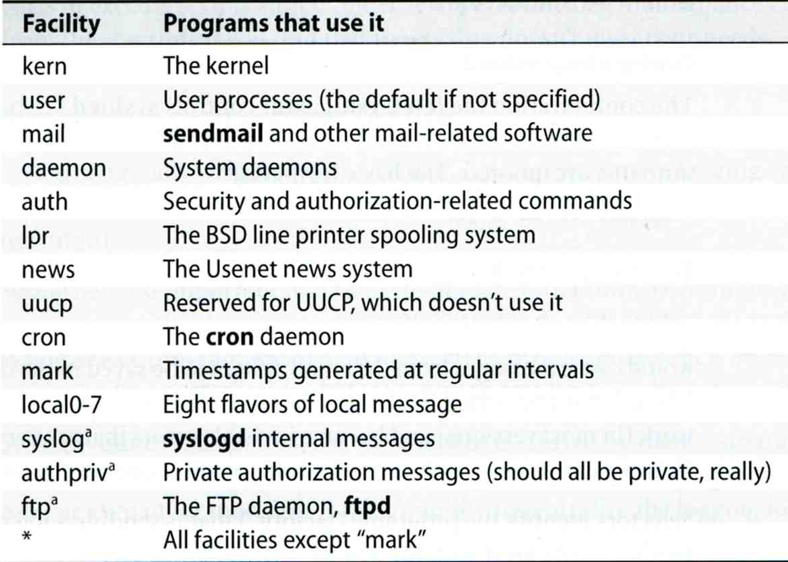
Configuring syslogd (3/6)
Facility | Programs that use it
kern | The kernel
user | User processes (the default if not specified)
mail | sendmail and other mail-related software
daemon | System daemons
auth | Security and authorization-related commands
lpr | The BSD line printer spooling system
news | The Usenet news system
uucp | Reserved for UUCP, which doesn’t use it
cron | The cron daemon
mark | Timestamps generated at regular intervals
local0-7 | Eight flavors of local message
syslog | syslogd internal messages
authpriv | Private authorization messages (should all be private, really)
ftp | The FTP daemon, ftpd
* | All facilities except "mark"
Level | Approximate meaning
emerg | Panic situations
alert | Urgent situations
crit | Critical conditions
err | Other error conditions
warning | Warning messages
notice | Things that might merit investigation
info | Informational messages
debug | For debugging only
facility: auth, authpriv, console, cron, daemon, ftp, kern, lpr, mail, mark, news, ntp, security, syslog, user, uucp, and local0 through local7

Slide 13
Configuring syslogd (4/6)
Action
filename
Write the message to a local file
@hostname
Forward the message to the syslogd on hostname
@ipaddress
Forwards the message to the host at that IP address
user1, user2
Write the message to the user’s screen if they are logged in
*
Write the message to all user logged in

Slide 14
Configuring syslogd (5/6)
Ex.
*.emerg /dev/console
*.err;kern,mark.debug;auth.notice;user.none /var/log/console.log
*.info;kern,user,mark,auth.none @loghost
*.alert;kern.crit;local0,local1,local2.info root
*.emerg /dev/console
*.err;kern,mark.debug;auth.notice;user.none /var/log/console.log
*.info;kern,user,mark,auth.none @loghost
*.alert;kern.crit;local0,local1,local2.info root
lpr.err ➔/var/log/console.log
@loghost
Level | Approximate meaning
emerg | Panic situations
alert | Urgent situations
crit | Critical conditions
err | Other error conditions
warning | Warning messages
notice | Things that might merit investigation
info | Informational messages
debug | For debugging only

Slide 15
Configuring syslogd (6/6)
Output of syslogd
Aug 28 20:00:00 chbsd newsyslog[37324]: logfile turned over due to size>100K
Aug 28 20:01:45 chbsd sshd[37338]: error: PAM: authentication error for root from 204.16.125.3
Aug 28 20:01:47 chbsd sshd[37338]: error: PAM: authentication error for root from 204.16.125.3
Aug 28 20:07:15 chbsd sshd[37376]: error: PAM: authentication error for root from 204.16.125.3
Aug 28 20:07:17 chbsd sshd[37376]: error: PAM: authentication error for root from 204.16.125.3
Aug 30 09:47:49 chbsd sudo: chwong : TTY=ttyp4 ; PWD=/usr/home/chwong ; USER=root ; COMMAND=
Aug 30 22:02:02 chbsd kernel: arp: 140.113.215.86 moved from 00:d0:b7:b2:5d:89 to 00:04:e2:10:
Aug 30 22:05:13 chbsd kernel: arp: 140.113.215.86 moved from 00:04:e2:10:11:9c to 00:d0:b7:b2:
Sep 1 14:50:11 chbsd kernel: arplookup 0.0.0.0 failed: host is not on local network
Sep 3 13:16:29 chbsd sudo: chwong : TTY=ttyp4 ; PWD=/usr/ports ; USER=root ; COMMAND=/usr/b
Sep 3 13:18:40 chbsd sudo: chwong : TTY=ttyp4 ; PWD=/usr/ports ; USER=root ; COMMAND=/usr/l
Sep 3 13:25:06 chbsd sudo: chwong : TTY=ttyp4 ; PWD=/usr/ports ; USER=root ; COMMAND=/usr/l
Sep 3 13:27:09 chbsd kernel: arp: 140.113.215.86 moved from 00:d0:b7:b2:5d:89 to 00:04:e2:10:
Sep 3 13:27:14 chbsd kernel: arp: 140.113.215.86 moved from 00:04:e2:10:11:9c to 00:d0:b7:b2:
Sep 3 15:27:05 chbsd sudo: chwong : TTY=ttyp4 ; PWD=/usr/ports ; USER=root ; COMMAND=/usr/l
Sep 3 15:27:10 chbsd sudo: chwong : TTY=ttyp4 ; PWD=/usr/ports ; USER=root ; COMMAND=/usr/l
Sep 3 15:27:25 chbsd sudo: chwong : TTY=ttyp4 ; PWD=/usr/ports ; USER=root ; COMMAND=/usr/l
Aug 28 20:00:00 chbsd newsyslog[37324]: logfile turned over due to size>100K
Aug 28 20:01:45 chbsd sshd[37338]: error: PAM: authentication error for root from 204.16.125.3
Aug 28 20:01:47 chbsd sshd[37338]: error: PAM: authentication error for root from 204.16.125.3
Aug 28 20:07:15 chbsd sshd[37376]: error: PAM: authentication error for root from 204.16.125.3
Aug 28 20:07:17 chbsd sshd[37376]: error: PAM: authentication error for root from 204.16.125.3
Aug 30 09:47:49 chbsd sudo: chwong : TTY=ttyp4 ; PWD=/usr/home/chwong ; USER=root ; COMMAND=
Aug 30 22:02:02 chbsd kernel: arp: 140.113.215.86 moved from 00:d0:b7:b2:5d:89 to 00:04:e2:10:
Aug 30 22:05:13 chbsd kernel: arp: 140.113.215.86 moved from 00:04:e2:10:11:9c to 00:d0:b7:b2:
Sep 1 14:50:11 chbsd kernel: arplookup 0.0.0.0 failed: host is not on local network
Sep 3 13:16:29 chbsd sudo: chwong : TTY=ttyp4 ; PWD=/usr/ports ; USER=root ; COMMAND=/usr/b
Sep 3 13:18:40 chbsd sudo: chwong : TTY=ttyp4 ; PWD=/usr/ports ; USER=root ; COMMAND=/usr/l
Sep 3 13:25:06 chbsd sudo: chwong : TTY=ttyp4 ; PWD=/usr/ports ; USER=root ; COMMAND=/usr/l
Sep 3 13:27:09 chbsd kernel: arp: 140.113.215.86 moved from 00:d0:b7:b2:5d:89 to 00:04:e2:10:
Sep 3 13:27:14 chbsd kernel: arp: 140.113.215.86 moved from 00:04:e2:10:11:9c to 00:d0:b7:b2:
Sep 3 15:27:05 chbsd sudo: chwong : TTY=ttyp4 ; PWD=/usr/ports ; USER=root ; COMMAND=/usr/l
Sep 3 15:27:10 chbsd sudo: chwong : TTY=ttyp4 ; PWD=/usr/ports ; USER=root ; COMMAND=/usr/l
Sep 3 15:27:25 chbsd sudo: chwong : TTY=ttyp4 ; PWD=/usr/ports ; USER=root ; COMMAND=/usr/l

Slide 16
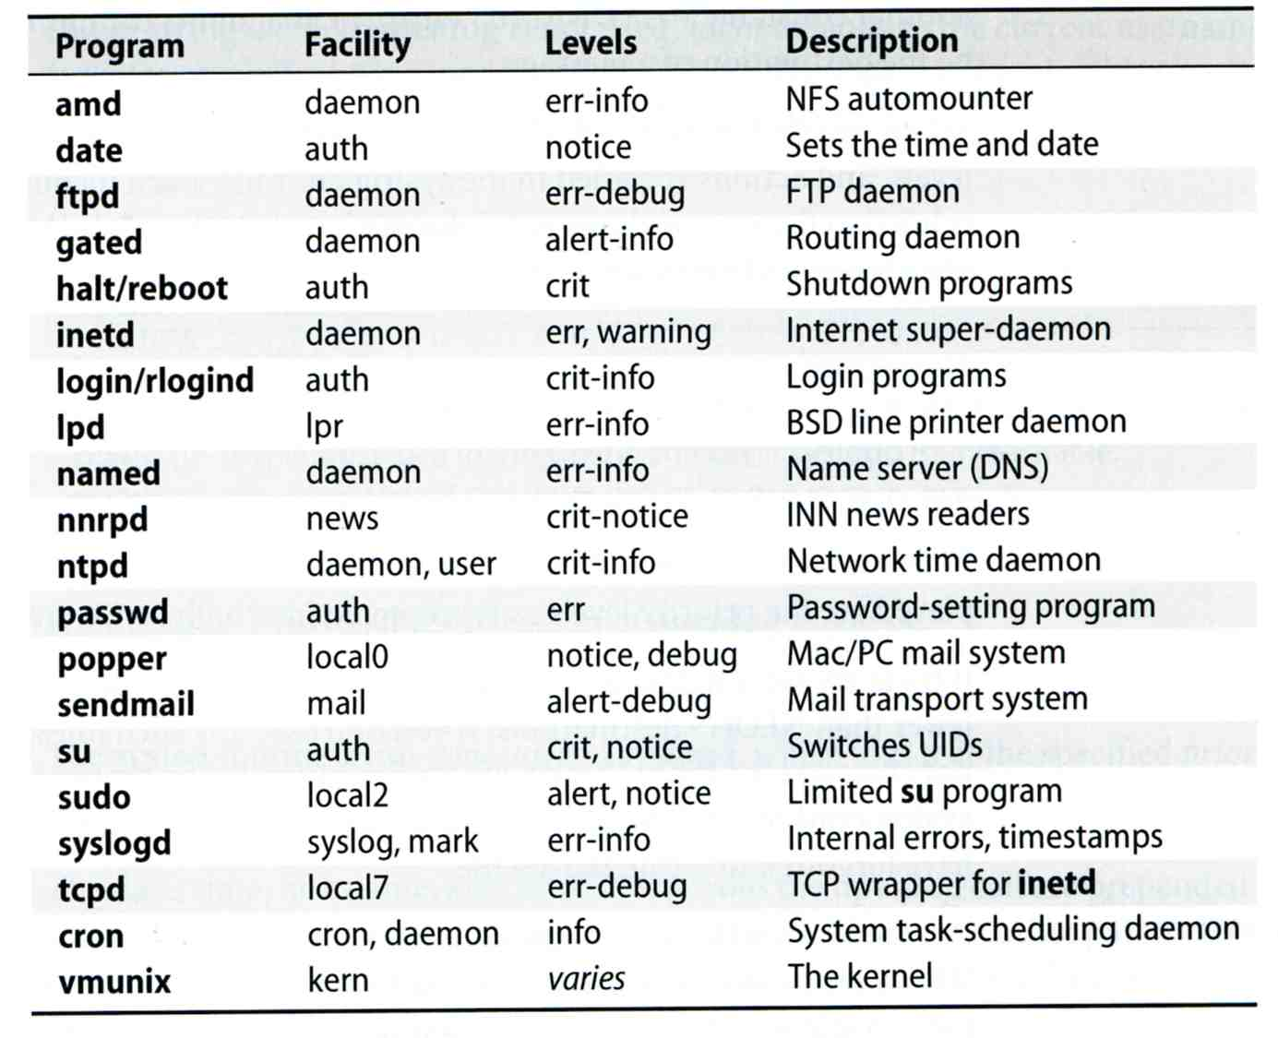
Software that use syslog (1/2)
Program | Facility | Levels | Description
amd | daemon | err-info | NFS automounter
date | auth | notice | Sets the time and date
ftpd | daemon | err-debug | FTP daemon
gated | dameno | alert-info | Routing daemon
halt/reboot | auth | crit | Shutdown programs
inted | daemon | err, warning | Internet super-daemon
login/rlogind | auth | crit-info | Login programs
lpd | lpr | err-info | BSD line printer daemon
named | daemon | err-info | Name server (DNS)
nnrpd | news | crit-notice | INN news readers
ntpd | daemon, user | crit-info | Network time daemon
passwd | auth | err | Password-setting program
popper | local0 | notice, debug | Mac/PC mail system
sendmail | mail | alert-debug | Mail transport system
su | suth | crit, notice | Switches UIDs
sudo | local2 | alert, notice | Limited su program
syslogd | syslog, mark | err-info | Internal errors, timestamps
tcpd | local7 | err-debug | TCP wrapper for inetd
cron | cron, daemon | info | System task-scheduling damemon
vmunix | kern | varies | The kernel

Slide 17
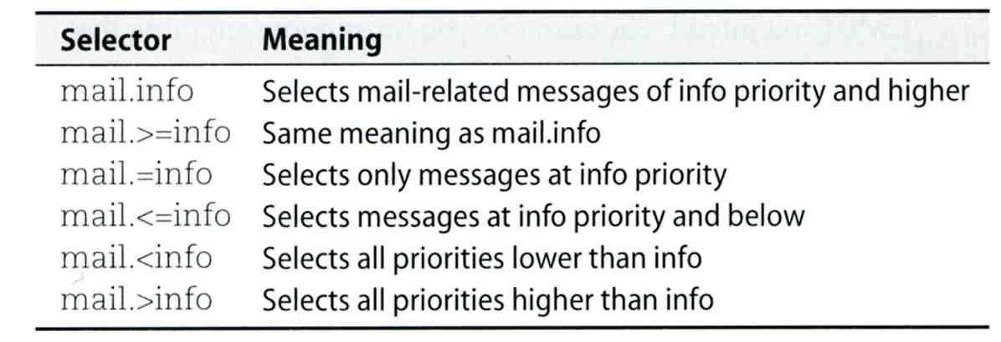
FreeBSD Enhancement (1/2)
Facility name
FreeBSD allows you to select messages based on the name of the program
Severity level
!sudo
*.* /var/log/sudo.log
!sudo
*.* /var/log/sudo.log
Selector | Meaning
mail.info | Selects mail-related messages of info priority and higher
mail.>=info | Same meaning as mail.info
mail.=info | Selects only messages at info priority
mail.<=info | Selects messages at info priority and below
mail.<info | Selects all priorities lower than info
mail.>info | Selects all priorities lower than info

Slide 18
FreeBSD Enhancement (2/2)
Restriction log messages from remote hosts
syslogd -a *.csie.nctu.edu.tw -a 140.113.209.0/24
Use -ss option to prevent syslogd from opening its network port
rc.conf
syslogd_enable="YES"
syslogd_flags="-a 140.113.209.0/24:* -a 140.113.17.0/24:*"
syslogd_enable="YES"
syslogd_flags="-a 140.113.209.0/24:* -a 140.113.17.0/24:*"

Slide 19
Debugging syslog
logger
It is useful for submitting log from shell
For example
Add the following line into /etc/syslog.conf
Use logger to verify
logger(1)
The default priority is user.info
logger -h host
local5.warning /tmp/evi.log
# logger –p local5.warning "test message"
# cat /tmp/evi.log
Nov 22 22:22:50 zfs chiahung: test message

Slide 20
Using syslog in programs
#include <syslog.h>
int main() {
openlog("mydaemon", LOG_PID, LOG_DAEMON);
syslog(LOG_NOTICE, "test message");
closelog();
return 0;
}
zfs[~] -chiahung- tail -1 /var/log/messages
Nov 22 22:40:28 zfs mydaemon[4676]: test message

Slide 21
Log rotate
Logs are rotated – because newsyslog facility
In crontab
newsyslog.conf (newsyslog.conf(5), newsyslog(8))
ISO 8601 restricted time format: [[[[[cc]yy]mm]dd][T[hh[mm[ss]]]]]
Day, week, and month time format: [Dhh], [Ww[Dhh]], and [Mdd[Dhh]]
chbsd [/etc] -chwong- grep newsyslog /etc/crontab
0 * * * * root newsyslog
chbsd [/etc] -chwong- cat /etc/newsyslog.conf
# logfilename [owner:group] mode count size when flags [/pid_file] [sig_num]
/var/log/all.log 600 7 * @T00 J
/var/log/amd.log 644 7 100 * J
/var/log/auth.log 600 7 100 * JC
/var/log/console.log 600 5 100 * J
/var/log/cron 600 3 100 * JC
/var/log/daily.log 640 7 * @T00 JN
/var/log/debug.log 600 7 100 * JC
/var/log/maillog 640 7 * @T00 JC
/var/log/messages 644 5 100 * JC
/var/log/monthly.log 640 12 * $M1D0 JN
/var/log/security 600 10 100 * JC
/var/log/sendmail.st 640 10 * 168 B

Slide 22
Vendor Specifics
FreeBSD
newsyslog utility
/etc/newsyslog.conf
/usr/ports/sysutils/logrotate
Red Hat
logrotate utility
/etc/logrotate.conf, /etc/logrotate.d directory
linux1[/etc/logrotate.d] -chiahung- cat mail
/var/log/mail/maillog /var/log/mail/mail.info /var/log/mail.warn /var/log/mail.err {
missingok
monthly
size=100M
rotate 4
create 0640 root security
nocompress
}

