Slide 1
Web
jnlin (2019-2021, CC BY)
? (?-2018)

Slide 2
Outline
Web hosting
Basics
Client-Server architecture
HTTP protocol
Static vs. dynamic pages
Virtual hosts
Proxy
Forward proxy
Reverse proxy

Slide 3
Web Hosting – Basics (1)
Three major techniques in WWW (World Wide Web) System
HTML
HTTP
URL
HTML (1) – HyperText Markup Language
Providing a means to describe the structure of text-based information in a document.
The original HTML is created by Tim Berners-Lee.
Published in 1993 by the IETF as a formal "application" of SGML (with an SGML Document Type Definition defining the grammar).
The HTML specifications have been maintained by the World Wide Web Consortium (W3C).
http://www.w3.org/

Slide 4
Web Hosting – Basics (2)
HTML (2)
Mark-up the text and define presentation effect by HTML Tags.
<!DOCTYPE HTML PUBLIC "-//W3C//DTD HTML 4.01//EN">
<html>
<head>
<title>Hello World!</title>
</head>
<body>
<p>Hello World!</p>
</body>
</html>

Slide 5
Web Hosting – Basics (3)
HTML5
Published in October 2014 by the World Wide Web Consortium (W3C)
Many new syntactic features are included.
article, aside, footer, header, nav, section, …
include and handle multimedia and graphical content
video, canvas, audio
<!DOCTYPE html>
header
nav
section | aside
footer
article
article

Slide 6
Web Hosting – Basics (4)
HTTP – Hyper-Text Transfer Protocol
A TCP-based protocol
Stateless
Communication method between client and server. All browsers and web servers have to follow this standard.
Originally designed to transmit HTML pages.
Now it is used to format, transmit, and link documents of variety media types
Text, picture, sound, animation, video, …
Mobile App APIs
https://developer.pixnet.pro/#!/doc/pixnetApi/oauthApi
https://developers.facebook.com/docs/graph-api?locale=zh_TW
HTTPS – secured version.

Slide 7
Web Hosting – Basics (5)
URL – Uniform Resource Locator
Describe how to access an object shared on the Internet (RFC 1738)
Format
Protocol :// [ [ username [ :password ] @ ] hostname [ :port ] ] [ /directory ] [ /filename ]
e.g.,
http://www.cs.nctu.edu.tw/
ftp://ca.nctu.edu.tw/
telnet://ptt.cc/
WHERE
The file is on the machine localhost in the directory /page
http://localhost/page/index.html
HOW
Hyper-Text Transfer Protocol
WHAT
The file I want is index.html

Slide 8
Web Hosting – Basics (6)
URL Protocols
Proto | What it does | Example
http | Accesses a remote file via HTTP | http://www.cs.nctu.edu.tw
https | Accesses a remote file via HTTP/SSL | https://www.cs.nctu.edu.tw
ftp | Accesses a remote file via FTP | ftp://ftp.cs.nctu.edu.tw/
file | Access a local file | file:///home/lwhsu/.tcshrc
mailto | Sends mail | mailto:liuyh@cs.nctu.edu.tw
news | Accesses Usenet newsgroups | news:tw.bbs.comp.386bsd

Slide 9
Web Hosting – Client-Server Architecture (1)
Client-server architecture
Web Server: Answer HTTP request
Web Client: Request certain page using URL
1. Send the request to server which URL point to
3. Respond the HTML resource pointed by URL
Client
Browser
Web Server
2. HTTP Request
4. HTTP Response
5. Show the data which HTML resource describes.

Slide 10
Web Hosting – Client-Server Architecture (2)
Using "telnet" to retrieve data from web server
liuyh@bsd5 ~/public_html $ telnet www.cs.nctu.edu.tw 80
Trying 140.113.235.47...
Connected to www.cs.nctu.edu.tw.
Escape character is '^]'.
GET /~liuyh/sa.html HTTP/1.0
HTTP/1.1 200 OK
Server: nginx/0.7.62
Date: Sat, 12 Dec 2009 02:14:45 GMT
Content-Type: text/html
Connection: close
Last-Modified: Sat, 12 Dec 2009 02:14:09 GMT
Accept-Ranges: bytes
Content-Length: 201
Vary: Accept-Encoding
<!DOCTYPE HTML PUBLIC "-//W3C//DTD HTML 4.01//EN">
<html>
<head>
<title>Hello World!</title>
</head>
<body>
<p>Hello Wrold!</p>
</body>
</html>

Slide 11
Web Hosting – The HTTP Protocol (1)
HTTP: Hypertext Transfer Protocol
RFCs: (HTTP 1.1)
http://www.faqs.org/rfcs/rfc2068.html
http://www.faqs.org/rfcs/rfc2616.html (Updated Version)
Useful Reference: http://jmarshall.com/easy/http/
A network protocol used to deliver virtually all files and other data on the World Wide Web.
HTML files, image files, query results, or anything else.
Client-Server Architecture
A browser is an HTTP client because it sends requests to an HTTP server (Web server), which then sends responses back to the client.

Slide 12
Web Hosting – The HTTP Protocol (2)
Clients:
※ Send Requests to Servers
Action "path or URL" Protocol
Actions: GET, POST, HEAD
e.g. : GET /index.php HTTP/1.1
Headers
Header_Name: value
e.g. : Host: www.cs.nctu.edu.tw
(blank line)
Data …
Servers:
※ Respond to the clients
Status:
200: OK
403: Forbidden
404: Not Found
426: Upgrade Required
…
e.g. : HTTP/1.1 200 OK
Headers
Same as clients
e.g. : Content-Type: text/html
(blank line)
Data…

Slide 13
Web Hosting – The HTTP Protocol (3)
liuyh@bsd5 ~/public_html $ telnet www.cs.nctu.edu.tw 80
Trying 140.113.235.47...
Connected to www.cs.nctu.edu.tw.
Escape character is '^]'.
GET /~liuyh/sa.html HTTP/1.0
HTTP/1.1 200 OK
Server: nginx/0.7.62
Date: Sat, 12 Dec 2009 02:14:45 GMT
Content-Type: text/html
Connection: close
Last-Modified: Sat, 12 Dec 2009 02:14:09 GMT
Accept-Ranges: bytes
Content-Length: 201
Vary: Accept-Encoding
<!DOCTYPE HTML PUBLIC "-//W3C//DTD HTML 4.01//EN">
<html>
<head>
<title>Hello World!</title>
</head>
<body>
<p>Hello Wrold!</p>
</body>
</html>
Action
Headers
status
Headers
Data

Slide 14
Web Hosting – The HTTP Protocol (4)
GET vs. POST (client side)
GET:
Parameters in URL: GET /get.php?a=1&b=3 HTTP/1.1
No data content
Corresponding in HTML files
Link URL: http://nasa.cs.nctu.edu.tw/get.php?a=1&b=3
Using Form: <form method="GET" action="get.php"> … </form>
POST:
Parameters in Data Content
POST /post.php HTTP/1.1
Corresponding in HTML files
Using Form: <form method="POST" action="post.php"> … </form>

Slide 15
Web Hosting – The HTTP Protocol (5)
Get vs. Post Security Issue
GET:
GET requests can be cached
GET requests remain in the browser history
GET requests can be bookmarked
GET requests should never be used when dealing with sensitive data
GET requests have length restrictions
GET requests should be used only to retrieve data
POST:
POST requests are never cached
POST requests do not remain in the browser history
POST requests cannot be bookmarked
POST requests have no restrictions on data length
https://developer.mozilla.org/zh-TW/docs/Web/HTTP/Methods

Slide 16
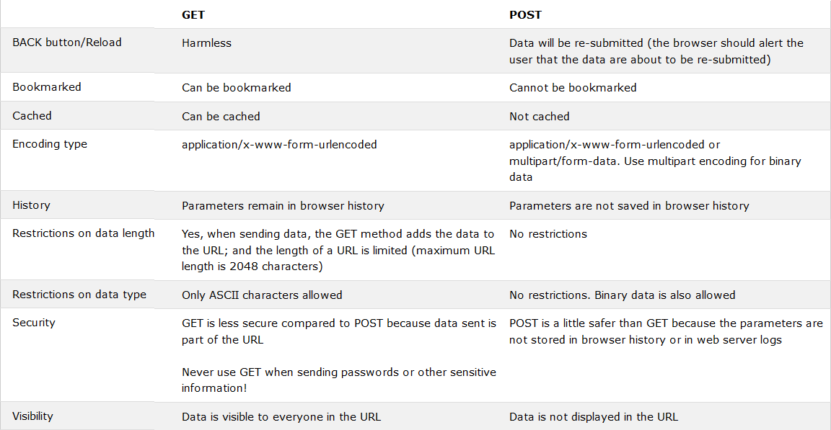
Web Hosting – The HTTP Protocol (6)
https://developer.mozilla.org/zh-TW/docs/Web/HTTP/Methods

Slide 17
Web Hosting – The HTTP Protocol (7)
HTTP Headers:
What HTTP Headers can do?
Content information (type, date, size, encoding, …)
Cache control
Authentication
URL Redirection
Transmitting cookies
Knowing where client come from
Knowing what software client use
…
http://www.cs.tut.fi/~jkorpela/http.html

Slide 18
Web Hosting – The HTTP Protocol (7)
HTTP/2:
RFC 7540
https://tools.ietf.org/html/rfc7540
Solve some problems of HTTP/1.1
Server Push
Multiplexing
Previously: domain sharding
Reuse TCP Connection
Smaller header
HPACK Compression

Slide 19
Web Hosting – Static vs. Dynamic Pages (1)
Static vs. Dynamic Pages
Technologies of Dynamic Web Pages
Client Script Language
JavaScript, Jscript, VBScript
Client Interactive Technology
AJAX, SPA (Single Page Application)
Server Side
CGI
Languages: Perl, ASP, JSP, PHP, NodeJS, Golang, C/C++, …etc.
Static
Dynamic
Request
Request
Fetch
Client
Server
Fetch
Client
Server
Answer
Answer
Generate

Slide 20
Web Hosting – Static vs. Dynamic Pages (2)
CGI (Common Gateway Interface)
A specification that allows an HTTP server to exchange information with other programs
DB
(MOSAIC)
(CERN, HTTPD)
GATEWAY
Text
Image
Sound
Video
WWW
Browser
WWW
Server
stdin
Application
stdout
File
Temp

Slide 21
Web Hosting – Virtual Hosting (1)
Providing services for more than one domain-name (or IP) in one web server.
IP-Based Virtual Hosting vs. Name-Based Virtual Hosting
IP-Base – Several IPs (or ports)
Name-Base – Singe IP, several hostnames
Example (Apache configuration)
NameVirtualHost 140.113.17.225
<VirtualHost 140.113.17.225>
ServerName nabsd.cs.nctu.edu.tw
DocumentRoot "/www/na"
</VirtualHost>
<VirtualHost 140.113.17.225>
ServerName sabsd.cs.nctu.edu.tw
DocumentRoot "/www/sa"
</VirtualHost>
<VirtualHost 140.113.17.215:80>
DocumentRoot /www/sabsd
ServerName sabsd.cs.nctu.edu.tw
</VirtualHost>
<VirtualHost 140.113.17.221:80>
DocumentRoot /www/tphp
ServerName tphp.cs.nctu.edu.tw
</VirtualHost>

Slide 22
Web Hosting – Virtual Hosting (2)
Q: How Name-Based Virtual Hosting works?
A: It takes use of HTTP Headers.
$ telnet www.cs.nctu.edu.tw 80
Trying 140.113.235.47...
Connected to www.cs.nctu.edu.tw.
Escape character is '^]'.
GET / HTTP/1.0
Host: www.ccs.nctu.edu.tw
HTTP/1.1 200 OK
Server: nginx/0.7.62
Date: Sat, 12 Dec 2009 02:51:43 GMT
Content-Type: text/html
Connection: close
Vary: Accept-Encoding
<!DOCTYPE html PUBLIC "-//W3C//DTD HTML 4.01//EN" "http://www.w3.org/TR/html4/strict.dtd">
<html lang="zh-Hant">
<head>
<meta http-equiv="content-type" content="text/html; charset=utf-8">
<title>國立交通大學資訊學院</title>
...
$ telnet www.cs.nctu.edu.tw 80
Trying 140.113.235.47...
Connected to www.cs.nctu.edu.tw.
Escape character is '^]'.
GET / HTTP/1.0
Host: www.cs.nctu.edu.tw
HTTP/1.1 301 Moved Permanently
Server: nginx/0.7.62
Date: Sat, 12 Dec 2009 02:50:22 GMT
Content-Type: text/html
Connection: close
Cache-Control: no-cache, must-revalidate
Location: cht/announcements/index.php
Vary: Accept-Encoding
Connection closed by foreign host.

Slide 23
Web Hosting - Server Name Indication (SNI)
An extension to the TLS protocol by which a client indicates which hostname it is attempting to connect to at the start of the handshaking process.
Use single IP Address for multiple SSL sites
No encryption of hostname
Possible information leak
- Supported Ciphers
- Random Number
- Session ID
- SNI
ClientHello
- Selected Ciphers
- Random Number
- Session ID
- SNI (empty)
ServerHello
ServerCertification
Continue Handshake steps
ServerHelloDone
Application Data
Application Data

Slide 24



Proxy
Proxy
A proxy server is a server which services the requests of its clients by:
Making requests to other servers
Caching some results for further same requests
Goals:
Performance
Stability
Central Control
…etc.
Roles:
Forward Proxy
Reverse Proxy
Targets
Web pages/FTP files
TCP/IP Connections
…etc.
Proxy Server
Requests
Requests
Client
Reply
client
Reply
Original
Server
Requests
Reply
Client
client

Slide 25
Proxy – The Forward Proxy
Forward Proxy
Proxy the outgoing requests, for the reason of
Bandwidth saving
Performance
Central control
When objects requested are
In cache, return the cached objects
Otherwise, proxy server requests object from origin server, then cache it and return to client
Proxy Server
Requests
Requests
Client
Reply
client
Reply
Requests
Original
Server
Reply
Client
client

Slide 26
Proxy – The Reverse Proxy
Reverse Proxy
Proxy the incoming requests, for the reason of
Reducing Server Load (by caching)
Load Balance
Fault Tolerant
Reverse proxy acts as the original server, accept incoming requests, reply corresponding result. SEAMLESS for clients!
Proxy Server
Requests
Client
Internet
client
Reply
Server 1
Requests
Client
Reply
client
Server 2

Slide 27
Proxy – The Reverse Proxy - Cont.
Modem Hardware Server Load Balance
Application layer load balancing (L7)
Application layer service health check
Global server load balancing
SSL off load
Data acceleration
Cache
Compression (gzip)
Programmable server load balancing
F5 iRule
A10 aFlex

