Slide 1
FAMP / LAMP
FreeBSD/Linux/Apache/MySQL/PHP jnlin (2019-2021, CC BY)
? (?-2018)

Slide 2
Introduction
Web service
Apache
GWS, Nginx, IIS
SQL service
MySQL, MariaDB
MS SQL, Oracle DB, PostgreSQL
NoSQL service
MongoDB
Web backend language
Golang, Python, Node.js, PHP

Slide 3
Outline
Introduction
Apache
MySQL
PHP
Installation and Administration
MySQL
Apache
PHP
Appendix
phpMyAdmin
lighttpd
FastCGI

Slide 4
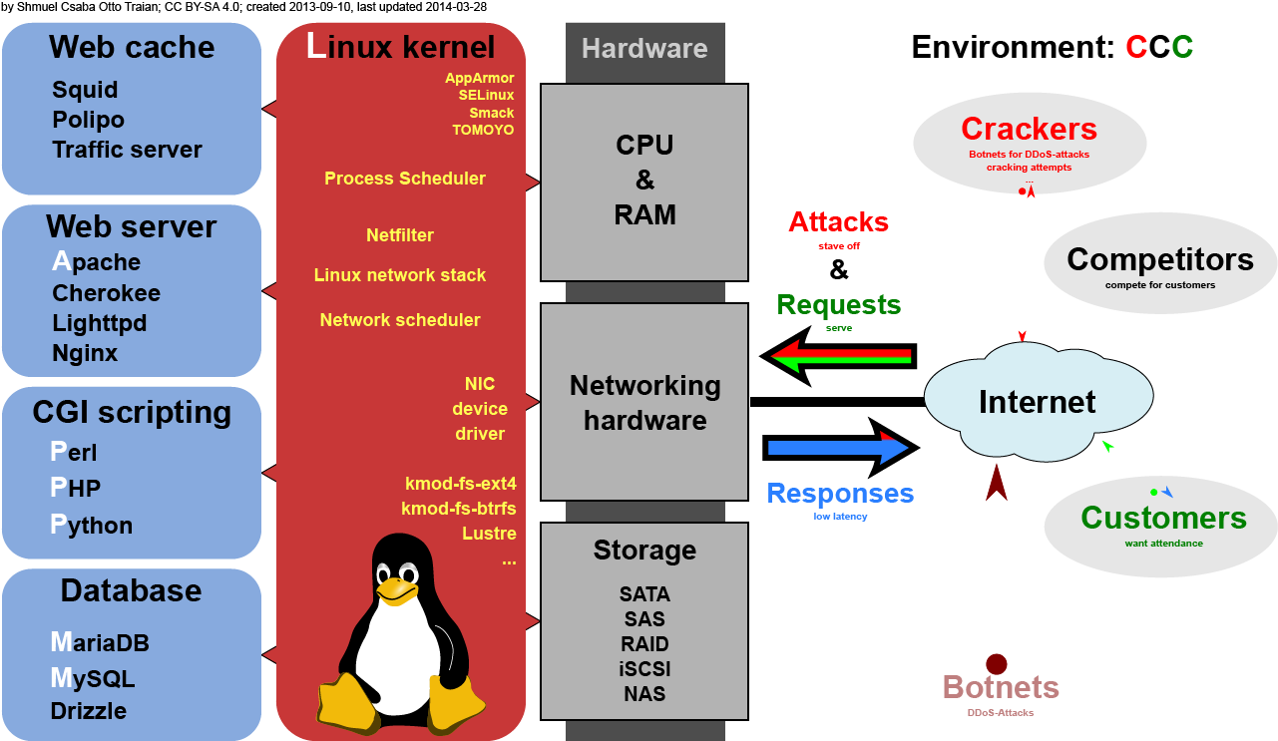
Overview
https://commons.wikimedia.org/w/index.php?curid=28224098

Slide 5
Apache
Apache Software Foundation: http://www.apache.org/
Apache HTTP Server Project: http://httpd.apache.org/
Web httpd server that supports
HTTP/2
Modular design
Can be customized by writing modules using Apache module API
Freely available across many platforms
Two main parts
Core: implements basic functions and provide the interface for Apache modules
Modules: extends or overrides the function of Core
Example: Access control, logging, CGI, proxy, cache control, PHP…

Slide 6
How Apache Works – request and response
httpd.conf
The Internet
DocumentRoot Directory
index.html
page.html
nasa.pdf
Port 80
Server
Client

Slide 7
How Apache Works – each request-response
Apache breaks client request into several steps which are implemented as modules
Core
Translation
Access Control
MIME Type
Response
Logging
Abstract control / data flow
Actual control / data flow

Slide 8
Apache Core
mod_userdir
mod_rewrite
URL => filename module
HTTP Request
mod_auth*
mod_alias
mod_env
det. MIME Type module
mod_mime
mod_mime_magic
return object module
mod_asis
HTTP Response
mod_log_agent
mod_log_config
mod_referer
log modules
Calls/Uses
Returns control / data
Component / Module
Initialize call
HTTP Req / Resp
Execution Flow(for a Request)

Slide 9
Apache with mod_ssl
1
OpenSSL
mod_ssl
mod_foo
mod_bar
mod_quux
Apache API
RSAref
Apache Core
EAPI
2

Slide 10
MySQL (1)
SQL (Structured Query Language)
The most popular computer language used to create, modify, retrieve and manipulate data from relational database management systems.
Introduction to SQL: http://www.1keydata.com/tw/sql/sql.html
A multithreaded, multi-user, SQL Database Management System.
Owned and sponsored by a Swedish company MySQL AB, acquired by Sun Microsystems 2008. Oracle acquired Sun in 2009.
Forked version: MariaDB, Percona Server
Official Site: http://www.mysql.com
Documentation: http://dev.mysql.com/doc

Slide 11
MySQL (2)
Features:
Writing in C/C++, tested by many compilers, portable to many platforms.
AIX, FreeBSD, HP-UX, Linux, Mac OS, Solaris, Windows, …etc.
Providing APIs for C/C++, Java, Perl, PHP, Python, Ruby, Tcl, …etc.
Multi-threaded kernel, supporting systems with multiple CPUs.
Optimized algorithm for SQL Query.
Multi-Language (coding) Supports.
Lots of connecting method: TCP/IP, ODBC, JDBC, Unix domain socket.
Free Software (GNU General Public License version 2)
Popular for web applications

Slide 12
PHP
PHP: Hypertext Preprocessor
A widely-used Open Source general-purpose scripting language.
Originally designed to create dynamic web pages, PHP's principal focus is server-side scripting.
PHP scripts can be embedded into HTML.
The LAMP architecture has become popular in the Web industry as a way of deploying inexpensive, reliable, scalable, secure web applications.
Official Site: http://php.net/

Slide 13
Installation and Administration
MySQL, Apache, PHP, phpMyAdmin

Slide 14
Installing MySQL (1)
Steps
$ cd /usr/ports/databases/mysql57-server/
$ make OPTIONS install clean
You may use the following build options:
WITH_CHARSET=charset Define the primary built-in charset (latin1).
WITH_XCHARSET=list Define other built-in charsets (may be 'all').
WITH_COLLATION=collate Define default collation (latin1_swedish_ci).
WITH_OPENSSL=yes Enable secure connections
(define WITHOUT_YASSL for backward compatibility).
WITH_LINUXTHREADS=yes Use the linuxthreads pthread library.
WITH_PROC_SCOPE_PTH=yes Use process scope threads
(try it if you use libpthread).
WITH_FAST_MUTEXES=yes Replace mutexes with spinlocks.
BUILD_OPTIMIZED=yes Enable compiler optimizations
(use it if you need speed).
BUILD_STATIC=yes Build a static version of mysqld.
(use it if you need even more speed).
WITH_NDB=yes Enable support for NDB Cluster.

Slide 15
Installing MySQL (2)
OPTIONS:
WITH_CHARSET=utf8
WITH_XCHARSET=ascii,big5,… (all)
Installed…
===> SECURITY REPORT:
This port has installed the following files which may act as network
servers and may therefore pose a remote security risk to the system.
/usr/local/libexec/mysqld
This port has installed the following startup scripts which may cause
these network services to be started at boot time.
/usr/local/etc/rc.d/mysql-server

Slide 16
Installing MySQL (3)
Startup script…
#
# Add the following line to /etc/rc.conf to enable mysql:
# mysql_enable (bool): Set to "NO" by default.
# Set it to "YES" to enable MySQL.
# mysql_limits (bool): Set to "NO" by default.
# Set it to yes to run `limits -e -U mysql`
# just before mysql starts.
# mysql_dbdir (str): Default to "/var/db/mysql"
# Base database directory.
# mysql_args (str): Custom additional arguments to be passed
# to mysqld_safe (default empty).
#

Slide 17
Managing MySQL (1)
Configuration file
Copy config file
$ cd /usr/local/share/mysql
$ cp my-huge.cnf /usr/local/etc/my.cnf
Edit /usr/local/etc/my.cnf
Start mysql daemon
Using startup script
$ /usr/local/etc/rc.d/mysql-server start

Slide 18
Managing MySQL (2)
Test
$ mysql –u root –p
The initial password for root is empty
nasa [/usr/local/etc] -randy- mysql -u root -p
Enter password:
Welcome to the MySQL monitor. Commands end with ; or \g.
Your MySQL connection id is 1
Server version: 5.1.41-log FreeBSD port: mysql-server-5.1.41
Type 'help;' or '\h' for help. Type '\c' to clear the current input statement.
mysql> show databases;
+-------------------------+
| Database |
+-------------------------+
| information_schema |
| mysql |
| test |
+-------------------------+
3 rows in set (0.06 sec)

Slide 19
Managing MySQL (3)
Securing initial accounts
Two initial accounts
root
anonymous
mysql> SELECT Host, User From mysql.user;
+-----------------------------+------+
| Host | User |
+-----------------------------+------+
| 127.0.0.1 | root |
| nasa.cs.nctu.edu.tw | |
| nasa.cs.nctu.edu.tw | root |
| localhost | |
| localhost | root |
+-----------------------------+------+
mysql> UPDATE mysql.user SET Password = PASSWORD('test123') WHERE User = 'root';
Query OK, 3 rows affected (0.08 sec)
Rows matched: 3 Changed: 3 Warnings: 0
mysql> FLUSH PRIVILEGES; # Reload the grant tables
Query OK, 0 rows affected (0.00 sec)
mysql> SET PASSWORD FOR 'root'@'localhost' = PASSWORD('ttt123');
Query OK, 0 rows affected (0.02 sec)

Slide 20
Installing Apache (1)
Steps
$ cd /usr/ports/www/apache24/
$ make install clean
Options
A lot of options for modules
WITH_SSL (default)
WITH_MPM=worker
WITH_THREADS=yes
WITH_SUEXEC=yes

Slide 21
Installing Apache (2)
Installed…
Startup script
/usr/local/etc/rc.d/apache24
apache24_http_accept_enable
To run apache www server from startup, add apache22_enable="YES"
in your /etc/rc.conf. Extra options can be found in startup script.
Your hostname must be resolvable using at least 1 mechanism in
/etc/nsswitch typically DNS or /etc/hosts or apache might
have issues starting depending on the modules you are using.
===> SECURITY REPORT:
This port has installed the following binaries which execute with
increased privileges.
/usr/local/sbin/suexec

Slide 22
Apache configuration – Configuration files
Location
The default location of apache (in ports) is /usr/local/etc/apache24
Major configuration file: httpd.conf
Other configuration files could be included. (setting in httpd.conf)
extra/httpd-*.conf, Includes/*.conf
Two types
Global settings
Server configurations
Options of modules
Directory Configuration
Local setting for certain directory

Slide 23
Apache configuration – Global Settings (httpd.conf)
Server configuration
Listen 80
ServerAdmin liuyh@cs.nctu.edu.tw
ServerName nasa.cs.nctu.edu.tw
DocumentRoot "/home/wwwadm/data“
Remember create DocumentRoot directory if you modify it
Options of modules
Include supplemental configuration files
Include etc/apache22/extra/httpd-*.conf
Include etc/apache22/Includes/*.conf

Slide 24
Apache configuration – Directory Configuration (1)
Configuration parameters
Options
All
ExecCGI
FollowSymLinks
Indexs
MultiViews
SymLinksIfOwnerMatch
http://httpd.apache.org/docs/2.4/mod/core.html#options
<Directory "/home/wwwadm/data">
Options Indexes FollowSymLinks MultiViews
AllowOverride None
Order allow,deny
Allow from all
</Directory>

Slide 25
Apache configuration – Directory Configuration (2)
Configuration parameters
AllowOverride
All (Read .htaccess)
None (ignoring .htaccess)
Order
Solve collision of deny and allow rules
Deny/Allow
IP/DN (control access to this directory)
<Directory "/home/wwwadm/data">
Options Indexes FollowSymLinks MultiViews
AllowOverride None
Order allow,deny
Allow from all
</Directory>

Slide 26
Apache configuration – Options of Modules
dir_module
alias_module (http://httpd.apache.org/docs/2.2/mod/mod_alias.html)
mime_module
<IfModule dir_module>
DirectoryIndex index.html
</IfModule>
<IfModule alias_module>
Redirect /foo http://www.example.com/bar
Alias /webpath /full/filesystem/path
ScriptAlias /cgi-bin/ "/usr/local/www/apache22/cgi-bin/"
</IfModule>
DefaultType text/plain
<IfModule mime_module>
TypesConfig etc/apache22/mime.types
AddType application/x-compress .Z
AddHandler cgi-script .cgi
</IfModule>

Slide 27
Supplemental configuration –
httpd-mpm.conf (Multi-Processing Module)
Server-pool management (MPM specific)
Include etc/apache22/extra/httpd-mpm.conf
WITH_MPM
prefork: non-threaded, pre-forking
worker: hybrid multi-process multi-threaded
<IfModule mpm_worker_module>
StartServers 2
MaxClients 150
MinSpareThreads 25
MaxSpareThreads 75
ThreadsPerChild 25
MaxRequestsPerChild 0
</IfModule>

Slide 28
Supplemental configuration – httpd-userdir.conf
User home directories
Include etc/apache22/extra/httpd-userdir.conf
Methods: http://www.w3.org/Protocols/rfc2616/rfc2616-sec9.html
UserDir public_html
UserDir disabled root toor daemon operator bin tty kmem games news man sshd bind proxy _pflogd _dhcp uucp pop www nobody mailnull smmsp
<Directory "/home/*/public_html">
AllowOverride FileInfo AuthConfig Limit Indexes
Options MultiViews Indexes SymLinksIfOwnerMatch IncludesNoExec
<Limit GET POST OPTIONS>
Order allow,deny
Allow from all
</Limit>
<LimitExcept GET POST OPTIONS>
Order deny,allow
Deny from all
</LimitExcept>
</Directory>

Slide 29
Supplemental configuration – httpd-vhosts.conf
Virtual hosts
Include etc/apache24/extra/httpd-vhosts.conf
Name-based
NameVirtualHost
<VirtualHost>
IP-based
<VirtualHost>
ServerName
DocumentRoot
http://httpd.apache.org/docs/2.2/vhosts
Listen 80
Listen 8080
NameVirtualHost 172.20.30.40:80
NameVirtualHost 172.20.30.40:8080
<VirtualHost 172.20.30.40:80>
ServerName www.example.com
DocumentRoot /www/domain-80
</VirtualHost>
<VirtualHost 172.20.30.40:8080>
ServerName www.example.com
DocumentRoot /www/domain-8080
</VirtualHost>
<VirtualHost 172.20.30.40:80>
ServerName www.example.org
DocumentRoot /www/otherdomain-80
</VirtualHost>
<VirtualHost 172.20.30.40:8080>
ServerName www.example.org
DocumentRoot /www/otherdomain-8080
</VirtualHost>

Slide 30
Supplemental configuration – More…
Multi-language error messages
httpd-multilang-errordoc.conf
Fancy directory listings
httpd-autoindex.conf
Language settings
httpd-languages.conf
Real-time info on requests and configuration
httpd-info.conf
Local access to the Apache HTTP Server Manual
httpd-manual.conf
Various default settings
httpd-default.conf

Slide 31
Other configuration for Apache – log
Rotate your log using newsyslog
In httpd config
ErrorLog "/var/log/httpd-error.log"
TransferLog "/var/log/httpd-access.log"
In startup script
_pidprefix="/var/run/httpd"
pidfile="${_pidprefix}.pid"
/var/log/httpd-access.log 640 5 * @T00 Z /var/run/httpd.pid
/var/log/httpd-error.log 640 5 * @T00 z /var/run/httpd.pid

Slide 32
.htaccess (1)
.htaccess
Allow admin or users to control access to certain directory
Usage
Modify httpd.conf
Create .htaccess file
Generate password database
Test

Slide 33
.htaccess (2)
<Directory "/home/wwwadm/data/test1">
Options None
AllowOverride All
Order allow,deny
Allow from all
</Directory>
Example
Modify httpd.conf
Create .htaccess file
Generate password file
$ cat .htaccess
AuthName "SA-test1"
AuthType "Basic"
AuthUserFile "/home/wwwadm/data/test1/.htpasswd"
Require valid-user
Options Indexes
$ htpasswd -c ./.htpasswd SA-user1
New password:
Re-type new password:
Adding password for user SA-user1

Slide 34
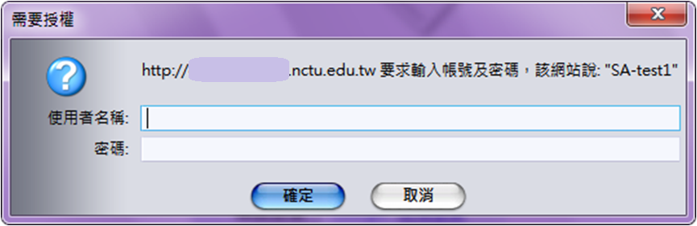
.htaccess (3)
You can use these tools to generate .htaccess
http://www.linuxkungfu.org/tools/htaccesser/index.php
http://www.htaccesseditor.com/

Slide 35
Installing PHP7 (1)
Steps
$ pkg install php74 php74-mysqli mod_php74 php74-zlib \ php74-mbstring php74-gd php74-json php74-curl
$ vim /usr/local/etc/apache24/Includes/php.conf
<IfModule dir_module>
DirectoryIndex index.php index.html
<FilesMatch "\.php$">
SetHandler application/x-httpd-php
</FilesMatch>
<FilesMatch "\.phps$">
SetHandler application/x-httpd-php-source
</FilesMatch>
</IfModule>

Slide 36
Test PHP7 in apache (2)
Start apache
$ /usr/local/etc/rc.d/apache24 start
$ service apache24 restart
Test PHP
$ vim /usr/local/www/apache24/data/index.php
<?
phpinfo();
?>

Slide 37
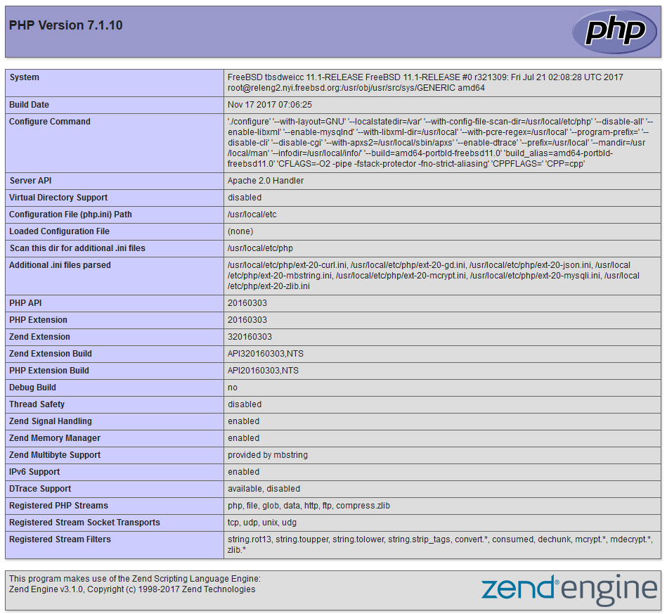
phpinfo()

Slide 38
Architecture
Cluster, Server Load Balancer

Slide 39






Load balance
Nginx proxy
VIRTUAL MACHINE
Docker Containers
upstream backend {
server 172.16.1.1:3000;
server 172.16.1.2:3000;
}
server {
listen 80;
server_name www.example.com;
location / {
proxy_pass http://backend;
}
}
MySQL
node1
tcp /
3306
tcp /
3306
MySQL
node1
tcp /
3306
MySQL Client
MySQL
node1
tcp /
3306
HTTP HTTPS
MYSQL

Slide 40
Load balance
Open Source
haproxy - http://www.haproxy.org/
envoy - https://www.envoyproxy.io/
Commercial
F5
A10
AWS ELB
Google Cloud Load Balance

Slide 41
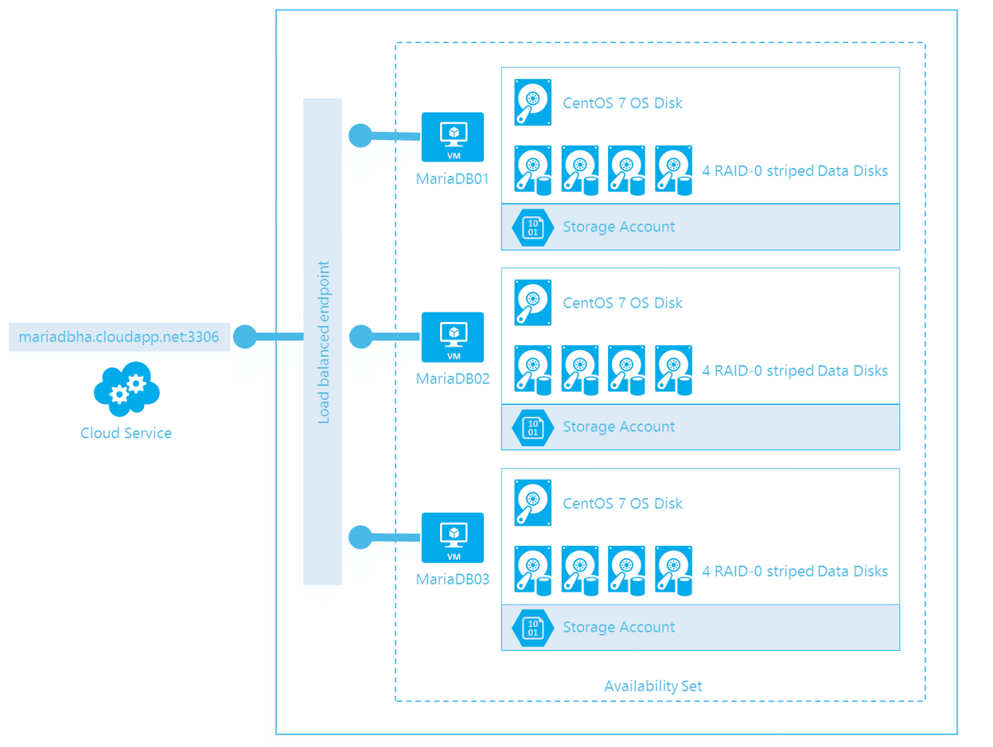
MySQL cluster
https://sabbour.me/running-a-mariadb-cluster-on-azure/

Slide 42
Up to 150 users
One machine running the application server.
Web server
database server
local storage
Authentication via an existing LDAP or Active Directory server.
Web Server
DB Local Storage
LDAP

Slide 43
150 to 1,000 users
High availability level
Every component is fully redundant and can fail without service interruption.
Backups without service interruption
DB Primary
DB Replica
Web Server 1
Redis
Load balancer
Web Server 2
LDAP
NFS

Slide 44
5,000 to >100,000 users
4 to 20 application/Web servers.
A cluster of two or more database servers
behind a load balancer to send all writes to the master and reads to the slaves.
Storage is an NFS server, or an object store that is S3 compatible.
Web Server 1
Local LDAP Replica
LDAP
DB Replica 1
Load balancer 1
Web Server 1
Local LDAP Replica
Redis 2
Redis 1
DB
Loader balancer
DB
Primary
DB Replica 2
Web Server 1
Local LDAP Replica
NFS
DB Replica 3
Load balancer 2
Web Server 1
Local LDAP Replica
DB
Load balancer

Slide 45
Appendix
phpMyAdmin / lighttpd / FastCGI

Slide 46
phpMyAdmin
phpMyAdmin can manage a whole MySQL server as well as a single database over the World Wide Web.
Official Site: http://www.phpmyadmin.net/
Documentation: http://www.phpmyadmin.net/documentation/
Features
Browser-based, Supporting PHP5.3+, MySQL 5.0+, Open Source
There are four authentication modes offered:
http
cookie
signon
config (the less secure one, not recommended).

Slide 47
Installing phpMyAdmin (1)
databases/phpmyadmin
$ make install clean
Installed…
phpMyAdmin-4.7.4 has been installed into:
/usr/local/www/phpMyAdmin
Please edit config.inc.php to suit your needs.
To make phpMyAdmin available through your web site, I suggest
that you add something like the following to httpd.conf:
Alias /phpmyadmin/ "/usr/local/www/phpMyAdmin/"
<Directory "/usr/local/www/phpMyAdmin/">
Options none
AllowOverride Limit
Order Deny,Allow
Deny from all
Allow from 127.0.0.1 .example.com
</Directory>

Slide 48
Installing phpMyAdmin (2)
config.inc.php
Override libraries/config.default.php
config.sample.inc.php
$cfg['blowfish_secret']

Slide 49
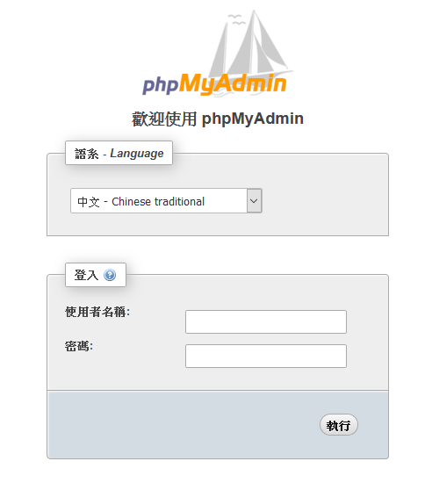
Administering MySQL – Using phpMyAdmin (3)

Slide 50
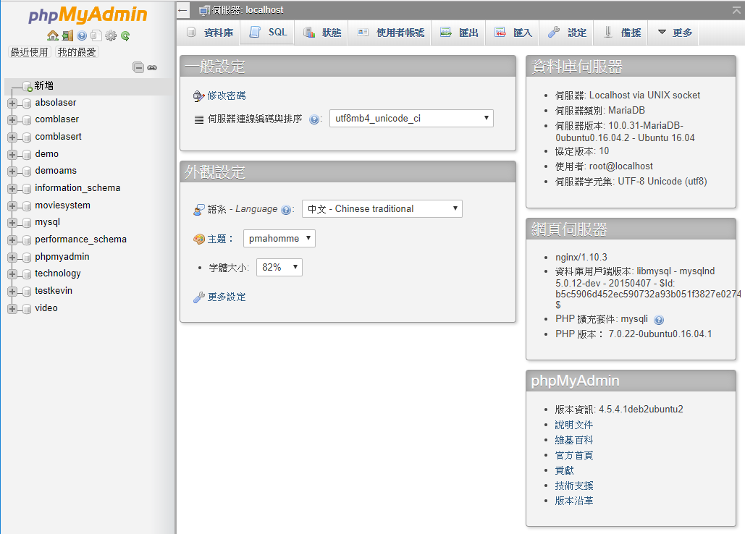
Administering MySQL – Using phpMyAdmin (4)

Slide 51
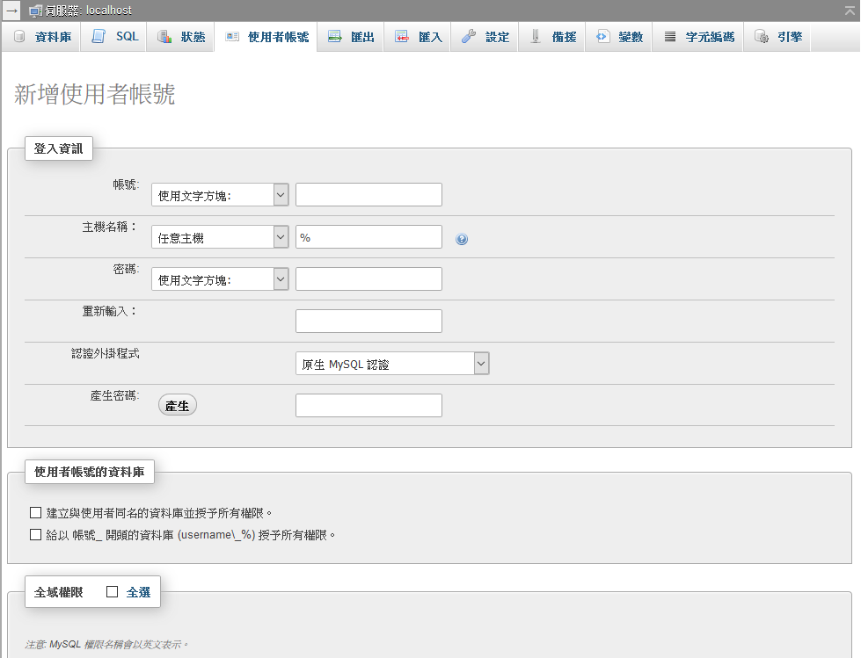
Administering MySQL – Using phpMyAdmin (5)
Create another user with limited privilege

Slide 52
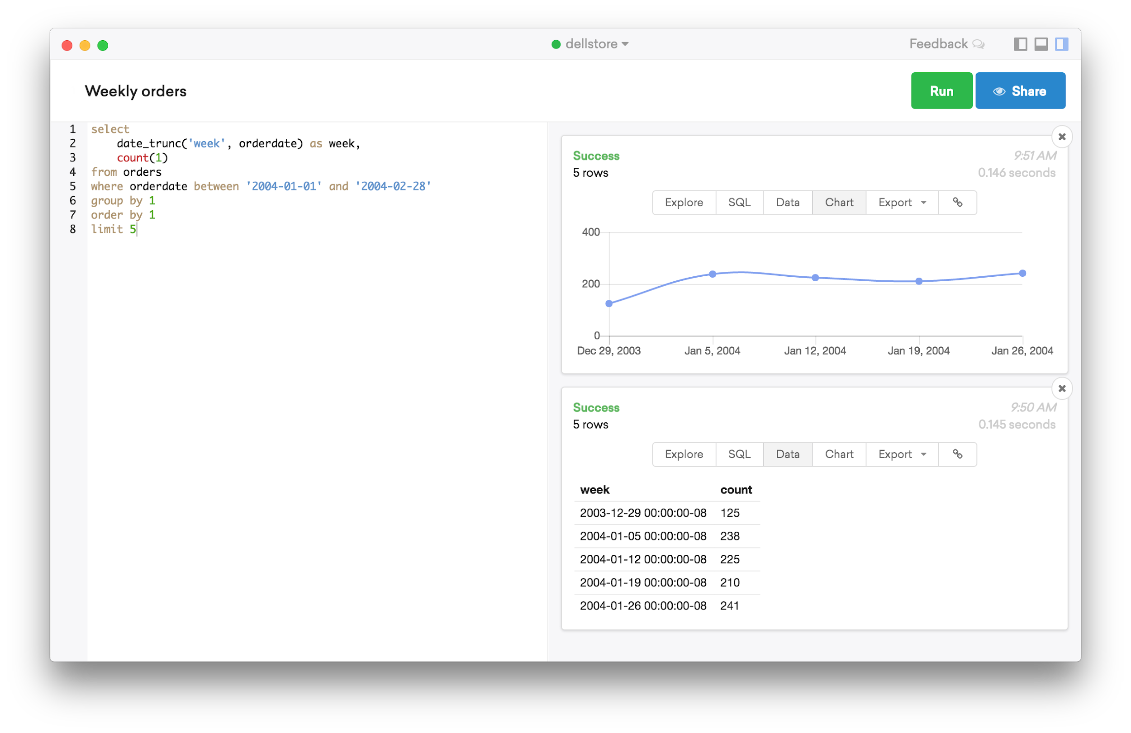
PopSQL & SQLpro (1)
https://popsql.io/

Slide 53
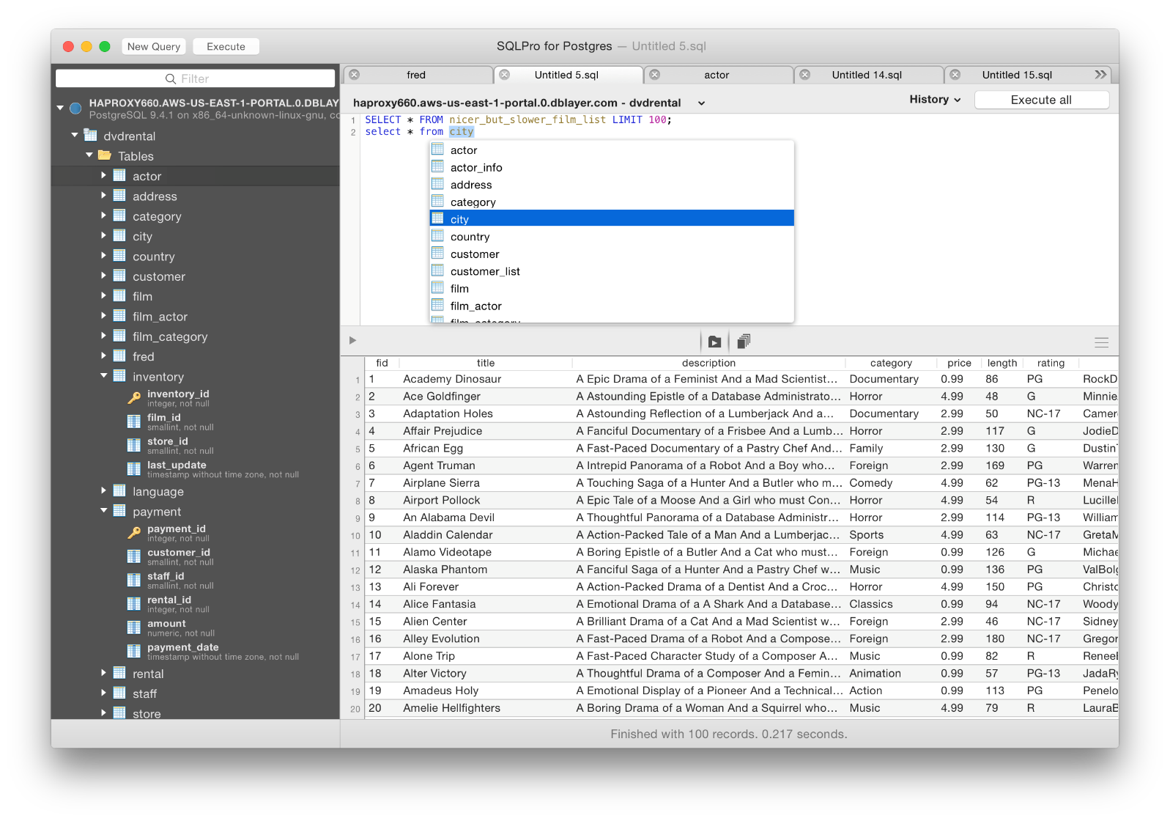
PopSQL & SQLpro (2)
https://www.compose.com/articles/tooltime-sqlpro-for-postgres-and-keylord-for-redis/

Slide 54
Installing lighttpd
www/lighttpd
Official: http://www.lighttpd.net/
Configuration files
/usr/local/etc/lighttpd/{lighttpd,modules}.conf
/usr/local/etc/lighttpd/{vhosts,conf}.d/
Startup script
/usr/local/etc/rc.d/lighttpd
Documentation:
/usr/ports/www/lighttpd/work/lighttpd-1.4.28/doc/*.txt
alias, cgi, dirlisting, fastcgi, ssl, userdir
Virtual hosts: evhost, mysqlvhost, simple-vhost

Slide 55
FastCGI
FastCGI is actually CGI with only a few extensions.
FastCGI is language-independent.
FastCGI run applications in processes isolated from the core Web server, which provides greater security than APIs.
FastCGI developers are committed to propagating FastCGI as an open standard. (C/C++, Java, Perl, Tcl)
FastCGI is not tied to the internal architecture of any Web server and is therefore stable even when server technology changes.
Benefits:
Distributed computing
Multiple and extensible roles
Official site: http://www.fastcgi.com/drupal/

