Slide 1
Drivers and the Kernel
lwhsu (2019-2021, CC BY)
? (?-2018)

Slide 2
Introduction – UNIX Kernel and Shell
YOUR SHELL PROGRAMS
KORN SHELL C SHELL
KERNEL
FETCH COMMAND
HARDWARE
OTHER UNIX COMMANDS BOURNE SHELL
ANALYZE
OTHER APPLICATION PROGRAMS
EXECUTE
Interpret

Slide 3
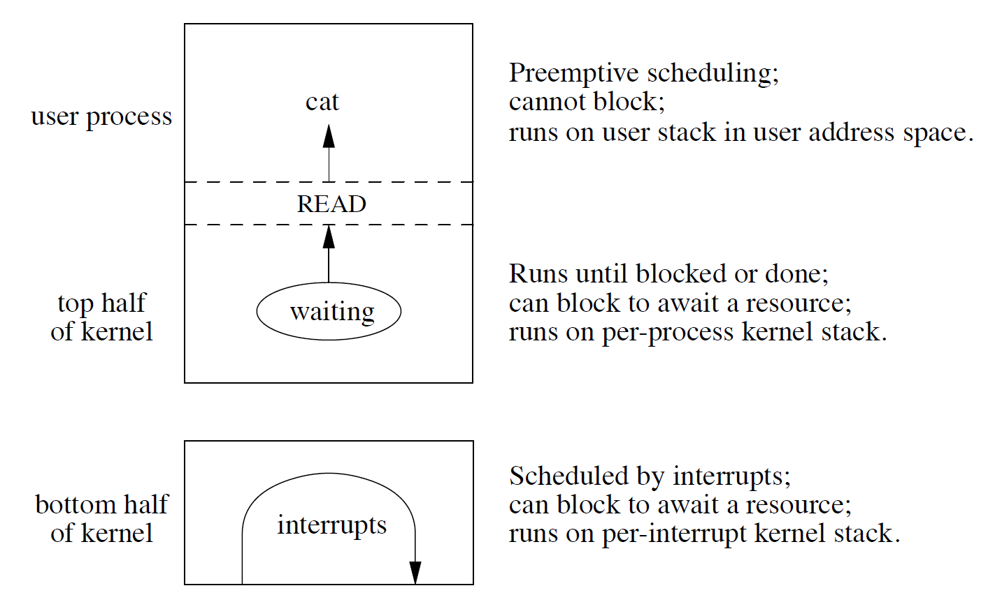
Run-time structure of the kernel
Figure 3.1 - Design and Implementation of the FreeBSD Operating System, The, 2nd Edition

Slide 4
Roles of Kernel
Components of a UNIX System
User-level programs
Kernel
Hardware
Two roles of kernel (OS)
High-level abstractions
Process managements
Time sharing, memory protect
File system management
Memory management
I/O management
Low-level interfaces
drivers
Applications
Libraries
Kernel
High-level abstractions
File systems
Network protocols
Low-level interfaces
Hardware

Slide 5
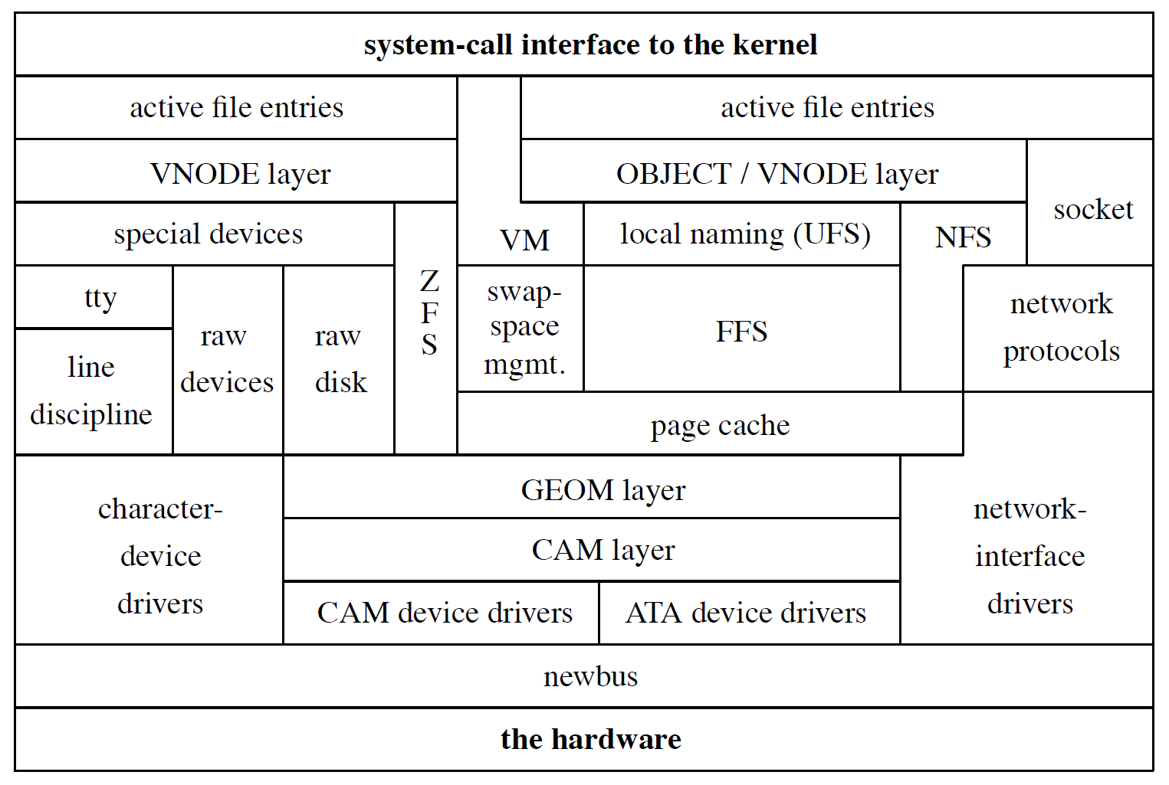
Kernel I/O structure
Figure 7.1 - Design and Implementation of the FreeBSD Operating System, The, 2nd Edition

Slide 6
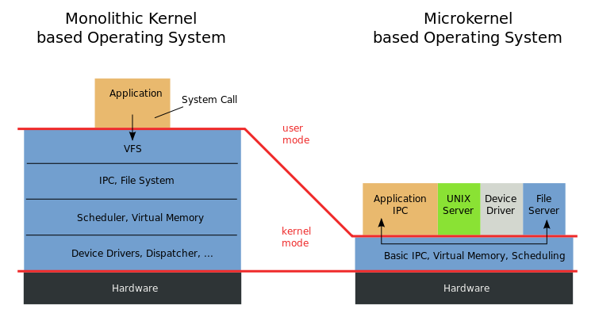
Kernel Types
https://en.wikipedia.org/wiki/Microkernel

Slide 7
Kernel Types
Concept of being modulized …
only provides essential functionalities;
Put other sophisticated functions into user level
e.g., I/O management in the user level
increase scalability and less difficult in maintenance
How to communicate?
-> Message passing – less efficient
Two extreme types
Microkernel
Provide only necessarily, compact and small functionalities
Other functions is added via well-defined interfaces
Monolithic kernel (a huge kernel - e.g., UNIX)
Whole functionalities in one kernel, tightly integrated
Modern OS
Solaris
Completely modular kernel
Load necessary module when it is needed
BSD/Linux-derived system
Much of the kernel's functionality is contained in modules
Monolithic kernel developing towards micro kernel (being more modulized),
but without IPC (message passing) problem

Slide 8
Kernel related directories
Source directory and location
System | Source Directory | Kernel file
FreeBSD | /usr/src/sys | /kernel (< 4.x) /boot/kernel/kernel (>= 5.x)
Linux | /usr/src/linux | /vmlinuz or /boot/vmlinuz
Solaris | - | /kernel/unix
SunOS | /usr/kvm/sys | /vmunix

Slide 9
Why customize kernel?
GENERIC: with most common devices and feature supported
The GENERIC kernel is for general purpose
Tailoring kernel to match site situation
Purge unnecessary kernel devices and options
Add functionalities that you want
Patching
Remedy security hole of kernel implementation
Fine-tuning system performance
Such as adjusting important system parameters
Add device drivers or features
Decrease boot time
Lower memory usage
kernel image -> memory usage
Notes:
https://github.com/libimobiledevice/libimobiledevice/issues/1038

Slide 10
Build and install FreeBSD Kernel
Kernel source
/usr/src/sys
Kernel configuration file
/usr/src/sys/<ARCH>/conf
GENERIC
LINT (generated by `make LINT` under this directory)
NOTES (all options with comments)
Steps to build a new kernel
Edit /usr/src/sys/<ARCH>/conf/<KERNCONF>
For example, save a configuration file named as SABSD
$ cd /usr/src ;
$ make –j<N> buildkernel KERNCONF=SABSD
$ make installkernel KERNCONF=SABSD
https://freebsdfoundation.org/updating-freebsd-from-git/
https://docs.freebsd.org/en/books/handbook/kernelconfig/#kernelconfig-building

Slide 11
To Build a FreeBSD Kernel…
What to Choose?
What to Load?
Option Settings?
Device Drivers?

Slide 12
Finding the system hardware (1)
Before venturing into kernel configuration
Get an inventory list of the machine’s hardware
Focus on what you want to use
Microsoft's Device Manager
dmesg
dmesg(8) - display the system message buffer
cat /var/run/dmesg.boot
vtnet0: <VirtIO Networking Adapter> on virtio_pci0
vtnet0: Ethernet address: xx:xx:xx:xx:xx:xx
vtnet0: netmap queues/slots: TX 8/256, RX 8/128
vtnet0: link state changed to UP

Slide 13
Finding the system hardware (2)
pciconf & man page
man -k atheros
Find drivers from company name
pciconf -l & man
List all attached devices
ehci1@pci0:0:29:7: class=0x0c0320 card=0x3a3a8086 chip=0x3a3a8086 rev=0x00 hdr=0x00
pcib10@pci0:0:30:0: class=0x060401 card=0x244e8086 chip=0x244e8086 rev=0x90 hdr=0x01
isab0@pci0:0:31:0: class=0x060100 card=0x3a168086 chip=0x3a168086 rev=0x00 hdr=0x00
ahci0@pci0:0:31:2: class=0x010601 card=0x3a228086 chip=0x3a228086 rev=0x00 hdr=0x00
none8@pci0:0:31:3: class=0x0c0500 card=0x3a308086 chip=0x3a308086 rev=0x00 hdr=0x00
em0@pci0:3:0:0: class=0x020000 card=0x00008086 chip=0x10d38086 rev=0x00 hdr=0x00
em1@pci0:2:0:0: class=0x020000 card=0x00008086 chip=0x10d38086 rev=0x00 hdr=0x00

Slide 14
Finding the system hardware (3)
pciconf
pciconf -lv
none3@pci0:0:20:3: class=0x028000 card=0x00348086 chip=0x9df08086 rev=0x30 hdr=0x00
vendor = 'Intel Corporation'
device = 'Cannon Point-LP CNVi [Wireless-AC]'
class = network
em0@pci0:0:31:6: class=0x020000 card=0x20748086 chip=0x15be8086 rev=0x30 hdr=0x00
vendor = 'Intel Corporation'
device = 'Ethernet Connection (6) I219-V'
class = network
subclass = ethernet
nvme0@pci0:109:0:0: class=0x010802 card=0x2263c0a9 chip=0x2263c0a9 rev=0x03 hdr=0x00
vendor = 'Micron/Crucial Technology'
device = 'P1 NVMe PCIe SSD'
class = mass storage
subclass = NVM
May not support by GENERIC because of size, license, or…

Slide 15
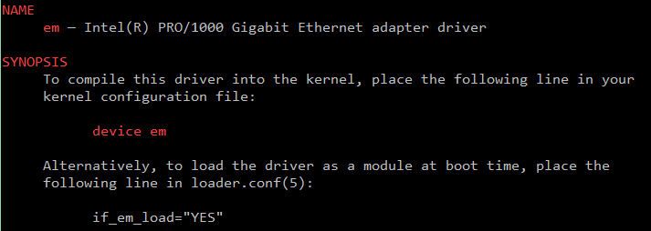
Finding the system hardware (4)
Man page for devices
man [device]
e.g.: man em

Slide 16
Configuration file of FreeBSD Kernel
Each line is a control phrase
Keyword + arguments
config(5), config(8)
Keyword | Function | Example
machine | Sets the machine architecture | amd64 or arm64
cpu | Sets the CPU type | HAMMER or ARM64
ident | Sets the name of the kernel | SABSD
(no)options | Sets various compile-time options | INET, INET6
device | Declares devices | em, ix
envvar | Set compiled-in env prepared for loader(8) | hint.psm.0.irq=“12"
(no)makeoptions | Set options for generated makefile | DEBUG=g
cpu HAMMER
ident GENERIC
makeoptions DEBUG=-g # Build kernel with gdb(1) debug symbols
options SCHED_ULE # ULE scheduler
options INET # InterNETworking
device em
amd64/conf/GENERIC
https://docs.freebsd.org/en/books/handbook/kernelconfig/#kernelconfig-config

Slide 17
Kernel backup
Old kernel is automatically moved to kernel.old
when you’re installing the new kernel
Kernel file locations
Put in the /boot directory
/boot/kernel/kernel, /boot/kernel.old/kernel
If something goes wrong
ok mode !
unload kernel; load kernel.old/kernel
load kernel modules
mv /boot/kernel /boot/kernel.bad
https://docs.freebsd.org/en/books/handbook/kernelconfig/#kernelconfig-trouble

Slide 18
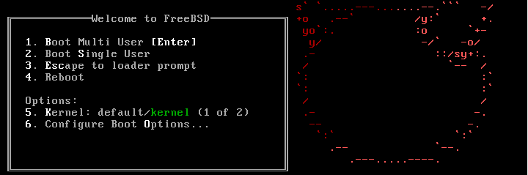
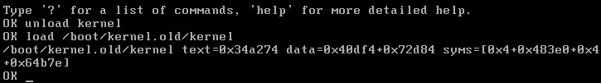
Ok mode
Or “enable modules” in the ok mode..

Slide 19
Tuning the FreeBSD Kernel
sysctl(8) command
Dynamically set or get kernel parameters
All changes made by sysctl will be lost across reboot
Use sysctl to tune the kernel and test it, then recompile the kernel
The other way is to write your settings into /etc/sysctl.conf…
Format:
% sysctl [options] name[=value] …
E.g.:
% sysctl -a # list all kernel variables
% sysctl -d vfs.zfs.arc_max # print the description of the variable
% sysctl vfs.zfs.arc_max # print the value of the variable
% sudo sysctl vfs.zfs.arc_max=4294967296 # set (only root writable) value
tuning(7)

Slide 20
Kernel modules
Kernel module location
/boot/kernel/*.ko
/boot/modules
kldstat
Load/unload kernel modules
kldload(8), kldunload(8)
E.g., kldload if_em
Examples in share/examples/kld
zfs[/boot/kernel] -chiahung- kldstat
Id Refs Address Size Name
1 15 0xc0400000 4abd60 kernel
2 1 0xc08ac000 13b0fc zfs.ko
3 2 0xc09e8000 3d5c opensolaris.ko
4 2 0xc09ec000 16b84 krpc.ko
5 1 0xc0a03000 8c48 if_le.ko

Slide 21
Procedure of Loading a Device Module
Loading a device module
pciconf -l for a device
man vendor name for module name in BSD
find the name in /boot/kernel/*.ko
kldload [module name]
Setup permanently by
Recompile the kernel or
Add [module name]_enable="YES" in /boot/loader.conf or
Put to “kld_list” in /etc/rc.conf
devmatch(8)

Slide 22
Building Linux Kernel
General procedure
Install kernel toolchain
Get source code from https://kernel.org
Extract to /usr/src/linux
make menuconfig
make –jN
make modules
make modules_install
make install
Check /boot/{initramfs.img,System.map,vmlinuz}
Check the distribution specified method
Kernel package

Slide 23
Reference
https://docs.freebsd.org/en/books/handbook/kernelconfig/#kernelconfig-config
/usr/src/sys/<ARCH>/conf
NOTES -> machine dependent kernel configuration with comments
LINT
GENERIC
"building kernel" of Linux distributions documents
https://kernel-team.pages.debian.net/kernel-handbook/ch-common-tasks.html#s-common-official
https://wiki.ubuntu.com/Kernel/BuildYourOwnKernel
https://wiki.archlinux.org/index.php/Kernel/Arch_Build_System
https://wiki.centos.org/HowTos/Custom_Kernel

Slide 24
Backup Slides

Slide 25
Kernel Module (c.)
Build & install kernel module from 3rd party
DKMS (Dynamic Kernel Module Support)

