Slide 1
Public-key Infrastructure
wangth (2017-2020, CC BY-SA)
? (1996-2016)

Slide 2
Public-key Infrastructure
A set of hardware, software, people, policies, and procedures
To create, manage, distribute, use, store, and revoke digital certificates
Encryption, authentication, signature
Bootstrapping secure communication protocols

Slide 3
CA: Certificate Authority (1)
最高層認證中心
Root CA
簽名授權
認證中心 認證中心
CA CA
簽名核發
簽名核發
憑證 憑證 憑證
Certificate Certificate Certificate

Slide 4
CA: Certificate Authority (2)
Certificate
Contains data of the owner, such as Company Name, Server Name, Name, Email, Address,…
Public key of the owner.
Followed by some digital signatures.
Sign for the certificate.
In X.509
A certificate is signed by a CA.
To verify the correctness of the certificate, check the signature of CA.

Slide 5
CA: Certificate Authority (3)
Certificate Authority (CA)
“憑證授權” in Windows CHT version.
In X.509, it is itself a certificate.
The data of CA.
To sign certificates for others.
Each CA contains a signature of Root CA.
To verify a valid certificate
Check the signature of Root CA in the certificate of CA.
Check the signature of CA in this certificate.
Reference: http://www.imacat.idv.tw/tech/sslcerts.html

Slide 6
What is a CA ? (1)
Certificate Authority (認證中心)
Trusted server which signs certificates
One private key and relative public key
Tree structure of X.509
Root CA

Slide 7
What is a CA ? (2)
Root CA (最高層認證中心)
In Microsoft:「根目錄授權憑證」
Root CA do not sign the certificates for users
Authorize CA to sign the certificates for users, instead.
Root CA signs for itself
It is in the sky
To trust Root CA
Install the certificate of Root CA via secure channel.
security/ca_root_nss
Root certificate bundle from the Mozilla Project

Slide 8
What is a CA ? (3)
最高層認證中心
Root CA
Tree structure of CA
Cost of certificate
PublicCA : NT $9,600 / per year / per host
Myself : NT $0
Let's Encrypt : NT $0
https://letsencrypt.org
簽名授權
認證中心 認證中心
CA CA
簽名核發
簽名核發
憑證 憑證 憑證
Certificate Certificate Certificate

Slide 9
Certificate (1)
Digital Certificate, Public-key Certificate, Network Identity
A certificate is issued by a CA X
A certificate of a user A consists:
The name of the issuer CA X
His/her public key Apub
The signature Sig(Xpriv, A, Apub) by the CA X
The expiration date
Applications
Encryption / Signature

Slide 10
Certificate (2)
(2) Alice, A_{pub}, ID proof
Alice:
Generate
A_{pub}, A_{priv}
CA X:
(3) Generate Sig(X_{priv}, Alice, A_{pub}, T)
(4) Sig(X_{priv}, Alice, A_{pub}, T)
Cert_{A,X}=[Alice, A_{pub}, Sig(X_{priv}, Alice, A_{pub}, T)]
Note: CA does not know A_{priv}

Slide 11
Certificate (3)
Guarantee of CA and certificate
Guarantee the public key is of someone
Someone is not guaranteed to be safe
Security of transmitting DATA
Transmit session key first
Public-key cryptosystem
Transmit DATA by session key
Symmetric-key cryptosystem

Slide 12
SSL & TLS

Slide 13
SSL/TLS
SSL/TLS
Provide communication security over the Internet
Prevent eavesdropping and tampering
Encrypt segments over Transport Layer
※ SSL: Secure Sockets Layer
※ TLS: Transport Layer Security

Slide 14
History – (1)
SSL - developed by Netscape
SSL 1.0: never publicly released
SSL 2.0: released in 1995
A number of security flaws
SSL 3.0: released in 1996
A complete redesign
Newer versions of SSL/TLS are based on SSL 3.0
SSL 2.0 was prohibited in 2011 by RFC 6176, and SSL 3.0 followed in June 2015 by RFC 7568

Slide 15
History – (2)
TLS - IETF RFC
TLS 1.0 (SSL 3.1): RFC 2246 in 1999.
Backward compatible to SSL 3.0
CBC vulnerability discovered in 2002
TLS 1.1 (SSL 3.2): RFC 4346 in 2006
Prevent CBC attacks
TLS 1.2 (SSL 3.3): RFC 5246 in 2008
Enhance security strength
Introduce new cryptographic algorithms
TLS 1.3: RFC 8446 in 2018

Slide 16
SSL/TLS Negotiation
(C) Request a secure connection, and present a list
of supported ciphers and hash functions
(S) Select common cipher and hash function, and
send back with server’s digital certificate
(C) Confirm the validity of the certificate
(C) Encrypt a random number with server’s public
key, and send it to server
(C/S) Generate session key(s) from the random
number
C: Client / S: Server

Slide 17
SSL/TLS Applications
Implemented on top of Transport Layer protocols
TCP
UDP (DTLS)
Protect application-specific protocols
HTTP, FTP, SMTP, NNTP, …
VPN (OpenVPN), SIP, VoIP
Activate SSL/TLS connection
Use a different port number (https/433, smtps/465)
Use a protocol specific mechanism (STARTTLS)

Slide 18
Support for Named-based Virtual Servers
All virtual servers belong to the same domain
Wildcard certificate
Add all virtual host names in subjectAltName
Disadvantages
Certificate needs reissuing whenever adding a new virtual server
Cannot support named-based virtual hosts for web service
Server Name Indication (SNI)
RFC 4366
http://wiki.apache.org/httpd/NameBasedSSLVHostsWithSNI
The client browser must also support SNI
https://www.digicert.com/ssl-support/apache-multiple-ssl-certificates-using-sni.htm

Slide 19
OpenSSL

Slide 20
OpenSSL
https://www.openssl.org/
In system
/usr/src/crypto/openssl
In ports
security/openssl
SSL library selection (in make.conf)
WITH_ options is deprecated
WITH_OPENSSL_BASE, WITH_OPENSSL_PORT
Base OpenSSL and Ports' OpenSSL, LibreSSL or their -devel versions
Possible values: base, openssl, openssl-devel, libressl, libressl-devel
DEFAULT_VERSIONS+=ssl=base
https://wiki.freebsd.org/DEFAULT_VERSIONS

Slide 21
Heartbleed bug
CVE-2014-0160
http://heartbleed.com/
https://www.openssl.org/news/secadv/20140407.txt
Test https://filippo.io/heartbleed/

Slide 22
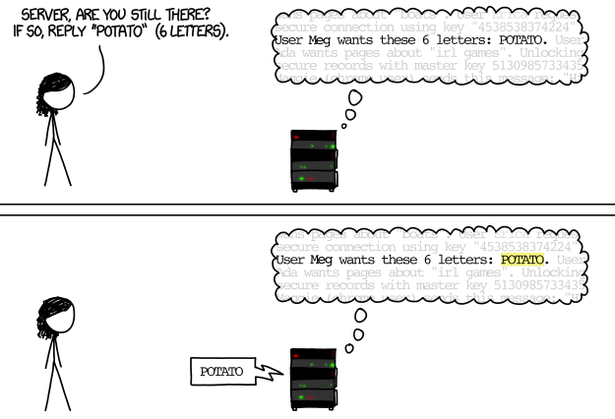
Heartbleed illustrated (1)
https://teskalabs.com/blog/heartbleed

Slide 23
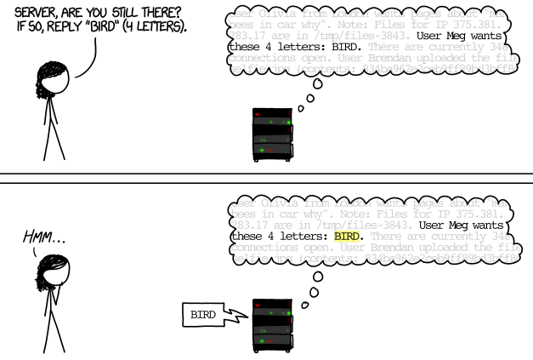
Heartbleed illustrated (2)
https://teskalabs.com/blog/heartbleed

Slide 24
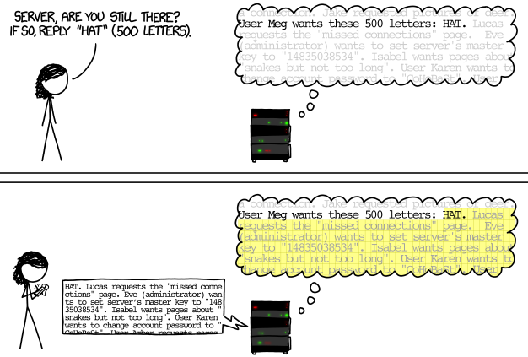
Heartbleed illustrated (3)
https://teskalabs.com/blog/heartbleed

Slide 25
Security Advisories
https://cve.mitre.org/cgi-bin/cvename.cgi?name=CVE-2014-0160
https://www.freebsd.org/security/advisories/FreeBSD-SA-14:06.openssl.asc
https://security-tracker.debian.org/tracker/CVE-2014-0160

Slide 26
Example: Apache SSL settings

Slide 27
Example: Apache SSL settings - Flow
Flow
Generate random seed
Generate RootCA
Generate private key of RootCA
Fill the Request of Certificate.
Sign the certificate itself.
Generate certificate of Web Server
Generate private key of Web Server
Fill the Request of certificate
Sign the certificate using RootCA
Modify apache configuration 🡺 restart apache

Slide 28
Example: Apache SSL settings -
Generate random seed
openssl rand -out rnd-file num
% openssl rand -out /etc/ssl/RootCA/private/.rnd 1024
chmod go-rwx rnd-file
% chmod go-rwx /etc/ssl/RootCA/private/.rnd

Slide 29
Example: Apache SSL settings -
Generate private key of RootCA
openssl genrsa -aes256 -rand rnd-file -out rootca-key-file num
% openssl genrsa -aes256 -rand /etc/ssl/RootCA/private/.rnd \
-out /etc/ssl/RootCA/private/rootca.key.pem 2048
Note: phrase are asked (something like password)
openssl-genrsa(1)
chmod go-rwx rootca-key-file
% chmod go-rwx /etc/ssl/RootCA/private/rootca.key.pem

Slide 30
Example: Apache SSL settings -
Fill the Request of Certificate
openssl req -new -key rootca-key-file -out rootca-req-file
% openssl req -new -key /etc/ssl/RootCA/private/rootca.key.pem \
-out /etc/ssl/RootCA/private/rootca.req.pem
chmod go-rwx rootca-req-file
% chmod go-rwx /etc/ssl/RootCA/private/rootca.req.pem
Enter pass phrase for rootca-key-file:
Country Name (2 letter code) [AU]:TW
State or Province Name (full name) [Some-State]:Taiwan
Locality Name (eg, city) []:HsinChu
Organization Name (eg, company) [Internet Widgits Pty Ltd]:NCTU
Organizational Unit Name (eg, section) []:CS
Common Name (eg, YOUR name) []:nasa.cs.nctu.edu.tw
Email Address []:liuyh@cs.nctu.edu.tw
A challenge password []: (No need，Enter please)
An optional company name []: (Enter please)

Slide 31
Example: Apache SSL settings -
Sign the certificate itself (1)
openssl x509 -req -days num -sha1 -extfile path_of_openssl.cnf -extensions v3_ca -signkey
rootca-key-file -in rootca-req-file -out rootca-crt-file
% openssl x509 -req -days 5109 -sha1 -extfile /etc/ssl/openssl.cnf
-extensions v3_ca -signkey /etc/ssl/RootCA/private/rootca.key.pem
-in /etc/ssl/RootCA/private/rootca.req.pem -out /etc/ssl/RootCA/private/rootca.crt.pem

Slide 32
Example: Apache SSL settings -
Sign the certificate itself (2)
rm -f rootca-req-file
% rm -f /etc/ssl/RootCA/private/rootca.req.pem
chmod go-rwx rootca-crt-file
% chmod go-rwx /etc/ssl/RootCA/private/rootca.crt.pem

Slide 33
Example: Apache SSL settings -
Generate private key of Web Server
openssl genrsa -out host-key-file num
% openssl genrsa -out /etc/ssl/nasa/private/nasa.key.pem 2048
chmod go-rwx host-key-file
% chmod go-rwx /etc/ssl/nasa/private/nasa.key.pem

Slide 34
Example: Apache SSL settings -
Fill the Request of Certificate
openssl req -new -key host-key-file -out host-req-file
% openssl req -new -key /etc/ssl/nasa/private/nasa.key.pem -out /etc/ssl/nasa/private/nasa.req.pem
chmod go-rwx host-req-file
% chmod go-rwx /etc/ssl/nasa/private/nasa.req.pem

Slide 35
Example: Apache SSL settings -
Sign the certificate using RootCA (1)
Transmit host-req-file to Root CA, and do following steps in RootCA
openssl x509 -req -days num -sha1 -extfile path_of_openssl.cnf
-extensions v3_ca -CA rootca-crt-file -CAkey rootca-key-file
-CAserial rootca-srl-file -CAcreateserial -in host-req-file
-out host-crt-file

Slide 36
Example: Apache SSL settings -
Sign the certificate using RootCA (2)
Transmit host-req-file to Root CA, and do following steps in RootCA
% openssl x509 -req -days 365 -sha1 -extfile /etc/ssl/openssl.cnf
-extensions v3_ca -CA /etc/ssl/RootCA/private/rootca.crt.pem
-CAkey /etc/ssl/RootCA/private/rootca.key.pem
-CAserial /etc/ssl/RootCA/private/rootca.srl -CAcreateserial
-in /etc/ssl/nasa/private/nasa.req.pem
-out /etc/ssl/nasa/private/nasa.crt.pem
rm -f host-req-file ( in both RootCA and Web Server)
% rm -f /etc/ssl/nasa/private/nasa.req.pem
Transmit host-crt-file back to Web Server

Slide 37
Example: Apache SSL settings -
Certificate Authority
Include etc/apache22/extra/httpd-ssl.conf
##
## SSL Virtual Host Context
##
<VirtualHost _default_:443>
# General setup for the virtual host
DocumentRoot /home/wwwadm/data
<Directory "/home/wwwadm/data">
Options Indexes FollowSymLinks
AllowOverride All
Order allow,deny
Allow from all
</Directory>
ServerName nasa.cs.nctu.edu.tw:443
ServerAdmin liuyh@nasa.cs.nctu.edu.tw
ErrorLog /var/log/httpd/nasa.cs-error.log
CustomLog /var/log/httpd/nasa.cs-access.log common
Q
SSLEngine on
SSLCipherSuite ALL:!ADH:!EXPORT56:RC4+RSA:+HIGH:+MEDIUM:+LOW:!SSLv2:+EXP:+eNULL
SSLCertificateFile /etc/ssl/nasa/nasa.crt.pem
SSLCertificateKeyFile /etc/ssl/nasa/private/nasa.key.pem

Slide 38
View the content of Certificate - (1)
% vim host-crt-file
-----BEGIN CERTIFICATE-----
MIIE0DCCA7igAwIBAgIJAL5UBzbv+hl1MA0GCSqGSIb3DQEBBQUAMIGgMQswCQYD
VQQGEwJUVzEPMA0GA1UECBMGVGFpd2FuMRAwDgYDVQQHEwdIc2luQ2h1MQ0wCwYD
VQQKEwROQ1RVMQswCQYDVQQLEwJBTTEiMCAGA1UEAxMZZXZpbGJpZzUubWF0aC5u
……
9xMw8qMBHnxUVHOUVbECAwEAAaOCAQkwggEFMB0GA1UdDgQWBBR958Azmc9N7gbm
kFLgfOpw+9RW9TCB1QYDVR0jBIHNMIHKgBR958Azmc9N7gbmkFLgfOpw+9RW9aGB
pqSBozCBoDELMAkGA1UEBhMCVFcxDzANBgNVBAgTBlRhaXdhbjEQMA4GA1UEBxMH
SHNpbkNodTENMAsGA1UEChMETkNUVTELMAkGA1UECxMCQU0xIjAgBgNVBAMTGWV2
aWxiaWc1Lm1hdGgubmN0dS5lZHUudHcxLjAsBgkqhkiG9w0BCQEWH3JhbmR5QGV2
aWxiaWc1Lm1hdGgubmN0dS5lZHUudHeCCQC+VAc27/oZdTAMBgNVHRMEBTADAQH/
MA0GCSqGSIb3DQEBBQUAA4IBAQCLkNba9LSpCTOh7Ws3h18WSKQXVxnLHxWUepC8
ZG3Q/dT++L54EiyBLmXwnr67gfUPhN1Qb/v1ixThlNBIjIrOZvEiyqjrmrQBABpt
x0+APW8TAdYfslQvGfhDptNeKWoYc7fxlxw3TXwQf2JhL+a10m2ZeEMSg1iuIyqg
+Dq3jGCb3R66NoKo/ToO5J6CAnkG7spYiDNukkvoEPNKaqXMC3K6pOzBDQwWBpH7
pCE9dEqbmHvUb+hwvI2OTJAKcM0G1wBmFF7au1G9e6O9hj34voppLdfVz5+mu5ai
ELgGQXpVrFPSzZG0PyAr5rxtOI8E7yl7jl2pu7yXk9jgsiWl
-----END CERTIFICATE-----

Slide 39
View the content of Certificate - (2)
% openssl x509 -text -in host-crt-file
Certificate:
Data:
......
Signature Algorithm: sha1WithRSAEncryption
Issuer: C=TW, ST=Taiwan, L=HsinChu, O=NCTU, OU=CS, CN=../emailAddress=..
Validity ...
Subject: C=TW, ST=Taiwan, L=HsinChu, O=NCTU, OU=CS, CN=../emailAddress=.
Subject Public Key Info:
Public Key Algorithm: rsaEncryption
RSA Public Key: (2048 bit)
Modulus (2048 bit):
......
Exponent: 65537 (0x10001)
X509v3 extensions:
......
Signature Algorithm: sha1WithRSAEncryption
8b:90:d6:da:f4:b4:a9:09:33:a1:ed:6b:37:87:5f:16:48:a4:
......
e0:b2:25:a5
-----BEGIN CERTIFICATE-----
MIIE0DCCA7igAwIBAgIJAL5UBzbv+hl1MA0GCSqGSIb3DQEBBQUAMIGgMQswCQYD
......
ELgGQXpVrFPSzZG0PyAr5rxtOI8E7yl7jl2pu7yXk9jgsiWl
-----END CERTIFICATE-----

Slide 40
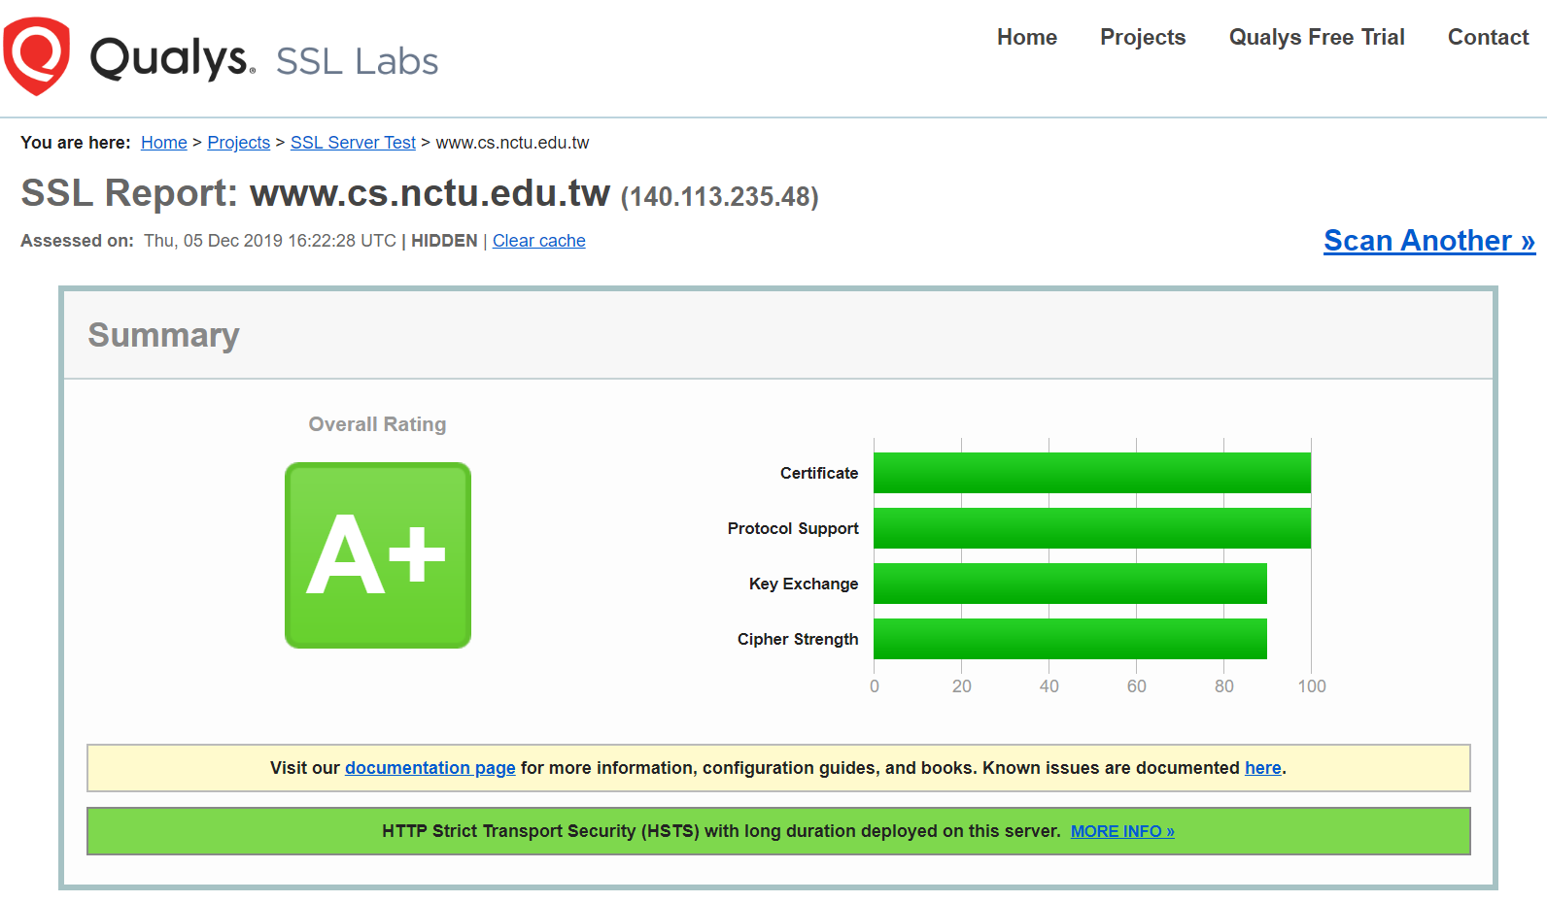
SSL Server Test
https://www.ssllabs.com/ssltest/
https://github.com/ssllabs/research/wiki/SSL-and-TLS-Deployment-Best-Practices

Slide 41
Appendix: PGP

Slide 42
PGP
Pretty Good Privacy
Public key system
Encryption
Signature
security/gnupg (GNU Privacy Guard)
Will talk more in Network Administration
Reference:
http://security.nknu.edu.tw/textbook/chap15.pdf
http://blog.theerrorlog.com/using-gpg-zh.html

