Slide 1
TCP/IP Networking
wangth (2017-2020, CC BY-SA)
? (1996-2016)

Slide 2
Overview
Introduction
Layers of TCP/IP
Link Layer
Network Layer
Transport Layer
Application Layer
Network Interface and Hardware
Networking
ARP
Setting up Network

Slide 3
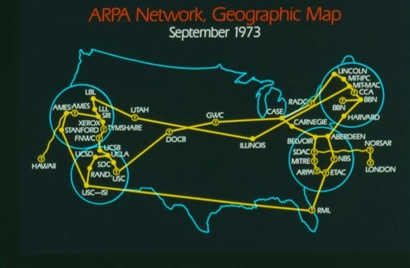
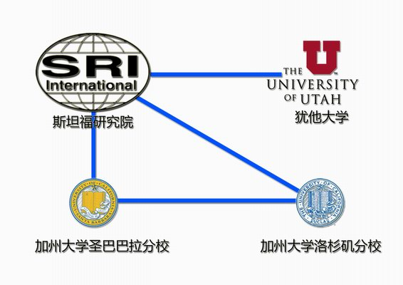
Introduction – ARPANET
Advanced Research Projects Agency Network
NCP (Network Control Protocol)
Allow an exchange of information between separated computers
Stanford Research Institute
University of Utah
UC Santa Barbara
UCLA
https://inventiontourblog.wordpress.com/2015/03/31/internet-advanced-research-project-agency-arpa-develops-the-first-computer-network/

Slide 4
Introduction – Why TCP/IP ?
Transmission Control Protocol / Internet Protocol
The gap between applications and Network
Network
802.3 Ethernet
802.4 Token bus
802.5 Token Ring
802.11 Wireless
802.16 WiMAX
Application
Reliable
Performance
Applications
Libraries
Linux kernel
High-level abstractions
File-systems
Network protocols
Low-level interfaces
Hardware

Slide 5
Introduction – Layers of TCP/IP (1)
TCP/IP is a suite of networking protocols
4-layer architecture
Link layer (data-link layer)
Include device drivers to handle hardware details
Network layer (IP)
Handle the movement of packets around the network
Transport layer (Port)
Handle flow of data between hosts
Application
Application | Telnet
Transport | TCP, UDP
Network | IP, ICMP, IGMP
Link | Device driver and interface card

Slide 6
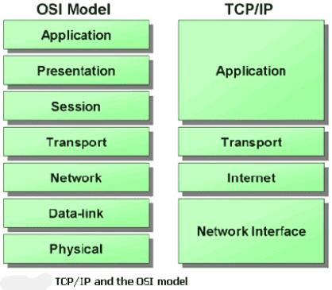
Introduction – Layers of TCP/IP (2)
ISO/OSI Model (International Organization for Standardization / Open System Interconnection Reference Model)
TCP/IP Model
http://wiki.cas.mcmaster.ca/index.php/TCP/IP_Application_Development

Slide 7
Introduction – Layers of TCP/IP (3)
Encapsulation (Multiplexing)
Gathering data from multiple sockets, enveloping data with header
Application data
Data
Transport
Header
Application data
Segment
Network
Header
Transport
Header
Application data
Packet
Frame
Header
Network
Header
Transport
Header
Application data
Frame
CRC
0110101……………………………………………
Bits

Slide 8
Introduction – Layers of TCP/IP (4)
Decapsulation (Demultiplexing)
Delivering received segments to correct socket
Application
...
Application
Application
...
Application
demultiplexing based on destination port number in TCP or UDP header
ICMP
IGMP
TCP
UDP
demultiplexing based on protocol value in IP header
ARP
IP
RARP
demultiplexing based on frame type in Ethernet header
Ethernet
Driver
Incoming frame

Slide 9
Introduction – TCP/IP Family
arp
FTP
HTTP
SMTP
DNS
DNS
TFTP
traceroute
TCP
UDP
IP
ICMP
ARP, Device drivers
Copper, optical fiber, radio waves

Slide 10
Introduction – Addressing
Addressing
Nearby (same network)
Handles
Application
Details
User
Process
FTP
Client
FTP Protocol
FTP
Server
Application
Transport
TCP
TCP Protocol
TCP
Kernel
Handles
Communication
Details
Network
IP
IP Protocol
IP
Link
Ethernet
Driver
Ethernet Protocol
Ethernet
Driver
Ethernet

Slide 11
Introduction – Addressing
Addressing
Faraway (across network)
FTP
Client
FTP Protocol
FTP
Server
Application
Transport
TCP
TCP Protocol
TCP
Router
IP
IP Protocol
IP
IP Protocol
IP
Network
Link
Ethernet
Driver
Ethernet
Protocol
Ethernet
Driver
Token ring
Driver
Token ring
Protocol
Ethernet
Driver
Ethernet
Token Ring

Slide 12
Introduction – Addressing
IP
32-bits, Unique Internet Address of a host
Port
16-bits, Uniquely identify application
MAC Address
Media Access Control Address
48-bits, Network Interface Card (NIC) Hardware address
$ ifconfig
sk0: flags=8843<UP,BROADCAST,RUNNING,SIMPLEX,MULTICAST> mtu 1500
options=b<RXCSUM,TXCSUM,VLAN_MTU>
inet 140.113.17.215 netmask 0xffffff00 broadcast 140.113.17.255
inet 140.113.17.221 netmask 0xffffffff broadcast 140.113.17.221
ether 00:11:d8:06:1e:81
media: Ethernet autoselect (100baseTX <full-duplex,flag0,flag1>)
status: active
lo0: flags=8049<UP,LOOPBACK,RUNNING,MULTICAST> mtu 16384
inet 127.0.0.1 netmask 0xff000000

Slide 13
Link Layer

Slide 14
Network Interface and Hardware
LAN (Local), WAN (Wide), MAN (Metropolitan)
Ethernet, Token-Ring, FDDI
PPP, xDSL, ISDN
Physical Topologies (see next slide)
Logical Topologies
Broadcast, Token-passing
Common LAN Devices
NIC, Repeater, Hub, Bridge, Switch, Router
Common LAN Media
UTP, STP, Coaxial Cable, Fiber Optic Cable

Slide 15
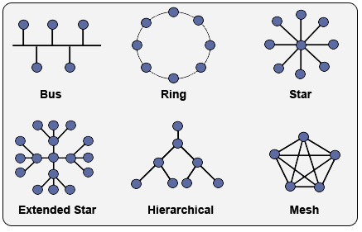
Network Interface and Hardware
– Physical Topologies
https://www.itprc.com/a-guide-to-network-topology/

Slide 16
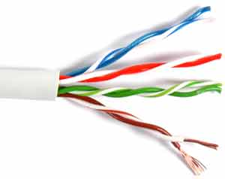
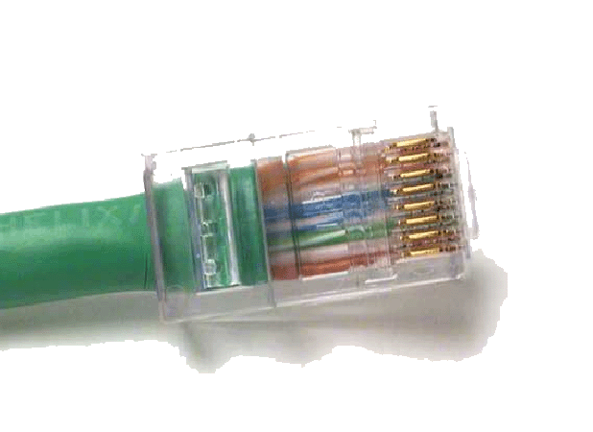
Network Interface and Hardware
– Media
Media
Coaxial Cable
Thicknet v.s. thinnet
BNC connector
Twisted Pair Standards
Straight-through v.s. Crossover
RJ-45 connector
Fiber Optic Cable
Multimode v.s. single mode
Wireless
IrDA, Radio (2.4GHz, 5GHz)
Pin# | 1 | 2 | 3 | 4 | 5 | 6 | 7 | 8
T568-A | W/G | Green | W/O | Blue | W/Blue | Orange | W/Br | Brown
T568-B | W/O | Orange | W/G | Blue | W/Blue | Green | W/Br | Brown

Slide 17
The Link Layer
Ethernet: the common LAN
10 Mb/s →100 Mb/s →1Gb/s
802.3 → 802.3u → 802.3z
CSMA/CD (Carrier Sense Multiple Access/Collision Detect)
Ethernet Address (48bits)
00:80:c8:92:0e:e1
Ethernet Frame
Ethernet MTU (Maximum Transmission Unit) is 1500 bytes
IP fragmentation
Path MTU
MTU of various physical device
Preamble
64 bits
D addr
48 bits
S addr
48 bits
Type
16 bits
Data
(max 1500 bytes)
CRC
32 bits

Slide 18
Network Layer

Slide 19
The Network Layer
Path Determination
The Internet Protocol (IP)
IP address (32 bits)
Topics
IP Address
Subnetting and netmask
Address types
Routing

Slide 20
The Network Layer – IP Address
32-bit long
Network part
Identify a logical network
Host part
Identify a machine on certain network
IP address category
E.g.,
NCTU
Class B address: 140.113.0.0
Network ID: 140.113
Number of hosts: 256*256 = 65536
Class | 1st byte | Format | Comments
A | 1-126 | N.H.H.H | Very early networks, or reserved for DOD
B | 128-191 | N.N.H.H | Large sites, usually subnetted, were to get
C | 192-223 | N.N.N.H | Easy to get, often obtained in sets
D | 224-239 | - | Multicast addresses, not permanently assigned
E | 240-254 | - | Experimental addresses

Slide 21
The Network Layer
– Subnetting and Netmask (1)
Subnetting
Borrow some bits from network ID to extends hosts ID
E.g.,
Class B address : 140.113.0.0
= 256 Class C-like IP addresses
in N.N.N.H subnetting method
140.113.209.0 subnet
Netmask
Specify how many bits of network-ID are used for network-ID
Continuous 1 bits form the network part
E.g.:
255.255.255.0 in NCTU-CS example
256 hosts available
255.255.255.248 in ADSL example
Only 8 hosts available

Slide 22
The Network Layer
– Subnetting and Netmask (2)
How to determine your network ID?
Bitwise-AND IP and netmask
E.g.,
140.113.214.37 & 255.255.255.0 → 140.113.214.0
140.113.209.37 & 255.255.255.0 → 140.113.209.0
140.113.214.37 & 255.255.0.0 → 140.113.0.0
140.113.209.37 & 255.255.0.0 → 140.113.0.0
211.23.188.78 & 255.255.255.248 → 211.23.188.72
78 = 01001110
78 & 248= 01001110 & 11111000 =72

Slide 23
The Network Layer
– Subnetting and Netmask (3)
In a subnet, not all IP are available
The first one IP → network ID
The last one IP → broadcast address
E.g.,
Netmask 255.255.255.0
140.113.209.32/24
140.113.209.0 => network ID
140.113.209.255 => broadcast address
1 ~ 254, total 254 IPs are usable
Netmask 255.255.255.252
211.23.188.78/29
211.23.188.72 => network ID
211.23.188.79 => broadcast address
73 ~ 78, total 6 IPs are usable

Slide 24
The Network Layer
– Subnetting and Netmask (4)
The smallest subnetting
Network portion : 30 bits
Host portion : 2 bits
=> 4 hosts, but only 2 IPs are available
ipcalc
$ pkg install ipcalc
/usr/ports/net-mgmt/ipcalc
$ ipcalc 140.113.235.100/28
Address: 140.113.235.100 10001100.01110001.11101011.0110 0100
Netmask: 255.255.255.240 = 28 11111111.11111111.11111111.1111 0000
Wildcard: 0.0.0.15 00000000.00000000.00000000.0000 1111
=>
Network: 140.113.235.96/28 10001100.01110001.11101011.0110 0000
HostMin: 140.113.235.97 10001100.01110001.11101011.0110 0001
HostMax: 140.113.235.110 10001100.01110001.11101011.0110 1110
Broadcast: 140.113.235.111 10001100.01110001.11101011.0110 1111
Hosts/Net: 14 Class B

Slide 25
The Network Layer
– Subnetting and Netmask (5)
Network configuration for various lengths of netmask
Length | Host bits | Hosts/net | Dec. netmask | Hex netmask
/20 | 12 | 4094 | 255.255.240.0 | 0xFFFFF000
/21 | 11 | 2046 | 255.255.248.0 | 0xFFFFF800
/22 | 10 | 1022 | 255.255.252.0 | 0xFFFFFC00
/23 | 9 | 510 | 255.255.254.0 | 0xFFFFFE00
/24 | 8 | 254 | 255.255.255.0 | 0xFFFFFF00
/25 | 7 | 126 | 255.255.255.128 | 0xFFFFFF80
/26 | 6 | 62 | 255.255.255.192 | 0xFFFFFFC0
/27 | 5 | 30 | 255.255.255.224 | 0xFFFFFFE0
/28 | 4 | 14 | 255.255.255.240 | 0xFFFFFFF0
/29 | 3 | 6 | 255.255.255.248 | 0xFFFFFFF8
/30 | 2 | 2 | 255.255.255.252 | 0xFFFFFFFC

Slide 26
The Network Layer
– IP address crisis
IP address crisis
Run out of class B address
The most desirable ones for moderately large organizations
IP address were being allocated on a FCFS
With no locality of reference
Solutions
Short term
Subnetting and CIDR (classless inter-domain routing)
NAT (network address translation)
Long term
IPv6

Slide 27
The Network Layer
– NAT (1)
Private Address
Packets with private address will not go out to the Internet
3 private address ranges
Depend on the size of your organization
IP class | From | To | CIDR range
Class A | 10.0.0.0 | 10.255.255.255 | 10.0.0.0/8
Class B | 172.16.0.0 | 172.31.255.255 | 172.16.0.0/12
Class C | 192.168.0.0 | 192.168.255.255 | 192.168.0.0/16

Slide 28

The Network Layer
– NAT (2)
NAT
Network Address Translation
Allow hosts using private address to talk with outside
NAT mapping table
Orig | Alias | Remote
192.168.1.1:1029 192.168.1.1:1030 192.168.1.2:1029 192.168.1.2:1030 | 140.113.235.219:1029 140.113.235.219:1030 140.113.235.219:30029 140.113.235.219:30030 | ⇔ 140.113.235.72:23 ⇔ 140.113.235.72:23 ⇔ 140.113.235.72:21 ⇔ 140.113.235.72:21
140.113.235.72
140.113.235.0
140.113.235.219
Router with NAT
192.168.1.0
192.168.1.253
Orig:
192.168.1.1:1029 ⇔ 140.113.235.72:23
After NAT:
140.113.235.219:1092 ⇔ 140.113.235.72:23
192.168.1.1
192.168.1.2

Slide 29
The Network Layer
– Routing (1)
Goal: Direct a packet closer to the destination
Flat v.s. Hierarchical
Routing table
Routing information (which kind of packets to which way)
Rule-based information
Kernel will pick the most suitable way to route the packets
$ netstat -rn
Routing tables
Internet:
Destination Gateway Flags Refs Use Netif Expire
default 140.113.17.254 UGS 0 4439610 dc0
127.0.0.1 127.0.0.1 UH 0 3887 lo0
140.113.17/24 link#1 UC 0 0 dc0
140.113.17.209 00:0d:61:21:02:54 UHLW 1 38 dc0 477
140.113.17.212 00:90:96:23:8f:7d UHLW 1 22558 lo0
140.113.17.215 00:11:d8:06:1e:81 UHLW 1 17 dc0 1188

Slide 30
The Network Layer
– Routing (2)
Static route
Statically configured by "route" command
E.g.:
$ route add default 140.113.235.254
$ route add 192.168.1.0/24 192.168.1.254
Dynamic route
gated

Slide 31
The Network Layer
– Routing (3)
"ping -R" and "traceroute"
$ ping -c 1 -R www.nctu.edu.tw
PING www.nctu.edu.tw (140.113.250.5): 56 data bytes
64 bytes from 140.113.250.5: icmp_seq=0 ttl=61 time=2.249 ms
RR: ProjE27-253.NCTU.edu.tw (140.113.27.253)
140.113.0.57
CC250-gw.NCTU.edu.tw (140.113.250.253)
www.NCTU.edu.tw (140.113.250.5)
www.NCTU.edu.tw (140.113.250.5)
140.113.0.58
ProjE27-254.NCTU.edu.tw (140.113.27.254)
e3rtn.csie.nctu.edu.tw (140.113.17.254)
chbsd.csie.nctu.edu.tw (140.113.17.212)
--- www.nctu.edu.tw ping statistics ---
1 packets transmitted, 1 packets received, 0$ packet loss
round-trip min/avg/max/stddev = 2.249/2.249/2.249/0.000 ms
$ traceroute www.nctu.edu.tw
traceroute to www.nctu.edu.tw (140.113.250.5), 64 hops max, 40 byte packets
1 e3rtn (140.113.17.254) 0.524 ms 0.406 ms 0.512 ms
2 ProjE27-254.NCTU.edu.tw (140.113.27.254) 0.574 ms 0.501 ms 0.422 ms
3 140.113.0.58 (140.113.0.58) 0.487 ms 0.583 ms 0.541 ms
4 www.NCTU.edu.tw (140.113.250.5) 0.673 ms 0.611 ms 0.621 ms

Slide 32
Transport Layer

Slide 33
The Transport Layer – ports
16-bits number
Preserve ports
1 ~ 1024 (root access only)
Well-known port
/etc/services
chargen 19/tcp ttytst source #Character Generator
chargen 19/udp ttytst source #Character Generator
ftp-data 20/tcp #File Transfer [Default Data]
ftp-data 20/udp #File Transfer [Default Data]
ftp 21/tcp #File Transfer [Control]
ftp 21/udp #File Transfer [Control]
ssh 22/tcp #Secure Shell Login
ssh 22/udp #Secure Shell Login
telnet 23/tcp
telnet 23/udp
IANA Service Name and Transport Protocol Port Number Registry
https://www.iana.org/assignments/service-names-port-numbers

Slide 34
The Transport Layer
UDP v.s. TCP
Function | UDP | TCP
Connection-oriented | No | Yes
Message boundaries | Yes | No
Data checksum | Optional | Yes
Positive acknowledgement | No | Yes
Time-out and retransmit | No | Yes
Duplicate detection | No | Yes
Sequencing | No | Yes
Flow control | No | Yes

Slide 35
The Transport Layer – useful commands
tcpdump, sniffit, trafshow, netstat -s
$ tcpdump -n host 140.113.235.131
tcpdump: verbose output suppressed, use -v or -vv for full protocol decode
listening on dc0, link-type EN10MB (Ethernet), capture size 96 bytes
11:25:50.996542 IP 140.113.17.212.61233 > 140.113.235.131.22: P 266166194:266166226(32) ack 938637316 win 33304 <nop,nop,timestamp 3368918203 130908112>
11:25:50.998247 IP 140.113.235.131.22 > 140.113.17.212.61233: P 1:33(32) ack 32 win 33304 <nop,nop,timestamp 134993614 3368918203>
11:25:50.998396 IP 140.113.235.131.22 > 140.113.17.212.61233: P 33:65(32) ack 32 win 33304 <nop,nop,timestamp 134993614 3368918203>
11:25:50.998438 IP 140.113.17.212.61233 > 140.113.235.131.22: . ack 65 win 33288 <nop,nop,timestamp 3368918205 134993614>
11:26:36.935422 IP 140.113.17.212 > 140.113.235.131: ICMP echo request, id 28124, seq 0, length 64
11:26:36.935761 IP 140.113.235.131 > 140.113.17.212: ICMP echo reply, id 28124, seq 0, length 64
^C
6 packets captured
697 packets received by filter
0 packets dropped by kernel

Slide 36
The Application Layer
The Client-Server Model
Port Numbers:
/etc/services
The first 1024 ports are reserved ports
Internet Services
inetd and /etc/inetd.conf
DNS

Slide 37
The Application Layer – inted
inetd - internet "super-server"
add inetd_enable="YES" into /etc/rc.conf
/etc/inetd.conf
daytime stream tcp nowait root internal
ftp stream tcp nowait root /usr/libexec/ftpd ftpd -l
ssh stream tcp nowait root /usr/sbin/sshd sshd -i -4
telnet stream tcp nowait root /usr/libexec/telnetd telnetd
pop3 stream tcp nowait root /usr/local/libexec/popper popper
/etc/services
daytime 13/tcp
ftp-data 20/tcp #File Transfer [Default Data]
ftp 21/tcp #File Transfer [Control]
ssh 22/tcp #Secure Shell Login
telnet 23/tcp
pop3 110/tcp #Post Office Protocol - Version 3

Slide 38
The Application Layer – DNS
Domain Name System
Record IP-hostname mapping
DNS query
"what is the IP of vangogh.cs.berkeley.edu" from lair.cs.colorado.edu
Hierarchical architecture
Recursive
Non-recursive
root(".")
2-Q
3-R
lair
1-Q
ns.cs.colorado.edu
4-Q
edu
10-A
5-R
6-Q
9-A
8-Q
7-R
berkeley.edu
Q = Query
A = Answer
R = Referral
cs.berkeley.edu

Slide 39
ARP (1)
Address Resolution Protocol
Ask MAC address of certain IP
Broadcast
Any one receiving ARP packet and having this IP will reply to the sender
When the host owing this IP is not on the same network, sender will use the MAC address of next-hop router to send the packet

Slide 40
ARP (2)
hostname
hostname
resolver
FTP
IP addr
(1)
(2)
establish connection with IP address
TCP
(3)
send IP datagram to IP address
IP
ARP
(4)
(5)
(6)
(8)
(9)
Ethernet
Driver
ARP request (Ethernet broadcast)
Ethernet
Driver
Ethernet
Driver
ARP
(7)
ARP
IP
TCP

Slide 41
ARP (3)
Maintain recent ARP results
Come from both ARP request and reply
Expiration time
Complete entry = 20 minutes
Incomplete entry = 3 minutes
Use arp command to see the cache
E.g.:
$ arp -a
$ arp -da
$ arp -a
crypto23.csie.nctu.edu.tw (140.113.208.143) at 00:16:e6:5b:fa:e9 on fxp1 [ethernet]
e3rtn-208.csie.nctu.edu.tw (140.113.208.254) at 00:0e:38:a4:c2:00 on fxp1 [ethernet]
e3rtn-210.csie.nctu.edu.tw (140.113.210.254) at 00:0e:38:a4:c2:00 on fxp2 [ethernet]
winpc7.csie.nctu.edu.tw (140.113.215.187) at 00:17:31:84:6c:0f on fxp3 [ethernet]
e3rtn-215.csie.nctu.edu.tw (140.113.215.254) at 00:0e:38:a4:c2:00 on fxp3 [ethernet]
e3rtn-216.csie.nctu.edu.tw (140.113.216.254) at 00:0e:38:a4:c2:00 on fxp0 [ethernet]

Slide 42
Setup network connection
Steps
Assign an IP address and hostname
Default route
DNS
Utility to test whether you connect to the Internet

Slide 43
Setup network connection
– assign IP, hostname and default route (1)
FreeBSD
In /etc/rc.conf
Linux
/etc/sysconfig/network
/etc/sysconfig/network-scripts/ifcfg-eth0
defaultrouter="140.113.17.254"
hostname="chbsd.csie.nctu.edu.tw"
ifconfig_fxp0="inet 140.113.17.212 netmask 255.255.255.0"
ifconfig_fxp0_alias0="inet 140.113.17.214 netmask 255.255.255.255"
ifconfig_fxp1="inet 192.168.1.254 netmask 255.255.255.0"
DEVICE=eth0
BOOTPROTO=static
BROADCAST=140.113.209.255
IPADDR=140.113.209.143
NETMASK=255.255.255.0
NETWORK=140.113.209.0
ONBOOT=yes
NETWORKING=yes
HOSTNAME=linux3
GATEWAY=140.113.209.254

Slide 44
Setup network connection
– assign IP, hostname and default route (2)
/etc/hosts
Host name database
Each line is a host
Internet address
Official host name
aliases
$ less /etc/hosts
127.0.0.1 localhost
140.113.209.72 ccbsd12.csie.nctu.edu.tw
140.113.209.2 ccserv
140.113.209.6 ccduty
140.113.209.7 mailgate
140.113.209.32 qkmj

Slide 45
Setup network connection
– assign IP, hostname and default route (3)
Solaris
/etc/inet/netmasks (network and netmask)
/etc/inet/hosts (hosts)
/etc/defaultrouter (default router)
/etc/nodename (host name)
/etc/resolv.conf (domain, nameserver, search)
/etc/hostname.interface (IP, either hostname in hosts or IP)
$ cat hostname.rtls0 nodename defaultrouter resolv.conf
sun1
sun1.cs.nctu.edu.tw
140.113.235.254
domain cs.nctu.edu.tw
nameserver 140.113.235.107
nameserver 140.113.6.2
$ /etc/inet/netmasks /etc/inet/hosts
140.113.235.0 255.255.255.0
127.0.0.1 localhost
140.113.235.102 csduty
140.113.235.171 sun1
140.113.235.101 cshome

Slide 46
Setup network connection
– assign IP, hostname and default route (4)
Change IP manually
E.g.,
$ ifconfig fxp0 inet 140.113.235.4 netmask 255.255.255.0
$ ifconfig fxp0 up
$ ifconfig fxp0 down
Specify default route manually
E.g.,
$ route add default 140.113.235.254

Slide 47
Setup network connection
– configuring DNS
FreeBSD, Linux
Host lookup order
/etc/resolv.conf
search cc.cs.nctu.edu.tw cs.nctu.edu.tw
nameserver 10.1.1.1
nameserver 140.113.235.1
/etc/nsswitch.conf
group: compat
group_compat: ldap nis
hosts: files dns
netgroup: ldap
networks: files
passwd: compat
passwd_compat: ldap nis
shells: files
services: compat
services_compat: nis
protocols: files
rpc: files
automount: ldap files

Slide 48
Utilities for network connection
ping
Send ICMP ECHO_REQUEST to a host
traceroute
Print the route packets take to network host
$ ping -c 1 www.nctu.edu.tw
PING www.nctu.edu.tw (140.113.250.5): 56 data bytes
64 bytes from 140.113.250.5: icmp_seq=0 ttl=60 time=3.022 ms
--- www.nctu.edu.tw ping statistics ---
1 packets transmitted, 1 packets received, 0$ packet loss
round-trip min/avg/max/stddev = 3.022/3.022/3.022/0.000 ms
$ traceroute www.nctu.edu.tw
traceroute to www.nctu.edu.tw (140.113.250.5), 64 hops max, 40 byte packets
1 e3rtn-235 (140.113.235.254) 0.640 ms 0.449 ms 0.474 ms
2 140.113.0.210 (140.113.0.210) 0.465 ms 0.310 ms 0.361 ms
3 140.113.0.166 (140.113.0.166) 0.415 ms 0.379 ms 0.403 ms
4 140.113.0.149 (140.113.0.149) 0.678 ms 0.536 ms 0.574 ms
5 www.NCTU.edu.tw (140.113.250.5) 0.533 ms 0.415 ms 0.438 ms

Slide 49
Useful Utilities in ports
net/mtr
Traceroute and ping in a single graphical network diagnostic tool
net/nload
Console application which monitors network traffic in real time
net/wireshark
net/tshark
A powerful network analyzer/capture tool

Slide 50
Other issues
The following issues will be given in NA (Network Administration)
DHCP
NAT
DNS
Mail
…

