Slide 1
Security
jnlin (2020-2021)
? (~ 2019)

Slide 2
Security Principles
Network Security is a very very big issue, can not full covered in this course
Aimed at security issues of single host
KISS: Keep it simple and stupid
Minimum exposure to the Internet
Stop unused service and application
Principles
Keep your application and system updated (like Windows Update)
Follow security advisories
FreeBSD
Linux: distro related
https://ubuntu.com/security/notices

Slide 3
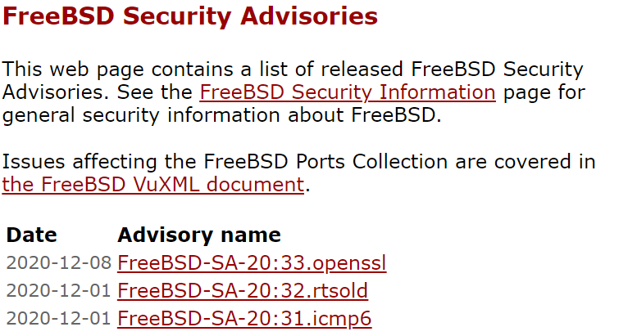
FreeBSD Security Advisories
http://www.freebsd.org/security/advisories.html

Slide 4
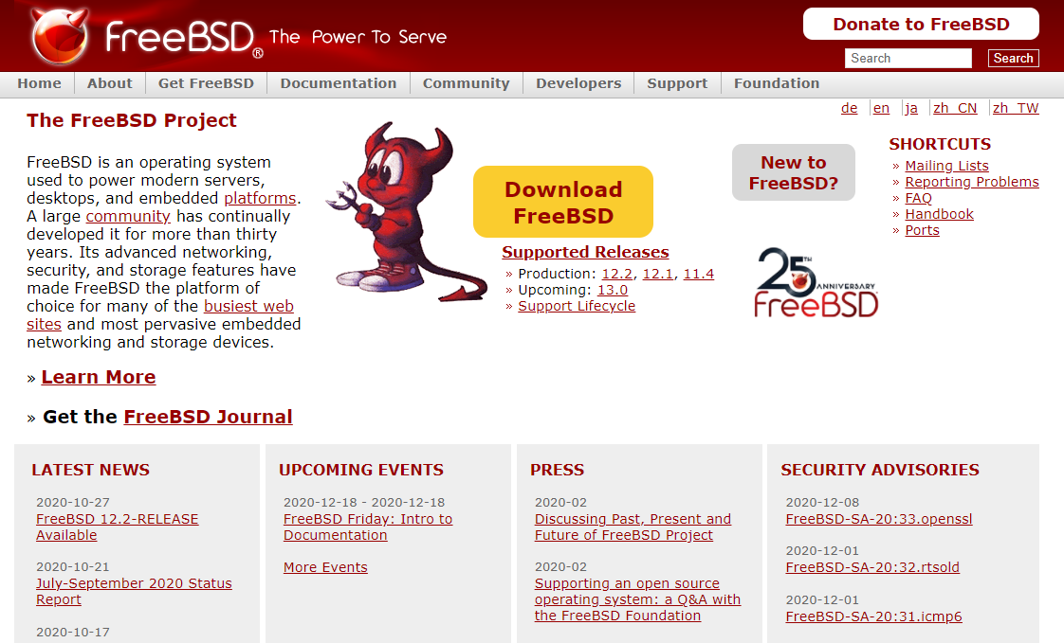
FreeBSD Security Advisories
Advisory
Security information
Where to find it
Web page (Security Advisories Channel)
https://www.freebsd.org

Slide 5
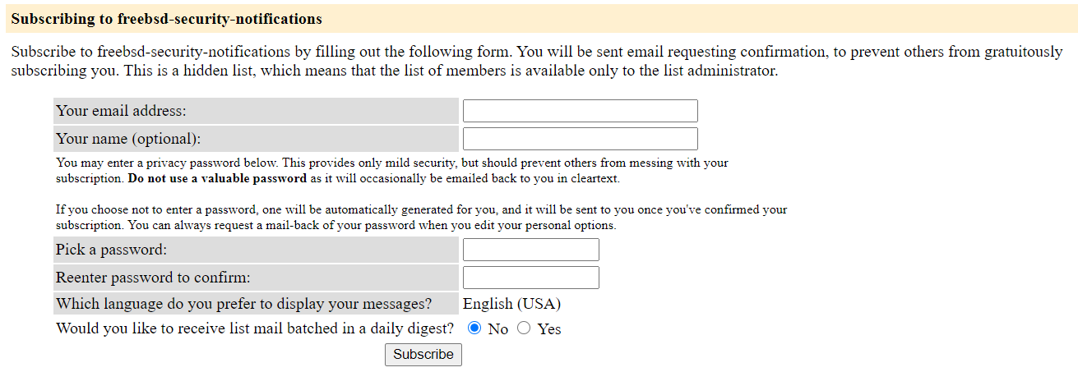
FreeBSD Security Advisories
Where to find it
freebsd-security-notifications Mailing list
http://lists.freebsd.org/mailman/listinfo/freebsd-security-notifications

Slide 6
FreeBSD Security Advisories
Example
openssl: https://www.freebsd.org/security/advisories/FreeBSD-SA-20:33.openssl.asc
-----BEGIN PGP SIGNED MESSAGE-----
Hash: SHA512
=============================================================================
FreeBSD-SA-20:33.openssl Security Advisory
The FreeBSD Project
Topic: OpenSSL NULL pointer de-reference
Category: contrib
Module: openssl
Announced: 2020-12-08
Affects: All supported versions of FreeBSD.
Corrected: 2020-12-08 18:28:49 UTC (stable/12, 12.2-STABLE)
2020-12-08 19:10:40 UTC (releng/12.2, 12.2-RELEASE-p2)
2020-12-08 19:10:40 UTC (releng/12.1, 12.1-RELEASE-p12)
CVE Name: CVE-2020-1971
CVE: Common Vulnerabilities and Exposures

Slide 7
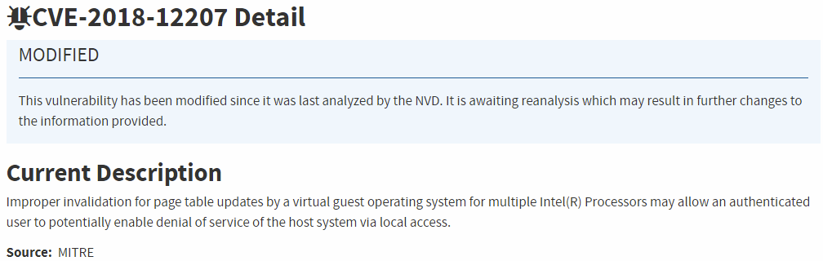
FreeBSD Security Advisories
CVE-2018-12207
https://nvd.nist.gov/vuln/detail/CVE-2018-12207
CVSS: Common Vulnerability Scoring System

Slide 8
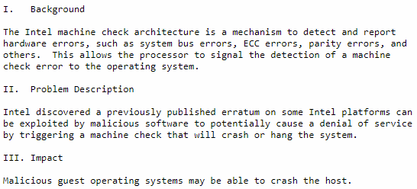
FreeBSD Security Advisories
Example
Problem Description

Slide 9

FreeBSD Security Advisories
Example
Workaround

Slide 10
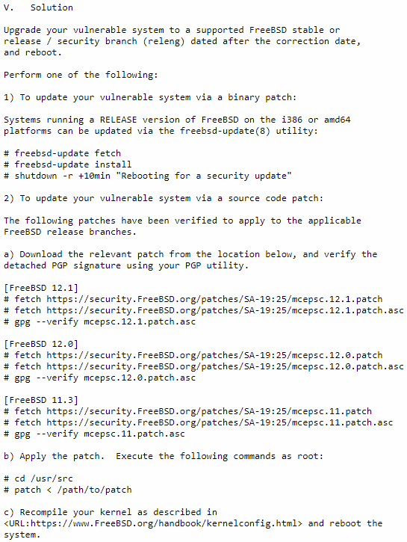
FreeBSD Security Advisories
Example
Solution
Upgrade to
Source code patch
Binary patch

Slide 11
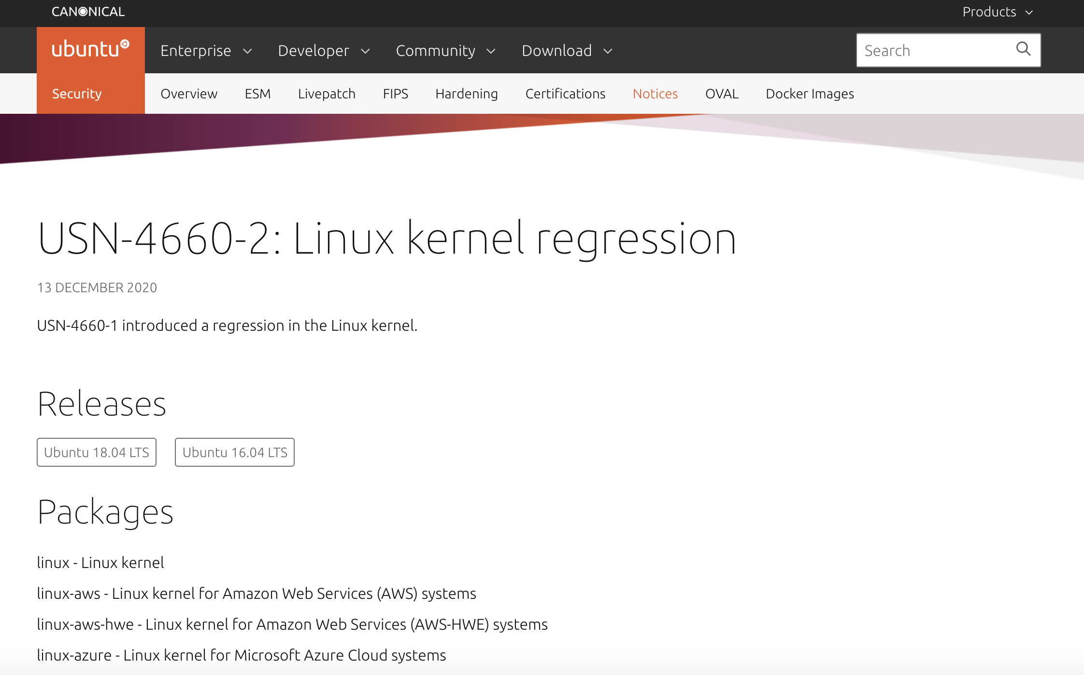
Ubuntu Security Notices
Where to find it
https://ubuntu.com/security/notices
Example

Slide 12
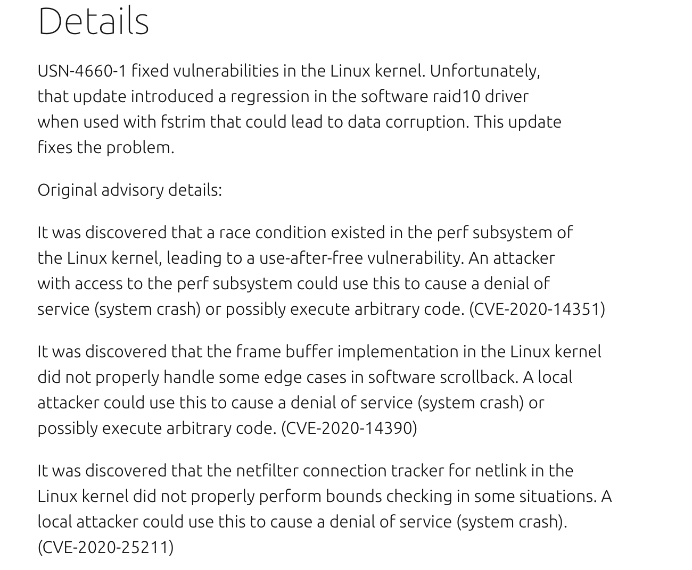
Ubuntu Security Notice
Details

Slide 13
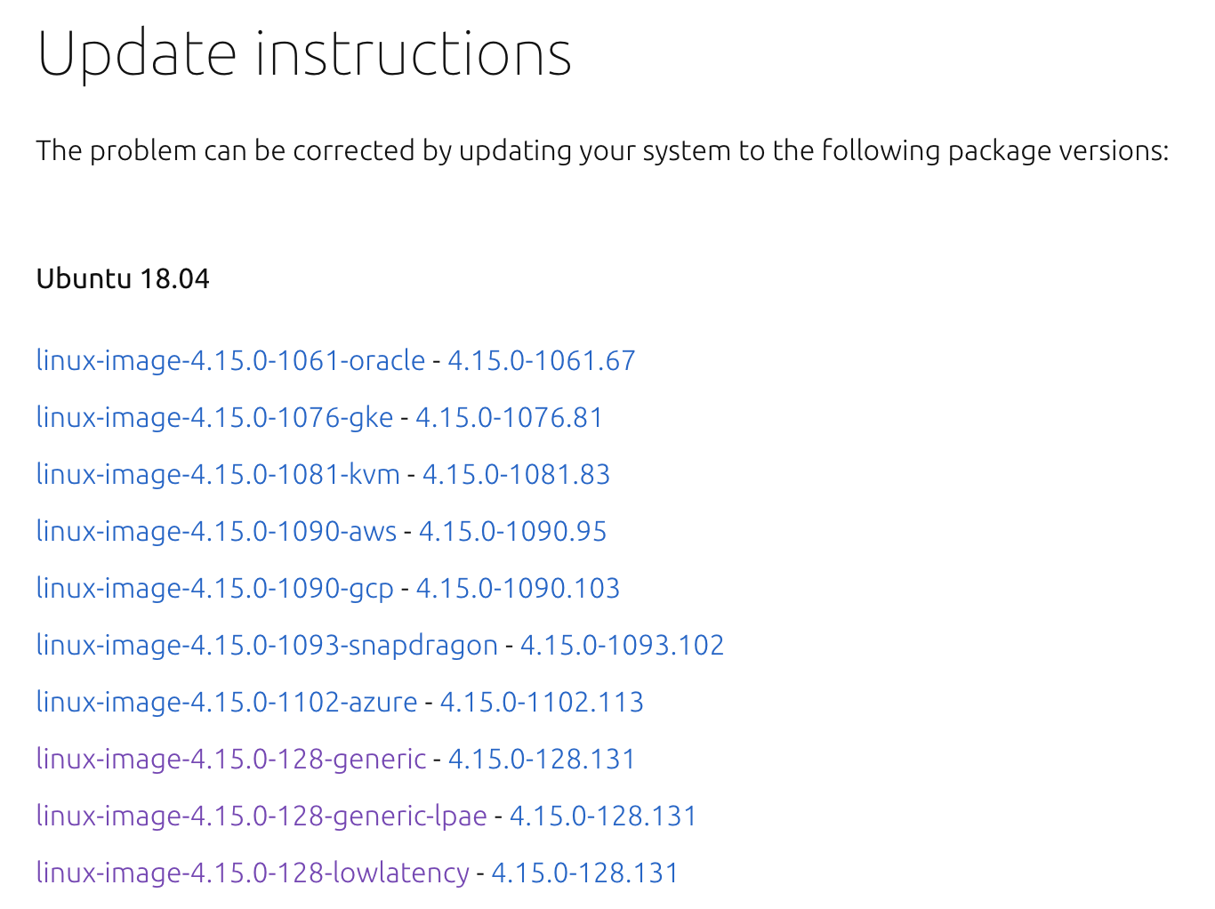
Ubuntu Security Notice
Update instructions
Use apt-get to update packages

Slide 14
Common Security Problems
Software bugs
FreeBSD security advisor
pkg audit
pkg-audit(8)
lynis https://cisofy.com/lynis/
Unreliable wetware
Phishing site
Open doors
Weak password
Lack of 2 factor authentication
Disk share with the world

Slide 15
pkg audit (1)
pkg audit
Checks installed ports against a list of security vulnerabilities
pkg audit -F
-F: Fetch the current database from the FreeBSD servers.
Security Output

Slide 16
pkg audit (2)
pkg audit -F
http://www.freshports.org/<category>/<portname>
https://www.freshports.org/databases/postgresql96-server/
Fetching vuln.xml.bz2: 100% 694 KiB 710.2kB/s 00:01
libxml2-2.9.4 is vulnerable:
libxml2 -- Multiple Issues
CVE: CVE-2017-9050
CVE: CVE-2017-9049
CVE: CVE-2017-9048
CVE: CVE-2017-9047
CVE: CVE-2017-8872
WWW: https://vuxml.FreeBSD.org/freebsd/76e59f55-4f7a-4887-bcb0-11604004163a.html
1 problem(s) in the installed packages found.

Slide 17
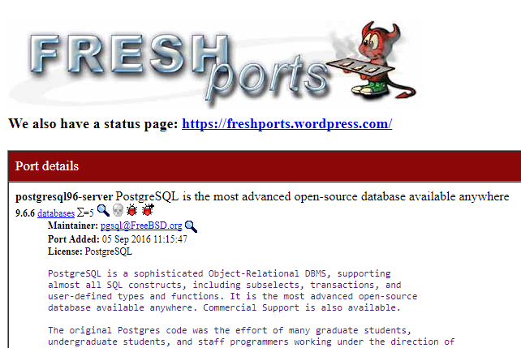
pkg audit (3)

Slide 18
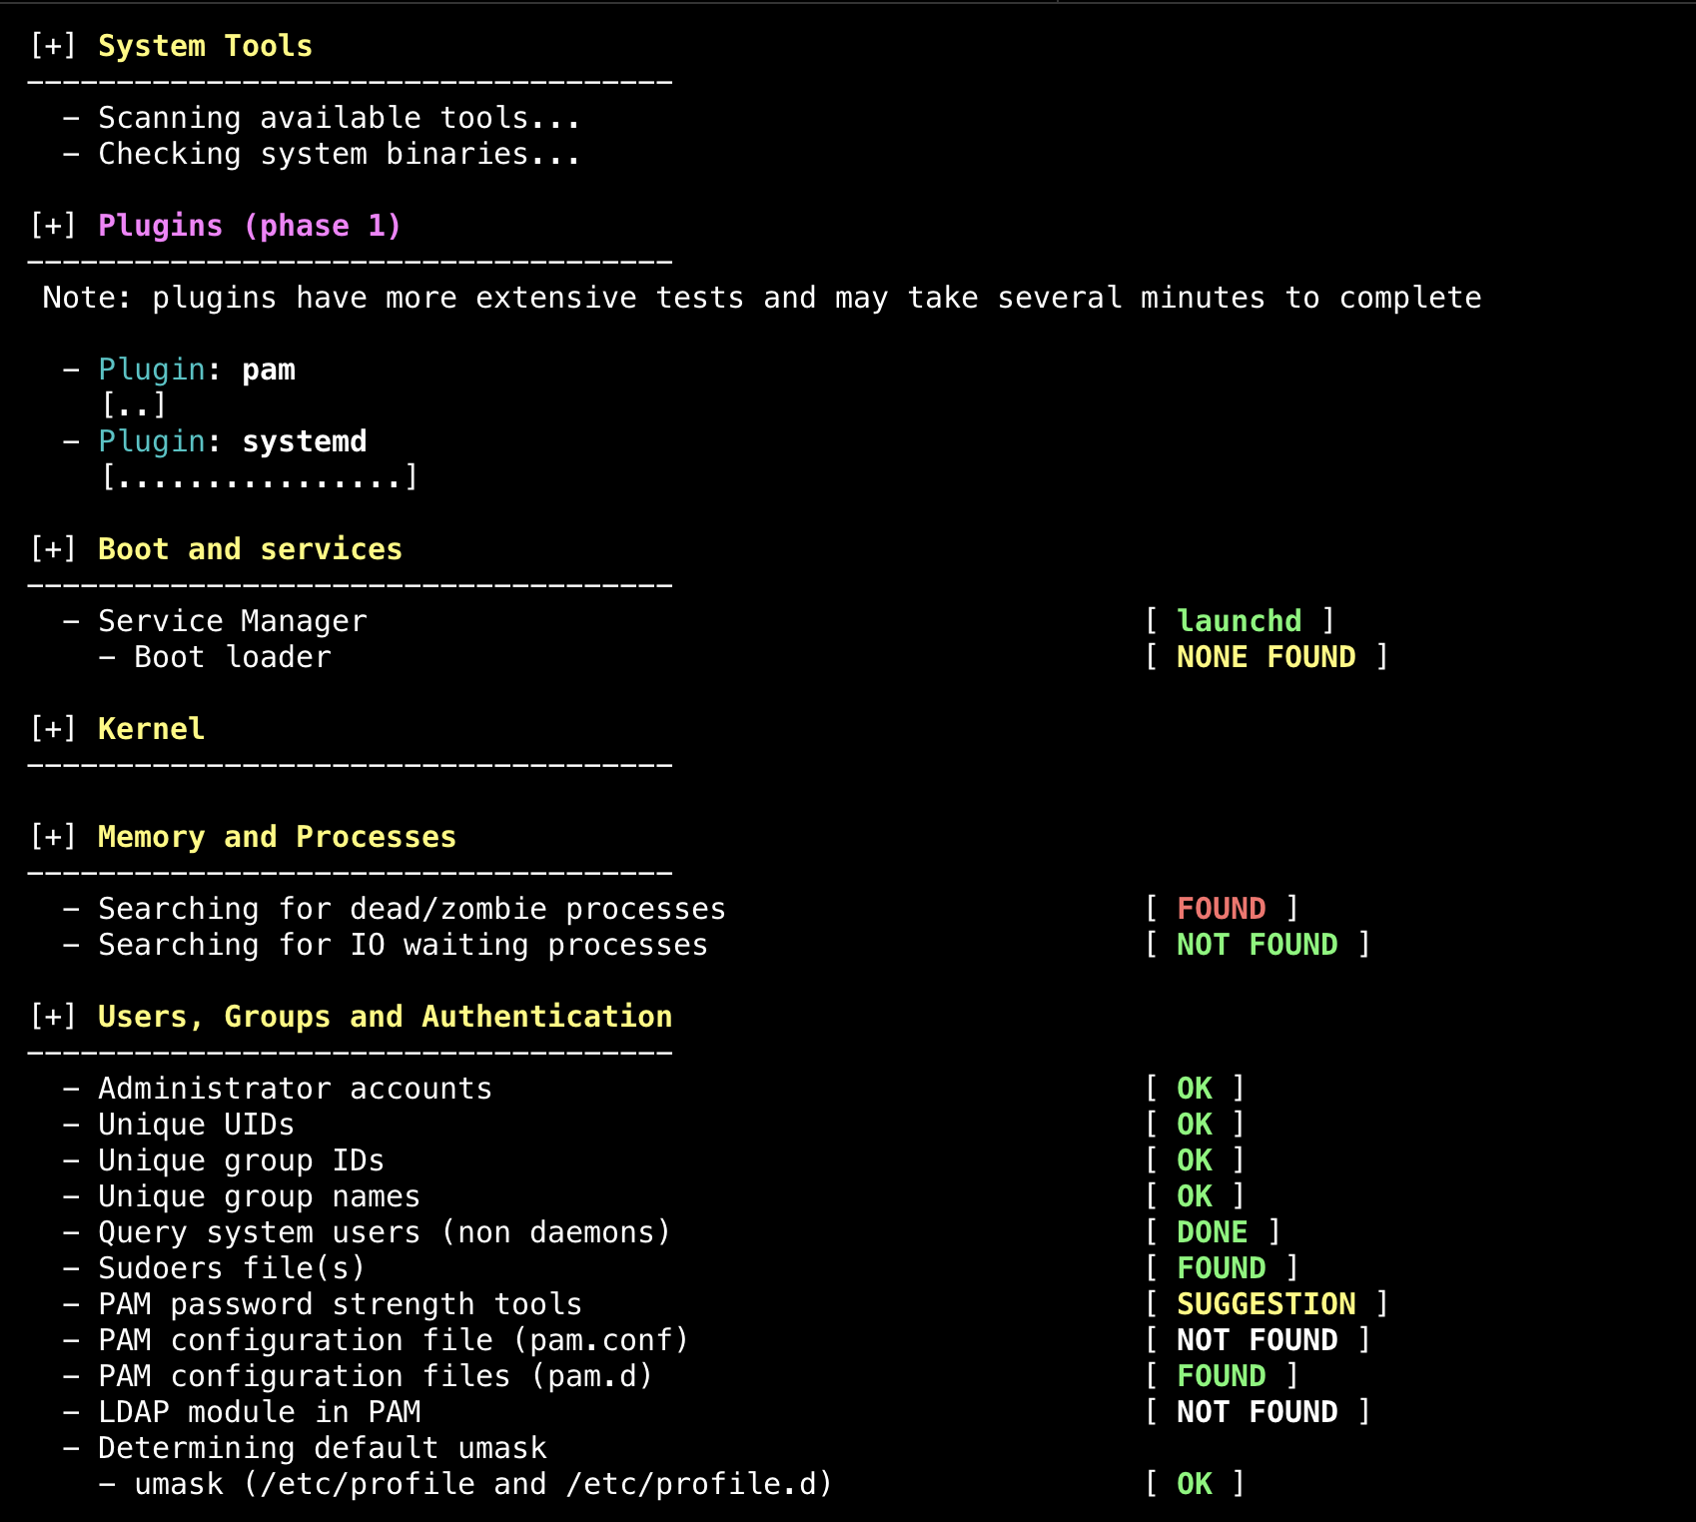
lynis
lynis audit system
Can use lynis for remote system auditing

Slide 19
Common trick
Tricks
ssh scan and hack
ssh guard
sshit
…
Phishing
XSS & SQL injection
…
Objective
Spam
Jump gateway
File sharing
…

Slide 20
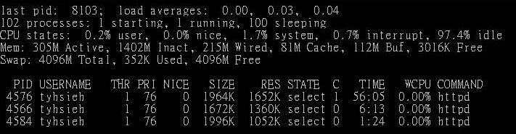
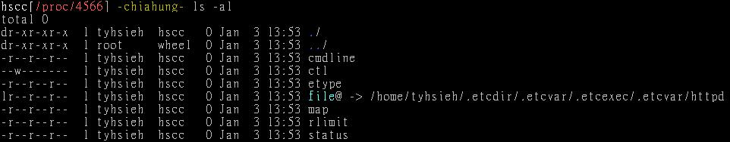
Process file system – procfs
Procfs
A view of the system process table
Normally mount on /proc
mount -t procfs proc /proc

Slide 21
Simple SQL injection example
Username/password authentication
No input validation
SELECT * FROM usrTable
WHERE user =
AND pass = ;
SELECT * FROM usrTable
WHERE user = 'test'
AND pass = 'a' OR 'a' = 'a'

Slide 22
setuid program
passwd
/etc/master.passwd is of mode 600 (-rw-------) !
Setuid shell scripts are especially apt to cause security problems
Minimize the number of setuid programs
Disable the setuid execution on individual filesystems
-o nosuid
$ ls -al /usr/bin/passwd
-r-sr-xr-x 2 root wheel 8224 Dec 5 22:00 /usr/bin/passwd
/usr/bin/find / -user root -perm -4000 -print |
/bin/mail -s "Setuid root files" username

Slide 23
Security issues
/etc/hosts.equiv and ~/.rhosts
Trusted remote host and user name DB
Allow user to login (via rlogin) and copy files (rcp) between machines without passwords
Format:
Simple: hostname [username]
Complex: [+-][hostname|@netgroup] [[+-][username|@netgorup]]
Example
bar.com foo (trust user "foo" from host "bar.com")
+@adm_cs_cc (trust all from amd_cs_cc group)
+@adm_cs_cc -@user123
Do not use this

Slide 24
Why not su nor sudo?
Becoming other users
A pseudo-user for services, sometimes shared by multiple users
sudo -u news -s (?)
/etc/inetd.conf
login stream tcp nowait root /usr/libexec/rlogind rlogind
~notftpadm/.rhosts
localhost user123
rlogin -l news localhost
User_Alias newsTA=user123
Runas_Alias NEWSADM=news
newsTA ALL=(NEWSADM) ALL
Too dirty!
Not secure

Slide 25
Security tools
nmap
john, crack
PGP
CA
…
Firewall
TCP Wrapper
…

Slide 26
TCP Wrapper
There are something that a firewall will not handle
Sending text back to the source
TCP wrapper
Extend the abilities of inetd
Provide support for every server daemon under its control
Logging support
Return message
Permit a daemon to only accept internal connections

Slide 27
TCP Wrapper
TCP Wrapper
Provide support for every server daemon under its control
ftpd
telnetd
inted
TCP-Wrapper
tcpd
talked
‧‧‧
hosts.allow hosts.deny
fingerd

Slide 28
TCP Wrapper
To see what daemons are controlled by inetd, see /etc/inetd.conf
TCP wrapper should not be considered a replacement of a good firewall. Instead, it should be used in conjunction with a firewall or other security tools
#ftp stream tcp nowait root /usr/libexec/ftpd ftpd -l
#ftp stream tcp6 nowait root /usr/libexec/ftpd ftpd -l
#telnet stream tcp nowait root /usr/libexec/telnetd telnetd
#telnet stream tcp6 nowait root /usr/libexec/telnetd telnetd
shell stream tcp nowait root /usr/libexec/rshd rshd
#shell stream tcp6 nowait root /usr/libexec/rshd rshd
login stream tcp nowait root /usr/libexec/rlogind rlogind
#login stream tcp6 nowait root /usr/libexec/rlogind rlogind

Slide 29
TCP Wrapper
To use TCP wrapper
inetd daemon must start up with "-Ww" option (default) or edit /etc/rc.conf
Edit /etc/hosts.allow
Format: daemon:address:action
daemon is the daemon name which inetd started
address can be hostname, IPv4 addr, IPv6 addr
action can be "allow" or "deny"
Keyword “ALL” can be used in daemon and address fields to means everything
/etc/rc.conf
inetd_enable="YES"
inetd_flags="-wW"

Slide 30
/etc/hosts.allow
First rule match semantic
Meaning that the configuration file is scanned in ascending order for a matching rule
When a match is found, the rule is applied and the search process will be stopped
E.g.,
ALL : localhost, loghost @adm_cc_cs : allow
ptelnetd pftpd sshd: @sun_cc_cs, @bsd_cc_cs, @linux_cc_cs : allow
ptelnetd pftpd sshd: zeiss, chbsd, sabsd : allow
identd : ALL : allow
portmap : 140.113.17. ALL : allow
sendmail : ALL : allow
rpc.rstatd : @all_cc_cs 140.113.17.203: allow
rpc.rusersd : @all_cc_cs 140.113.17.203: allow
ALL : ALL : deny

Slide 31
/etc/hosts.allow
Advanced configuration
External commands (twist option)
twist will be called to execute a shell command or script
External commands (spawn option)
spawn is like twist, but it will not send a reply back to the client
# The rest of the daemons are protected.
telnet : ALL \
: severity auth.info \
: twist /bin/echo "You are not welcome to use %d from %h."
# We do not allow connections from example.com:
ALL : .example.com \
: spawn (/bin/echo %a from %h attempted to access %d >> \
/var/log/connections.log) \
: deny

Slide 32
/etc/hosts.allow
Wildcard (PARANOID option)
Match any connection that is made from an IP address that differs from its hostname
See
hosts_access(5)
hosts_options(5)
# Block possibly spoofed requests to sendmail:
sendmail : PARANOID : deny

Slide 33
When you perform any change.
Philosophy of SA
Know how things really work.
Plan it before you do it.
Do a full backup
Make it reversible
Make changes incrementally.
Test before you unleash it .
Backup before changing
Think your fallback
Apply chang in new file on test environment
Restore Procedures Think another solution
Restart the system
No
No
Is everything fine?
Yes
Run Test
Is everything fine?
Apply to Real System

Slide 34
Appendix

Slide 35
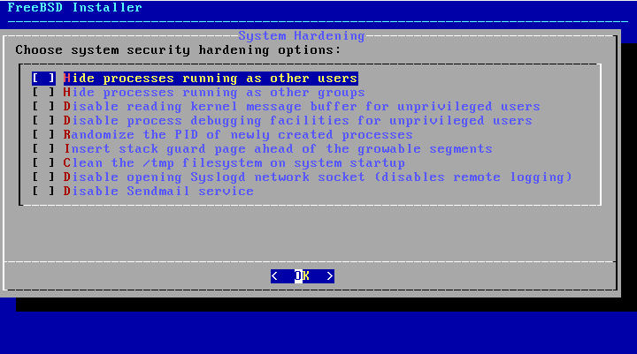
System Security Hardening Options (1/3)
Include various system hardening options during installation since FreeBSD 11.0-RELEASE
/usr/src/usr.sbin/bsdinstall/scripts/hardening

Slide 36
System Security Hardening Options (2/3)
Hide processes running as other users
security.bsd.see_other_uids=0
Type: Integer, Default: 1
Hide processes running as other groups
security.bsd.see_other_gids=0
Type: Integer, Default: 1
Disable reading kernel message buffer for unprivileged users
security.bsd.unprivileged_read_msgbuf=0
Type: Integer, Default: 1
Disable process debugging facilities for unprivileged users
security.bsd.unprivileged_proc_debug=0
Type: Integer, Default: 1

Slide 37
System Security Hardening Options (3/3)
Randomize the PID of newly created processes
kern.randompid=$(jot -r 1 9999)
Random PID modulus
Type: Integer, Default: 0
Insert stack guard page ahead of the growable segments
security.bsd.stack_guard_page=1
Type: Integer, Default: 0
Clean the /tmp filesystem on system startup
clear_tmp_enable="YES" (/etc/rc.conf)
Disable opening Syslogd network socket (disables remote logging)
syslogd_flags="-ss" (/etc/rc.conf)
Disable Sendmail service
sendmail_enable="NONE" (/etc/rc.conf)

